Slide 1
CSE314 OS Sessional Offline2 - System Call
Nafis Tahmid

Slide 2
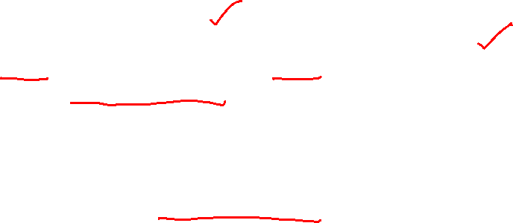
Prerequisites & Challenges
Prerequisites
You know how to add a system call
You have watched xv6 lecture2 video (A brief overview of codebase)
You have cloned and gone through the code a bit
You have read the offline description
Challenges
Too many files ( you may use grep <PATTERN> * to find in which file the code belongs )
We are biased in OOP style (c++ or java syntax) in all these years

Slide 3

Preliminaries
What happens in a system call? (which function is executed?)
Usys.pl -> syscall.c -> (sysproc.c/sysfile.c)[we focus on these two]

Slide 4
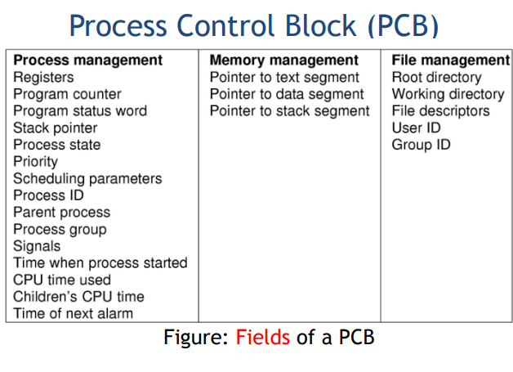
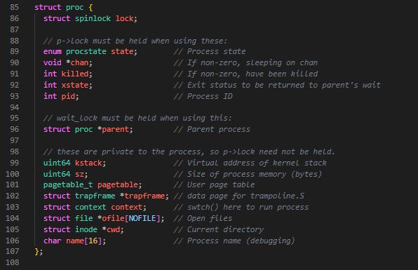

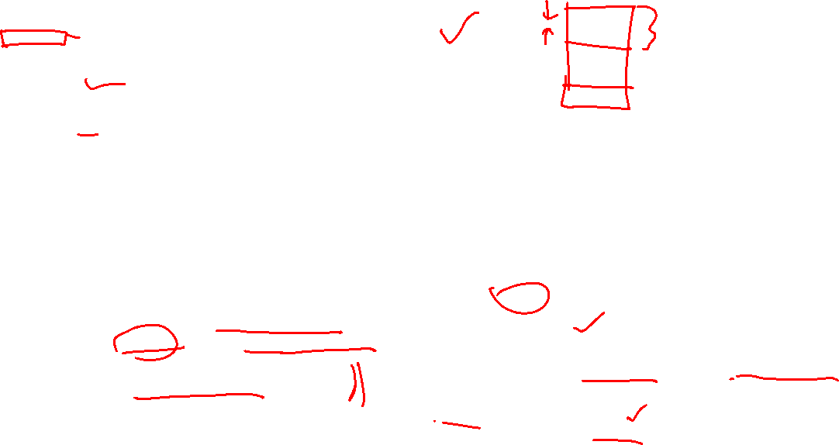
Proc.h
Trap Frames are used to store the registers of the current thread when an interrupt occurs, or when there is a system service call (the transfer from user mode to kernel mode).

Slide 5
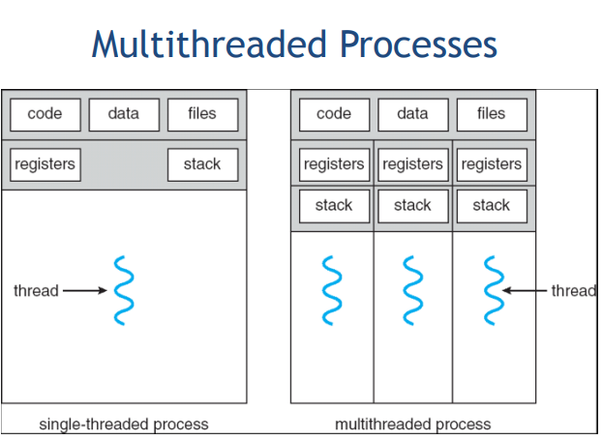
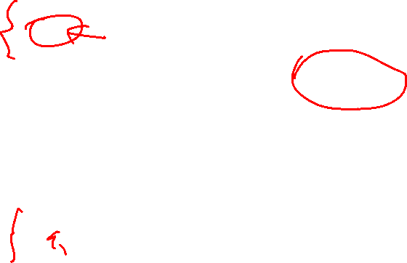
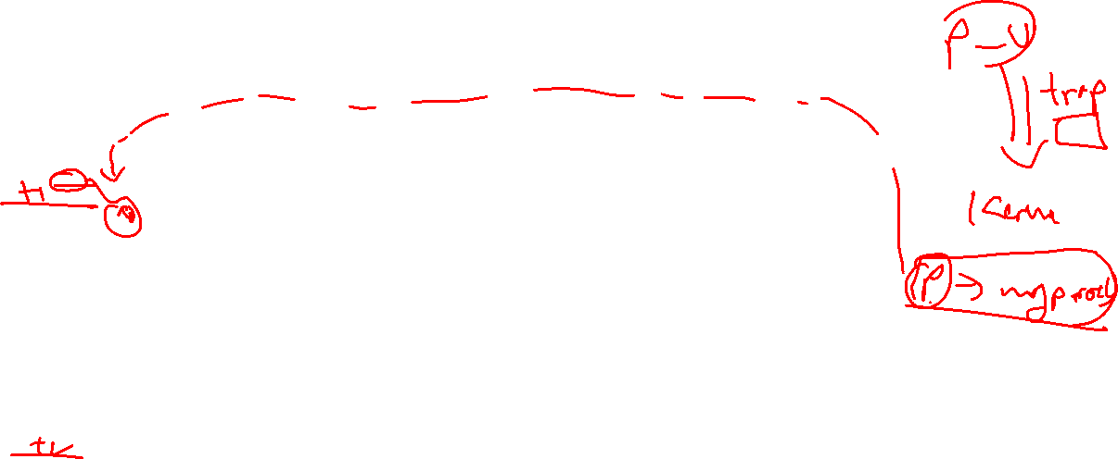
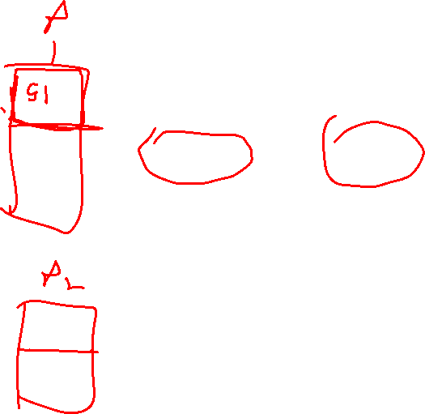

Slide 6
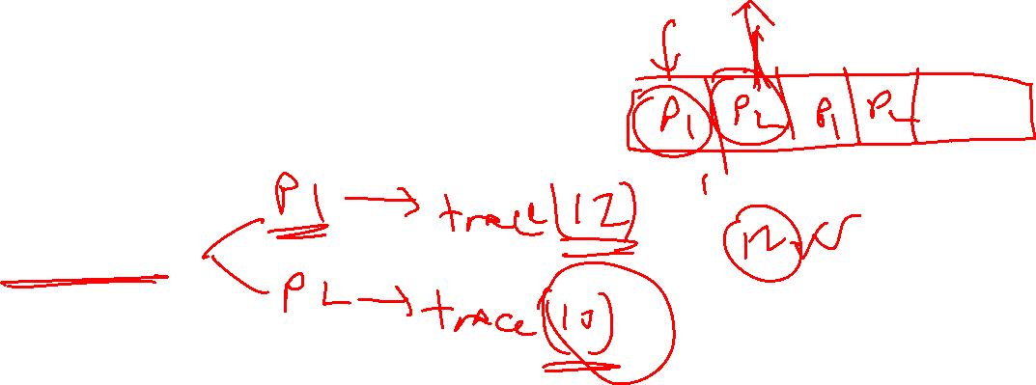
Trace – Wrong Approach
What if we code like in practice class? getuid() and setuid()
uid was a global variable
Problem?
Multiple processes

Slide 7
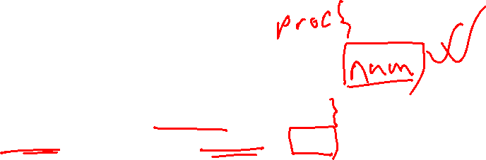
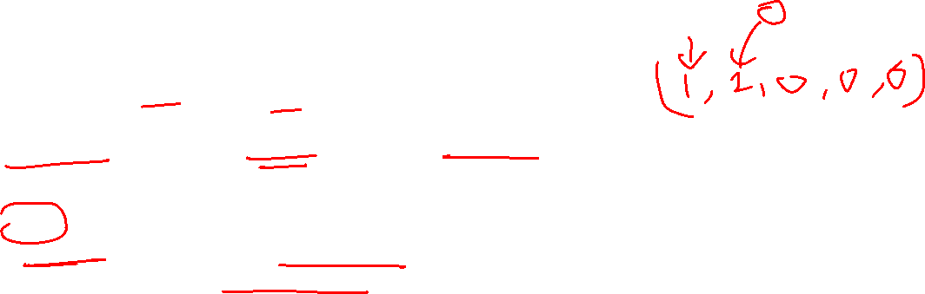
Correct One
Trace call num should be a field of struct proc(proc.h)
This will be set in trace systemCall, flag initialization in proc.c [ UNUSED -> USED ]
Now if-else for printing(syscall() in syscall.c)
What about arguments and printing?
Naive but works – store the types in an array in your own encoding
A tip:
Process the arguments before syscall[num](), otherwise
you will face problems in string arguments

Slide 8

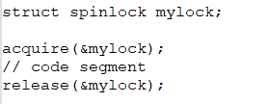
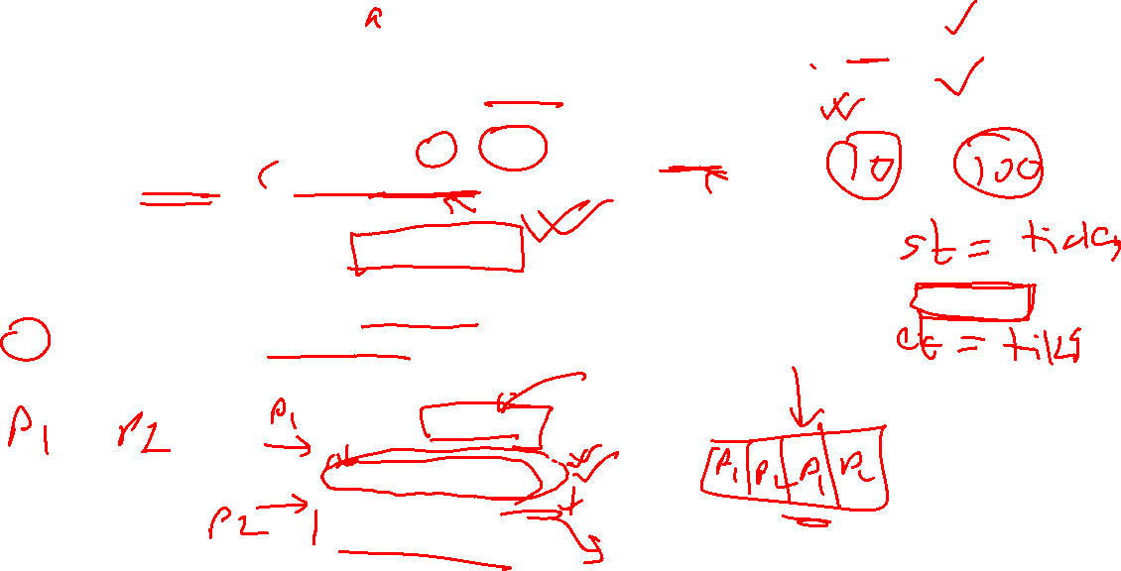
History
2 parts
System call independent (keep computing sysCall count, time) [may use ticks]
- And proper locking while modifying #, and time (Shared Resource)
System call response (struct syscall_status) [follow fstat]
Lock
1. Mechanism to block access to a “code segment”
2. If P1 acquires a lock, before the lock is released, no other process can run the code segment in between
3. Therefore, we use lock for shared or “global” resources
4. We don’t need lock for “local variables” and “parameters ???”

Slide 9
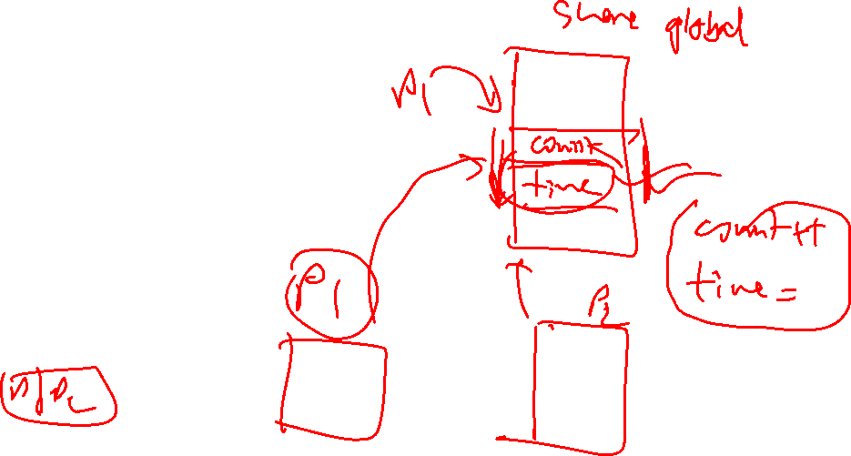
Miscelleneous
If you see panic: acquire
You should probably check your locking code
Struct sys_s stat; history(13, &stat);

Slide 10
Thank you

