Slide 1

Brainiacs and Beyond
CSE 408

Slide 2
Team Members
Pushpita Joardar, 1705052
Tousif Tanjim Anan, 1705053
MD Anwarul Karim, 1705055

Slide 3

Motivation
“Why do we fall, Sir? So that we can learn to pick ourselves up.”
-Alfred Pennyworth

Slide 4
Motivation
The ultimate solution to quench the age-long thirst for knowledge by challenging oneself
BRAINIACS AND BEYOND

Slide 5
Motivation
Helps a person to have an increasing learning curve.
One to one practices can make solving quizzes fun.
Quiz clubs can have a helping hand
Good communication between club members and quizzers

Slide 6
Modules
Admin
User
Club
Quiz

Slide 7
Sub Modules: Admin
Adding
Privilege
Sign-Up
Sign-In

Slide 8
Sub Modules: User
Practice
Rating
Single
Player
Multi
Player

Slide 9
Sub Modules: Quiz
Archive
Flash
Card
Categorization

Slide 10
Sub Modules: Club
Hosting
quiz
About
Club
Event
Archive

Slide 11
Feasibility
Abundance of quiz enthusiasts
Abundance of quiz materials
Easy-to-produce modules
Available quiz clubs

Slide 12
Usage
Smoother club activity
Enrich oneself with varieties of quizzes
One-stop solution for everything quizzing

Slide 13
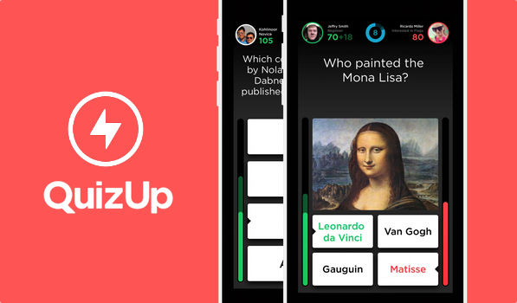
Sample Websites
About
Club

Slide 14

Sample Websites
About
Club

Slide 15
Thank You

