Slide 1

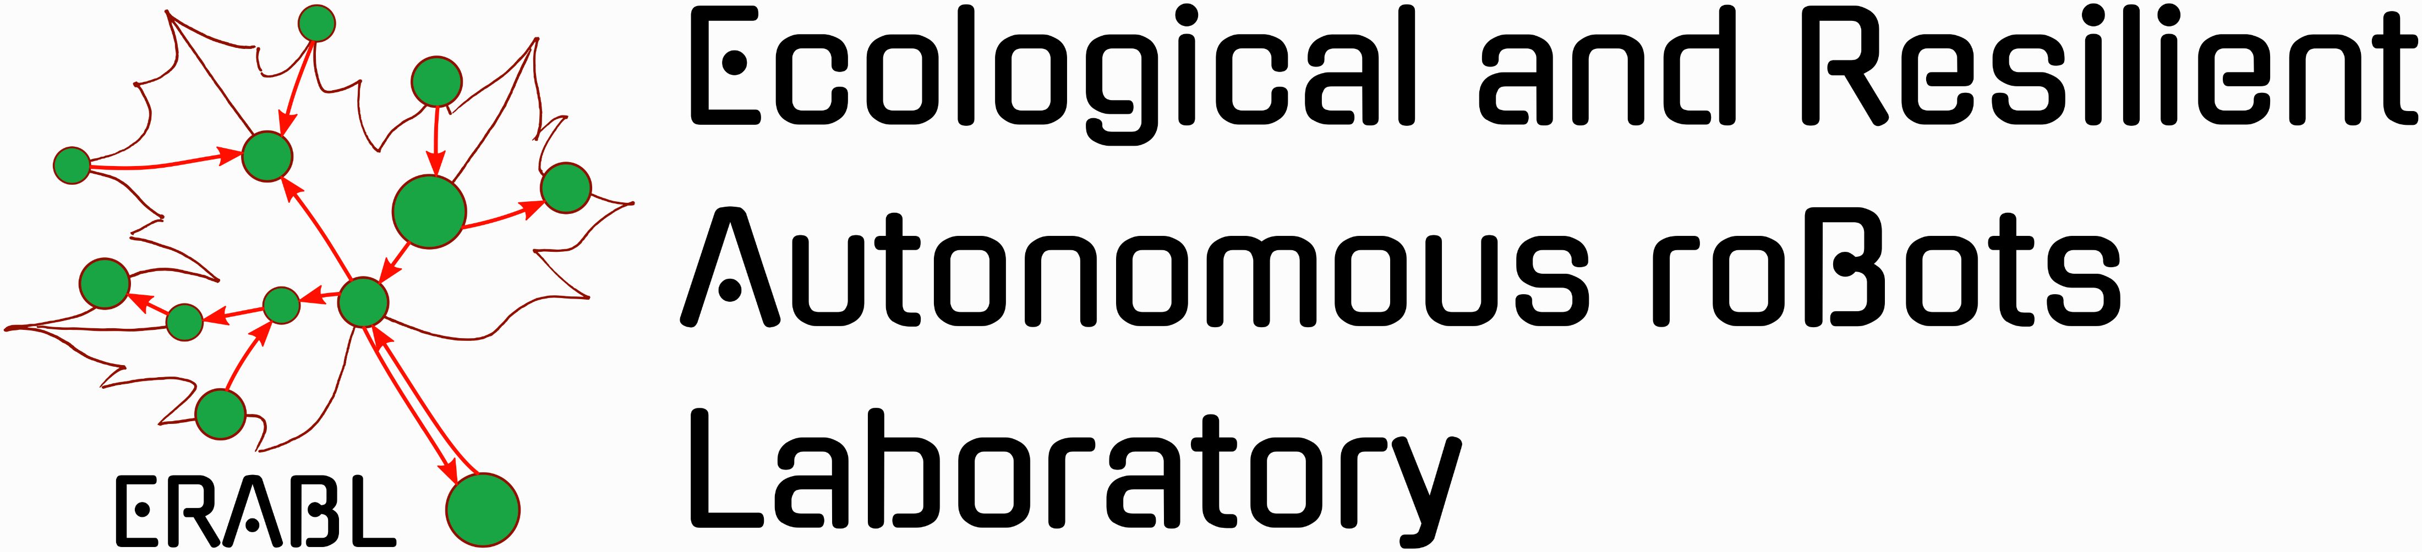
Value Iteration for Learning Concurrently Executable Robotic Control Tasks
Sheikh A. Tahmid and Gennaro Notomista
Department of Electrical and Computer Engineering

Slide 2

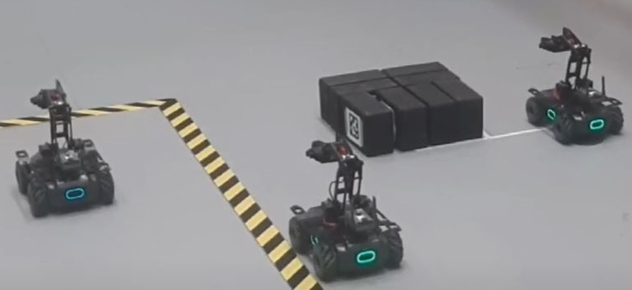
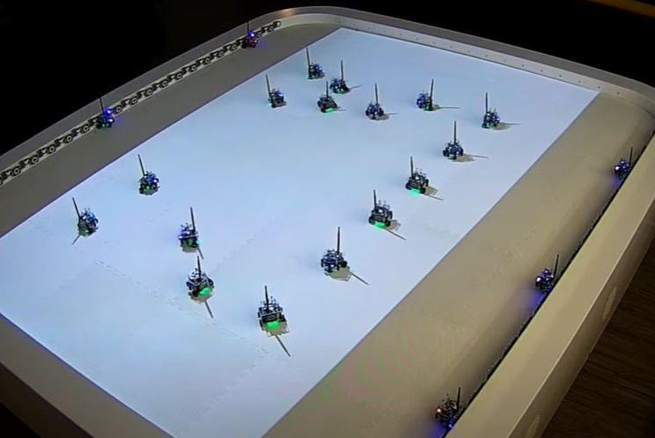

Motivation
Modern robotic systems exhibit “redundancy”

Slide 3
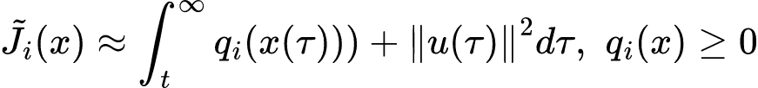
Assumptions
Assume that system is control-affine:
Use RL to approximate optimal “cost-to-go”/value functions:
If we learn tasks 1,…,N, can we somehow execute all N tasks together?

Slide 4
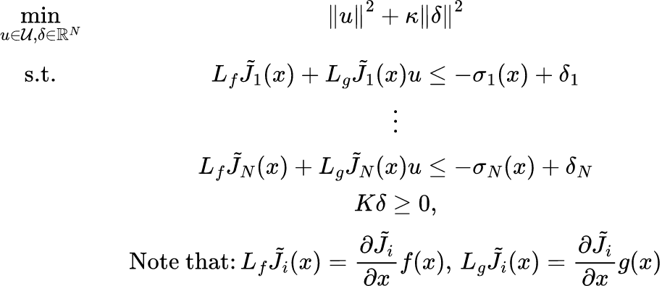
Related Work - Combining Learned Tasks Using a Min-Norm Controller
Treat learned value functions as Control Lyapunov Functions
Make progress on each task using constrained optimization problem
RHS expressions – variant of Sontag formula for recovering “optimal” inputs
[1] G. Notomista, “A Constrained-Optimization Approach to the Execution of Prioritized Stacks of Learned Multi-robot Tasks,” in Distributed Autonomous Robotic Systems, 2024, pp. 479–493

Slide 5
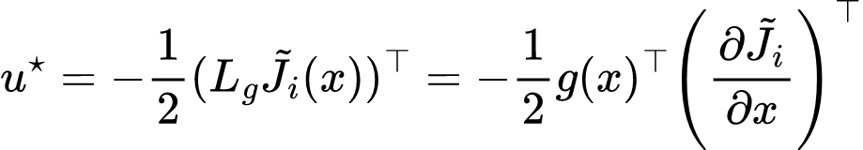
Related Work – Value Iteration for Continuous Action Space
Assume continuous, control-affine dynamics and cost function as before
Use expression from solved HJB equation as “optimal input” at each iteration
2] M. Lutter, S. Mannor, J. Peters, D. Fox, and A. Garg, “Value Iteration in Continuous Actions, States and Time,” in Proceedings of the 38th International Conference on Machine Learning, Jul. 2021, vol. 139, pp. 7224–7234.

Slide 6
How do we know that tasks are compatible with each other?
We do not.

Slide 7
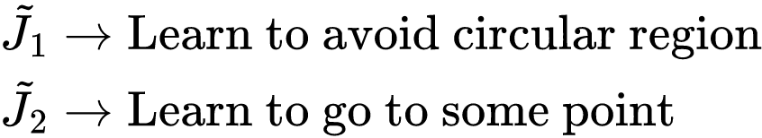
Sometimes, they are compatible.
<INSERT VID OR GIF OF EXAMPLE HERE>

Slide 8
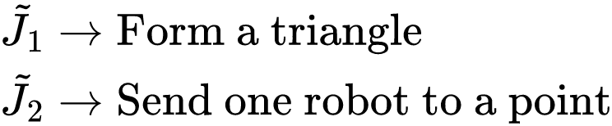
Sometimes, they are compatible.
<INSERT VID OR GIF OF EXAMPLE HERE>

Slide 9
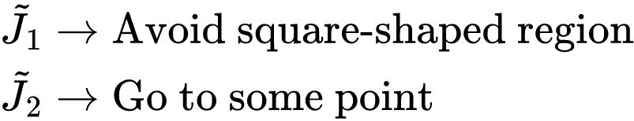
Sometimes, they are NOT compatible.
<INSERT VID OR GIF OF EXAMPLE HERE>

Slide 10
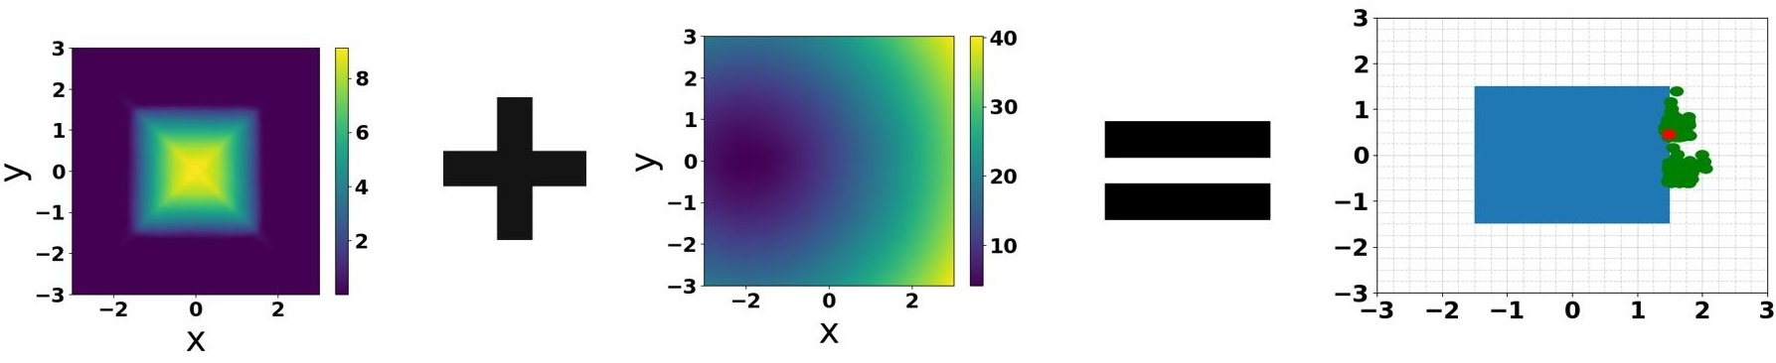
Sometimes, they are NOT compatible.
But we can try to make them compatible.

Slide 11
Definitions of Independence and Orthogonality

Slide 12
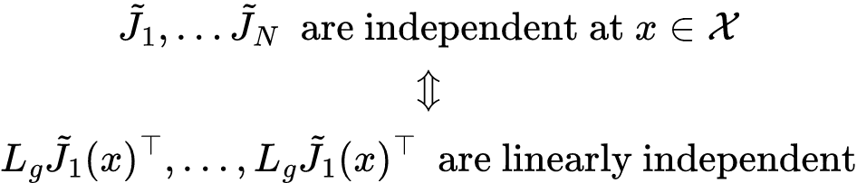
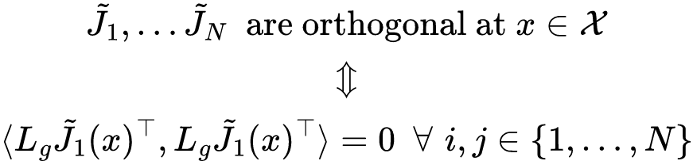
Definitions of Independence and Orthogonality

Slide 13

Introducing “Interference” Input Cost
Proposition 2 in the paper shows that this can be used to make the (N + 1)th task independent to previously trained tasks.

Slide 14
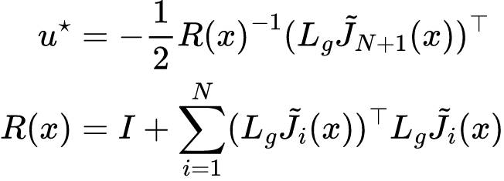
Variant of Value Iteration in Continuous Action Space
Can extend previous work in [2] to approximate this new cost functional.
At each iteration, use the following input to estimate the next iteration of the value function:
2] M. Lutter, S. Mannor, J. Peters, D. Fox, and A. Garg, “Value Iteration in Continuous Actions, States and Time,” in Proceedings of the 38th International Conference on Machine Learning, Jul. 2021, vol. 139, pp. 7224–7234.

Slide 15
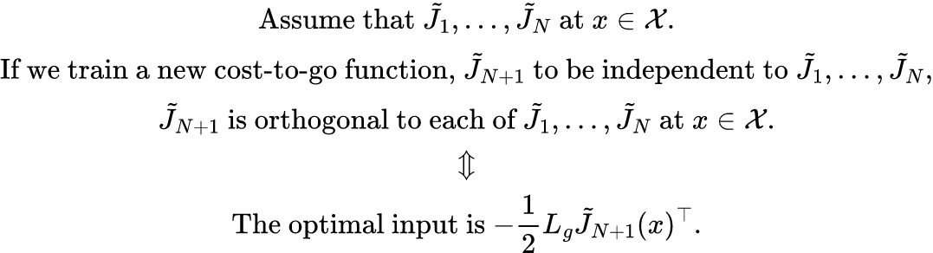
Relating Orthogonality to the Optimal Input
Proved in Proposition 3 in paper

Slide 16
Now they are compatible.
<INSERT VID OR GIF OF EXAMPLE HERE>

Slide 17
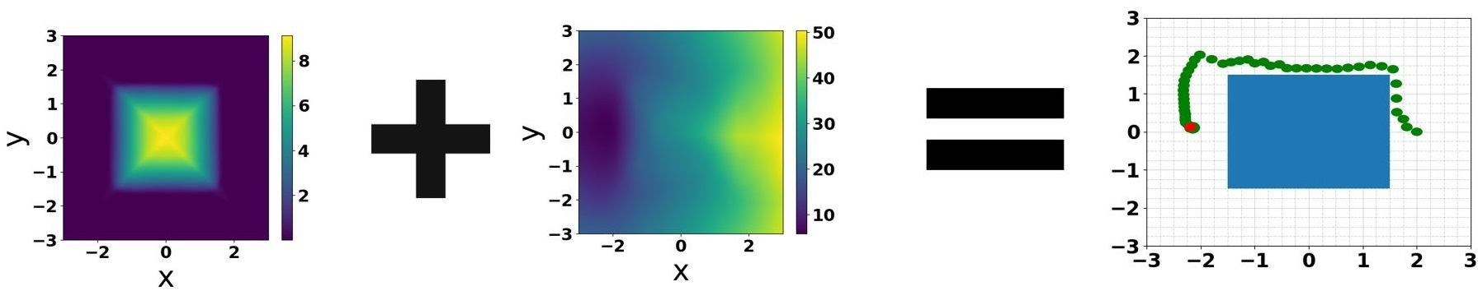
Now they are compatible.

Slide 18
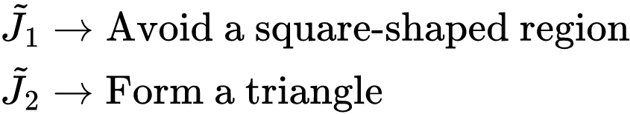
Another Example
<INSERT VID OR GIF OF EXAMPLE HERE>

Slide 19
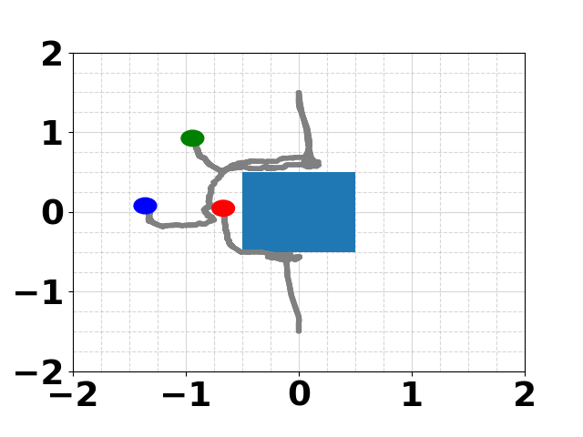
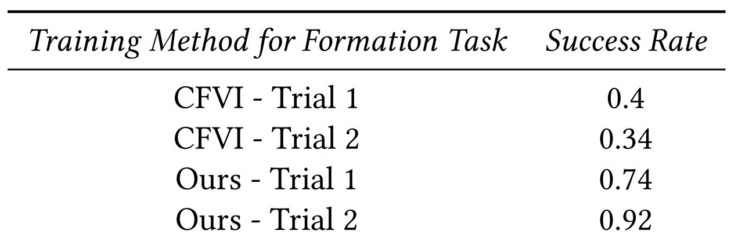
Another Example

Slide 20
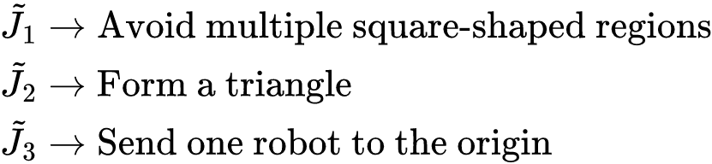
Another Example
<INSERT VID OR GIF OF EXAMPLE HERE>

Slide 21
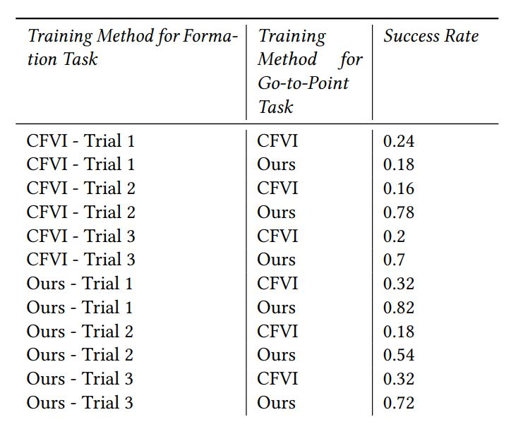
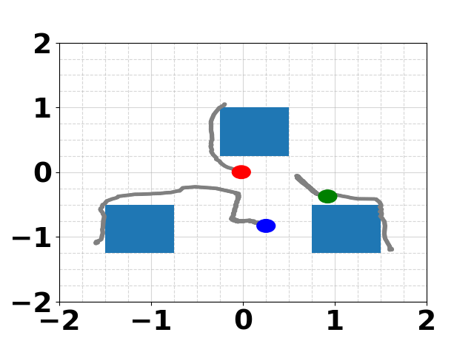
Another Example

Slide 22
Value Iteration for Learning Concurrently Executable Robotic Control Tasks
Sheikh A. Tahmid and Gennaro Notomista
Department of Electrical and Computer Engineering

