Slide 1

AlphaCode
Group 3

Slide 2

Introduction
AlphaCode is a programming language that adopts the NATO phonetic alphabet for its syntax, aiming to enhance clarity and minimize ambiguity in code communication. This unconventional language replaces traditional programming symbols with phonetic representations of English letters, offering a distinctive and unambiguous approach to coding. AlphaCode maintains the essential elements of a Turing-complete programming language while introducing a novel linguistic perspective

Slide 3

Inspiration
AlphaCode draws inspiration from the NATO phonetic alphabet, a system designed to ensure clear and precise communication of letters and words in challenging environments. The irony of using a system meant to eliminate confusion in communication to represent programming constructs adds a silly twist to AlphaCode. While traditional programming languages may inadvertently introduce ambiguity in the interpretation of symbols, AlphaCode embraces a linguistic approach to enhance code clarity.

Slide 4
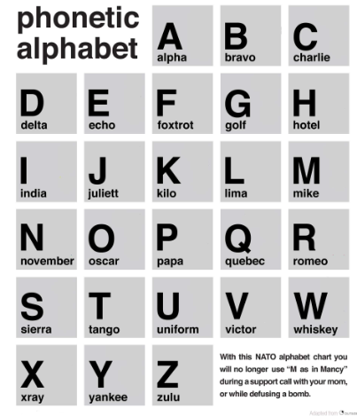
NATO Phonetic Alphabet

Slide 5
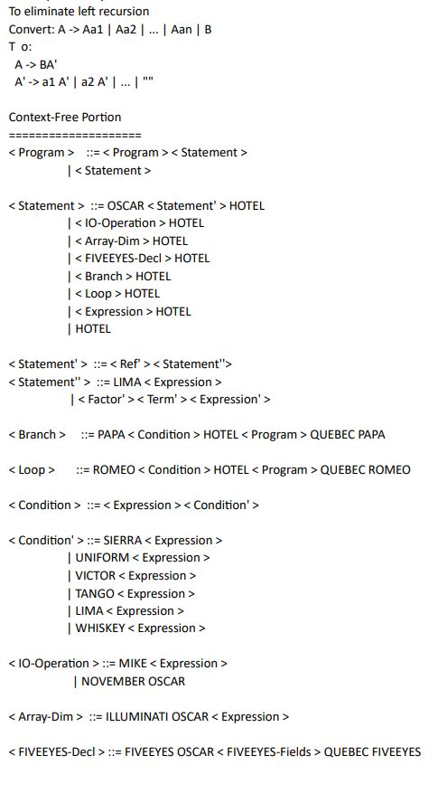
BNF SYNTAX OF DESCRIPTION

Slide 6
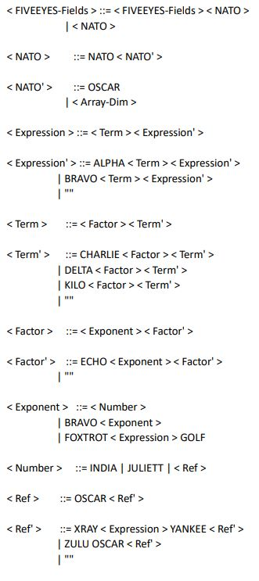
cONTINUING

Slide 7
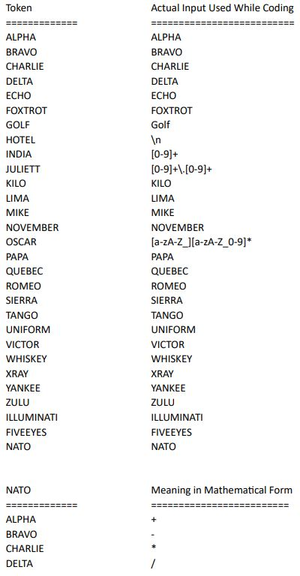
Lexer grammer

Slide 8
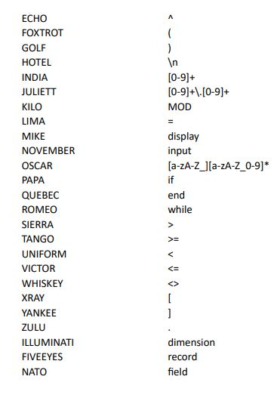
Continuing

Slide 9

Comparing With Other Languages
EDSAC vs AlphaCode: Simplifying Coding
EDSAC known for complex coding requirements
AlphaCode: High-level language ease
Simple functions replace intricate tasks
Example: MIKE command in AlphaCode for printing
Unachievable with EDSAC's capabilities

Slide 10

Continuing
Fortran vs AlphaCode: Programming Simplicity
AlphaCode offers a higher level of simplicity than Fortran
Emphasizes ease of basic programming tasks
Resembles Pseudocode for straightforwardness
Lacks complex syntax found in JAVA or C

Slide 11

Continuing
COBOL vs AlphaCode: Language Structure
COBOL: English-like language syntax
AlphaCode: Utilizes NATO phonetic alphabets for clarity
Skips traditional sections like IDENTIFICATION in COBOL
Maintains simplicity with a singular main code block

Slide 12

Continuing
F# vs AlphaCode: Functional Programming
F#: Function-centric approach for all tasks
AlphaCode: Functions employed judiciously as needed
F# features an extensive built-in library
AlphaCode currently without a built-in library, underscoring its novelty

Slide 13

Some programs to test
Hello World
Implementation and Test of Bubble Sort
Tower of Hanoi Solver

Slide 14
Hello World
MIKE Hello World!

Slide 15
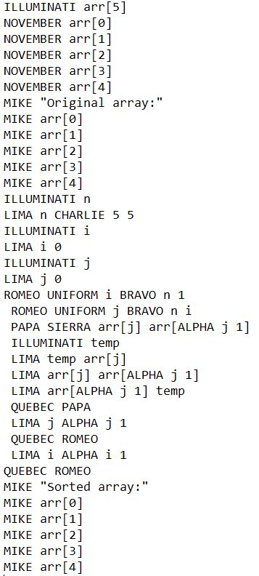
Implementation and Test of Bubble Sort

Slide 16
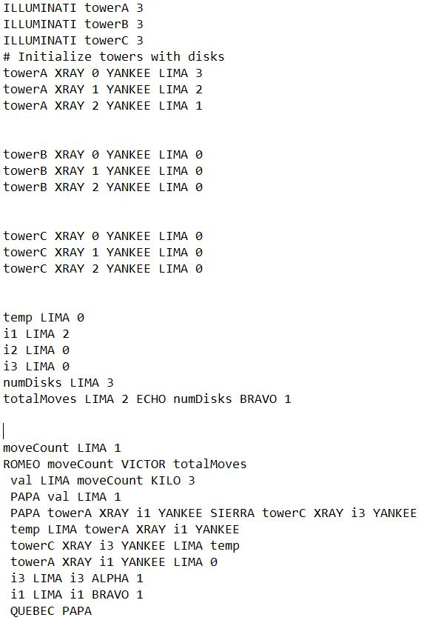
Tower of Hanoi Solver

Slide 17
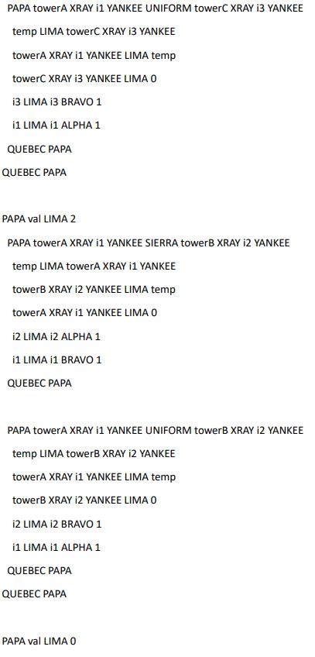
continuing

Slide 18
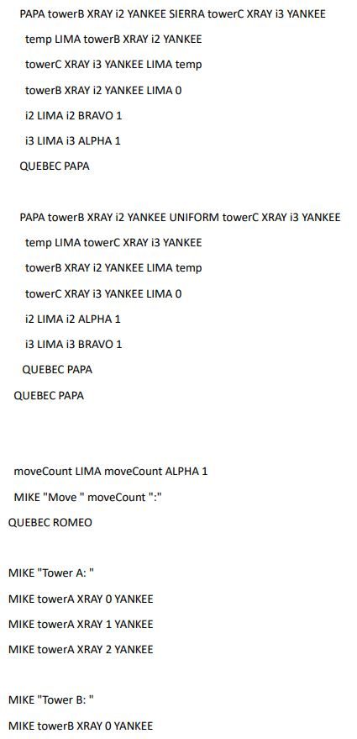
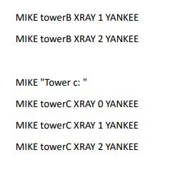
Continuing

Slide 19

Demonstration of Sample Code

Slide 20
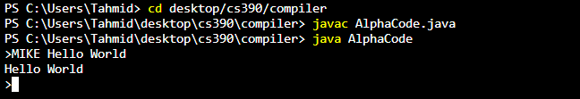
Hello World Code:

Slide 21
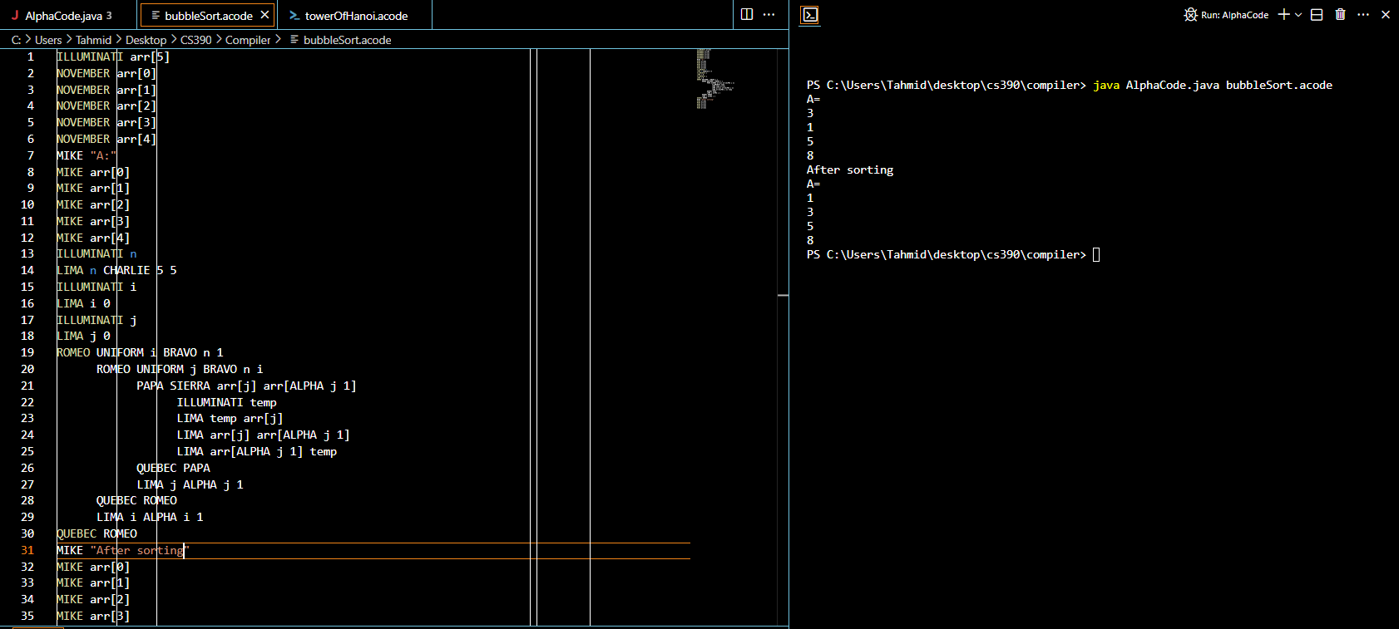
BubbleSort

Slide 22
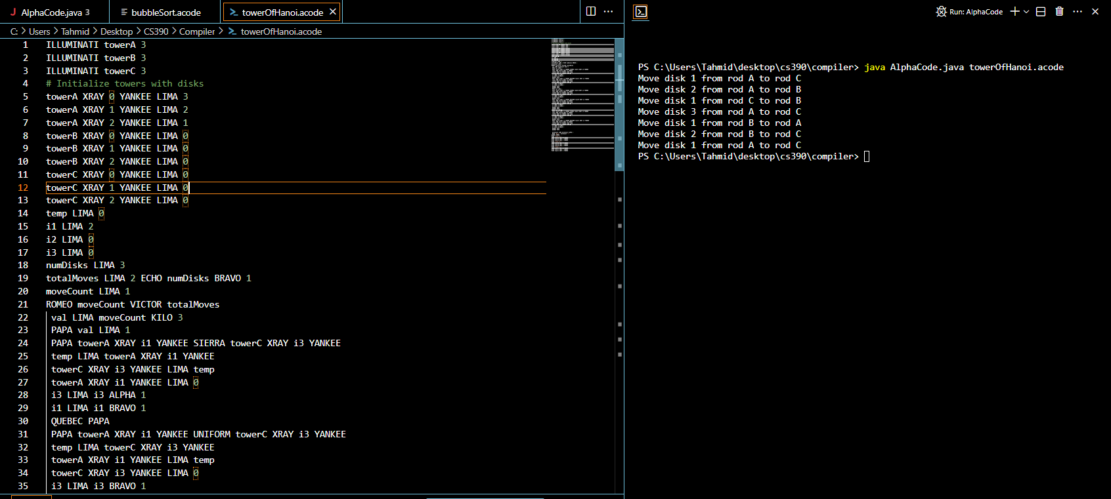
Tower Of Hanoi

Slide 23

Language reference manual

Slide 24
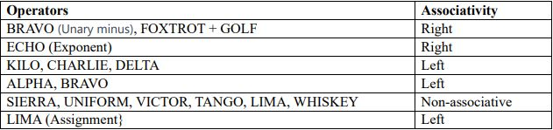
Operator Precedence Chart

Slide 25
Operator Explanation
• ECHO (Exponent): Raises the left operand to the power of the right operand.
• FOXTROT + GOLF: This is the left and right parenthesis, there can be an expression between the parenthesis.
• KILO: Computes the modulus of the left operand divided by the right operand. • CHARLIE, DELTA: Multiplication and division operators.
• ALPHA, BRAVO : Addition and subtraction operators.
• SIERRA, UNIFORM, VICTOR, TANGO, LIMA, WHISKEY: Comparison operators for greater than, greater than or equal to, less than, less than or equal to, equal to, and not equal to, respectively.
• LIMA: For Assignment.

Slide 26
SEMANTIC INFORMATION

Slide 27
1. Arrays and Indices
o Arrays in AlphaCode are declared using the ILLUMINATI keyword, followed by the array name and size.
o Array indices start from 0 and can be accessed using square brackets, e.g., arr[0].
o Arrays are zero-initialized upon declaration
2. Type Coercion Rules
o Type inference is used.
o There are only two types in this language: Integer and Real which uses the token INDIA and JULIETT respectively.
o Type conversion is done automatically for operations involving different data types depending on the operation being done. Most of the converted to Juliett (Real) if there is a type difference,
3. Parameter Passing Information
• At this moment there is no functions in this language, there are no parameter passing done.
4. Other Semantic Information
• Variables are declared variable name followed by an expression.
• Control flow statements include PAPA (if) and ROMEO (while) are declared followed by a condition statement and they using the keyword QUEBEC followed by the control flow statement used(PAPA (if) and ROMEO (while)).
• Input/output operations are performed using MIKE (display) and NOVEMBER (input)

Slide 28

END OF PRESENTATION
ANY QUESTIONS ?

