Slide 1
Covid-19 Simulator
CSE413 - Simulation and Modeling Lab

Slide 2


Members
2215151101 - Maleka Parvez Chandrima (7C1)
Faculty
2114951008 - Tahmid Nasif Tamal (7C1)
Saima Siddique Tashfia
Lecture,
Department of Computer Science and Engineering,
University of Information Technology and Sciences
2215151106 - Zobayer Hasan (7C1)
2215151102 - Murtoza Mahir (7C1)

Slide 3


Introduction
COVID-19 forecasting is uncertain due to behavioral and policy shifts.
Traditional models give single outcomes insufficient for real scenarios.
Use Monte Carlo Simulation to predict daily new COVID-19 cases.
Focused on Bangladesh data from March–April 2020

Slide 4

Objective
Develop a model to simulate future daily cases probabilistically
Provide confidence intervals rather than fixed predictions
Offer insights for public health planning and educational purposes

Slide 5

Preprocess and clean data
01
Extract statistical parameters
02
Methodology
Run Monte Carlo simulations
03
Visualize trends and quantify uncertain
04

Slide 6




Generate daily cases using normal distribution
Monte Carlo Simulation Logic
Apply non-negativity constraint
Analyze ensemble mean and percentiles

Slide 7
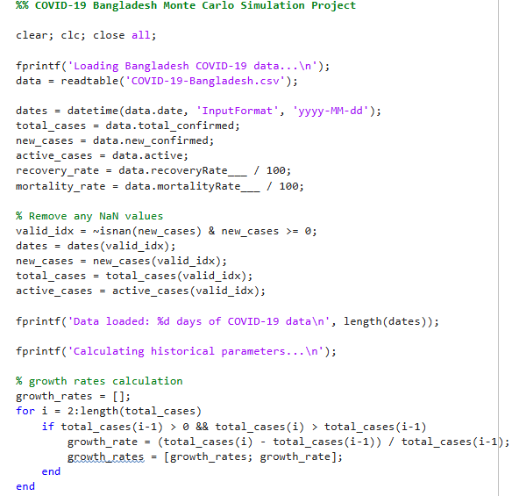
MATLAB Implementation
Used built-in function.
Data import.
Parameter estimation.
Simulation loop.
Plot generation.
Summary statistics.
7

Slide 8
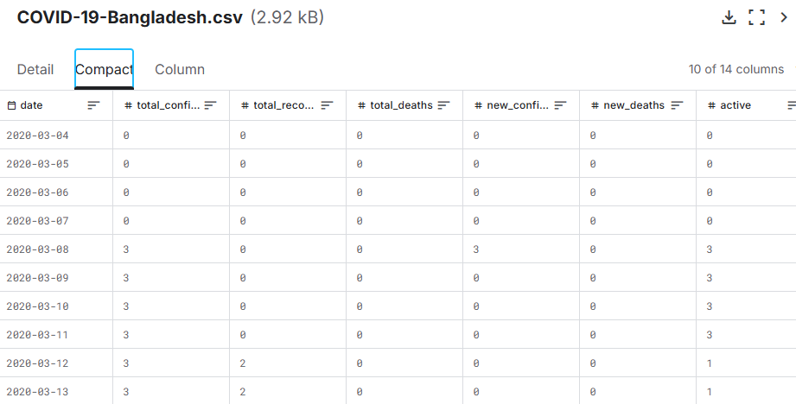
Dataset

Slide 9
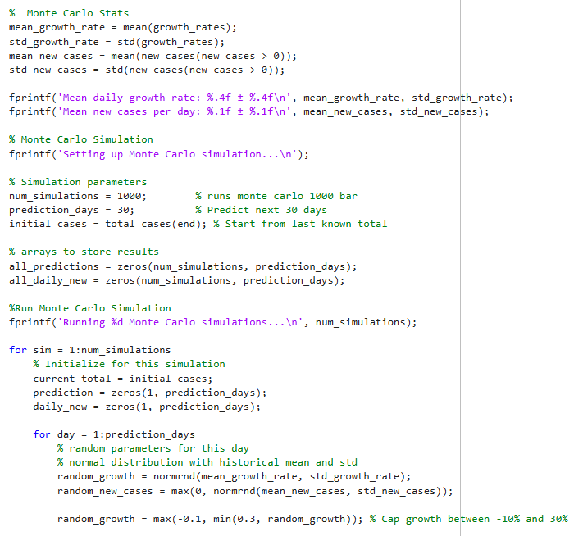
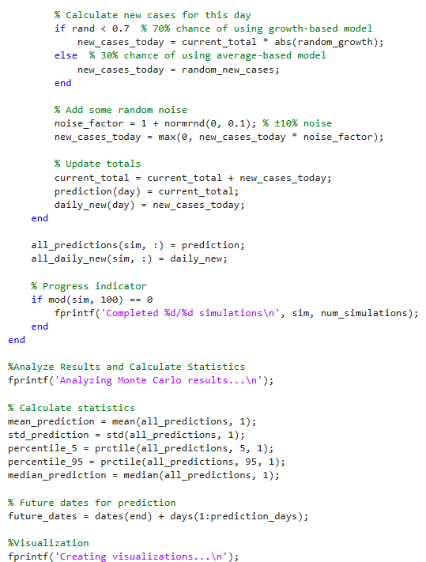

Slide 10
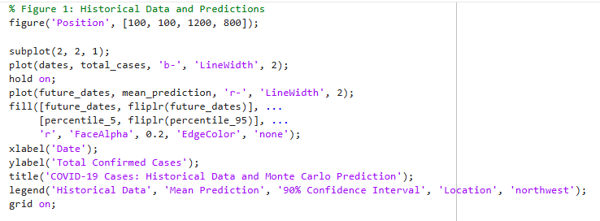

Slide 11
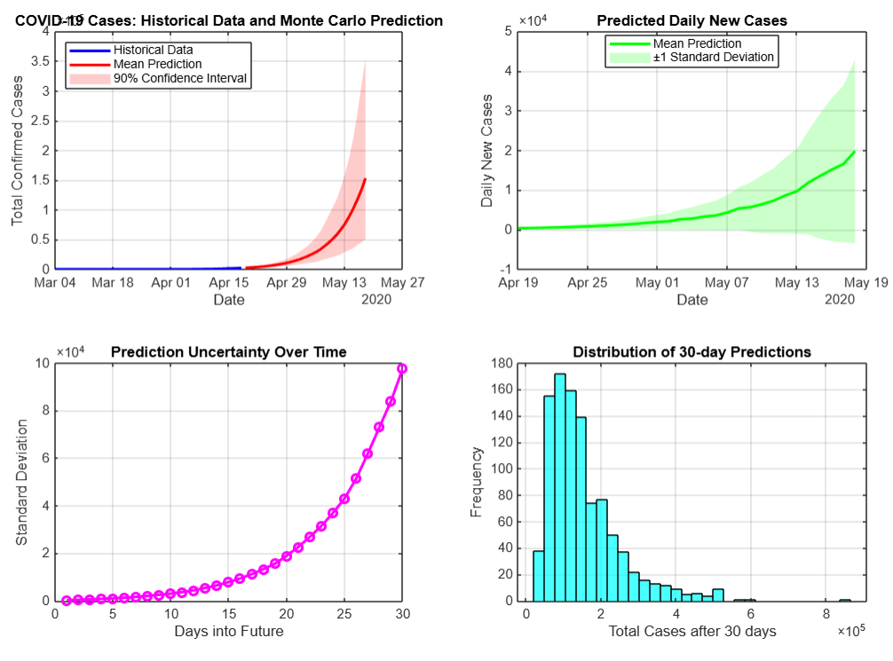
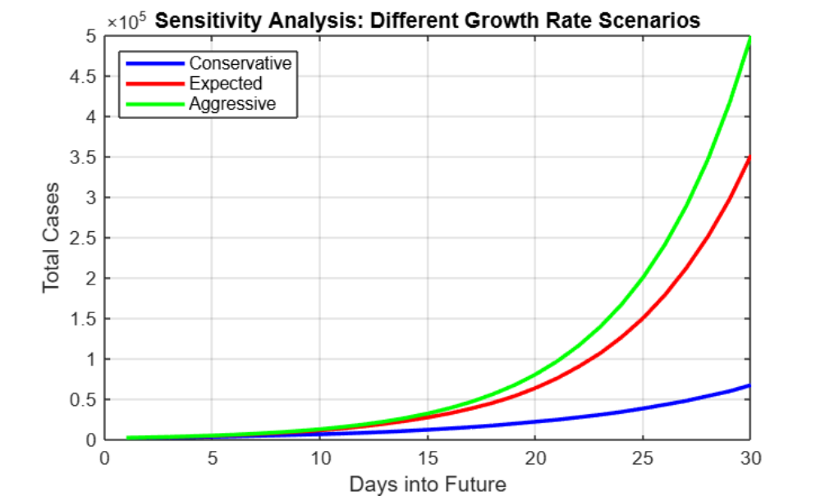
9

Slide 12

Key Takeaways
Monte Carlo is ideal for uncertain forecasts.
The model shows possible outcomes, not certainties.
Useful for teaching, planning, and rapid prototyping.
Can be extended to more complex models.

Slide 13
References
Kaggle, “COVID-19 Bangladesh Dataset,” Kaggle.com, 2020. [Online]. Available: 123-456-7890. [Accessed: May 29, 2025].
World Health Organization (WHO), “Coronavirus disease (COVID-19) Situation Reports,” World Health Organization, 2020. [Online]. Available: https://www.who.int/emergencies/diseases/novel-coronavirus-2019/situation-reports. [Accessed: May 29, 2025].
P. E. McKnight and J. Najab, Monte Carlo Simulation and Resampling Methods for Social Science. New York: Springer, 2010.
Github: https://github.com/tahmidnasiftamal/Covid-19-Simulator-using-Matlab

Slide 14
Thank You!
Any Queries?

