Slide 1

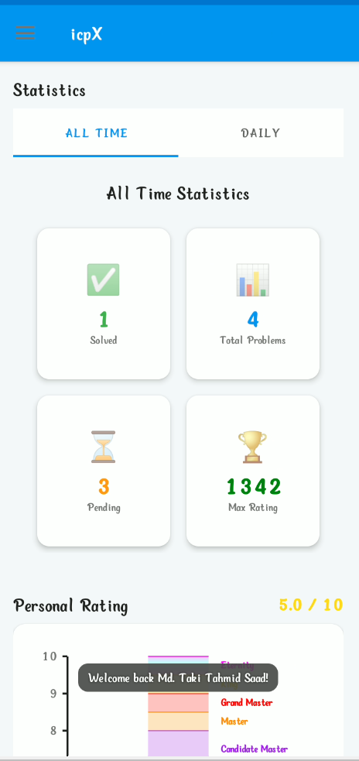
icpX: Elevating Competitive Programming
icpX is a powerful cross-platform application meticulously designed for competitive programmers. It offers comprehensive tools to track, manage, and analyze problem-solving progress, with seamless integration for Codeforces and cloud synchronization across devices.

Slide 2
Why do you use this app?

Slide 3
Problem : Inconsistency in CP
Solution :
This App

Slide 4
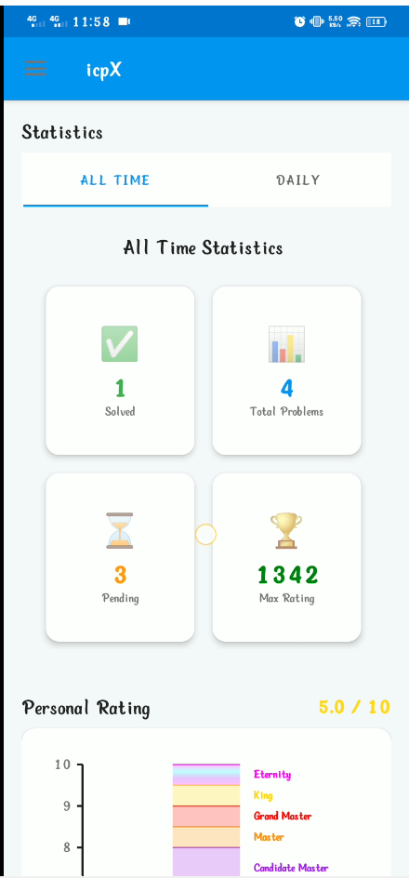
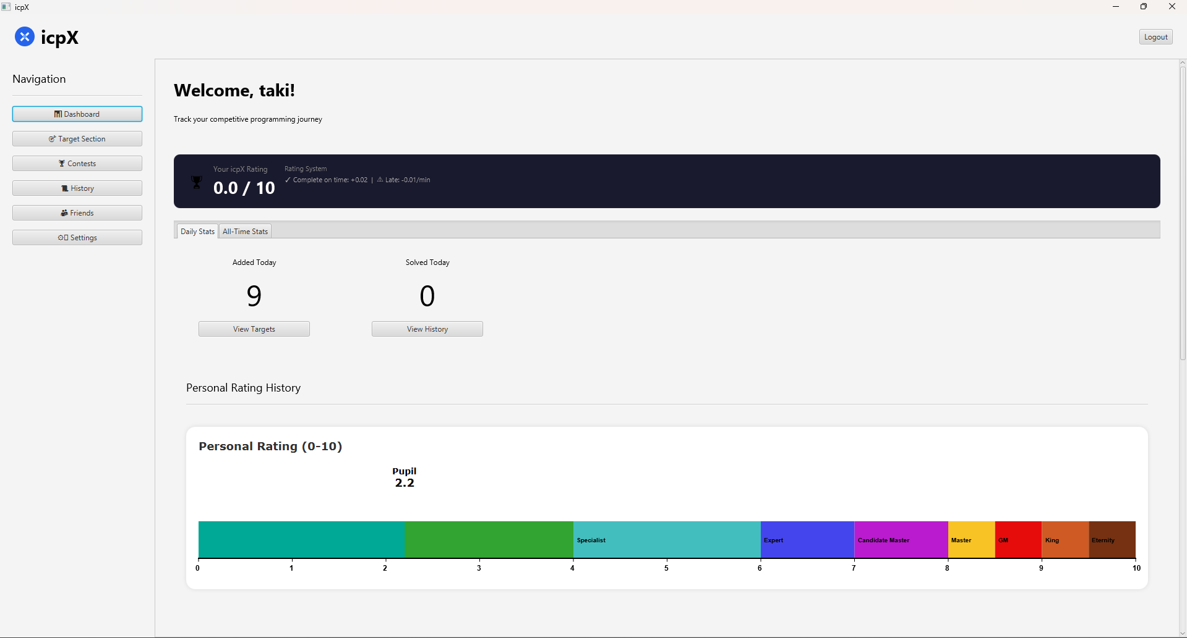
A Unified Experience: Android & Desktop
Desktop Application
Android Application
Java Desktop Application

Slide 5



Core Features: Track, Manage, Analyze
User Authentication
Problem & Target Management
History & Statistics
Visualize progress with solved problem history, rating charts, performance heatmaps, and detailed statistics.
Secure sign-in using Google, BCrypt password hashing, and Firebase Auth for robust account management.
Add, edit, delete, and track programming problems ("targets") with automatic fetching from the Codeforces API.

Slide 6

Data Flow & Architecture
Built in ‘
WebView system
User can read problem statement
through this app
Built in
Ratting Calculation System
Offline
Problem Viewing System
Core
Features
Encourage User to get his/her ratting
User can see statement when if he/she is offline
Online
database System
Contest Schedule
Viewing System
Track upcoming and past contest
User can access his IcpX id through any device
icpX utilizes an MVC pattern on the desktop, with data access facilitated by DAOs and API integrations handled by dedicated services. This architecture ensures efficient data management and seamless cloud synchronization.

Slide 7
How help to increase Consistency
Add your target for 24h
Prevent you from distraction
Solve the target before 24h
Access to read problem statement offline
Unable to solve lead before time cause you penalty in ratting
Seamless data synchronization between your Desktop and Android
Successfully solve the target give you increase of ratting

Slide 8




Usage Scenarios: Empowering Programmers
Add Codeforces Problems
Set Training Targets
Quickly import problems from Codeforces to your personal list.
Define and track specific problem-solving goals for focused practice.
Analyze Performance
Sync Data Across Devices
Leverage the interactive dashboard with visualizations and statistics to pinpoint strengths and weaknesses.
Maintain a consistent progress record whether you're on your phone or desktop.

Slide 9

Seamless Cloud Synchronization
Data Consistency Across Devices
icpX ensures your progress is always up-to-date. Manual and automatic synchronization options keep your problems, status, ratings, and handle perfectly aligned across all your devices.
Local Storage: SQLite
Cloud Storage: Firebase Firestore
Automated & On-demand Sync

Slide 10



Modern UI/UX Design
Material Design (Android)
JavaFX (Desktop)
Custom Themes & Layouts
Intuitive and visually appealing interface for a smooth mobile experience.
Rich, responsive, and customizable desktop interface for enhanced productivity.
Personalize your environment with various themes and responsive layouts adapting to your screen.

Slide 11

Technical Foundation: Android Stack
Gradle-based Build System: Efficient project management and dependency handling.
Firebase Integration: Powers authentication, cloud storage (Firestore), and other backend services.
WorkManager: Manages background tasks, ensuring reliable data synchronization.
Local SQLite Database: Stores user data offline for quick access and robust persistence.
Modular Code Structure: Enhances maintainability and scalability.

Slide 12
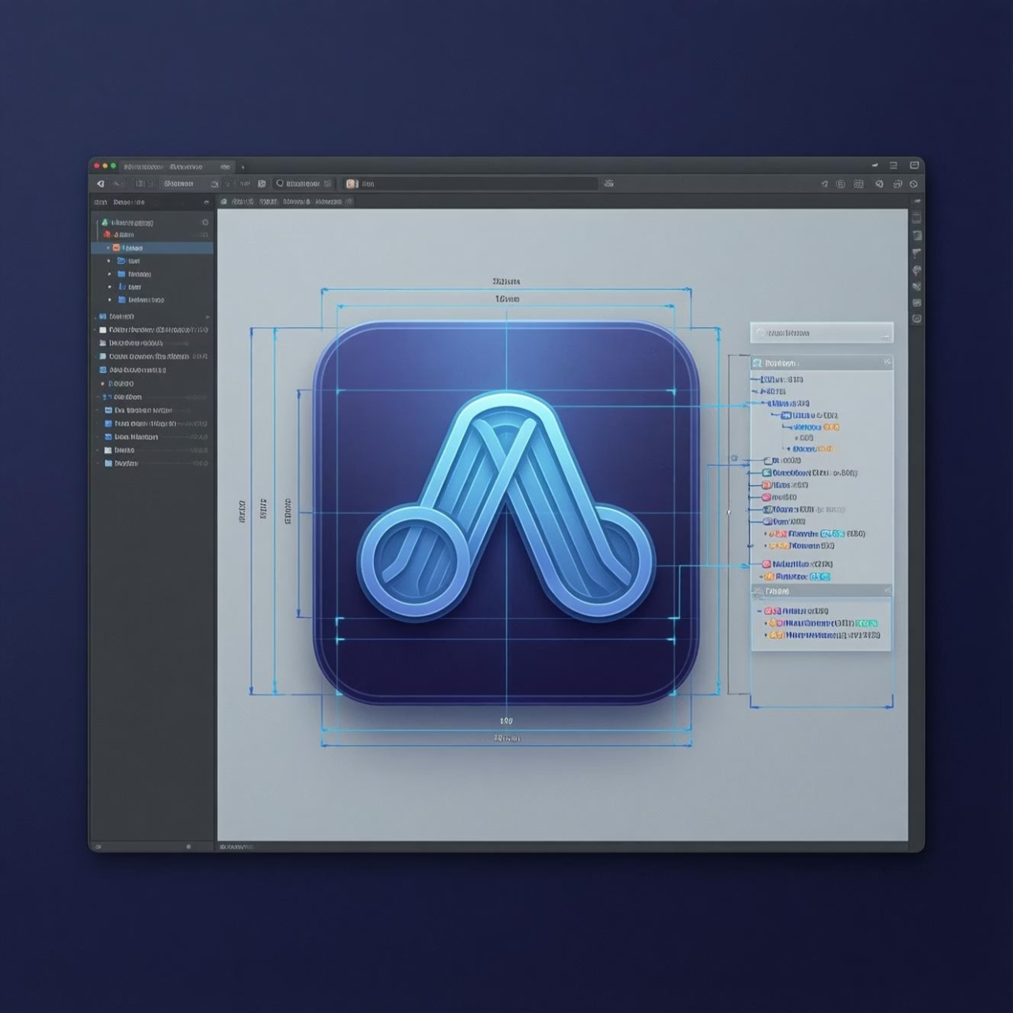
Technical Foundation: Desktop Stack
JavaFX Framework: Powers the modern and interactive graphical user interface.
Maven Build System: Streamlines the build process and dependency management.
SQLite Database: Provides local data storage for fast and reliable access.
MVC Architecture: Promotes clear separation of concerns for robust development.
FXML Views: Declarative UI design for easier development and maintenance.
Google OAuth: Secure and convenient user authentication.

Slide 13
How do you use this app?

Slide 14
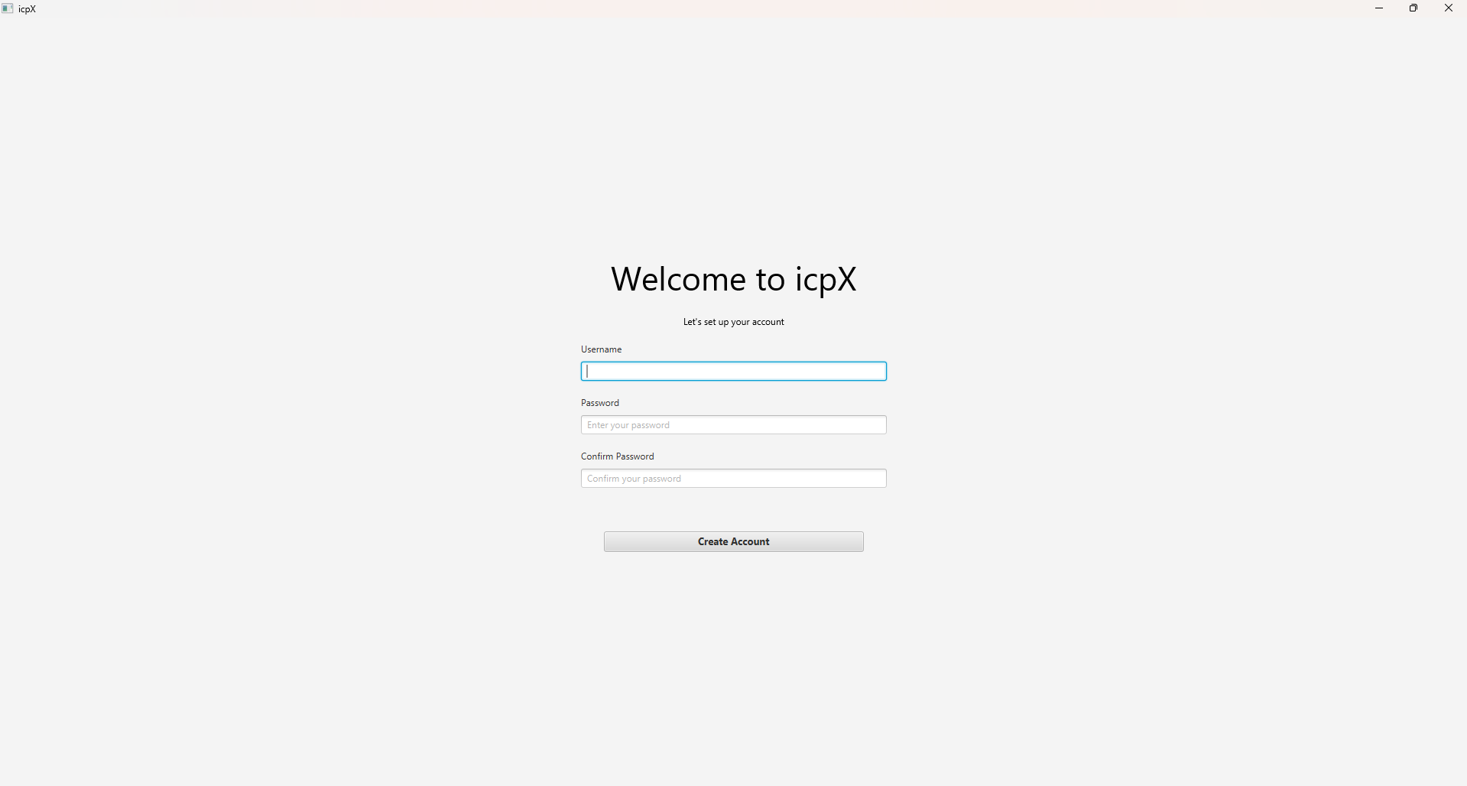
Desktop
Welcome Screen: Create Account here :-

Slide 15
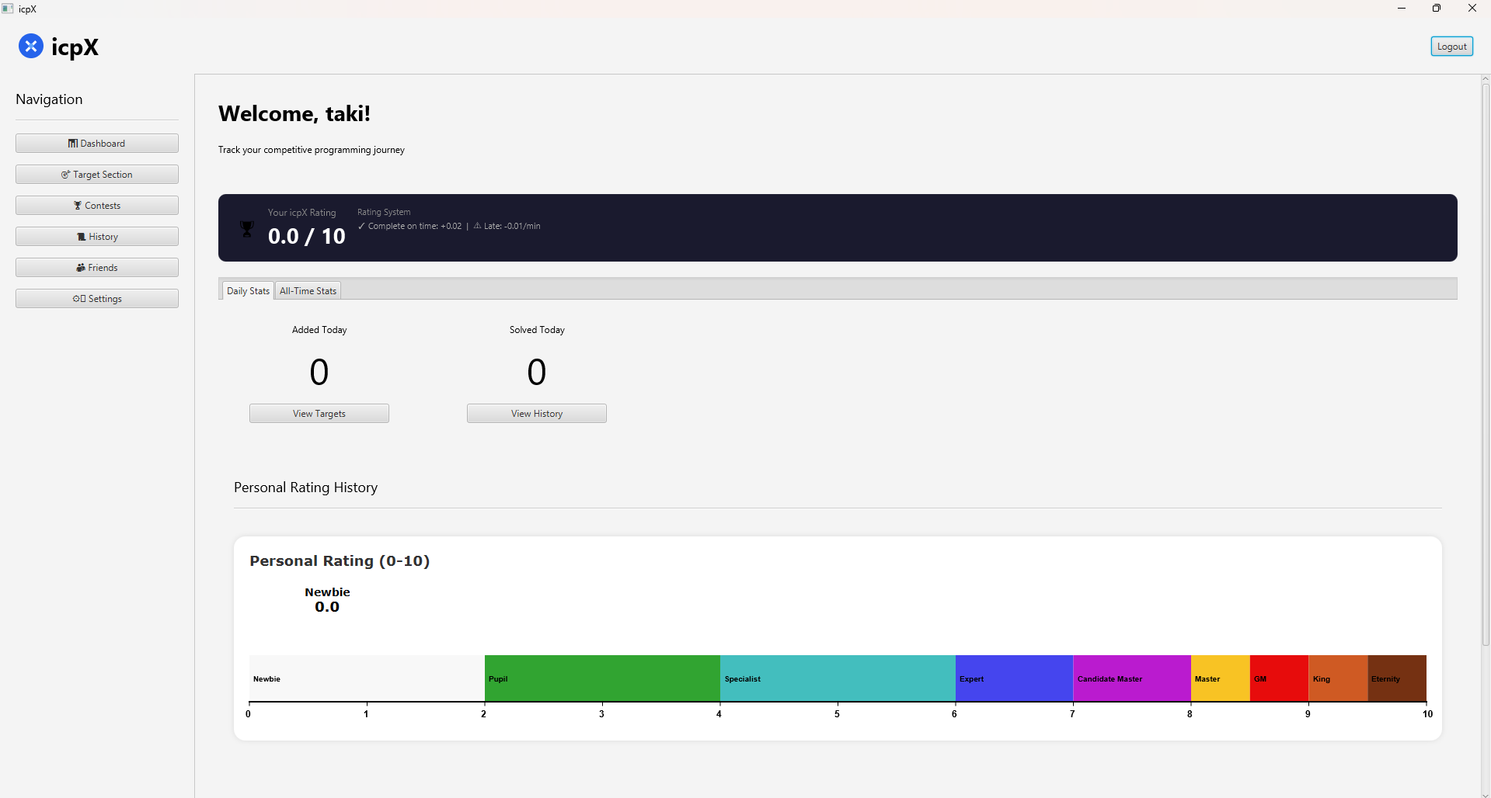
Desktop
Dashboard :
Contain Ratings
Graph
Heatmap
Shortcuts

Slide 16
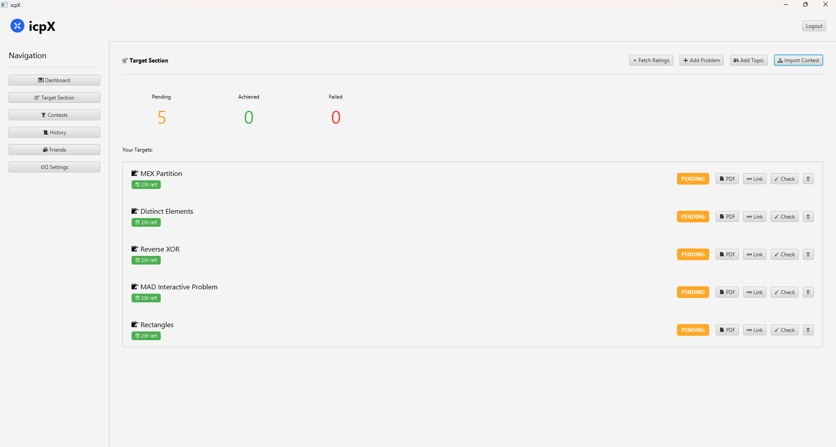
Desktop
Target Section:
Contain Targets
Status of Targets
Countdown

Slide 17
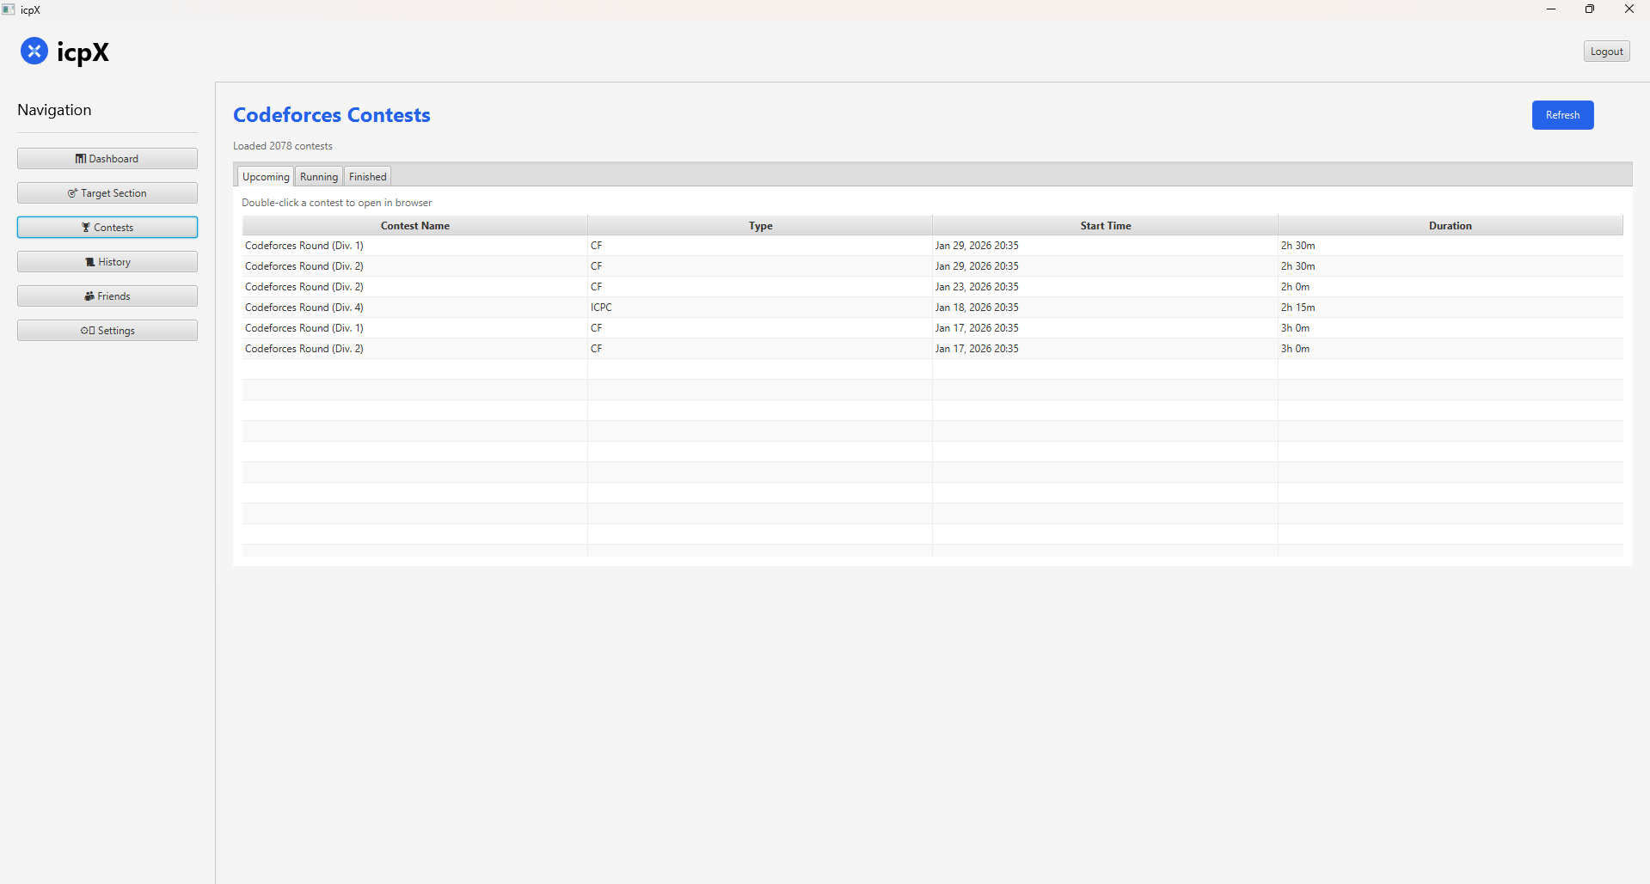
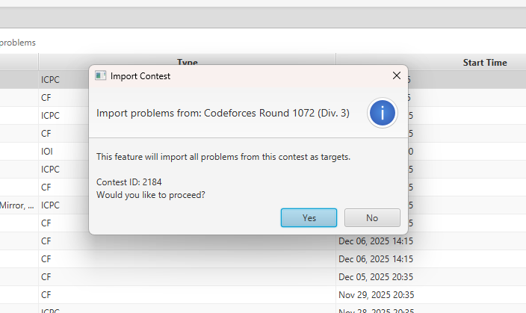
Desktop
Contests Section:
Upcoming Contests
Running Contests
Past Contests
Import Problem direct from contest

Slide 18
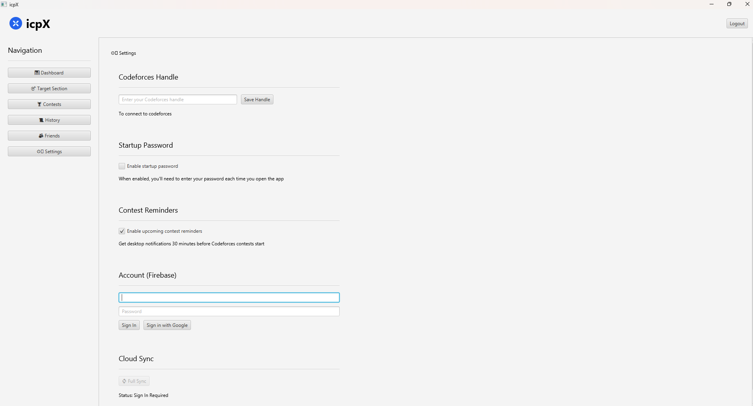
Desktop
Settings:
Add CF handle
Connect you Gmail
Full Sync

Slide 19
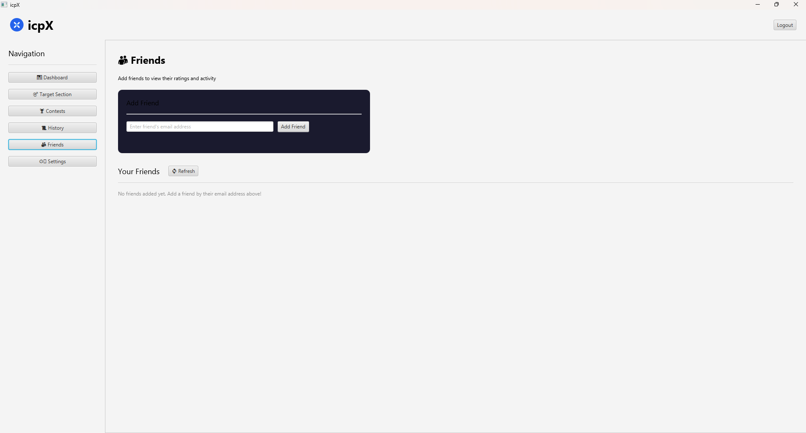
Desktop
Friends:
Add Friends
Observe
Friends Progress

Slide 20
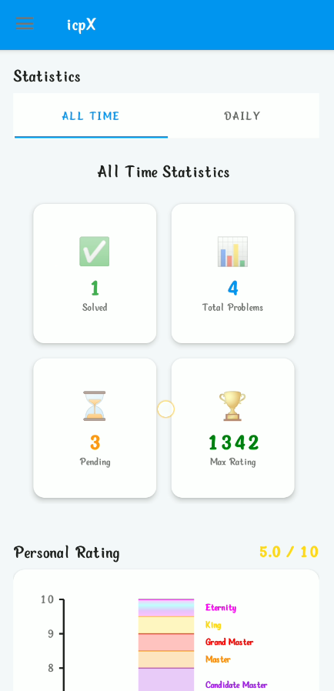
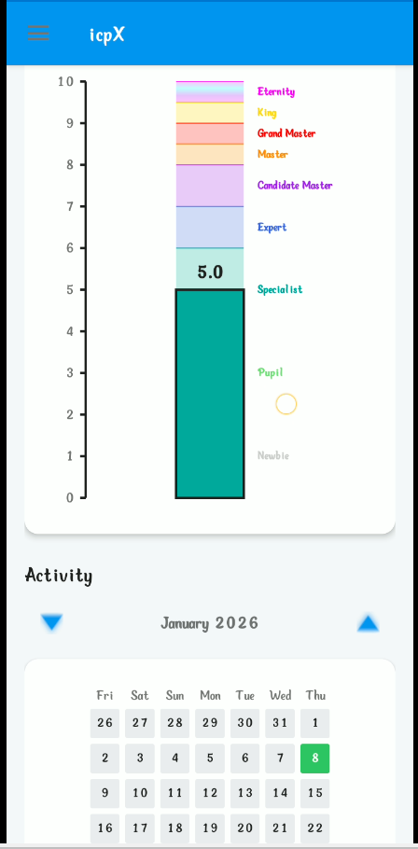
Android
Dashboard Section:
Contains Statistics
Rating Graph
Heatmap

Slide 21
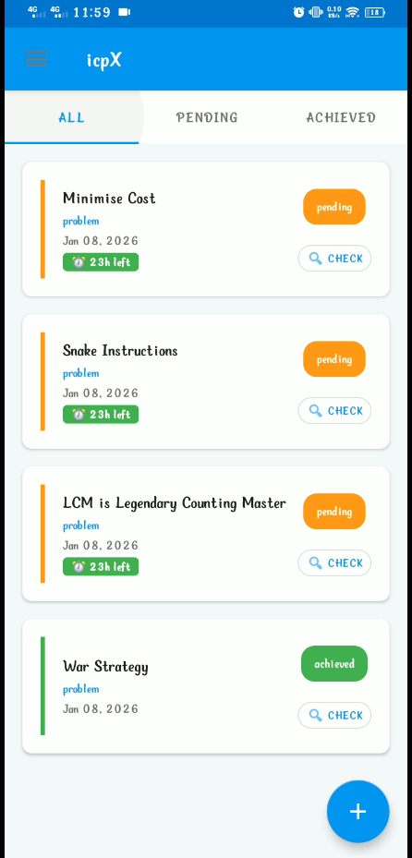
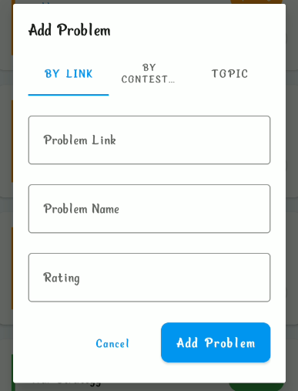
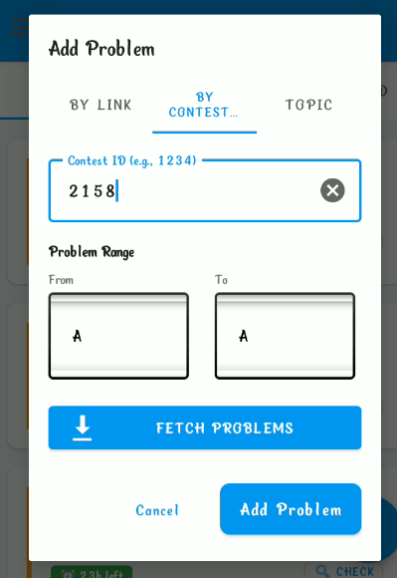
Android
Target Section:
Contain Targets
Status of Targets
Countdown
Add Problem By Links
Add Problem By Contests

Slide 22
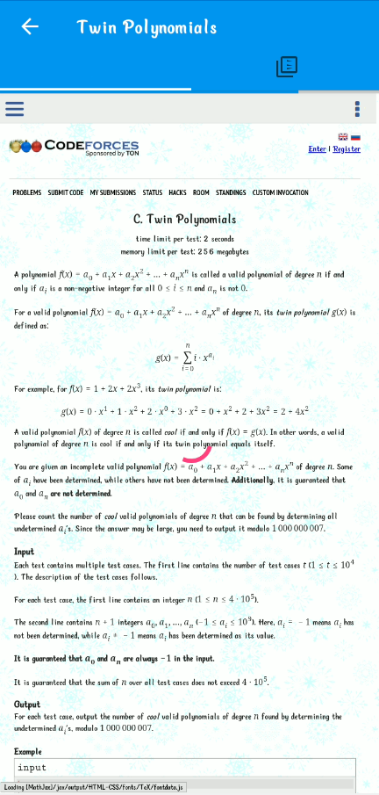

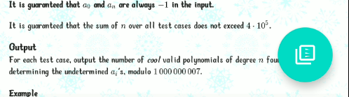
Android
WebView Through icpX:
WebView Through icpX:
Offline Viewing Option

Slide 23
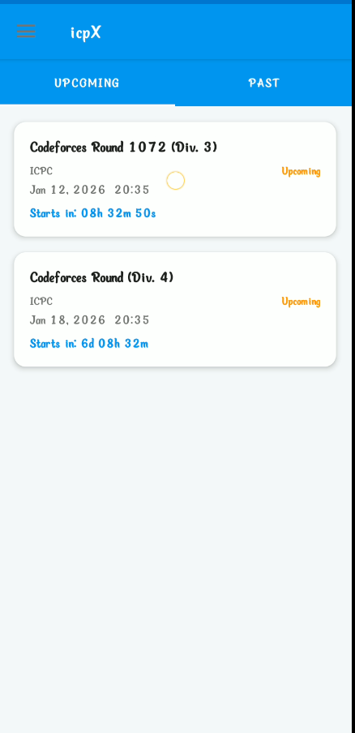
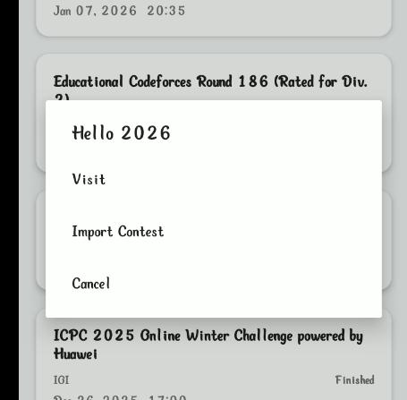
Android
Contest Section:
Upcoming Contests
Running Contests
Past Contests
Can import targets direct from contest

Slide 24
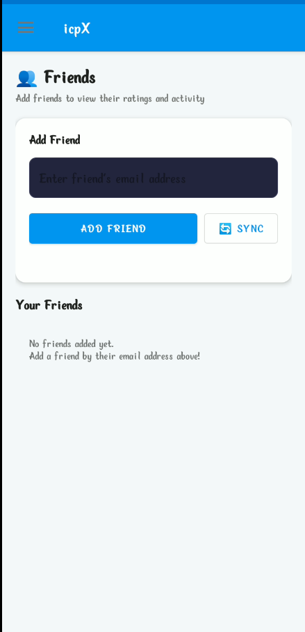
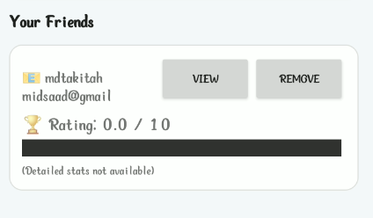
Android
Friends Section:
Add Friends
View Friends
- icpX Ratings
Friends Ratting

Slide 25
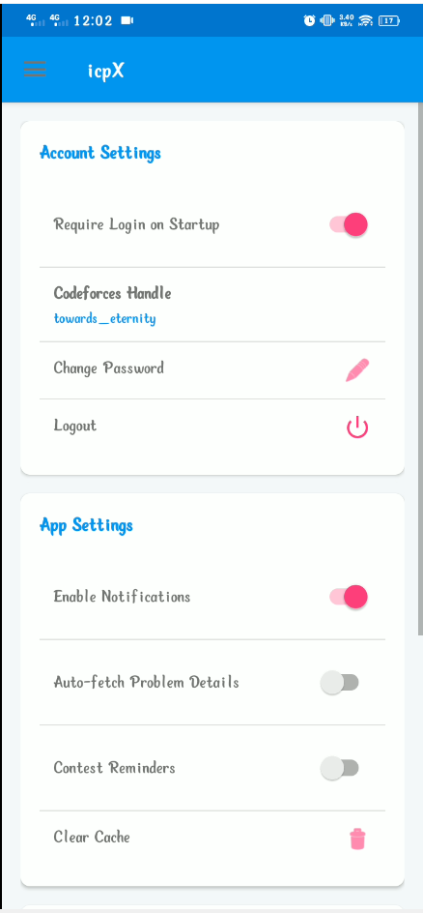
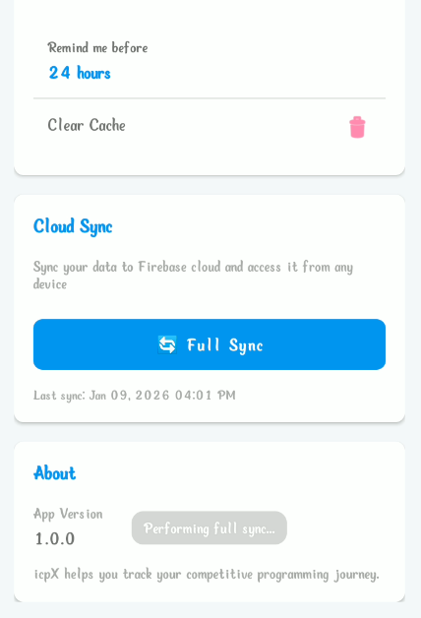
Android
Settings :
Add CF Handle
Contest Reminder E/D
Sync from database

Slide 26
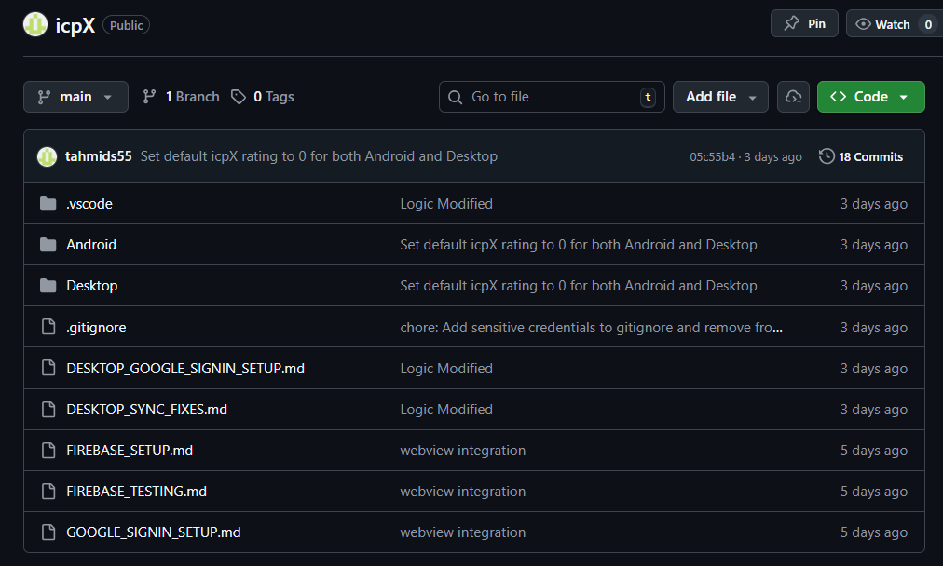
GitHub Repository
Link : https://github.com/tahmids55/icpX

Slide 27
Download Links
Android : icpX.apk
Windows : icpX.exe

Slide 28
Thank You

