Slide 1
1
Introduction to Computers, the Internet and the Web

Slide 2
The chief merit of language is clearness.
  Galen
Our life is frittered away by detail. …Simplify, simplify.
  Henry David Thoreau
He had a wonderful talent for packing thought close, and rendering it portable.
  Thomas B. Macaulay

Slide 3
Man is still the most extraordinary computer of all.
  John F. Kennedy
Things are always at their best in their beginning.
  Blaise Pascal.

Slide 4
OBJECTIVES
In this chapter you will learn:
Basic computer concepts.
The different types of programming languages.
The history of the C programming language.
The purpose of the C Standard Library.
The elements of a typical C program development environment.
Why it is appropriate to learn C in a first programming course.
How C provides a foundation for further study of programming languages in general and of C++, Java and C# in particular.
The history of the Internet and the World Wide Web.

Slide 5
1.1 Introduction
1.2 What Is a Computer?
1.3 Computer Organization
1.4 Early Operating Systems
1.5 Personal, Distributed and Client/Server Computing
1.6 Machine Languages, Assembly Languages and
High-Level Languages
1.7 Fortran, COBOL, Pascal and Ada
1.8 History of C
1.9 C Standard Library

Slide 6
1.10 C++
1.11 Java
1.12 BASIC, Visual Basic, Visual C++, Visual C# and .NET
1.13 Key Software Trend: Object Technology
1.14 Typical C Program Development Environment
1.15 Hardware Trends
1.16 History of the Internet
1.17 History of the World Wide Web
1.18 Notes About C and This Book
1.19 Web Resources

Slide 7
1.1 Introduction
We will learn
  The C programming language
  Structured programming and proper programming techniques
This book also covers C++
  Chapters 18-27 introduce the C++ programming language
This course is appropriate for
  Technically oriented people with little or no programming experience
  Experienced programmers who want a deep and rigorous treatment of the language

Slide 8
1.2 What is a Computer?
Computer
  Device capable of performing computations and making logical decisions
  Computers process data under the control of sets of instructions called computer programs
Hardware
  Various devices comprising a computer
  Keyboard, screen, mouse, disks, memory, CD-ROM, and processing units
Software
  Programs that run on a computer

Slide 9
1.3 Computer Organization
Six logical units in every computer:
  Input unit
    Obtains information from input devices (keyboard, mouse)
  Output unit
    Outputs information (to screen, to printer, to control other devices)
  Memory unit
    Rapid access, low capacity, stores input information
  Arithmetic and logic unit (ALU)
    Performs arithmetic calculations and logic decisions
  Central processing unit (CPU)
    Supervises and coordinates the other sections of the computer
  Secondary storage unit
    Cheap, long-term, high-capacity storage
    Stores inactive programs

Slide 10
1.4 Early Operating Systems
Batch processing
  Do only one job or task at a time
Operating systems
  Manage transitions between jobs
  Increased throughput
    Amount of work computers process
Multitasking
  Computer resources are shared by many jobs or tasks
Timesharing
  Computer runs a small portion of one user’s job then moves on to service the next user

Slide 11
1.5 Personal Computing, Distributed Computing, and Client/Server Computing
Personal computers
  Economical enough for individual
Distributed computing
  Computing distributed over networks
Client/server computing
  Sharing of information across computer networks between file servers and clients (personal computers)

Slide 12
1.6 Machine Languages, Assembly Languages, and High-level Languages
Three types of programming languages
  Machine languages
    Strings of numbers giving machine specific instructions
    Example:
        +1300042774
        +1400593419
        +1200274027
  Assembly languages
    English-like abbreviations representing elementary computer operations (translated via assemblers)
    Example:
        LOAD BASEPAY
        ADD OVERPAY
        STORE GROSSPAY

Slide 13
1.6 Machine Languages, Assembly Languages, and High-level Languages
Three types of programming languages (continued)
  High-level languages
    Codes similar to everyday English
    Use mathematical notations (translated via compilers)
    Example:
      grossPay = basePay + overTimePay

Slide 14
1.7 Fortran, COBOL, Pascal and Ada
Fortran
  developed by IBM Corporation in the 1950s
  used for scientific and engineering applications that require complex mathematical computations
COBOL
  developed in 1959 by computer manufacturers, the government and industrial computer users
  used for commercial applications that require precise and efficient manipulation of large amounts of data

Slide 15
1.7 Fortran, COBOL, Pascal and Ada
Pascal
  Developed by Professor Niklaus Wirth in 1971
  Designed for teaching structured programming
Ada
  Developed under the sponsorship of the U.S. Department of Defense (DOD) during the 1970s and early 1980s
  Able to perform multitasking

Slide 16
1.8 History of C
C
  Evolved by Ritchie from two previous programming languages, BCPL and B
  Used to develop UNIX
  Used to write modern operating systems
  Hardware independent (portable)
  By late 1970's C had evolved to "Traditional C"
Standardization
  Many slight variations of C existed, and were incompatible
  Committee formed to create a "unambiguous, machine-independent" definition
  Standard created in 1989, updated in 1999

Slide 17
Portability Tip 1.1
Because C is a hardware-independent, widely available language, applications written in C can run with little or no modifications on a wide range of different computer systems.

Slide 18
1.9 C Standard Library
C programs consist of pieces/modules called functions
  A programmer can create his own functions
    Advantage: the programmer knows exactly how it works
    Disadvantage: time consuming
  Programmers will often use the C library functions
    Use these as building blocks
  Avoid re-inventing the wheel
    If a pre-made function exists, generally best to use it rather than write your own
    Library functions carefully written, efficient, and portable

Slide 19
Performance Tip 1.1
Using Standard C library functions instead
of writing your own comparable versions can improve program performance, because these functions are carefully written to perform efficiently.

Slide 20
Portability Tip 1.2
Using Standard C library functions instead
of writing your own comparable versions can improve program portability, because these functions are used in virtually all Standard C implementations.

Slide 21
1.10 C++
C++
  Superset of C developed by Bjarne Stroustrup at Bell Labs
  "Spruces up" C, and provides object-oriented capabilities
  Dominant language in industry and academia
Learning C++
  Because C++ includes C, some feel it is best to master C, then learn C++
  Starting in Chapter 18, we begin our introduction to C++

Slide 22
1.11 Java
Java is used to
  Create Web pages with dynamic and interactive content
  Develop large-scale enterprise applications
  Enhance the functionality of Web servers
  Provide applications for consumer devices (such as cell phones, pagers and personal digital assistants)
Java How to Program
  Closely followed the development of Java by Sun
  Teaches first-year programming students the essentials of graphics, images, animation, audio, video, database, networking, multithreading and collaborative computing

Slide 23
1.12 BASIC, Visual Basic, Visual C++, Visual C# and .NET
BASIC
  Developed in the mid-1960s by Professors John Kemeny and Thomas Kurtz of Dartmouth College as a language for writing simple programs
Visual Basic
  Introduced by Microsoft in 1991 to simplify the process of making Windows applications
Visual Basic, Visual C++, and Visual C#
  Designed for Microsoft’s .NET programming platform

Slide 24
1.13 Key Software Trend: Object Technology
Objects
  Reusable software components that model items in the real world
  Meaningful software units
    Date objects, time objects, paycheck objects, invoice objects, audio objects, video objects, file objects, record objects, etc.
    Any noun can be represented as an object
  Very reusable
  More understandable, better organized, and easier to maintain than procedural programming
  Favor modularity

Slide 25
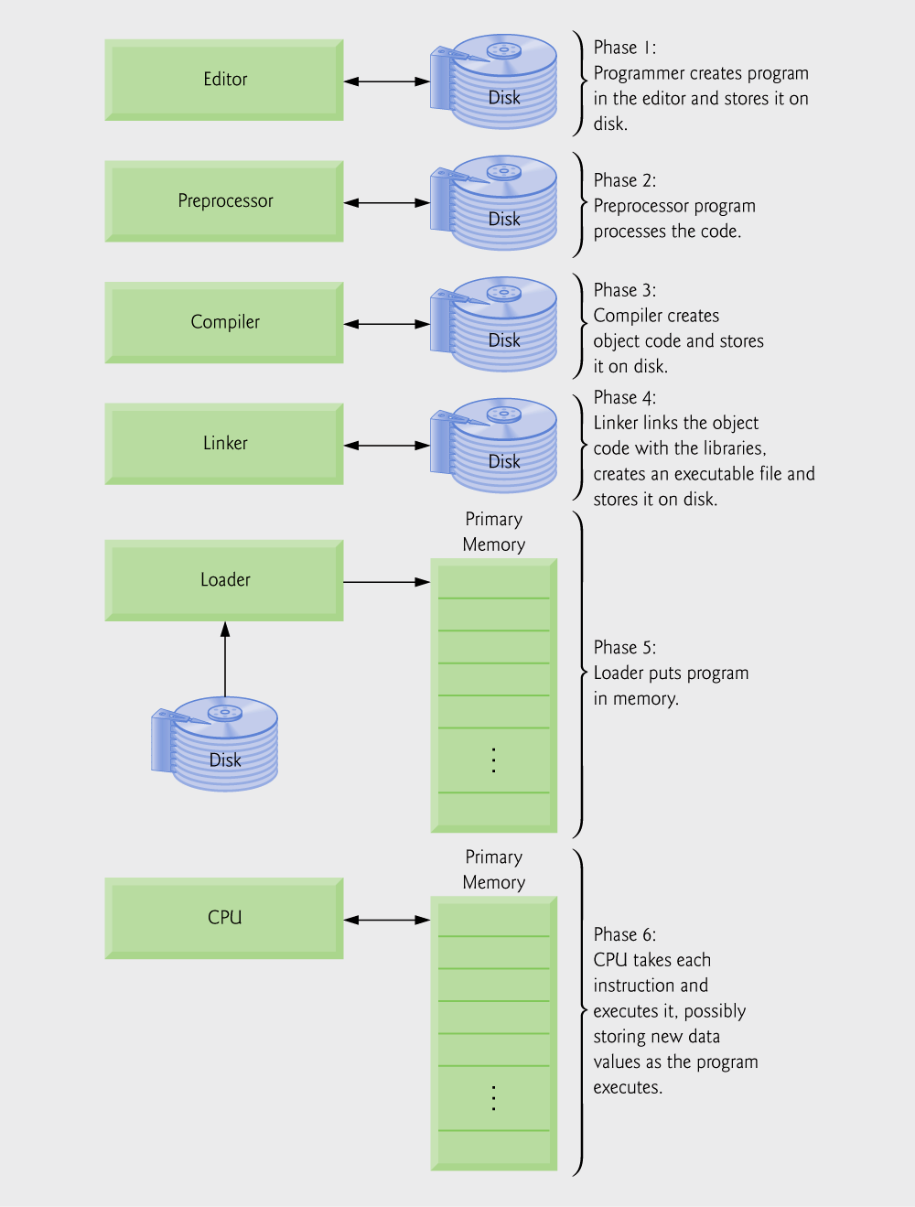
1.14 Typical C Program Development Environment
Phases of C++ Programs:
  Edit
  Preprocess
  Compile
  Link
  Load
  Execute
Fig. 1.1 | Typical C development environment.

Slide 26
Common Programming Error 1.1
Errors like division-by-zero occur as a program runs, so these errors are called runtime errors or execution-time errors. Divide-by-zero is generally a fatal error, i.e., an error that causes the program to terminate immediately without successfully performing its job. Nonfatal errors allow programs to run to completion, often producing incorrect results. [Note: On some systems, divide-by-zero is not a fatal error. Please see your system documentation.]

Slide 27
1.15 Hardware Trends
Every year or two the following approximately double:
  Amount of memory in which to execute programs
  Amount of secondary storage (such as disk storage)
    Used to hold programs and data over the longer term
  Processor speeds
    The speeds at which computers execute their programs

Slide 28
1.16 History of the Internet
The Internet enables
  Quick and easy communication via e-mail
  International networking of computers
Packet switching
  The transfer of digital data via small packets
  Allows multiple users to send and receive data simultaneously
No centralized control
  If one part of the Internet fails, other parts can still operate
TCP/IP
Bandwidth
  Information carrying capacity of communications lines

Slide 29
1.17 History of the World Wide Web
World Wide Web
  Locate and view multimedia-based documents on almost any subject
  Makes information instantly and conveniently accessible worldwide
  Possible for individuals and small businesses to get worldwide exposure
  Changing the way business is done

Slide 30
1.18 General Notes About C and This Book
Program clarity
  Programs that are convoluted are difficult to read, understand, and modify
C is a portable language
  Programs can run on many different computers
  However, portability is an elusive goal
We will do a careful walkthrough of C
  Some details and subtleties are not covered
  If you need additional technical details
    Read the C standard document
    Read the book by Kernigan and Ritchie

Slide 31
Good Programming Practice 1.1
Write your C programs in a simple and straightforward manner. This is sometimes referred to as KIS (“keep it simple”). Do not “stretch” the language by trying bizarre usages.

Slide 32
Portability Tip 1.3
Although it is possible to write portable programs, there are many problems between different C compilers and different computers that make portability difficult to achieve. Simply writing programs in C does not guarantee portability. The progammer will often need to deal directly with complex computer variations.

Slide 33
Software Engineering Observation 1.1
Read the manuals for the version of C you are using. Reference these manuals frequently to be sure you are aware of the rich collection of C features and that you are using these features correctly.

Slide 34
Software Engineering Observation 1.2
Your computer and compiler are good teachers. If you are not sure how a feature of C works, write a sample program with that feature, compile and run the program and see what happens.

