Slide 1
6
C Arrays

Slide 2
Now go, write it before them in a table,
and note it in a book.
  Isaiah 30:8
To go beyond is as wrong as to fall short.
  Confucius
Begin at the beginning, …
and go on till you come to the end: then stop.
  Lewis Carroll

Slide 3
OBJECTIVES
In this chapter you will learn:
To use the array data structure to represent lists and tables of values.
To define an array, initialize an array and refer to individual elements of an array.
To define symbolic constants.
To pass arrays to functions.
To use arrays to store, sort and search lists and tables of values.
To define and manipulate multiple-subscripted arrays.

Slide 4
6.1 Introduction
6.2 Arrays
6.3 Defining Arrays
6.4 Array Examples
6.5 Passing Arrays to Functions
6.6 Sorting Arrays
6.7 Case Study: Computing Mean, Median and Mode Using Arrays
6.8 Searching Arrays
6.9 Multiple-Subscripted Arrays

Slide 5
6.1 Introduction
Arrays
  Structures of related data items
  Static entity – same size throughout program
  Dynamic data structures discussed in Chapter 12

Slide 6
6.2 Arrays
Array
  Group of consecutive memory locations
  Same name and type
To refer to an element, specify
  Array name
  Position number
Format:
    arrayname[ position number ]
  First element at position 0
  n element array named c:
    c[ 0 ], c[ 1 ]...c[ n – 1 ]

Slide 7
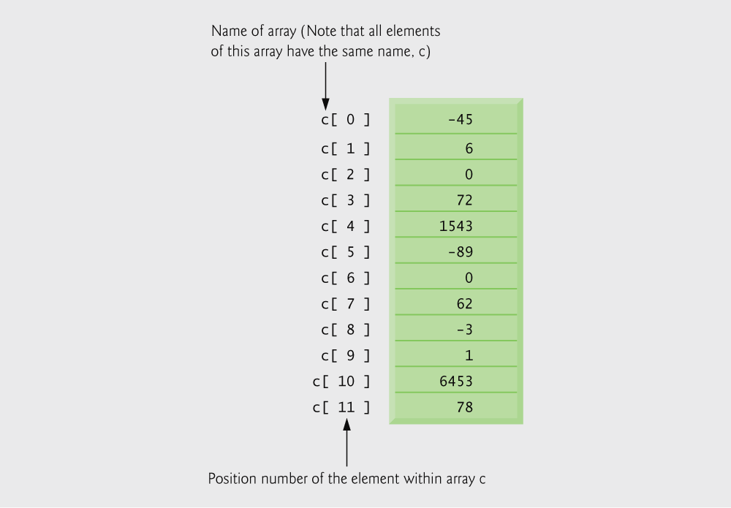
Fig. 6.1 | 12-element array.

Slide 8
6.2 Arrays
Array elements are like normal variables
    c[ 0 ] = 3;
    printf( "%d", c[ 0 ] );
  Perform operations in subscript. If x equals 3
    c[ 5 - 2 ] == c[ 3 ] == c[ x ]

Slide 9
Common Programming Error 6.1
It is important to note the difference between the “seventh element of the array” and “array element seven.” Because array subscripts begin at 0, the “seventh element of the array” has a subscript of 6, while “array element seven” has a subscript of 7 and is actually the eighth element of the array. This is a source of “off-by-one” errors.

Slide 10
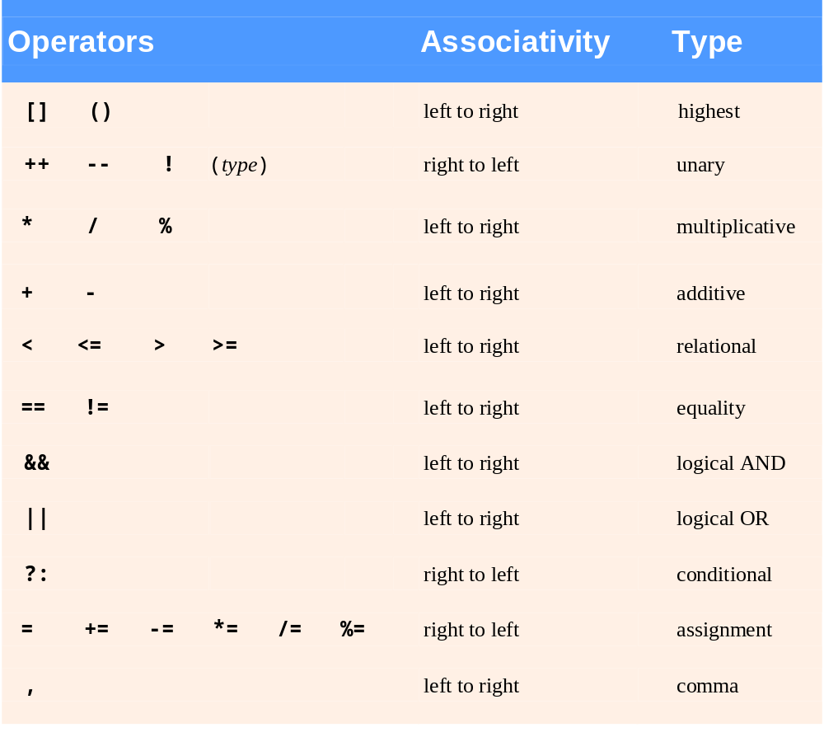
Fig. 6.2 | Operator precedence.

Slide 11
6.3 Defining Arrays
When defining arrays, specify
  Name
  Type of array
  Number of elements
    arrayType arrayName[ numberOfElements ];
  Examples:
    int c[ 10 ];
    float myArray[ 3284 ];
Defining multiple arrays of same type
  Format similar to regular variables
  Example:
    int b[ 100 ], x[ 27 ];

Slide 12
6.4 Array Examples
Initializers
    int n[ 5 ] = { 1, 2, 3, 4, 5 };
  If not enough initializers, rightmost elements become 0
      int n[ 5 ] = { 0 }
    All elements 0
  If too many initializers, a syntax error occurs
  C arrays have no bounds checking
If size omitted, initializers determine it
    int n[ ] = { 1, 2, 3, 4, 5 };
  5 initializers, therefore 5 element array

Slide 13
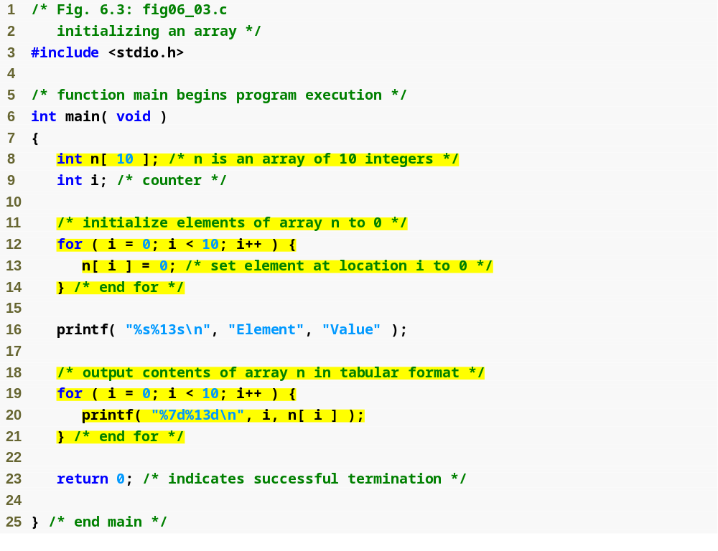
Outline
fig06_03.c
(1 of 2 )
for loop initializes each array element separately
for loop outputs all array elements

Slide 14
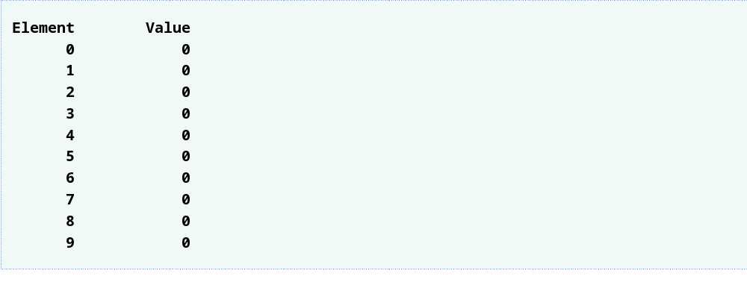
Outline
fig06_03.c
(2 of 2 )

Slide 15
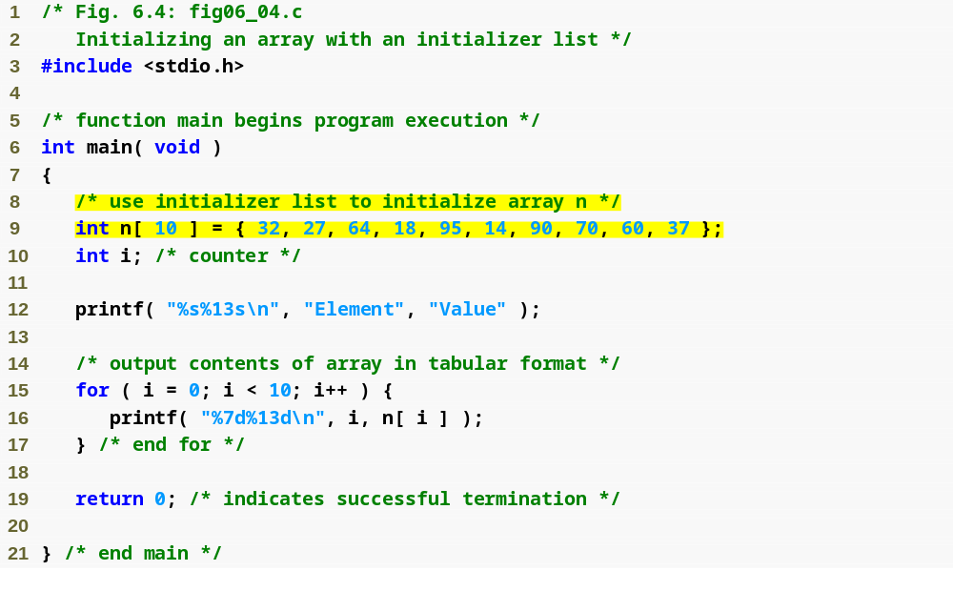
Outline
fig06_04.c
(1 of 2 )
initializer list initializes all array elements simultaneously

Slide 16
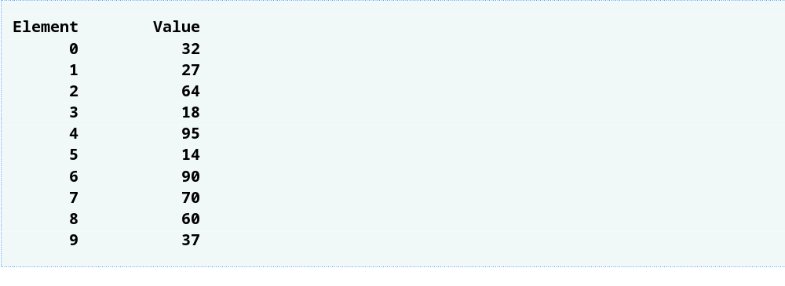
Outline
fig06_04.c
(2 of 2 )

Slide 17
Common Programming Error 6.2
Forgetting to initialize the elements of an
array whose elements should be initialized.

Slide 18
Common Programming Error 6.3
Providing more initializers in an array
initializer list than there are elements
in the array is a syntax error.

Slide 19
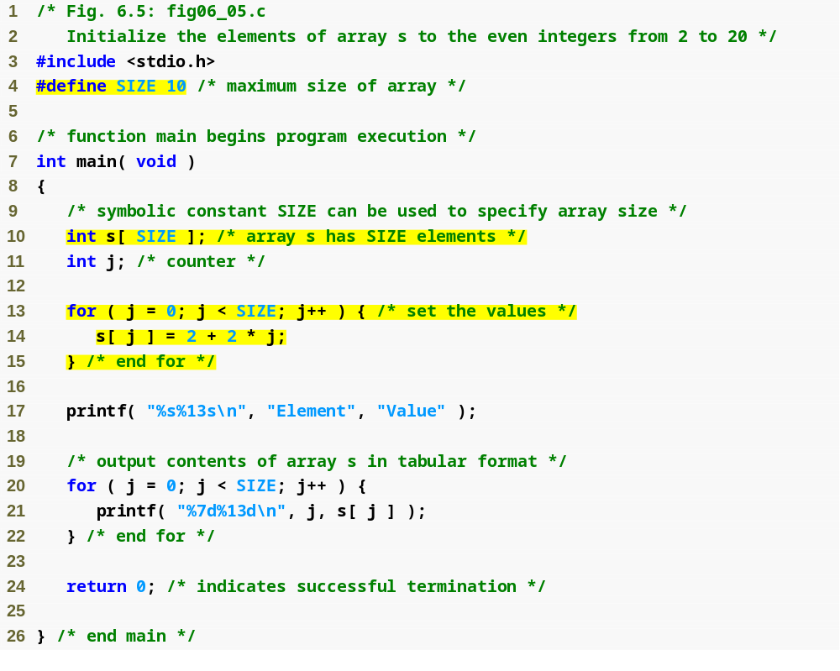
Outline
#define directive tells compiler to replace all instances of the word SIZE with 10
fig06_05.c
(1 of 2 )
SIZE is replaced with 10 by the compiler, so array s has 10 elements
for loop initializes each array element separately

Slide 20
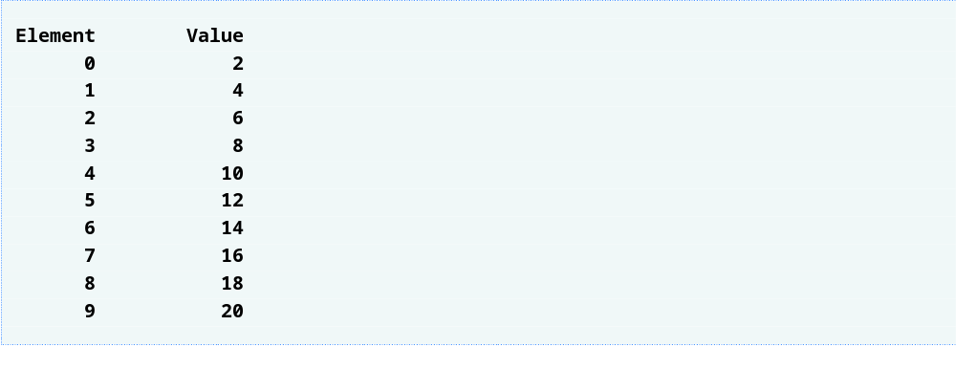
Outline
fig06_05.c
(2 of 2 )

Slide 21
Common Programming Error 6.4
Ending a #define or #include preprocessor directive with a semicolon. Remember that preprocessor directives are not C statements.

Slide 22
Common Programming Error 6.5
Assigning a value to a symbolic constant in
an executable statement is a syntax error.
A symbolic constant is not a variable. No
space is reserved for it by the compiler as with variables that hold values at execution time.

Slide 23
Software Engineering Observation 6.1
Defining the size of each array as a symbolic constant makes programs more scalable.

Slide 24
Good Programming Practice 6.1
Use only uppercase letters for symbolic constant names. This makes these constants stand out in a program and reminds you that symbolic constants are not variables.

Slide 25
Good Programming Practice 6.2
In multiword symbolic constant names, use underscores to separate the words for readability.

Slide 26
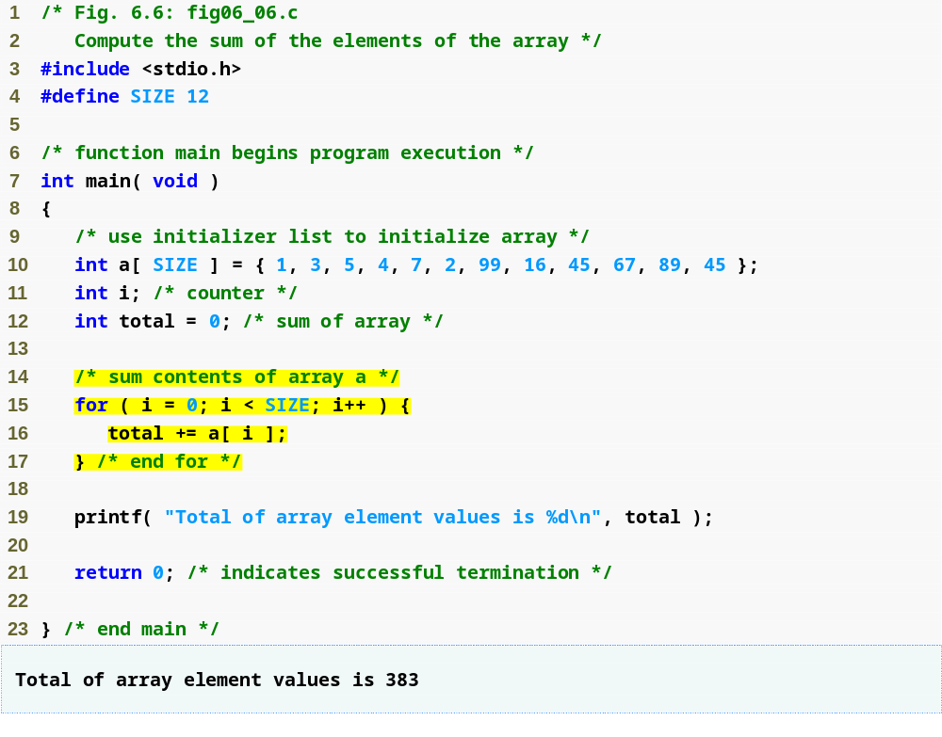
Outline
fig06_06.c
initializer list initializes all array elements simultaneously
for loop adds each element of the array to variable total

Slide 27
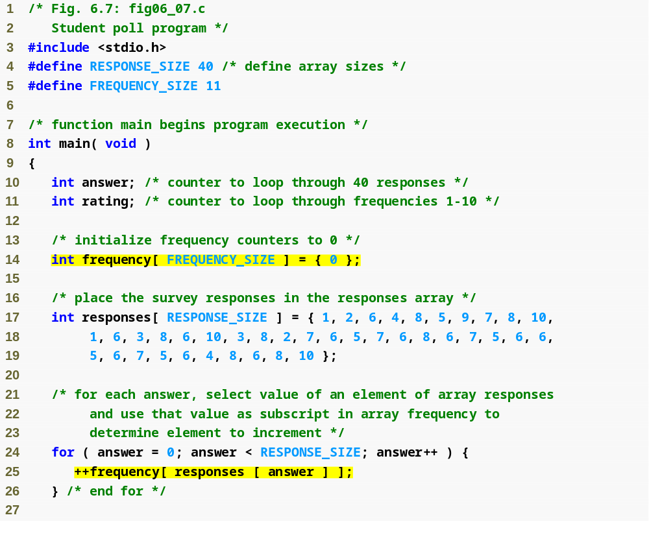
Outline
#define directives create symbolic constants
fig06_07.c
(1 of 2 )
frequency array is defined with 11 elements
responses array is defined with 40 elements and its elements are initialized
subscript of frequency array is given by value in responses array

Slide 28
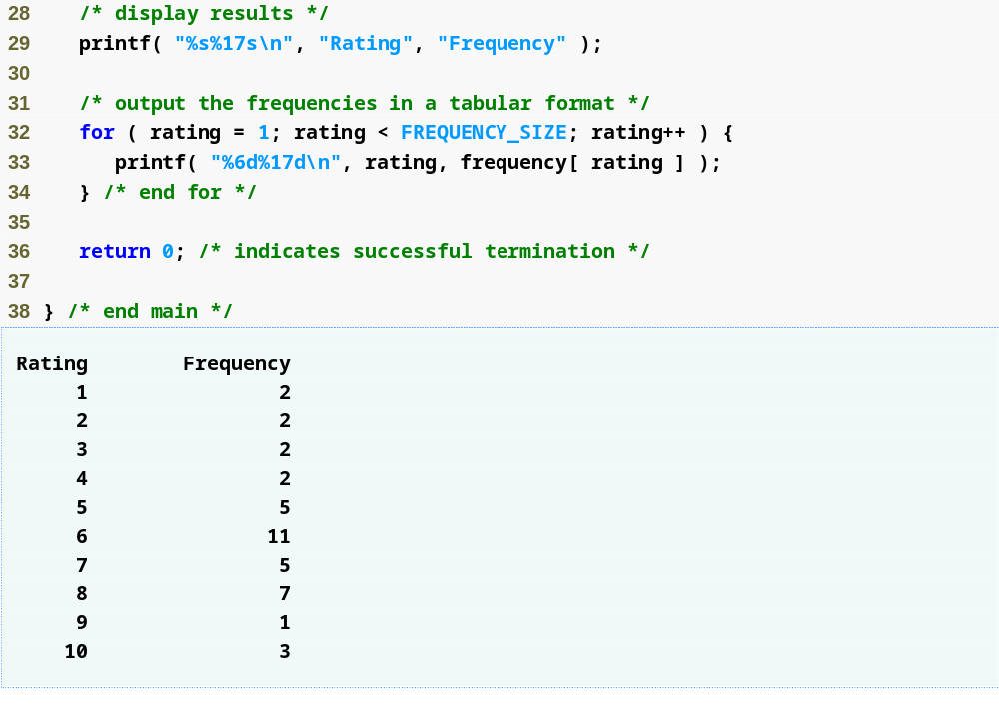
Outline
fig06_07.c
(2 of 2 )

Slide 29
Good Programming Practice 6.3
Strive for program clarity. Sometimes it may be worthwhile to trade off the most efficient use of memory or processor time in favor of writing clearer programs.

Slide 30
Performance Tip 6.1
Sometimes performance considerations
far outweigh clarity considerations.

Slide 31
Common Programming Error 6.6
Referring to an element outside the array bounds.

Slide 32
Error-Prevention Tip 6.1
When looping through an array, the array subscript should never go below 0 and should always be less than the total number of elements in the array (size – 1). Make sure the loop-terminating condition prevents accessing elements outside this range.

Slide 33
Error-Prevention Tip 6.2
Programs should validate the correctness of all input values to prevent erroneous information from affecting a program’s calculations.

Slide 34
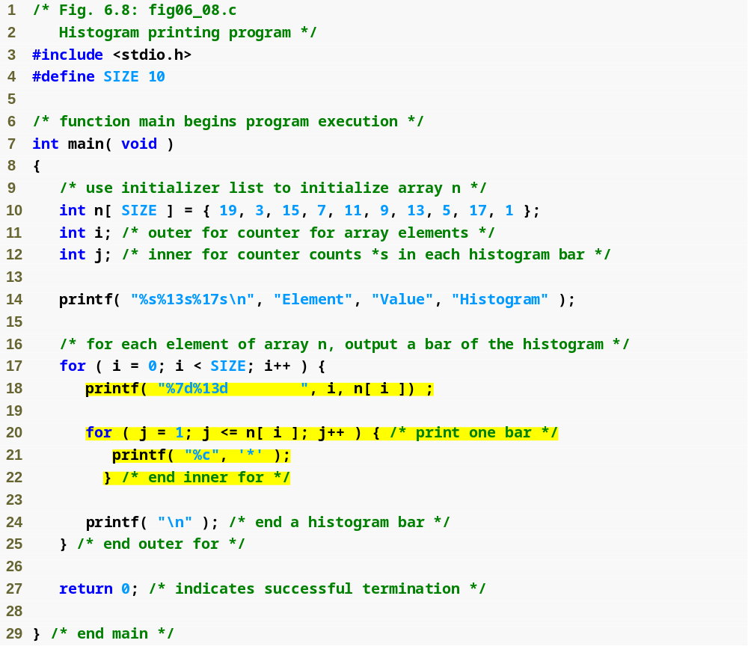
Outline
fig06_08.c
(1 of 2 )
nested for loop prints n[ i ] asterisks on the ith line

Slide 35
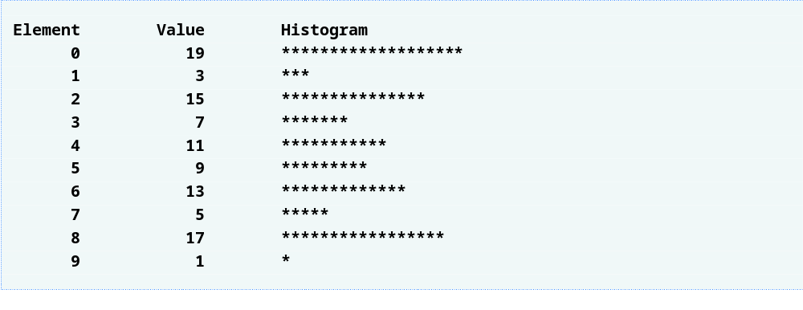
Outline
fig06_08.c
(2 of 2 )

Slide 36
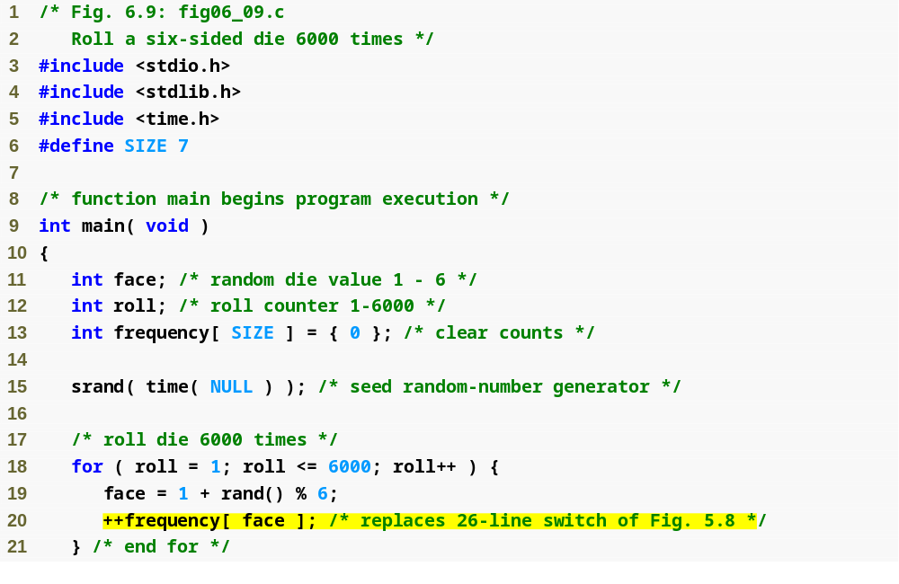
Outline
fig06_09.c
(1 of 2 )
for loop uses one array to track number of times each number is rolled instead of using 6 variables and a switch statement

Slide 37
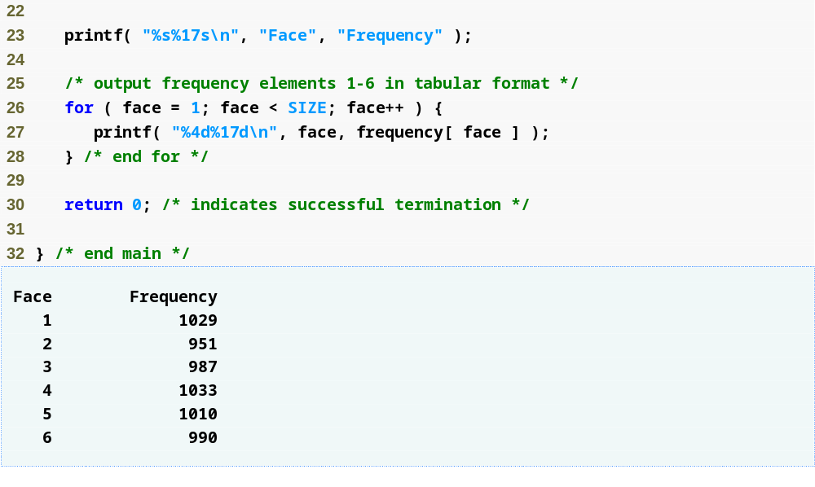
Outline
fig06_09.c
(2 of 2 )

Slide 38
6.4 Array Examples
Character arrays
  String “first” is really a static array of characters
  Character arrays can be initialized using string literals
      char string1[] = "first";
    Null character '\0' terminates strings
    string1 actually has 6 elements
      It is equivalent to
  char string1[] = { 'f', 'i', 'r', 's', 't', '\0' };
  Can access individual characters
    string1[ 3 ] is character ‘s’
  Array name is address of array, so & not needed for scanf
      scanf( "%s", string2 );
    Reads characters until whitespace encountered
    Be careful not to write past end of array, as it is possible to do so

Slide 39
Common Programming Error 6.7
Not providing scanf with a character array large enough to store a string typed at the keyboard can result in destruction of data in a program and other runtime errors. This can also make a system susceptible to worm and virus attacks.

Slide 40
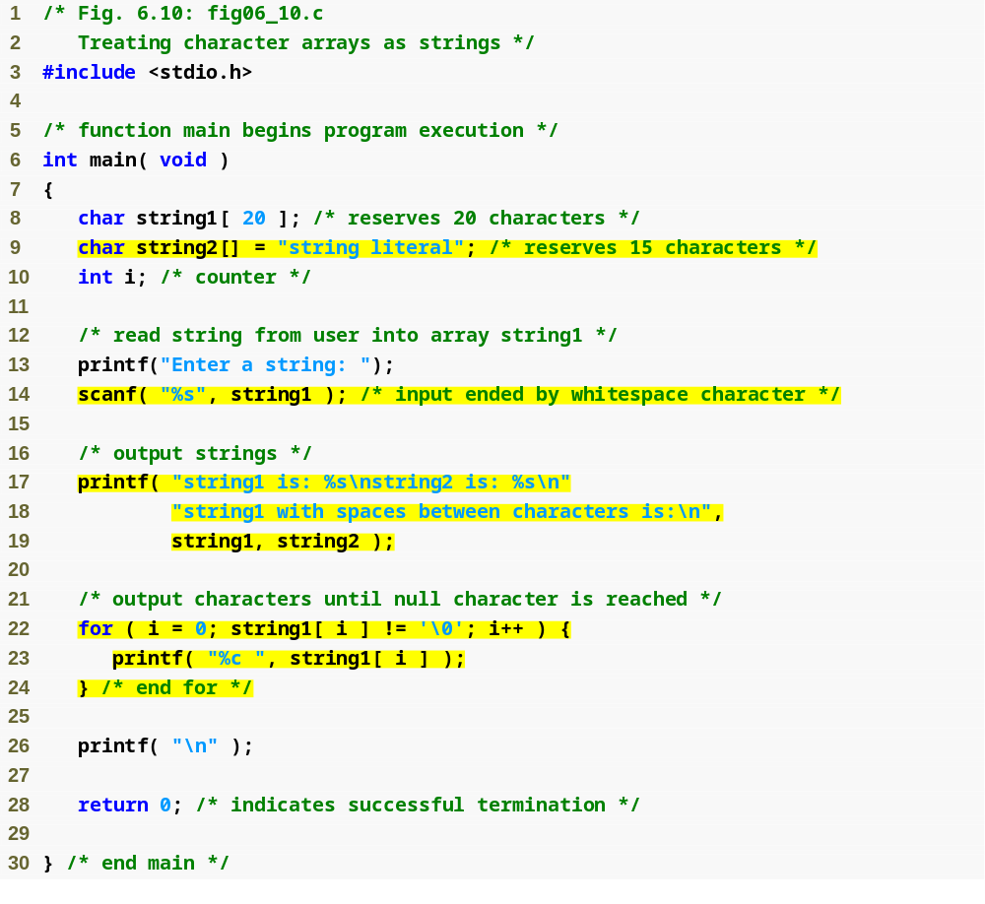
Outline
fig06_10.c
(1 of 2 )
string2 array is defined with one element for each character, so 15 elements including null character /0
for loop prints characters of string1 array with spaces in between

Slide 41
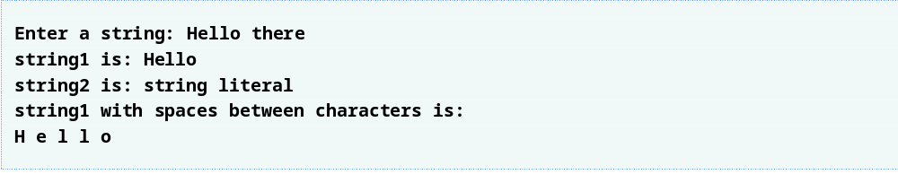
Outline
fig06_10.c
(2 of 2 )

Slide 42
Performance Tip 6.2
In functions that contain automatic arrays where the function is in and out of scope frequently, make the array static so it is not created each time the function is called.

Slide 43
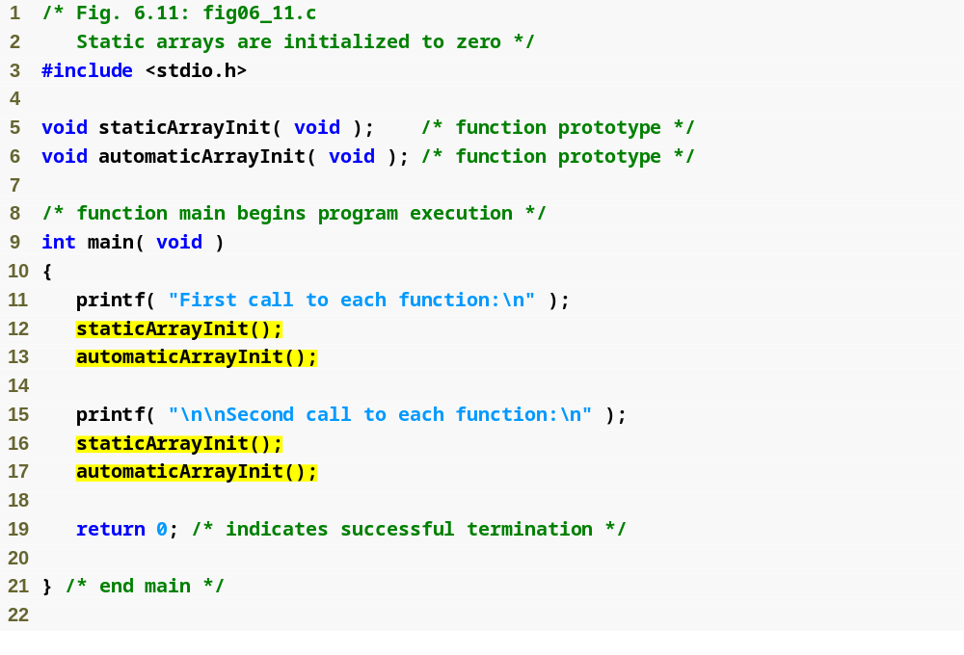
Outline
fig06_11.c
(1 of 4 )

Slide 44
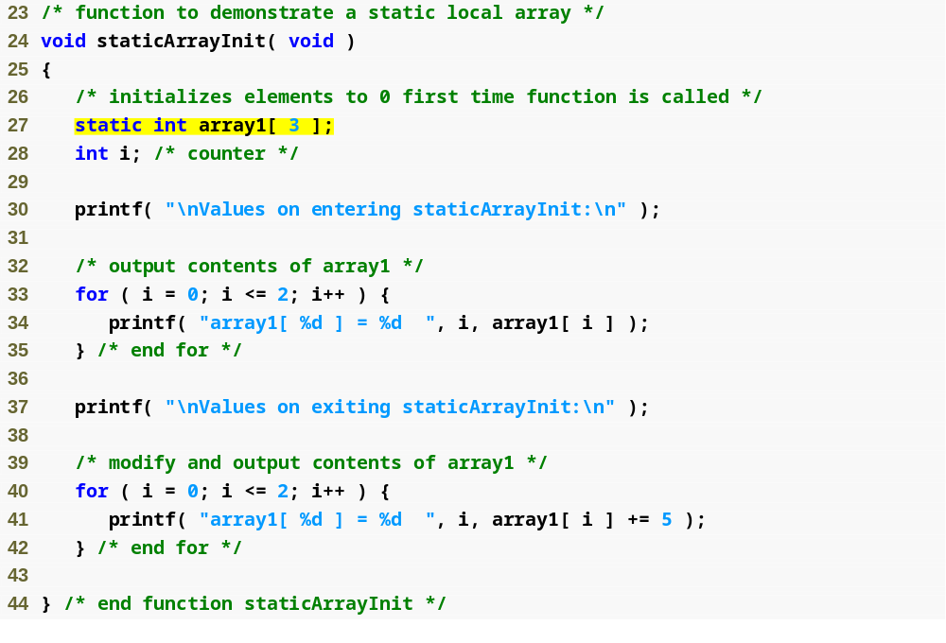
Outline
static array is created only once, when staticArrayInit is first called
fig06_11.c
(2 of 4 )

Slide 45
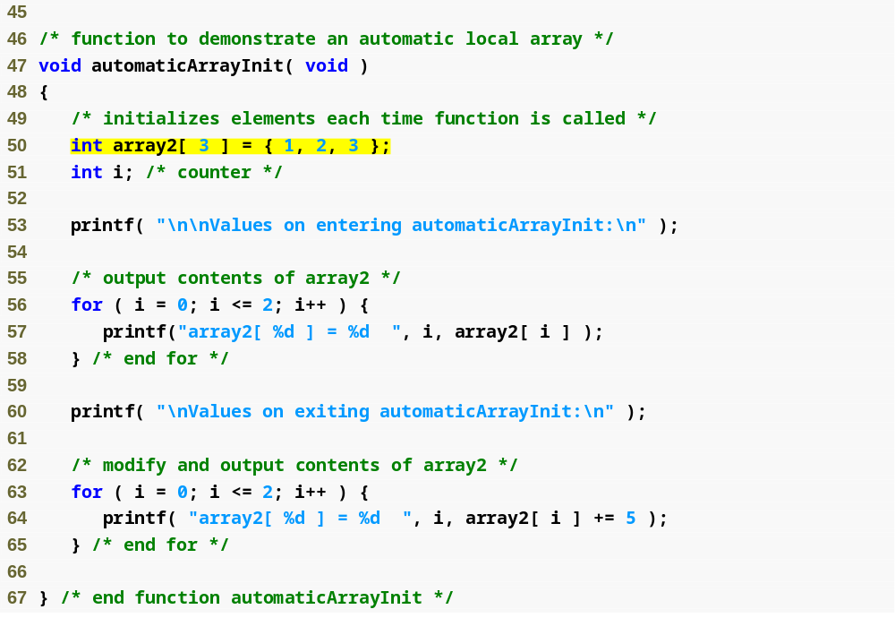
Outline
automatic array is recreated every time automaticArrayInit is called
fig06_11.c
(3 of 4 )

Slide 46
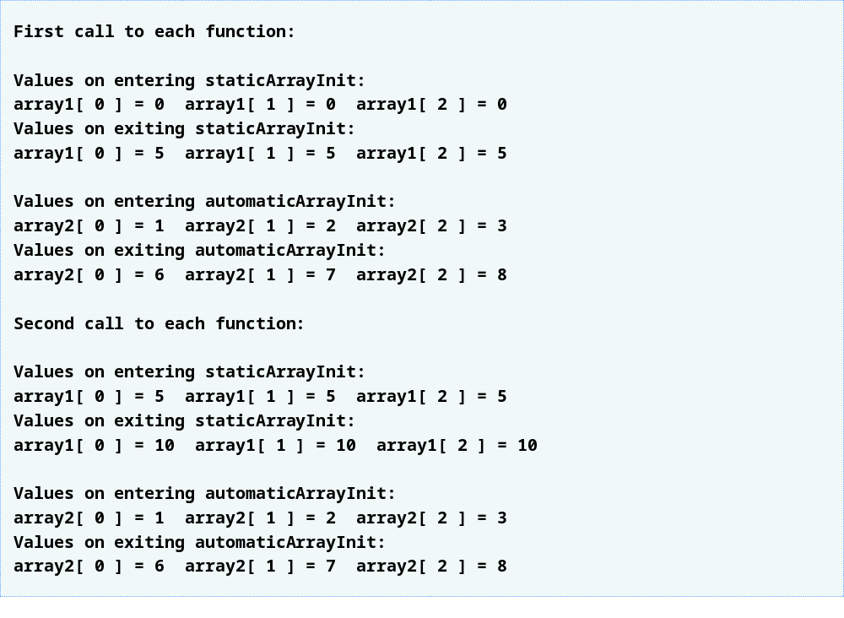
Outline
fig06_11.c
(4 of 4 )

Slide 47
Common Programming Error 6.8
Assuming that elements of a local static
array are initialized to zero every time the function in which the array is defined is called.

Slide 48
6.5 Passing Arrays to Functions
Passing arrays
  To pass an array argument to a function, specify the name of the array without any brackets
      int myArray[ 24 ];
      myFunction( myArray, 24 );
    Array size usually passed to function
  Arrays passed call-by-reference
  Name of array is address of first element
  Function knows where the array is stored
    Modifies original memory locations
Passing array elements
  Passed by call-by-value
  Pass subscripted name (i.e., myArray[ 3 ]) to function

Slide 49
6.5 Passing Arrays to Functions
Function prototype
    void modifyArray( int b[], int arraySize );
  Parameter names optional in prototype
    int b[] could be written int []
    int arraySize could be simply int

Slide 50
Performance Tip 6.3
Passing arrays by reference makes sense for performance reasons. If arrays were passed by value, a copy of each element would be passed. For large, frequently passed arrays, this would be time consuming and would consume considerable storage for the copies of the arrays.

Slide 51
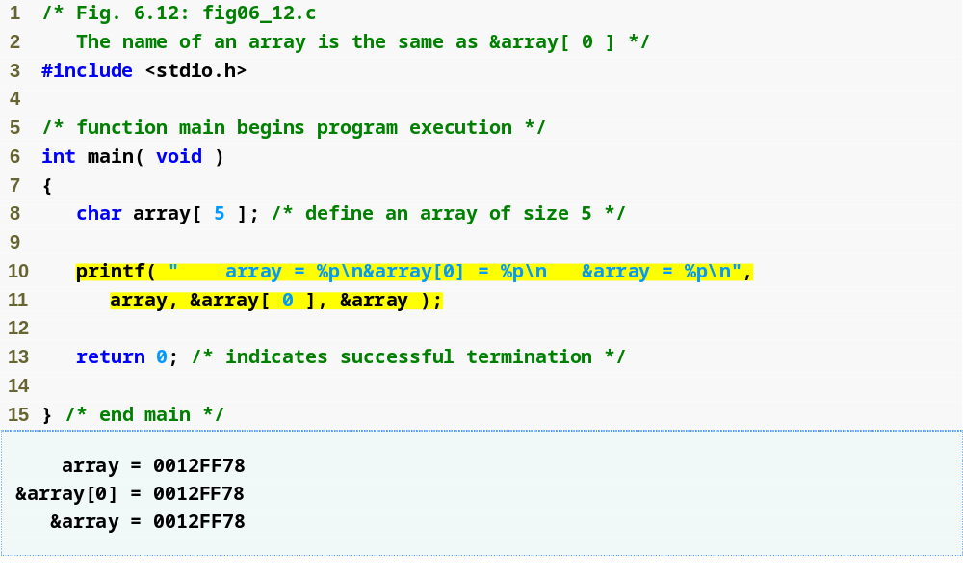
Outline
fig06_12.c

Slide 52
Software Engineering Observation 6.2
It is possible to pass an array by value (by
using a simple trick we explain in Chapter 10).

Slide 53
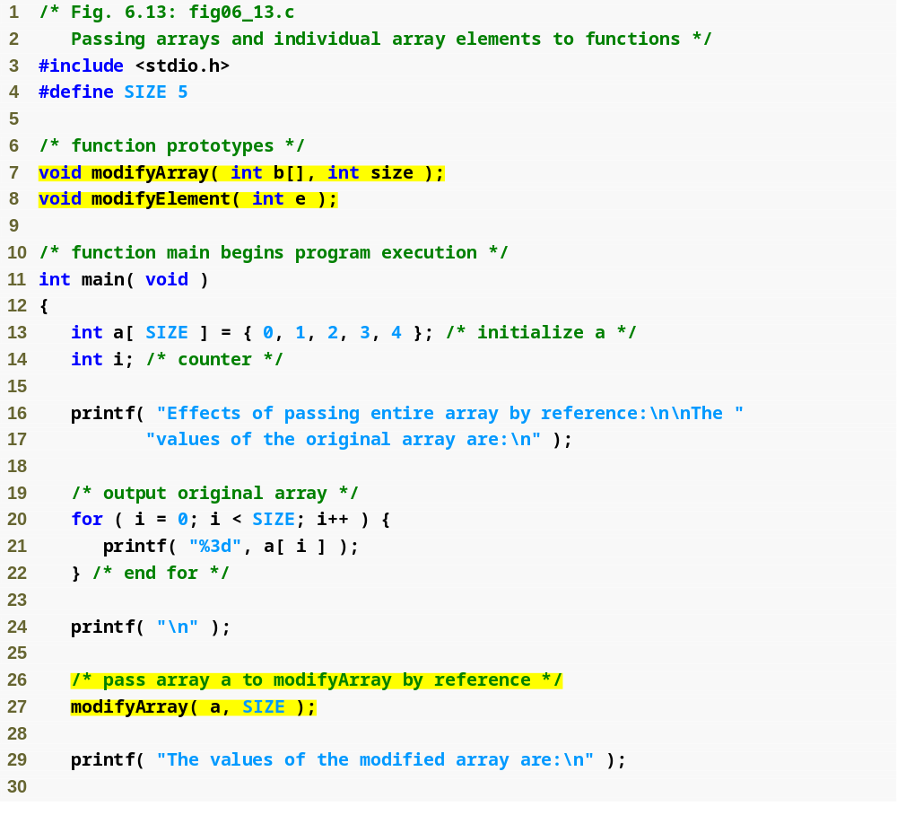
Outline
Function prototype indicates function will take an array
fig06_13.c
(1 of 3 )
Array a is passed to modifyArray by passing only its name

Slide 54
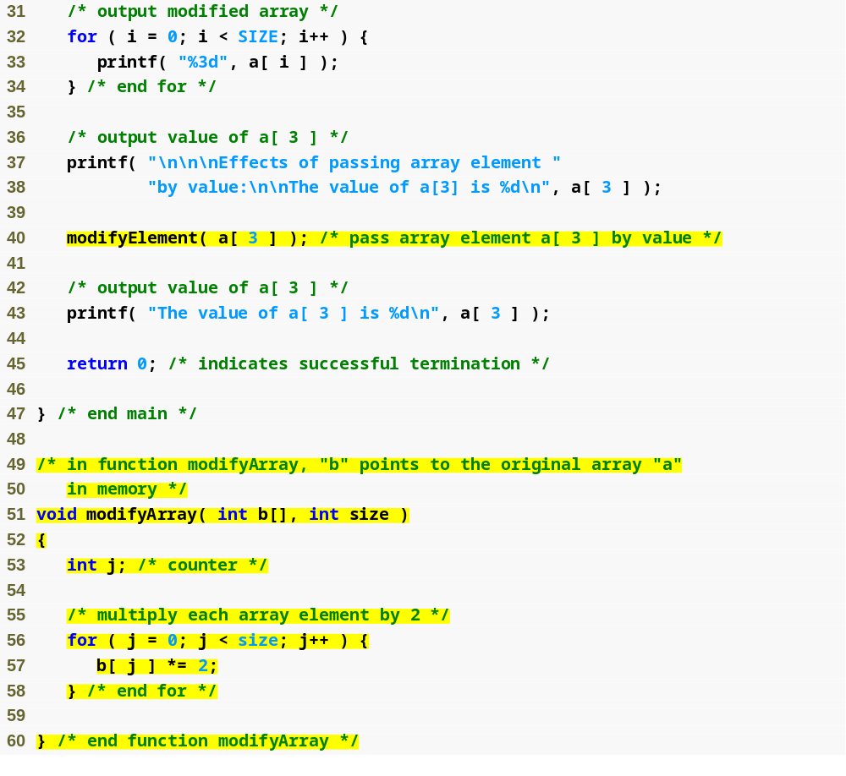
Outline
fig06_13.c
(2 of 3 )
Array element is passed to modifyElement by passing a[ 3 ]

Slide 55
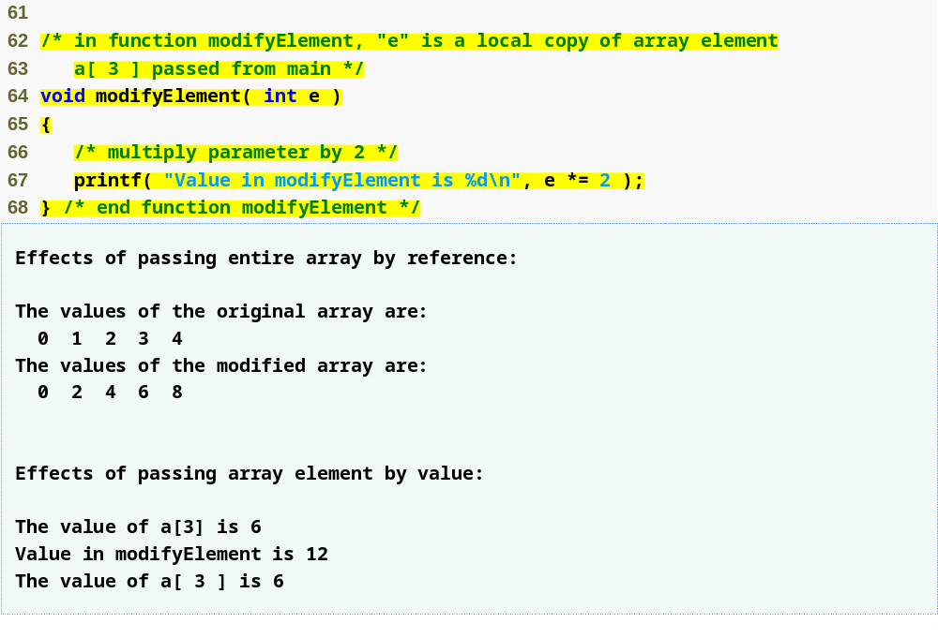
Outline
fig06_13.c
(3 of 3 )

Slide 56
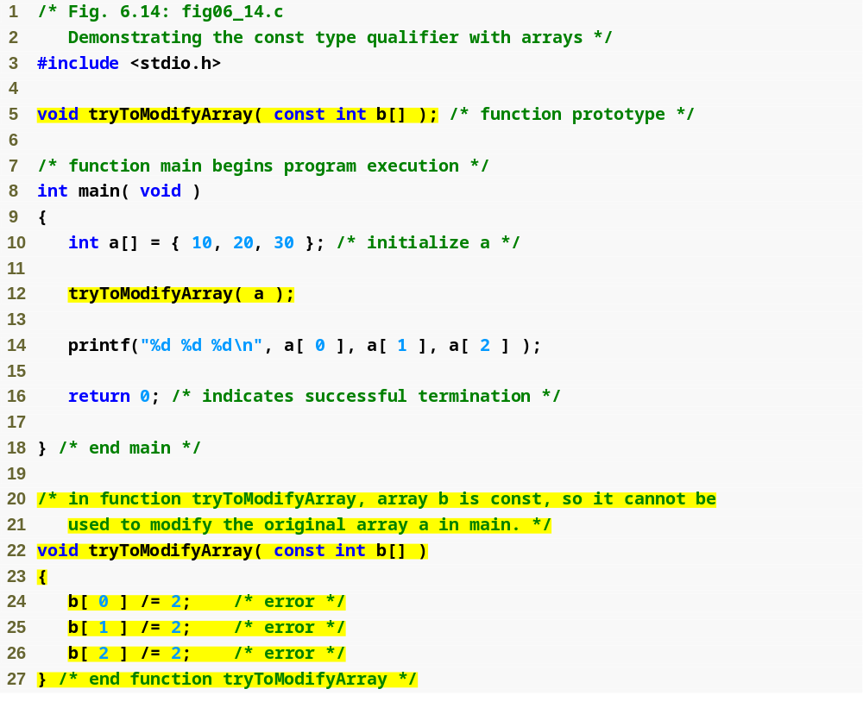
Outline
fig06_14.c
(1 of 2 )
const qualifier tells compiler that array cannot be changed
Any attempts to modify the array will result in errors

Slide 57
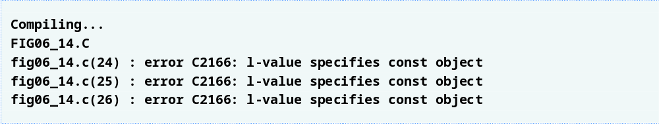
Outline
fig06_14.c
(2 of 2 )

Slide 58
Software Engineering Observation 6.3
The const type qualifier can be applied to an array parameter in a function definition to prevent the original array from being modified in the function body. This is another example of the principle of least privilege. Functions should not be given the capability to modify an array unless it is absolutely necessary.

Slide 59
6.6 Sorting Arrays
Sorting data
  Important computing application
  Virtually every organization must sort some data
Bubble sort (sinking sort)
  Several passes through the array
  Successive pairs of elements are compared
    If increasing order (or identical ), no change
    If decreasing order, elements exchanged
  Repeat
Example:
  original: 3 4 2 6 7
  pass 1: 3 2 4 6 7
  pass 2: 2 3 4 6 7
  Small elements "bubble" to the top

Slide 60
Performance Tip 6.4
Often, the simplest algorithms perform poorly. Their virtue is that they are easy to write, test and debug. However, more complex algorithms are often needed to realize maximum performance.

Slide 61
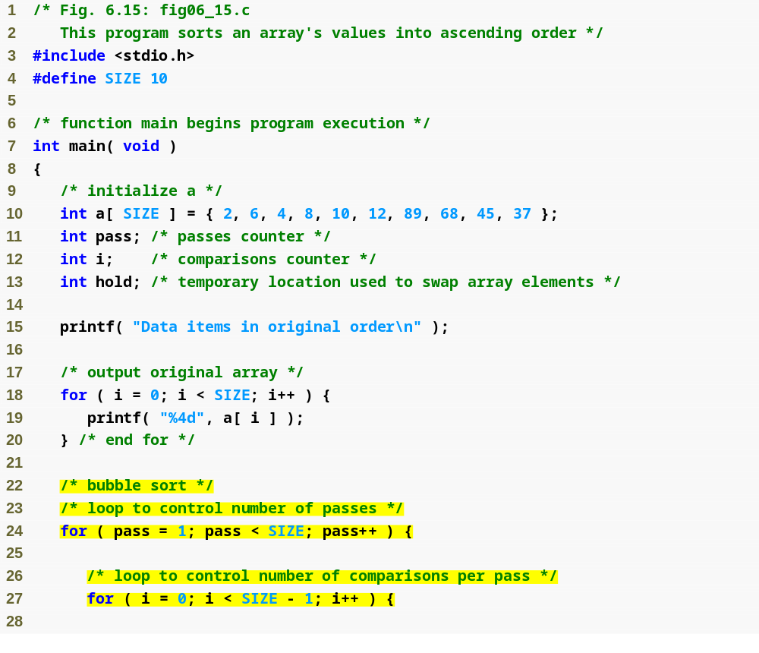
Outline
fig06_15.c
(1 of 2 )

Slide 62
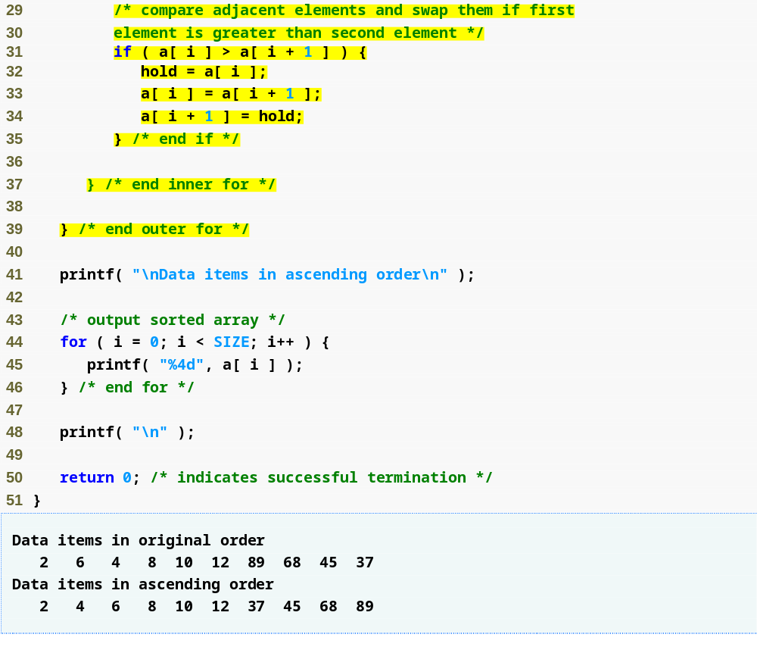
Outline
If any two array elements are out of order, the function swaps them
fig06_15.c
(2 of 2 )

Slide 63
6.7 Case Study: Computing Mean, Median and Mode Using Arrays
Mean – average
Median – number in middle of sorted list
  1, 2, 3, 4, 5
  3 is the median
Mode – number that occurs most often
  1, 1, 1, 2, 3, 3, 4, 5
  1 is the mode

Slide 64
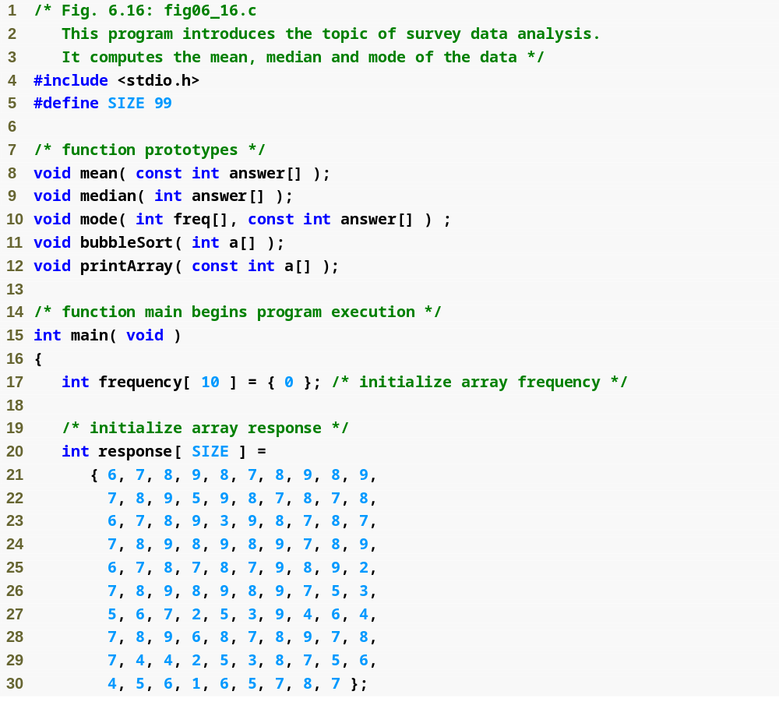
Outline
fig06_16.c
(1 of 6 )

Slide 65
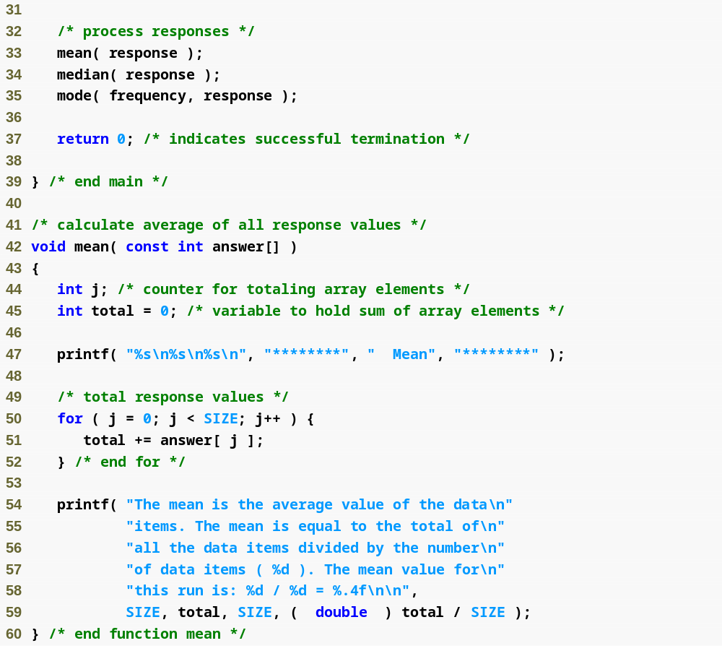
Outline
fig06_16.c
(2 of 6 )

Slide 66
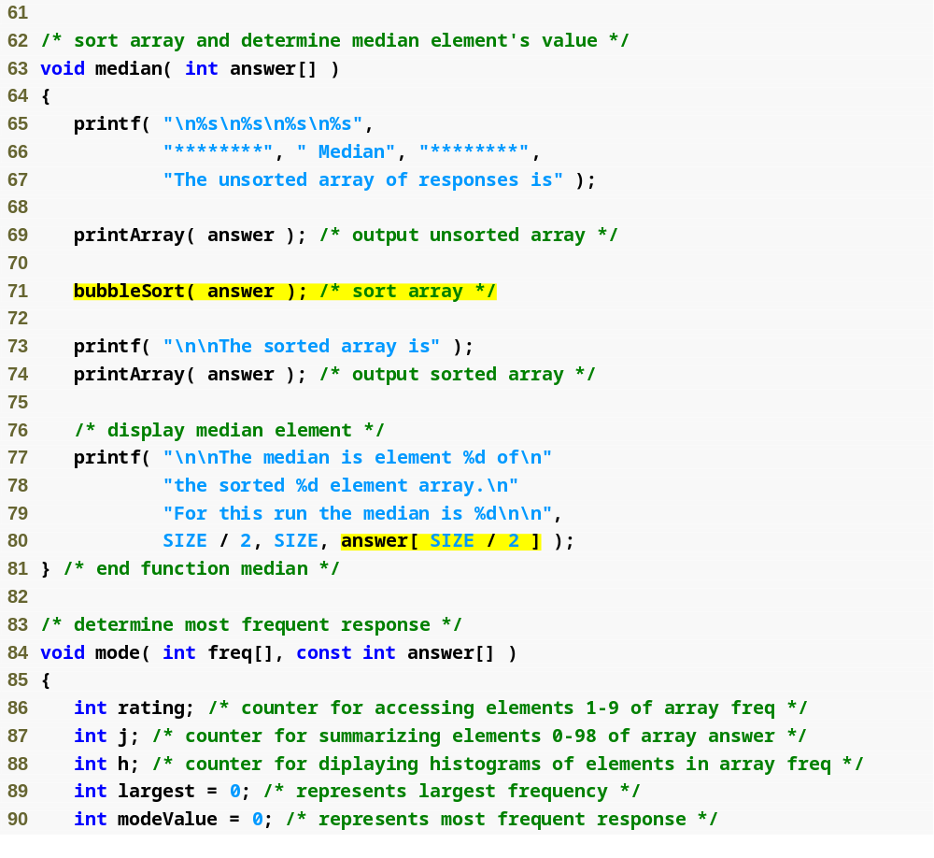
Outline
fig06_16.c
(3 of 6 )
Once the array is sorted, the median will be the value of the middle element

Slide 67
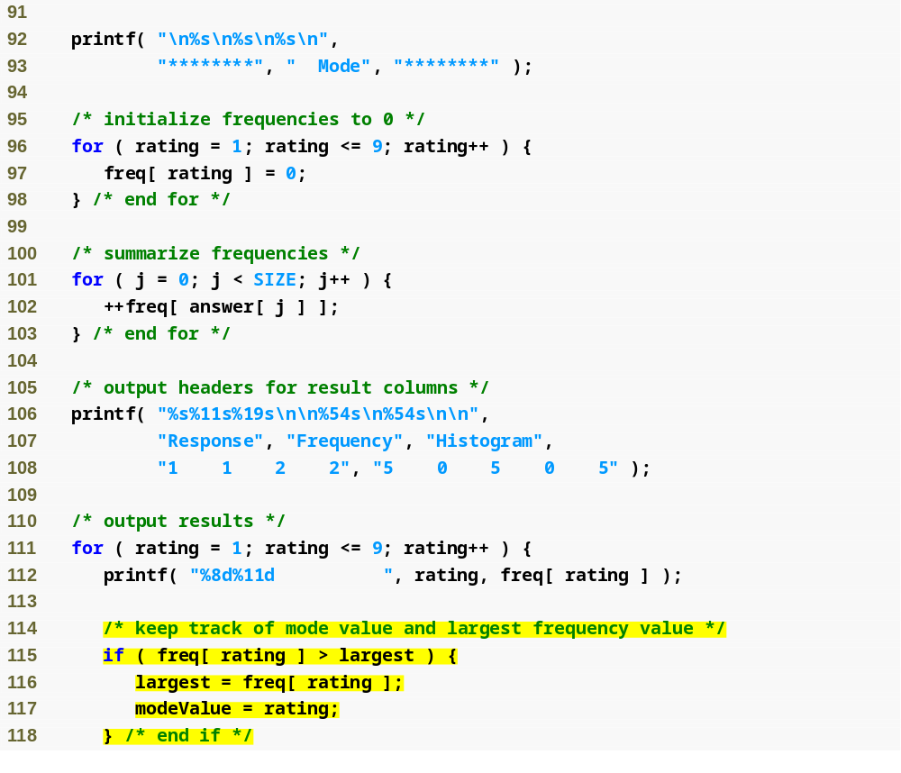
Outline
fig06_16.c
(4 of 6 )

Slide 68
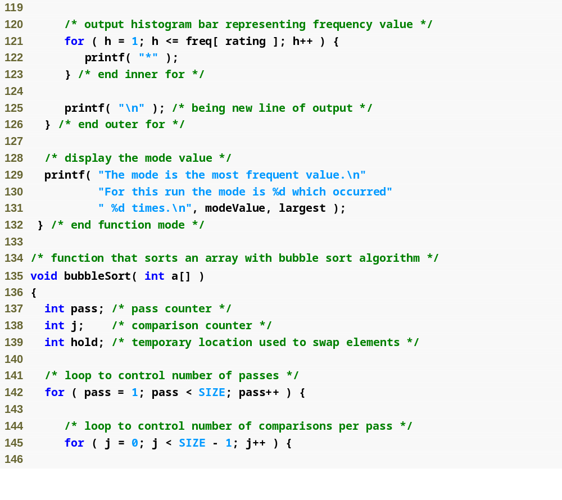
Outline
fig06_16.c
(5 of 6 )

Slide 69
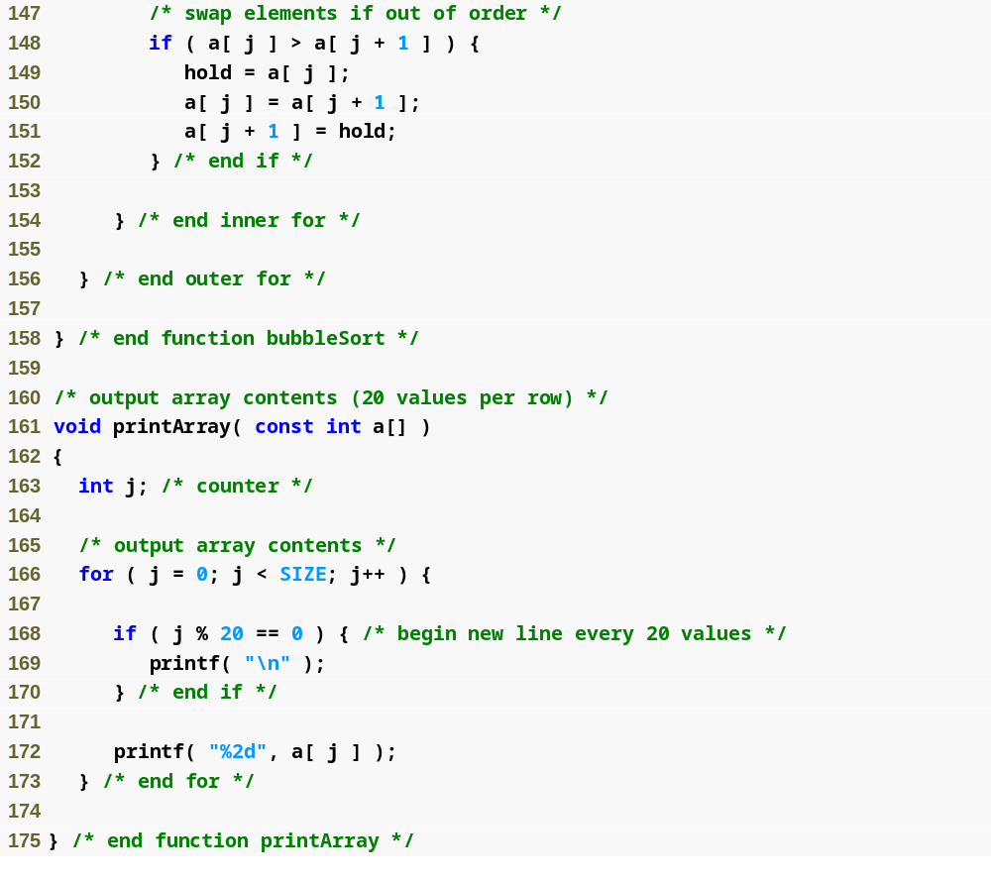
Outline
fig06_16.c
(6 of 6 )

Slide 70
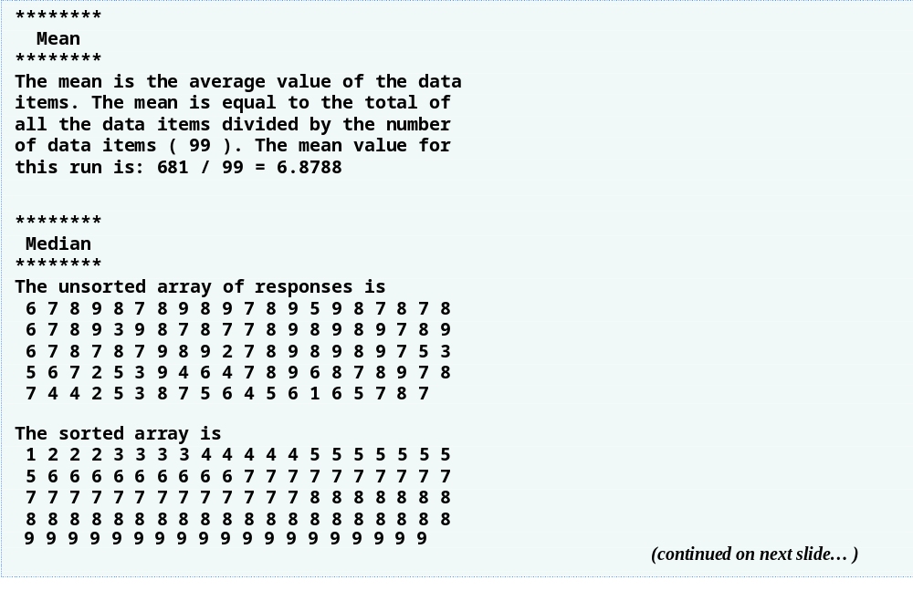
Outline
(1 of 2 )

Slide 71
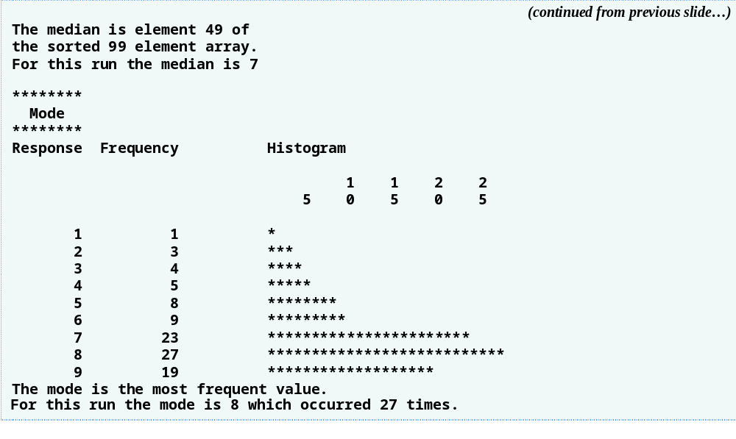
Outline
(2 of 2 )

Slide 72
6.8 Searching Arrays
Search an array for a key value
Linear search
  Simple
  Compare each element of array with key value
  Useful for small and unsorted arrays

Slide 73
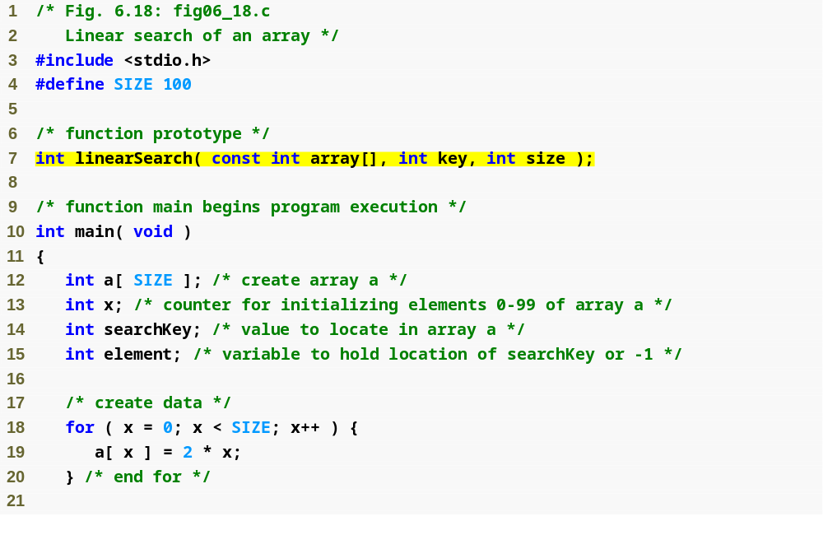
Outline
fig06_18.c
(1 of 3 )

Slide 74
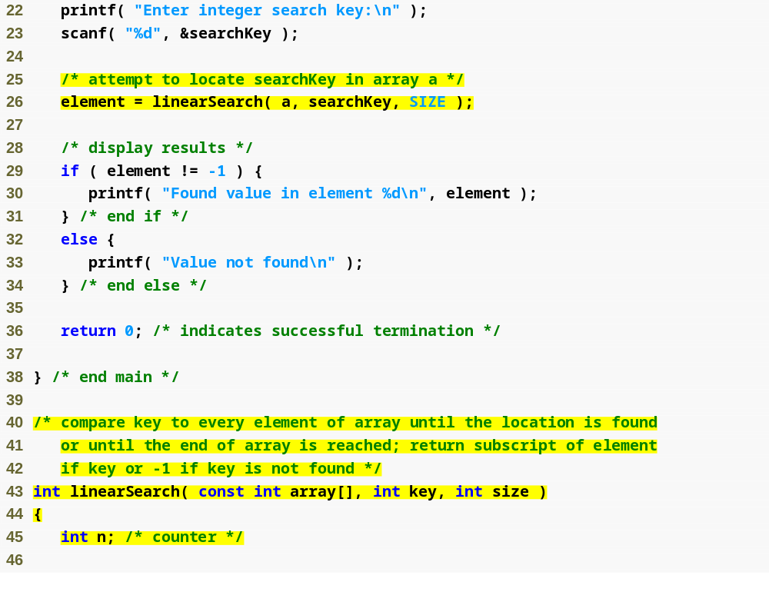
Outline
fig06_18.c
(2 of 3 )

Slide 75
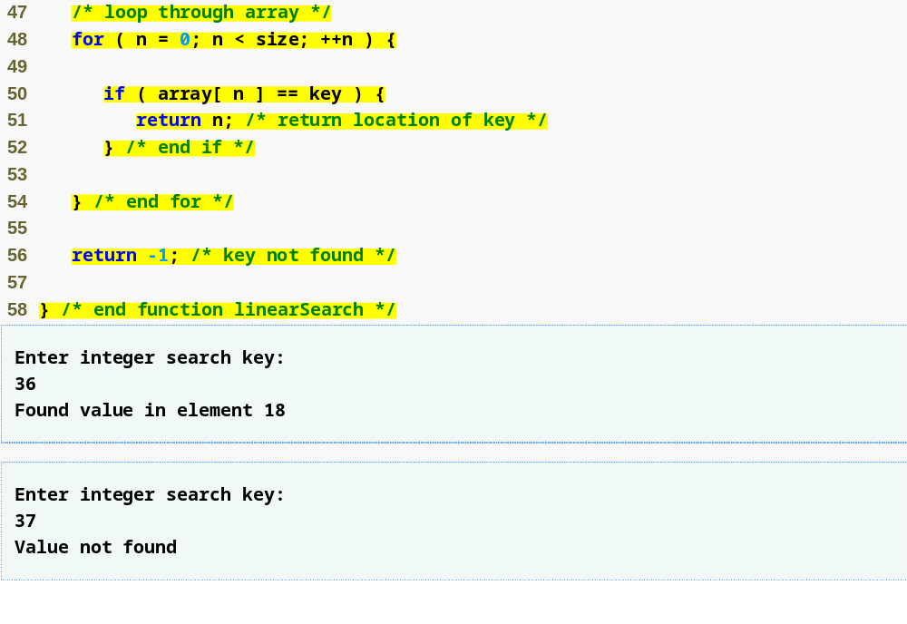
Outline
Linear search algorithm searches through every element in the array until a match is found
fig06_18.c
(3 of 3 )

Slide 76
6.8 Searching Arrays
Binary search
  For sorted arrays only
  Compares middle element with key
    If equal, match found
    If key < middle, looks in first half of array
    If key > middle, looks in last half
    Repeat
  Very fast; at most n steps, where 2^{n} > number of elements
    30 element array takes at most 5 steps
      2⁵ > 30 so at most 5 steps

Slide 77
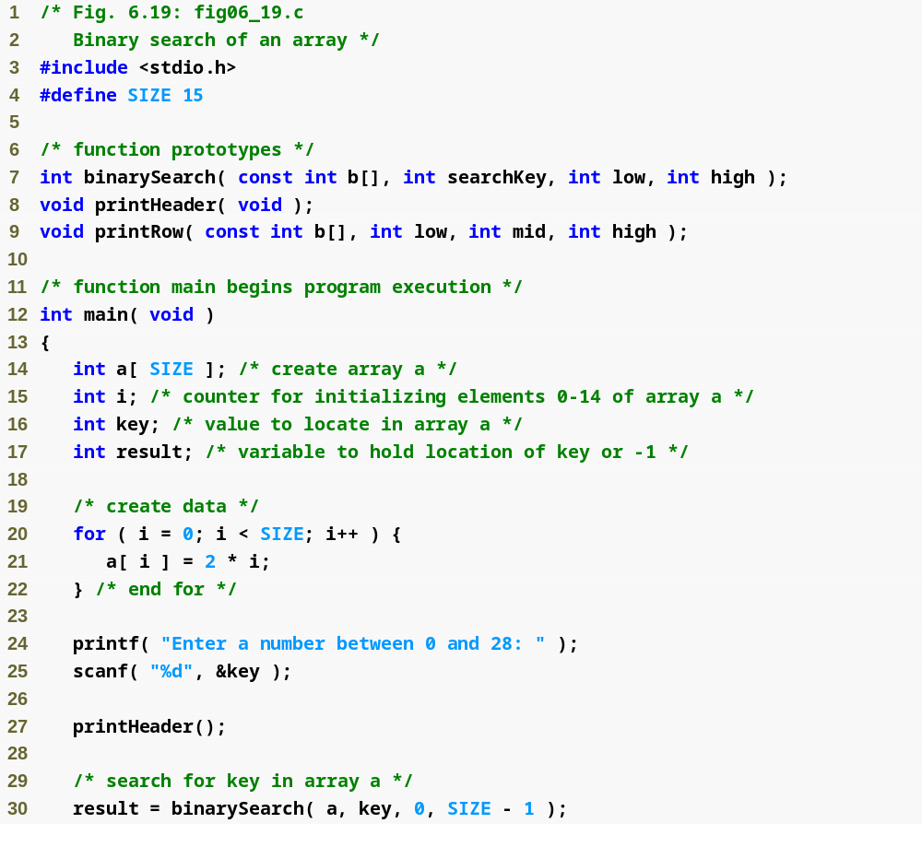
Outline
fig06_19.c
(1 of 6 )

Slide 78
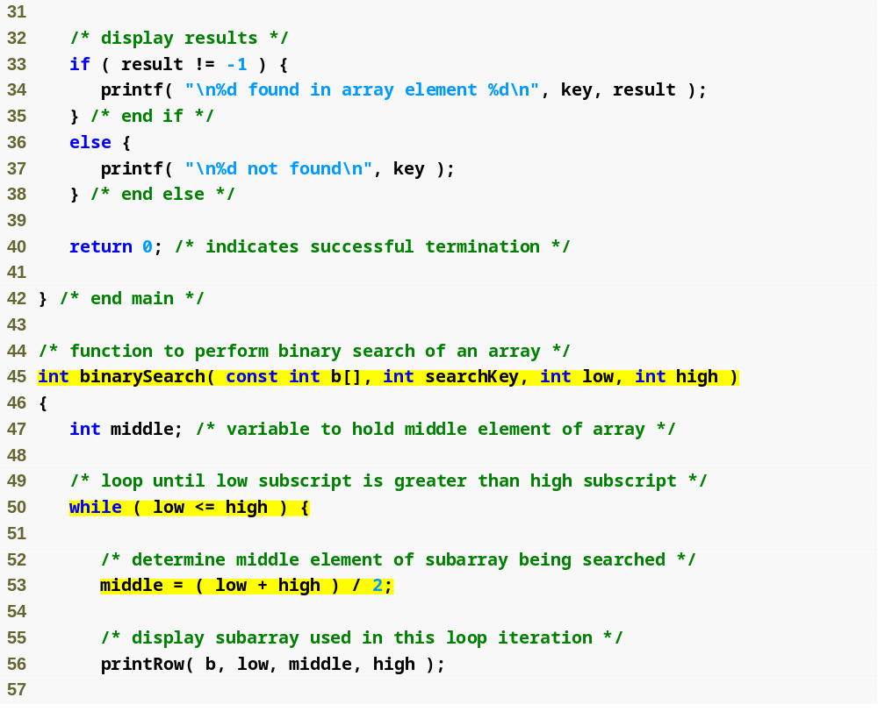
Outline
fig06_19.c
(2 of 6 )

Slide 79
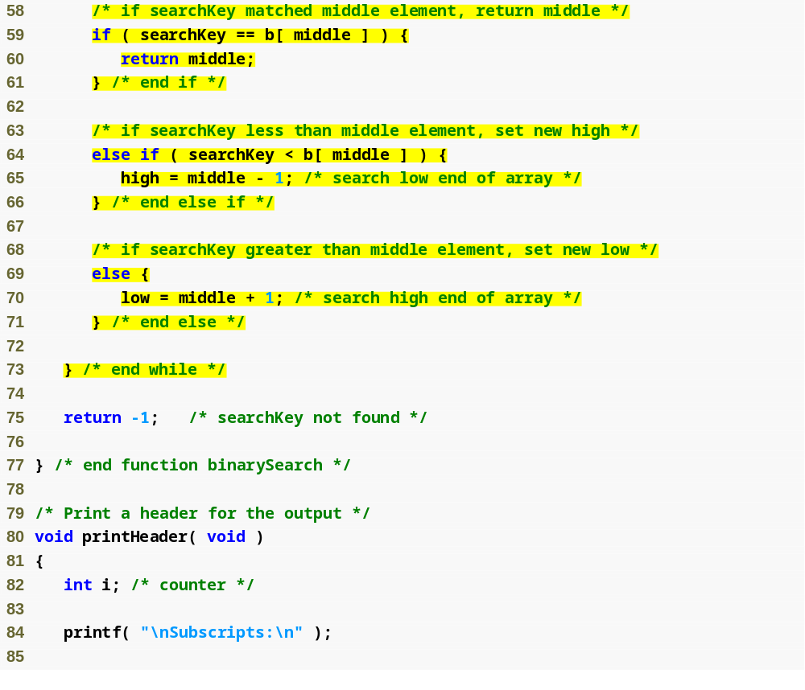
Outline
If value is found, return its index
fig06_19.c
(3 of 6 )
If value is too high, search the left half of array
If value is too low, search the right half of array

Slide 80
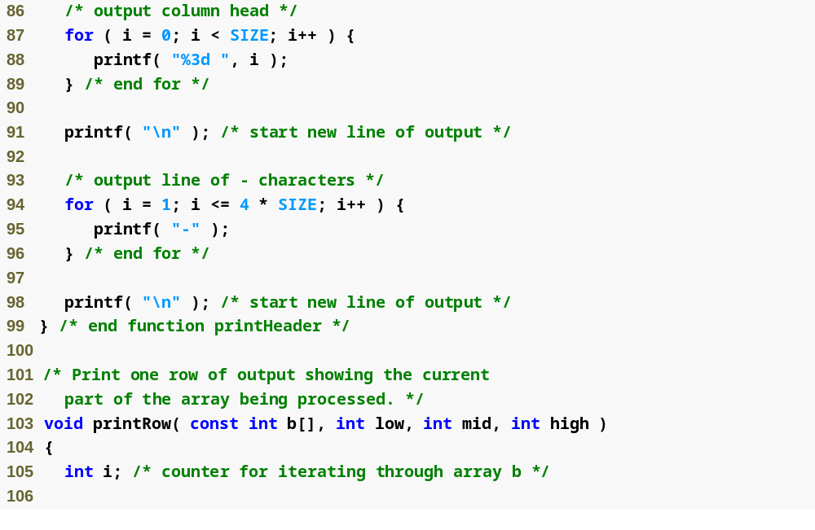
Outline
fig06_19.c
(4 of 6 )

Slide 81
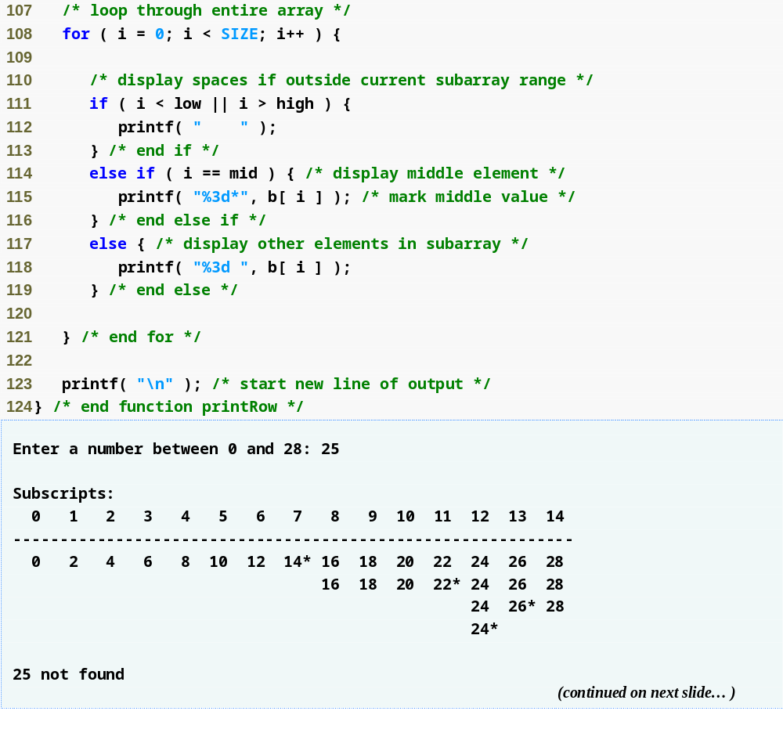
Outline
fig06_19.c
(5 of 6 )

Slide 82
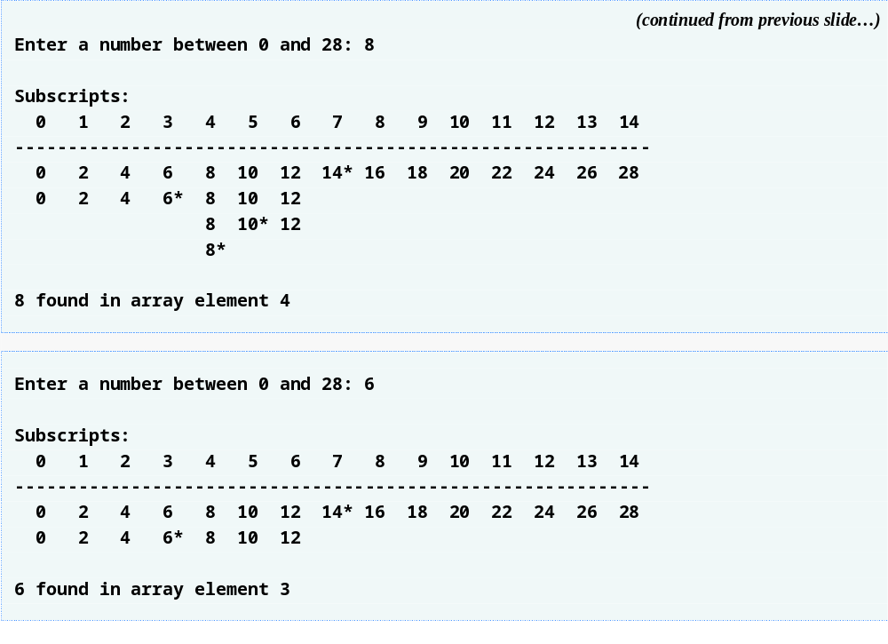
Outline
fig06_19.c
(6 of 6 )

Slide 83
6.9 Multiple-Subscripted Arrays
Multiple subscripted arrays
  Tables with rows and columns (m by n array)
  Like matrices: specify row, then column
Initialization
  int b[ 2 ][ 2 ] = { { 1, 2 }, { 3, 4 } };
  Initializers grouped by row in braces
  If not enough, unspecified elements set to zero
    int b[ 2 ][ 2 ] = { { 1 }, { 3, 4 } };
Referencing elements
  Specify row, then column
    printf( "%d", b[ 0 ][ 1 ] );

Slide 84
Common Programming Error 6.9
Referencing a double-subscripted array element as a[ x, y ] instead of a[ x ][ y ]. C interprets a[ x, y ] as a[ y ], and as such it does not cause a syntax error.

Slide 85
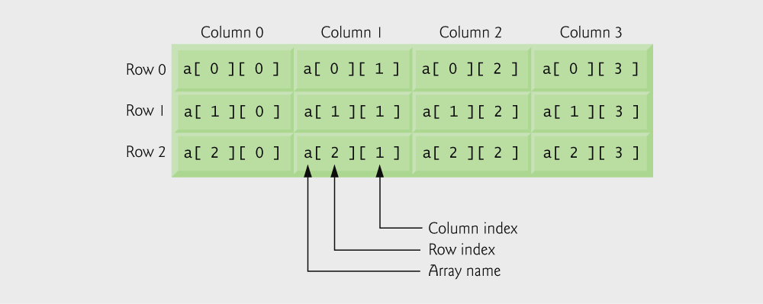
Fig. 6.20 | Double-subscripted array with three rows and four columns.

Slide 86
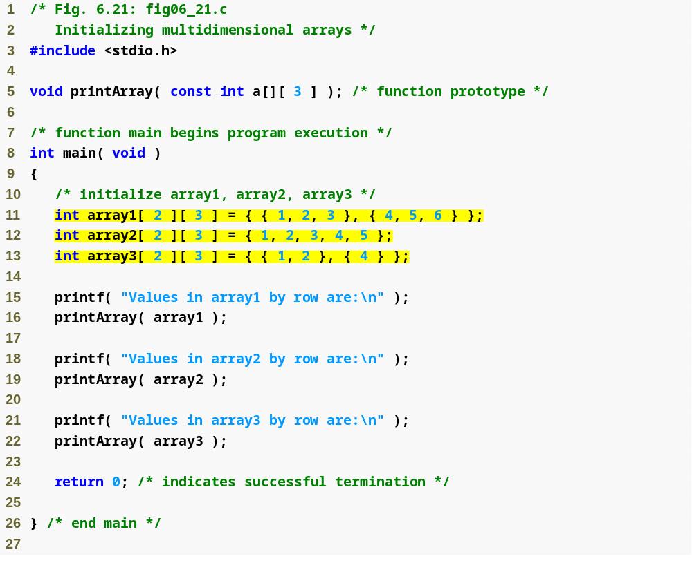
Outline
fig06_21.c
(1 of 2 )
array1 is initialized with both rows full
array2 and array3 are initialized only partially

Slide 87
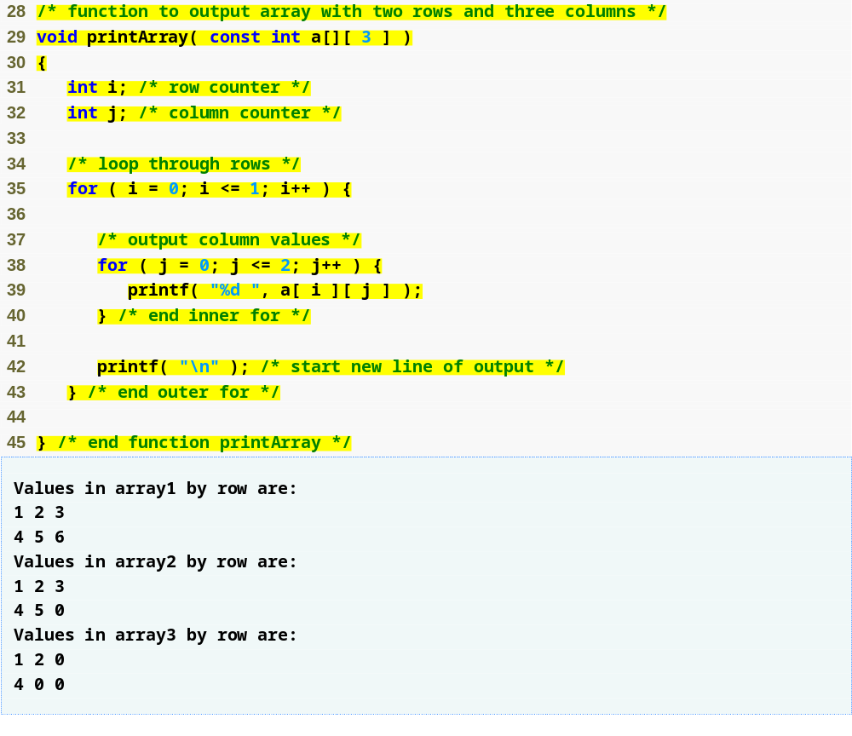
Outline
fig06_21.c
(2 of 2 )

Slide 88
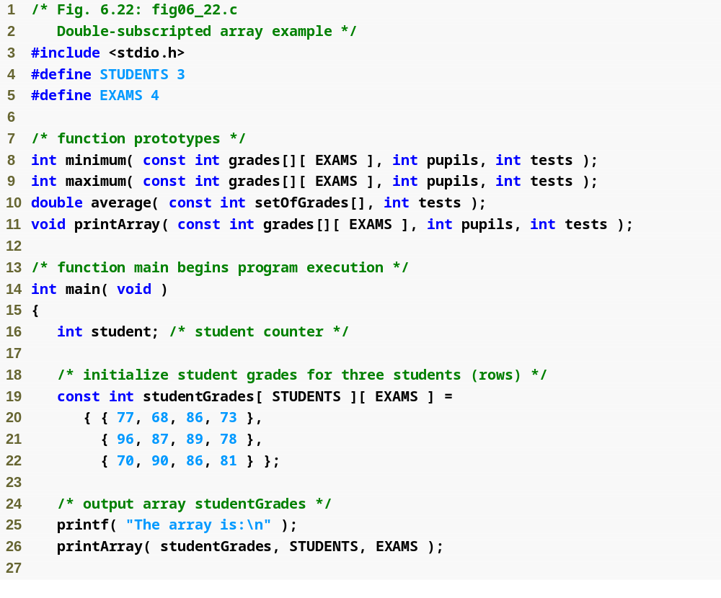
Outline
fig06_22.c
(1 of 6 )
Each row in the array corresponds to a single student’s set of grades

Slide 89

Outline
fig06_22.c
(2 of 6 )
average function is passed a row of the array

Slide 90

Outline
fig06_22.c
(3 of 6 )

Slide 91

Outline
fig06_22.c
(4 of 6 )

Slide 92

Outline
fig06_22.c
(5 of 6 )

Slide 93

Outline
fig06_22.c
(6 of 6 )

