Slide 1
Chapter 8 - Characters and Strings
Outline
8.1 Introduction
8.2 Fundamentals of Strings and Characters
8.3 Character Handling Library
8.4 String Conversion Functions
8.5 Standard Input/Output Library Functions
8.6 String Manipulation Functions of the String Handling Library
8.7 Comparison Functions of the String Handling Library
8.8 Search Functions of the String Handling Library
8.9 Memory Functions of the String Handling Library
8.10 Other Functions of the String Handling Library

Slide 2
8.1 Introduction
Introduce some standard library functions
  Easy string and character processing
  Programs can process characters, strings, lines of text, and blocks of memory
These techniques used to make
  Word processors
  Page layout software
  Typesetting programs

Slide 3
8.2 Fundamentals of Strings and Characters
Characters
  Building blocks of programs
    Every program is a sequence of meaningfully grouped characters
  Character constant
    An int value represented as a character in single quotes
    'z' represents the integer value of z
Strings
  Series of characters treated as a single unit
    Can include letters, digits and special characters (*, /, $)
  String literal (string constant) - written in double quotes
    "Hello"
  Strings are arrays of characters
    String a pointer to first character
    Value of string is the address of first character

Slide 4
8.2 Fundamentals of Strings and Characters
String declarations
  Declare as a character array or a variable of type char *
      char color[] = "blue";
      char *colorPtr = "blue";
  Remember that strings represented as character arrays end with '\0'
    color has 5 elements
Inputting strings
  Use scanf
      scanf("%s", word);
    Copies input into word[]
    Do not need & (because a string is a pointer)
  Remember to leave room in the array for '\0'

Slide 5
8.3 Character Handling Library
Character handling library
  Includes functions to perform useful tests and manipulations of character data
  Each function receives a character (an int) or EOF as an argument
The following slide contains a table of all the functions in <ctype.h>

Slide 6
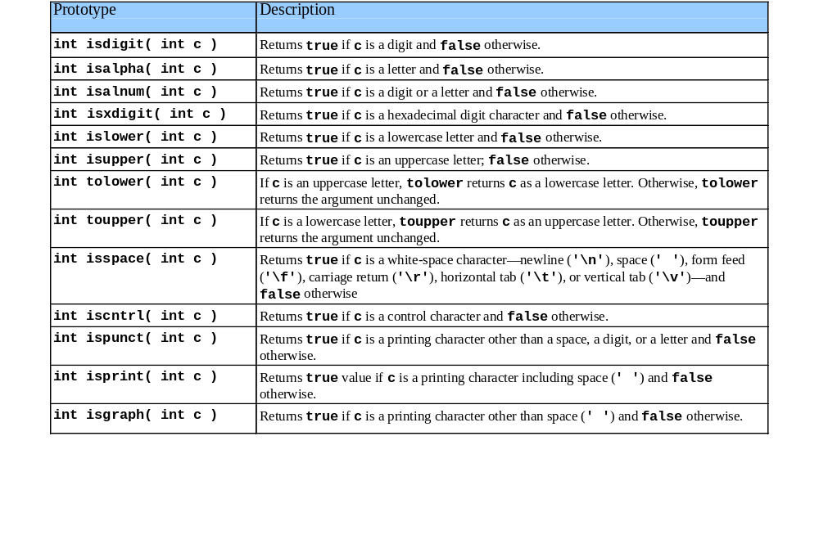
8.3 Character Handling Library

Slide 7
1 /* Fig. 8.2: fig08_02.c
2 Using functions isdigit, isalpha, isalnum, and isxdigit */
3 #include <stdio.h>
4 #include <ctype.h>
1. Load header
2. Perform tests
3. Print
5
6 int main()
7 {
8 printf( "%s\n%s%s\n%s%s\n\n", "According to isdigit: ",
9 isdigit( '8' ) ? "8 is a " : "8 is not a ", "digit",
10 isdigit( '#' ) ? "# is a " :
11 "# is not a ", "digit" );
12 printf( "%s\n%s%s\n%s%s\n%s%s\n%s%s\n\n",
13 "According to isalpha:",
14 isalpha( 'A' ) ? "A is a " : "A is not a ", "letter",
15 isalpha( 'b' ) ? "b is a " : "b is not a ", "letter",
16 isalpha( '&' ) ? "& is a " : "& is not a ", "letter",
17 isalpha( '4' ) ? "4 is a " :
18 "4 is not a ", "letter" );
19 printf( "%s\n%s%s\n%s%s\n%s%s\n\n",
20 "According to isalnum:",
21 isalnum( 'A' ) ? "A is a " : "A is not a ",
22 "digit or a letter",
23 isalnum( '8' ) ? "8 is a " : "8 is not a ",
24 "digit or a letter",
25 isalnum( '#' ) ? "# is a " : "# is not a ",
26 "digit or a letter" );
27 printf( "%s\n%s%s\n%s%s\n%s%s\n%s%s\n%s%s\n",
28 "According to isxdigit:",
29 isxdigit( 'F' ) ? "F is a " : "F is not a ",
30 "hexadecimal digit",
31 isxdigit( 'J' ) ? "J is a " : "J is not a ",
32 "hexadecimal digit",

Slide 8
33 isxdigit( '7' ) ? "7 is a " : "7 is not a ",
34 "hexadecimal digit",
35 isxdigit( '$' ) ? "$ is a " : "$ is not a ",
36 "hexadecimal digit",
3. Print
Program Output
37 isxdigit( 'f' ) ? "f is a " : "f is not a ",
38 "hexadecimal digit" );
39 return 0;
40 }
According to isdigit:
8 is a digit
# is not a digit
According to isalpha:
A is a letter
b is a letter
& is not a letter
4 is not a letter
According to isalnum:
A is a digit or a letter
8 is a digit or a letter
# is not a digit or a letter
According to isxdigit:
F is a hexadecimal digit
J is not a hexadecimal digit
7 is a hexadecimal digit
$ is not a hexadecimal digit
f is a hexadecimal digit

Slide 9
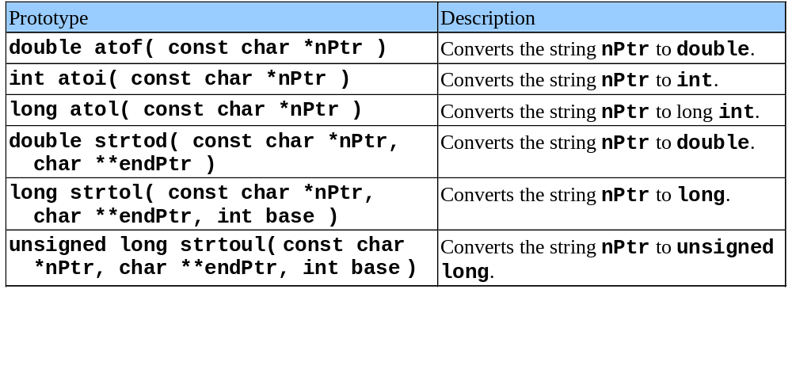
8.4 String Conversion Functions
Conversion functions
  In <stdlib.h> (general utilities library)
Convert strings of digits to integer and floating-point values

Slide 10
1 /* Fig. 8.6: fig08_06.c
2 Using atof */
3 #include <stdio.h>
4 #include <stdlib.h>
1. Initialize variable
2. Convert string
2.1 Assign to variable
3. Print
Program Output
5
6 int main()
7 {
8 double d;
9
10 d = atof( "99.0" );
11 printf( "%s%.3f\n%s%.3f\n",
12 "The string \"99.0\" converted to double is ", d,
13 "The converted value divided by 2 is ",
14 d / 2.0 );
15 return 0;
16 }
The string "99.0" converted to double is 99.000
The converted value divided by 2 is 49.500

Slide 11
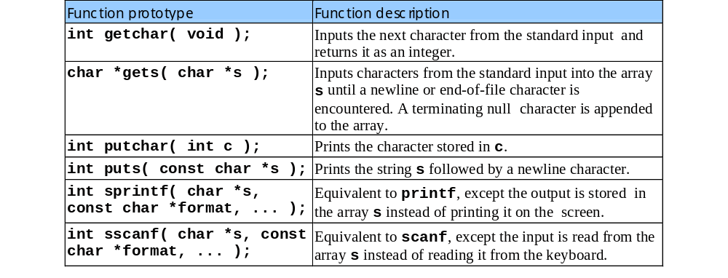
8.5 Standard Input/Output Library Functions
Functions in <stdio.h>
  Used to manipulate character and string data

Slide 12
1 /* Fig. 8.13: fig08_13.c
2 Using gets and putchar */
3 #include <stdio.h>
4
5 int main()
1. Initialize variables
2. Input
3. Print
3.1 Function definition (note recursion)
Program Output
6 {
7 char sentence[ 80 ];
8 void reverse( const char * const );
9
10 printf( "Enter a line of text:\n" );
11 gets( sentence );
12
13 printf( "\nThe line printed backwards is:\n" );
14 reverse( sentence );
15
16 return 0;
17 }
18
19 void reverse( const char * const sPtr )
20 {
21 if ( sPtr[ 0 ] == '\0' )
reverse calls itself using substrings of the original string. When it reaches the '\0' character it prints using putchar
22 return;
23 else {
24 reverse( &sPtr[ 1 ] );
25 putchar( sPtr[ 0 ] );
26 }
27 }
Enter a line of text:
Characters and Strings
The line printed backwards is:
sgnirtS dna sretcarahC

Slide 13
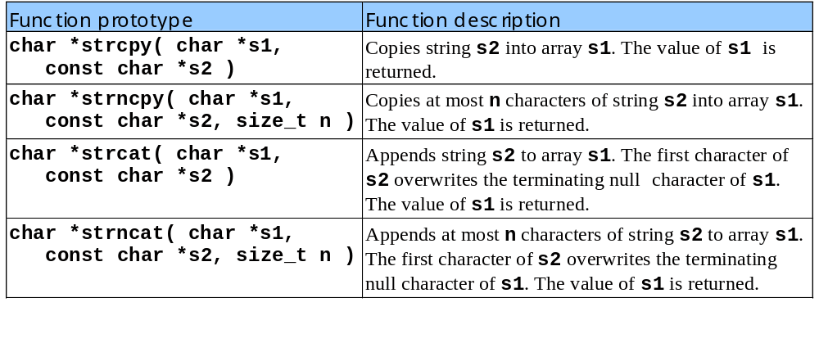
8.6 String Manipulation Functions of the String Handling Library
String handling library has functions to
  Manipulate string data
  Search strings
  Tokenize strings
  Determine string length

Slide 14
1 /* Fig. 8.19: fig08_19.c
2 Using strcat and strncat */
3 #include <stdio.h>
4 #include <string.h>
1. Initialize variables
2. Function calls
3. Print
Program Output
5
6 int main()
7 {
8 char s1[ 20 ] = "Happy ";
9 char s2[] = "New Year ";
10 char s3[ 40 ] = "";
11
12 printf( "s1 = %s\ns2 = %s\n", s1, s2 );
13 printf( "strcat( s1, s2 ) = %s\n", strcat( s1, s2 ) );
14 printf( "strncat( s3, s1, 6 ) = %s\n", strncat( s3, s1, 6 ) );
15 printf( "strcat( s3, s1 ) = %s\n", strcat( s3, s1 ) );
16 return 0;
17 }
s1 = Happy
s2 = New Year
strcat( s1, s2 ) = Happy New Year
strncat( s3, s1, 6 ) = Happy
strcat( s3, s1 ) = Happy Happy New Year

Slide 15
8.7 Comparison Functions of the String Handling Library
Comparing strings
  Computer compares numeric ASCII codes of characters in string
  Appendix D has a list of character codes
int strcmp( const char *s1, const char *s2 );
  Compares string s1 to s2
  Returns a negative number if s1 < s2, zero if s1 == s2 or a positive number if s1 > s2
int strncmp( const char *s1, const char *s2, size_t n );
  Compares up to n characters of string s1 to s2
  Returns values as above

Slide 16
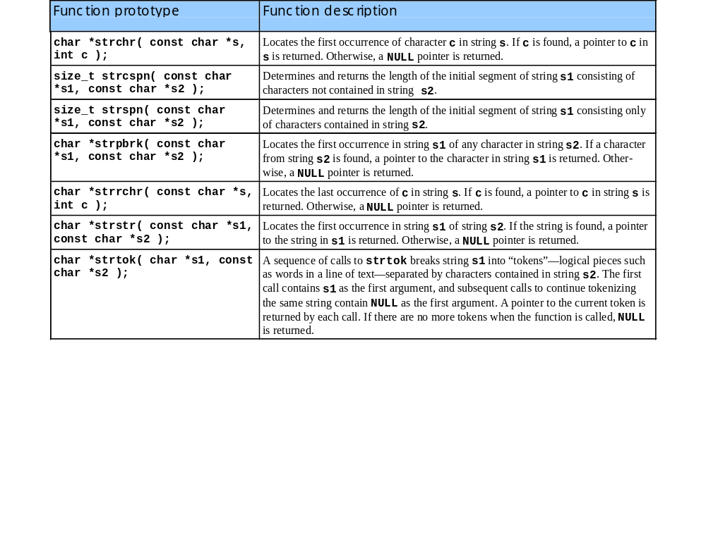
8.8 Search Functions of the String Handling Library

Slide 17
1 /* Fig. 8.27: fig08_27.c
2 Using strspn */
3 #include <stdio.h>
4 #include <string.h>
1. Initialize variables
2. Function calls
3. Print
Program Output
5
6 int main()
7 {
8 const char *string1 = "The value is 3.14159";
9 const char *string2 = "aehi lsTuv";
10
11 printf( "%s%s\n%s%s\n\n%s\n%s%u\n",
12 "string1 = ", string1, "string2 = ", string2,
13 "The length of the initial segment of string1",
14 "containing only characters from string2 = ",
15 strspn( string1, string2 ) );
16 return 0;
17 }
string1 = The value is 3.14159
string2 = aehi lsTuv
The length of the initial segment of string1
containing only characters from string2 = 13

Slide 18
1 /* Fig. 8.29: fig08_29.c
2 Using strtok */
3 #include <stdio.h>
4 #include <string.h>
5
1. Initialize variables
2. Function calls
3. Print
Program Output
6 int main()
7 {
8 char string[] = "This is a sentence with 7 tokens";
9 char *tokenPtr;
10
11 printf( "%s\n%s\n\n%s\n",
12 "The string to be tokenized is:", string,
13 "The tokens are:" );
14
15 tokenPtr = strtok( string, " " );
16
17 while ( tokenPtr != NULL ) {
18 printf( "%s\n", tokenPtr );
19 tokenPtr = strtok( NULL, " " );
20 }
21
22 return 0;
23 }
The string to be tokenized is:
This is a sentence with 7 tokens
The tokens are:
This
is
a
sentence
with
7
tokens

Slide 19
8.9 Memory Functions of the String- handling Library
Memory Functions
  In <stdlib.h>
  Manipulate, compare, and search blocks of memory
  Can manipulate any block of data
Pointer parameters are void *
  Any pointer can be assigned to void *, and vice versa
  void * cannot be dereferenced
    Each function receives a size argument specifying the number of bytes (characters) to process

Slide 20
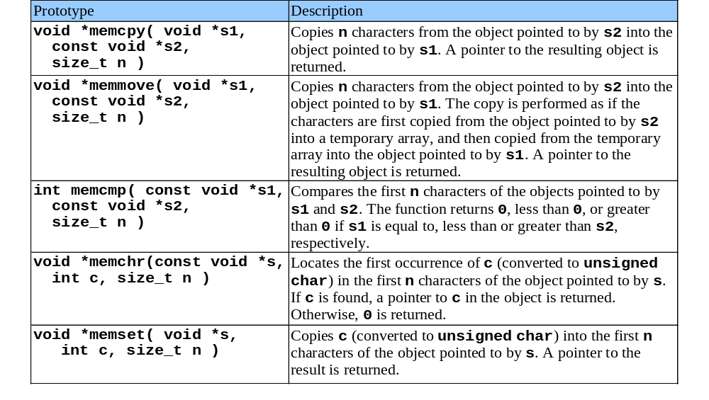
8.9 Memory Functions of the String- handling Library

Slide 21
1 /* Fig. 8.32: fig08_32.c
2 Using memmove */
3 #include <stdio.h>
4 #include <string.h>
1. Initialize variables
2. Function calls
3. Print
Program Output
5
6 int main()
7 {
8 char x[] = "Home Sweet Home";
9
10 printf( "%s%s\n",
11 "The string in array x before memmove is: ", x );
12 printf( "%s%s\n",
13 "The string in array x after memmove is: ",
14 memmove( x, &x[ 5 ], 10 ) );
15
16 return 0;
17 }
The string in array x before memmove is: Home Sweet Home
The string in array x after memmove is: Sweet Home Home

Slide 22
8.10 Other Functions of the String Handling Library
char *strerror( int errornum );
  Creates a system-dependent error message based on errornum
  Returns a pointer to the string
size_t strlen( const char *s );
  Returns the number of characters (before NULL) in string s

Slide 23
1 /* Fig. 8.37: fig08_37.c
2 Using strerror */
3 #include <stdio.h>
1. Function call
2. Print
Program Output
4 #include <string.h>
5
6 int main()
7 {
8 printf( "%s\n", strerror( 2 ) );
9 return 0;
10 }
No such file or directory

