Slide 1
EEE 109 Electrical Circuits
Dr. Md. Forkan Uddin
Associate Professor
Department of Electrical and Electronic Engineering (EEE)
Bangladesh University of Engineering and Technology (BUET)

Slide 2
Y (WYE) - ∆ (DELTA) Conversions
Boylestad – Chapter 8

Slide 3
Y (WYE) - ∆ (DELTA) Circuits

Slide 4
Y - ∆ Conversions: Concept

Slide 5

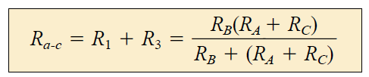

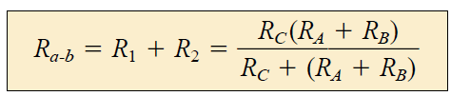



Y–to-∆ Conversions: Derivation
Now,
Solving them,
Similarly,

Slide 6

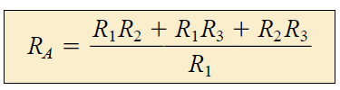
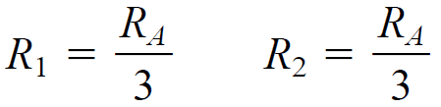
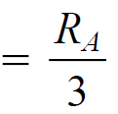

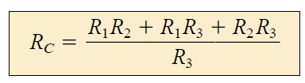
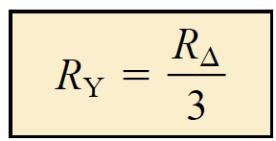


∆-to-Y Conversions: Derivation
After some algebraic processing,
Special Case:

Slide 7
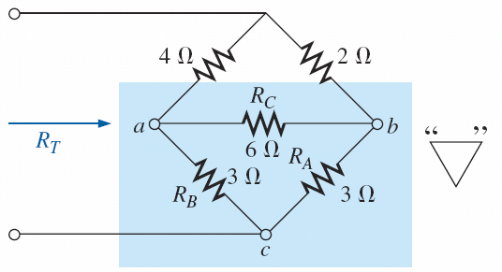
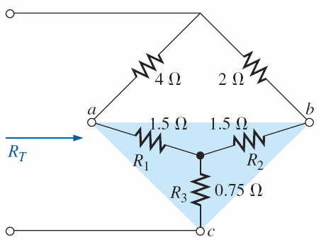

∆-to-Y Conversions: Example
Example 1

Slide 8

∆-to-Y Conversions: Example
Example 2

Slide 9
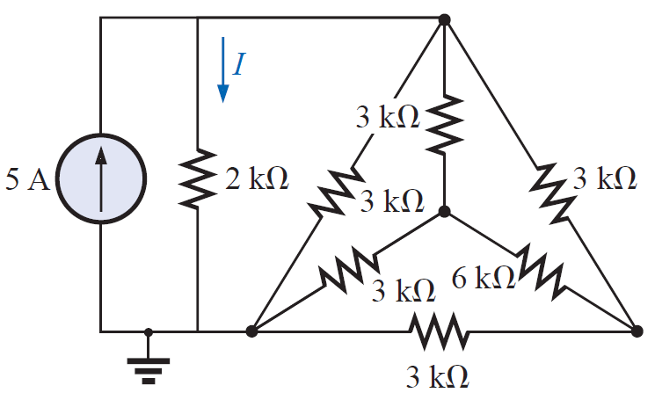
∆-to-Y Conversions: Example
Example 3
Calculate current I and power supplied by the 5A current source.
Note: Delta is not balanced
Answers: 2.14 A, 21.43 W

