Slide 1
CSE 109 Electrical Circuits
Dr. Md. Forkan Uddin
Associate Professor
Department of Electrical and Electronic Engineering (EEE)
Bangladesh University of Engineering and Technology (BUET)

Slide 2
AC Circuits: Waveforms

Slide 3
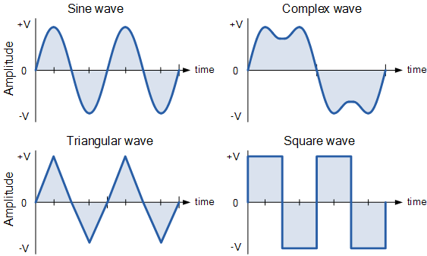
Periodic and Alternating Waveforms
A periodic function is one that satisfies f (t ) = f (t + nT), for all t and for all integers n.
can have non-zero average value
Alternating current is a periodic current with zero average taken over a cycle
Alternating waveforms
Sinusoids are easy to generate and transmits
Easy to handle mathematically

Slide 4
Sources of AC Power
Various sources of ac power: (a) generating plant; (b) portable ac generator; (c) wind-power station; (d) solar panel; (e) function generator

Slide 5
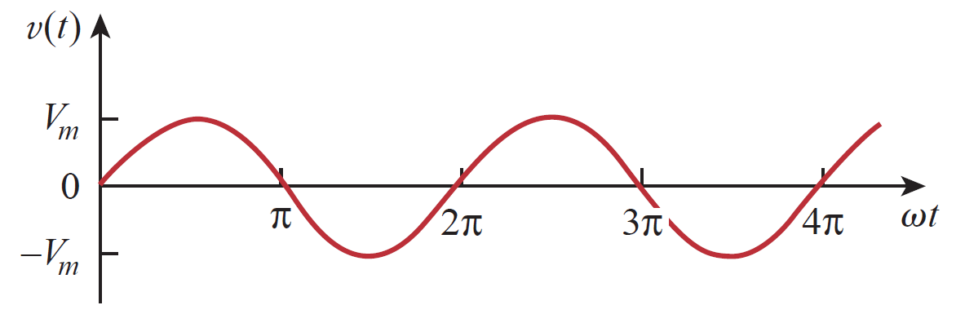
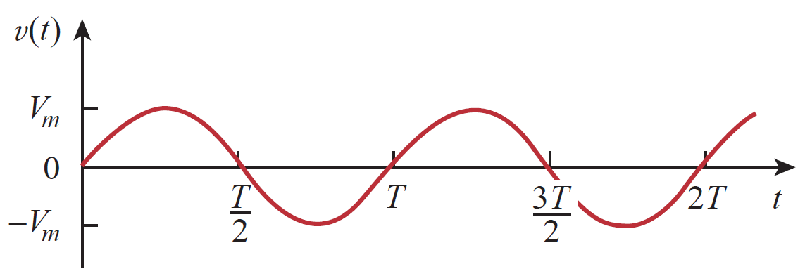
Sinusoids: Characteristics and Definitions

Slide 6
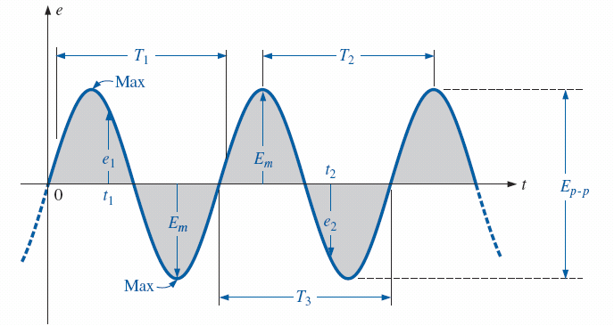
Sinusoids: Characteristics and Definitions
T1 = T2 = T3
Waveform
Instantaneous value
Peak amplitude
Peak value
Peak-to-peak value
Periodic waveform
Period (T)
Cycle
Frequency (f)
Important parameters for a sinusoidal voltage

Slide 7
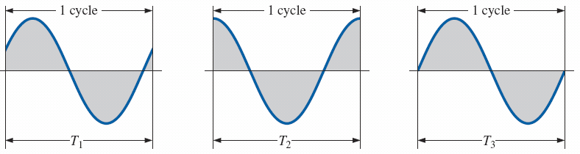

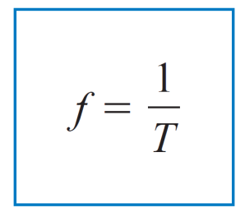

Sinusoids: Cycle, Period and Frequency
Defining the cycle and period of a sinusoidal waveform
Hz
rad/s

Slide 8
Phase
V_{m}
V_{m}
v(t) = V_{m} sin(ωt+θ)
ωt
V_{m}
v(t) = V_{m} sin(ωt-θ)
- V_{m}
ωt

Slide 9
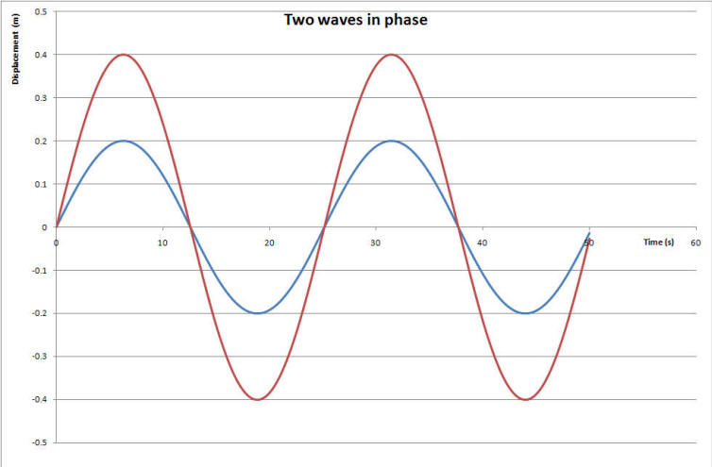
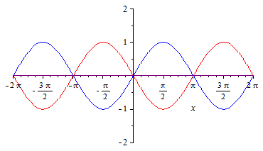
Phase Relationship
Phase relationship between a sine wave and a cosine wave (Quadrature phase)
In phase
Out of phase

Slide 10
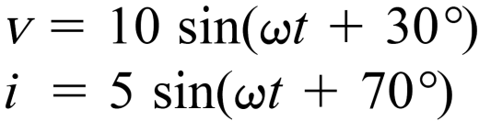
Example 1
i leads v by 40°
or v lags i by 40°
Alternatively:
i lags v by (360° - 40°) = 320°
or v leads i by (360° - 40°) = 320°

Slide 11
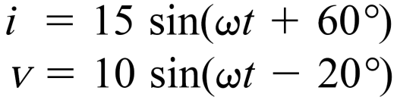
Example 2
i leads v by 80°
or v lags i by 80°

Slide 12
Example 3
Calculate the phase angle between v₁ and v₂. State the phase relationship.

Slide 13
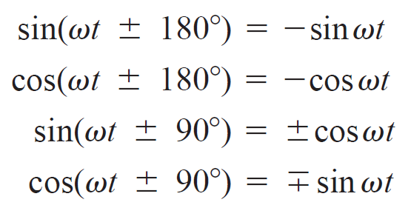
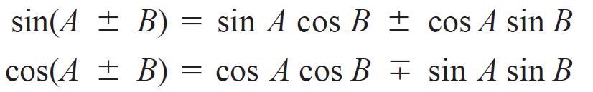
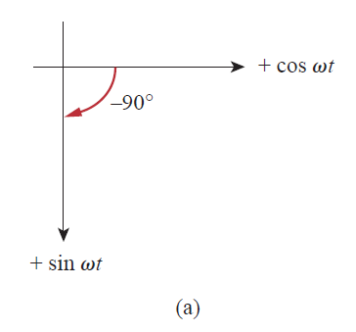
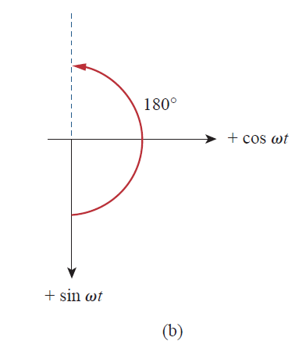
Phase Relationship: Mathematical Approach
Trigonometric identities
Graphical means of relating cosine and sine
Angle:
-ve :: clockwise
+ve :: counterclockwise

Slide 14

Example 3
Calculate the phase angle between v₁ and v₂. State the phase relationship.
Solution:
θ_{v1} = - 40º
and θ_{v2} = - 10º
θ_{d} = θ_{v1} – θ_{v2} = -30º
V₁ leads V₂ by -30º, i.e., V₁ lags V₂ by 30º
Note: When comparing sinusoid, express them in the same form.

Slide 15
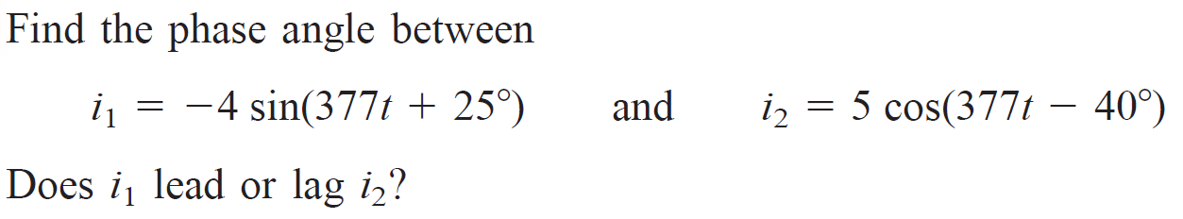

Example 4

Slide 16
Reading
Corcoran – Ch 2
Alexander – Ch 9

