Slide 1
CSE 109 Electrical Circuits
Dr. Md. Forkan Uddin
Associate Professor
Department of Electrical and Electronic Engineering (EEE)
Bangladesh University of Engineering and Technology (BUET)

Slide 2
AC Circuits: R, L, C Circuits (Chapter 2 – Corcoron)

Slide 3
Impedance, Z
“Impedance function” or simply “Impedance ” -
Relates voltage and currents in AC circuits
Must tell two things:
Ratio of peak voltage (V_{m}) to peak current (I_{m})
Phase relationship between voltage and current wave forms
_{+ angle: Voltage leads}
_{- angle: Current leads}

Slide 4
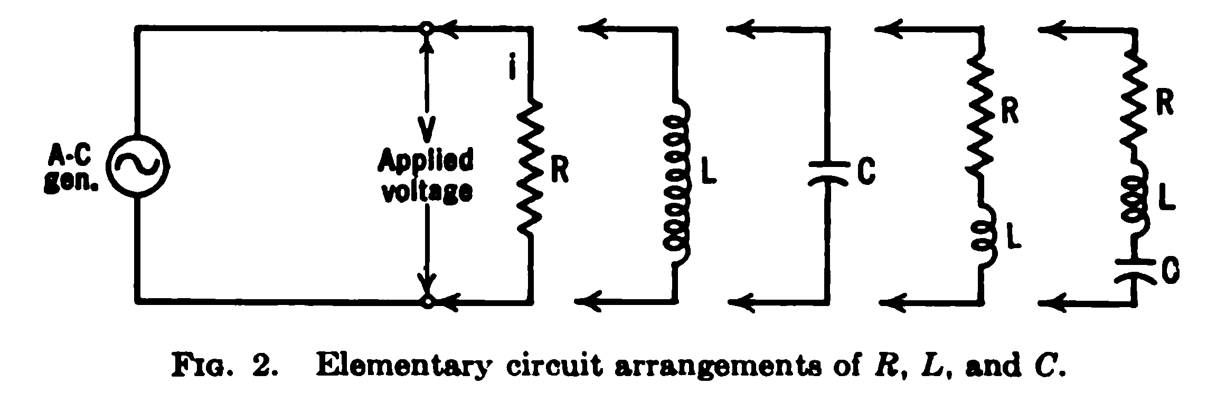
Elementary Circuit Arrangements Using R, L, C

Slide 5
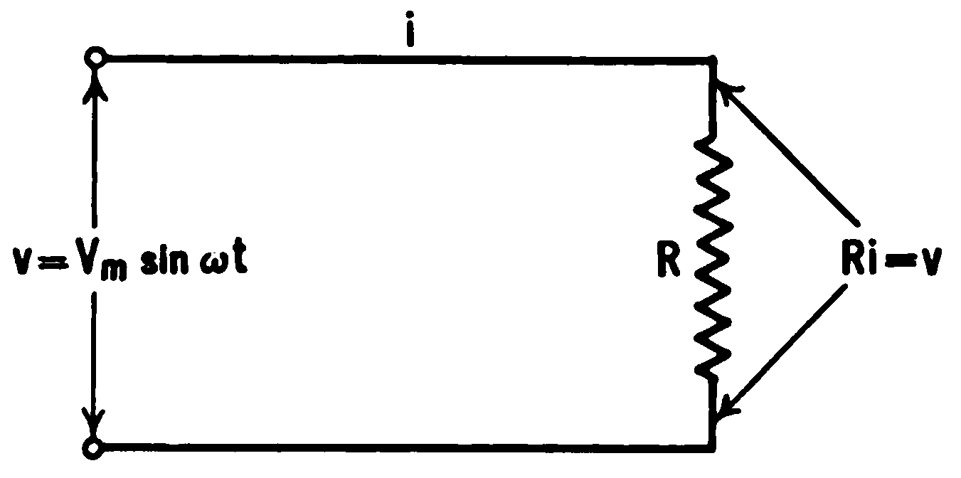
R (Pure Resistive) Branch
v(t) = i(t)R
i (t) = V_{m}/R sin ωt
I_{m} = V_{m}/R
Impedance
Current wave in time phase with voltage wave

Slide 6
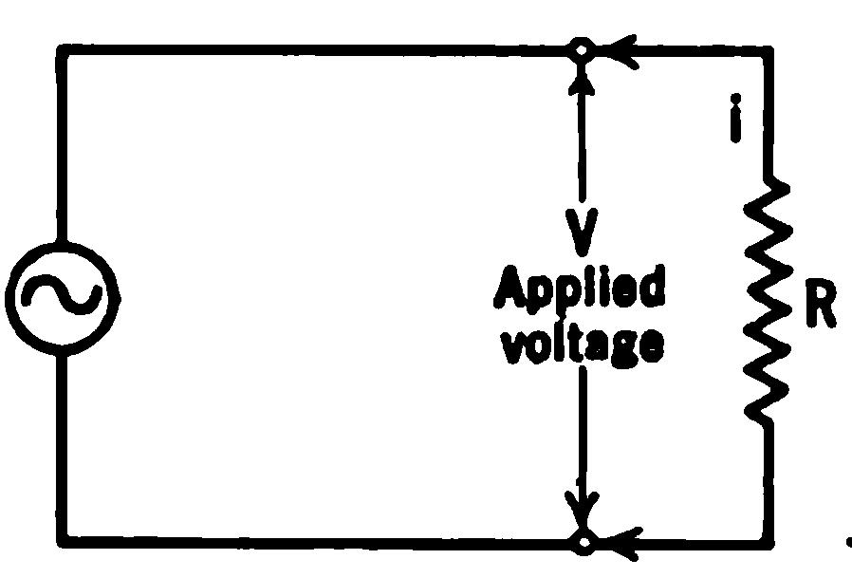
R (Pure Resistive) Branch
v (t)= V_{m} sin ωt
Instantaneous Power
= v(t)i (t)
= V_{m} I_{m} sin² ωt
= (1/2)V_{m} I_{m} - (1/2)V_{m} I_{m} cos 2ωt
Average Power: P_{avg} = V_{m} I_{m} / 2

Slide 7
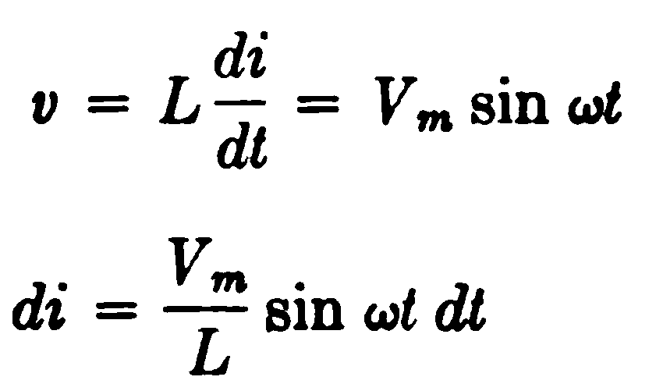
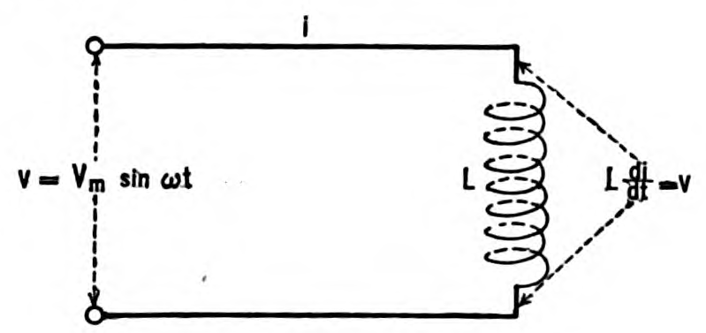
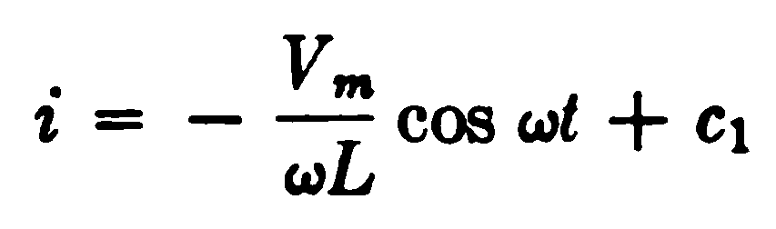
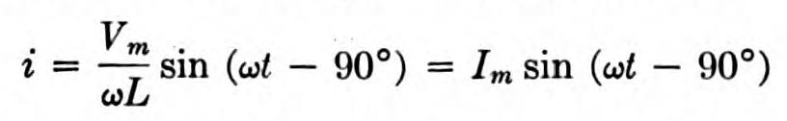
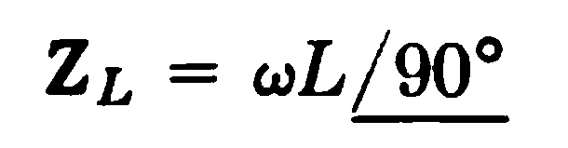
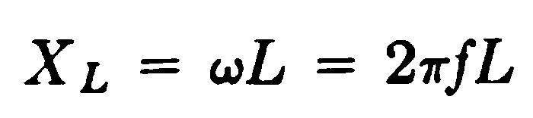
L-Branch
Impedance
v leads i by 90º
Inductive
Reactance

Slide 8
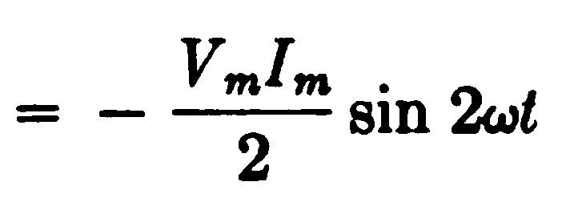
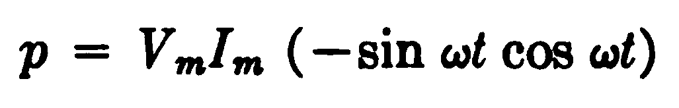
L-Branch: Power
Average Power: P_{avg} = 0

Slide 9

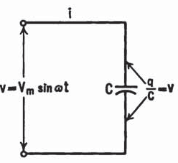

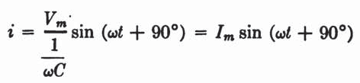

C-Branch

Slide 10
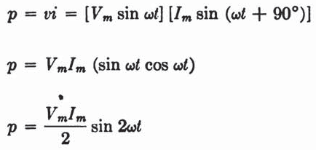
C-Branch: Power
Average power : P_{avg} = 0

Slide 11
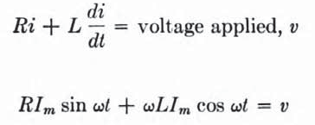
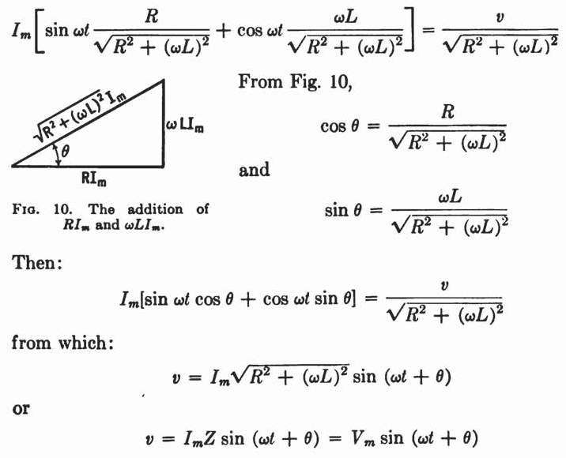
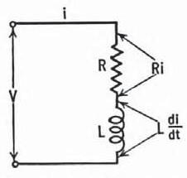
R-L Branch

Slide 12
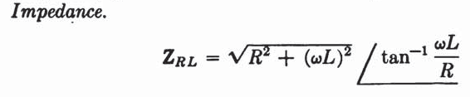
R-L: Impedance
Voltage lead current by an angle: θ = tan⁻¹ (ωL/R)
0º ≤ θ ≤ 90º

Slide 13

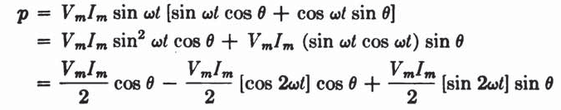
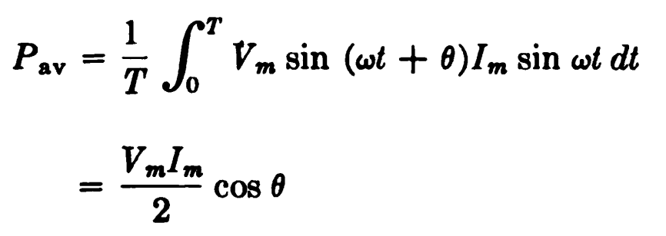
R-L: Power
Power:

Slide 14




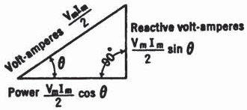

Real Power, Reactive Power and VA
Instantaneous Real Power:
(Watt)
Average Real Power /
Real Power:
(Watt)
Instantaneous Reactive / Instantaneou Quadrature Power / Instantaneous Reactive Volt-Ampere:
(VAR)
Average Reactive Power: zero
Reactive Power / Reactive Volt-Ampere:
(VAR)
Volt-Ampere:
(VA)

Slide 15
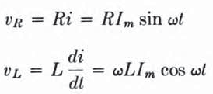
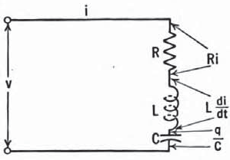



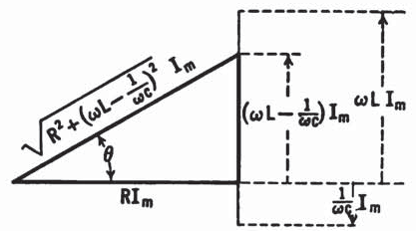
R-L-C Branch
Writing KVL,
where,

Slide 16
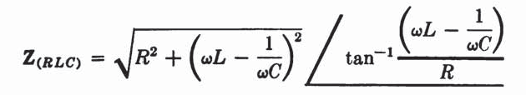
R-L-C Branch
Impedance:
Voltage lead current by an angle:
- 90º ≤ θ ≤ + 90º

Slide 17
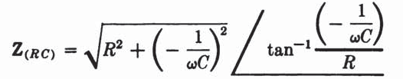
R-L-C Branch
Impedance:
All the impedance functions derived so far are directly deducible from this general equation
For example: Setting ωL = 0, we can derive the expression for an RC branch as follow:
Important Note:
ωL > 1/ ωC: RLC branch is equivalent to an RL branch
ωL < 1/ ωC: RLC branch is equivalent to an RC branch
ωL = 1/ ωC: RLC branch is equivalent to a pure R branch

Slide 18
R-L-C Branch: Real Power, Reactive Power and VA
All Expressions are same as those of R-L branch

Slide 19
Important Note
Lagging / Leading Load:
Determined by the lag/lead of current
Lagging Load / Lagging pf:
Current lags voltage
Inductive circuit (i.e., ωL > 1/ ωC)
Most of the practical loads are inductive
Leading Load / Leading pf:
Current leads voltage
Capacitive circuit (i.e., ωL < 1/ ωC)
Unity pf Load:
Current and voltage in phase
Resistive circuit (i.e., ωL = 1/ ωC)

Slide 20
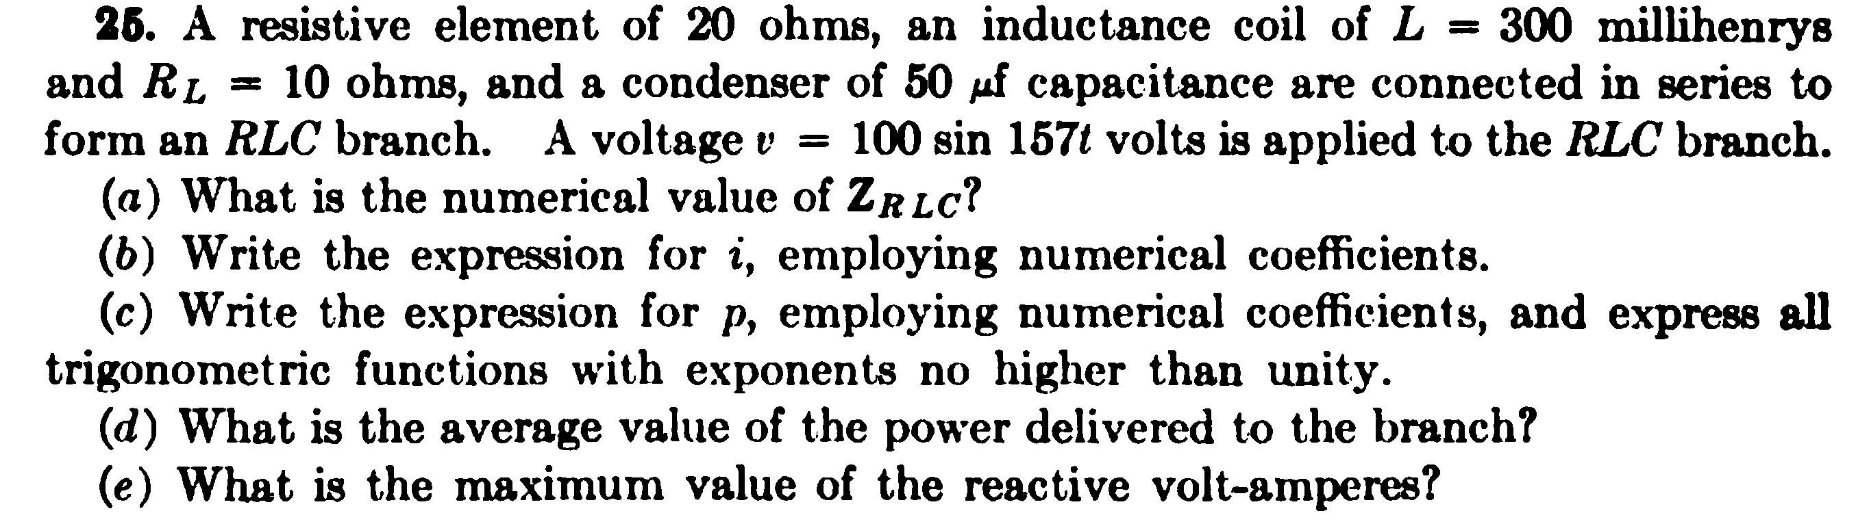
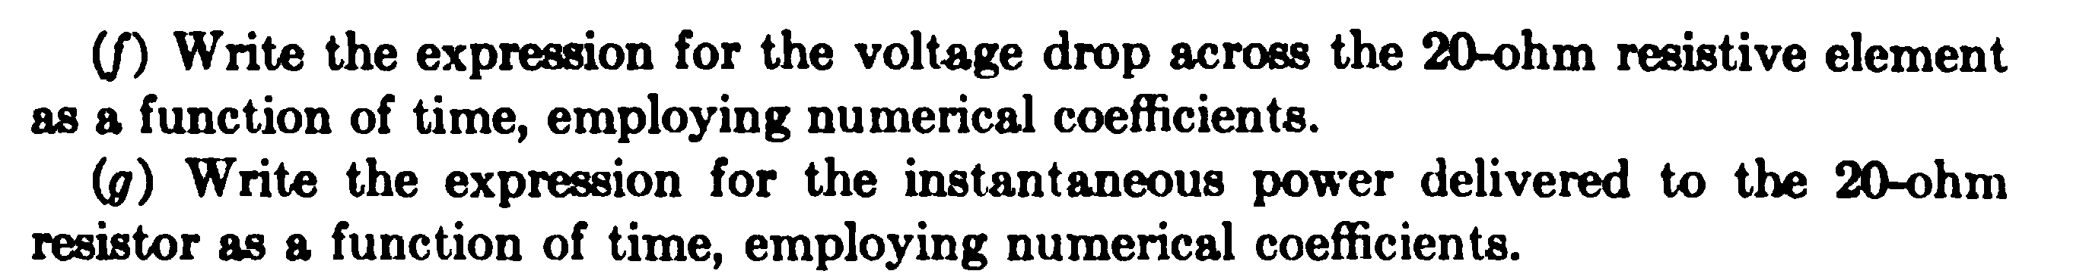
Example

Slide 21
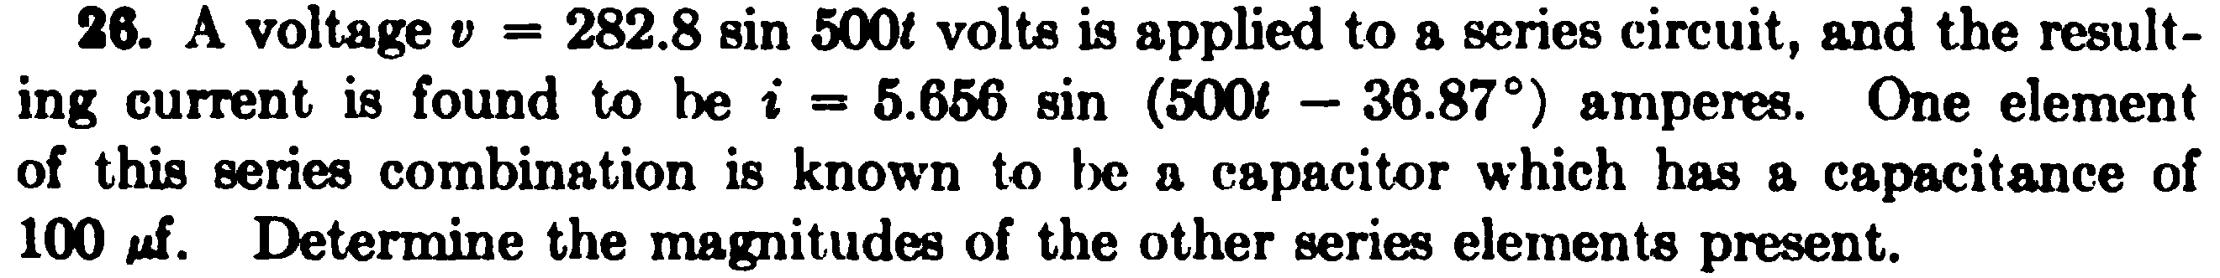
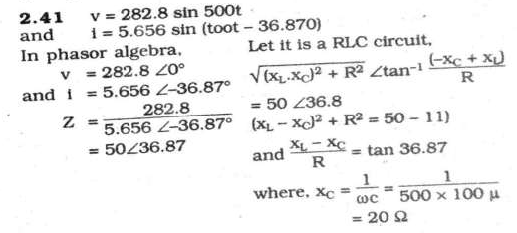
Example
Solution

