Slide 1
RECURSION

Slide 2
Two approaches to writing repetitive algorithms:
Iteration
Recursion
Recursion is a repetitive process in which an algorithm calls itself.
Usually recursion is organized in such a way that a subroutine calls itself or a function calls itself

Slide 3
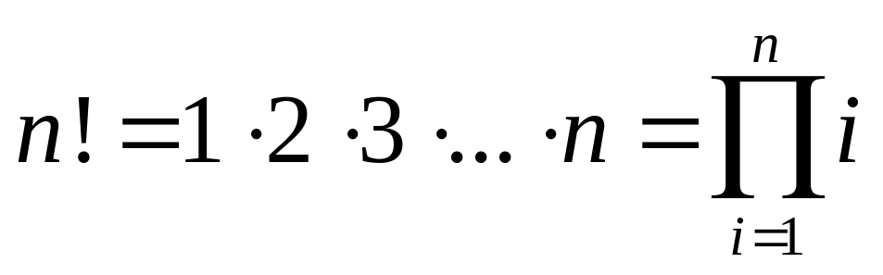
Factorial – a case study
The factorial of a positive number is the product of the integral values from 1 to the number:

Slide 4
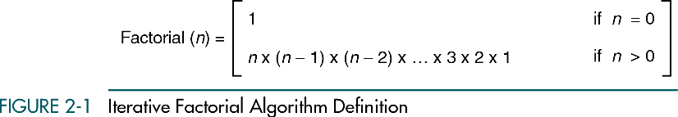
Factorial: Iterative Algorithm
A repetitive algorithm is defined iteratively whenever the definition involves only the algorithm parameter (parameters) and not the algorithm itself.

Slide 5
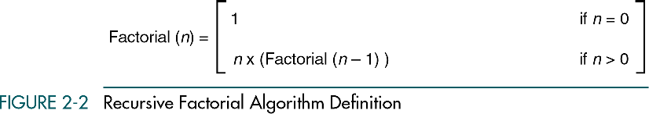
Factorial: Recursive Algorithm
A repetitive algorithm uses recursion whenever the algorithm appears within the definition itself.

Slide 6
Recursion: basic point
The recursive solution for a problem involves a two-way journey:
First we decompose the problem from the top to the bottom
Then we solve the problem from the bottom to the top.

Slide 7
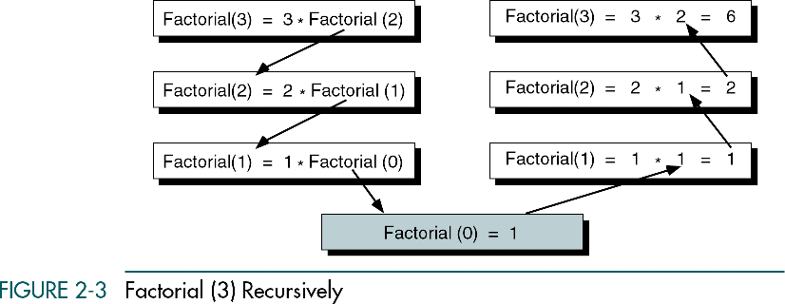
Factorial (3):
Decomposition and solution

Slide 8
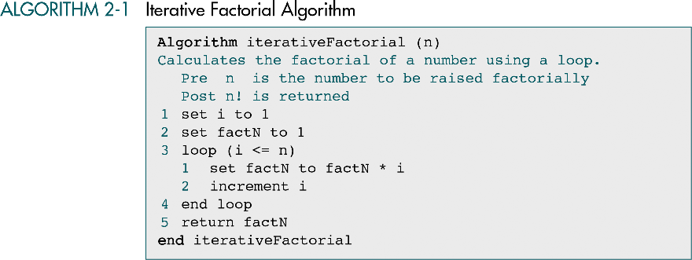

Slide 9
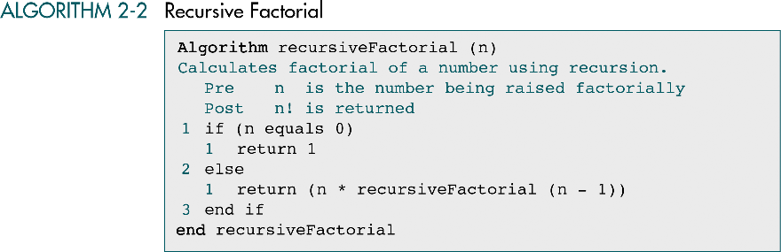

Slide 10
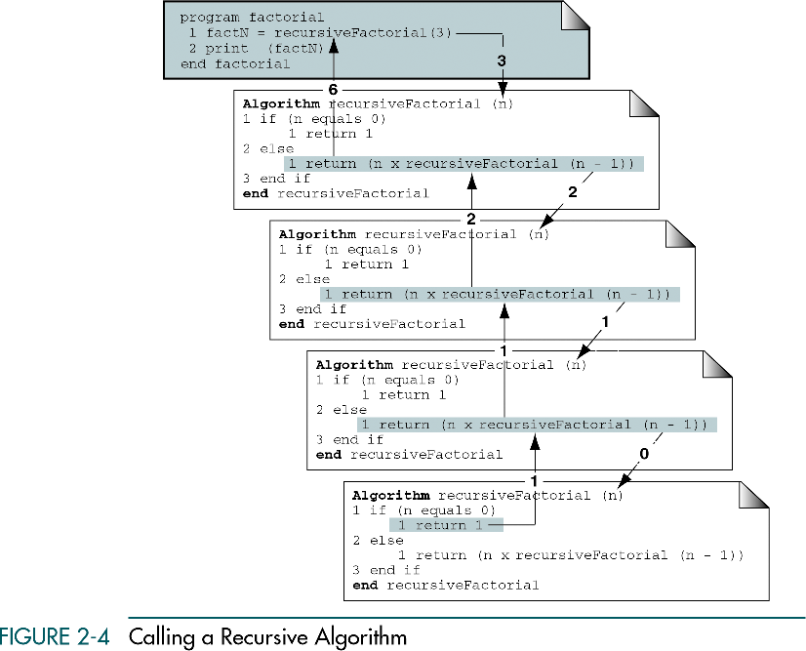

Slide 11
Designing recursive algorithms
Each call of a recursive algorithm either solves one part of the problem or it reduces the size of the problem.
The general part of the solution is the recursive call. At each recursive call, the size of the problem is reduced.

Slide 12
Designing recursive algorithms
The statement that “solves” the problem is known as the base case.
Every recursive algorithm must have a base case.
The rest of the algorithm is known as the general case. The general case contains the logic needed to reduce the size of the problem.

Slide 13
Designing recursive algorithms
Once the base case has been reached, the solution begins.
We now know one part of the answer and can return that part to the next, more general statement.
This allows us to solve the next general case.
As we solve each general case in turn, we are able to solve the next-higher general case until we finally solve the most general case, the original problem.

Slide 14
Designing recursive algorithms
The rules for designing a recursive algorithm:
First, determine the base case.
Then determine the general case.
Combine the base case and the general cases into an algorithm

Slide 15
Designing recursive algorithms
Each recursive call must reduce the size of the problem and move it toward the base case.
The base case, when reached, must terminate without a call to the recursive algorithm; that is, it must execute a return.

Slide 16
Limitations of Recursion
Recursion should not be used if the answer to any of the following questions is no:
Is the algorithm or data structure naturally suited to recursion (tree is the first choice) ?
Is the recursive solution shorter and more understandable?
Does the recursive solution run within acceptable time and space limits?
As a general rule, recursive algorithms should be effectively used only when their efficiency is logarithmic.

Slide 17
Example-Problem
Assume that we are reading data from the keyboard and need to print the data in reverse.
The easiest formal way to print the list in reverse is to write a recursive algorithm.

Slide 18
Solution
It should be obvious that to print the list in reverse, we must first read all of the data. If we print before we read all of the data, we print the list in sequence. If we print after we read the last piece of data - that is, if we print it as we back out of the recursion – we print it in reverse sequence.
The base case, therefore, is that we have read the last piece of data.
Similarly, the general case is to read the next piece of data.

Slide 19
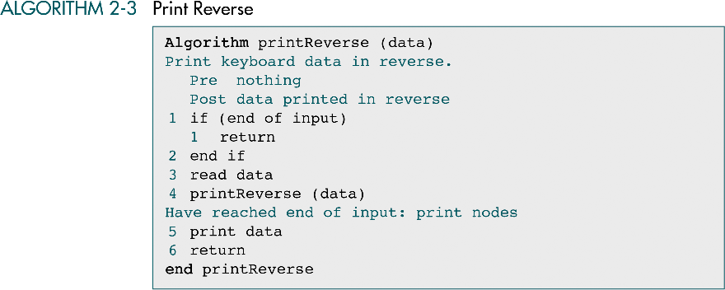
Implementation

Slide 20
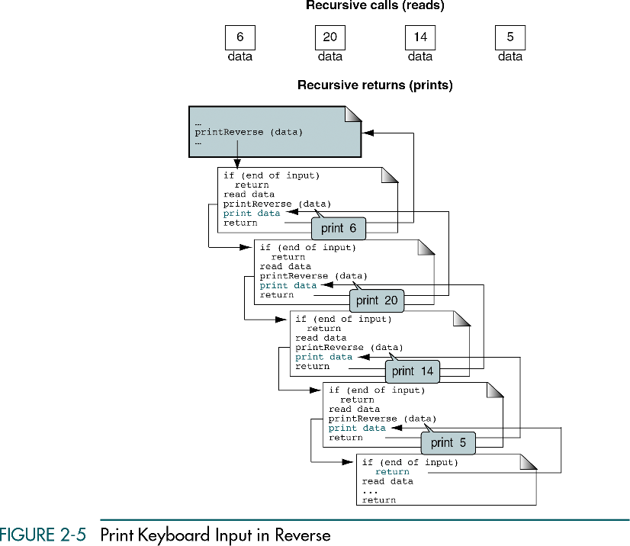

Slide 21
Analysis
Is the algorithm or data structure naturally suited to recursion? A list, such as data read from the keyboard, is not naturally recursive structure. Moreover, the algorithm is not a logarithmic algorithm.
Is the recursive solution shorter and more understandable? Yes
Does the recursive solution run within acceptable time and space limits? The number of iterations in the traversal of a list can become quite large because the algorithm has a linear efficiency - O(n).

Slide 22
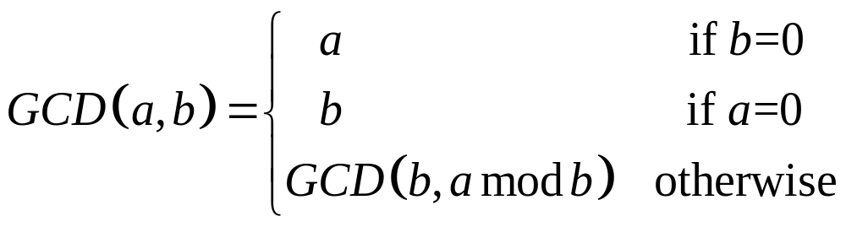
Example-Problem
Determine the greatest common divisor (GCD) for two numbers.
Euclidean algorithm: GCD (a,b) can be recursively found from the formula

Slide 23
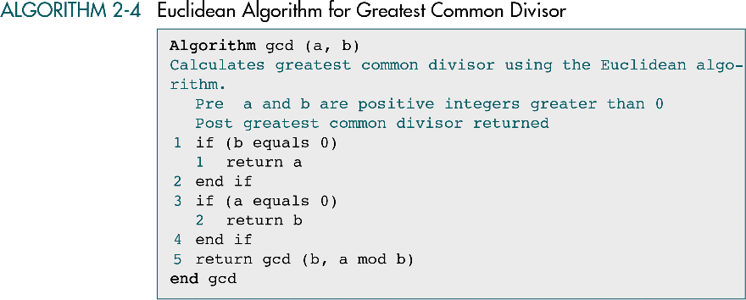
Pseudocode Implementation

Slide 24
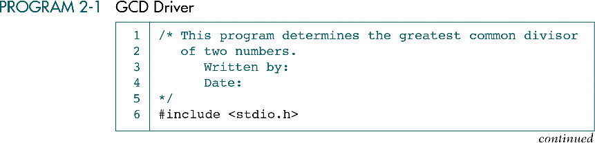
C implementation

Slide 25
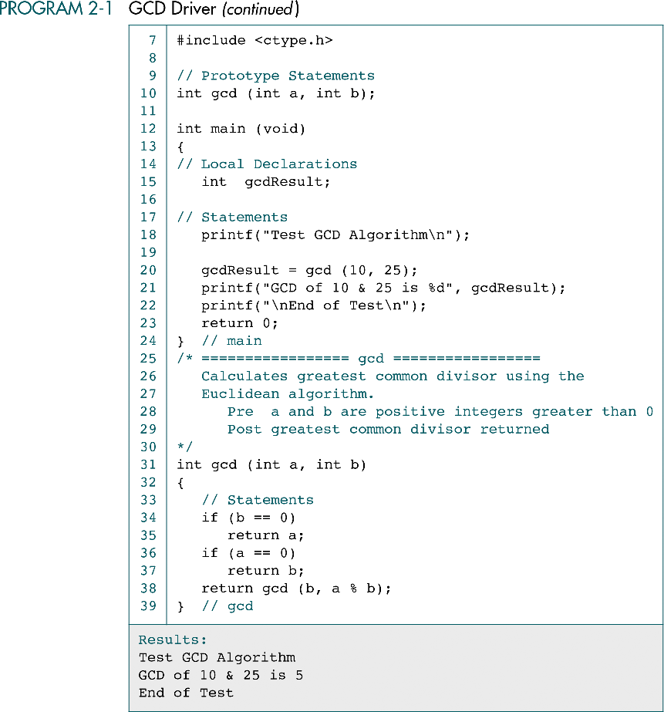

Slide 27
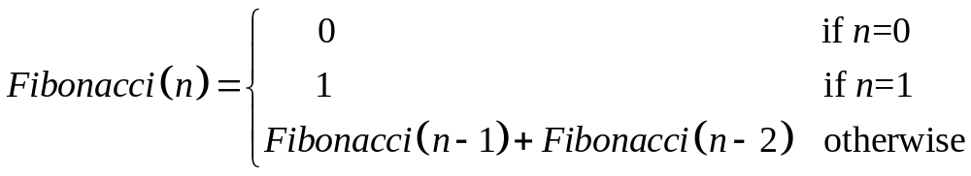
Example-Problem
Generation of the Fibonacci numbers series.
Each next number is equal to the sum of the previous two numbers.
A classical Fibonacci series is 0, 1, 1, 2, 3, 5, 8, 13, …
The series of n numbers can be generated using a recursive formula

Slide 28
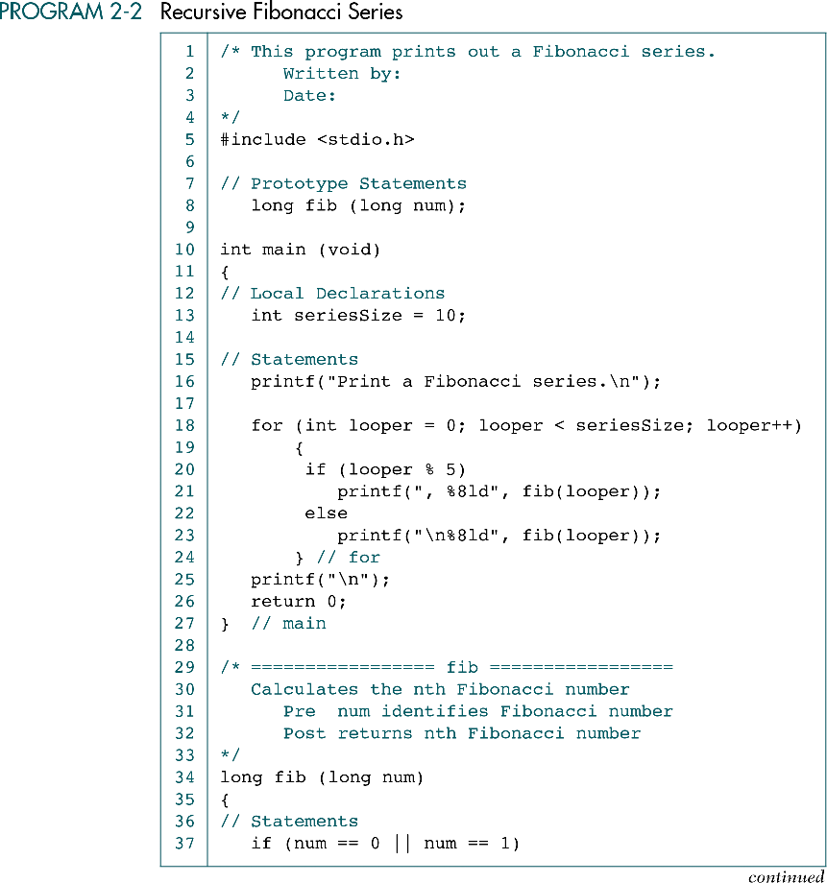

Slide 29
(Continued)

Slide 30
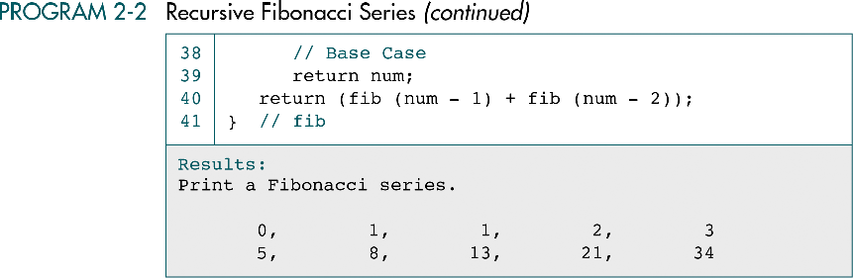

Slide 31
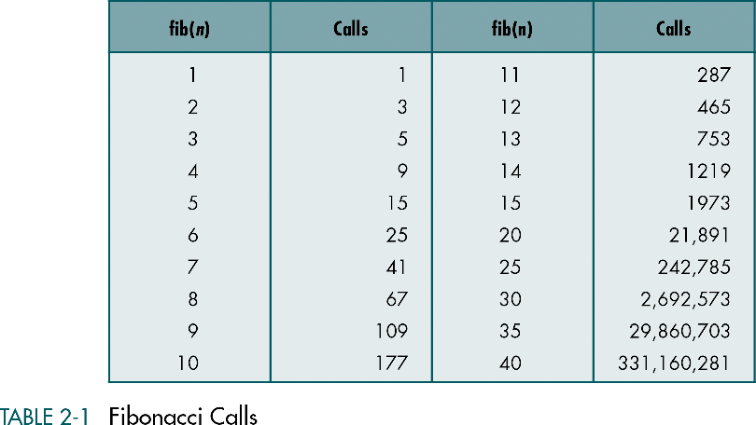

Slide 32
Example-Problem
Prefix to Postfix conversion of an arithmetic expression.
Prefix: + A B operator comes before the operands
Infix: A + B operator comes between the operands
Postfix: A B + operator comes after the operands
The basic concept is to convert the expression like *AB to the one AB*
To keep the algorithm as simple as possible, we assume that each operand is only one character and there are only four operators +, -, *,/

Slide 33
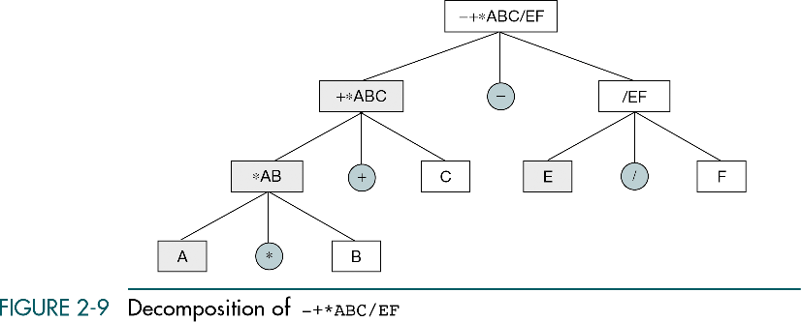
Decomposition of (A*B+C)-E/F

Slide 34
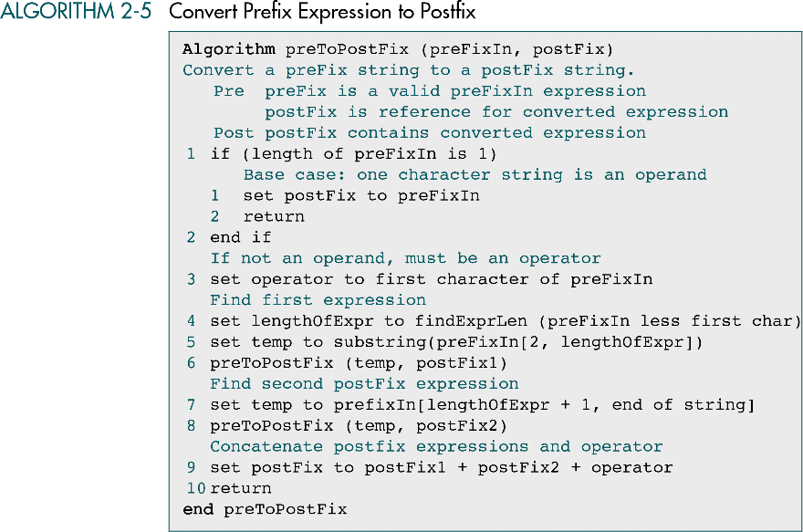

Slide 35
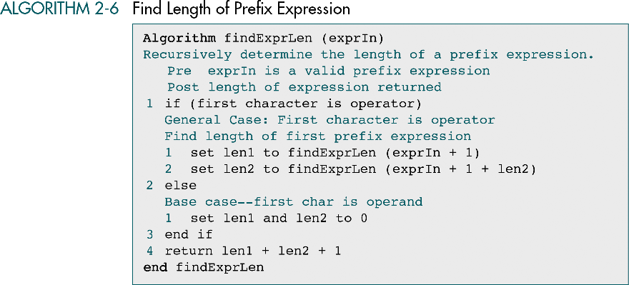

Slide 36
Homework
Chapter 2
Exercises 1, 2, 3 (pp. 72-73).
Problems 7, 8 (p. 74)

