Slide 1
Chapter 6
Introduction to Trees
Objectives
Upon completion you will be able to:
Understand and use basic tree terminology and concepts
Recognize and define the basic attributes of a binary tree
Process trees using depth-first and breadth-first traversals
Parse expressions using a binary tree
Understand the basic use and processing of general trees

Slide 2
Basic Tree Concepts
A tree consists of finite set of elements, called nodes, and a finite set of directed lines called branches, that connect the nodes.
The number of branches associated with a node is the degree of the node.

Slide 3
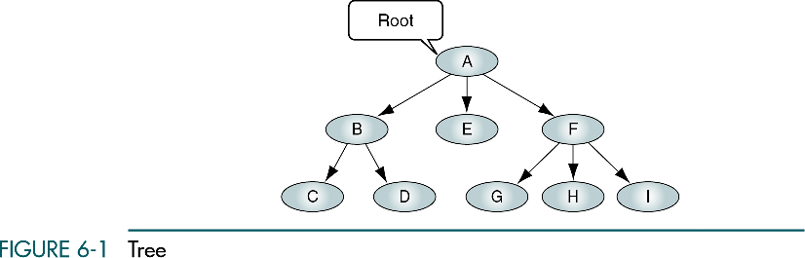

Slide 4
Basic Tree Concepts
When the branch is directed toward the node, it is indegree branch.
When the branch is directed away from the node, it is an outdegree branch.
The sum of the indegree and outdegree branches is the degree of the node.
If the tree is not empty, the first node is called the root.

Slide 5
Basic Tree Concepts
The indegree of the root is, by definition, zero.
With the exception of the root, all of the nodes in a tree must have an indegree of exactly one; that is, they may have only one predecessor.
All nodes in the tree can have zero, one, or more branches leaving them; that is, they may have outdegree of zero, one, or more.

Slide 6
Basic Tree Concepts
A leaf is any node with an outdegree of zero, that is, a node with no successors.
A node that is not a root or a leaf is known as an internal node.
A node is a parent if it has successor nodes; that is, if it has outdegree greater than zero.
A node with a predecessor is called a child.

Slide 7
Basic Tree Concepts
Two or more nodes with the same parents are called siblings.
An ancestor is any node in the path from the root to the node.
A descendant is any node in the path below the parent node; that is, all nodes in the paths from a given node to a leaf are descendants of that node.

Slide 8
Basic Tree Concepts
A path is a sequence of nodes in which each node is adjacent to the next node.
The level of a node is its distance from the root. The root is at level 0, its children are at level 1, etc. …

Slide 9
Basic Tree Concepts
The height of the tree is the level of the leaf in the longest path from the root plus 1. By definition the height of any empty tree is -1.
A subtree is any connected structure below the root. The first node in the subtree is known is the root of the subtree.

Slide 10
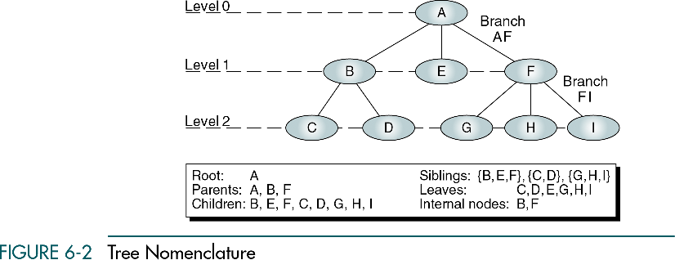

Slide 11
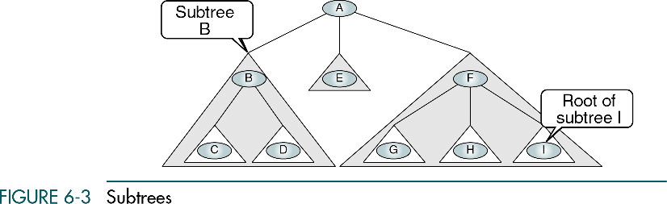

Slide 12
Recursive definition of a tree
A tree is a set of nodes that either:
is empty or
has a designated node, called the root, from which hierarchically descend zero or more subtrees, which are also trees.

Slide 13
6-2 Binary Trees
A binary tree can have no more than two descendents. In this section we discuss the properties of binary trees, four different binary tree traversals
Properties
Binary Tree Traversals
Expression Trees

Slide 14
Binary Trees
A binary tree is a tree in which no node can have more than two subtrees; the maximum outdegree for a node is two.
In other words, a node can have zero, one, or two subtrees.
These subtrees are designated as the left subtree and the right subtree.

Slide 15
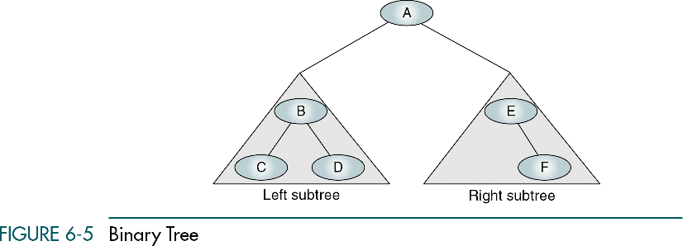

Slide 16
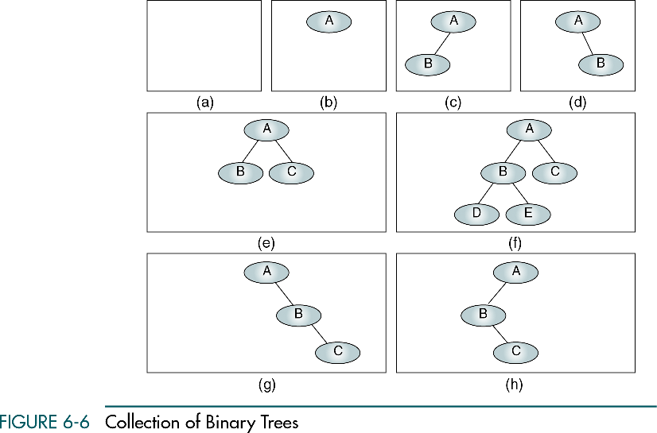
A null tree is a tree with no nodes

Slide 17
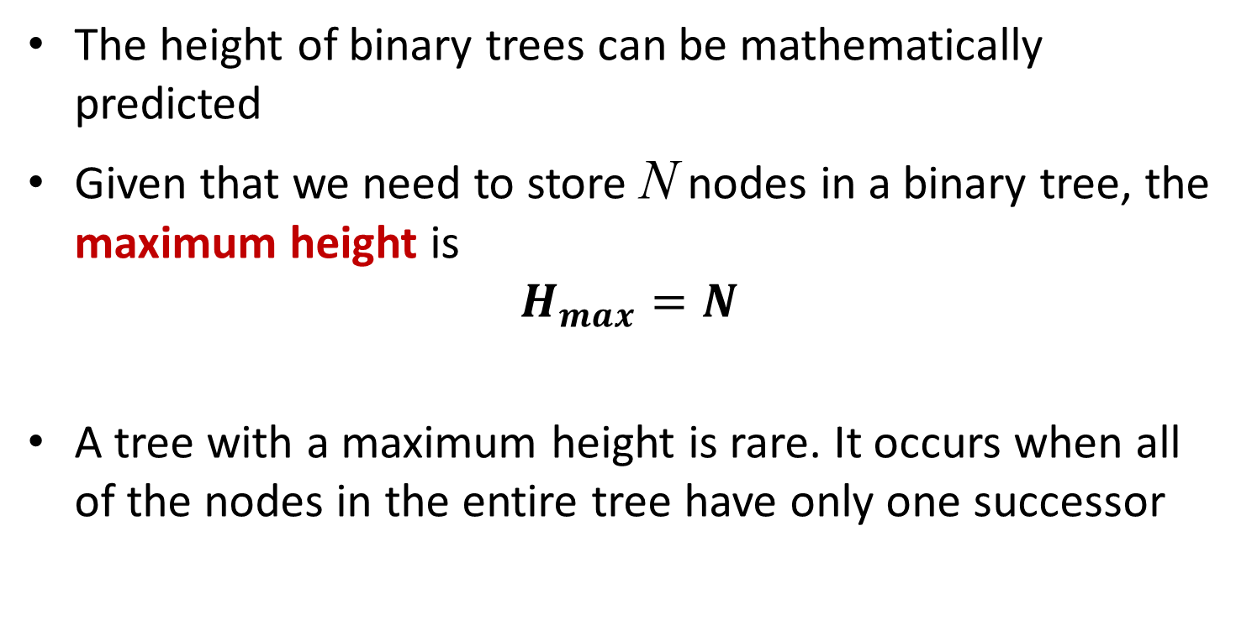
Some Properties of Binary Trees
The height of binary trees can be mathematically predicted
Given that we need to store N nodes in a binary tree, the maximum height is
$$H_{max}=N$$
A tree with a maximum height is rare. It occurs when all of the nodes in the entire tree have only one successor

Slide 18
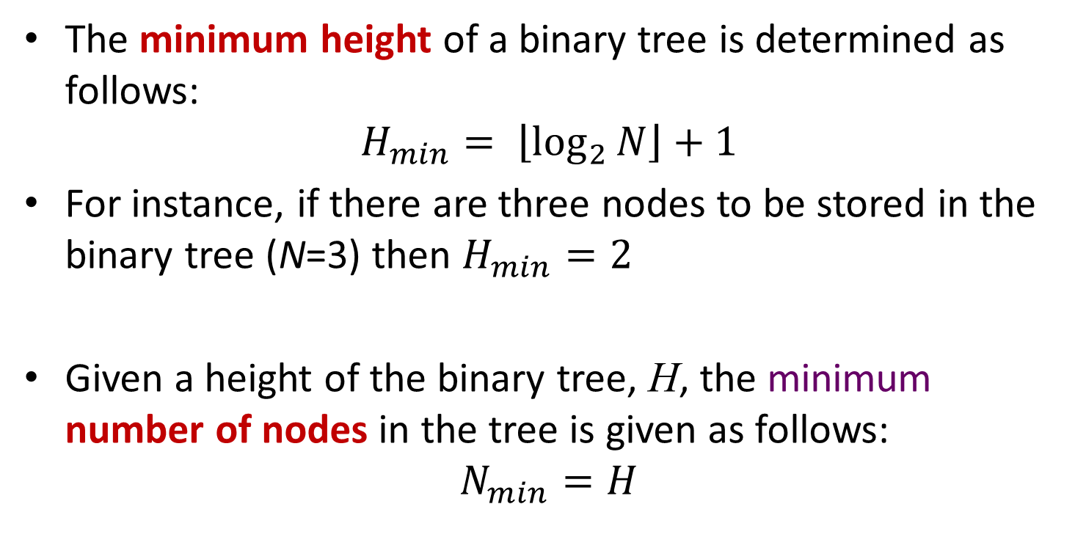
Some Properties of Binary Trees
The minimum height of a binary tree is determined as follows:
$$H_{min}= \left\lfloor \log_{2}{N}\right\rfloor +1$$
For instance, if there are three nodes to be stored in the binary tree (N=3) then $H_{min}=2$
Given a height of the binary tree, H, the minimum number of nodes in the tree is given as follows:
$$N_{min}=H$$

Slide 19
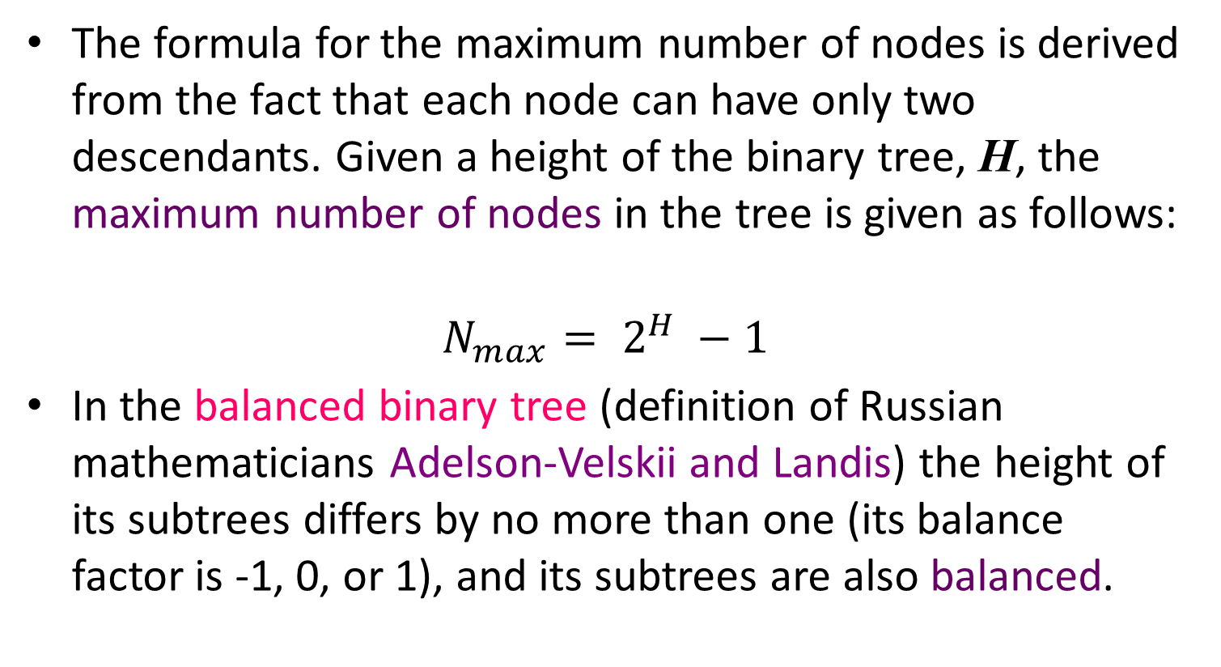
Some Properties of Binary Trees
The formula for the maximum number of nodes is derived from the fact that each node can have only two descendants. Given a height of the binary tree, H, the maximum number of nodes in the tree is given as follows:
$$N_{max}= 2^{H} −1$$
In the balanced binary tree (definition of Russian mathematicians Adelson-Velskii and Landis) the height of its subtrees differs by no more than one (its balance factor is -1, 0, or 1), and its subtrees are also balanced.
Dr. Shamim Ripon, CSE 207
19

Slide 20
Balance of the tree
B=0
B=0
B=1
B=-1
B=0
B=1
B=-2
B=2

Slide 21
Complete and nearly complete binary trees
A complete tree has the maximum number of entries for its height. The maximum number is reached when the last level is full.
A tree is considered nearly complete if it has the minimum height for its nodes and all nodes in the last level are found on the left

Slide 22
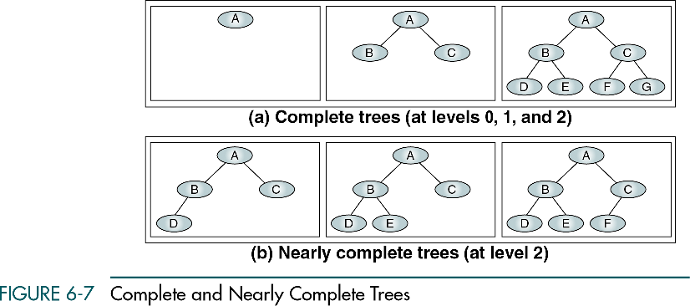

Slide 23
Binary Tree Traversal
A binary tree traversal requires that each node of the tree be processed once and only once in a predetermined sequence.
In the depth-first traversal processing process along a path from the root through one child to the most distant descendant of that first child before processing a second child.

Slide 24
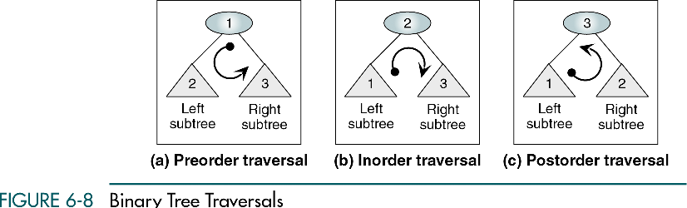

Slide 25
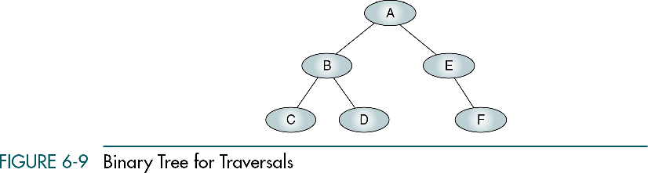

Slide 26
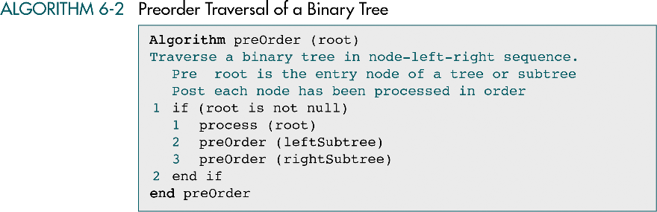

Slide 27
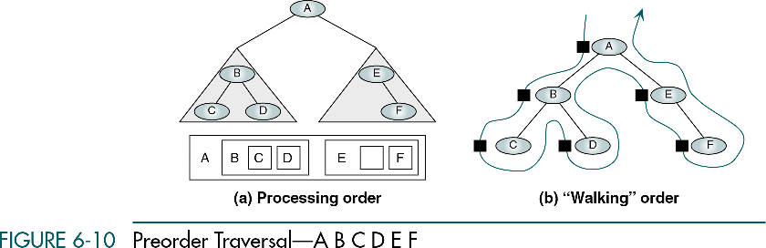

Slide 28
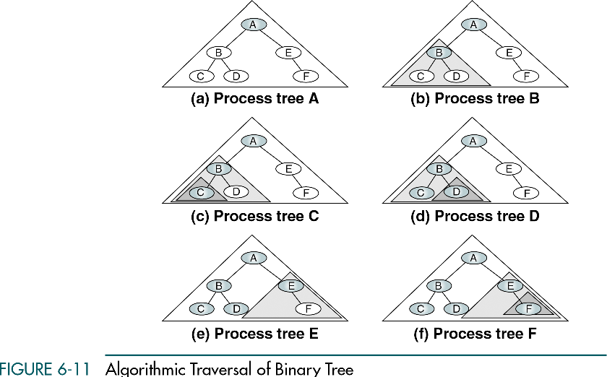

Slide 29
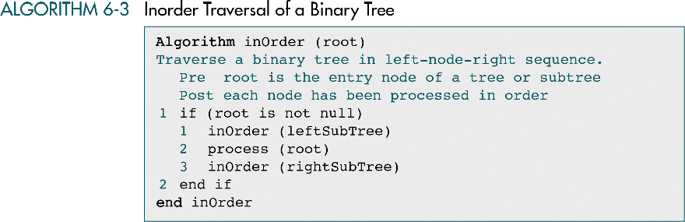

Slide 30
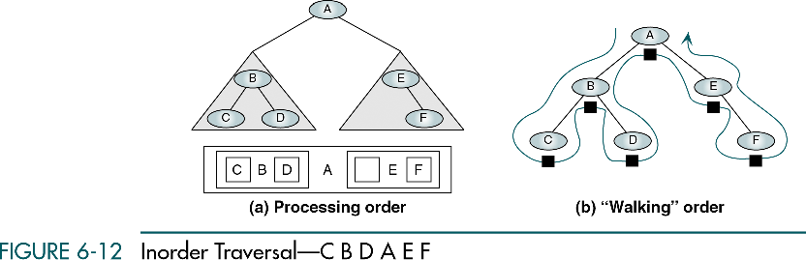

Slide 31
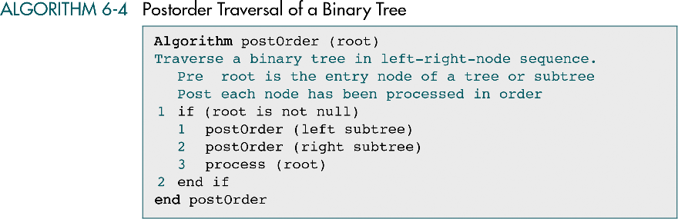

Slide 32
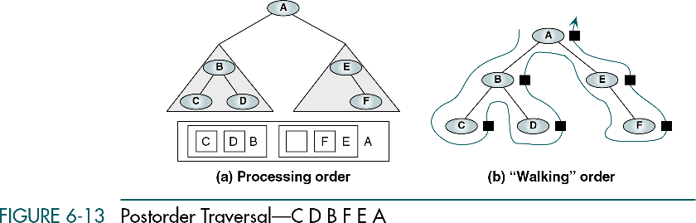

Slide 33
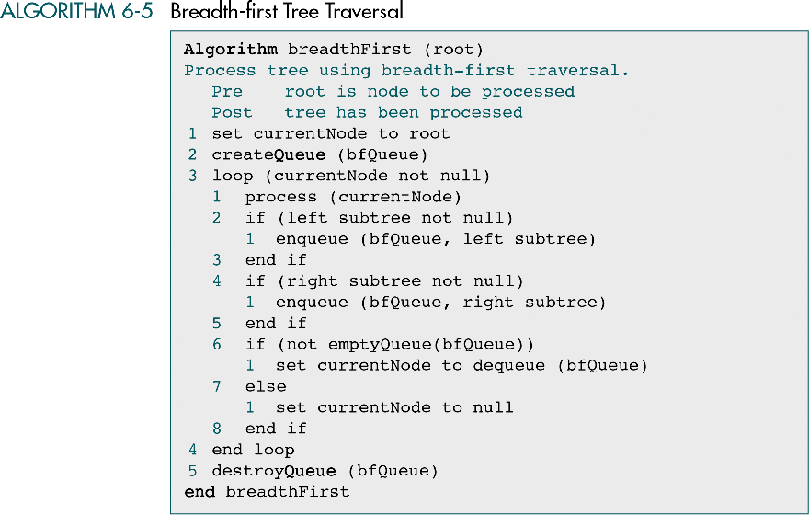

Slide 34
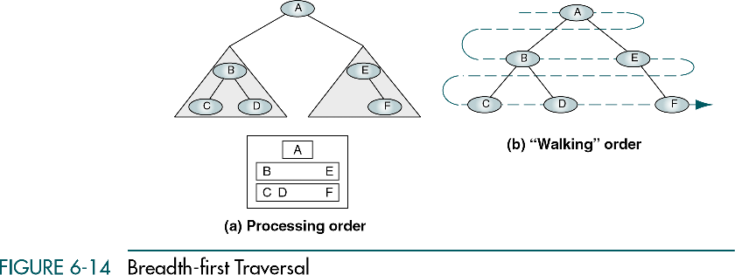

Slide 35
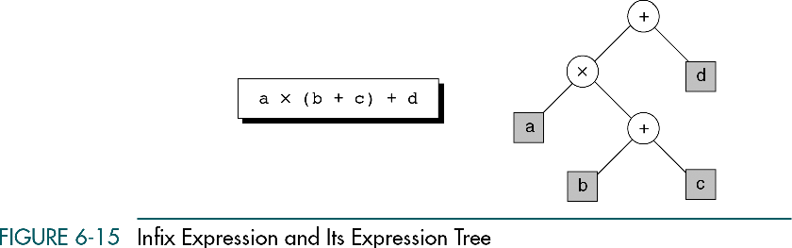

Slide 36
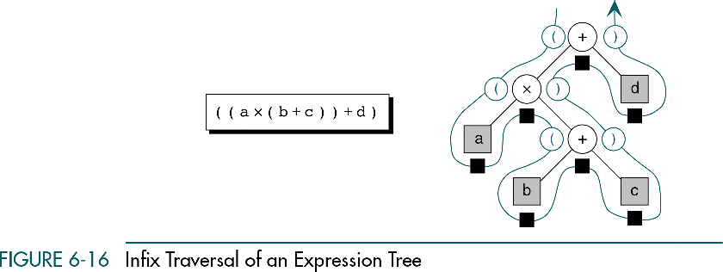

Slide 37
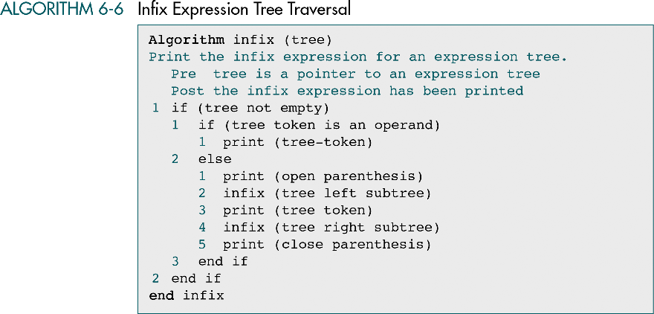

Slide 38
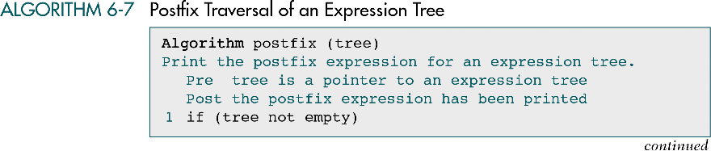


Slide 39
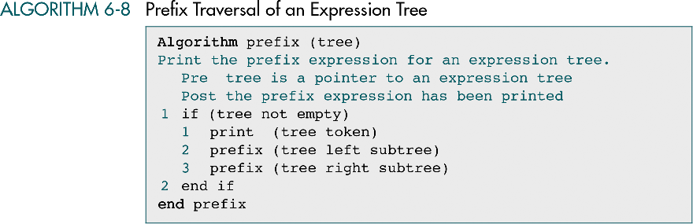

Slide 41
6-2 General Trees
A general tree can have an unlimited number of descendants. We discuss tree topic in this section: general tree insertion, deletions and converting a tree into a binary tree.
Properties
Binary Tree Traversals
Expression Trees

Slide 42
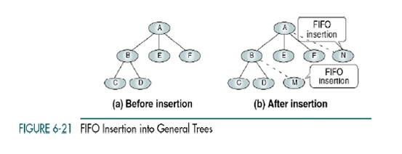
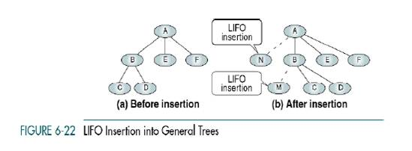

Slide 43
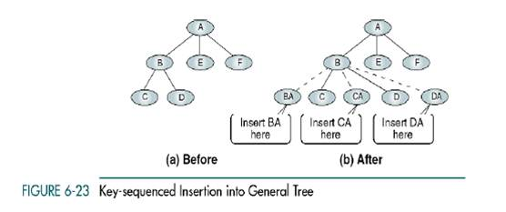

Slide 44
