Slide 1
Chapter 7
Lecture – 6
Binary Search Trees
Objectives
Upon completion you will be able to:
Create and implement binary search trees
Understand the operation of the binary search tree

Slide 2
Properties
A Binary Search Tree is a binary tree with the following properties:
All items in the left subtree are less than the root.
All items in the right subtree are greater or equal to the root.
Each subtree is itself a binary search tree.

Slide 3
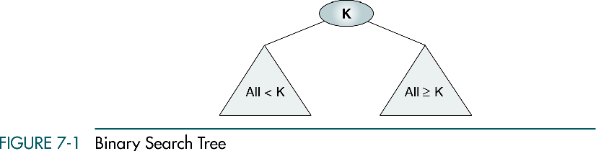

Slide 4
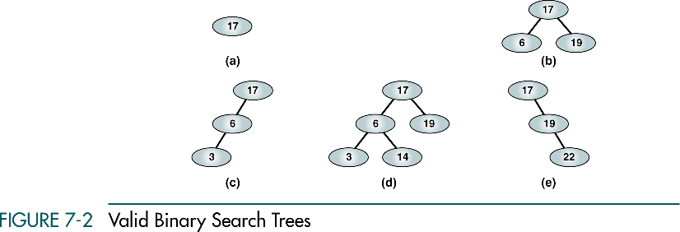
(a), (b) - complete and balanced trees;
(d) – nearly complete and balanced tree;
(c), (e) – neither complete nor balanced trees

Slide 5
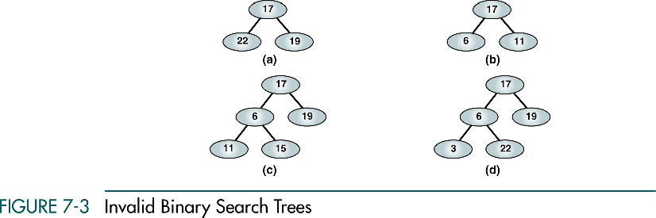

Slide 6
7-2 BST Operations
We discuss four basic BST operations: traversal, search, insert, and delete; and develop algorithms for searches, insertion, and deletion.
Traversals
Searches
Insertion
Deletion

Slide 7
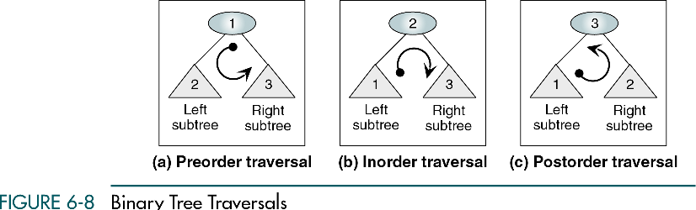

Slide 8
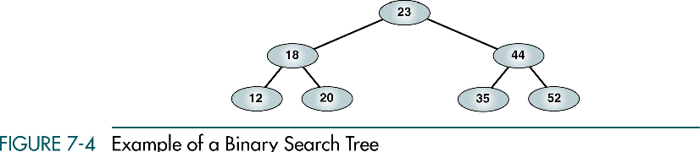

Slide 9
Preorder Traversal
23 18 12 20 44 35 52

Slide 10
Postorder Traversal
12 20 18 35 52 44 23

Slide 11
Inorder Traversal
12 18 20 23 35 44 52
Inorder traversal of a binary search tree produces a sequenced list

Slide 12
Right-Node-Left Traversal
52 44 35 23 20 18 12
Right-node-left traversal of a binary search tree produces a descending sequence

Slide 13
Three BST search algorithms:
Find the smallest node
Find the largest node
Find a requested node

Slide 14
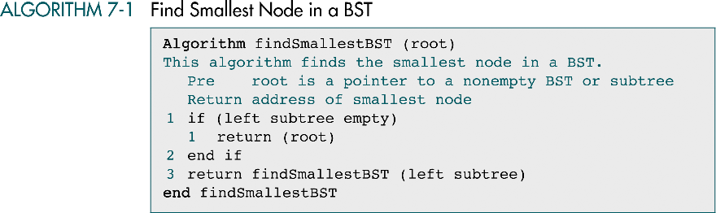

Slide 15
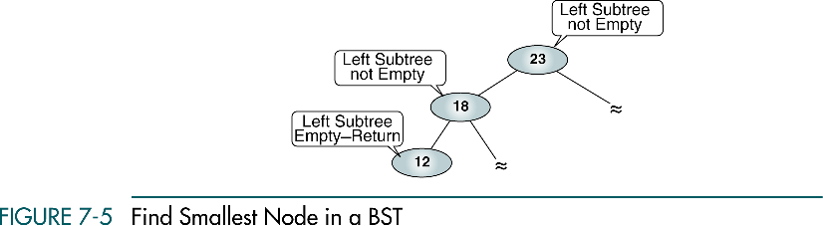

Slide 16
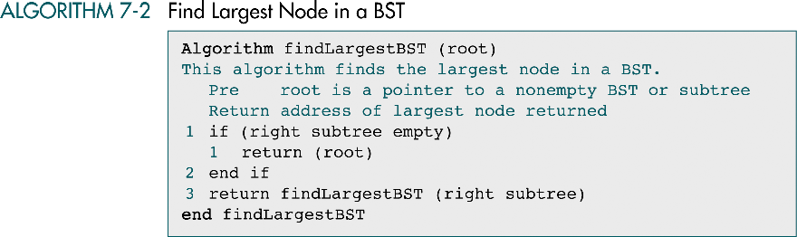

Slide 17
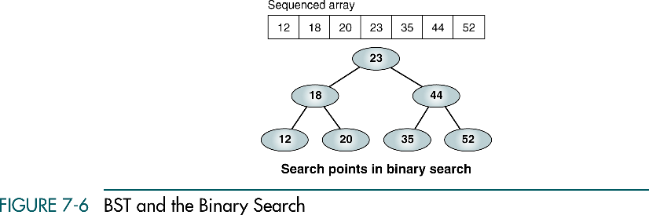

Slide 18
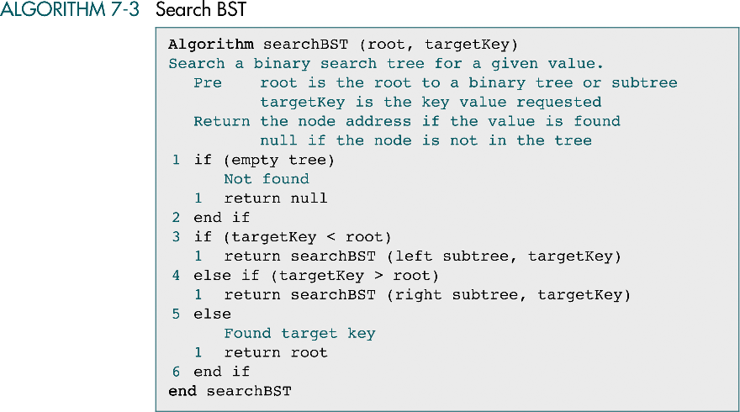

Slide 19
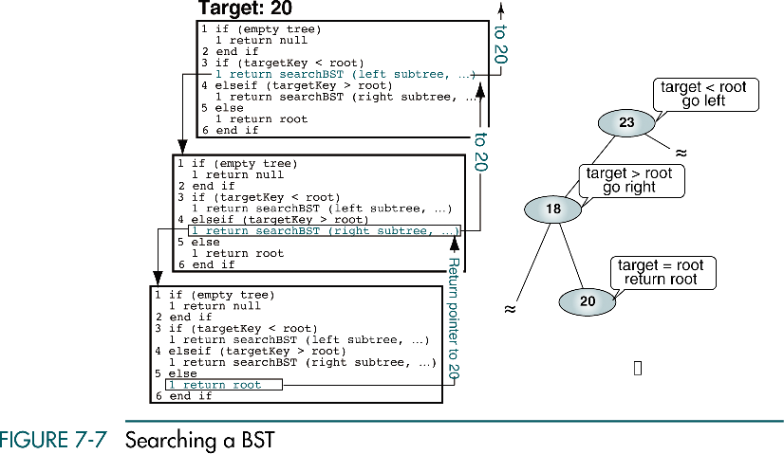

Slide 20
BST Insertion
To insert data all we need to do is follow the branches to an empty subtree and then insert the new node.
In other words, all inserts take place at a leaf or at a leaflike node – a node that has only one null subtree.

Slide 21
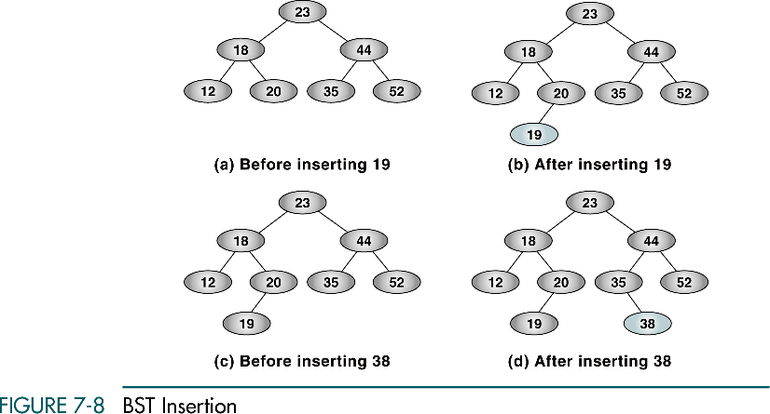

Slide 22
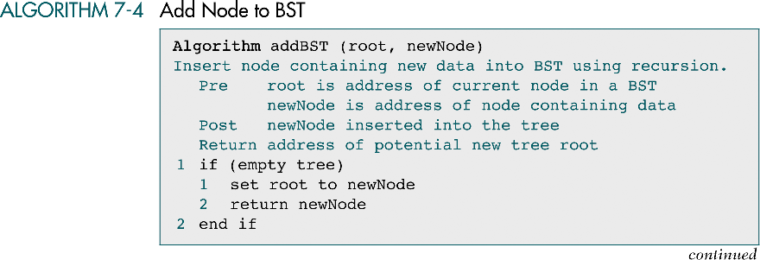

Slide 23
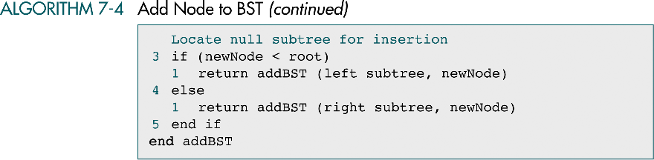

Slide 24
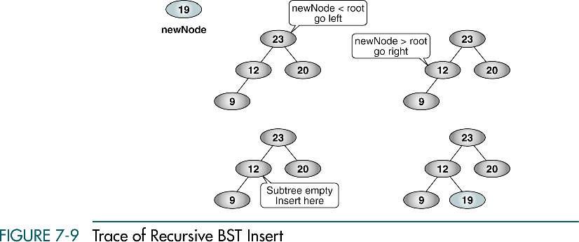
30
30
30
30

Slide 25
Deletion
There are the following possible cases when we delete a node:
The node to be deleted has no children. In this case, all we need to do is delete the node.
The node to be deleted has only a right subtree. We delete the node and attach the right subtree to the deleted node’s parent.
The node to be deleted has only a left subtree. We delete the node and attach the left subtree to the deleted node’s parent.
The node to be deleted has two subtrees. It is possible to delete a node from the middle of a tree, but the result tends to create very unbalanced trees.

Slide 26
Deletion from the middle of a tree
Rather than simply delete the node, we try to maintain the existing structure as much as possible by finding data to take the place of the deleted data. This can be done in one of two ways.

Slide 27
Deletion from the middle of a tree
We can find the largest node in the deleted node’s left subtree and move its data to replace the deleted node’s data.
We can find the smallest node on the deleted node’s right subtree and move its data to replace the deleted node’s data.
Either of these moves preserves the integrity of the binary search tree.

Slide 28
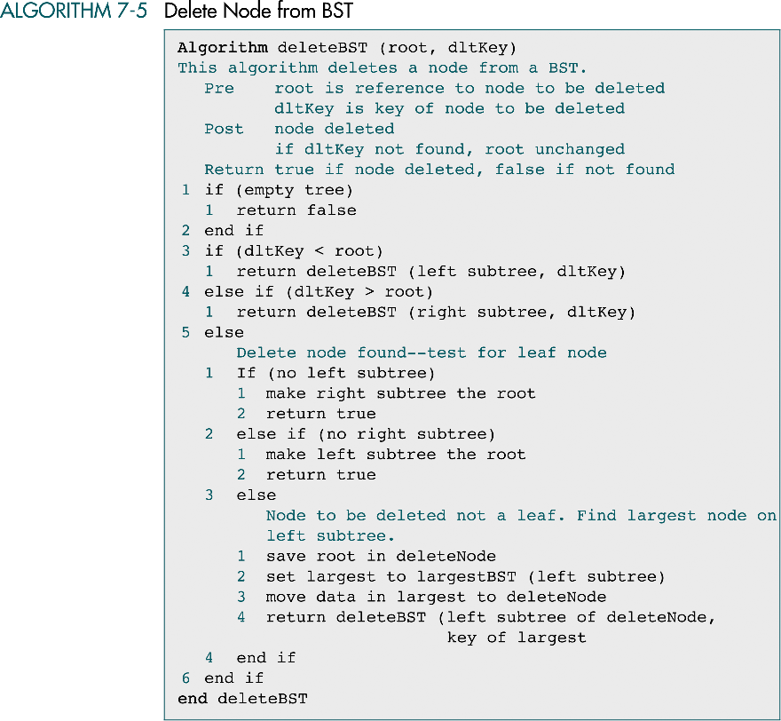

Slide 29
(continued)

Slide 30
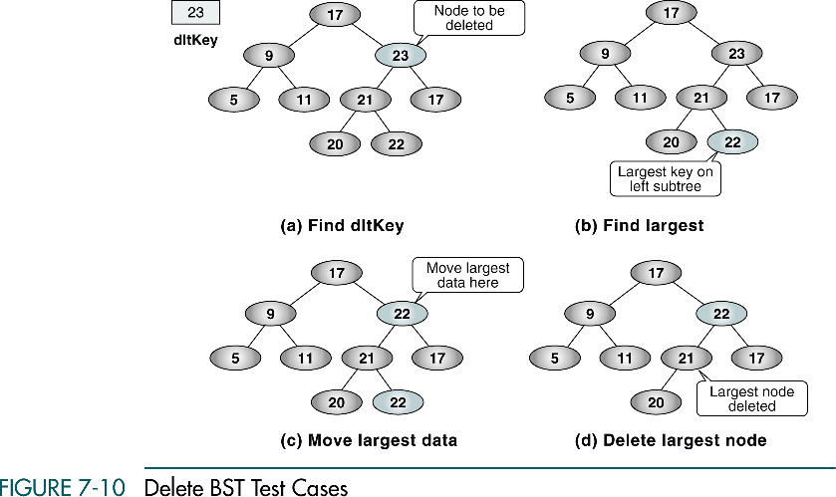
27
27
27
27

