Slide 1
QUEUES

Slide 2
Definition
A queue is a linear list in which data can only be inserted at one end, called the rear, and deleted from the other end, called the front.
Hence, the data are processed through the queue in the order in which they are received (first in → first out – FIFO)

Slide 3
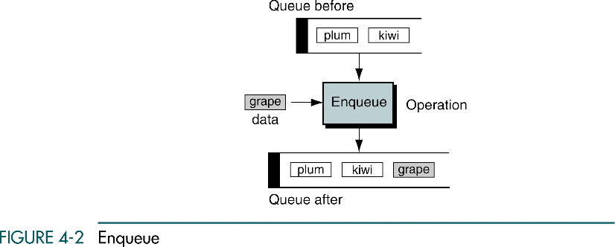

Slide 4
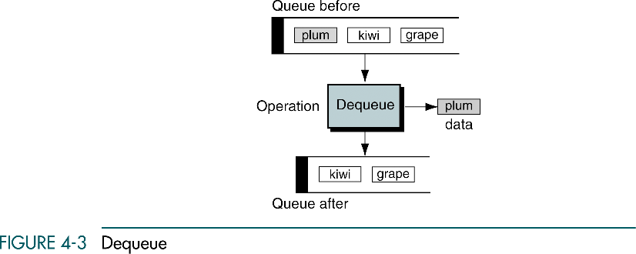

Slide 5
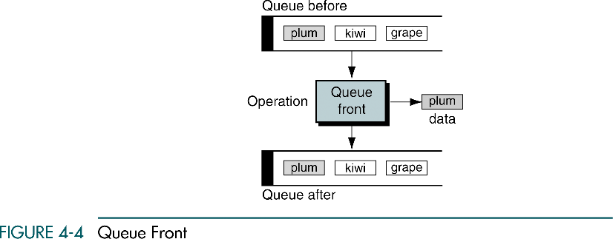

Slide 6
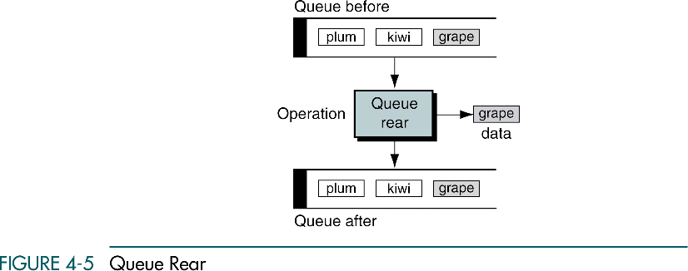

Slide 7
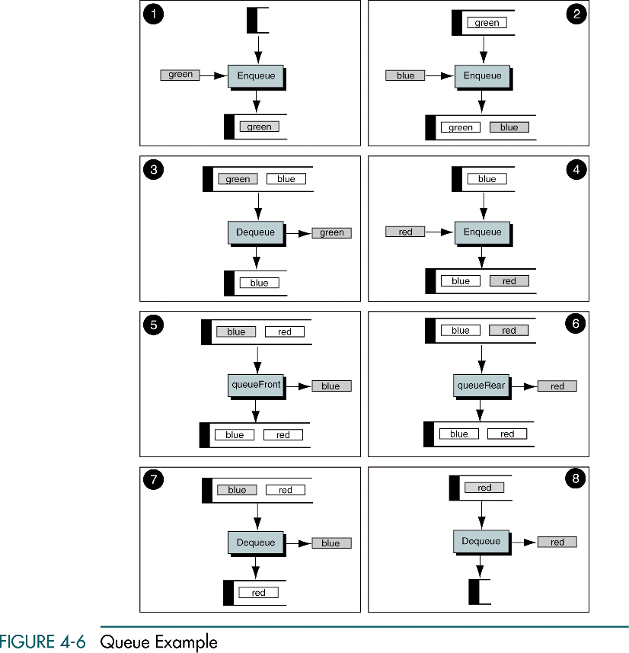

Slide 8
(Continued)

Slide 9
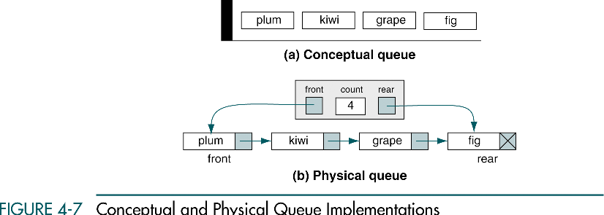

Slide 10
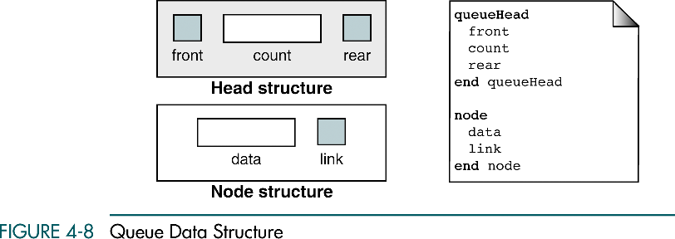

Slide 11
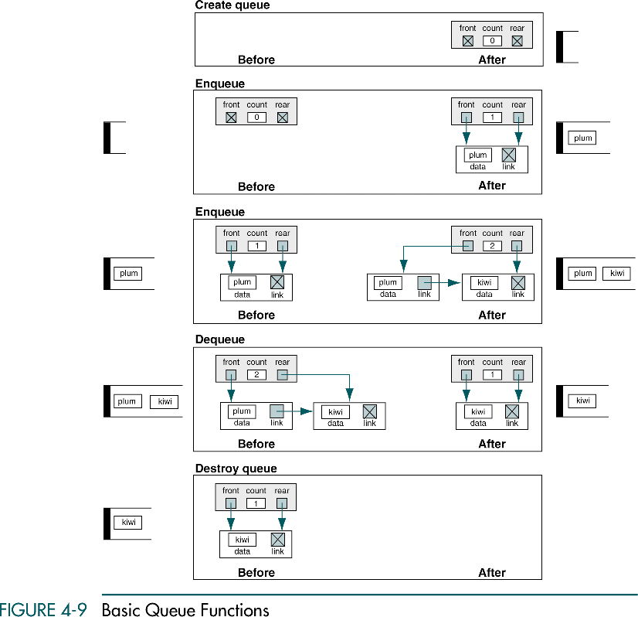

Slide 12
(Continued)

Slide 13
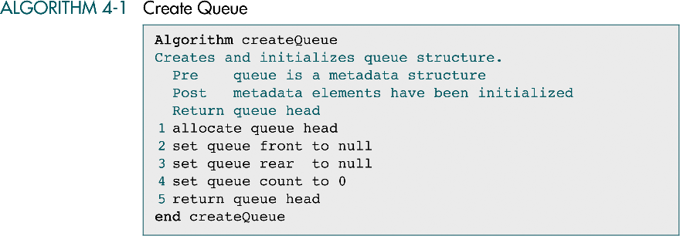

Slide 14
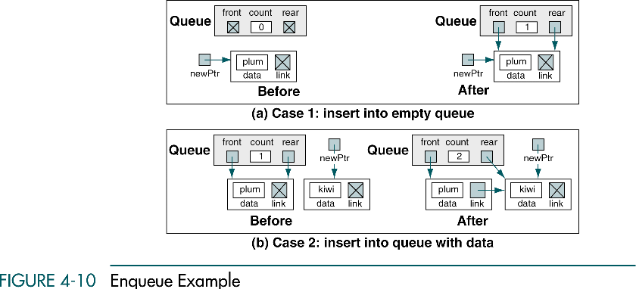

Slide 15
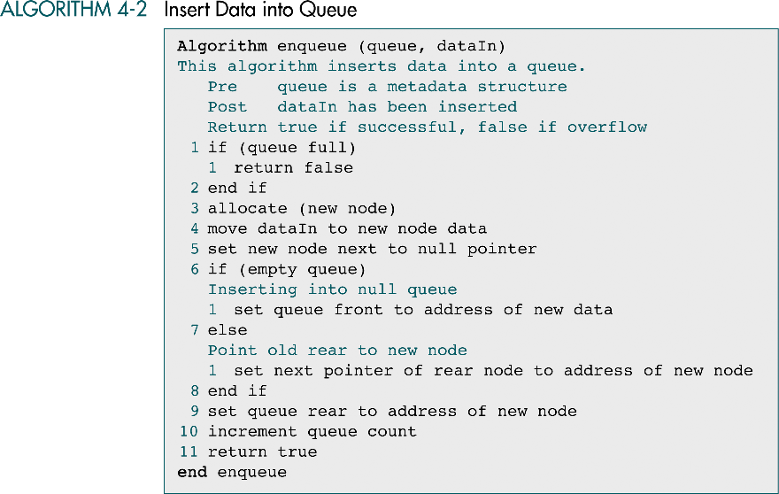

Slide 16
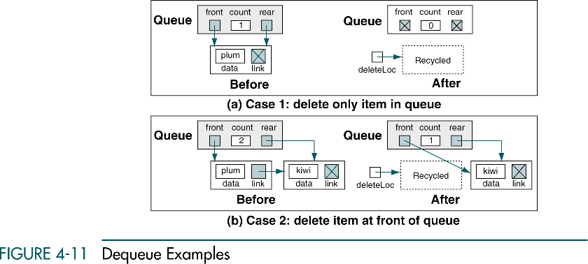

Slide 17
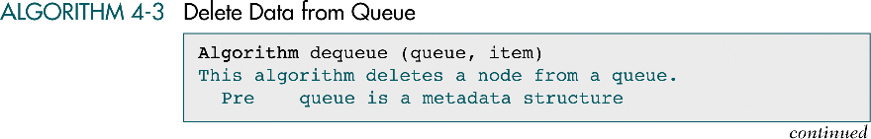

Slide 18
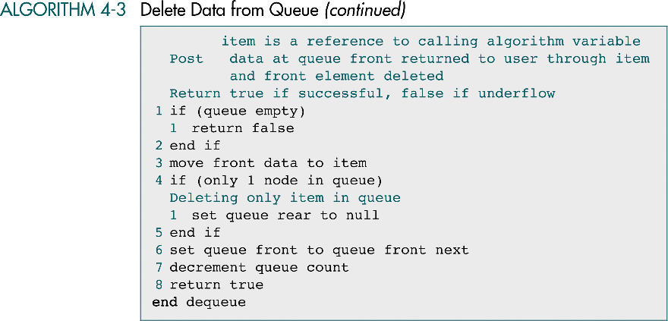

Slide 19
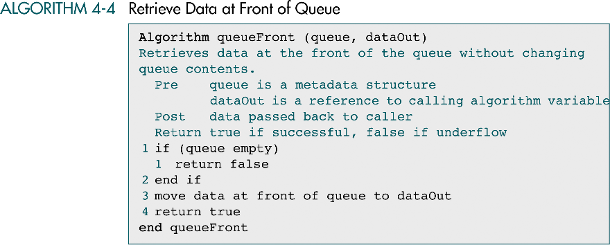

Slide 20
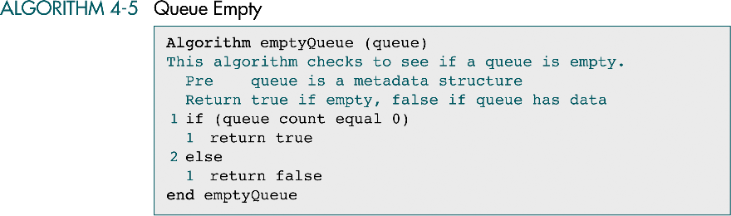

Slide 21
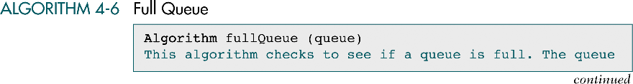

Slide 22
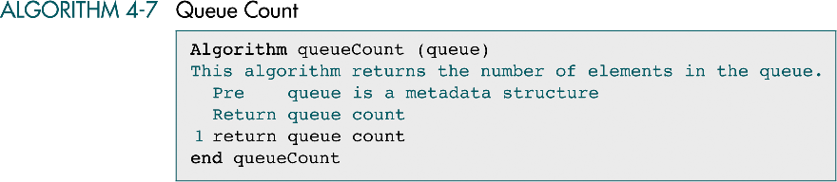

Slide 23
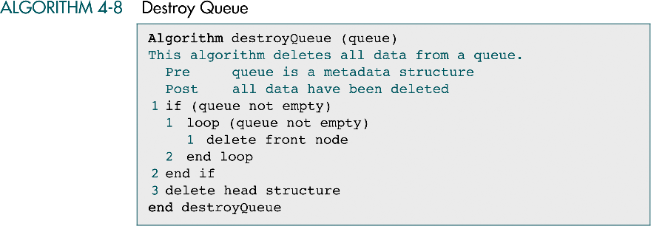

Slide 24
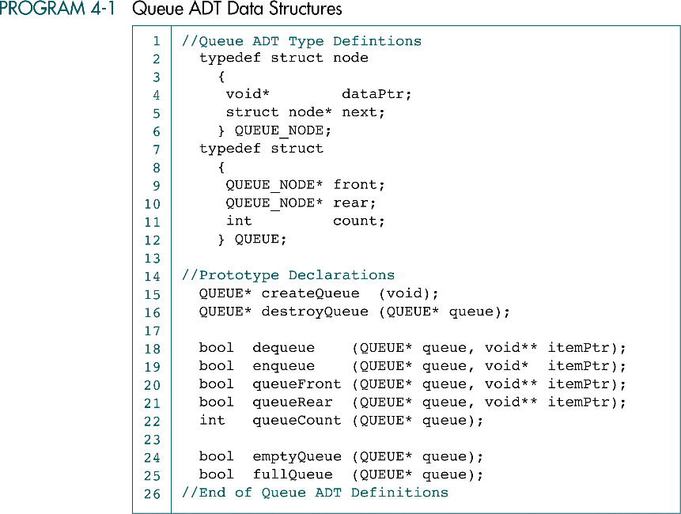

Slide 25
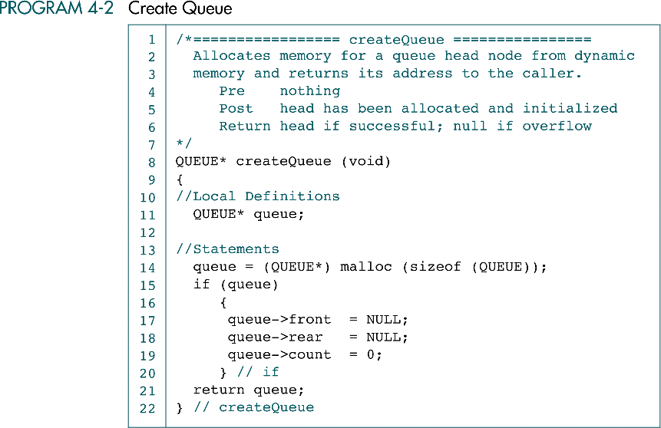

Slide 26
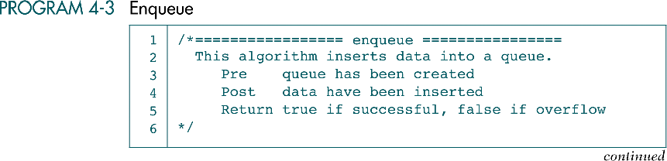

Slide 27
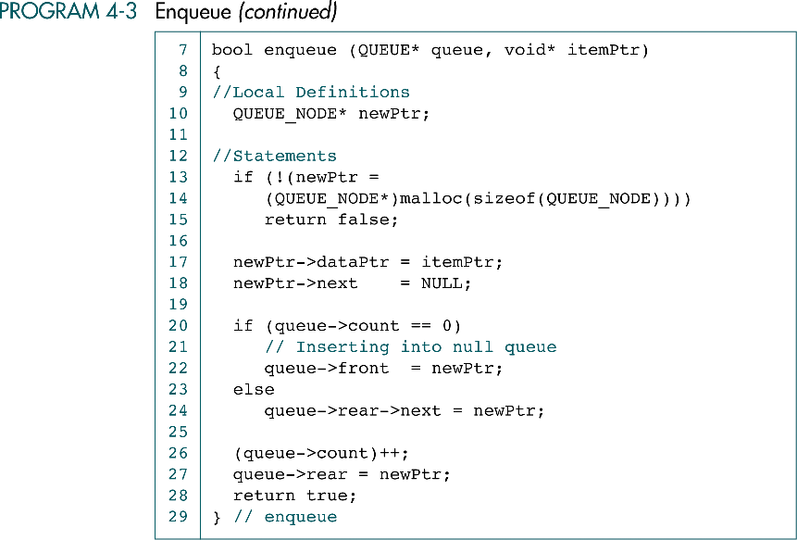

Slide 28
QUEUING THEORY
Queuing Theory is a field of applied mathematics and computer science that is used to predict the performance of queues

Slide 29
Queuing Theory
A single-server queue can provide service to only one customer at a time (hot food vendor on street corner).
A multi-server queue can provide service to many customers at a time (bank, post-office).
Multiqueues – multiple single-server queues (a grocery store).
A customer is any person or thing needing the service.
The service is any activity needed to accomplish the required result.

Slide 30
Queuing Theory
The rate at which customers arrive in the queue for service is known as the arrival rate. It may be random or regular.
Service time is the average time required to complete the processing of a customer request.

Slide 31
Queuing Theory
In an ideal situation, customers would arrive at a rate that matches the service time.
However, things are seldom ideal. Sometimes the server can be idle because there are no customers to be served. At other times there will be many customers to be served.
If we can predict the patterns, we may be able to minimize idle servers and waiting customers.

Slide 32
Queuing Theory
One of the main tasks in Queuing Theory is to predict such patterns.
Specifically, it attempts to predict queue time (which is defined as the average length of time customers wait in the queue), the average size of the queue, and the maximum queue size.
These predictions are based on the two factors: the arrival rate and the average service time (the average of the total service time between idle periods)

Slide 33
Queuing Theory
Given queue time and service time, we know response time, - a measure of the average time from the point at which customers enter the queue until the moment they leave the server.

Slide 34
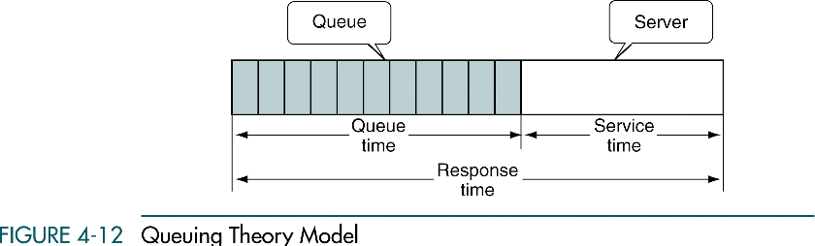

Slide 35
Queuing Theory
The two factors that most affect the performance of queues are the arrival rate and the service time.

Slide 36
4-5 Queue Applications
We develop two queue applications. The first shows how to use a
queue to categorize data. The second is a queue simulator, which is an excellent tool to simulate the performance and to
increase our understanding of its operation.
Categorizing Data
Queue Simulation

Slide 37
Categorizing Data
Categorizing Data is the rearrangement of data without destroying their basic sequence.
As an example: suppose, it is necessary to rearrange a list of numbers grouping them, while maintaining original order in each group (multiple-queue application).

Slide 38
Categorizing Data
Initial list of numbers:
3 22 12 6 10 34 65 29 9 30 81 4 5 19 20 57 44 99
We need to categorize them into four different groups:
Group 1: less than 10
Group 2: between 10 and 19
Group 3: between 20 and 29
Group4: 30 and greater
| 3 6 9 4 5 | 12 10 19 | 22 29 20 | 34 65 30 81 57 44 99

Slide 39
Categorizing Data
The solution: we build a queue for each of the four categories. We than store the numbers in the appropriate queue as we read them.
After all the data have been processed, we print each queue to demonstrate that we categorized data correctly.

Slide 40
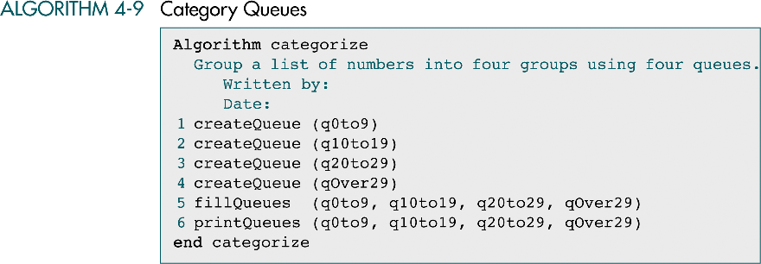

Slide 41
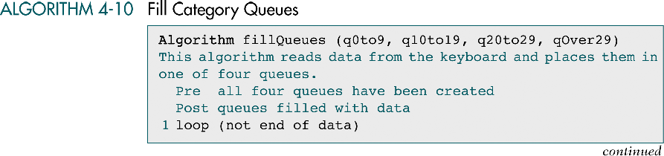

Slide 42
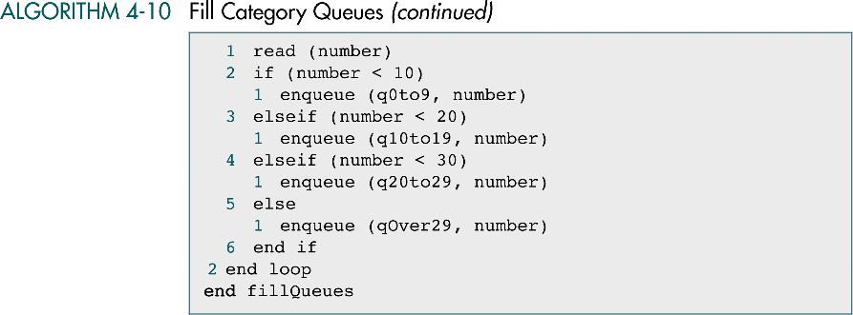

Slide 43
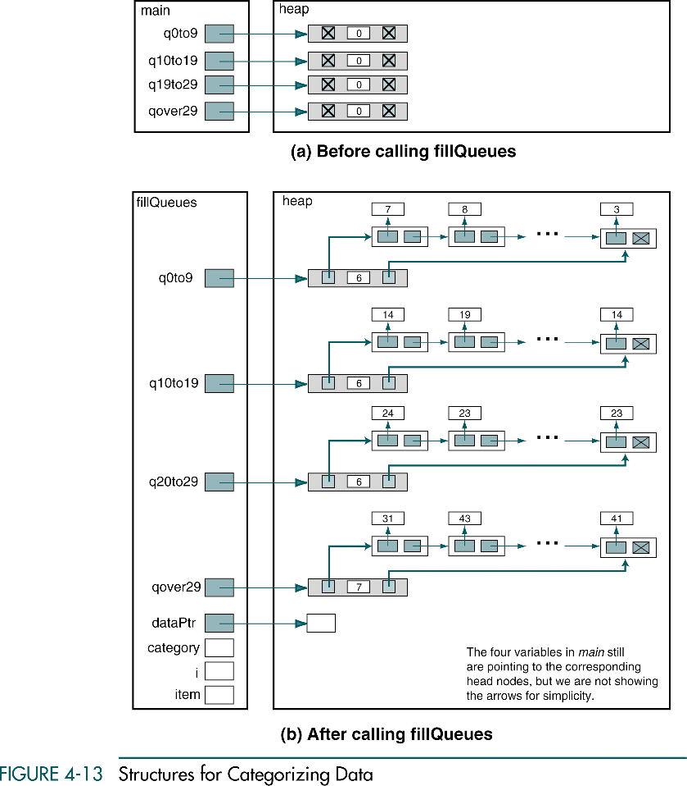

Slide 44
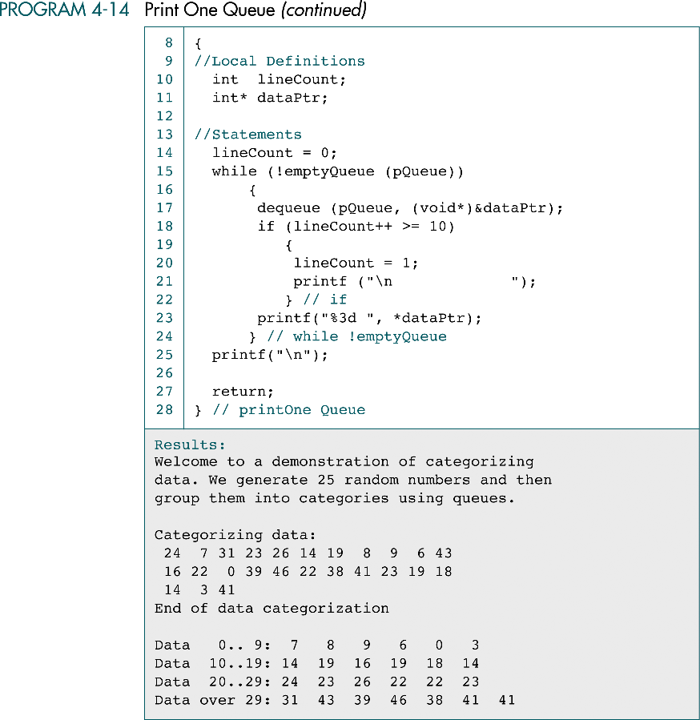

Slide 45
(Continued)

