Slide 1
Chapter 11
Lecture - 9
Graphs

Slide 2
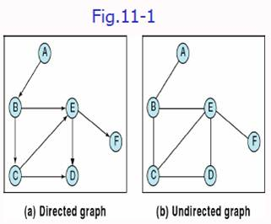
Terminology
Graph – A collection of
Nodes (Vertices)
Line segments (Edges)
Two different types of graphs
Directed
Undirected

Slide 3
Terminology
Adjacent vertices – two vertices having an edge between them
Path – a sequence of vertices in which each vertex is adjacent to the next one
Cycle – a path consisting of at least three vertices that starts and ends with the same vertex
Loop – a special case of cycle – a single arc begins and ends with same vertex
Connected – two vertices having a path between them
Strongly connected – path from each vertex to every other vertex in the diagraph
Weakly connected – at least two vertices that are not connected

Slide 4
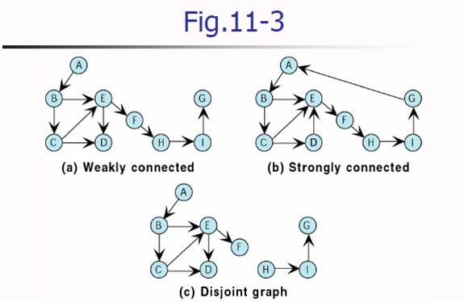

Slide 5
Operations
Add vertex
Inserting a new vertex
Delete vertex
Remove all connecting edge
Add edge
Delete Edge
Find Vertex
Traverse Graph
Depth-first Traversal
Breadth-first Traversal

Slide 6
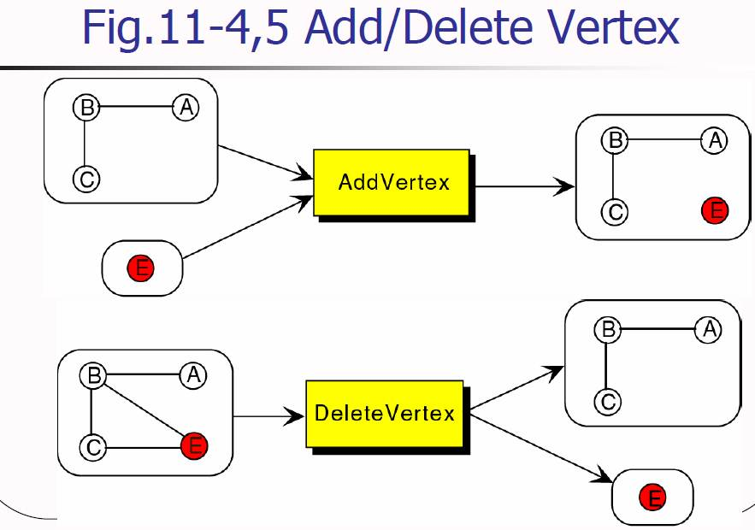

Slide 7
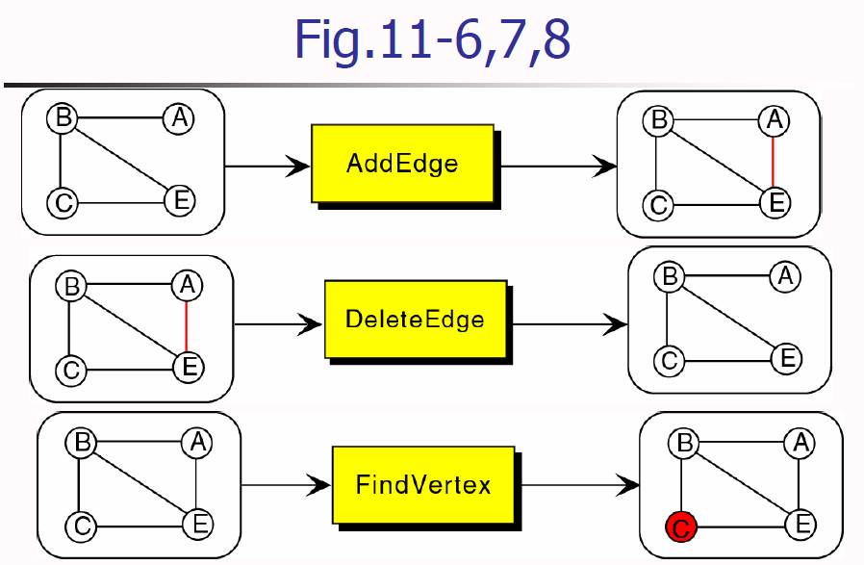

Slide 8
Traversals
New challenge – a vertex in a graph having multiple parents
Possible to have different paths to a vertex
Goals – to assure processing the data
To use a “visited flag”
Set all flags off initially
Set the flag of a vertex on when paying a visit

Slide 9
Depth-First Traversal
All of a vertex’s descendants are processed before we move to an adjacent vertex.
Fig.12-8 Preorder traversal
Steps
Process the first vertex of the graph
Select any vertex adjacent to the first vertex and process
Select and process any adjacent vertex until reaching a vertex with no adjacent vertex

Slide 10
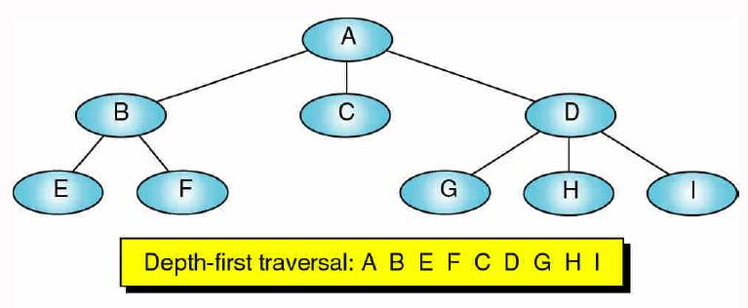
Fig.11-9 Depth First Traversal

Slide 11
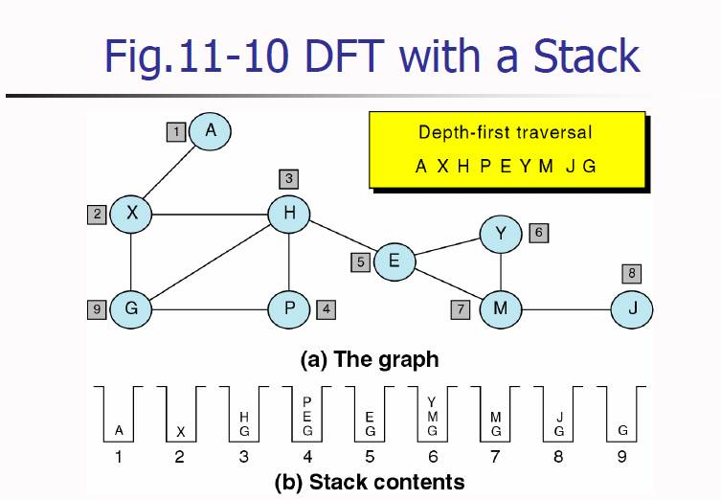

Slide 12
Breadth-First Traversal
All adjacent vertices of a vertex are processed before going to the next level.
Fig.11-11 Breadth-first traversal
Steps
Process the first vertex of the graph
Process all the of its adjacent vertices
Select the each adjacent vertex and process vertices adjacent it.
Repeat …

Slide 13
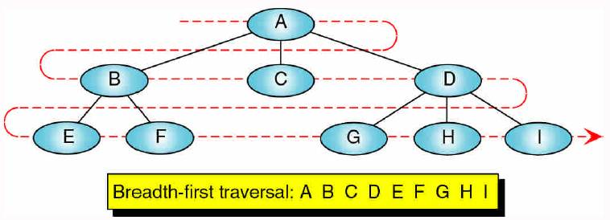
Fig.11-11 Breadth-First Traversal

Slide 14
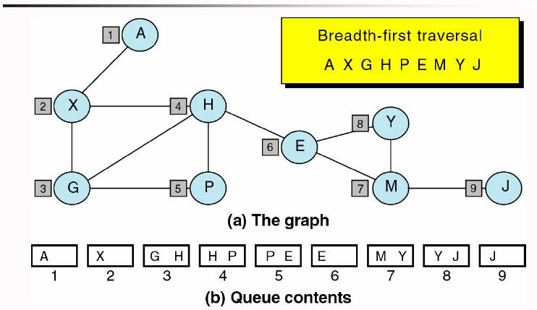
Fig.11-12 BFT with a Queue

Slide 15
Graph Storage Structures
Need to store two sets
Vertices
Edges
Data structures
Adjacent matrix
Adjacent list

Slide 16
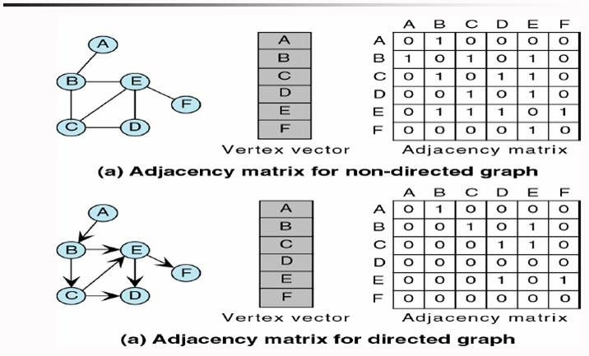
Fig.11-13 Adjacent Matrix

Slide 17
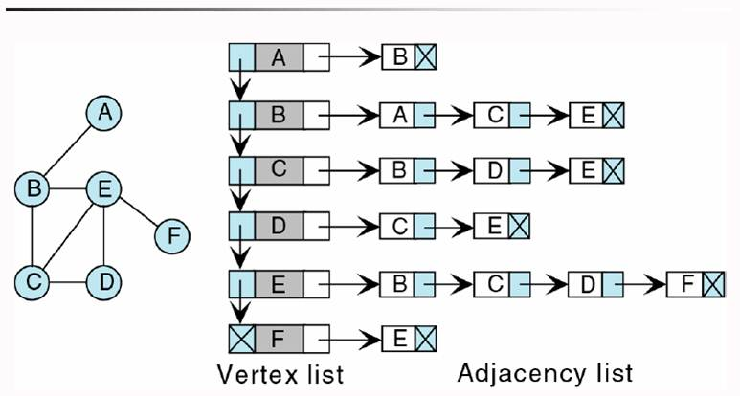
Fig.11-14 Adjacent List

Slide 18
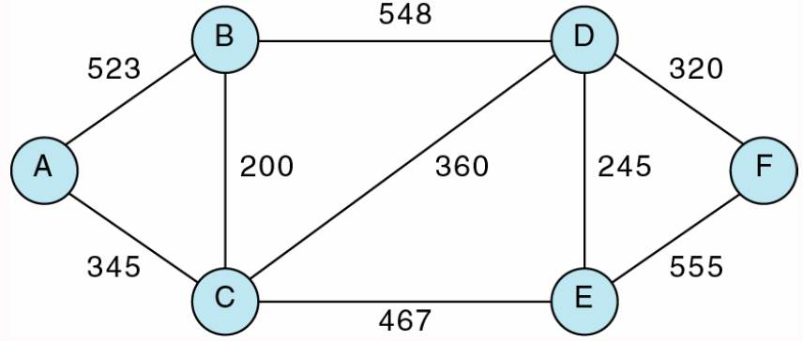
Networks
Graph with weighted arcs –Weighted Graph
Fig.11-18

Slide 19
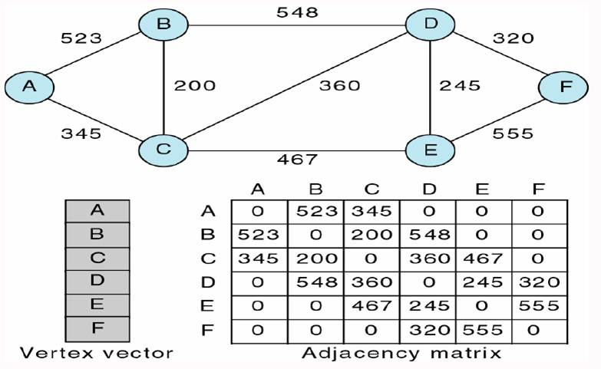
Fig.11-19 Adjacency Matrix

Slide 20
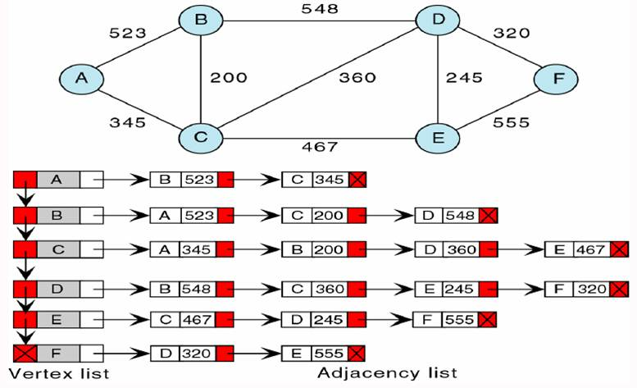
Fig.11-19 Adjacency List

Slide 21
Minimum Spanning Tree
Spanning tree
a tree containing all of the vertices in the graph
Minimum spanning tree
a network such that the sum of its weights are guaranteed to be minimal
Applications
Given a network of computers, we could create a tree that connects all of the computers.
Minimum spanning tree –shortest length of cable that can be used to connect all the computers together

Slide 22
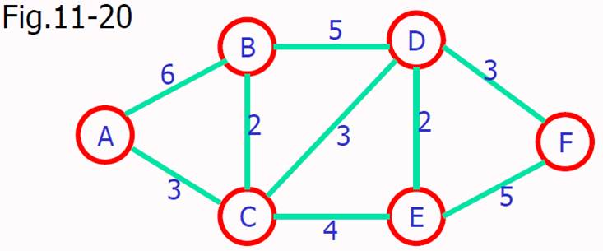
Minimum Spanning Tree (cont.)

Slide 23
Shortest Path Algorithm
Finding the shortest path between two vertices in a network
Application: to find the least expensive route between home and our destination
Steps
Insert the first vertex into the tree
From every vertex already in the tree
Examine the total path length to all adjacent vertices not in the tree
Select the edge with the minimum total path weight and insert it into the tree
Repeat Step 2 until all vertices are in the tree

Slide 24
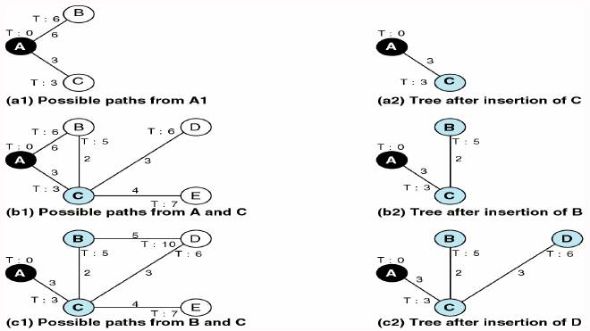
Fig.11-22

Slide 25
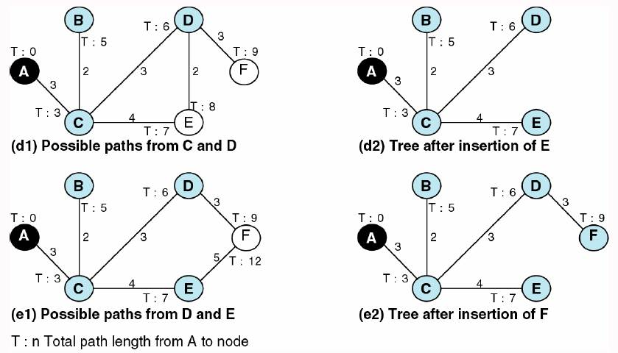
Fig.11-22 (cont.)

