Slide 1
STACKS
CSE207
CSE, EWU
Dr. Shamim H Ripon

Slide 2
Linear Lists
A Linear List is a list in which each element has a unique successor.
In a restricted linear list, addition and deletion of data are restricted to the ends of the list.
In a general linear list, addition and deletion of data are allowed everywhere.

Slide 3
Stack
A stack is a linear list in which additions and deletions of data are restricted to one end, called the top.
If we insert a data series into a stack and then remove it, the order of data is reversed.
This property is known as the last in – first out.

Slide 4
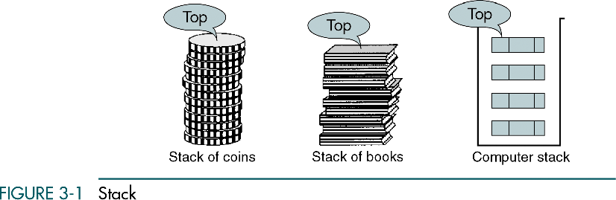

Slide 5
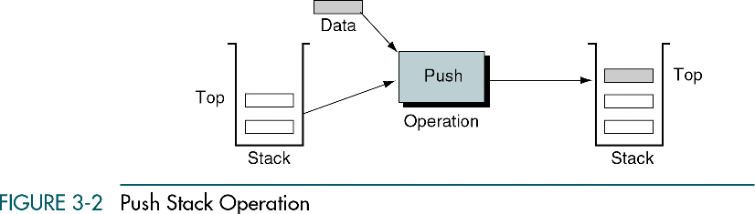

Slide 6
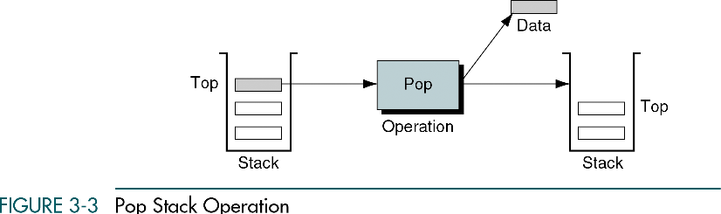

Slide 7
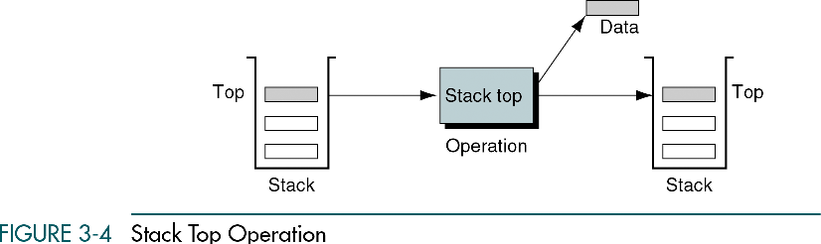

Slide 8
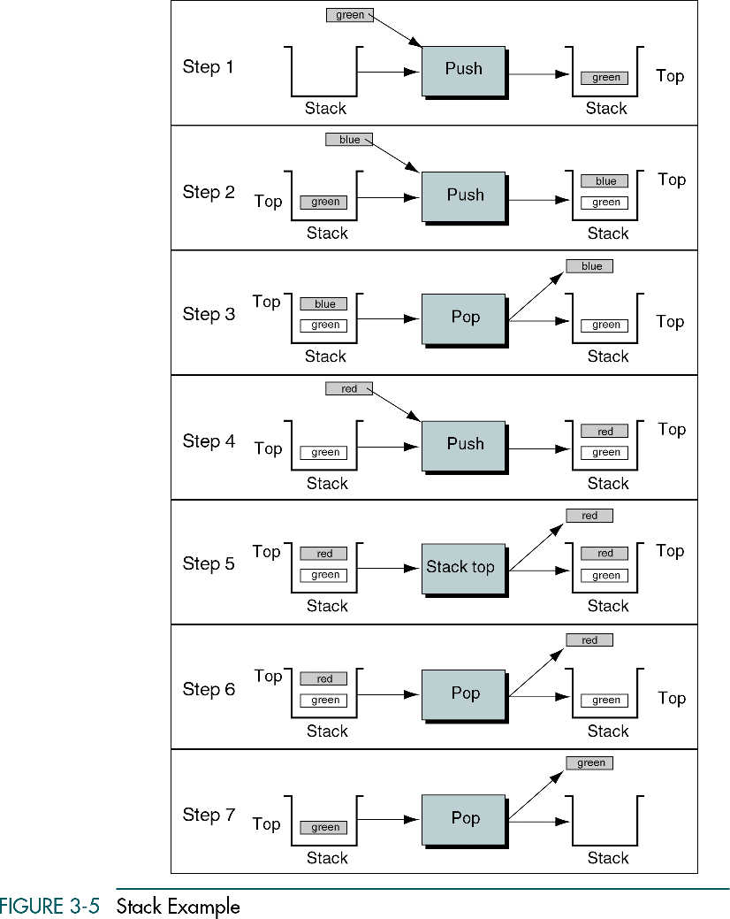

Slide 9
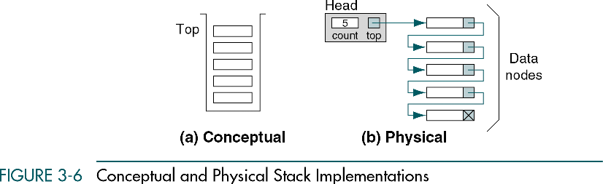

Slide 10
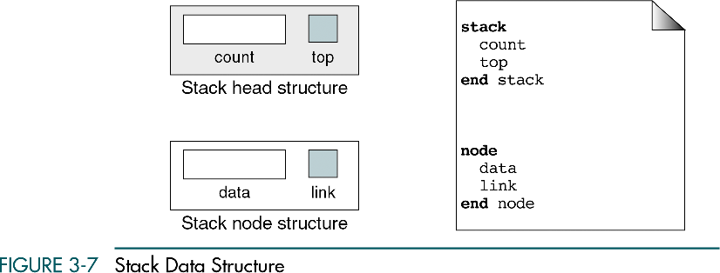
struct node
{
int data;
struct node *next;
}*tmp;
struct Head
{
int count;
struct node *top;
}*head;

Slide 11
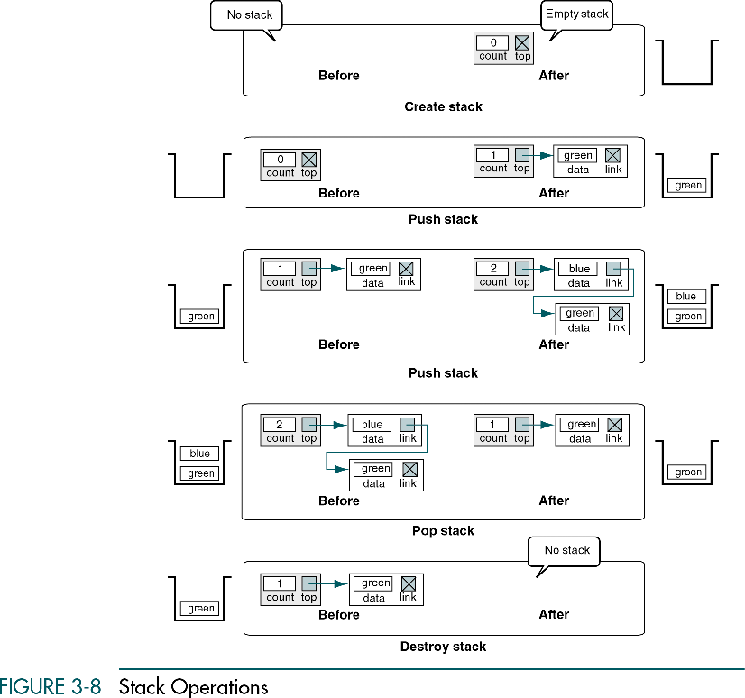

Slide 12
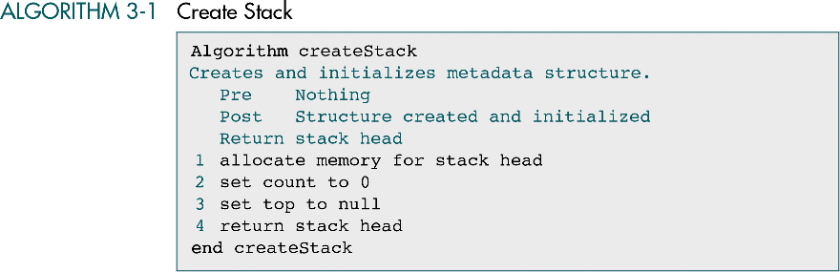
void create()
{
head = (struct Head *)malloc(sizeof(struct Head));
head->count = 0;
head->top = NULL;
}

Slide 13
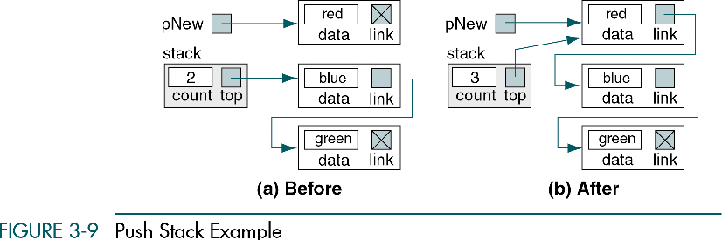

Slide 14
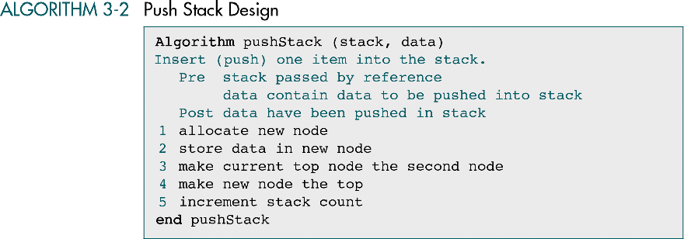

Slide 15
void push(int data)
{
if(head->top==NULL)
{
tmp= (struct node *)malloc(sizeof(struct node));
tmp->data = data;
tmp->next = NULL;
head->top = tmp;
}
else
{
tmp = (struct node *)malloc(sizeof(struct node));
tmp->data = data;
tmp->next = head->top;
head->top = tmp;
}
head->count++;
}

Slide 16
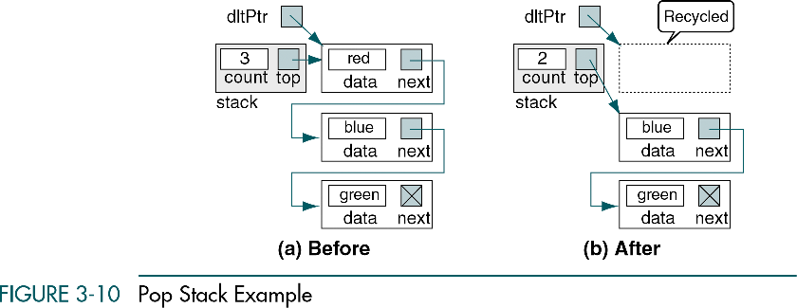

Slide 17
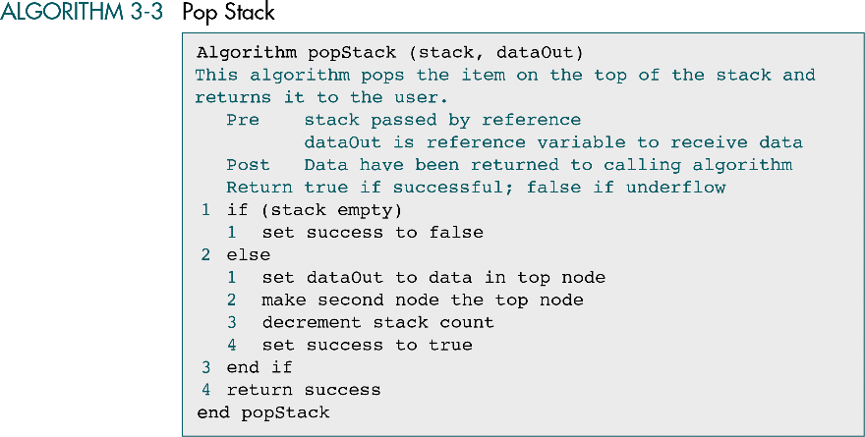

Slide 18
void pop()
{
tmp = head->top;
if(tmp == NULL)
{
printf("\nError - Empty Stack");
return;
}
else
{
head->top = head->top->next;
printf("\nPopped value: %d",tmp->data);
free(tmp);
head->count--;
}
}

Slide 19
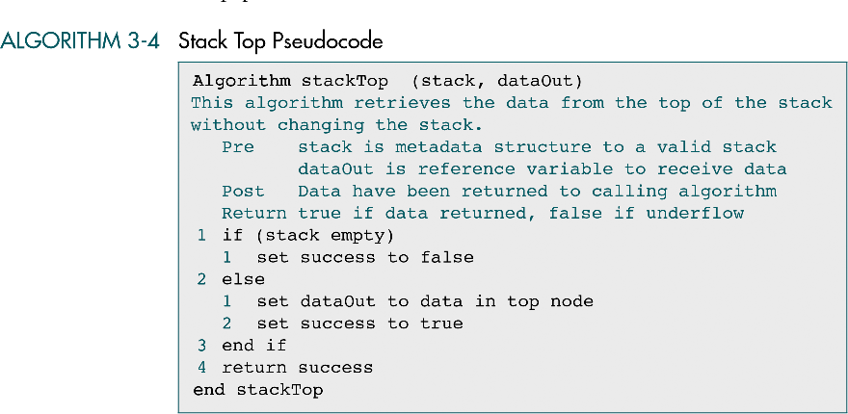
int topelement()
{
return(head->top->data);
}

Slide 20
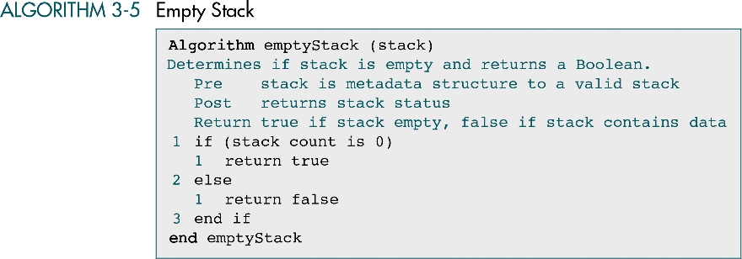
void empty()
{
if(head->count == 0)
printf("Stack Empty");
else
printf("Stack not empty");
}

Slide 21
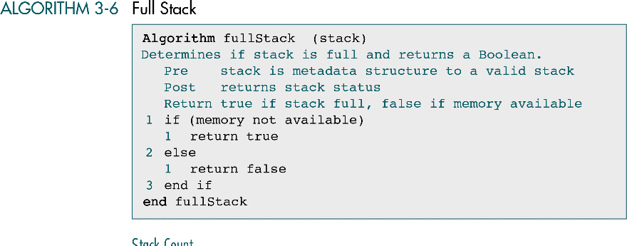

Slide 22
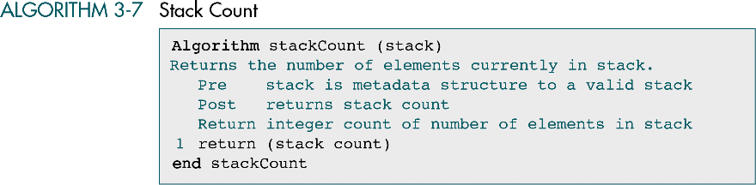
void stack_count()
{
printf("No. of element in the stack is %d", head->count);
}

Slide 23
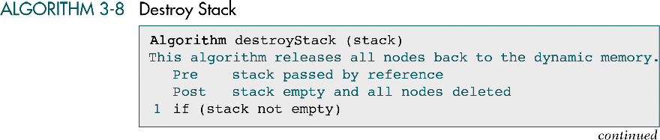
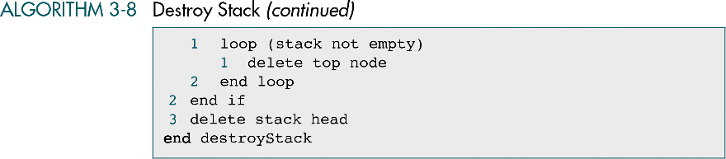

Slide 24
void destroy()
{
tmp = head->top;
while(tmp != NULL)
{
head->top = head->top->next;
free(tmp);
tmp = head->top;
}
free(tmp);
head->top = NULL;
head->count = 0;
printf("All element destroyed");
}

