Slide 1
CSE-245 Algorithms
Asymptotic Notation

Slide 2
Analyzing Algorithms
Predict the amount of resources required:
memory: how much space is needed?
computational time: how fast the algorithm runs?
FACT: running time grows with the size of the input
Input size (number of elements in the input)
Size of an array, polynomial degree, # of elements in a matrix, # of bits in the binary representation of the input, vertices and edges in a graph
Def: Running time = the number of primitive operations (steps) executed before termination
Arithmetic operations (+, -, *), data movement, control, decision making (if, while), comparison

Slide 3
Algorithm Analysis: Example
Alg.: MIN (a[1], …, a[n])
m ← a[1];
for i ← 2 to n
if a[i] < m
then m ← a[i];
Running time:
the number of primitive operations (steps) executed before termination
T(n) =1 [first step] + (n) [for loop] + (n-1) [if condition] +
(n-1) [the assignment in then] = 3n - 1
Order (rate) of growth:
The leading term of the formula
Expresses the asymptotic behavior of the algorithm

Slide 4
Typical Running Time Functions
1 (constant running time):
Instructions are executed once or a few times
logN (logarithmic)
A big problem is solved by cutting the original problem in smaller sizes, by a constant fraction at each step
N (linear)
A small amount of processing is done on each input element
N logN
A problem is solved by dividing it into smaller problems, solving them independently and combining the solution

Slide 5
Typical Running Time Functions
N² (quadratic)
Typical for algorithms that process all pairs of data items (double nested loops)
N³ (cubic)
Processing of triples of data (triple nested loops)
N^{K} (polynomial)
2^{N} (exponential)
Few exponential algorithms are appropriate for practical use

Slide 6
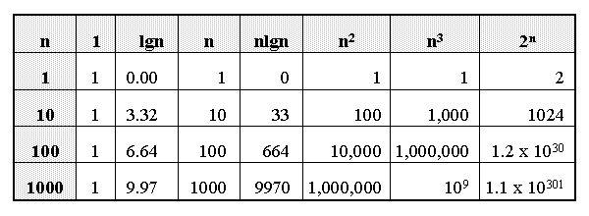
Growth of Functions

Slide 7
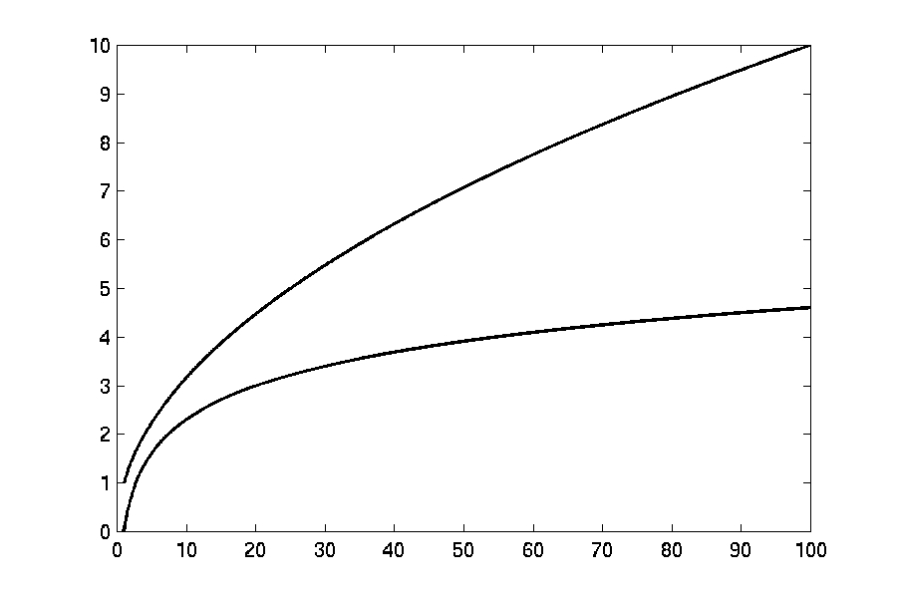
Complexity Graphs
log(n)

Slide 8
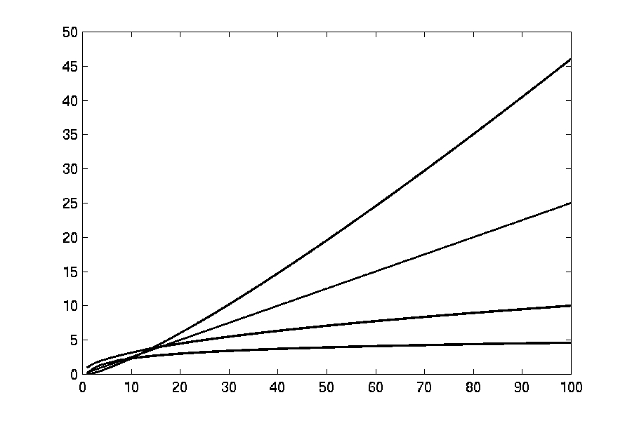
Complexity Graphs
n log(n)
n
log(n)

Slide 9
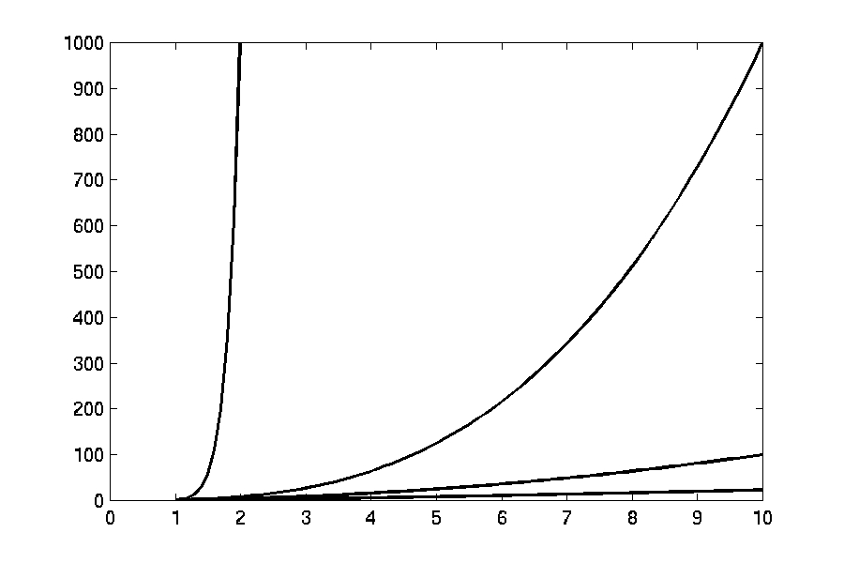
Complexity Graphs
n¹⁰
n³
n²
n log(n)

Slide 10
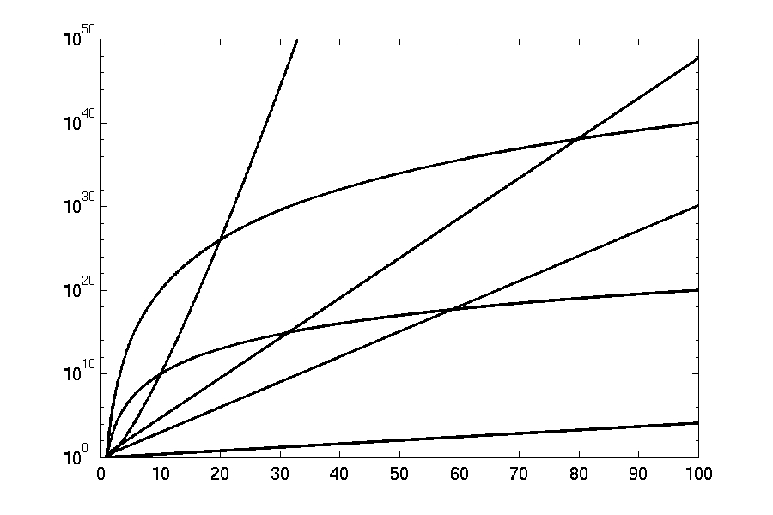
Complexity Graphs (log scale)
3^{n}
n^{n}
n²⁰
2^{n}
n¹⁰
1.1^{n}

Slide 11
Algorithm Complexity
Worst Case Complexity:
the function defined by the maximum number of steps taken on any instance of size n
Best Case Complexity:
the function defined by the minimum number of steps taken on any instance of size n
Average Case Complexity:
the function defined by the average number of steps taken on any instance of size n

Slide 12
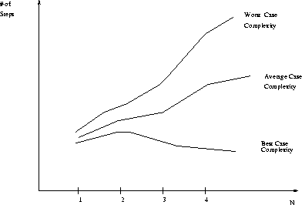
Best, Worst, and Average Case Complexity
Number of steps
Worst Case Complexity
Average Case Complexity
Best Case Complexity
N
(input size)

Slide 13
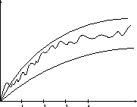
Doing the Analysis
It’s hard to estimate the running time exactly
Best case depends on the input
Average case is difficult to compute
So we usually focus on worst case analysis
Easier to compute
Usually close to the actual running time
Strategy: find a function (an equation) that, for large n, is an upper bound to the actual function (actual number of steps, memory usage, etc.)
Upper bound
Actual function
Lower bound
Notes:
5 is a lower bound for the set { 5, 10, 34, 13934 }, but 8 is not. 42 is both an upper and a lower bound for the set { 42 }; all other numbers are either an upper bound or a lower bound for that set.

Slide 14
Motivation for Asymptotic Analysis
An exact computation of worst-case running time can be difficult
Function may have many terms:
4n² - 3n log n + 17.5 n - 43 n^{⅔} + 75
An exact computation of worst-case running time is unnecessary
Remember that we are already approximating running time by using RAM model
Notes:
Random Access Machine (RAM) model. This model assumes a single processor. In the RAM model, instructions are executed one after the other, with no concurrent operations. This model of computation is an abstraction that allows us to compare algorithms on the basis of performance. The assumptions made in the RAM model to accomplish this are:
Each simple operation takes 1 time step.
Loops and subroutines are not simple operations.
Each memory access takes one time step, and there is no shortage of memory.

Slide 15
Classifying functions by their Asymptotic Growth Rates (1/2)
asymptotic growth rate, asymptotic order, or order of functions
Comparing and classifying functions that ignores
constant factors and
small inputs.
The Sets big oh O(g), big theta Θ(g), big omega Ω(g)

Slide 16
Classifying functions by their Asymptotic Growth Rates (2/2)
O(g(n)), Big-Oh of g of n, the Asymptotic Upper Bound;
Θ(g(n)), Theta of g of n, the Asymptotic Tight Bound; and
Ω(g(n)), Omega of g of n, the Asymptotic Lower Bound.
Notes:
asymptotically tight bound: Definition: When the asymptotic complexity of an algorithm exactly matches the theoretically proved asymptotic complexity of the corresponding problem. Informally, when an algorithm solves a problem at the theoretical minimum.

Slide 17
Big-O
What does it mean?
If f(n) = O(n²), then:
f(n) can be larger than n² sometimes, but…
We can choose some constant c and some value n₀ such that for every value of n larger than n₀ : f(n) < cn²
That is, for values larger than n₀, f(n) is never more than a constant multiplier greater than n²
Or, in other words, f(n) does not grow more than a constant factor faster than n².

Slide 18
Visualization of O(g(n))
cg(n)
f(n)
n₀

Slide 19
Examples
2n² = O(n³):
n² = O(n²):
1000n²+1000n = O(n²):
n = O(n²):
2n² ≤ cn³ ⇒ 2 ≤ cn ⇒ c = 1 and n₀= 2
n² ≤ cn² ⇒ c ≥ 1 ⇒ c = 1 and n₀= 1
1000n²+1000n ≤ cn² ≤ cn²+ 1000n ⇒ c=1001 and n₀ = 1
n ≤ cn² ⇒ cn ≥ 1 ⇒ c = 1 and n₀= 1

Slide 20
Big-O

Slide 21
More Big-O
Prove that:
Let c = 21 and n₀ = 4
21n² > 20n² + 2n + 5 for all n > 4
n² > 2n + 5 for all n > 4
TRUE

Slide 22
Tight bounds
We generally want the tightest bound we can find.
While it is true that n² + 7n is in O(n³), it is more interesting to say that it is in O(n²)

Slide 23
Big Omega – Notation
Ω() – A lower bound
n² = Ω(n)
Let c = 1, n₀ = 2
For all n ≥ 2, n² > 1 × n

Slide 24
Visualization of Ω(g(n))
f(n)
cg(n)
n₀

Slide 25
Θ-notation
Big-O is not a tight upper bound. In other words n = O(n²)
Θ provides a tight bound
In other words,

Slide 26
Visualization of Θ(g(n))
c₂g(n)
f(n)
c₁g(n)
n₀

Slide 27
A Few More Examples
n = O(n²) ≠ Θ(n²)
200n² = O(n²) = Θ(n²)
n^{2.5} ≠ O(n²) ≠ Θ(n²)

Slide 28
Example 2
Prove that:
Let c = 21 and n₀ = 10
21n³ > 20n³ + 7n + 1000 for all n > 10
n³ > 7n + 5 for all n > 10
TRUE, but we also need…
Let c = 20 and n₀ = 1
20n³ < 20n³ + 7n + 1000 for all n ≥ 1
TRUE

Slide 29
Example 3
Show that
Let c = 2 and n₀ = 5
✓

Slide 30
Asymptotic Notations - Examples
Θ notation
n²/2 – n/2
(6n³ + 1)lgn/(n + 1)
n vs. n²
Ω notation
n³ vs. n²
n vs. logn
n vs. n²
= Θ(n²)
= Θ(n²lgn)
n ≠ Θ(n²)
O notation
2n² vs. n³
n² vs. n²
n³ vs. nlogn
n³ = Ω(n²)
2n² = O(n³)
n = Ω(logn)
n² = O(n²)
n ≠ Ω(n²)
n³ ≠ O(nlgn)

Slide 31
Asymptotic Notations - Examples
For each of the following pairs of functions, either f(n) is O(g(n)), f(n) is Ω(g(n)), or f(n) = Θ(g(n)). Determine which relationship is correct.
f(n) = log n²; g(n) = log n + 5
f(n) = n; g(n) = log n²
f(n) = log log n; g(n) = log n
f(n) = n; g(n) = log² n
f(n) = n log n + n; g(n) = log n
f(n) = 10; g(n) = log 10
f(n) = 2^{n}; g(n) = 10n²
f(n) = 2^{n}; g(n) = 3^{n}
f(n) = Θ (g(n))
f(n) = Ω(g(n))
f(n) = O(g(n))
f(n) = Ω(g(n))
f(n) = Ω(g(n))
f(n) = Θ(g(n))
f(n) = Ω(g(n))
f(n) = O(g(n))

Slide 32
Simplifying Assumptions
1. If f(n) = O(g(n)) and g(n) = O(h(n)), then f(n) = O(h(n))
2. If f(n) = O(kg(n)) for any k > 0, then f(n) = O(g(n))
3. If f₁(n) = O(g₁(n)) and f₂(n) = O(g₂(n)),
then f₁(n) + f₂(n) = O(max (g₁(n), g₂(n)))
4. If f₁(n) = O(g₁(n)) and f₂(n) = O(g₂(n)),
then f₁(n) * f₂(n) = O(g₁(n) * g₂(n))

Slide 33
Example #1: carry n items from one room to another room
How many operations?
n pick-ups, n forward moves, n drops and n reverse moves → 4 n operations
4n operations = c. n = O(c. n) = O(n)
Similarly, any program that reads n inputs from the user will have minimum time complexity O(n).

Slide 34
Example #2: Locating patient record in Doctor Office
What is the time complexity of search?
Binary Search algorithm at work
O(log n)
Sequential search?
O(n)

Slide 35
Example #3: Store manager gives gifts to first 10 customers
There are n customers in the queue.
Manager brings one gift at a time.
Time complexity = O(c. 10) = O(1)
Manager will take exactly same time irrespective of the line length.

Slide 36
Loops with Break
for (j = 0; j < n; ++j) {
// 3 atomics
if (condition) break;
}
Upper bound = O(4n) = O(n)
Lower bound = Ω(4) = Ω(1)
Complexity = O(n)
Home Work Ques: Why don’t we have a Θ(…) notation here?

Slide 37
Sequential Search
Given an unsorted vector/list a[ ], find the location of element X.
for (i = 0; i < n; i++) {
if (a[i] == X) return true;
}
return false;
Input size: n = array size()
Complexity = O(n)

Slide 38
If-then-else Statement
if(condition)
i = 0;
else
for ( j = 0; j < n; j++)
a[j] = j;
Complexity = ??
= O(1) + max ( O(1), O(N))
= O(1) + O(N)
= O(N)

Slide 39
Consecutive Statements
Add the complexity of consecutive statements
Complexity = Θ(3n + 5n) = Θ(n)
for (j = 0; j < n; ++j) {
// 3 atomics
}
for (j = 0; j < n; ++j) {
// 5 atomics
}

Slide 40
Nested Loop Statements
Analyze such statements inside out
for (j = 0; j < n; ++j) {
// 2 atomics
for (k = 0; k < n; ++k) {
// 3 atomics
}
}
Complexity = Θ((2 + 3n)n) = Θ(n²)

Slide 41
Recursion
long factorial( int n )
{
if( n <= 1 )
return 1;
else
return n*factorial(n- 1);
}
In terms of big-Oh:
t(1) = 1
t(n) = 1 + t(n-1) = 1 + 1 + t(n-2)
= ... k + t(n-k)
Choose k = n-1
t(n) = n-1 + t(1) = n-1 + 1 = O(n)
Consider the following time complexity:
t(0) = 1
t(n) = 1 + 2t(n-1) = 1 + 2(1 + 2t(n-2)) = 1 + 2 + 4t(n-2)
= 1 + 2 + 4(1 + 2t(n-3)) = 1 + 2 + 4 + 8t(n-3)
= 1 + 2 + ... + 2^{k-1} + 2^{k}t(n-k)
Choose k = n
t(n) - 1 + 2 + ... 2^{n-1} + 2^{n} = 2^{n+1} - 1

Slide 42
Binary Search
Given a sorted vector/list a[ ], find the location of element X
unsigned int binary_search(vector<int> a, int X)
{
unsigned int low = 0, high = a.size()-1;
while (low <= high) {
int mid = (low + high) / 2;
if (a[mid] < X)
low = mid + 1;
else if( a[mid] > X )
high = mid - 1;
else
return mid;
}
return NOT_FOUND;
}
Input size: n = array size()
Complexity = O( k iterations x (1 comparison+1 assignment) per loop)
= O(log(n))

Slide 43
Example
Code:
a = b;
Complexity:
Notes:
constant

Slide 44
Example
Code:
sum = 0;
for (i=1; i <=n; i++)
sum += n;
Complexity:
Notes:
linear

Slide 45
Example
Code:
sum = 0;
for (j=1; j<=n; j++)
for (i=1; i<=j; i++)
sum++;
for (k=0; k<n; k++)
A[k] = k;
Complexity:
Notes:
N squared == 1 + 2 + … + N

Slide 46
Example
Code:
sum1 = 0;
for (i=1; i<=n; i++)
for (j=1; j<=n; j++)
sum1++;
Complexity:
Notes:
Obviousy n squared

Slide 47
Example
Code:
sum2 = 0;
for (i=1; i<=n; i++)
for (j=1; j<=i; j++)
sum2++;
Complexity:

Slide 48
Example
Code:
sum1 = 0;
for (k=1; k<=n; k*=2)
for (j=1; j<=n; j++)
sum1++;
Complexity:
Notes:
outer loop O(lg N), inner loop (N) == O (N lg N) by product rule

Slide 49
Example
Code:
sum2 = 0;
for (k=1; k<=n; k*=2)
for (j=1; j<=k; j++)
sum2++;
Complexity:
Notes:
outer O (lg N) inner = sum of powers of 2 which is linear since
The sum of powers of 2 dividing into N is 2N so its O (N lg N) by product rule

Slide 50
Summary
Time complexity is a measure of algorithm efficiency
Efficient algorithm plays the major role in determining the running time.
Q: Is it possible to determine running time based on algorithm’s time complexity alone?
Minor tweaks in the code can cut down the running time by a factor too.
Other items like CPU speed, memory speed, device I/O speed can help as well.
For certain problems, it is possible to allocate additional space & improve time complexity.

Slide 51
Summary
Time complexity is a measure of algorithm efficiency
Efficient algorithm plays the major role in determining the running time.
Q: Is it possible to determine running time based on algorithm’s time complexity alone?
Minor tweaks in the code can cut down the running time by a factor too.
Other items like CPU speed, memory speed, device I/O speed can help as well.
For certain problems, it is possible to allocate additional space & improve time complexity.

