Slide 1
CSE 245: Algorithms
Lecture 4
DFS (Revisited) & Topological Sort

Slide 2
DFS(V, E)
for each u ∈ V
do color[u] ← WHITE
prev[u] ← NIL
time ← 0
for each u ∈ V
do if color[u] = WHITE
then DFS-VISIT(u)
Every time DFS-VISIT(u) is called, u becomes the root of a new tree in the depth-first forest
u
v
w
x
y
z

Slide 3
DFS-VISIT(u)
color[u] ← GRAY
time ← time+1
d[u] ← time
for each v ∈ Adj[u]
do if color[v] = WHITE
then prev[v] ← u
DFS-VISIT(v)
color[u] ← BLACK
time ← time + 1
f[u] ← time
u
v
w
x
y
z
time = 1
u
v
w
1/
x
y
z
u
v
w
1/
2/
x
y
z

Slide 4
Example
u
v
w
u
v
w
u
v
w
1/
1/
2/
1/
2/
3/
x
y
z
x
y
z
x
y
z
u
v
w
u
v
w
u
v
w
1/
2/
1/
2/
1/
2/
B
B
4/
3/
4/
3/
4/5
3/
x
y
z
x
y
z
x
y
z
u
v
w
u
v
w
u
v
w
1/
2/
1/
2/7
1/
2/7
B
B
F
B
4/5
3/6
4/5
3/6
4/5
3/6
x
y
z
x
y
z
x
y
z

Slide 5
Example (cont.)
u
v
w
u
v
w
u
v
w
1/8
2/7
1/8
2/7
9/
1/8
2/7
9/
B
B
C
F
B
F
F
4/5
3/6
4/5
3/6
4/5
3/6
x
y
z
x
y
z
x
y
z
u
v
w
u
v
w
u
v
w
1/8
2/7
9/
1/8
2/7
9/
1/8
2/7
9/
B
C
B
C
B
C
F
F
B
F
B
4/5
3/6
10/
4/5
3/6
10/
4/5
3/6
10/11
x
y
z
x
y
z
x
y
z
u
v
w
The results of DFS may depend on:
The order in which nodes are explored in procedure DFS
The order in which the neighbors of a vertex are visited in DFS-VISIT
1/8
2/7
9/12
B
C
F
B
4/5
3/6
10/11
x
y
z

Slide 6
Edge Classification
Tree edge (reaches a WHITE vertex):
(u, v) is a tree edge if v was first discovered by exploring edge (u, v)
Back edge (reaches a GRAY vertex):
(u, v), connecting a vertex u to an ancestor v in a depth first tree
Self loops (in directed graphs) are also back edges
u
v
w
1/
x
y
z
u
v
w
1/
2/
B
4/
3/
x
y
z

Slide 7
Edge Classification
Forward edge (reaches a BLACK vertex & d[u] < d[v]):
Non-tree edges (u, v) that connect a vertex u to a descendant v in a depth first tree
Cross edge (reaches a BLACK vertex & d[u] > d[v]):
Can go between vertices in same depth-first tree (as long as there is no ancestor / descendant relation) or between different depth-first trees
u
v
w
1/
2/7
F
B
4/5
3/6
x
y
z
u
v
w
1/8
2/7
9/
B
C
F
4/5
3/6
x
y
z

Slide 8
Analysis of DFS(V, E)
for each u ∈ V
do color[u] ← WHITE
π[u] ← NIL
time ← 0
for each u ∈ V
do if color[u] = WHITE
then DFS-VISIT(u)
Θ(V)
Θ(V) – exclusive of time for
DFS-VISIT

Slide 9
Analysis of DFS-VISIT(u)
color[u] ← GRAY
time ← time+1
d[u] ← time
for each v ∈ Adj[u]
do if color[v] = WHITE
then π[v] ← u
DFS-VISIT(v)
color[u] ← BLACK
time ← time + 1
f[u] ← time
DFS-VISIT is called exactly once for each vertex
Each loop takes
|Adj[v]|
Total: Σ_{v∈V} |Adj[v]| + Θ(V) =
Θ(V + E)
Θ(E)

Slide 10
Properties of DFS
u = prev[v] ⇔ DFS-VISIT(v) was called during a search of u’s adjacency list
Vertex v is a descendant of vertex u in the depth first forest ⇔ v is discovered during the time in which u is gray
u
v
w
1/
2/
3/
x
y
z

Slide 11
Parenthesis Theorem
In any DFS of a graph G, for all u, v, exactly one of the following holds:
[d[u], f[u]] and [d[v], f[v]] are disjoint, and neither of u and v is a descendant of the other
[d[v], f[v]] is entirely within [d[u], f[u]] and v is a descendant of u
[d[u], f[u]] is entirely within [d[v], f[v]] and u is a descendant of v
y
z
s
t
3/6
2/9
1/10
11/16
4/5
7/8
12/13
14/15
x
w
v
u
s
t
z
v
u
y
w
x
1
2
3
4
5
6
7
8
9
10
11
12
13
14
15
16
(s
(z
(y
(x
x)
y)
(w
w)
z)
s)
(t
(v
u)
(u
u)
t)
Well-formed expression: parenthesis are
properly nested

Slide 12
Other Properties of DFS
Corollary
Vertex v is a proper descendant of u
⇔ d[u] < d[v] < f[v] < f[u]
Theorem (White-path Theorem)
In a depth-first forest of a graph G, vertex v is a descendant of u if and only if at time d[u], there is a path u  v consisting of only white vertices.
u
1/8
2/7
9/12
B
C
F
B
4/5
3/6
10/11
v
u
1/
2/
v

Slide 13
Directed Acyclic Graph
DAG – Directed graph with no cycles.
Good for modeling processes and structures that have a partial order:
a > b and b > c ⇒ a > c.
But may have a and b such that neither a>b nor b>a.
Can always make a total order (either a>b or b>a for all a ≠ b) from a partial order.

Slide 14
Characterizing a DAG
Lemma 22.11
A directed graph G is acyclic iff a DFS of G yields no back edges.
T
T
T
v
u
B
Already Proved in Previous Class !

Slide 15
Topological Sort
Topological sort of a directed acyclic graph G = (V, E): a linear order of vertices such that if there exists an edge (u, v), then u appears before v in the ordering.
Directed acyclic graphs (DAGs)
Used to represent precedence of events or processes that have a partial order
a before b b before c
b before c a before c
What about
a and b?
a before c
Topological sort helps us establish a total order

Slide 16
Topological Sort
Want to “sort” a directed acyclic graph (DAG).
A
B
D
C
E
A
B
C
D
E
Think of original DAG as a partial order.
Want a total order that extends this partial order.

Slide 17
Topological Sort - Application
Application 1
in scheduling a sequence of jobs.
The jobs are represented by vertices,
there is an edge from x to y if job x must be completed before job y can be done
(for example, washing machine must finish before we put the clothes to dry). Then, a topological sort gives an order in which to perform the jobs
Application 2
In open credit system, how to take courses (in order) such that, pre-requisite of courses will not create any problem

Slide 18
Topological Sort (Fig – Cormen)
undershorts
11/
16
17/
18
socks
TOPOLOGICAL-SORT(V, E)
Call DFS(V, E) to compute finishing times f[v] for each vertex v
When each vertex is finished, insert it onto the front of a linked list
Return the linked list of vertices
12/
15
pants
shoes
13/
14
1/
shirt
8
6/
7
belt
watch
9/
10
tie
2/
5
jacket
3/
4
socks
undershorts
pants
shoes
watch
shirt
belt
tie
jacket
Running time: Θ(V + E)

Slide 19
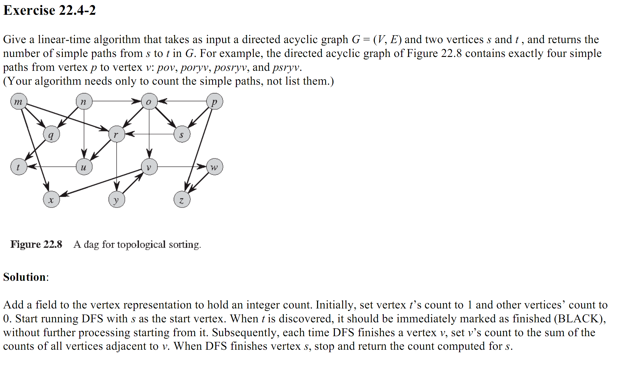
Solutions

Slide 20
Solutions

Slide 21

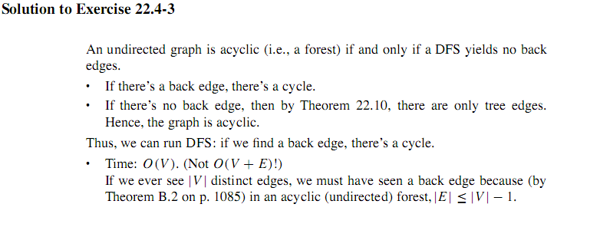
Solutions

Slide 22
Readings
Cormen - Chapter 22
Exercise:
22.4-5 : Topological sort using degree

Slide 23
Home Work-1
Two lists are given: A - courses list. Every student must study all the courses in A.
B – Prerequisites. B contains tuples (a, b) (where a andbare in A), indicating that course amust be taken before course b. The prerequisites dependencies are acyclic.
Design a schedule for each of the following students.
A lazy student who wants to take only one course in a semester.
A student who wants to take all the courses in A in the minimal number of semesters. The student is willing to take any number of courses in a semester.
Example:
A = { Alg, Eng, Ds1, Ds2, Mat, Ph1, Ph2 } B = { (Alg, Ds2), (Ds1, Ds2), (Mat, Ds1), (Ph1, Ph2) }
Optional output for student no. 1: Semester 1: Eng Semester 2: Mat Semester 3: Alg Semester 4: Ds1 Semester 5: Ds2 Semester 6: Ph1 Semester 7: Ph2
Optional output for student no. 2: Semester 1: Eng, Mat, Ph1, Alg Semester 2:Ds1, Ph2 Semester 3: Ds2

Slide 24
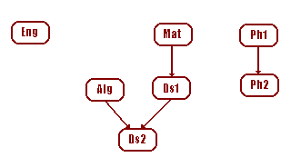
Home Work-1
Example:
A = { Alg, Eng, Ds1, Ds2, Mat, Ph1, Ph2 } B = { (Alg, Ds2), (Ds1, Ds2), (Mat, Ds1), (Ph1, Ph2) }
Optional output for student no. 1: Semester 1: Eng Semester 2: Mat Semester 3: Alg Semester 4: Ds1 Semester 5: Ds2 Semester 6: Ph1 Semester 7: Ph2
Optional output for student no. 2: Semester 1: Eng, Mat, Ph1, Alg Semester 2:Ds1, Ph2 Semester 3: Ds2
The graph for the given example is:

Slide 25
Home Work-2
Update the BFS algorithm so that every vertex v in the graph contains not only d[v], the length of shortest path from s to v, but also the number of different paths of that length.
A super-sink is a vertex with in-degree |V|-1 and out-degree 0 (at most one super-sink can exist in a graph). When an adjacency-matrix representation is used, most graph algorithms require time . Show that determining whether a directed graph, represented in an adjacency-matrix contains a super-sink can be done in time O(|V|).
a
c
b
e
h
s
d
i

Slide 26
Exercise
For a given dag G, determine the topological number of each vertex using the degree-based topological sorting algorithm.
For a given dag G, determine for the length of the longest path.
For a given dag G, use the topological numbers and the longest paths entries to generate a schedule that completes all manufacturing steps in the shortest production span. Return the schedule.
For a given dag G and an integer k, 1< k < n, use the topological numbers to determine a schedule using at most k stations. Return the schedule.
For those interested in using graph visualization tools, we provide the following links to resources:
Network Workbench - http://nwb.cns.iu.edu/index.html
graphviz - http://www.linuxdevcenter.com/pub/a/linux/2004/05/06/graphviz_dot.html
Cytoscape - http://www.cytoscape.org/

Slide 27
Next Class
Strongly Connected Component

