Slide 1
CSE 245: Algorithms Lecture 7 : Sorting Md. Shamsujjoha

Slide 2
Sorting
Given a set (container) of n elements
E.g. array, set of words, etc.
Suppose there is an order relation that can be set across the elements
Goal Arrange the elements in ascending order
Start → 1 23 2 56 9 8 10 100
End → 1 2 8 9 10 23 56 100

Slide 3
Selection Sort
5 | 1 | 3 | 4 | 6 | 2
Comparison
Data Movement
Sorted

Slide 4
Selection Sort
5 | 1 | 3 | 4 | 6 | 2
Comparison
Data Movement
Sorted

Slide 5
Selection Sort
5 | 1 | 3 | 4 | 6 | 2
Comparison
Data Movement
Sorted

Slide 6
Selection Sort
5 | 1 | 3 | 4 | 6 | 2
Comparison
Data Movement
Sorted

Slide 7
Selection Sort
5 | 1 | 3 | 4 | 6 | 2
Comparison
Data Movement
Sorted

Slide 8
Selection Sort
5 | 1 | 3 | 4 | 6 | 2
Comparison
Data Movement
Sorted

Slide 9
Selection Sort
5 | 1 | 3 | 4 | 6 | 2
Comparison
Data Movement
Sorted

Slide 10
Selection Sort
5 | 1 | 3 | 4 | 6 | 2
•
Largest
Comparison
Data Movement
Sorted

Slide 11
Selection Sort
5 | 1 | 3 | 4 | 2 | 6
Comparison
Data Movement
Sorted

Slide 12
Selection Sort
5 | 1 | 3 | 4 | 2 | 6
Comparison
Data Movement
Sorted

Slide 13
Selection Sort
5 | 1 | 3 | 4 | 2 | 6
Comparison
Data Movement
Sorted

Slide 14
Selection Sort
5 | 1 | 3 | 4 | 2 | 6
Comparison
Data Movement
Sorted

Slide 15
Selection Sort
5 | 1 | 3 | 4 | 2 | 6
Comparison
Data Movement
Sorted

Slide 16
Selection Sort
5 | 1 | 3 | 4 | 2 | 6
Comparison
Data Movement
Sorted

Slide 17
Selection Sort
5 | 1 | 3 | 4 | 2 | 6
Comparison
Data Movement
Sorted

Slide 18
Selection Sort
5 | 1 | 3 | 4 | 2 | 6
•
Largest
Comparison
Data Movement
Sorted

Slide 19
Selection Sort
2 | 1 | 3 | 4 | 5 | 6
Comparison
Data Movement
Sorted

Slide 20
Selection Sort
2 | 1 | 3 | 4 | 5 | 6
Comparison
Data Movement
Sorted

Slide 21
Selection Sort
2 | 1 | 3 | 4 | 5 | 6
Comparison
Data Movement
Sorted

Slide 22
Selection Sort
2 | 1 | 3 | 4 | 5 | 6
Comparison
Data Movement
Sorted

Slide 23
Selection Sort
2 | 1 | 3 | 4 | 5 | 6
Comparison
Data Movement
Sorted

Slide 24
Selection Sort
2 | 1 | 3 | 4 | 5 | 6
Comparison
Data Movement
Sorted

Slide 25
Selection Sort
2 | 1 | 3 | 4 | 5 | 6
•
Largest
Comparison
Data Movement
Sorted

Slide 26
Selection Sort
2 | 1 | 3 | 4 | 5 | 6
Comparison
Data Movement
Sorted

Slide 27
Selection Sort
2 | 1 | 3 | 4 | 5 | 6
Comparison
Data Movement
Sorted

Slide 28
Selection Sort
2 | 1 | 3 | 4 | 5 | 6
Comparison
Data Movement
Sorted

Slide 29
Selection Sort
2 | 1 | 3 | 4 | 5 | 6
Comparison
Data Movement
Sorted

Slide 30
Selection Sort
2 | 1 | 3 | 4 | 5 | 6
Comparison
Data Movement
Sorted

Slide 31
Selection Sort
2 | 1 | 3 | 4 | 5 | 6
•
Largest
Comparison
Data Movement
Sorted

Slide 32
Selection Sort
2 | 1 | 3 | 4 | 5 | 6
Comparison
Data Movement
Sorted

Slide 33
Selection Sort
2 | 1 | 3 | 4 | 5 | 6
Comparison
Data Movement
Sorted

Slide 34
Selection Sort
2 | 1 | 3 | 4 | 5 | 6
Comparison
Data Movement
Sorted

Slide 35
Selection Sort
2 | 1 | 3 | 4 | 5 | 6
Comparison
Data Movement
Sorted

Slide 36
Selection Sort
2 | 1 | 3 | 4 | 5 | 6
•
Largest
Comparison
Data Movement
Sorted

Slide 37
Selection Sort
1 | 2 | 3 | 4 | 5 | 6
Comparison
Data Movement
Sorted

Slide 38
Selection Sort
1 | 2 | 3 | 4 | 5 | 6
DONE!
Comparison
Data Movement
Sorted

Slide 39
At glance in Reverse Order
23 | 78 | 45 | 8 | 32 | 56
8 | 78 | 45 | 23 | 32 | 56
8 | 23 | 45 | 78 | 32 | 56
8 | 23 | 32 | 78 | 45 | 56
8 | 23 | 32 | 45 | 78 | 56
8 | 23 | 32 | 45 | 56 | 78
Original List
After pass 1
After pass 2
After pass 3
After pass 4
After pass 5

Slide 40
Algorithm
Input: An array A[1 ... n] of n elements.
Output: A[1... n] sorted in non-decreasing order.
for i ← 1 to n - 1
k ← i
for j ← i + 1 to n {Find the i th smallest element.}
if A[j] < A[k] then k ← j
end for
if k ≠ i then
SWAP A[i] and A[k]
end for
Notes:
template <class Item>
void selectionSort( Item a[], int n) {
for (int i = 0; i < n-1; i++) {
int min = i;
for (int j = i+1; j < n; j++)
if (a[j] < a[min]) min = j;
swap(a[i], a[min]);
}
}

Slide 41
Selection Sort -- Analysis
In general, we compare keys and move items (or exchange items) in a sorting algorithm (which uses key comparisons).
➔ So, to analyze a sorting algorithm we should count the number of key comparisons and the number of moves.
Ignoring other operations does not affect our final result.
In selectionSort function, the outer for loop executes n-1 times.
We invoke swap function once at each iteration.
➔ Total Swaps: n-1
➔ Total Moves: 3*(n-1) (Each swap has three moves)

Slide 42
Selection Sort – Analysis (cont.)
The inner for loop executes the size of the unsorted part minus 1 (from 1 to n-1), and in each iteration we make one key comparison.
➔ # of key comparisons = 1+2+...+n-1 = n*(n-1)/2
➔ So, Selection sort is O(n²)
The best case, the worst case, and the average case of the selection sort algorithm are same. ➔ all of them are O(n²)
This means that the behavior of the selection sort algorithm does not depend on the initial organization of data.
Since O(n²) grows so rapidly, the selection sort algorithm is appropriate only for small n.
Although the selection sort algorithm requires O(n²) key comparisons, it only requires O(n) moves.
A selection sort could be a good choice if data moves are costly but key comparisons are not costly (short keys, long records).

Slide 43
Comparison of N, logN and N²
N O(LogN) O(N²)
16 4 256
64 6 4K
256 8 64K
1,024 10 1M
16,384 14 256M
131,072 17 16G
262,144 18 6.87E+10
524,288 19 2.74E+11
1,048,576 20 1.09E+12
1,073,741,824 30 1.15E+18

Slide 44
Bubble Sort
1. Set flag = false
2. Traverse the array and compare pairs of two consecutive elements
1.1 If E1 ≤ E2 -> OK (do nothing)
1.2 If E1 > E2 then Swap(E1, E2) and set flag = true
3. repeat 1. and 2. while flag=true.

Slide 45
Bubble Sort
1. Set flag = false
2. Traverse the array and compare pairs of two consecutive elements
1.1 If E1 ≤ E2 -> OK (do nothing)
1.2 If E1 > E2 then Swap(E1, E2) and set flag = true
3. repeat 1. and 2. while flag=true.
1 23 2 56 9 8 10 100

Slide 46
Bubble Sort
1. Set flag = false
2. Traverse the array and compare pairs of two consecutive elements
1.1 If E1 ≤ E2 -> OK (do nothing)
1.2 If E1 > E2 then Swap(E1, E2) and set flag = true
3. repeat 1. and 2. while flag=true.
1 23 2 56 9 8 10 100
1 2 23 56 9 8 10 100

Slide 47
Bubble Sort
1. Set flag = false
2. Traverse the array and compare pairs of two consecutive elements
1.1 If E1 ≤ E2 -> OK (do nothing)
1.2 If E1 > E2 then Swap(E1, E2) and set flag = true
3. repeat 1. and 2. while flag=true.
1 23 2 56 9 8 10 100
1 2 23 56 9 8 10 100

Slide 48
Bubble Sort
1. Set flag = false
2. Traverse the array and compare pairs of two consecutive elements
1.1 If E1 ≤ E2 -> OK (do nothing)
1.2 If E1 > E2 then Swap(E1, E2) and set flag = true
3. repeat 1. and 2. while flag=true.
1 23 2 56 9 8 10 100
1 2 23 56 9 8 10 100
1 2 23 9 56 8 10 100

Slide 49
Bubble Sort
1. Set flag = false
2. Traverse the array and compare pairs of two consecutive elements
1.1 If E1 ≤ E2 -> OK (do nothing)
1.2 If E1 > E2 then Swap(E1, E2) and set flag = true
3. repeat 1. and 2. while flag=true.
1 23 2 56 9 8 10 100
1 2 23 56 9 8 10 100
1 2 23 9 56 8 10 100

Slide 50
Bubble Sort
1. Set flag = false
2. Traverse the array and compare pairs of two consecutive elements
1.1 If E1 ≤ E2 -> OK (do nothing)
1.2 If E1 > E2 then Swap(E1, E2) and set flag = true
3. repeat 1. and 2. while flag=true.
1 23 2 56 9 8 10 100
1 2 23 56 9 8 10 100
1 2 23 9 56 8 10 100
1 2 23 9 8 56 10 100

Slide 51
Bubble Sort
1. Set flag = false
2. Traverse the array and compare pairs of two consecutive elements
1.1 If E1 ≤ E2 -> OK (do nothing)
1.2 If E1 > E2 then Swap(E1, E2) and set flag = true
3. repeat 1. and 2. while flag=true.
1 23 2 56 9 8 10 100
1 2 23 56 9 8 10 100
1 2 23 9 56 8 10 100
1 2 23 9 8 56 10 100
1 2 23 9 8 10 56 100

Slide 52
Bubble Sort
1. Set flag = false
2. Traverse the array and compare pairs of two consecutive elements
1.1 If E1 ≤ E2 -> OK (do nothing)
1.2 If E1 > E2 then Swap(E1, E2) and set flag = true
3. repeat 1. and 2. while flag=true.
1 23 2 56 9 8 10 100
1 2 23 56 9 8 10 100
1 2 23 9 56 8 10 100
1 2 23 9 8 56 10 100
1 2 23 9 8 10 56 100
1st Traversal finishes

Slide 53
Bubble Sort
1. Set flag = false
2. Traverse the array and compare pairs of two consecutive elements
1.1 If E1 ≤ E2 -> OK (do nothing)
1.2 If E1 > E2 then Swap(E1, E2) and set flag = true
3. repeat 1. and 2. while flag=true.
1 2 23 9 8 10 56 100
2nd Traversal started

Slide 54
Bubble Sort
1. Set flag = false
2. Traverse the array and compare pairs of two consecutive elements
1.1 If E1 ≤ E2 -> OK (do nothing)
1.2 If E1 > E2 then Swap(E1, E2) and set flag = true
3. repeat 1. and 2. while flag=true.
1 2 23 9 8 10 56 100

Slide 55
Bubble Sort
1. Set flag = false
2. Traverse the array and compare pairs of two consecutive elements
1.1 If E1 ≤ E2 -> OK (do nothing)
1.2 If E1 > E2 then Swap(E1, E2) and set flag = true
3. repeat 1. and 2. while flag=true.
1 2 23 9 8 10 56 100
1 2 9 23 8 10 56 100

Slide 56
Bubble Sort
1. Set flag = false
2. Traverse the array and compare pairs of two consecutive elements
1.1 If E1 ≤ E2 -> OK (do nothing)
1.2 If E1 > E2 then Swap(E1, E2) and set flag = true
3. repeat 1. and 2. while flag=true.
1 2 23 9 8 10 56 100
1 2 9 23 8 10 56 100
1 2 9 8 23 10 56 100

Slide 57
Bubble Sort
1. Set flag = false
2. Traverse the array and compare pairs of two consecutive elements
1.1 If E1 ≤ E2 -> OK (do nothing)
1.2 If E1 > E2 then Swap(E1, E2) and set flag = true
3. repeat 1. and 2. while flag=true.
1 2 23 9 8 10 56 100
1 2 9 23 8 10 56 100
1 2 9 8 23 10 56 100
1 2 9 8 10 23 56 100
We are almost done

Slide 58
Bubble Sort
1. Set flag = false
2. Traverse the array and compare pairs of two consecutive elements
1.1 If E1 ≤ E2 -> OK (do nothing)
1.2 If E1 > E2 then Swap(E1, E2) and set flag = true
3. repeat 1. and 2. while flag=true.
As there is no default boolean in C Make Sure you do the following before code
typedef unsigned int boolean;
#define false 0
#define true (!false)

Slide 59
Bubble Sort – Analysis
Best-case: ➔ O(n)
Array is already sorted in ascending order.
The number of moves: 0 ➔ O(1)
The number of key comparisons: (n-1) ➔ O(n)
Worst-case: ➔ O(n²)
Array is in reverse order:
Outer loop is executed n-1 times,
The number of moves: 3*(1+2+...+n-1) = 3 * n*(n-1)/2 ➔ O(n²)
The number of key comparisons: (1+2+...+n-1)= n*(n-1)/2 ➔ O(n²)
Average-case: ➔ O(n²)
We have to look at all possible initial data organizations.
So, Bubble Sort is O(n²)

Slide 60
Example of a Cost Function
Cost Function: t_{A}(n) = n² + 20n + 100
Which term dominates?
It depends on the size of n
n = 2, t_{A}(n) = 4 + 40 + 100
The constant, 100, is the dominating term
n = 10, t_{A}(n) = 100 + 200 + 100
20n is the dominating term
n = 100, t_{A}(n) = 10,000 + 2,000 + 100
n² is the dominating term
n = 1000, t_{A}(n) = 1,000,000 + 20,000 + 100
n² is the dominating term

Slide 61
Insertion Sort
Insertion sort keeps making the left side of the array sorted until the whole array is sorted.
Real life example:
Playing cards: To sort the cards in your hand you extract a card, shift the remaining cards, and then insert the extracted card in the correct place.

Slide 62
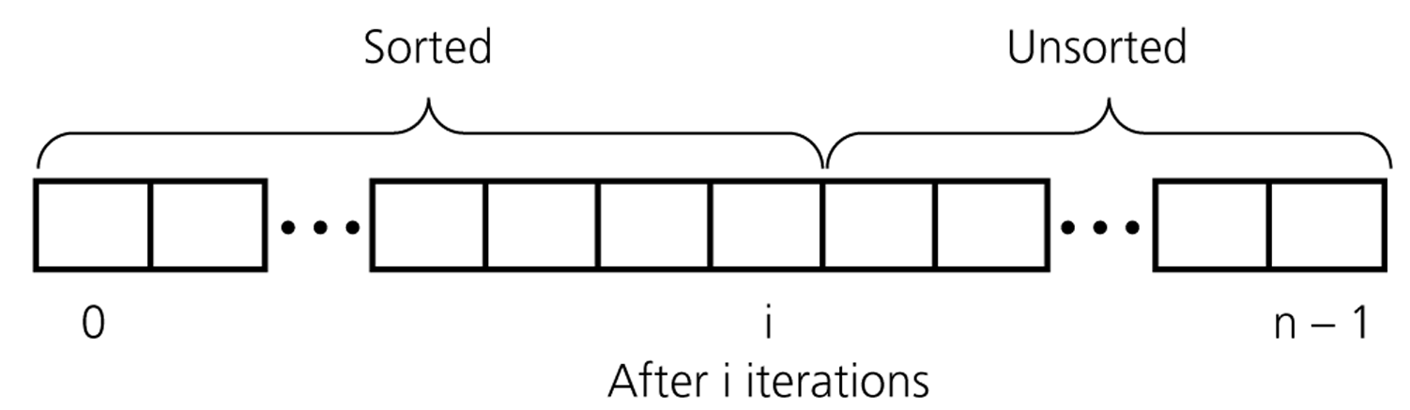
Insertion Sort
Insertion sort keeps making the left side of the array sorted until the whole array is sorted.
An insertion sort partitions the array into two regions

Slide 63
Insertion Sort
while some elements unsorted:
Using linear search, find the location in the sorted portion where the 1st element of the unsorted portion should be inserted
Move all the elements after the insertion location up one position to make space for the new element
45
38
60
45
66
60
45
66
79
47
13
74
36
21
94
22
57
16
29
81
the fourth iteration of this loop is shown here

Slide 64
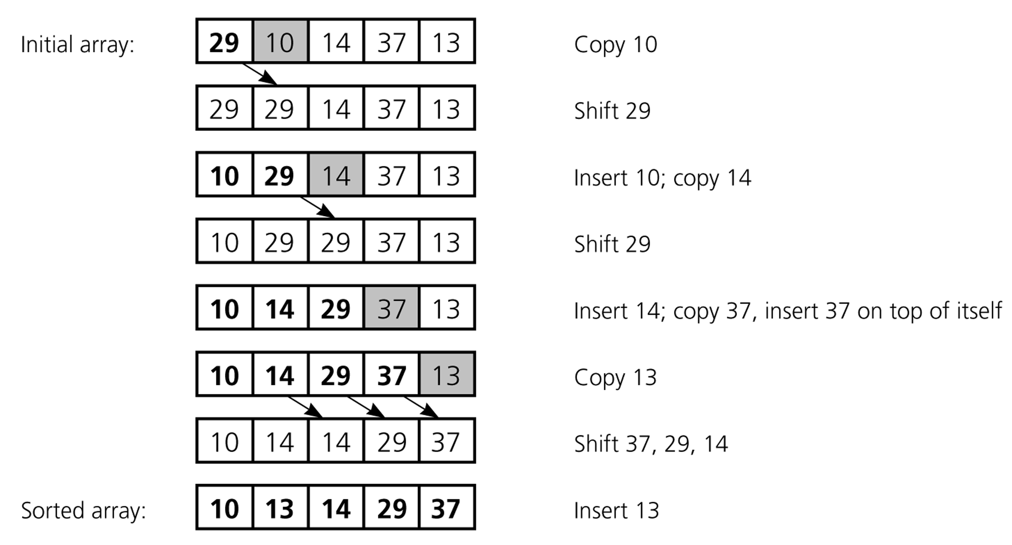
Insertion Sort
An insertion sort of an array of five integers

Slide 65
Insertion Sort
An insertion sort of an array of five integers

Slide 66
Insertion Sort
An insertion sort of an array of five integers

Slide 67
Insertion Sort
An insertion sort of an array of five integers

Slide 68
Insertion Sort
An insertion sort of an array of five integers

Slide 69
Insertion Sort
An insertion sort of an array of five integers

Slide 70
Insertion Sort
13
An insertion sort of an array of five integers

Slide 71
Insertion Sort
13
An insertion sort of an array of five integers

Slide 72
Insertion Sort
Complexity ?
for j ←1 to n-1
key ← A[ j ]
i ← j – 1
while i >= 0 & A [ i ] > key
A[ i +1 ] ← A[ i ]
i ← i -1
A [i +1] ← key

Slide 73
Insertion Sort: Number of Comparisons
# of Sorted Elements | Best case | Worst case
0 | 0 | 0
1 | 1 | 1
2 | 1 | 2
… | … | …
n-1 | 1 | n-1
 | n-1 | n(n-1)/2
Remark: we only count comparisons of elements in the array.

Slide 74
Analysis of Insertion Sort
INSERTION-SORT(A)
for j ← 2 to n
do key ← A[ j ]
Insert A[ j ] into the sorted sequence A[1 . . j -1]
i ← j - 1
while i > 0 and A[i] > key
do A[i + 1] ← A[i]
i ← i – 1
A[i + 1] ← key
cost times
c₁ n
c₂ n-1
0 n-1
c₄ n-1
c₅
c₆
c₇
c₈ n-1
t_{j}: # of times the while statement is executed at iteration j
Notes:
₇

Slide 75
Best Case Analysis
The array is already sorted
A[i] ≤ key upon the first time the while loop test is run (when i = j -1)
t_{j} = 1
T(n) = c₁n + c₂(n -1) + c₄(n -1) + c₅(n -1) + c₈(n-1) = (c₁ + c₂ + c₄ + c₅ + c₈)n + (c₂ + c₄ + c₅ + c₈)
= an + b = Θ(n)
“while i > 0 and A[i] > key”

Slide 76
Worst Case Analysis
The array is in reverse sorted order
Always A[i] > key in while loop test
Have to compare key with all elements to the left of the j-th position ⇒ compare with j-1 elements ⇒ t_{j} = j
a quadratic function of n
T(n) = Θ(n²) order of growth in n²
“while i > 0 and A[i] > key”
using
we have:

Slide 77
Comparisons and Exchanges in Insertion Sort
cost times
c₁ n
c₂ n-1
0 n-1
c₄ n-1
c₅
c₆
c₇
c₈ n-1
INSERTION-SORT(A)
for j ← 2 to n
do key ← A[ j ]
Insert A[ j ] into the sorted sequence A[1 . . j -1]
i ← j - 1
while i > 0 and A[i] > key
do A[i + 1] ← A[i]
i ← i – 1
A[i + 1] ← key
≈ n²/2 comparisons
≈ n²/2 exchanges

Slide 78
Insertion Sort - Summary
Advantages
Good running time for “almost sorted” arrays Θ(n)
Disadvantages
Θ(n²) running time in worst and average case
≈ n²/2 comparisons and exchanges

Slide 79
Divide-and-Conquer
Divide and Conquer is a method of algorithm design that has created such efficient algorithms as Merge Sort.
In terms or algorithms, this method has three distinct steps:
Divide: If the input size is too large to deal with in a straightforward manner, divide the data into two or more disjoint subsets.
Recur: Use divide and conquer to solve the subproblems associated with the data subsets.
Conquer: Take the solutions to the subproblems and “merge” these solutions into a solution for the original problem.

Slide 80
Merging
X:
3 | 10 | 23 | 54
Y:
1 | 5 | 25 | 75
Result:

Slide 81
Merging (cont.)
X:
3 | 10 | 23 | 54
Y:
 | 5 | 25 | 75
Result:
1

Slide 82
Merging (cont.)
X:
 | 10 | 23 | 54
Y:
 | 5 | 25 | 75
Result:
1 | 3

Slide 83
Merging (cont.)
X:
 | 10 | 23 | 54
Y:
 |  | 25 | 75
Result:
1 | 3 | 5

Slide 84
Merging (cont.)
X:
 |  | 23 | 54
Y:
 |  | 25 | 75
Result:
1 | 3 | 5 | 10

Slide 85
Merging (cont.)
X:
 |  |  | 54
Y:
 |  | 25 | 75
Result:
1 | 3 | 5 | 10 | 23

Slide 86
Merging (cont.)
X:
 |  |  | 54
Y:
 |  |  | 75
Result:
1 | 3 | 5 | 10 | 23 | 25

Slide 87
Merging (cont.)
X:
Y:
 |  |  | 75
Result:
1 | 3 | 5 | 10 | 23 | 25 | 54

Slide 88
Execution Example
Partition
7 2 9 4 ⏐ 3 8 6 1 → 1 2 3 4 6 7 8 9
7 2 9 4 → 2 4 7 9
3 8 6 1 → 1 3 8 6
7 2 → 2 7
9 4 → 4 9
3 8 → 3 8
6 1 → 1 6
7 → 7
2 → 2
9 → 9
4 → 4
3 → 3
8 → 8
6 → 6
1 → 1

Slide 89
Execution Example (cont.)
Recursive call, partition
7 2 9 4 ⏐ 3 8 6 1 → 1 2 3 4 6 7 8 9
7 2 ⏐ 9 4 → 2 4 7 9
3 8 6 1 → 1 3 8 6
7 2 → 2 7
9 4 → 4 9
3 8 → 3 8
6 1 → 1 6
7 → 7
2 → 2
9 → 9
4 → 4
3 → 3
8 → 8
6 → 6
1 → 1

Slide 90
Execution Example (cont.)
Recursive call, partition
7 2 9 4 ⏐ 3 8 6 1 → 1 2 3 4 6 7 8 9
7 2 ⏐ 9 4 → 2 4 7 9
3 8 6 1 → 1 3 8 6
7 ⏐ 2 → 2 7
9 4 → 4 9
3 8 → 3 8
6 1 → 1 6
7 → 7
2 → 2
9 → 9
4 → 4
3 → 3
8 → 8
6 → 6
1 → 1

Slide 91
Execution Example (cont.)
Recursive call, base case
7 2 9 4 ⏐ 3 8 6 1 → 1 2 3 4 6 7 8 9
7 2 ⏐ 9 4 → 2 4 7 9
3 8 6 1 → 1 3 8 6
7 ⏐ 2 → 2 7
9 4 → 4 9
3 8 → 3 8
6 1 → 1 6
7 → 7
2 → 2
9 → 9
4 → 4
3 → 3
8 → 8
6 → 6
1 → 1

Slide 92
Execution Example (cont.)
Recursive call, base case
7 2 9 4 ⏐ 3 8 6 1 → 1 2 3 4 6 7 8 9
7 2 ⏐ 9 4 → 2 4 7 9
3 8 6 1 → 1 3 8 6
7 ⏐ 2 → 2 7
9 4 → 4 9
3 8 → 3 8
6 1 → 1 6
7 → 7
2 → 2
9 → 9
4 → 4
3 → 3
8 → 8
6 → 6
1 → 1

Slide 93
Execution Example (cont.)
Merge
7 2 9 4 ⏐ 3 8 6 1 → 1 2 3 4 6 7 8 9
7 2 ⏐ 9 4 → 2 4 7 9
3 8 6 1 → 1 3 8 6
7 ⏐ 2 → 2 7
9 4 → 4 9
3 8 → 3 8
6 1 → 1 6
7 → 7
2 → 2
9 → 9
4 → 4
3 → 3
8 → 8
6 → 6
1 → 1

Slide 94
Execution Example (cont.)
Recursive call, …, base case, merge
7 2 9 4 ⏐ 3 8 6 1 → 1 2 3 4 6 7 8 9
7 2 ⏐ 9 4 → 2 4 7 9
3 8 6 1 → 1 3 8 6
7 ⏐ 2 → 2 7
9 4 → 4 9
3 8 → 3 8
6 1 → 1 6
7 → 7
2 → 2
9 → 9
4 → 4
3 → 3
8 → 8
6 → 6
1 → 1

Slide 95
Execution Example (cont.)
Merge
7 2 9 4 ⏐ 3 8 6 1 → 1 2 3 4 6 7 8 9
7 2 ⏐ 9 4 → 2 4 7 9
3 8 6 1 → 1 3 8 6
7 ⏐ 2 → 2 7
9 4 → 4 9
3 8 → 3 8
6 1 → 1 6
7 → 7
2 → 2
9 → 9
4 → 4
3 → 3
8 → 8
6 → 6
1 → 1

Slide 96
Execution Example (cont.)
Recursive call, …, merge, merge
7 2 9 4 ⏐ 3 8 6 1 → 1 2 3 4 6 7 8 9
7 2 ⏐ 9 4 → 2 4 7 9
3 8 6 1 → 1 3 6 8
7 ⏐ 2 → 2 7
9 4 → 4 9
3 8 → 3 8
6 1 → 1 6
7 → 7
2 → 2
9 → 9
4 → 4
3 → 3
8 → 8
6 → 6
1 → 1

Slide 97
Execution Example (cont.)
Merge
7 2 9 4 ⏐ 3 8 6 1 → 1 2 3 4 6 7 8 9
7 2 ⏐ 9 4 → 2 4 7 9
3 8 6 1 → 1 3 6 8
7 ⏐ 2 → 2 7
9 4 → 4 9
3 8 → 3 8
6 1 → 1 6
7 → 7
2 → 2
9 → 9
4 → 4
3 → 3
8 → 8
6 → 6
1 → 1

Slide 98
Analysis of Merge-Sort
The height h of the merge-sort tree is O(log n)
at each recursive call we divide in half the sequence,
The overall amount or work done at the nodes of depth i is O(n)
we partition and merge 2^{i} sequences of size n/2^{i}
we make 2^{i+1} recursive calls
Thus, the total running time of merge-sort is O(n log n)
depth | #seqs | size
0 | 1 | n
1 | 2 | n/2
i | 2^{i} | n/2^{i}
… | … | …

Slide 99
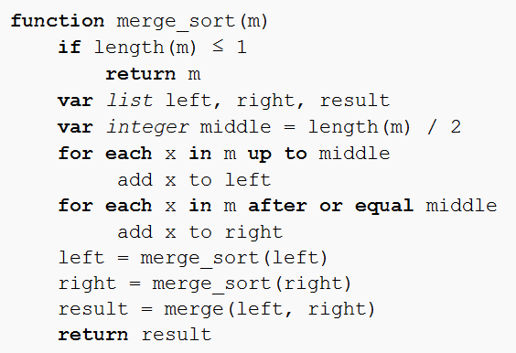
Merge-Sort Algorithm

Slide 100
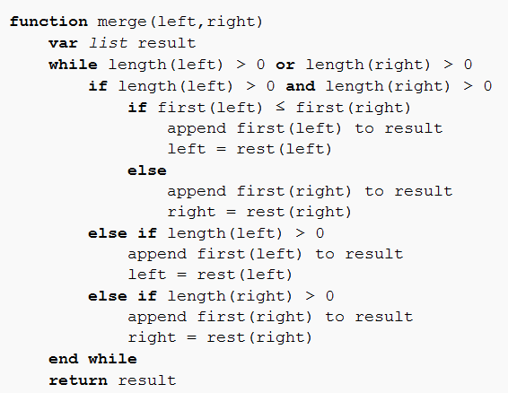
Merge-Sort Algorithm

Slide 101
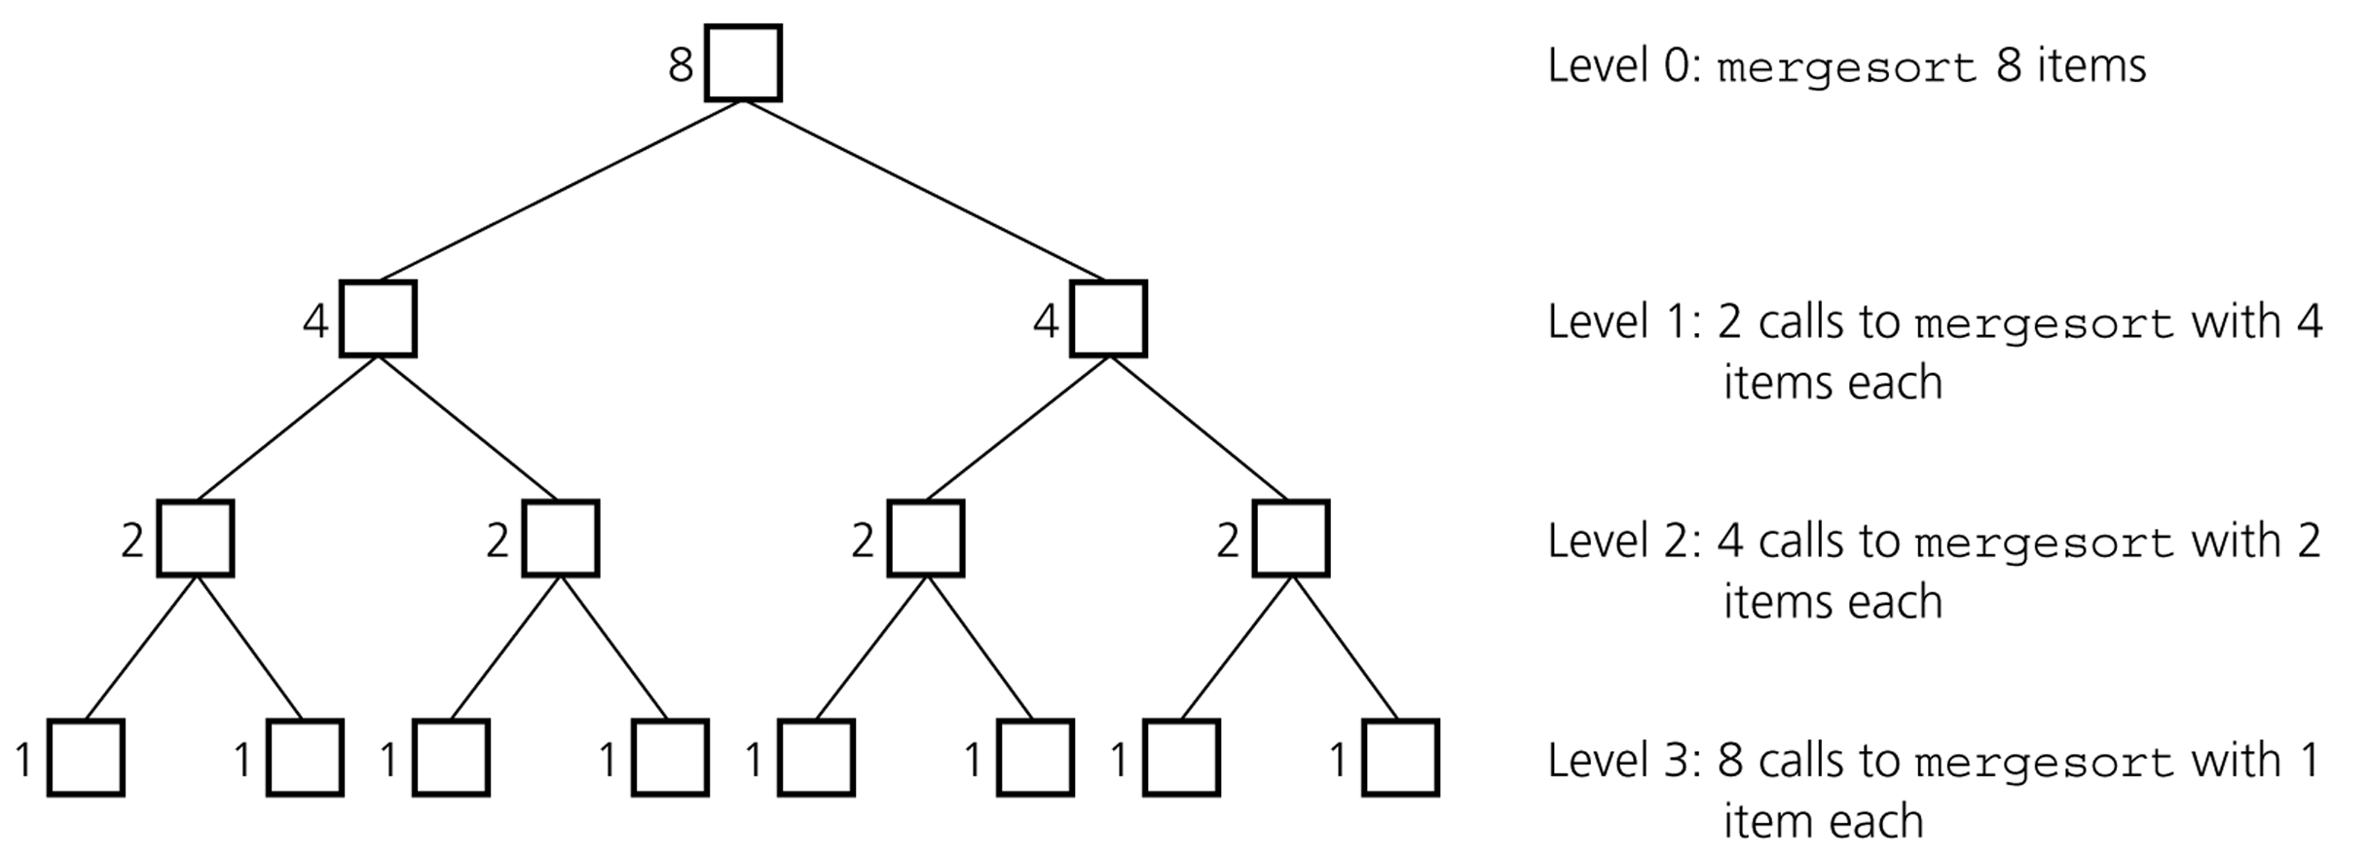
Mergesort - Analysis
Levels of recursive calls to mergesort, given an array of eight items

Slide 102
Mergesort - Analysis
2^{m}
level 0 : 1 merge (size 2^{m-1})
2^{m-1}
2^{m-1}
level 1 : 2 merges (size 2^{m-2})
level 2 : 4 merges (size 2^{m-3})
2^{m-2}
2^{m-2}
2^{m-2}
2^{m-2}
.
.
.
.
.
.
level m-1 : 2^{m-1} merges (size 2⁰)
2⁰
2⁰
. . . . . . . . . . . . . . . . .
level m

Slide 103
Mergesort - Analysis
Worst-case –
The number of key comparisons:
= 2⁰*(2*2^{m-1}-1) + 2¹*(2*2^{m-2}-1) + ... + 2^{m-1}*(2*2⁰-1)
= (2^{m} - 1) + (2^{m} - 2) + ... + (2^{m} – 2^{m-1}) ( m terms )
= m*2^{m} –
= m*2^{m} – 2^{m} – 1
Using m = log n
= n * log₂n – n – 1
➔ O (n * log₂n )

Slide 104
Mergesort – Analysis
Mergesort is extremely efficient algorithm with respect to time.
Both worst case and average cases are O (n * log₂n )
But, mergesort requires an extra array whose size equals to the size of the original array.
If we use a linked list, we do not need an extra array
But, we need space for the links
And, it will be difficult to divide the list into half ( O(n) )

Slide 105
Quick-Sort
Quick-sort is a randomized sorting algorithm based on the divide-and-conquer paradigm:
Divide: pick a random element x (called pivot) and partition S into
L elements less than x
E elements equal x
G elements greater than x
Recur: sort L and G
Conquer: join L, E and G
x
x
L
G
E
x

Slide 106
Partition
We partition an input sequence as follows:
We remove, in turn, each element y from S and
We insert y into L, E or G, depending on the result of the comparison with the pivot x
Each insertion and removal is at the beginning or at the end of a sequence, and hence takes O(1) time
Thus, the partition step of quick-sort takes O(n) time
Algorithm partition(S, p)
Input sequence S, position p of pivot
Output subsequences L, E, G of the elements of S less than, equal to, or greater than the pivot, resp.
L, E, G ← empty sequences
x ← S.remove(p)
while ¬S.isEmpty()
y ← S.remove(S.first())
if y < x
L.insertLast(y)
else if y = x
E.insertLast(y)
else { y > x }
G.insertLast(y)
return L, E, G

Slide 107
How to pick a pivot?
Use the first element as pivot
if the input is random, ok
if the input is presorted (or in reverse order)
all the elements go into S2 (or S1)
this happens consistently throughout the recursive calls
Results in O(n²) behavior (Analyze this case later)
Choose the pivot randomly
generally safe
random number generation can be expensive

Slide 108
Quick-Sort Tree
An execution of quick-sort is depicted by a binary tree
Each node represents a recursive call of quick-sort and stores
Unsorted sequence before the execution and its pivot
Sorted sequence at the end of the execution
The root is the initial call
The leaves are calls on subsequences of size 0 or 1
7 4 9 6 2 → 2 4 6 7 9
4 2 → 2 4
7 9 → 7 9
2 → 2
9 → 9

Slide 109
Execution Example
Pivot selection
7 2 9 4 3 7 6 1 → 1 2 3 4 6 7 8 9
7 2 9 4 → 2 4 7 9
3 8 6 1 → 1 3 8 6
2 → 2
9 4 → 4 9
3 → 3
8 → 8
9 → 9
4 → 4

Slide 110
Execution Example (cont.)
Partition, recursive call, pivot selection
7 2 9 4 3 7 6 1 → 1 2 3 4 6 7 8 9
2 4 3 1 → 2 4 7 9
3 8 6 1 → 1 3 8 6
2 → 2
9 4 → 4 9
3 → 3
8 → 8
9 → 9
4 → 4

Slide 111
Execution Example (cont.)
Partition, recursive call, base case
7 2 9 4 3 7 6 1 → → 1 2 3 4 6 7 8 9
2 4 3 1 →→ 2 4 7
3 8 6 1 → 1 3 8 6
1 → 1
9 4 → 4 9
3 → 3
8 → 8
9 → 9
4 → 4

Slide 112
Execution Example (cont.)
Recursive call, …, base case, join
7 2 9 4 3 7 6 1 → 1 2 3 4 6 7 8 9
2 4 3 1 → 1 2 3 4
3 8 6 1 → 1 3 8 6
1 → 1
4 3 → 3 4
3 → 3
8 → 8
9 → 9
4 → 4

Slide 113
Execution Example (cont.)
Recursive call, pivot selection
7 2 9 4 3 7 6 1 → 1 2 3 4 6 7 8 9
2 4 3 1 → 1 2 3 4
7 9 7 1 → 1 3 8 6
1 → 1
4 3 → 3 4
8 → 8
9 → 9
9 → 9
4 → 4

Slide 114
Execution Example (cont.)
Partition, …, recursive call, base case
7 2 9 4 3 7 6 1 → 1 2 3 4 6 7 8 9
2 4 3 1 → 1 2 3 4
7 9 7 1 → 1 3 8 6
1 → 1
4 3 → 3 4
8 → 8
9 → 9
9 → 9
4 → 4

Slide 115
Execution Example (cont.)
Join, join
7 2 9 4 3 7 6 1 → 1 2 3 4 6 7 7 9
2 4 3 1 → 1 2 3 4
7 9 7 → 17 7 9
1 → 1
4 3 → 3 4
8 → 8
9 → 9
9 → 9
4 → 4

Slide 116
Worst-case Running Time
The worst case for quick-sort occurs when the pivot is the unique minimum or maximum element
One of L and G has size n − 1 and the other has size 0
The running time is proportional to the sum
n + (n − 1) + … + 2 + 1
Thus, the worst-case running time of quick-sort is O(n²)
depth | time
0 | n
1 | n − 1
… | …
n − 1 | 1
…

Slide 117
Quicksort – Analysis
Worst Case: (assume that we are selecting the first element as pivot)
The pivot divides the list of size n into two sublists of sizes 0 and n-1.
The number of key comparisons
= n-1 + n-2 + ... + 1
= n²/2 – n/2 ➔ O(n²)
The number of swaps =
= n-1 + n-1 + n-2 + ... + 1
swaps outside of the for loop swaps inside of the for loop
= n²/2 + n/2 - 1 ➔ O(n²)
So, Quicksort is O(n²) in worst case

Slide 118
Quicksort – Analysis
Quicksort is O(n*log₂n) in the best case and average case.
Quicksort is slow when the array is sorted and we choose the first element as the pivot.
Although the worst case behavior is not so good, its average case behavior is much better than its worst case.
So, Quicksort is one of best sorting algorithms using key comparisons.

Slide 119
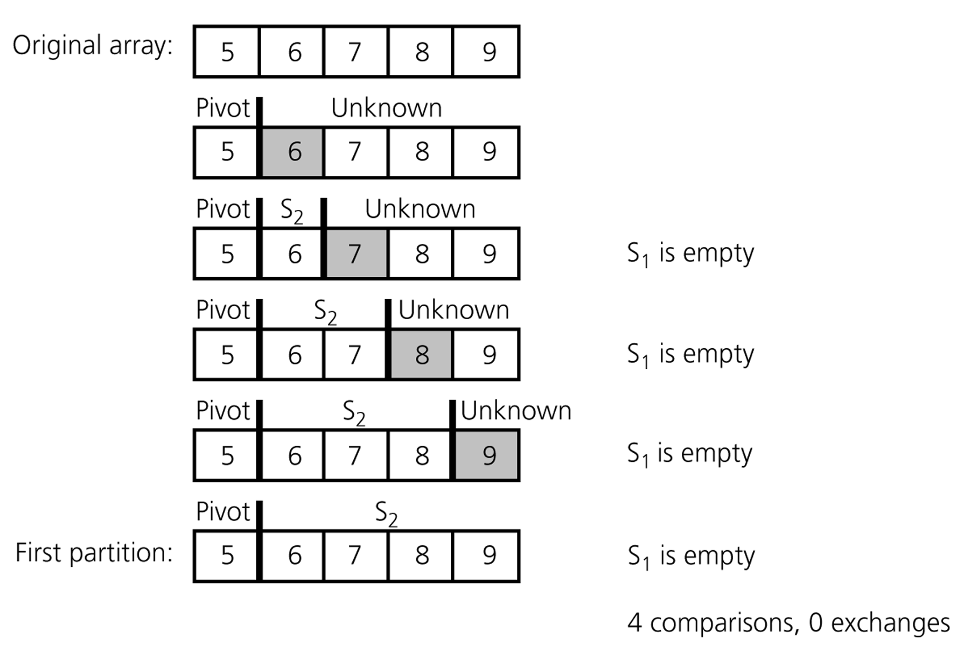
Quicksort – Analysis
A worst-case partitioning with quicksort

Slide 120
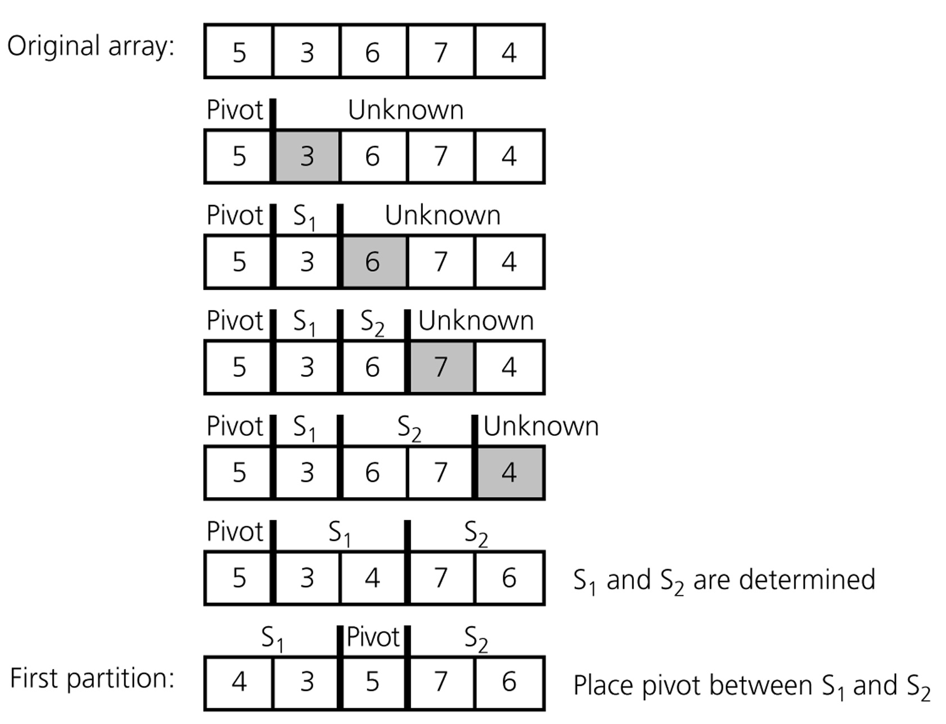
Quicksort – Analysis
An average-case partitioning with quicksort

Slide 121
In-Place Partitioning
Perform the partition using two indices to split S into L and E U G (a similar method can split E U G into E and G).
Repeat until j and k cross:
Scan j to the right until finding an element > x.
Scan k to the left until finding an element < x.
Swap elements at indices j and k
j
k
3 2 5 1 0 7 3 5 9 2 7 9 8 9 7 6 9
(pivot = 6)
j
k
3 2 5 1 0 7 3 5 9 2 7 9 8 9 7 6 9

