Slide 1
NETWORK FLOW

Slide 2
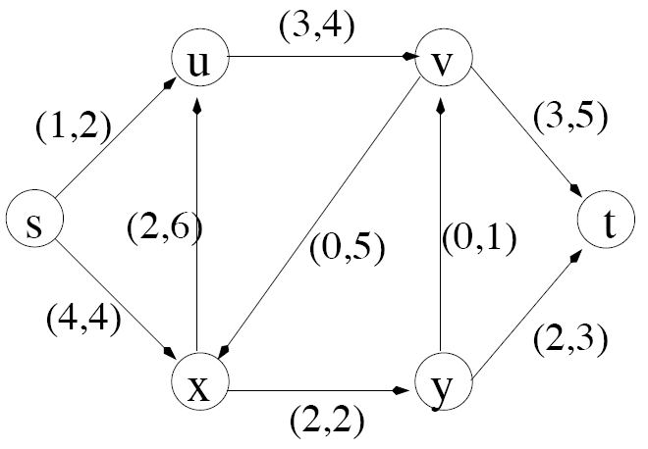
Example Graph
-
Sink node
Source node
Actual flow through this edge
Max. capacity of edge

Slide 3
Simplified Model
The network is modeled simply as
a directed graph G = (V,E) with
non-negative capacity on each edge,
a single source node, s, and
a single sink node, t

Slide 4
Some assumptions…
We will simplify our discussion by assuming the following:
No edge enters s, the source
No edge leaves t, the sink
At least one edge is incident to each node
All capacities are integers

Slide 5
What is Network Flow?
Each edge (u,v) has a nonnegative capacity c(u,v).
If (u,v) is not in E, assume c(u,v)=0.
We have a source s, and a sink t.
Assume that every vertex v in V is on some path from s to t.
c(s,v₁)=16; c(v₁,s)=0; c(v₂,v₃)=0

Slide 6
Formalization
Flow network – G=(V,E)
Directed, each edge has capacity c(u,v) ≥ 0
Two special vertices: source s, and sink t
For any other vertex v, there is a path s→…→v→…→t
Flow – f : V × V → R
Capacity constraint: ∀u,v ∈ V: f(u,v) ≤ c(u,v)
Skew symmetry: ∀u,v ∈ V: f(u,v) = –f(v,u)
Flow conservation: ∀u ∈ V – {s, t}:

Slide 7
Flow in a Flow Network
A flow in the network is an integer-valued function f defined on the edges of G satisfying 0 ≤ f(i,j) ≤ c(i,j) for every edge (i,j) in E.

Slide 8
The Value of a Flow
The value of a flow is given by
This it the total flow leaving s = the total flow arriving in t

Slide 9
Example:
|f| = f(s, v₁) + f(s, v₂) + f(s, v₃) + f(s, v₄) + f(s, t) =
11 + 8 + 0 + 0 + 0 = 19
|f|= f(s, t) + f(v₁, t) + f(v₂, t) + f(v₃, t) + f(v₄, t) =
0 + 0 + 0 + 15 + 4 = 19

Slide 10
Example of a Flow
flow
capacity
0
f(v₂, v₁) = 1, c(v₂, v₁) = 4.
f(v₁, v₂) = -1, c(v₁, v₂) = 10.
f(v3, s) + f(v3, v1) + f(v3, v2) + f(v3, v4) + f(v3, t) =
0 + (-12) + 4 + (-7) + 15 = 0

Slide 11
Maximum flow
What do we want to maximize?
Value of the flow f:

Slide 12
Network Flow
Instance:
A Network is a directed graph G
Edges represent pipes that carry flow
Each edge <u,v> has a maximum capacity c_{<u,v>}
A source node s in which flow arrives
A sink node t out which flow leaves

Slide 13
The Problem
Use a graph to model material that flows through conduits.
Each edge represents one conduit, and has a capacity, which is an upper bound on the flow rate = units/time.
Can think of edges as pipes of different sizes.
Want to compute max rate that we can ship material from a designated source to a designated sink.

Slide 14
A flow in a network
We assume that there is only flow in one direction at a time.
Sending 7 trucks from Edmonton to Calgary and 3 trucks from Calgary to Edmonton has the same net effect as sending 4 trucks from Edmonton to Calgary.

Slide 15
Some Lemmas:
Prove that, f(s,V)=f(V,t) [pg-649]
[Lemma26.2] Prove that, |f+f′|=|f|+|f′|
Lemma: 26.3
Lemma 26.4 |f′| = |f| + |f_{p}| ≥|f|
Lemma: 26.5 |f| = f(S,T)
Lemma: 26.6 |f| ≤ c(S,T)

Slide 16
Cuts
A cut is a partition of V into S and T=V – S, such that s∈S and t ∈T
The net flow (f(S,T)) through the cut is the sum of flows f(u,v), where s ∈ S and t ∈ T
Includes negative flows back from T to S
The capacity (c(S,T)) of the cut is the sum of capacities c(u,v), where s ∈ S and t ∈ T
The sum of positive capacities
Minimum cut – a cut with the smallest capacity of all cuts.
|f|= f(S,T) i.e. the value of a max flow is equal to the capacity of a min cut.
a
8/13
b
10/15
13/19
s
10
9
5/5
t
2/4
6/14
c
8/11
d
3/3
Cut capacity = 24
Min Cut capacity = 21

Slide 17
The Net Flow Through a Cut(S,T)
The value of any flow f in a flow network G is bounded from above by the capacity of any cut of G.
S
T
f(S,T) = 12 – 4 + 11 = 19

Slide 18
The Capacity of Cut(S,T)
c(S,T)= 12+ 14 = 26

Slide 19
Maxflow-Mincut Theorem
Max-flow min-cut theorem:
If f is the flow in G, the following conditions are equivalent:
1. f is a maximum flow in G
2. The residual network G_{f} contains no augmenting paths (A path constructed by repeatedly finding a path of positive capacity from a source to a sink and then adding it to the flow)
3. |f| = c(S,T) for some cut (S,T) of G

Slide 20
The Ford-Fulkerson Method
Try to improve the flow, until we reach the maximum.
The residual capacity of the network with a flow f is given by:
Always nonnegative (why?)

Slide 21
Example of residual capacities
Network:
Residual Network:
Augmenting path

Slide 22
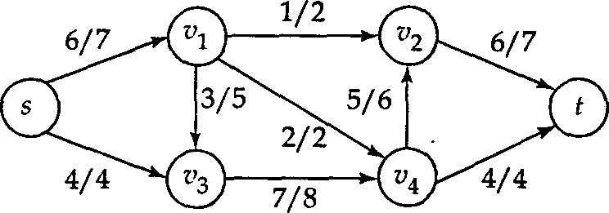
In Class exercise: Find an augmenting path p and use it to augment the flow along p. Draw the flow network of the augmented flow.

Slide 23
Why do we need residual networks?
Residual networks allow us to reverse flows if necessary.
If we have taken a bad path then residual networks allow one to detect the condition and reverse the flow.
A bad path is one which overlaps with too many other paths.

Slide 24
Example
a
Source
1
1
Destination
1
1
1
b
Paths source, a, destinations and source, b destination gives a flow of 2 units.
Path source, a, b, destination overlaps with both the optimal paths.
If we initially choose source, a, b, destination as our path, then no greedy strategy will be able to augment the network flow any further (unless we use residual edges which allows recovery)
Verify how we recover in spite of the initial bad choice, if we use the residual network to augment flows.

Slide 25
Augmenting Paths
An augmenting path p is a simple path from s to t on the residual network.
We can put more flow from s to t through p.
We call the maximum capacity by which we can increase the flow on p the residual capacity of p.

Slide 26
Augmenting Paths - example
The residual capacity of p = 4.
Can improve the flow along p by 4.

Slide 27
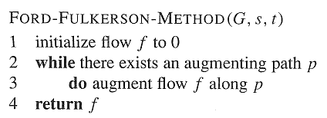
Ford-Fulkerson Method

Slide 28
Example
augmenting path
Original Network
Resulting Flow =4

Slide 29
Example
Resulting
Flow = 4
augmenting path
Residual Network

Slide 30
Example
Residual Network
Resulting Flow =11

Slide 31
Example
Resulting
Flow =11
augmenting path
Residual Network

Slide 32
Example
Residual Network
Resulting
Flow =19

Slide 33
Example
Resulting
Flow = 19
augmenting path
Residual Network

Slide 34
Example
Residual Network
Resulting
Flow = 23

Slide 35
Example
Resulting
Flow = 23
No augmenting path:
Maxflow=23
Residual Network
The residual network Gf contains no
augmented paths. So f is a maximum
flow in G.

Slide 36
Ford-Fulkerson method, with details
Ford-Fulkerson(G,s,t)
1 for each edge (u,v)∈G.E do
2 f(u,v) = f(v,u) = 0
3 while ∃ path p from s to t in residual network G_{f} do
4 c_{f} = min{c_{f}(u,v): (u,v)∈p}
5 for each edge (u,v) in p do
6 f(u,v) = f(u,v) + c_{f}
7 f(v,u) = -f(u,v)
8 return f
The algorithms based on this method differ in how they choose p in step 3.

Slide 37
Time Analysis I
A complete analysis establishing which specific method is best is a complex task, however, because their running times depend on
The number of augmenting paths needed to find a maxflow
The time needed to find each augmenting path

Slide 38
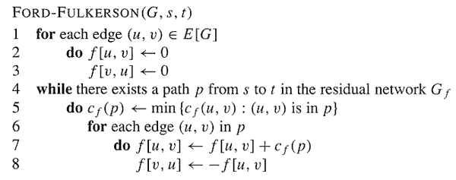
Analysis
O(E)
O(E)

Slide 39
Analysis
If capacities are all integer, then each augmenting path raises |f| by ≥ 1.
If max flow is f*, then need ≤ |f*| iterations
So time is O(E|f*|).
Note that this running time is not polynomial in input size. It depends on |f*|, which is not a function of |V| or |E|.
If capacities are rational, can scale them to integers.
If irrational, FORD-FULKERSON might never terminate!

Slide 40
The basic Ford-Fulkerson Algorithm
With time O ( E |f*|), the algorithm is not polynomial.
This problem is real: Ford-Fulkerson may perform very badly if we are unlucky:
|f*|=2,000,000

Slide 41
Run Ford-Fulkerson on this example
Augmenting Path
Residual Network

Slide 42
Run Ford-Fulkerson on this example
Augmenting Path
Residual Network

Slide 43
Run Ford-Fulkerson on this example
Repeat 999,999 more times…

Slide 44
The Edmonds-Karp Algorithm
A small fix to the Ford-Fulkerson algorithm makes it work in polynomial time.
Specify how to compute the path in line 4.

Slide 45
The Edmonds-Karp Algorithm
Compute the path in line 4 using breadth-first search on residual network.
The augmenting path p is the shortest path from s to t in the residual network (treating all edge weights as 1).
Runs in time O(V E²).

Slide 46
The Edmonds-Karp Algorithm - example
Edmonds-Karp’s algorithm runs only 2 iterations on this graph.

Slide 47
Time Complexity
Let, total number of flow augmentations performed by Edmonds-Karp algorithm is O(VE)
BFS to find the augmented path – O(E)
So, Total running time is O(VE²)

Slide 48
Conditions
If f is a flow in a flow network G=(V,E), with source s and sink t, then the following conditions are equivalent:
f is a maximum flow in G.
The residual network G_{f} contains no augmented paths.
|f| = c(S,T) for some cut (S,T) (a min-cut).
It is a flow since there is no augmented paths It is maximum since the sink is not reachable from the source

Slide 49
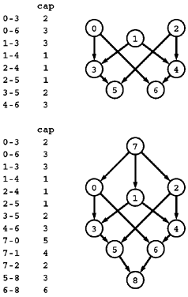
R1: Multiple sources and sinks
Problem:
What if you have a problem with more than one source and more than one sink?
The network at the top has three sources (0, 1, and 2) and two sinks (5 and 6).
Reduction: Create a network which
is a copy of the original network
with the addition of a new source 7 and
a new sink 8.
There is an edge from 7 to each original-network source with capacity equal to the sum of the capacities of that source's outgoing edges,
an edge from each original-network sink to 8 with capacity equal to the sum of the capacities of that sink's incoming edges.

Slide 50
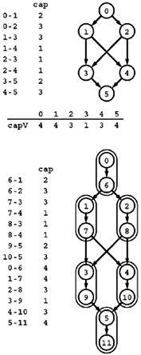
R2: Removing vertex capacities
Problem:
Given a flow network, find a maxflow satisfying additional constraints specifying that the flow through each vertex must not exceed some fixed capacity.
Reduction: Create a new network
Associate a new vertex u* (where u* denotes u+V) with each vertex u,
add an edge u->u* whose capacity is the capacity of u,
include an edge u*->v for each edge u->v.

Slide 51
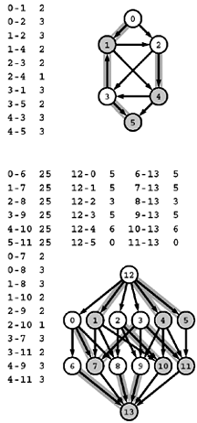
R3: Reduction to acyclic network
Problem:
Find a maxflow in an acyclic network.
Reduction: Create a new network where
Each vertex u in the top network corresponds to two vertices u and u* (where u* denotes u+V) in the bottom network,
each edge u-v in the top network corresponds to an edge u-v* in the bottom network.
Additionally, the bottom network has uncapacitated edges u-u*
a source s with an edge to each unstarred vertex,
a sink t with an edge from each starred vertex.

Slide 52
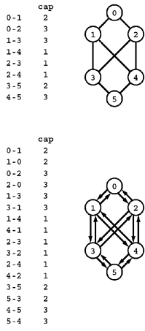
R4: Reduction from undirected networks
Problem:
Given an undirected weighted graph find the maximum flow
Reduction: Create a network s.t.
we can consider it to be a directed network with edges in each direction.

Slide 53
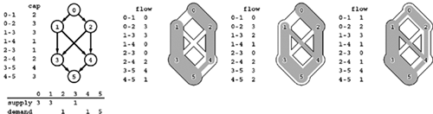
R5: Feasible flow
Problem:
Suppose that a weight is assigned to each vertex in a flow network and is to be interpreted as supply (if positive) or demand (if negative), with the sum of the vertex weights equal to zero. Define a flow to be feasible if the difference between each vertex's outflow and inflow is equal to that vertex's weight (supply if positive and demand if negative). Given such a network, determine whether or not a feasible flow exists.

Slide 54
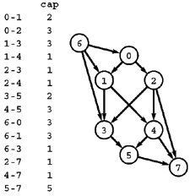
R5: Reduction from feasible solution
Reduction: Create a network
by adding edges from a new source vertex to the supply vertices (each with capacity equal to the amount of the supply) and
edges to a new sink vertex from the demand vertices (each with capacity equal to the amount of the demand).
The network has a feasible flow if and only if this network has a flow (a maxflow) that fills all the edges from the sink and all the edges to the source.

Slide 55
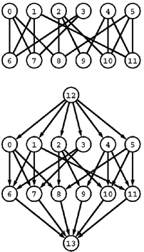
R6: Bipartite matching
Problem:
Given a bipartite graph, find a set of edges of maximum cardinality such that each vertex is connected to at most one other vertex.
Reduction: Construct an st-network
by directing all the edges from the top row to the bottom row,
adding a new source with edges to each vertex on the top row,
adding a new sink with edges to each vertex on the bottom row, and
assigning capacity 1 to all edges.
In any flow, at most one outgoing edge from each vertex on the top row can be filled and at most one incoming edge to each vertex on the bottom row can be filled, so a solution to the maxflow problem on this network gives a maximum matching for the bipartite graph.

Slide 56
Model for Matching Problem
Group1 on leftmost set, Group2 on rightmost set, edges if they are compatible
A
A
X
A
X
X
B
B
B
Y
Y
Y
C
C
C
Z
Z
D
Z
D
D
G1
G2
A matching
Optimal matching

Slide 57
Solution Using Max Flow
Add a supersouce, supersink, make each undirected edge directed with a flow of 1
A
A
X
X
B
B
t
Y
s
Y
C
C
Z
Z
D
D
Since the input is 1, flow conservation prevents multiple matchings

Slide 58
Edge Connectivity
What is the minimum number of edges that need to be removed to separate a given graph into two pieces?
Find a set of edges of minimal cardinality that does this separation.

Slide 59
Vertex Connectivity
What is the minimum number of vertices that need to be removed to separate a given graph into two pieces?
Try yourself

