Slide 1
CSE245 –Algorithms
Number Theoretic Algorithms
Chapter 31

Slide 2
Divisors
Let a, b and c be integers such that
a = b ·c .
Then b and c are said to divide (or are factors) of a; while a is said to be a multiple of b (as well as of c). The pipe symbol “|” denotes “divides” so the situation is summarized by:
b | a ∧ c | a .

Slide 3
Divisors Examples
Q: Which of the following is true?
77 | 7
7 | 77
24 | 24
0 | 24
24 | 0

Slide 4
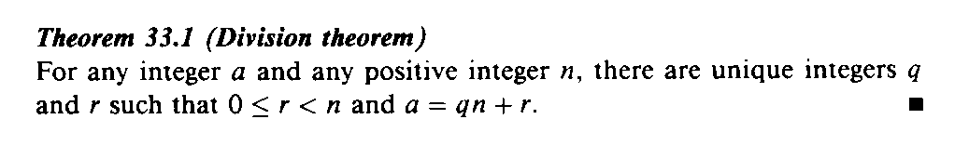
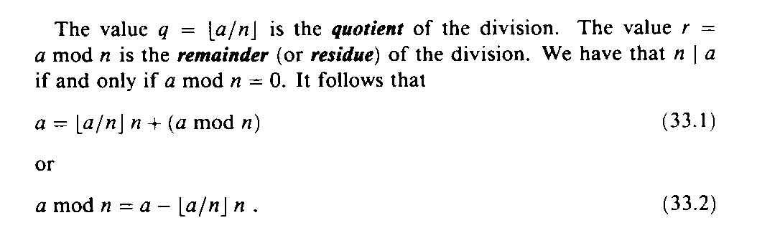
Division & Remainders
31.1

Slide 5
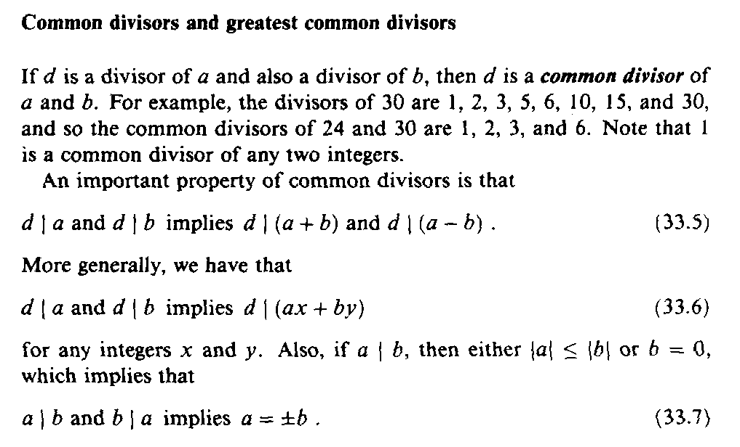
Common Divisors

Slide 6
Greatest Common Divisor Relatively Prime
Let a,b be integers, not both zero. The greatest common divisor of a and b (or gcd(a,b) ) is the biggest number d which divides both a and b.
a and b are said to be relatively prime if gcd(a,b) = 1, so no prime common divisors.

Slide 7
Greatest Common Divisor Relatively Prime
Q: Find the following gcd’s:
gcd(11,77)
gcd(33,77)
gcd(24,36)
gcd(24,25)

Slide 8
Greatest Common Divisor Relatively Prime
A:
gcd(11,77) = 11
gcd(33,77) = 11
gcd(24,36) = 12
gcd(24,25) = 1. Therefore 24 and 25 are relatively prime.
NOTE: A prime number are relatively prime to all other numbers which it doesn’t divide.

Slide 9
Greatest Common Divisor Relatively Prime
EG: More realistic. Find gcd(98,420).
Find prime decomposition of each number and find all the common factors:
98 = 2·49 = 2·7·7
420 = 2·210 = 2·2·105 = 2·2·3·35
= 2·2·3·5·7
Underline common factors: 2·7·7, 2·2·3·5·7
Therefore, gcd(98,420) = 14

Slide 10
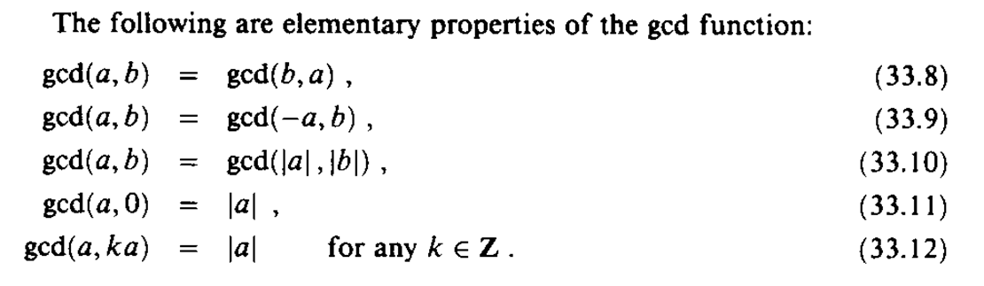
Greatest Common Divisor

Slide 11
The GCD and Linear Combinations
Theorem 31.2: If a and b are integers not both 0, then gcd(a, b) is the smallest positive element of the set {ax + by : x, y are integers} of linear combinations of a and b. Proof: see text p. 853.

Slide 12
The GCD and Linear Combinations (2)
Corollaries:
For any integers a and b, if d|a and d|b then d|gcd(a, b).
For all integers a and b and any nonegative integer n, gcd(an, bn) = n gcd(a, b).
For all positive integers n, a, and b, if n|ab and gcd(a, n) = 1, then n|b.

Slide 13
Relatively Prime Integers
Two integers a and b are relatively prime if and only if their only common divisor is 1 (i.e., gcd(a, b) = 1).
Theorem 31.6: For any integers a, b, and p, if both gcd(a, p) = 1 and gcd(b, p) = 1, then gcd(ab, p) = 1. Proof: p. 854 in text.

Slide 14
Divisibility by Primes
Theorem 31.7: For all primes p and all integers a, b, if p|ab, then p|a or p|b (or both). Proof: p. 854 in text

Slide 15
The Unique Factorization Theorem
Theorem 31.8 (Unique Factorization): A composite number a can be written in exactly one way as a product of the form
where the p_{i} are prime, p₁ < p₂ < …< p_{r}, and the e_{i} are positive integers. Proof: Exercise 31.1-10 in text

Slide 16
The GCD Recursion Theorem
Theorem 31.9 (GCD recursion theorem): For any nonnegative integer a and any positive integer b, gcd(a, b) = gcd(b, a mod b). Proof: p. 857 of the text.

Slide 17
Euclid’s Algorithm – Finding GCD
Based on the following theorem
gcd(a, b) = gcd(b, a mod b)
Proof
If d = gcd(a, b), then d|a and d|b
For any positive integer b, a = kb + r ≡ r mod b, a mod b = r
a mod b = a – kb (for some integer k)
because d|b, d|kb
because d|a, d|(a mod b)
∴ d is a common divisor of b and (a mod b)
Conversely, if d is a common divisor of b and (a mod b), then d|kb and d|[ kb+(a mod b)]
d|[ kb+(a mod b)] = d|a
∴ Set of common divisors of a and b is equal to the set of common divisors of b and (a mod b)
ex) gcd(18,12) = gcd(12,6) = gcd(6,0) = 6
gcd(11,10) = gcd(10,1) = gcd(1,0) = 1

Slide 18
Euclid’s GCD Algorithm
Euclid(a, b):
if (b == 0)
return a
else
return Euclid(b, a mod b)

Slide 19
Euclid’s Algorithm – Finding GCD
Recursive algorithm
Function Euclid (a, b) /* assume a ≥ b ≥ 0 */
if b = 0 then return a
else return Euclid(b, a mod b)
Iterative algorithm
Euclid(d, f) /* assume d > f > 0 */
1. X ← d; Y ← f
2. if Y=0 return X = gcd(d, f)
3. R = X mod Y
4. X ← Y
5. Y ← R
6. goto 2

Slide 20
Euclid’s Algorithm Example
Euclid(1155, 546) =
Euclid(546, 63) =
Euclid(63, 42) =
Euclid(42, 21) =
Euclid(21, 0)
The gcd of 1155 and 546 is 21.

Slide 21

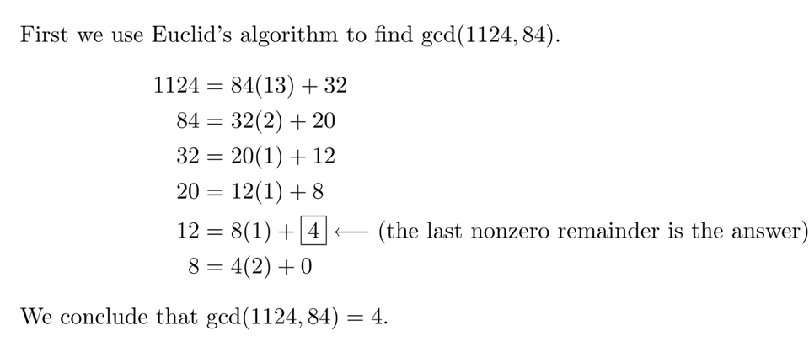
In Class Exercise

Slide 22
Properties of Euclid’s Algorithm
Since the second argument is monotonically decreasing, and the gcd is positive, the algorithm terminates.
Theorem 31.9 implies that the algorithm computes the gcd correctly.

Slide 23
Extended Euclidean Algorithm
You are given two integer number a and b. Find integer coefficients x and y such that
d=gcd(a, b) = ax+by
The extended Euclidean algorithm works the same as the regular Euclidean algorithm except that we keep track of more details –namely the quotient q = a/b in addition to the remainder r = a mod b. This allows us to backtrack and write the gcd(a,b) as a linear combination of a and b.

Slide 24
Extended Euclid’s Algorithm
ExtEuclid(a, b):
if b == 0
return (a, 1, 0)
(d´, x´, y´) ← ExtEuclid(b, a mod b)
(d, x, y) ← (d´, y´, x´-floor(a/b)·y´) return (d, x, y)
d = gcd(a, b) = ax + by

Slide 25
Extended Euclid’s Algorithm
Suppose a and b are given. Find x and y such that,
ax+by=gcd (a,b)
Let, d=gcd(a,b)
Then, ax+by=d [by Thm 31.2]
Again, gcd(a,b)=gcd(b, a mod b)
So, ax+by = d = bx´+(a mod b)y´
We know that, a = b.⎣a/b⎦+a mod b
So, a mod b = a – b.⎣a/b⎦
Thus, ax+by = bx´+(a – b.⎣a/b⎦).y´
= ay´+b(x´- ⎣a/b⎦.y´)
Finally, x = y´
y =x´- ⎣a/b⎦.y´

Slide 26
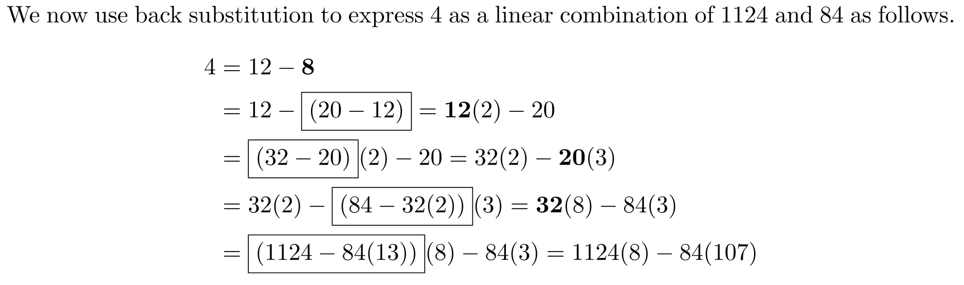
Extended Euclid’s Example

Slide 27
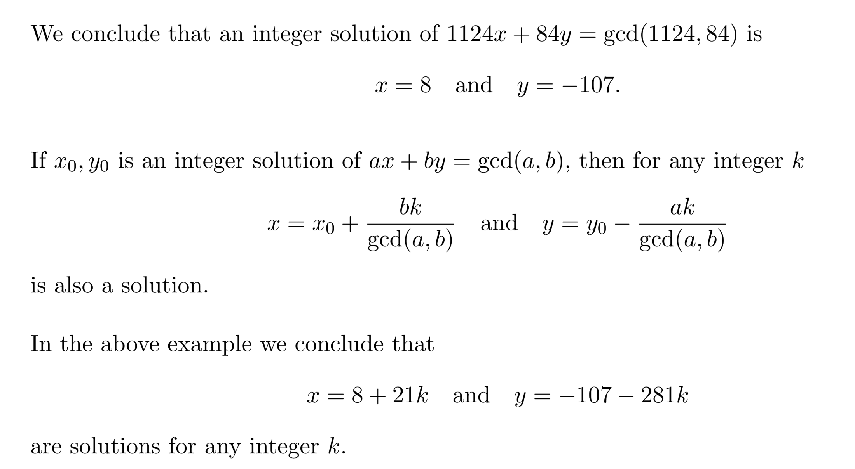
Extended Euclid’s Example

