Slide 1
Powerpuff Shell
THE UNIX SHELL

Slide 2
Presenting By:
S.M. Saikat Hossain
ID: 2016-2-60-068
Shaykh Siddique
ID: 2016-1-60-053
Jannatul Ferdous Sorna
ID: 2016-1-60-029
Shaik Md. Ibnay-Monen
ID: 2016-2-60-100
Md. Jadid Mustafiz
ID: 2014-3-60-29

Slide 3
Overview
Introduction
Shell, Unix Shell, Scripting Language
Different types of Shell
Software Structure
Parsing commands.
Command Structure.
Command description.
Command execution.
Terminology
Working mechanism
Conclusion

Slide 4
Introduction
Users communicate with operating system (kernel) through a program known as the Shell
Shell
GUI
CLI
GUI: Graphical User Interface
CLI: Command Line Interface

Slide 5
Introduction
Translates commands provided by the user and converts it into a language that is understood by the operating system (kernel).
Commands or scripts are varies from shell to shell. These are called scripting language.
Different types of scripting language: Bash, Batch.

Slide 6
Introduction
Servers, Raspberry Pi and many computers use remote shell controlling system for operating from distance.
E.g. Command Prompt(Windows), Terminal(Unix), Tilix(Unix), Parrot(Parrot-Linux) and many other third party open source shell.

Slide 7
Software Structure
Parsing: Resolve an input into its component parts and describe their syntactic roles.
Parsing Simulator: Primary stage parsing simulation we used an open source software called ANTLR.
For multiple commanding, each and every command will be separated by semicolon(;) .
For a single command parsing will be executed identifying by space.

Slide 8
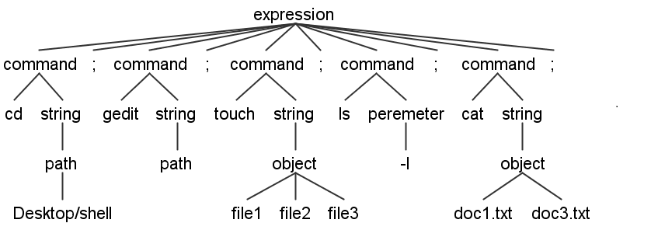
Software Structure
Valid parsing tree:
Commands: $ cd Desktop/shell;
$ gedit;
$ touch file1 file2 file3;
$ ls -l;
$ cat doc1.txt doc3.txt;

Slide 9
Software Structure
Working Commands:
cd [path];
ls;
mkdir [folder]+;
touch [file]+;
cp [source] [destination];
cat [object]+;
echo [string]+;
clear;
exit;

Slide 10
Software Structure
Command cd
cd [path]
Change Directory
Path of the directory where to go
Using a function called chdir(directory), where parameter directory is the path.

Slide 11
Software Structure
Command ls
Opening current directory, read and print all files and folder names. Using opendir(param), where param is the path of directory.
For reading files and folder names, readdir(dr), where dr is the current directory object and this function is return the names of all files and folders.

Slide 12
Software Structure
Command mkdir
mkdir [folder1] [folder2] . . .
Make directory
Name of the new folder
For multiple folder creation.
Using a function mkdir(param1, param2), where param1 is the name of new folder and param2 is the permission of this folder. Here we use the permission (777) read, write, and execute.

Slide 13
Software Structure
Command touch
touch [file1] [file2] . . .
Create file
Name of the new file
For multiple files creation.
Creating a file just in write mode.

Slide 14
Software Structure
Command cat
cat [folder1] [folder2] . . .
Printing resource from files
Name of file
For multiple files printing
Open all of those files, read and print in console.

Slide 15
Software Structure
Command echo
echo [string1] [string2] . . .
Printing command
String that want to print
For multiple string printing
Just printing all strings.

Slide 16
Software Structure
Command cp
cp [source] [destination]
Copy file
Path and name of source file
Path and name of destination file
Opening the source file, load all the data into program. Then go to destination file, create that destination file and write all data.

Slide 17
Software Structure
Command clear
Command clear is used to clear the screen of console.
Command exit
Command exit is used to terminate the program.

Slide 18
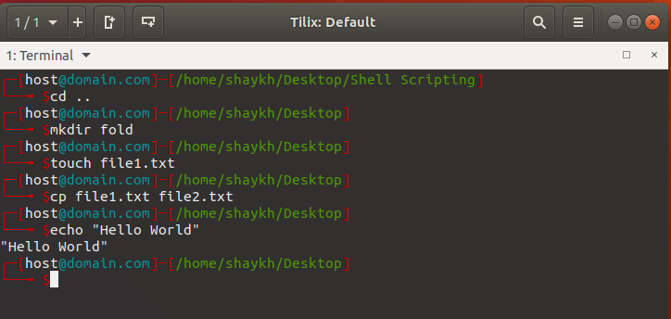
Terminology
We used C programming language to develop this shell.
Executing Commands

Slide 19
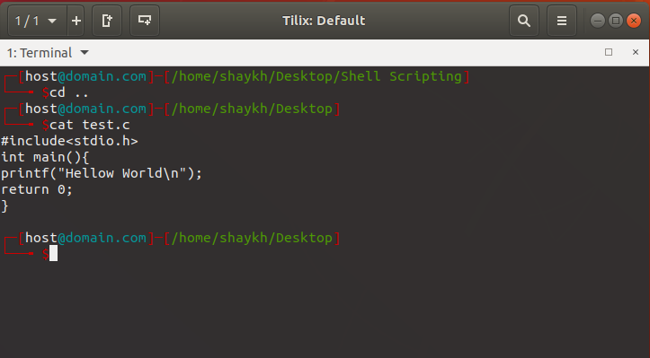
Terminology
Executing cat command

Slide 20
Conclusion
Without a shell we have just plenty of files, but we cannot access this.
For remote access of a server shell is one of the best way.
Many kind of web server uses shell for maintaining their client file access.
All kind of VPS server uses shell to communicate with kernel.

Slide 21


