Slide 1
Computer Architecture
Course Code: CSE360
Lecture 8
Computer Arithmetic

Slide 2
Arithmetic & Logic Unit (ALU)
ALU is a part of the computer that actually performs arithmetic and logical operation on the data.
All of other elements of the computer system-control unit, registers, memory, I/O- are there mainly to bring data into ALU for it to process and then to take the results back out.
Handles integers
May handle floating point (real) numbers
May be separate maths co-processor

Slide 3
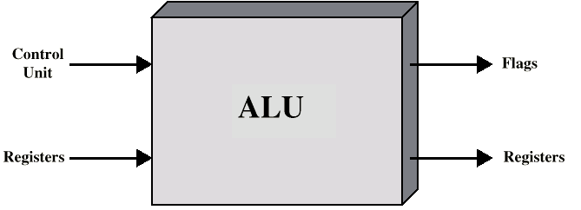
ALU Inputs and Outputs
ALU is interconnected with the processor
Data are presented to the ALU in registers, and the results of an operation are stored in registers
These registers are temporary storage locations within the processor
The ALU may also set flags as the result of operation (e.g. an overflow flag is set to 1 if the result of computation exceeds the length of the register into which it is to be stored).
The control unit provides signals that control the operation of the ALU and the movement of the data into and out of the ALU

Slide 4
Integer Representation
In the binary number system, arbitrary numbers can be represented with only 0 & 1, the minus sign, and the period (radix point)
For purpose of computer storage and processing, we do not have benefit of minus sign and periods
If we are limited to nonnegative integers, the representation is straightforward.
Positive numbers stored in binary
  e.g. 41=00101001

Slide 5
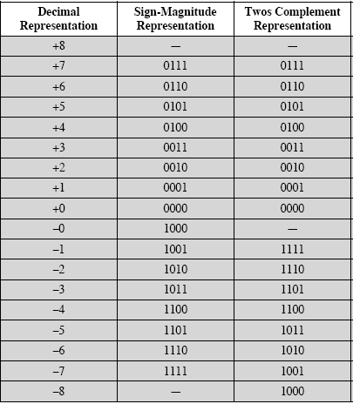
Sign-Magnitude
Left most bit is sign bit
0 means positive
1 means negative
+18 = 00010010
-18 = 10010010 (sign magnitude)
Problems to sign magnitude representation
  Need to consider both sign and magnitude in arithmetic
  Two representations of zero (+0 and -0)
  +0 = 00000000, -0 = 10000000 (sign magnitude)

Slide 6
Two’s Compliment
Like sign magnitude, twos complement representation uses the most significant bit as a sign bit (whether the integer is positive or negative)
But representation is different (Table 9.2, Page 280)
+3 = 00000011
+2 = 00000010
+1 = 00000001
+0 = 00000000
-1 = 11111111
-2 = 11111110
-3 = 11111101

Slide 7
Benefits
One representation of zero
Arithmetic works easily (see later)
Negating is fairly easy
  3 = 00000011
  Boolean complement gives 11111100
  Add 1 to LSB 11111101

Slide 8
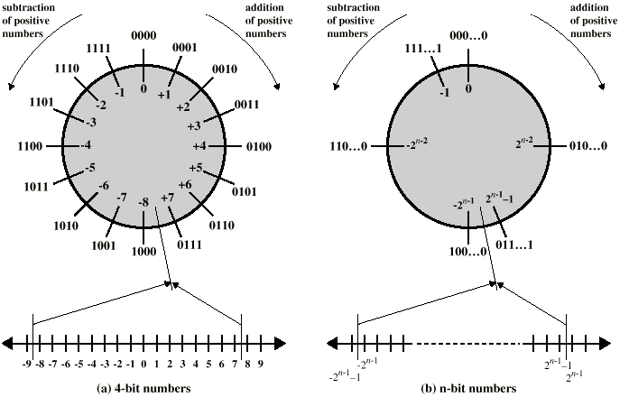
Geometric Depiction of Twos Complement Integers

Slide 9
Negation Special Case 1
0 = 00000000
Bitwise not 11111111
Add 1 to LSB +1
Result 1 00000000
Overflow is ignored, so:
- 0 = 0 √

Slide 10
Negation Special Case 2
-128 = 10000000
bitwise not 01111111
Add 1 to LSB +1
Result 10000000
So:
-(-128) = -128 X
Monitor MSB (sign bit)
It should change during negation

Slide 11
Range of Numbers
8 bit 2s compliment
  +127 = 01111111 = 2⁷ -1
  -128 = 10000000 = -2⁷
16 bit 2s compliment
  +32767 = 011111111 11111111 = 2¹⁵ - 1
  -32768 = 100000000 00000000 = -2¹⁵

Slide 12
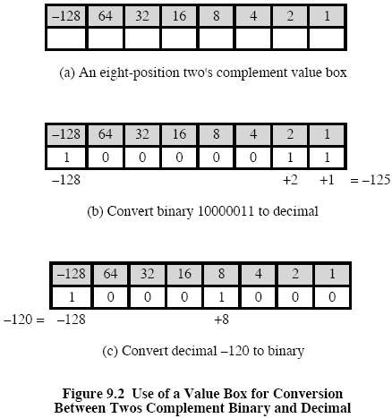
Conversion Between Lengths

Slide 13
Conversion Between Lengths
Positive number pack with leading zeros
+18 = 00010010
+18 = 00000000 00010010
Negative numbers pack with leading ones
-18 = 10010010
-18 = 11111111 10010010
i.e. pack with MSB (sign bit)

Slide 14
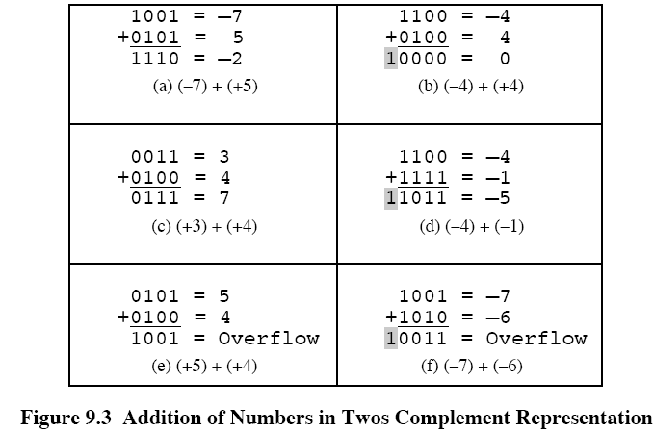
Addition and Subtraction
Normal binary addition
Carry bit beyond the end of word (shading), which is ignored
Monitor sign bit for overflow

Slide 15
Addition and Subtraction
Subtraction rule: Take twos compliment of subtrahend and add to minuend
  i.e. a - b = a + (-b)
So we only need addition and complement circuits

Slide 16
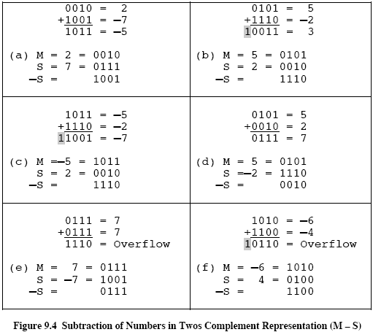
Addition and Subtraction

Slide 17
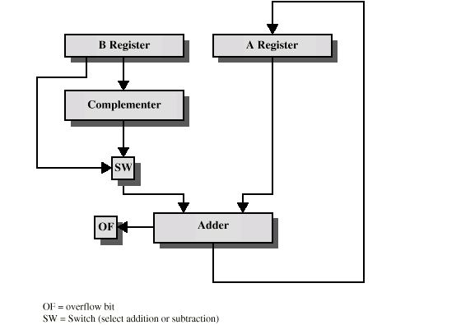
Hardware for Addition and Subtraction

Slide 18
Multiplication
Complex
Work out partial product for each digit
Take care with place value (column)
Add partial products

Slide 19
Multiplication Example
1011 Multiplicand (11 dec) [M]
x 1101 Multiplier (13 dec) [Q]
1011 Partial products
0000 Note: if multiplier bit is 1 copy
1011 multiplicand (place value)
1011 otherwise zero
10001111 Product (143 dec)
Note: need double length result

Slide 20
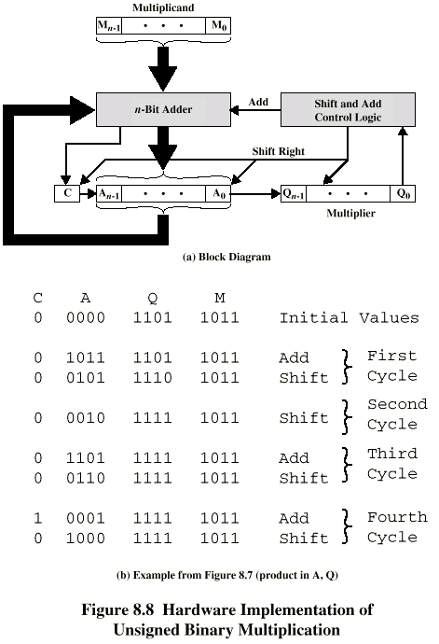
Unsigned Binary Multiplication

Slide 21
Execution of Example

Slide 22
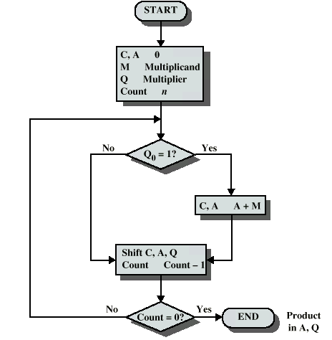
Flowchart for Unsigned Binary Multiplication

Slide 23
Multiplying Negative Numbers
This does not work!
Solution 1
  Convert to positive if required
  Multiply as above
  If signs were different, negate answer
Solution 2
  Booth’s algorithm

Slide 24
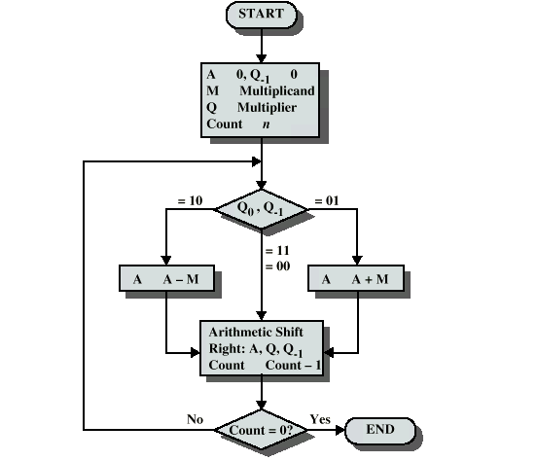
Booth’s Algorithm

Slide 25
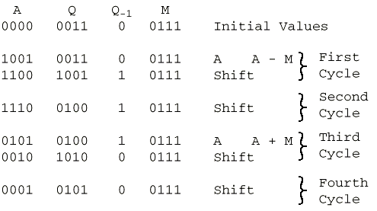
Example of Booth’s Algorithm

Slide 26
Division
More complex than multiplication
Negative numbers are really bad!
Based on long division

Slide 27
Division of Unsigned Binary Integers
00001101
Quotient
Divisor
1011
10010011
Dividend
1011
001110
Partial
Remainders
1011
001111
1011
Remainder
100

Slide 28
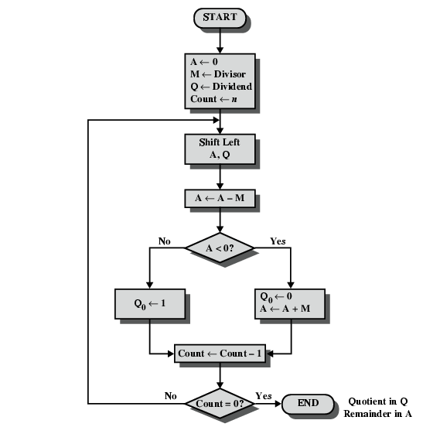
Flowchart for Unsigned Binary Division

Slide 29
Real Numbers
Numbers with fractions
Could be done in pure binary
  1001.1010 = 2³ + 2⁰ +2⁻¹ + 2⁻³ =9.625
Where is the binary point?
Fixed?
  Very limited
Moving?
  How do you show where it is?

Slide 30
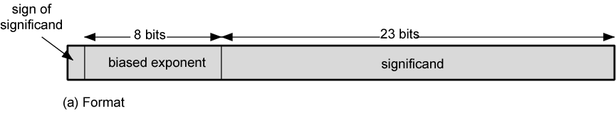
Floating Point
+/- .significand x 2^{exponent}
Misnomer
Point is actually fixed between sign bit and body of mantissa
Exponent indicates place value (point position)

Slide 31
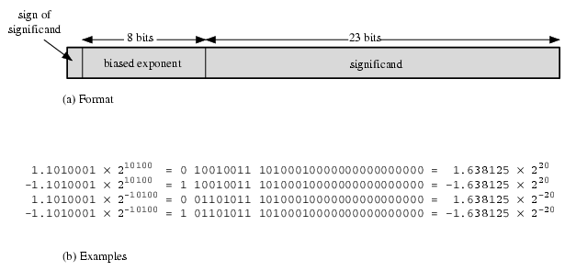
Floating Point Examples

Slide 32
Signs for Floating Point
Mantissa is stored in 2s compliment
Exponent is in excess or biased notation
  e.g. Excess (bias) 128 means
  8 bit exponent field
  Pure value range 0-255
  Subtract 128 to get correct value
  Range -128 to +127

Slide 33
Normalization
FP numbers are usually normalized
i.e. exponent is adjusted so that leading bit (MSB) of mantissa is 1
Since it is always 1 there is no need to store it
(c.f. Scientific notation where numbers are normalized to give a single digit before the decimal point
e.g. 3.123 x 10³)

Slide 34
FP Ranges
For a 32 bit number
  8 bit exponent
  +/- 2²⁵⁶ ≈ 1.5 x 10⁷⁷
Accuracy
  The effect of changing lsb of mantissa
  23 bit mantissa 2⁻²³ ≈ 1.2 x 10⁻⁷
  About 6 decimal places

Slide 35
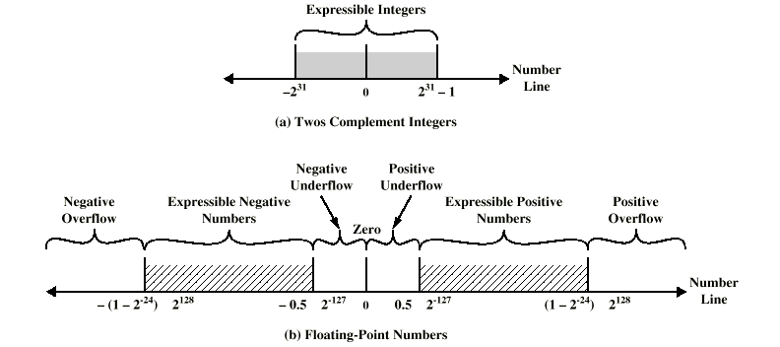
Expressible Numbers

Slide 36
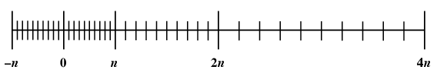
Density of Floating Point Numbers

Slide 37
FP Arithmetic +/-
Check for zeros
Align significands (adjusting exponents)
Add or subtract significands
Normalize result

Slide 38
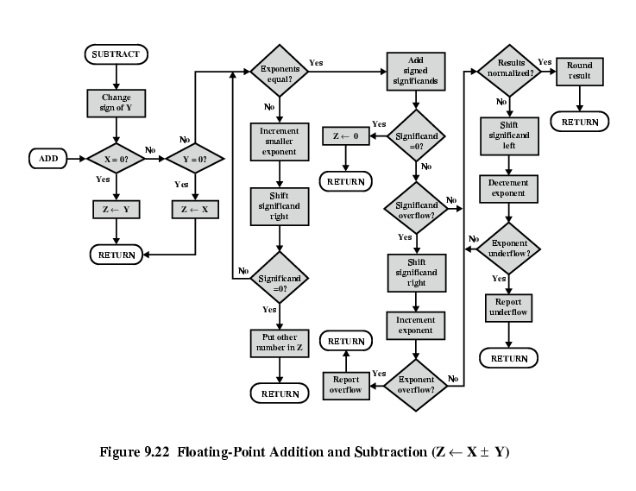
FP Addition & Subtraction Flowchart

Slide 39
FP Arithmetic x/÷
Check for zero
Add/subtract exponents
Multiply/divide significands (watch sign)
Normalize
Round
All intermediate results should be in double length storage

Slide 40
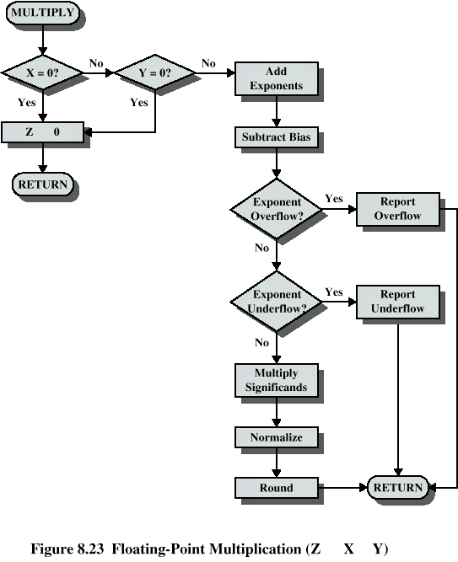
Floating Point Multiplication

Slide 41
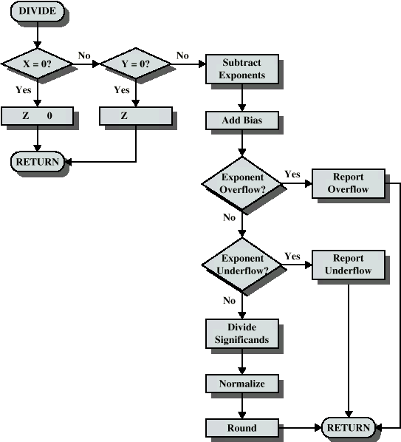
Floating Point Division

