Slide 1

Computer Architecture
Course Code: CSE360
Lecture 11
CPU Structure and Function

Slide 2
CPU Structure
CPU must:
  Fetch instructions: The processor reads an instruction from memory (register, cache, main memory).
  Interpret instructions: The instruction is decoded to determine what action is required.
  Fetch data: The execution of an instruction may require reading data from memory or I/O module
  Process data: The execution of an instruction may require performing some arithmetic or logical operation on data
  Write data: The results of an execution may require writing data to memory or I/O module.
Notes:
22

Slide 3
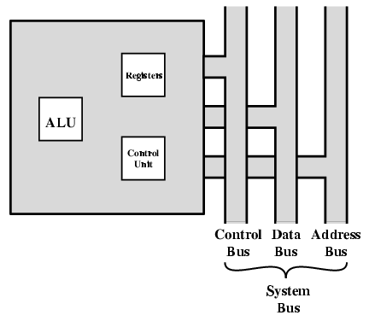
CPU With Systems Bus
ALU performs actual computation or processing of data.
The control unit controls the movement of data and instructions into and out of the processors, and controls the operation of ALU
Registers, minimal internal memory consisting of a set of storage locations
- processors need to store some data temporarily while execution of instructions as it needs to remember the location of last instruction to get the next instruction

Slide 4
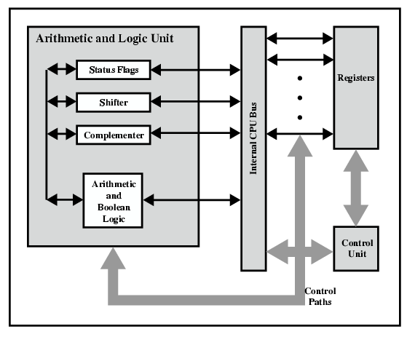
CPU Internal Structure
Data transfer and logic control paths are indicated (bold arrow), including an element labeled internal processor bus.
Internal processor bus is needed to transfer data between the various registers and the ALU. This is because, ALU operates only on data in the internal processor memory (e.g., registers)

Slide 5
Control & Status Registers
Program Counter (PC): Contains the address of an instruction to be fetched
Instruction Register (IR): Contains the instruction most recently fetched
Memory Address Register (MAR): Contains the address of a location in memory
Memory Buffer Register (MBR): Contains a word of data to be written to memory or the word most recently read.
Notes:
30

Slide 6
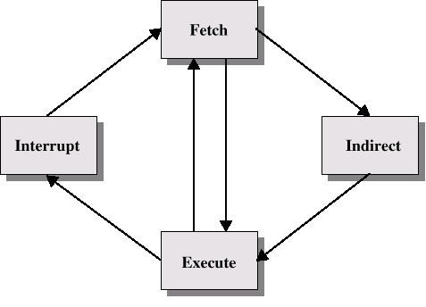
Instruction Cycle with Indirect

Slide 7

Instruction Cycle State Diagram
Once an instruction is fetched, its operand specifiers must be identified.
Each input operand in memory is then fetched and this process may require indirect addressing
Registers based operands need not be fetched.
Once the operand is executed, similar process may be needed to store the result in main memory

Slide 8
Data Flow (Instruction Fetch)
Depends on CPU design
In general:
Fetch
  PC contains address of next instruction
  Address moved to MAR
  Address placed on address bus
  Control unit requests memory read
  Result placed on data bus, copied to MBR, then to IR
  Meanwhile PC incremented by 1

Slide 9

Data Flow (Fetch Diagram)

Slide 10
Data Flow (Data Fetch)
IR is examined
If indirect addressing, indirect cycle is performed
  Right most N bits of MBR which contain the operand address, are transferred to MAR
  Control unit requests memory read
  Result (operand fetch) moved to MBR

Slide 11

Data Flow (Indirect Diagram)

Slide 12
Data Flow (Execute)
May take many forms
Depends on instruction being executed
May include
  Read/write from memory or I/O
  Transferring data among register
  ALU operations

Slide 13
Data Flow (Interrupt)
Simple
Predictable
Current PC saved to allow processor to resume activity after interrupt
Contents of PC copied to MBR to be written into memory through data bus
Special memory location reserved for this purpose is loaded into MAR from the control unit
PC loaded with address of interrupt handling routine
Next instruction (first of interrupt handler) can be fetched

Slide 14

Data Flow (Interrupt Diagram)

Slide 15
Prefetch
Fetch accessing main memory
Execution usually does not access main memory
Can fetch next instruction during execution of current instruction
Called instruction prefetch
Notes:
36

Slide 16
Improved Performance
But not doubled:
  Fetch usually shorter than execution
    Prefetch more than one instruction?
  Any jump or branch means that prefetched instructions are not the required instructions
Add more stages to improve performance
Notes:
37

Slide 17
Pipelining
Processors make use of instruction pipelining to speed up execution.
Pipeline involves breaking up the instruction cycle into number of separate stages that occur in sequence, such as fetch instruction, decode instruction, calculate operands, fetch operands, execute instructions, and write result (6)
Overlap these operations
Instructions move through these stages, as on an assembly line, so that , each stage can work with different instructions at the same time
Notes:
38

Slide 18
Two-Stage Instruction Pipeline
The pipeline has two independent stages
The first stage fetches an instruction and buffers it
When the second stage is free, the first stage passes it the buffered instruction
While the second stage is executing the instruction, the first stage takes advantage of unused memory cycles to fetch and buffer the next instruction
This is called instruction fetch/fetch overlap
Notes:
38

Slide 19
Two-Stage Instruction Pipeline-contd..
It should be clear that this process will speed up instruction execution.
If the fetch and execute stages were of equal duration, the instruction cycle time would be halved, but unlikely for two reasons:
(1)The execution time will generally be longer than the fetch time. Execution will involve reading and storing operands and the performance of some operation. Thus, the fetch stage may have to wait for some time before it can empty its buffer.
(2) A conditional branch instruction makes the address of the next instruction to be fetched unknown. Thus, the fetch stage must wait until it receives the next instruction address from the execute stage. The execute stage may then have to wait while the next instruction is fetched.
Notes:
38

Slide 20
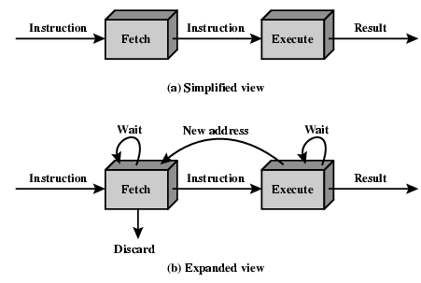
Two Stage Instruction Pipeline
Guessing can reduce the time loss from the second reason
When a conditional branch instruction is passed from fetch to the execute stage, the fetch stage fetches the next instruction in memory after the branch instruction
Then, if the branch is not taken, no time is lost
If the branch is taken, the fetched instruction must be discarded and a new instruction fetched

Slide 21
Decomposition of the Instruction Processing
While the factors reduce the potential effectiveness of the two stage pipeline, some speed up occurs
To gain further speedup, the pipeline must have some more stages:
Fetch instruction (FI)
Decode instruction (DI)
Calculate operands (CO)
Fetch operands (FO)
Execute instructions (EI)
Write operand (WO)
Notes:
38

Slide 22
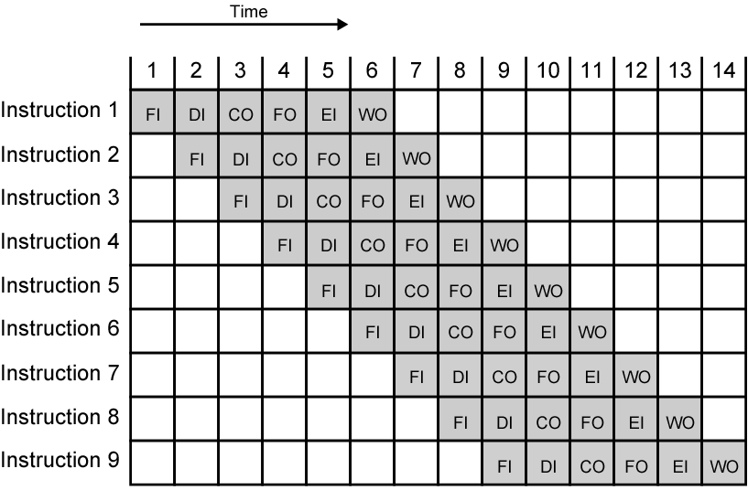
Timing Diagram for
Instruction Pipeline Operation
A six stage pipeline can reduce the execution for 9 instructions from 54 time units to 14 time units
Time is set by assuming that each instruction requires all six stages and all of the stages can be performed in parallel
There are no memory conflicts (e.g. FI, FO, and WO involve memory access and occur simultaneously)
Most memory system will not permit as desired value may be in cache and FO and WO stage may be null; memory conflicts will not slow down the pipeline
Notes:
39

Slide 23
Factors to Limit the performance
If six stages are not of equal duration, there will be some waiting involved at various pipeline stages
Another difficulty is the conditional branch instruction which can invalidate several instruction fetches
Notes:
38

Slide 24
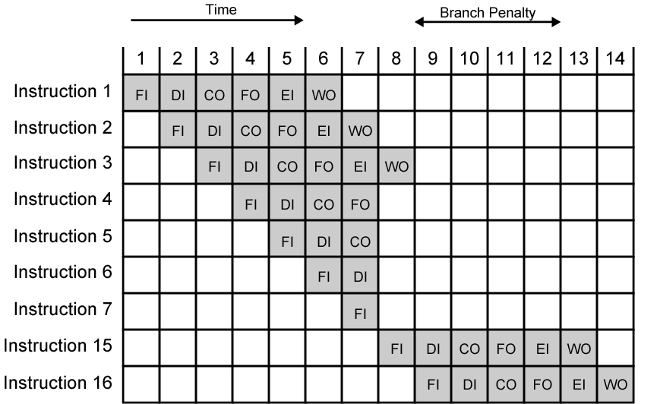
The Effect of a Conditional Branch on Instruction Pipeline Operation
Instruction 3 is a conditional branch to instruction 15.
Until the instruction is executed, there is no way of knowing which instruction will come next (at which point)
The pipeline simple loads the next instruction in sequence (instruction 4) and proceeds
If branch is not taken, we will get full performance benefit of the enhancement
Here branch is taken and is not determined until the end of time unit 7
At this point, the pipeline must be cleared of instructions that are not useful
During time unit 8, instruction 15 enters pipeline
No instructions complete during time units 9 through 13
Notes:
40

Slide 25
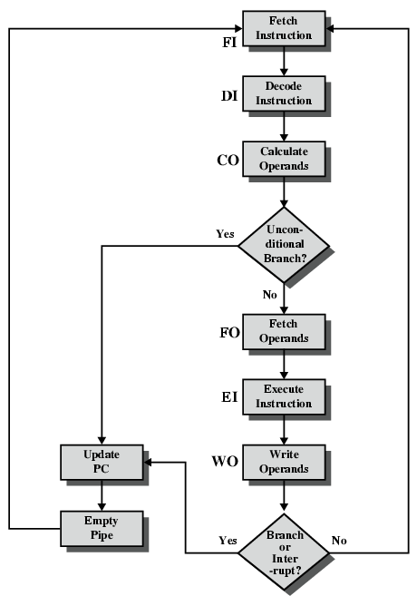
Six Stage
Instruction Pipeline

Slide 26
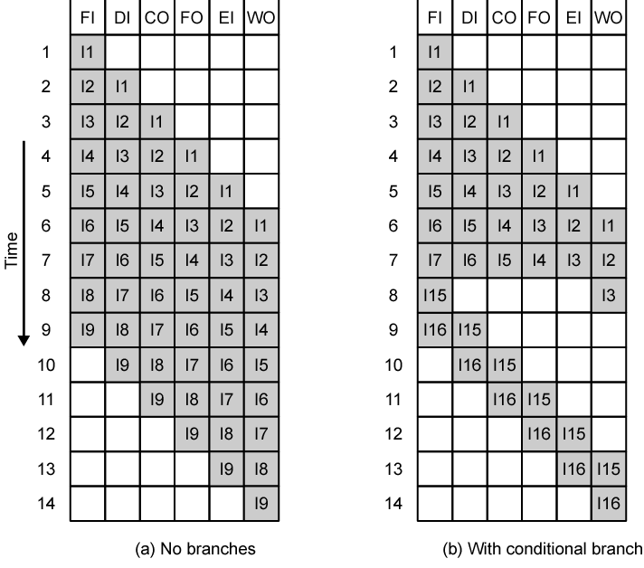
Alternative Pipeline Depiction
(a)
The pipeline is full at time 6, with 6 different instructions in various stages of execution and remains full through time 9; we assume that I9 is the last instruction
(b)
The pipeline is full at times 6 and 7.
At time 7, instruction 3 is in execution stage and executes a branch to instruction 15
At this point, instructions I4 through I7 are flushed from the pipeline, so that at time 8, only two instructions are in the pipeline, I3 and I15

Slide 27
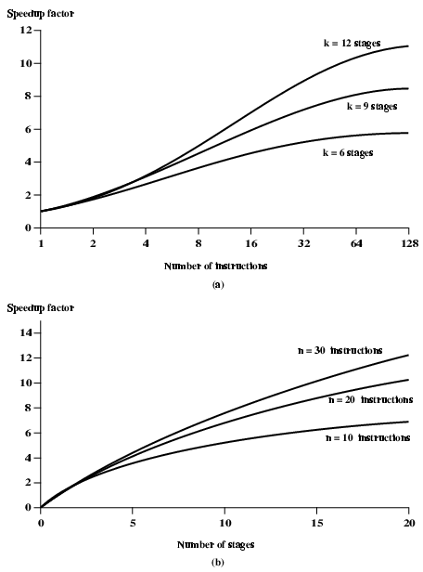
Speedup Factors with Instruction
Pipelining

