Slide 1
HTML
Notes:
Anyone already familiar with HTML?
Disclaimer: I do not work in HTML very often.

Slide 2
HTML Styles
Setting the style of an HTML element, can be done with the style attribute.
The HTML style attribute has the following syntax:
<tagname style="property:value;">
The property is a CSS property. The value is a CSS value.
The background-color property defines the background color for an HTML element.
The color property defines the text color for an HTML element.
The font-family property defines the font to be used for an HTML element.
The font-size property defines the text size for an HTML element.
The text-align property defines the horizontal text alignment for an HTML element.

Slide 3
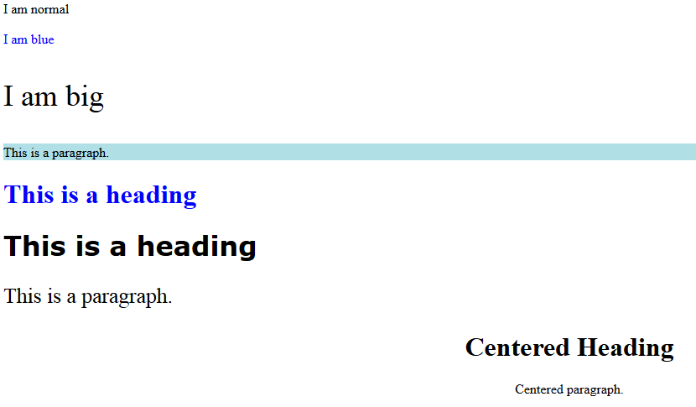
HTML Styles Example
<!DOCTYPE html>
<html>
<body>
<p>I am normal</p>
<p style="color:blue;">I am blue</p>
<p style="font-size:36px;">I am big</p>
<p style="background-color:powderblue;">This is a paragraph.</p>
<h1 style="color:blue;">This is a heading</h1>
<h1 style="font-family:verdana;">This is a heading</h1>
<p style="font-size:160%;">This is a paragraph.</p>
<h1 style="text-align:center;">Centered Heading</h1>
<p style="text-align:center;">Centered paragraph.</p>
</body>
</html>
Generally, 1em = 12pt = 16px = 100%.

Slide 4
HTML Text Formatting
HTML also defines special elements for defining text with a special meaning.
HTML uses elements like <b> and <i> for formatting output, like bold or italic text.
Formatting elements were designed to display special types of text:
<b> - Bold text
<strong> - Important text
<i> - Italic text
<em> - Emphasized text
<mark> - Marked text
<small> - Small text
<del> - Deleted text
<ins> - Inserted text
<sub> - Subscript text
<sup> - Superscript text

Slide 5
HTML Text Formatting
<b> element defines bold text, without any extra importance.
<strong> element defines strong text, with added semantic "strong" importance.
<i> element defines italic text, without any extra importance.
<em> element defines emphasized text, with added semantic importance.
<small> element defines smaller text
<mark> element defines marked or highlighted text
<del> element defines deleted (removed) text
<ins> element defines inserted (added) text
<sub> element defines _{subscripted} text.
<sup> element defines ^{superscripted} text.

Slide 6
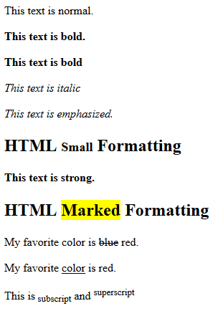
HTML Text Formatting Example
<!DOCTYPE html>
<html>
<body>
<p>This text is normal.</p>
<p><b>This text is bold.</b></p>
<p><b>This text is bold</b></p>
<p><i>This text is italic</i></p>
<p><em>This text is emphasized.</em></p>
<h2>HTML <small>Small</small> Formatting</h2>
<p><strong>This text is strong.</strong></p>
<h2>HTML <mark>Marked</mark> Formatting</h2>
<p>My favorite color is <del>blue</del> red.</p>
<p>My favorite <ins>color</ins> is red.</p>
<p>This is<sub> subscript</sub> and <sup>superscript</sup></p>
</body>
</html>

Slide 7
HTML Quotation and Citation
Tag | Description
<abbr> | Defines an abbreviation or acronym
<address> | Defines contact information for the author/owner of a document. <address> element is usually displayed in italic.
<bdo> | Defines the text direction. The <bdo> element is used to override the current text direction:
<blockquote> | Defines a section that is quoted from another source
<cite> | Defines the title of a work. Browsers usually display <cite> elements in italic.
<q> | Defines a short inline quotation

Slide 8
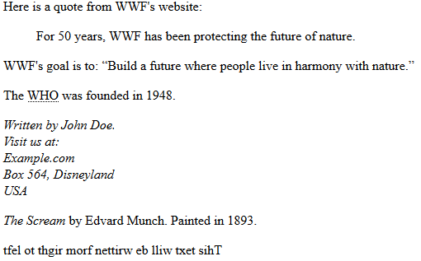
Example
<!DOCTYPE html>
<html>
<body>
<p>Here is a quote from WWF's website:</p>
<blockquote cite="http://www.worldwildlife.org/who/index.html">
For 50 years, WWF has been protecting the future of nature.
</blockquote>
<p>WWF's goal is to: <q>Build a future where people live in harmony with nature.</q></p>
<p>The <abbr title="World Health Organization">WHO</abbr> was founded in 1948.</p>
<address>
Written by John Doe.<br>
Visit us at:<br>
Example.com<br>
Box 564, Disneyland<br>
USA
</address>
<p><cite>The Scream</cite> by Edvard Munch. Painted in 1893.</p>
<bdo dir="rtl">This text will be written from right to left</bdo>
</body>
</html>

Slide 9
HTML Comments
You can add comments to your HTML source by using the following syntax:
<!-- Write your comments here -->
Notice that there is an exclamation point (!) in the opening
tag, but not in the closing tag.
Comments are also great for debugging HTML, because you can comment out HTML lines of code, one at a time, to search for errors

Slide 10
HTML Styles - CSS
CSS stands for Cascading Style Sheets.
CSS describes how HTML elements are to be displayed on screen, paper, or in other media.
CSS saves a lot of work. It can control the layout of multiple web pages all at once.
CSS can be added to HTML elements in 3 ways:
Inline - by using the style attribute in HTML elements
Internal - by using a <style> element in the <head> section
External - by using an external CSS file
The most common way to add CSS, is to keep the styles in separate CSS files. However, here we will use inline and internal styling, because this is easier to demonstrate, and easier for you to try it yourself.

Slide 11

Inline CSS
<!DOCTYPE html>
<html>
<body>
<h1 style="color:blue;">This is a Blue Heading</h1>
</body>
</html>

Slide 12

Internal CSS
An internal CSS is used to define a style for a single HTML page.
An internal CSS is defined in the <head> section of an HTML page, within a <style> element
<!DOCTYPE html>
<html>
<head>
<style>
body {background-color: powderblue;}
h1 {color: blue;}
p {color: red;}
</style>
</head>
<body>
<h1>This is a heading</h1>
<p>This is a paragraph.</p>
</body>
</html>

Slide 13
For External CSS
The <link> tag defines a link between a document and an external resource.
The <link> tag is used to link to external style sheets.

Slide 14
External CSS
An external style sheet is used to define style for many HTML pages.
With an external style sheet, you can change the look of an entire web site, by changing one file.
To use an external style sheet, add a link to it in the <head> section of the HTML page:
external css .html
<!DOCTYPE html> <html> <head> <link rel="stylesheet" href="styles.css"> </head> <body> <h1>This is a heading</h1> <p>This is a paragraph.</p> </body> </html>
styles.css
body { background-color: powderblue; } h1 { color: blue; } p { color: red; }

Slide 15
HTML Links
HTML Links - Image as Link
It is common to use images as links:
Example
<a href="default.asp“> Click me<img src="smiley.gif" alt=“image unload” style="width:42px;height:42px;border:0;"> </a>

Slide 16
HTML Tables
HTML table is defined with the <table> tag.
Each table row is defined with the <tr> tag.
A table header is defined with the <th> tag. By default, table headings are bold and centered.
A table data/cell is defined with the <td> tag. The <td> elements are the data containers of the table. They can contain all sorts of HTML elements; text, images, lists, other tables, etc.

Slide 17
HTML Tables
<html>
<body>
<table style="width:100%">
<tr>
<th>Firstname</th>
<th>Lastname</th>
<th>Age</th>
</tr>
<tr> <td>Jill</td> <td>Smith</td> <td>50</td> </tr>
<tr> <td>Eve</td> <td>Jackson</td> <td>94</td> </tr>
</table>
</body>
</html>

Slide 18
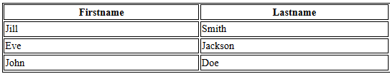
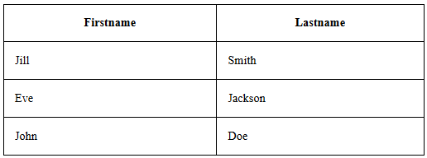
HTML Tables
Adding a Border
If you do not specify a border for the table, it will be displayed without borders. A border is set using the CSS border property:
Example
table, th, td { border: 1px solid black; }
Collapsed Borders
If you want the borders to collapse into one border, add the CSS border-collapse property
Example
table, th, td { border: 1px solid black; border-collapse: collapse; }

Slide 19
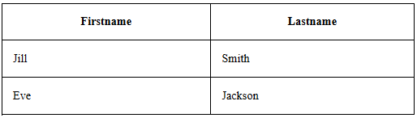
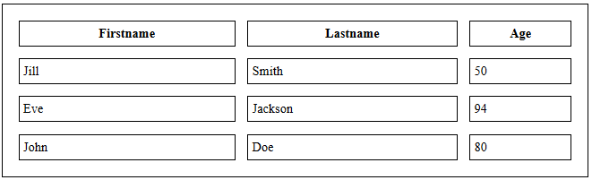
HTML Tables
Adding Cell Padding
Cell padding specifies the space between the cell content and its borders.
If you do not specify a padding, the table cells will be displayed without padding.
To set the padding, use the CSS padding property:
Example
th, td { padding: 15px; }
Adding Border Spacing
Border spacing specifies the space between the cells.
To set the border spacing for a table, use the CSS border-spacing property:
Example
table { border-spacing: 5px; }

Slide 20
HTML Tables
Cells that Span Many Columns
To make a cell span more than one column, use the colspan attribute
<table style="width:100%">
<tr>
<th>Name</th>
<th colspan="2">Telephone</th>
</tr>
<tr>
<td>Bill Gates</td>
<td>55577854</td>
<td>55577855</td>
</tr>
</table>

Slide 21

HTML Tables
Cells that Span Many Rows
To make a cell span more than one row, use the rowspan attribute
<table>
<tr>
<th>Name:</th>
<td>Bill Gates</td>
</tr>
<tr>
<th rowspan="2">Telephone:</th>
<td>55577854</td>
</tr>
<tr>
<td>55577855</td>
</tr>
</table>

Slide 22
HTML Unordered Lists
An unordered list starts with the <ul> tag. Each list item starts with the <li> tag.
The list items will be marked with bullets (small black circles) by default
Unordered HTML List - Choose List Item Marker
The CSS list-style-type property is used to define the style of the list item marker
Value | Description
disc | Sets the list item marker to a bullet (default)
circle | Sets the list item marker to a circle
square | Sets the list item marker to a square
none | The list items will not be marked

Slide 23
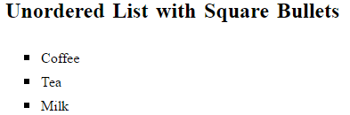
Unordered HTML List
<!DOCTYPE html>
<html>
<body>
<h2>Unordered List with Square Bullets</h2>
<ul style="list-style-type: square">
<li>Coffee</li>
<li>Tea</li>
<li>Milk</li>
</ul>
</body>
</html>

Slide 24
HTML Ordered Lists
An ordered list starts with the <ol> tag. Each list item starts with the <li> tag.
The list items will be marked with numbers by default
Ordered HTML List - The Type Attribute
The type attribute of the <ol> tag, defines the type of the list item marker
Type | Description
type="1" | The list items will be numbered with numbers (default)
type="A" | The list items will be numbered with uppercase letters
type="a" | The list items will be numbered with lowercase letters
type="I" | The list items will be numbered with uppercase roman numbers
type="i" | The list items will be numbered with lowercase roman numbers

Slide 25
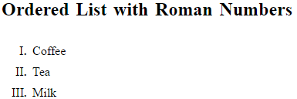
Ordered HTML List
<!DOCTYPE html>
<html>
<body>
<h2>Ordered List with Roman Numbers</h2>
<ol type="I">
<li>Coffee</li>
<li>Tea</li>
<li>Milk</li>
</ol>
</body>
</html>

Slide 26
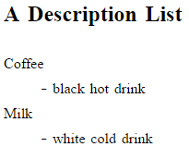
HTML Description Lists
HTML also supports description lists.
A description list is a list of terms, with a description of each term.
The <dl> tag defines the description list, the <dt> tag defines the term (name), and the <dd> tag describes each term
Example
<!DOCTYPE html>
<html>
<body>
<h2>A Description List</h2>
<dl>
<dt>Coffee</dt>
<dd>- black hot drink</dd>
<dt>Milk</dt>
<dd>- white cold drink</dd>
</dl>
</body>
</html>

Slide 27
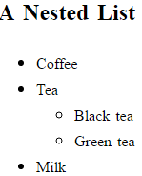
Nested HTML Lists Example
<!DOCTYPE html>
<html>
<body>
<h2>A Nested List</h2>
<ul>
<li>Coffee</li>
<li>Tea
<ul>
<li>Black tea</li>
<li>Green tea</li>
</ul>
</li>
<li>Milk</li>
</ul>
</body>
</html>

Slide 28
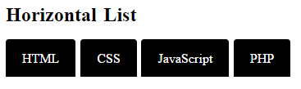
Horizontal Lists
<!DOCTYPE html>
<html>
<head>
<style>
ul#menu {
padding: 0;
}
ul#menu li {
display: inline;
}
ul#menu li a {
background-color: black;
color: white;
padding: 10px 20px;
text-decoration: none;
border-radius: 4px 4px 0 0;
}
ul#menu li a:hover {
background-color: orange;
}
</style>
</head>
<body>
<h2>Horizontal List</h2>
<ul id="menu">
<li><a href="#HTML">HTML</a></li>
<li><a href="#CSS">CSS</a></li>
<li><a href="#JAVASCRIPT">JavaScript</a></li>
<li><a href="#PHP">PHP</a></li>
</ul>
</body>
</html>

Slide 29
HTML Block and Inline Elements
Block-level Elements
A block-level element always starts on a new line and takes up the full width available (stretches out to the left and right as far as it can).
The <div> element is a block-level element.
Examples of block-level elements:
<div>
<h1> - <h6>
<p>
<form>
Inline Elements
An inline element does not start on a new line and only takes up as much width as necessary.
This is an inline <span> element inside a paragraph.
Examples of inline elements:
<span>
<a>
<img>

Slide 30
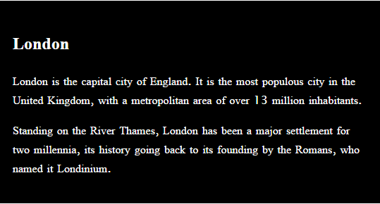
The <div> Element
The <div> element is often used as a container for other HTML elements.
The <div> element has no required attributes, but both style and class are common.
When used together with CSS, the <div> element can be used to style blocks of content
Example
<!DOCTYPE html>
<html>
<body>
<div style="background-color:black;color:white;padding:20px;">
<h2>London</h2>
<p>London is the capital city of England. It is the most populous city in the United Kingdom, with a metropolitan area of over 13 million inhabitants.</p>
<p>Standing on the River Thames, London has been a major settlement for two millennia, its history going back to its founding by the Romans, who named it Londinium.</p>
</div>
</body>
</html>

Slide 31
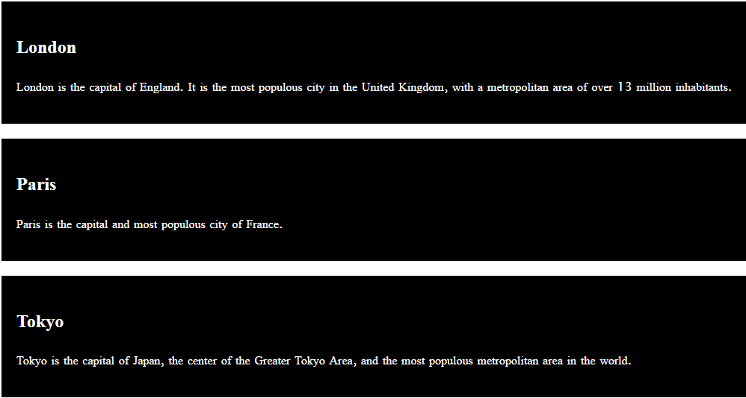
HTML The class Attribute
The HTML class attribute makes it possible to define equal styles for elements with the same class name.
Example
<!DOCTYPE html> <html> <head> <style> div.cities { background-color: black; color: white; margin: 20px 0 20px 0; padding: 20px; } </style> </head> <body> <div class="cities"> <h2>London</h2> <p>London is the capital of England. It is the most populous city in the United Kingdom, with a metropolitan area of over 13 million inhabitants.</p> </div> <div class="cities"> <h2>Paris</h2> <p>Paris is the capital and most populous city of France.</p> </div> <div class="cities"> <h2>Tokyo</h2> <p>Tokyo is the capital of Japan, the center of the Greater Tokyo Area, and the most populous metropolitan area in the world.</p> </div> </body> </html>

Slide 32
Audio Elements on Web in HTML
To play an audio file in HTML, use the <audio> element
The controls attribute adds audio controls, like play, pause, and volume.
The <source> element allows you to specify alternative audio files which the browser may choose from. The browser will use the first recognized format.
EXAMPLE
<!doctype html>
<html>
<head>
</head>
<body>
<audio controls="audiocontrols">
<source src="music.mp3"/>
<source src="music.wav"/>
</audio>
<!-- Three standard formats for web browsers are .mp3 .wav -->
</body>
</html>

Slide 33
Video Elements on Web in HTML
To show a video in HTML, use the <video> element
The controls attribute adds video controls, like play, pause, and volume.
It is a good idea to always include width and height attributes.
The <source> element allows you to specify alternative video files which the browser may choose from. The browser will use the first recognized format.
EXAMPLE
<!doctype html>
<html>
<head>
</head>
<body>
<video width="640" height="360" controls>
<source src="scientist.mp4"/>
<source src="scientist.wmv"/>
</video>
<!-- Standard video formats for web browsers are .mp4, wmv -->
</body>
</html>

Slide 34
HTML Marquees
An HTML marquee is a scrolling piece of text displayed either horizontally across or vertically down your webpage depending on the settings. This is created by using HTML <marquees> tag.
Example
<!DOCTYPE html>
<html>
<head>
<title>HTML marquee Tag</title>
</head>
<body>
<marquee>This is basic example of marquee</marquee>
</body>
</html>

Slide 35
HTML Frames
HTML frames are used to divide your browser window into multiple sections where each section can load a separate HTML document.
A collection of frames in the browser window is known as a frameset.
The <frameset> tag defines how to divide the window into frames. The rows attribute of <frameset> tag defines horizontal frames and cols attribute defines vertical frames.
Each frame is indicated by <frame> tag and it defines which HTML document shall open into the frame.
Example:
14.Frames in HTML

Slide 36
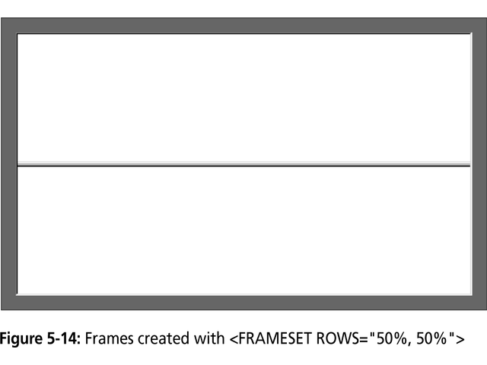

Slide 37
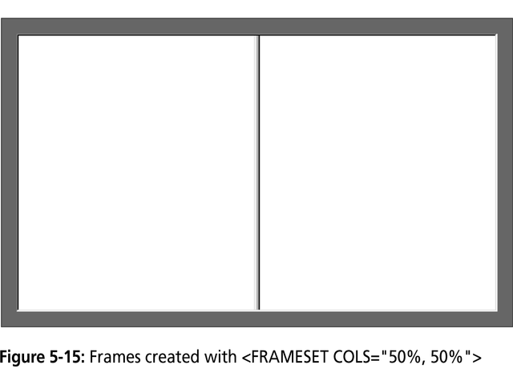

Slide 38
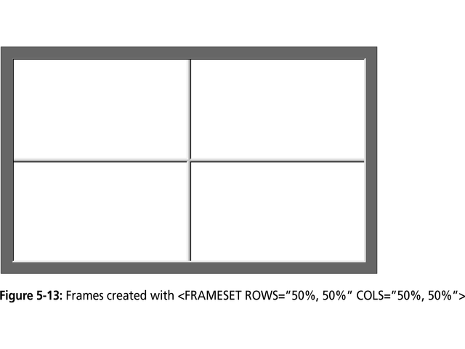

Slide 39
HTML Iframes
An iframe is used to display a web page within a web page.
The <iframe> tag defines a rectangular region within the document in which the browser can display a separate document, including scrollbars and borders.
An HTML iframe is defined with the <iframe> tag:
<iframe src="URL"></iframe>
The src attribute specifies the URL (web address) of the inline frame page.
Iframe - Set Height and Width
Use the height and width attributes to specify the size of the iframe.
Example
15.IFrame Example

Slide 40
References
https://www.w3schools.com/html/default.asp
http://www.tutorialspoint.com/html/

