Slide 1
hporvrs
GOOGLE CLASSROOM CODE

Slide 2
TEXT BOOKS
Discrete Mathematics and its Applications, 7th Edition by K. Rosen, McGraw Hill
Discrete Mathematics with Applications, 5th Edition by Susanna S. Epp Gagne
Discrete Mathematics, Schaum's outlines, 4th edition

Slide 3
INDUCTION

Slide 4
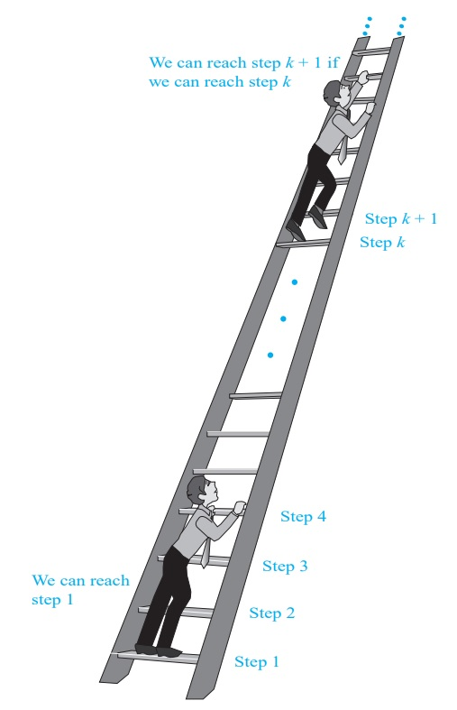
INTRODUCTION
Suppose that, there is an infinite ladder, as shown in the Figure
The query is: whether every step on this ladder is reachable
Two things are known:
(1) The first rung of the ladder is reachable
(2) If a particular rung is reachable, then the next is reachable.
As the first rung is reachable, by (2), the second rung is reachable
Applying (2) again, as the 2nd rung is reachable, the 3rd is also reachable
Continuing in this way, it can be shown that
We can reach the fourth rung, the fifth rung, and so on
Thus it can be concluded that, all the rungs are reachable
This technique for verifying something is: Mathematical Induction

Slide 5
INTRODUCTION
Mathematical Induction can be used to prove statements that assert that P (n) is true for all positive integers n,
Here P (n) is a propositional function.
A proof by mathematical induction has two parts
A basis step, where we show that P (1) is true
An inductive step, where we show that for all positive integers k, if P (k) is true, then P (k + 1) is true or, P (k) → P (k + 1) is true for all positive integers k.
This proof technique can be stated as the following rule of inference:
(P (1) ∧ ∀_{k} (P (k) → P (k + 1))) → ∀_{n}P (n)

Slide 6
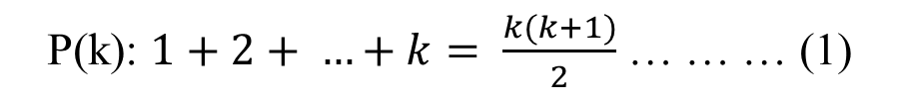
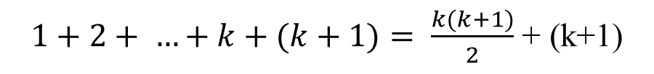
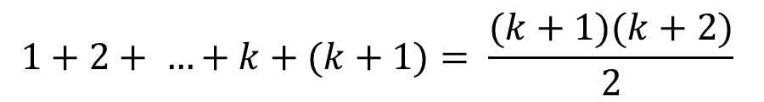
EXAMPLE
Basis step: Need to prove that P(1) is true
Inductive step: For the inductive hypothesis the assumption is that P(k) holds for an arbitrary positive integer k.
Under the assumption it must be shown that P(k+1) is true namely:
Now adding (k+1) at the both side of (1) to obtain P(k+1) from P(k)
[Proved]

Slide 7
EXAMPLE
Conjecture a formula for the sum of the first n positive odd integers. Then prove your conjecture using mathematical induction.
The sum of positive integers for n = 1, 2, 3, 4, 5 are
n | Sum
1
1
2
1 + 3 = 4
3
1 + 3 + 5 = 9
4
1 + 3 + 5 + 7 = 16
5
1 + 3 + 5 + 7 + 9 = 25
So, the conjecture is: the sum of the first n positive odd integers is n²
Now this conjecture need to be proven using Mathematical Induction

Slide 8
EXAMPLE
Basis step: Need to prove that P(1) is true
Inductive step: For the inductive hypothesis the assumption is that P(k) holds for an arbitrary positive integer k.
Under the assumption it must be shown that P(k+1) is true namely:
Now adding (2k+1) at the both side of (1) to obtain P(k+1) from P(k)
[Proved]

Slide 9
EXAMPLE
Basis step: Need to prove that P(0) is true
Inductive step: For the inductive hypothesis the assumption is that P(k) holds for an arbitrary positive integer k.
Under the assumption it must be shown that P(k+1) is true namely:
Now adding (2^{k}+1) at the both side of (1) to obtain P(k+1) from P(k)
[Proved]

Slide 10
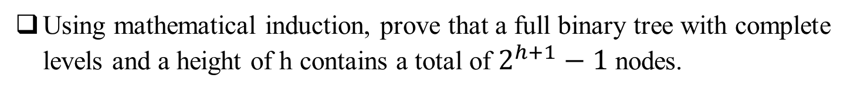
EXERCISE

Slide 11
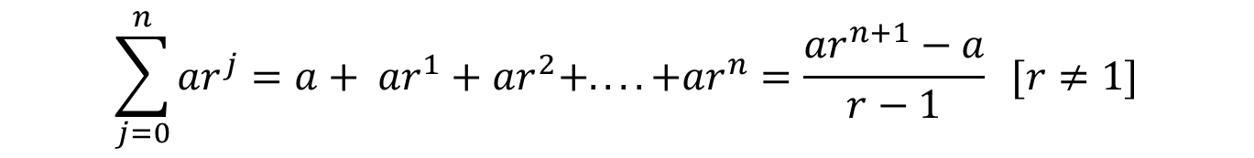
EXERCISE
Using Mathematical Induction prove the formula for the sum of a finite number of terms of a geometric progression with initial term a and common ratio r:

Slide 12
EXAMPLE
For all positive integers n, prove by Mathematical Induction that: n < 2^{n}
Inductive step: For the inductive hypothesis the assumption is that P(k) holds for an arbitrary positive integer k.
P(k): k < 2^{k} … … … (1)
Under the assumption it must be shown that P(k+1) is true namely:
P(k+1): k+1 < 2^{k+1} … … … (2)
Now adding 1 at the both side of (1) to obtain P(k+1) from P(k)
k+1 < 2^{k} + 1
k+1 < 2^{k} + 2^{k}
[In basis step it is proved that 1 is less than 2^{k}, for the lowest value of k. So, if the k is increased then 2^{K} gets more larger than 1]
k+1 < 2.2^{k}
k+1 < 2^{k+1}
[Proved]

Slide 13
EXAMPLE
For positive integers n>3, prove by Mathematical Induction that: 2^{n} < n!
Inductive step: For the inductive hypothesis the assumption is that P(k) holds for an arbitrary positive integer k.
P(k): 2^{k} < k! … … … (1)
Under the assumption it must be shown that P(k+1) is true namely:
P(k+1): 2^{k+1} < (k+1)! … … … (2)
Now multiplying 2 at the both side of (1) to obtain P(k+1) from P(k)
2^{k+1} < 2k!
k+1 < (k+1)k!
[For any values of k>3, k+1>2]
k+1 < (k+1)!
[Proved]

Slide 14

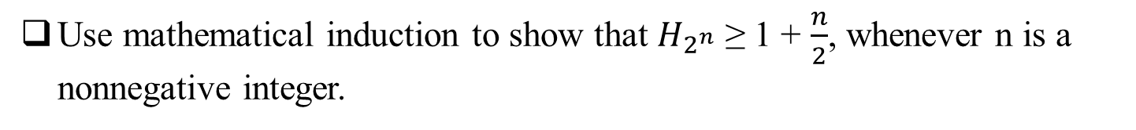
EXERCISE

Slide 15
THANK YOU!
ANY QUESTIONS?

