Slide 1
hporvrs
GOOGLE CLASSROOM CODE

Slide 2
TEXT BOOKS
Discrete Mathematics and its Applications, 7th Edition by K. Rosen, McGraw Hill
Discrete Mathematics with Applications, 5th Edition by Susanna S. Epp Gagne
Discrete Mathematics, Schaum's outlines, 4th edition

Slide 3
COUNTING PRINCIPLE

Slide 4
INTRODUCTION
How many bit strings are there of length 3?
Ans: 8
2
2
2
Total = 2 x 2 x 2 = 8
The leftmost slot can be filled up in two ways independently.
Either 0 or 1
The next slot can be filled up in two ways independently.
Either 0 or 1
The next slot can be filled up in two ways independently.
Either 0 or 1

Slide 5
EXAMPLE
Consider that a password consists of only 0 and 1. The length of the password can be 3 or 4 or 5. Determine the number of trials that a hacker need to complete in worst case to hack the password.
First try all the passwords of length 3:
2 x 2 x 2 = 8
Then try all the passwords of length 4:
2 x 2 x 2 x 2 = 16
Then try all the passwords of length 5:
2 x 2 x 2 x 2 x 2 = 32
Total number of trials:
8 + 16 + 32 = 56

Slide 6
PRODUCT RULE
Suppose that a procedure can be broken down into a sequence of two tasks. If there are n₁ ways to do the first task and for each of these ways of doing the first task, there are n₂ ways to do the second task, then there are n₁n₂ ways to do the procedure.

Slide 7
EXAMPLE
A new company with just two employees, Sanchez and Patel, rents a floor of a building with 12 offices. How many ways are there to assign different offices to these two employees?
Let the rooms are labeled from 1 to 12.
If Sanchez is assigned at Room-1
then rest 11 rooms can be assigned for Patel
Thus Sanchez can be assigned in 12 rooms (Room-1, 2, 3, …. , 12)
For each assignment of Sanchez
Patel can be assigned in any of the rest 11 rooms
Thus total possible ways: 12 x 11 = 132

Slide 8
EXAMPLE
The chairs of an auditorium are to be labeled with an uppercase English letter followed by a positive integer not exceeding 100. What is the largest number of chairs that can be labeled differently?
Upper case letters are : A, B, C, …. , Y, Z.
If the first part is A
then the next part can be labeled with the numbers from 1 to 100.
Thus the first part can be labeled from A to Z (26 letters)
Thus total possible ways: 26 x 100 = 2600.

Slide 9
EXAMPLE
How many different license plates can be made if each plate contains a sequence of three uppercase English letters followed by three digits (and no sequences of letters are prohibited, even if they are obscene)?
26
26
26
10
10
10
Total possible ways: 26 x 26 x 26 x10 x 10 x 10 = 17,576,000

Slide 10
EXAMPLE
The North American numbering plan (NANP) specifies the format of telephone numbers in the U.S., Canada, and many other parts of North America. A telephone number in this plan consists of 10 digits, which are split into a three-digit area code, a three-digit office code, and a four-digit station code. Because of signaling considerations, there are certain restrictions on some of these digits. To specify the allowable format, let X denote a digit that can take any of the values 0 through 9, let N denote a digit that can take any of the values 2 through 9, and let Y denote a digit that must be a 0 or a 1. Two numbering plans, which will be called the old plan, and the new plan, will be discussed. (The old plan, in use in the 1960s, has been replaced by the new plan, but the recent rapid growth in demand for new numbers for mobile phones and devices will eventually make even this new plan obsolete. In this example, the letters used to represent digits follow the conventions of the North American Numbering Plan.) As will be shown, the new plan allows the use of more numbers. In the old plan, the formats of the area code, office code, and station code are NYX, NNX, and XXXX, respectively, so that telephone numbers had the form NYX-NNX-XXXX. In the new plan, the formats of these codes are NXX, NXX, and XXXX, respectively, so that telephone numbers have the form NXX-NXX-XXXX. How many different North American telephone numbers are possible under the old plan and under the new plan?

Slide 11
EXAMPLE
X: 0 to 9
Total: 10
N: 2 to 9
Total: 8
Y: 0 or 1
Total: 2
Old plan:
NYX-NNX-XXXX
= 8 x 2 x 10 x 8 x 8 x 10 x 10 x 10 x 10 x 10

Slide 12
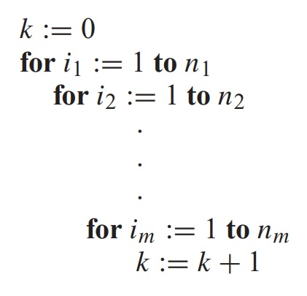
EXAMPLE
What is the value of k after the following code, where n₁, n₂,...,n_{m} are positive integers, has been executed?
The initial value of k is zero. Each time the nested loop is traversed, 1 is added to k. Let T_{i} be the task of traversing the i-th loop. Then the number of times the loop is traversed is the number of ways to do the tasks T₁, T₂,...,T_{m}. The number of ways to carry out the task T_{j} , j = 1, 2,...,m, is n_{j} , because the j-th loop is traversed once for each integer ij with 1 ≤ ij ≤ n_{j} . By the product rule, it follows that the nested loop is traversed n₁n₂ ··· n_{m} times. Hence, the final value of k is n₁n₂ ··· n_{m}.

Slide 13
SUM RULE
If a task can be done either in one of n₁ ways or in one of n₂ ways, where none of the set of n₁ ways is the same as any of the set of n₂ ways, then there are n₁ + n₂ ways to do the task.

Slide 14
EXAMPLE
Suppose that either a member of the mathematics faculty or a student who is a mathematics major is chosen as a representative to a university committee. How many different choices are there for this representative if there are 37 members of the mathematics faculty and 83 mathematics majors and no one is both a faculty member and a student?
By the sum rule it follows that there are 37 + 83 = 120 possible ways to pick this representative

Slide 15
EXAMPLE
A student can choose a computer project from one of three lists. The three lists contain 23, 15, and 19 possible projects, respectively. No project is on more than one list. How many possible projects are there to choose from?
The student can choose a project by selecting a project from the first list, the second list, or the third list. Because no project is on more than one list, by the sum rule there are 23 + 15 + 19 = 57 ways to choose a project.

Slide 16
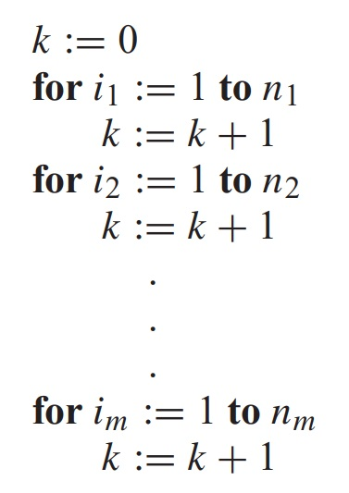
EXAMPLE
What is the value of k after the following code, where n₁, n₂,...,n_{m} are positive integers, has been executed?
The initial value of k is zero. This block of code is made up of m different loops. Each time a loop is traversed, 1 is added to k. To determine the value of k after this code has been executed, we need to determine how many times we traverse a loop. Note that there are n_{i} ways to traverse the i-th loop. Because we only traverse one loop at a time, the sum rule shows that the final value of k, which is the number of ways to traverse one of the m loops is n₁ + n₂ +···+ n_{m}.

Slide 17
EXAMPLE
In a version of the computer language BASIC, the name of a variable is a string of one or two alphanumeric characters, where uppercase and lowercase letters are not distinguished. (An alphanumeric character is either one of the 26 English letters or one of the 10 digits.) Moreover, a variable name must begin with a letter and must be different from the five strings of two characters that are reserved for programming use. How many different variable names are there in this version of BASIC?
Let V₁ be the number of these that are one character long and V₂ be the number of these that are two characters long
V₁ = 26
V₂ =
26
36
Total = V₁ + V₂ - 5
Letter
= 26 + (26 x 36) - 5
Letter or digit
= 931

Slide 18
EXAMPLE
In a version of the computer language BASIC, the name of a variable is a string of one or two alphanumeric characters, where uppercase and lowercase letters are not distinguished. (An alphanumeric character is either one of the 26 English letters or one of the 10 digits.) Moreover, a variable name must begin with a letter and must be different from the five strings of two characters that are reserved for programming use. How many different variable names are there in this version of BASIC?
Let V₁ be the number of these that are one character long and V₂ be the number of these that are two characters long
V₁ = 26
V₂ =
26
36
Total = V₁ + V₂ - 5
Letter
= 26 + (26 x 36) - 5
Letter or digit
= 931

Slide 19
EXAMPLE
Consider a coding system in computer where each code can be two characters long, and the allowed characters for codes are: A, B, C, 0, 1. Each password must contain at least one digit. How many possible codes are there?
All possible codes of two digits with A, B, C, 0, 1:
AA
AB
AC
A0
A1
BA
BB
BC
B0
B1
CA
CB
CC
C0
C1
0A
0B
0C
00
01
1A
1B
1C
10
11
So total number of codes with two digits with A, B, C, 0, 1 = 5²
But the codes with at least one digits are valid
Thus codes with no digits are invalid
Thus codes with only letters are invalid
Number of codes with only letters: 3²
Number of codes with at least one digit = 5² – 3² = 16

Slide 20
EXAMPLE
Each user on a computer system has a password, which is six to eight characters long, where each character is an uppercase letter or a digit. Each password must contain at least one digit. How many possible passwords are there?
Let P be the total number of possible passwords, and let P₆, P₇, and P₈ denote the number of possible passwords of length 6, 7, and 8, respectively
By the sum rule, P = P₆ + P₇ + P₈
P₆ = 36⁶ − 26⁶ = 1,867,866,560
P₇ = 36⁷ − 26⁷ = 70,332,353,920
P₈ = 36⁸ − 26⁸ = 2,612,282,842,880
P = P₆ + P₇ + P₈ = 2,684,483,063,360

Slide 21

SUBTRACTION RULE
If a task can be done in either n1 ways or n2 ways, then the number of ways to do the task is n1 + n2 minus the number of ways to do the task that are common to the two different ways.
This rule is also known as Principle of Inclusion-Exclusion
Suppose that A₁ and A₂ are sets.
|A₁ U A₂| = |A₁| + |A₂| - |A₁ $∩$ A₂|
There are |A₁| ways to select an element from A₁
And there are |A₂| ways to select an element from A₂
The number of ways to select an element from A₁ or from A₂, that is, the number of ways to select an element from their union, is the sum of the number of ways to select an element from A₁ and the number of ways to select an element from A₂, minus the number of ways to select an element that is in both A₁ and A₂.

Slide 22




EXAMPLE
How many bit strings of length five either start with a 1 bit or end with the two bits 00?
Let, the set of bits strings of length five starts with 1 is A₁
Let, the set of bits strings of length five ends with 00 is A₂
A1 and A2 have some common member who start with 1 and end with 00
A₁:
1
0/1
0/1
0/1
0/1
A₂:
0/1
0/1
0/1
0
0
|A₁|:
1
x 2
x 2
x 2
x 2
|A₂|:
2
x 2
x 2
x 1
x 1
|A₁| = 2⁴
|A₂| = 2³
A₁ $∩$ A₂ :
1
0/1
0/1
0
0
|A₁ $∩$ A₂|:
1
x 2
x 2
x 1
x 1
| A₁ $∩$ A₂ | = 2²
Ans: |A₁| + |A₂| - |A₁ $∩$ A₂| = 2⁴ + 2³ – 2² = 20.

Slide 23
EXERCISE
A computer company receives 350 applications from computer graduates for a job planning a line of new Web servers. Suppose that 220 of these applicants majored in computer science, 147 majored in business, and 51 majored both in computer science and in business. How many of these applicants majored neither in computer science nor in business?
Ans: 316

Slide 24
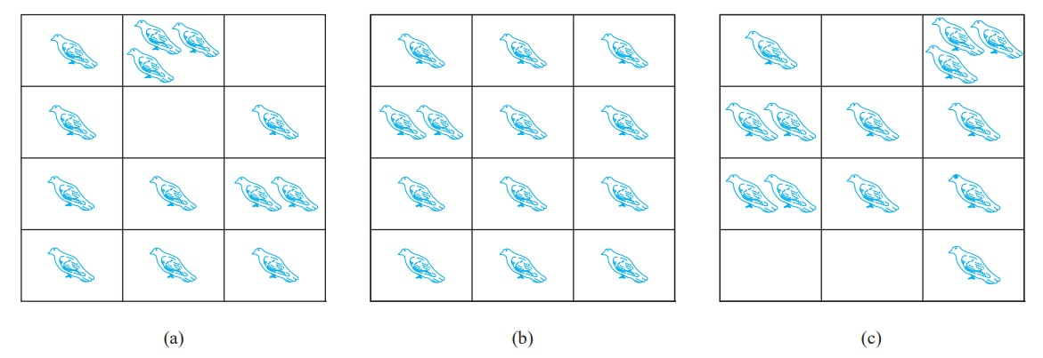
PIGEONHOLE PRINCIPLE
Suppose that, there are 11 pigeons and 10 pigeonholes
Then there is at least one pigeonhole containing two or more pigeons
The Pigeonhole Principle:
If k is a positive integer and k + 1 or more objects are placed into k boxes, then there is at least one box containing two or more of the objects.
Fig: There are more pigeons than pigeonholes

Slide 25
PIGEONHOLE PRINCIPLE
The pigeonhole principle is also called the Dirichlet drawer principle.
After the nineteenth century German mathematician G. Lejeune Dirichlet, who often used this principle in his work.

Slide 26
APPLICATIONS
Among any group of 367 people, there must be at least two with the same birthday, because there are only 366 possible birthdays.
In any group of 27 English words, there must be at least two that begin with the same letter, because there are 26 letters in the English alphabet.

Slide 27
APPLICATIONS
Among any group of 367 people, there must be at least two with the same birthday, because there are only 366 possible birthdays.
In any group of 27 English words, there must be at least two that begin with the same letter, because there are 26 letters in the English alphabet.
How many students must be in a class to guarantee that at least two students receive the same score on the final exam, if the exam is graded on a scale from 0 to 100 points?
Number of grades: 101 ( 0 to 100)
Required students: 102

Slide 28

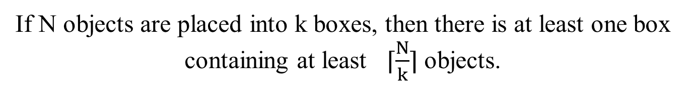

Generalized Pigeonhole Principle
If N objects are placed into k boxes, then there is at least one box containing at least ⌈$\frac{N}{k}$⌉ objects.
N is number of pigeons, k is number of pigeonholes
Lets say, there are 21 pigeons
N = 21
And 10 pigeonholes
k = 10
3
So, there is at least one box containing at least _____ pigeons.
$\frac{N}{k}$ = 2.1
⌈$\frac{N}{k}$⌉ = 3

Slide 29
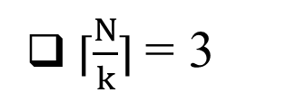
Generalized Pigeonhole Principle
At least how many people have the same month of birthday in the class?
N = 30
k = 12
⌈$\frac{N}{k}$⌉ = 3

Slide 30
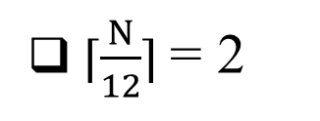
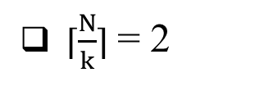
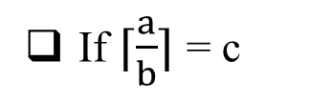
THE BIRTHDAY PROBLEM
What is the least number of people required to ensure that at least two of them have the same month of birthday?
⌈$\frac{N}{k}$⌉ = 2
k = 12
⌈$\frac{N}{12}$⌉ = 2
If ⌈$\frac{a}{b}$⌉ = c
N can be 13 to 24
Lowest of a = 1 + b(c-1)
How to determine?
Highest of a = bc
Ans: 13.

Slide 31
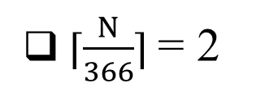
THE BIRTHDAY PROBLEM
What is the least number of people required to ensure that at least two of them have the same date of birthday?
⌈$\frac{N}{k}$⌉ = 2
k = 366
⌈$\frac{N}{366}$⌉ = 2
N = 1 + 366(2-1)
N = 367

Slide 32
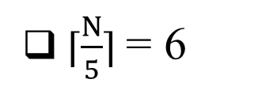
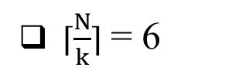
EXAMPLE
What is the minimum number of students required in a discrete mathematics class to be sure that at least six will receive the same grade, if there are five possible grades, A, B, C, D, and F?
⌈$\frac{N}{k}$⌉ = 6
k = 5
⌈$\frac{N}{5}$⌉ = 6
N = 1 + 5(6-1)
N = 26

Slide 33
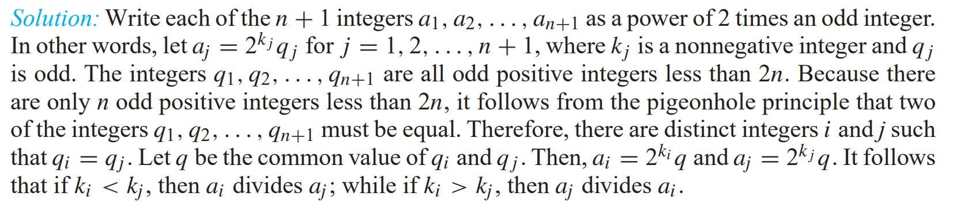
EXAMPLE
Show that among any n + 1 positive integers not exceeding 2n there must be an integer that divides one of the other integers.

Slide 34
THANK YOU!
ANY QUESTIONS?

