Slide 1
A STEP TOWARDS COMPETITIVE PROGRAMMING

Slide 2
WHAT IS A PROGRAMMING PROBLEM?
Consists of the following elements
Statement
Input Output
Input Constraints
Sample Input Output

Slide 3
EXAMPLE PROBLEM
Statement
Mr X has a son of 5 years old named Y. Mr X has recently admitted his son in to one of the most renowned school in Bangladesh but Mr X observed that his son has no attention in studies but loves to look at the screen of the computer-monitor for the entire day long. So, Mr X decided to buy a computer application for his son that takes an integer n as input from his son and prints the sum of the numbers from 1 to n so that his son can at least learn something from computer. So Mr X has come to you for his son to develop the application because he knows about you that you have started your studies at CSE.
Input
Constraints
Only line input contains a single integer n (1 ≤ n ≤ 10⁶).
Output
Print the sum of the numbers from 1 to n.
Sample Input Output
Input | Output
5 | 15
10 | 55

Slide 4
SOLUTION
#include <stdio.h>
int main( )
{
printf(“Enter a number: ”);
Additional text
int n;
scanf(“%d”, &n);
WRONG!
printf(“%d”, n*(n+1)/2);
return 0;
}

Slide 5
SOLUTION
#include <stdio.h>
int main( )
{
int n;
scanf(“%d”, &n);
Redundant!
if(n>=1 && n<=100000)
Unnecessary
{
printf(“%d”, n*(n+1)/2);
}
return 0;
}

Slide 6
SOLUTION
#include <stdio.h>
int main( )
{
int n;
WRONG!
scanf(“%d”, &n);
printf(“%d”, n*(n+1)/2);
Overflow
return 0;
}

Slide 7
ONLINE JUDGE
A website
Judges the solution of a programming based problems automatically
This automated judgment is done by a series of test cases
A test case contains of a set of input and corresponding output
Common Online Judges
Task
Codeforces (codeforces.com)
Creating account at all mentioned judges
UVA (onlinejudge.org)
Use professional name
SPOJ (www.spoj.com)
Use same email and password
SPOJ (lightoj.com)
hackerrank (hackerrank.com)
vjudge (vjudge.net)

Slide 8
PROGRAMMING CONTEST
An online competition to solve a series of programming based problems
Hosted in any online judge (We will host at vjudge.net)
A number of participants participate in a contest
Each participant attempts to solve maximum number of problems
The participant with most number of solved-problems holds the top rank
If two participants solve same number of problems their rank is judged by penalty
Penalty is a negative property: the more penalty is, the lower rank is
Penalty is generally measured by the following two criteria
Number of wrong attempts
Submission time
Each contest has a specific start time and an end time
Submission after end time is not considered to upgrade rank

Slide 9
PENALTY CALCULATION
Let there are n number of problems in a contest
The problems are denoted as A1, A2, A3 ….. An
Penalty of problem Ax is denoted as Px
Let for a problem Ax a participant takes
Wx number of wrong attempts to make his/her first AC
Tx (in min) amount of time to make his/her first AC after the starting of contest
Px = aWx + bTx
Generally, a is considered as 20 mins and b is considered as 1
Total penalty of a participant, P = P1 + P2 + P3 +….+ Pn

Slide 10
EXERCISE-1
Let there are two problems in a contest named A1 and A2.
Two participants Arafat and Moon is participating in the contest
Start time of the contest: 14 Feb, 2022 (19:00 hrs)
End time of the contest: 17 Feb, 2022 (09:00 hrs)
Their state of submission is given below, determine the winner
Prob | Arafat |  | Moon
 | Time of first AC | Wrong attempt before first AC | Time of first AC | Wrong attempt before first AC
A1 | 16 Feb (19:00) | 3 | 14 Feb (19:05) | 0
A2 | 17 Feb (08:00) | 2 | - | -
Arafat is the winner as his solve count is maximum

Slide 11
EXERCISE-2
Let there are two problems in a contest named A1 and A2.
Two participants Arafat and Moon is participating in the contest
Start time of the contest: 14 Feb, 2022 (19:00 hrs)
End time of the contest: 17 Feb, 2022 (09:00 hrs)
Their state of submission is given below, determine the winner
Prob | Arafat |  | Moon
 | Time of first AC | Wrong attempt before first AC | Time of first AC | Wrong attempt before first AC
A1 | 16 Feb (19:00) | 3 | 14 Feb (19:05) | 0
A2 | 19 Feb (08:00) | 2 | - | -
Here the solve-count is 1 for both Arafat because Arafat submits after contest
For Arafat P1 = 20 mins x 3 + 1 x 48 hrs x 60 mins = 2940 mins; P2 = 0; Total penalty, P = 2940 mins
For Moon P1 = 20 mins x 0 + 1 x 5 mins = 5 mins; P2 = 0; Total penalty, P = 5 mins
Moon is the winner as her solve count is same as Arafat but penalty is lower

Slide 12
RENOWNED PROGRAMMING CONTESTS
ICPC (International Collegiate Programming Contest)
International
NCPC (National Collegiate Programming Contest)
NGPC (National Girl’s Programming Contest)
National
Ada Lovelace National Girls' Programming Contest
IUPC (Inter University Programming Contest)

Slide 13
INTRODUCTION TO VJUDGE

Slide 14
CONTEST CREDENTIAL
2 types of contests
Public (No password, anyone can participate)
Private (A password, anyone who knows the password can participate)
A contest is identified by an unique link
For each contest: the link and the password (if any) will be provided
https://vjudge.net/contest/365255#rank
Pass: cse20

Slide 15
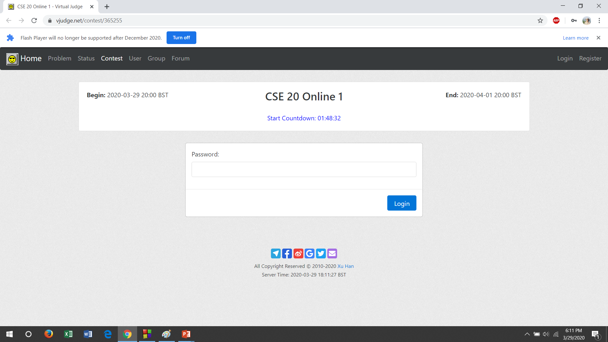
INTERFACE DESCRIPTION (STEP 1)
If you are not logged in with your vjudge account then the following interface will appear to your screen
So first of all, you need to login to your vjudge account
If you are logged in previously then directly go to the next step

Slide 16
INTERFACE DESCRIPTION (STEP 2)
Now you are just one step away from entering into the contest.
You need to provide the contest password. Your contest password is cse20
Now press the Login button to participate in the contest.
cse20

Slide 17
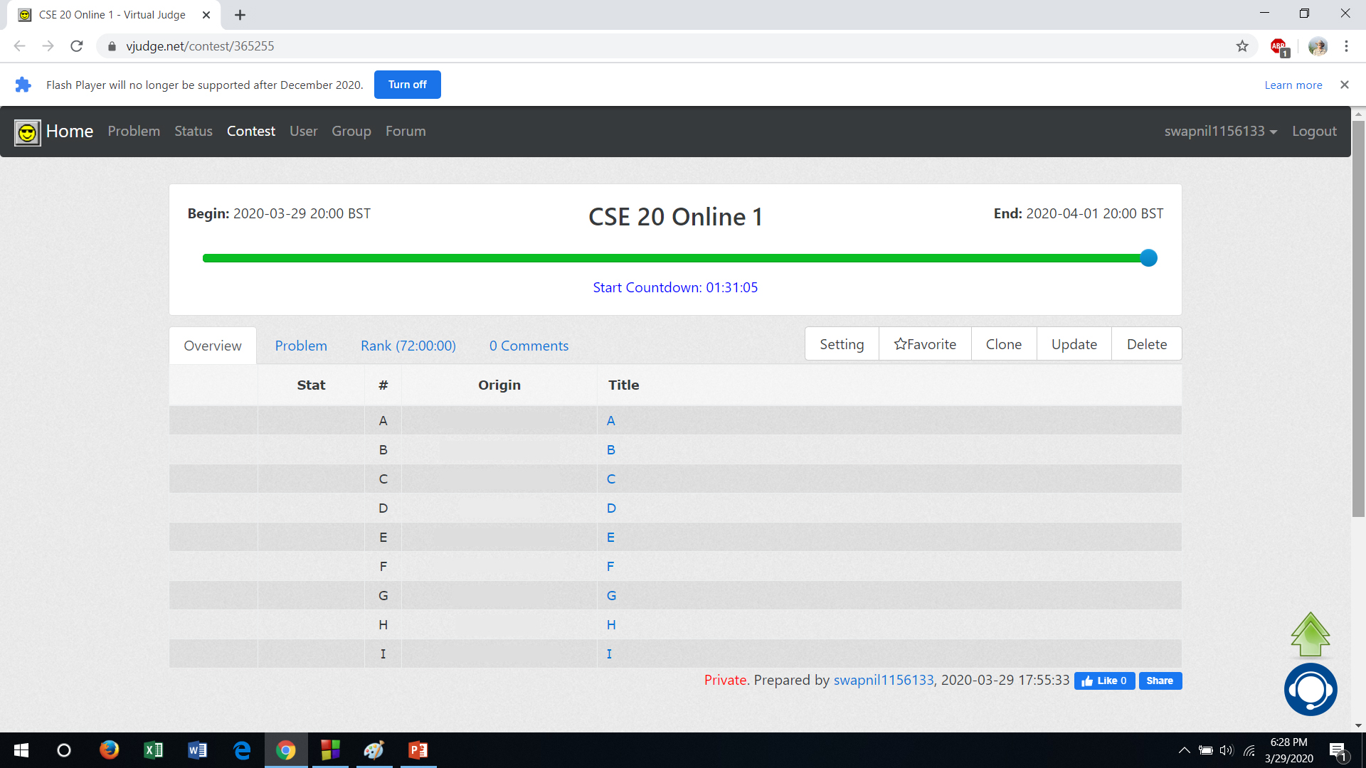
CONTEST DESCRIPTION
After successful login you will see the following interface. But if you login before the start time of the contest you will see a blank interface. Problem list will be appeared after the start time
You will find total 9 problems. A to I.
To solve a problem you need to click on that problem title. For example: let you want to solve problem A

Slide 18
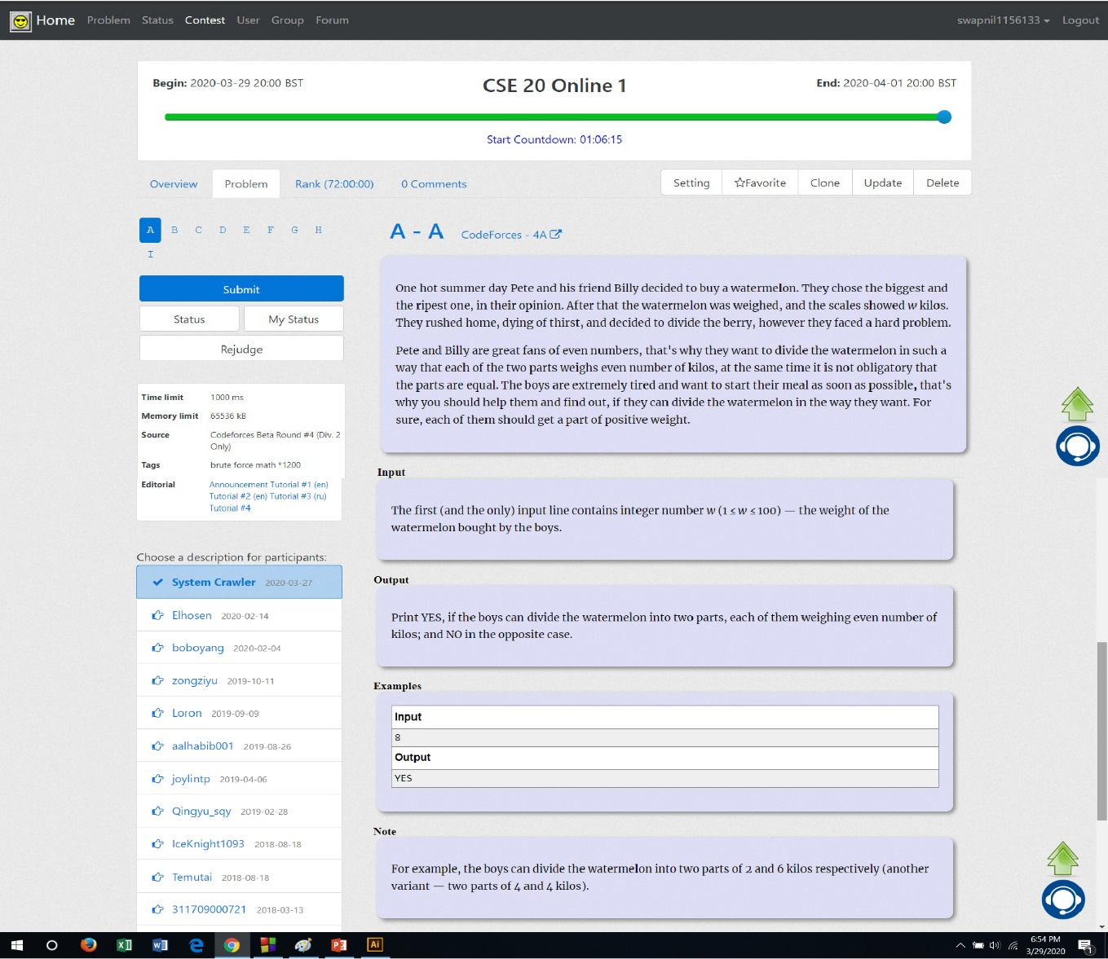
SUBMISSION DESCRIPTION (1)
This is the description of Problem A.
Now to submit the programming solution for Problem A, you need to click on the Submit button.

Slide 19
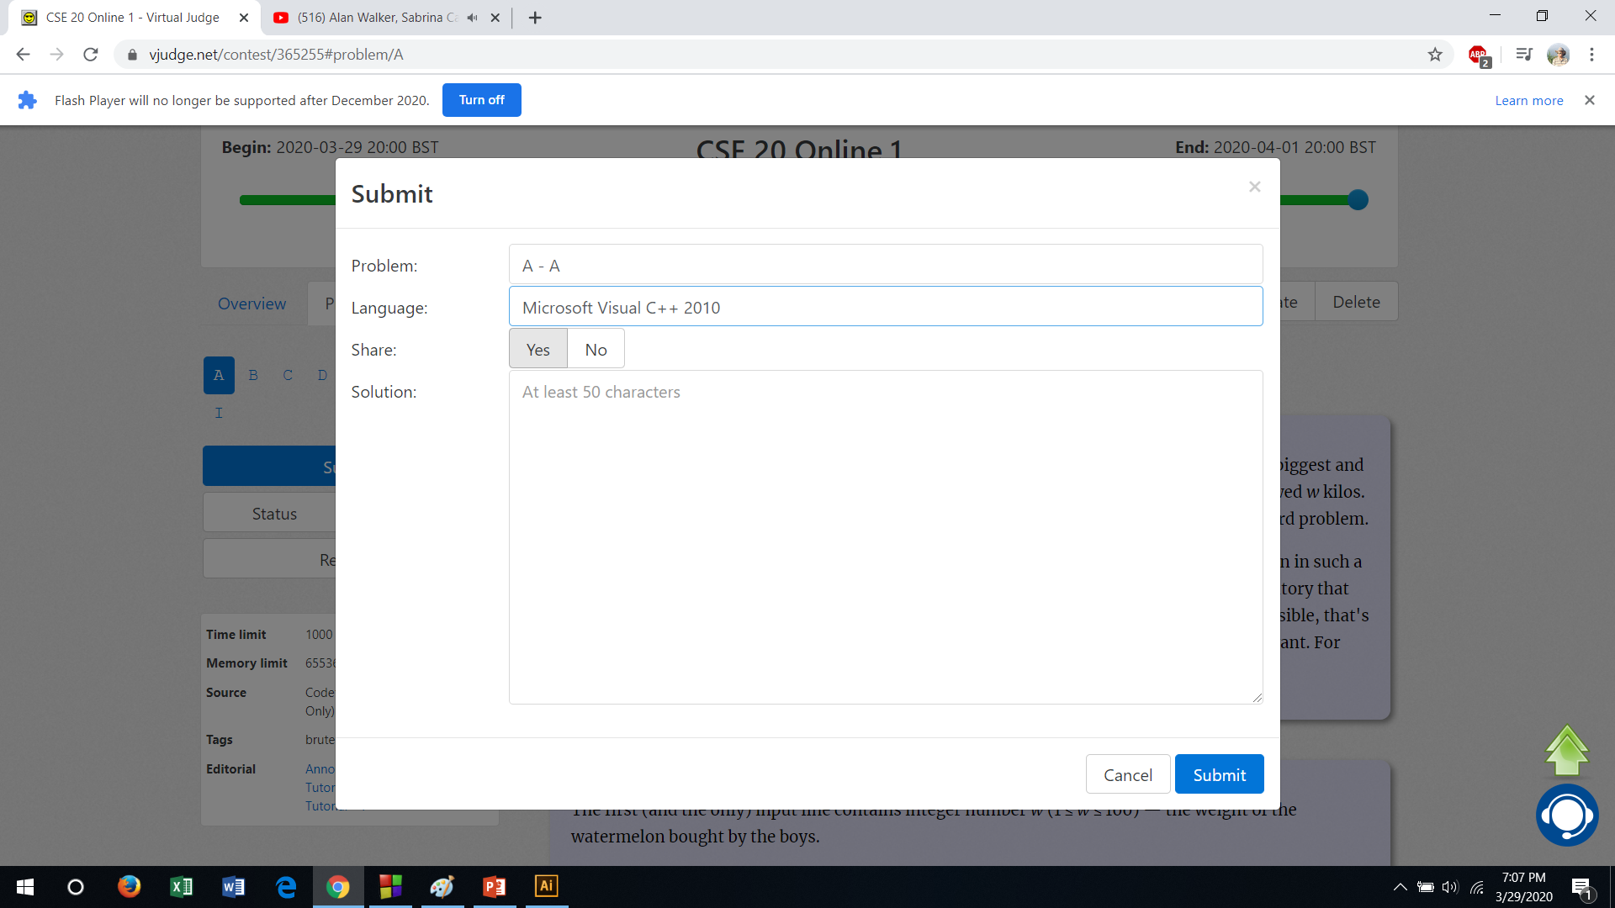
SUBMISSION DESCRIPTION (2)
This interface will appear after clicking on the Submit button.
Now you need to select appropriate language that we discussed in the class.

Slide 20
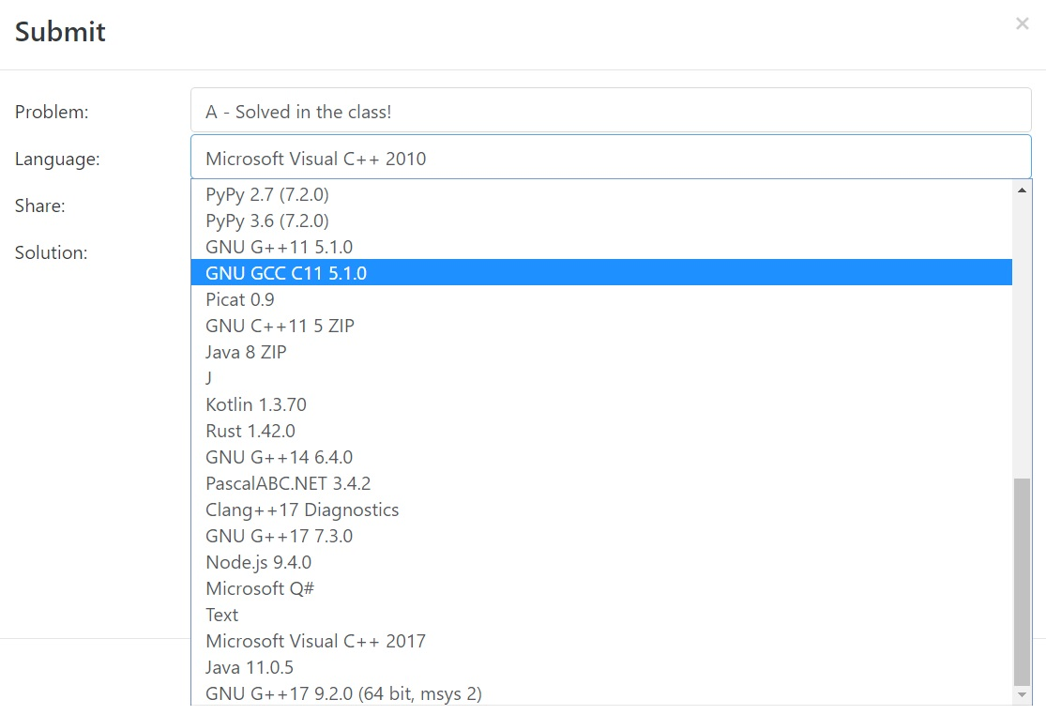
SUBMISSION DESCRIPTION (3)
Select the appropriate language as discussed in the class. If you fetch problem discuss in the group. You will find a solution.

Slide 21
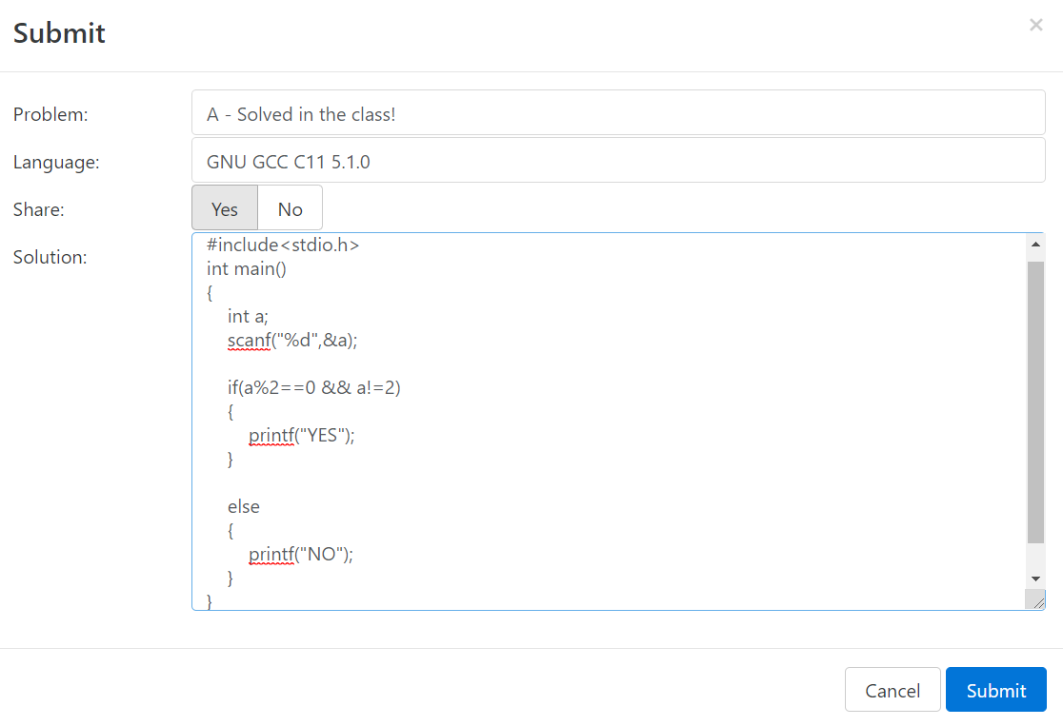
SUBMISSION DESCRIPTION (4)
Copy your code from Code::Blocks and paste your solution.
You must select Yes in the Share option.
Click the Submit button if you are confident.

Slide 22
SUBMISSION DESCRIPTION (5)
If your solution is correct for all possible cases then you will be notified as Accepted
Otherwise think more and submit your code again and again until the solution is perfect.

Slide 23
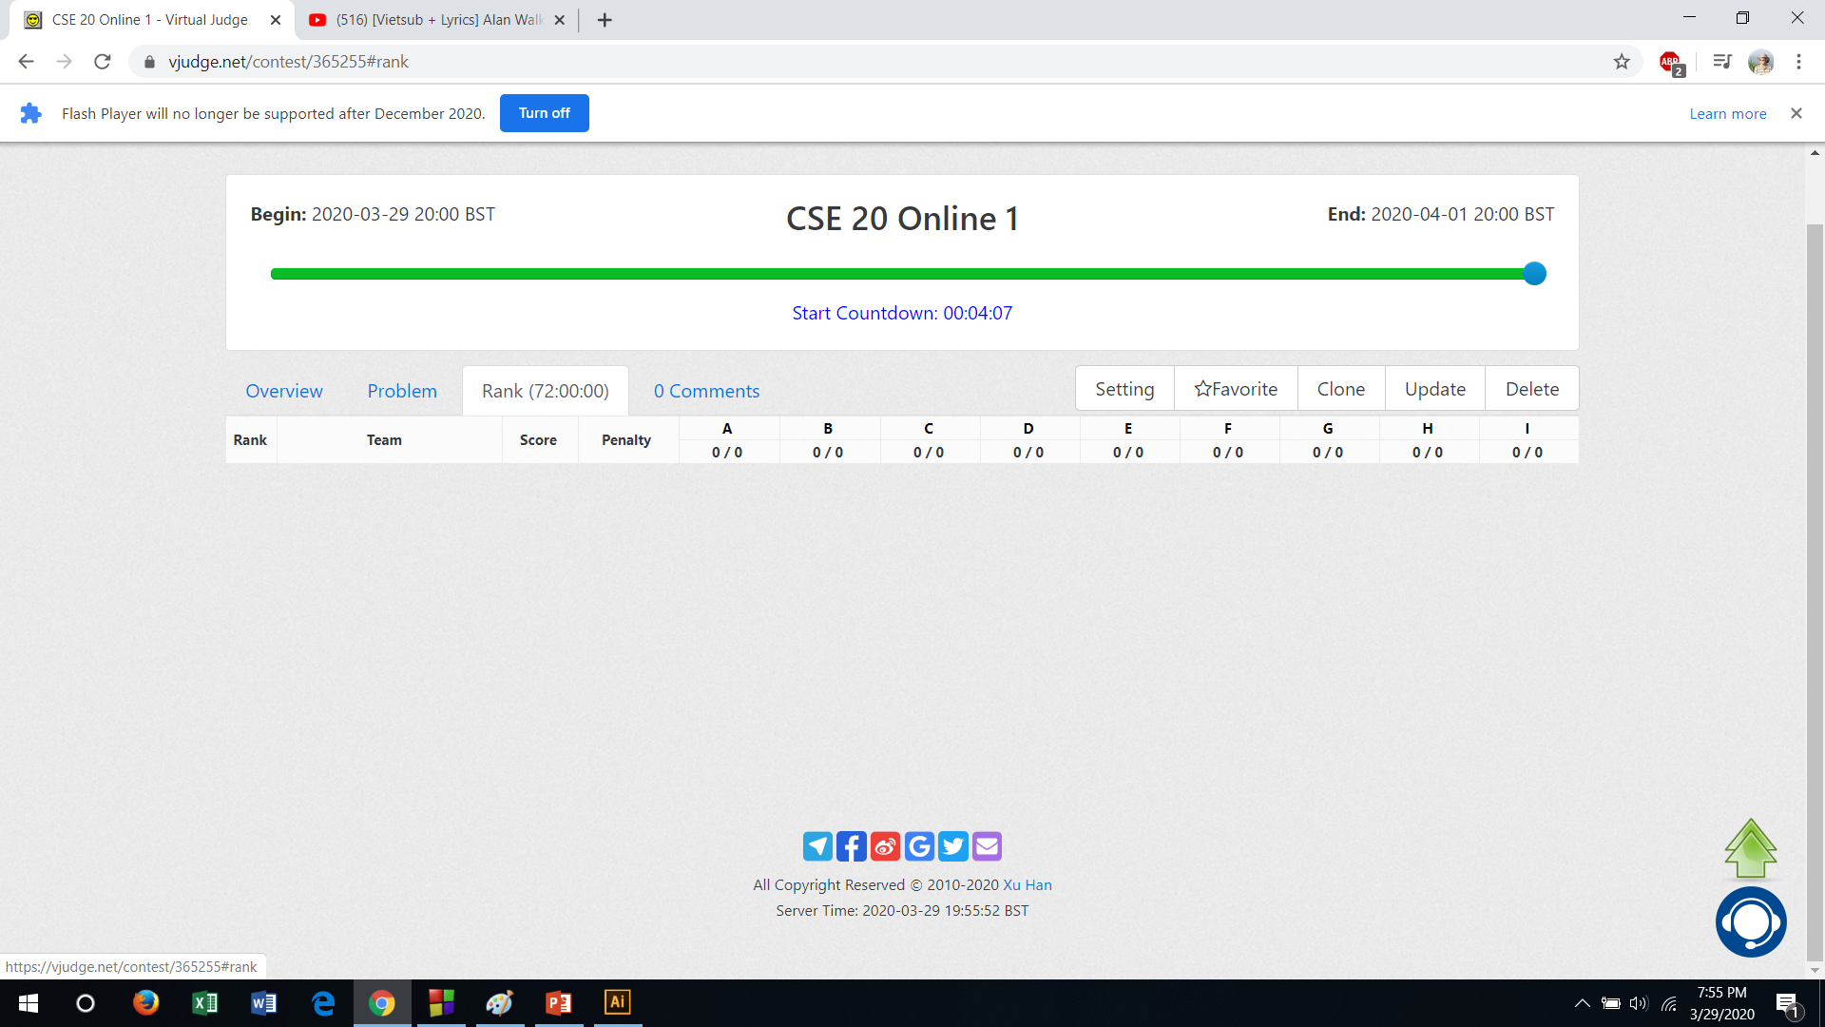
INTERFACE DESCRIPTION (3)
I know, after a correct submission you are very excited to know your rank among your friends
So, click on Rank button to see your rank

Slide 24
INTERFACE DESCRIPTION (4)
Now again get back to the problem list and start concentrating on the next problems
So, click on Overview button to get back to the problem list.

Slide 25
Some Words

Slide 26
WHY IS IT INTERESTING?
Watching the live rank
Going through a continuous healthy-mental competition
Getting the Accepted status is more satisfactory than having 1M views in Tiktok
Observing continuous self improvement
Making think continuously about a problem

Slide 27
WHY IS IT THE RIGHT TIME?
A competitive environment
Lots of your friends are facing same issues as you are doing. So, you can discuss.
Lots of people realize at later that they should start programming
But at that time, no one to help him/her
No one to set contest for him/her
Even if he/she gets a contest, no one to participate
Like Clash of Clans, it has very poor community right now.

Slide 28
UNETHICAL ISSUES
Plagiarism
Assigning other persons to solve problems on behalf
Making the healthy competition to an unhealthy one

Slide 29
NO TO DO
Doing unethical works
Taking the contest as a burden
Signing out from the contests out of frustration

Slide 30
PERSONS TO AVOID
Who advices to learn development before building skill in problem solving
Who says that CGPA has no market value
Who makes fun of you when you are doing something good to develop yourself
WHAT TO DO
Build a good problem solving skill by attending all the contests properly
Run after CGPA but do not run after only CGPA
Be respectful to other’s and believe in Almighty

