Slide 1
IEEE CSBDC Summer Symposium 2021, IEEE Computer Society Bangladesh Chapter, 4 June, 2021
Generating Scale-Free Planar Networks
Rabeeb Ibrat
Md. Tahmidur Rafid
Md. Saidur Rahman
Department of Computer Science and Engineering
Bangladesh University of Engineering and Technology (BUET)

Slide 2



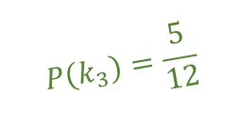
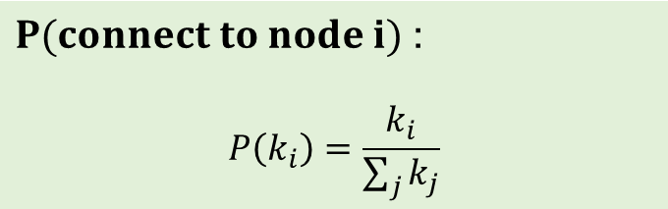

Barabási-Albert Model
Barabási-Albert Model
$$\sum_{j}{k_{j}=12}$$
$$N_{0}=6$$
New node
1
6
2
7
$$P\left(k_{3}\right)=\frac{5}{12}$$
3
$$m=3$$
$$k_{j}>0 ∀j$$
$P(connect to node i)$ :
$$P\left(k_{i}\right)=\frac{k_{i}}{\sum_{j}{k_{j}}}$$
4
5

Slide 3
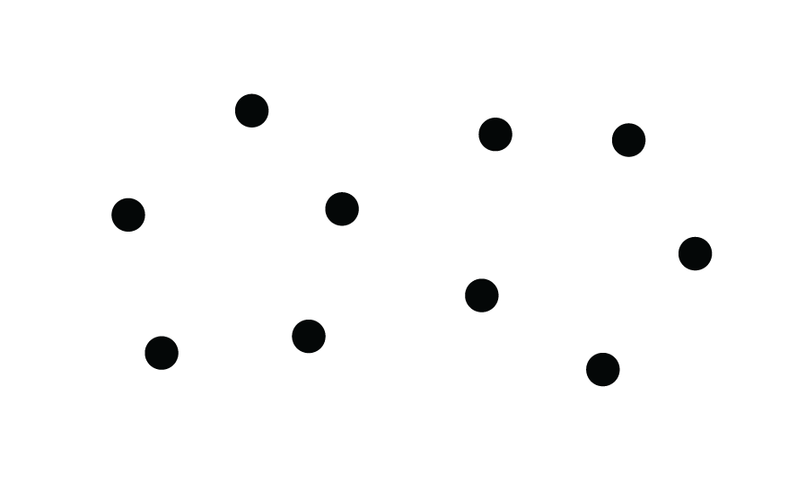
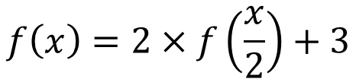


Divide and Conquer Approach
$$Number of nodes$$
$$f\left(x\right)=2×f\left(\frac{x}{2}\right)+3$$
$$Number of edges keeping all the nodes outside$$
$$f\left(x\right)=2x−3$$

Slide 4







Divide and Conquer Approach
$$Number of Nodes=1000$$
$$1997$$
$$Number of outer nodes=1000$$
$$Number of edges=$$
$$1997+1000 −3$$
$$Number of outer nodes=3$$
$$=3×1000 −6$$
$$Max. Degree for each node=2×\log_{2}{N}$$

Slide 5




Redefined Version
$$\frac{4}{14}$$
$$\frac{2}{14}$$
$$\frac{3}{14}$$
$$\frac{2}{14}$$
$$\frac{3}{14}$$
$$Total degree=14$$

Slide 6






Redefined Version
$$9$$
$$2$$
3
$$6$$
$$4$$
$$4$$
4
5
$$3$$
4

Slide 7
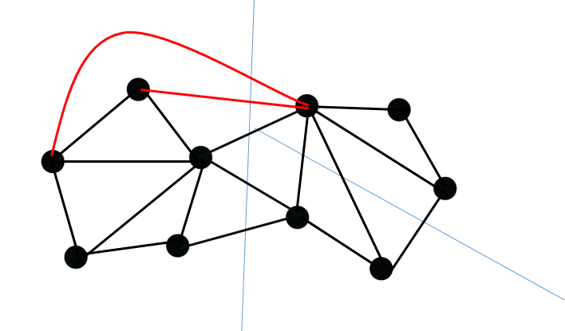





Complexity Analysis
$$Number of Nodes=N$$
$$Time complexity=O(N\log_{2}{N})$$
$$\left|E\right| ≤3N −6$$
$$Space complexity=O(N+\left|E\right|)$$
$$=O(N)$$
Data Structure:
Adjacency List

Slide 8
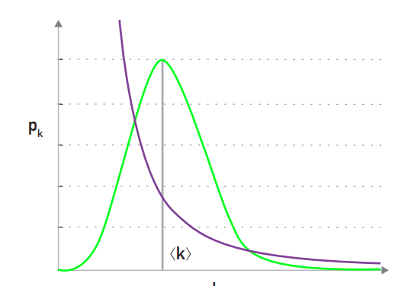
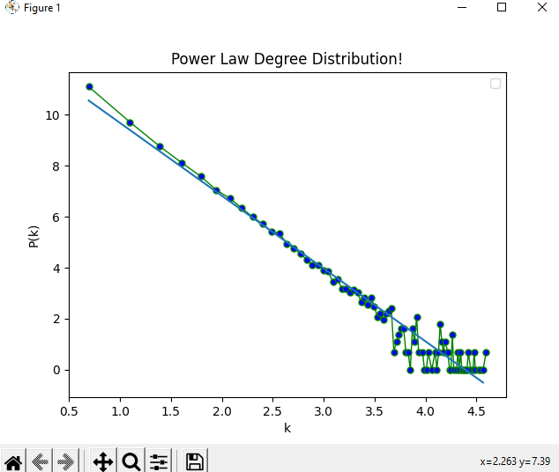


Power law distribution
Degree Distribution
Degree exponent
$p_{k}\sim k^{−γ}$
$$\log{p_{k}}\sim −γ\log{k}$$

Slide 9
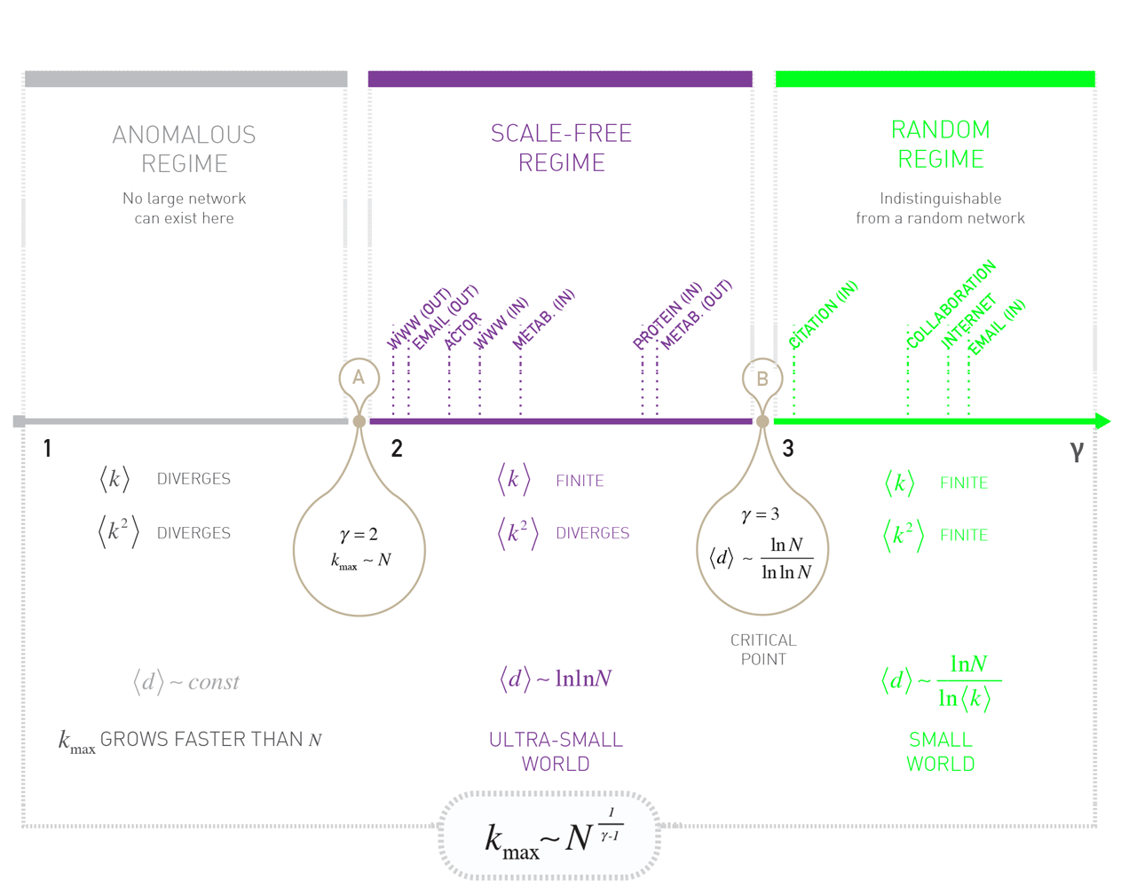
THE ROLE OF THE DEGREE EXPONENT

Slide 10
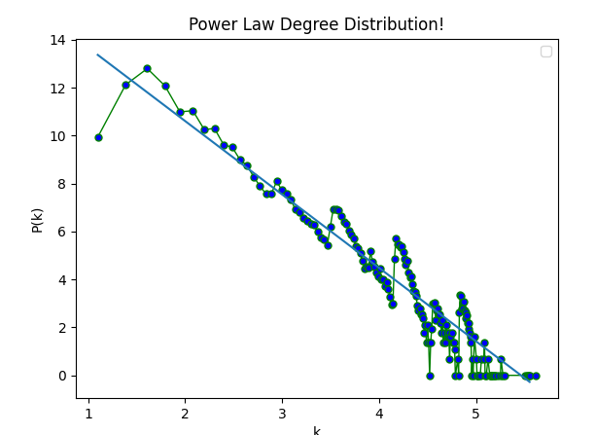


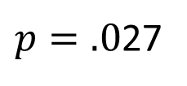
Experimental Result
$p=.0$27
$$n={10}^{6}$$
$$γ=3$$

Slide 11
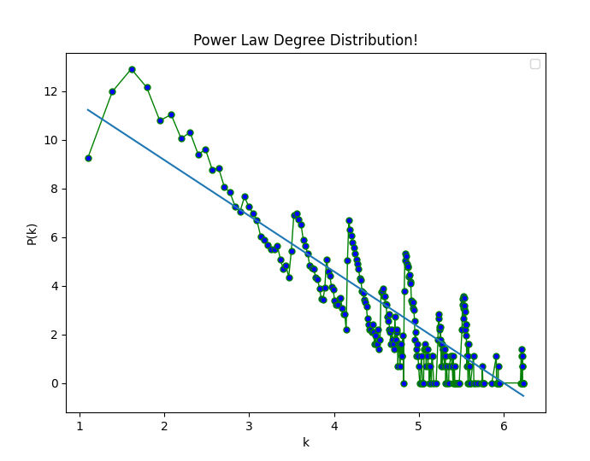


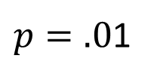
Experimental Result
$p=.0$1
$$n={10}^{6}$$
$$γ=2.29$$

Slide 12
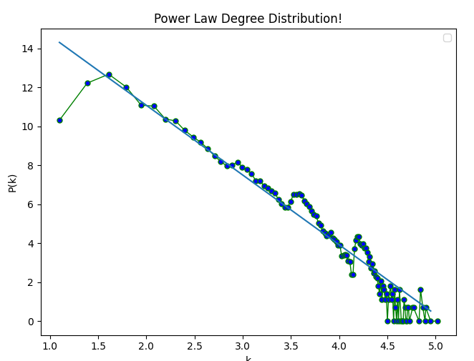

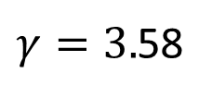
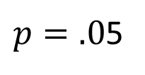
Experimental Result
$p=.0$5
$$n={10}^{6}$$
$γ=3.$58

Slide 13
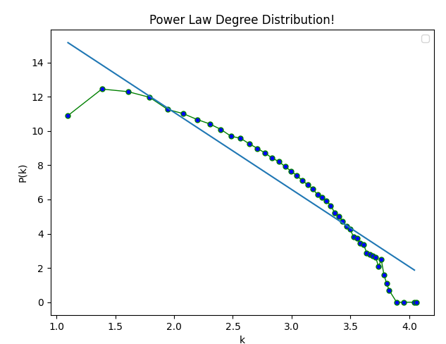


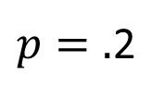
Experimental Result
$p=.$2
$$n={10}^{6}$$
$$γ=4.51$$

Slide 14
Thank You!

