Slide 1
Presentation on Machine learning for a 5g future of Introduction to Telecommunication Systems In Information and communication Technology By
Sadia Afrin Tahmina Afroze
It-17002 It-17014
Under the guidance of
Mr. Nazrul Islam
Assistant Proffesor
Dept of ICT
MBSTU

Slide 2
Outlines
We have posed some questions to better present the topic:
1. What is machine learning?
2. Advantage of machine learning .
3.Does machine learning have a future?
4.what is the future scope of machine learning.
5. What is the potential of the machine learning in the future?
6. Is 5g AI?
7.how will 5g affect AI ?
8. Potential of Machine Learning to Support 5G Requirements.
9. Enhanced Mobile Broadband (eMBB)
10. Massive Machine-Type Communications(mMTC)
11. Ultra-Reliable Low-Latency Communications (URLLC)
12. Interpretability Vs. Accuracy Trade-Off

Slide 3
First comes the question,what is machine learning?
Well,Machine learning is an application of artificial intelligence (AI) that provides systems the ability to automatically learn and improve from experience without being explicitly programmed. Machine learning focuses on the development of computer programs that can access data and use it learn for themselves. The process of learning begins with observations or data, such as examples, direct experience, or instruction, in order to look for patterns in data and make better decisions in the future based on the examples that we provide. The primary aim is to allow the computers learn automatically without human intervention or assistance and adjust actions accordingly.

Slide 4
The Advantages of Machine Learning
1.Data Input from Unlimited Resources. Machine learning can easily consume unlimited amounts of data with timely analysis and assessment. ...
2. Fast Processing and Real-Time Predictions.
3. Practical Scenarios as Machine Learning in the Medical Industry. Machine Learning in the Insurance Industry.
4. Easily identifies trends and patterns ·
5. No human intervention needed (automation) ·
6. Automation of everything.
7.Supplementing data mining.

Slide 5
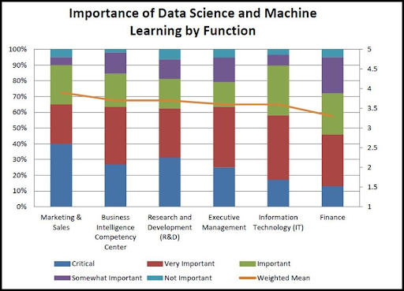
Does machine learning have a future?
Machine Learning has been one of the hottest topics of discussion among the C-suite. With its incredible potential to compute and analyze huge amounts of data, advanced ML techniques are being used in businesses to perform complex tasks quicker and more efficiently. The machine learning market is expected to grow from USD 1.03 Billion in 2016 to USD 8.81 Billion by 2022, at a Compound Annual Growth Rate (CAGR) of 44.1% during the forecast period.Machine learning-driven solutions are being leveraged by organizations to improve customer experience, ROI, and to gain a competitive edge in business. Big players in the field like Google, IBM, Microsoft, Apple, and Salesforce are already leveraging ML benefits, Hire an ML developer to incorporate ML benefits in your business.Being an intensively evolving language, continuous technological advancements are bound to hit the field of Machine Learning which are going to shape the future of Machine Learning.

Slide 6
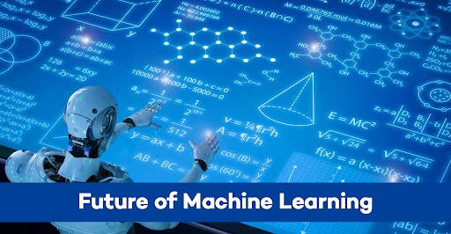
What is the future of machine learning?
Let’s take a sneak peek into the future of Machine Learning in 2020.Improved Unsupervised Algorithms are one of the applications of ML that you can witness in the coming days. Being used in multiple industries, improved unsupervised ML algorithms will certainly shape the future of Machine Learning.
“The world is running out of computing capacity. Moore’s law is kinda running out of steam … [we need quantum computing to] create all of these rich experiences we talk about, all of this artificial intelligence, said Satya Nadella, Microsoft CEO. Quantum computers when integrated into machine learning leads to faster processing of data. This can help to enhance the ability to analyze and draw meaningful insights from a given dataset. This increased performance helps businesses to achieve great results that were not possible using classical ML techniques. Companies are now trying hard to harness the power of quantum computing to create more effective techniques. Microsoft and Google have already announced their plans to leverage the technology in the near future. With such widespread adoption of quantum computing, it won’t be wrong to consider it as one of the major applications deciding the future of ML.

Slide 7
What is the potential of machine learning in future?
We have heard a lot about the scope of Machine Learning, its applications, job and salary trends, etc. But, do you know, what is Machine Learning? Why do we need Machine Learning? Where do we use it?
The investment sector has always been a profitable business. In earlier days, investing money required a thorough knowledge of domestic as well as international markets. People used to manually study and analyze the trends of the market. The manual analysis required a lot of time. But, nowadays, as the scope of Machine Learning is widening, we can see a lot of mobile applications that provide us assistance within seconds for investment in various sectors. For making a smart investment in the stock market, there is an application called ‘Upstox.‘ It uses Machine Learning for predicting the future possibilities of the market. Let us discuss it in detail.

Slide 8
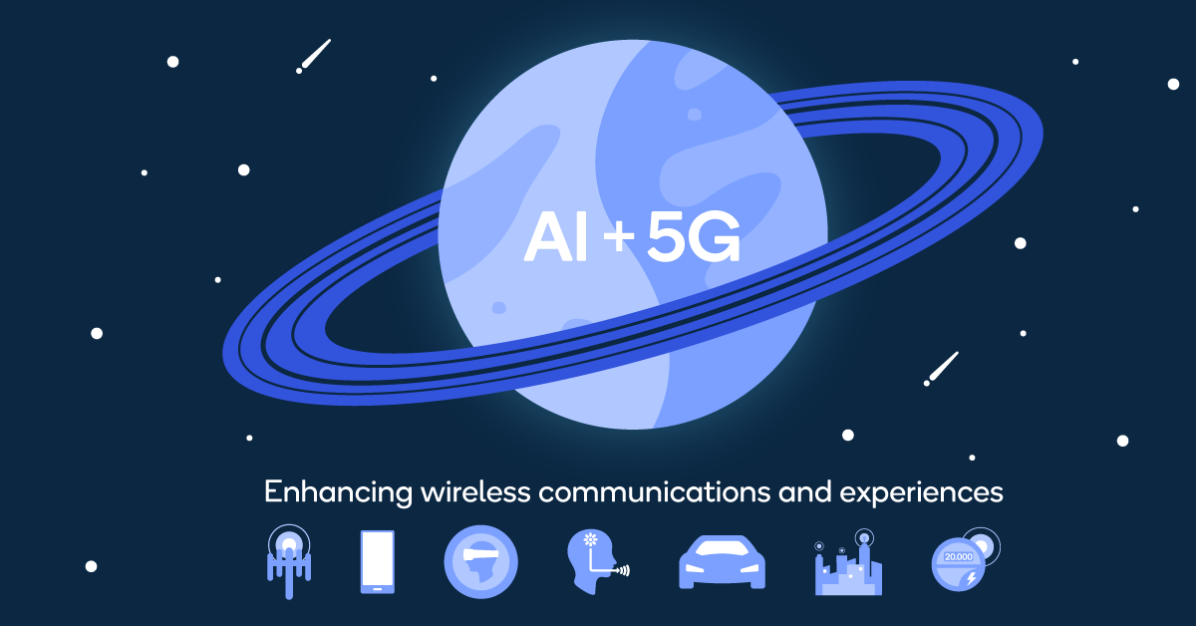
Is 5g AI?
5G and AI are two of the most disruptive technologies the world has seen in decades. While each is individually revolutionizing industries and enabling new experiences, the combination of 5G and AI is going to be truly transformative. In fact, this intersection is fundamental to our vision of the intelligent wireless edge, in which on-device processing, the edge cloud, and 5G go hand-in-hand to create a ubiquitous connectivity fabric of smart devices and services. Significant amounts data will be processed closer to its source, whether that be through on-device AI processing or through additional processing by the edge cloud over low-latency 5G. Processing data closer to the source through on-device AI is important since it offers crucial benefits such as privacy, personalization, and reliability, in addition to helping scale intelligence.We see 5G making AI-enhanced experiences better in scenarios such as personalized retail through boundless XR, intuitive virtual assistants through vastly improved voice UI, and the reconfigurable factory of the future through adaptive optimization.

Slide 9
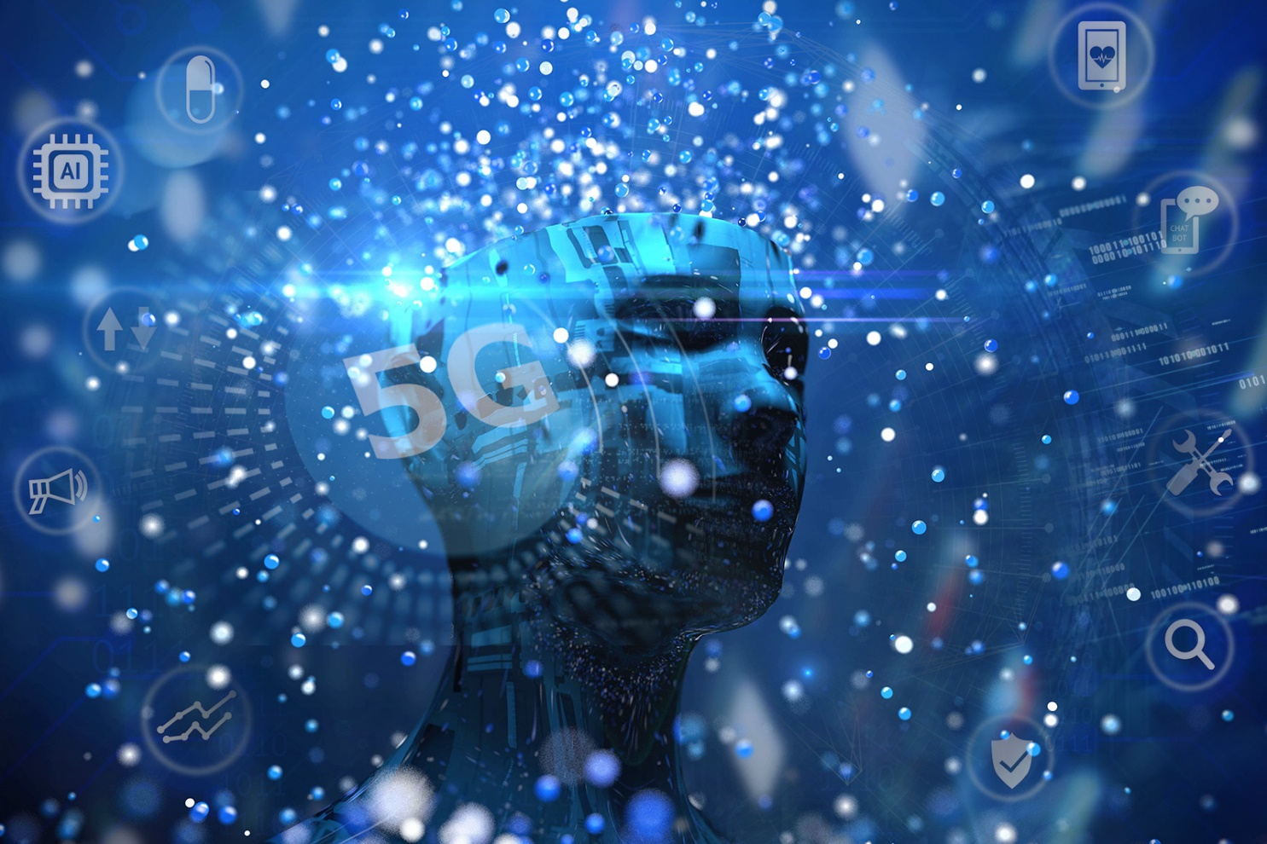
How will 5g affect AI?
Last week’s US State of the Union address by President Donald J. Trump promised legislation to invest in “the cutting edge industries of the future.” Without much detail initially available, the White House filled in the blanks by suggesting “President Trump’s commitment to American leadership in Artificial Intelligence, 5G wireless, quantum science and advanced will ensure that these technologies serve to benefit the American people and that the American innovation ecosystem remains the envy of the world for generations to come.”5G makes the debate around AI edge computing irrelevant.5G also promises significant breakthroughs in traditional mobile communications systems. 5G is going to enhance the capabilities of our traditional networks. Even the speed we get over wire or fiber goes much further over a 5G network and evolves to support the applications of IoT in various fields, including business, manufacturing, healthcare and transportation. 5G will serve as the basic technology for future IoT technologies that connect and operate entire organizations, the aim being to support differentiated applications with a uniform technical framework. However, with rapid development, AI is rising to these challenges as it becomes a promising potential support to the problems associated with the 5G era, and will lead to revolutionary concepts and capabilities in communications. This will also “up” the game in the applications world as business requirements become more prevalent. As mentioned, the narrowing gap between cloud and on-device processing will be foregone. The reinforcing of the massive IoT network dream will become more feasible.In reality, 5G will take some time to have significant impact on AI processing.

Slide 10
Potential of Machine Learning to Support 5G Requirements
In this section, we look at the road to the next generation network deployment, and explore the link between ML algorithms and 5G requirements [114]. 5G is not an incremental improvement over 4G, but rather the next major evolution of mobile communication with performance improvements of several orders of magnitude over IMT-advanced. The intent of these requirements is to ensure that IMT-2020 guarantees more flexibility, security, and reliability than previous technologies, providing a variety of services and deployment scenarios for a wide range of environments [115], [116]. By agreeing on these requirements, relevant parties (e.g., network operators, manufacturers, regulators, etc.) can work towards developing the same system, where their own particular needs may not be met at the moment. In this section, we have grouped the main 5G requirements into three generic communication services and have studied how ML can assist in reaching their demands. Each service emphasizes a different subset of requirements and applications related to some extent.

Slide 11
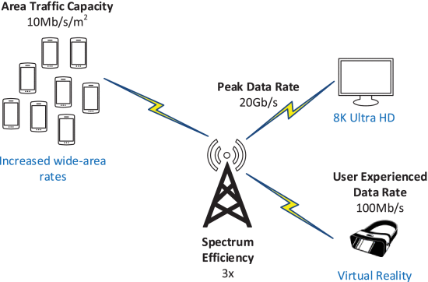
Enhanced Mobile Broadband (eMBB)
Enhancing the current MBB service will enable new applications with higher data rate demands over a uniform coverage area (e.g., ultra-high definition video streaming, and virtual reality) (Fig. 7). The essential rvequirements to enable eMBB are presented.
1) Peak Data Rate
Peak data rate is planned to increase and support high-demand data-driven use cases. IMT-2020 systems will be required to deliver 20-times higher data rate than the previous technology specification, from 1 Gb/s in 4G to 20 Gb/s in 5G. This is the maximum achievable data rate under ideal error-free conditions assigned to a single mobile station when all of the assignable radio resources for the corresponding link are utilized (excluding radio resources for physical layer synchronization, reference signals, guard bands, etc). An increase of the peak data rate in 5G should be viewed as an evolution that builds on all spectrum assets. The need for new additional spectrum has grown based on the emergence of new use cases, and as communication service providers consider their deployment options for 5G networks, they will need access to significant amounts.
2) User Experienced Data Rate
User experienced data rate is defined as the 5% point of the cumulative distribution function (CDF) of the user throughput over active time (i.e., the number of correctly received bits at MAC Layer 3), measured in a dense urban environment. IMT-2020 intends to brace 10-times higher user experienced data rate compared to 4G LTE, from 10 Mbit/s to 100 Mbit/s. Its strong connection with other requirements such as peak data rate and latency makes it ideal to be used as a 5G performance indicator in real-world environments.
3) Area Traffic Capacity
Area traffic capacity refers to the total traffic throughput served per geographic area in Mbit/s/m², that is, the number of correctly received bits contained in the service data unit (SDU), over a certain period of time. The target value for area traffic capacity increased from 0.1 Mbits/s/m² on IMT-advanced, to 10 Mbit/s/m² in 5G.

Slide 12
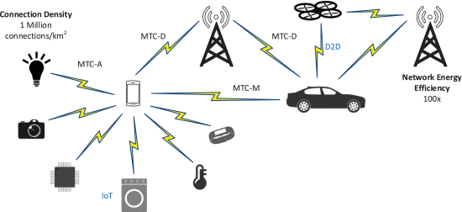
Massive Machine-Type Communications(mMTC)
Another key characteristic of 5G communication services is the scalable connectivity demand for the expanding number of wireless network-enabled devices, focusing on the efficient transmission of small payloads over an extended coverage area [131], [132]. Applications such as body-area networks, smart homes, internet of things (IoT), and drone delivery will generate sporadic traffic between a massive number of geographically spread equipments (Fig. 8), requiring mMTC to be able to support new, yet unforeseen use cases. The two central requirements to enable mMTC are:
1) Connection Density
An immense challenge for 5G systems is to connect a massive number of devices to the internet, taking IoT, and smart cities/homes/buildings to a higher level, from 100 thousand connections per km² in 4G to 1 million connections per km² in 5G. This requirement should be achieved for limited bandwidth and transmission-reception points (TRxPs). The emergence of IoT has given rise to a significant amount of data, collected from sensors, user devices, and BSs, that must be processed by the next-generation wireless system.
2)Network Energy Efficiency
Network energy efficiency is the capability of a RAT to minimize the radio access network energy consumption in relation to the traffic capacity provided. The RAT must have the ability to support a high sleep-ratio and a long sleep duration. This requirement needs to be studied in two sub-aspects: efficient data transmission in a loaded case, and low energy consumption when there is no data. Because the energy of sensor nodes is limited and usually un-rechargeable, a fundamental problem that mMTC use cases applications need to solve is the scheduling of sleep and wake-up states of BSs and wireless sensor networks (WSN).

Slide 13
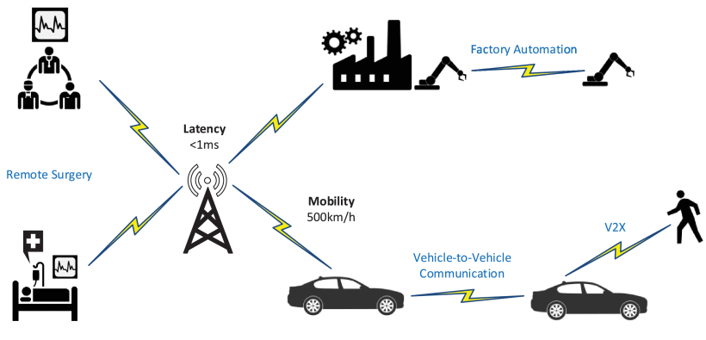
Ultra-Reliable Low-Latency Communications (URLLC)
Forthcoming network services, e.g., connected healthcare, remote surgery, mission-critical applications, autonomous driving, vehicle-to-vehicle (V2V) communications, high-speed train connectivity, and smart industry applications, will prioritize extreme reliability, low-latency, and mobility, over data rates (Fig. 9). The crucial requirements to enable URLL communications are:
1) Latency
Latency is probably one of the most influential performance measures of 5G. A reliable 5G system requires extremely low latency, and even a few milliseconds (ms) can make an enormous difference, making it an extremely important field for 5G researchers and engineers alike. The requirements for IMT-2020 give no room for unbounded delay, from an admissible 10 ms in 4G, to ¡1 ms in the specification for 5G. Several authors have indicated that ultimately the success of URLLC will rely on an anticipatory network management, capable of predicting the network needs
2) Mobility
Mobility is described as the maximum mobile station speed at which a defined QoS can be achieved (in km/h). For the high-speed vehicular mobility scenario, it is assumed that the user is moving at the maximum speed of 500 km/h, as opposed to the previous 350 km/h on 4G. To support these highly-mobile use cases, particularly in dense mmWave deployments where the users need to frequently hand-off between BSs, an optimal identification of the beamforming vectors is essential. ML models can use the uplink pilot signal received at the terminal BSs, and learn the implicit mapping function relating to the environment setup to predict

Slide 14
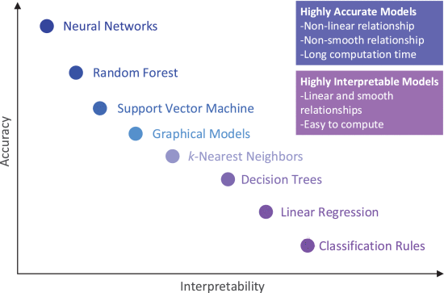
Interpretability Vs. Accuracy Trade-Off
After deploying an ML algorithm in a given 5G scheme, we would like to know why a BS allocates more network resources to a given user than the other, or why a specific RAT is selected to connect certain UEs in HetNets. From a stakeholder standpoint, these complex interactions between the independent variables are difficult to understand and might not always make business sense [179]. To explain why a certain model is best suited in a particular situation and how the selection of the algorithm is related to the given use case, a depth understanding of the trade-off between accuracy and interpretability becomes convenient
Depending on the application, our goal would be to find the right balance in a model that provides both good accuracy with high interpretability.
To be able to interpret DNN models it is essential to understand the functionality of the different hidden layers, and how nodes are activated. Segmenting a network by grouping interconnected neurons will provide a simpler level of abstraction to understand its functionality [180]. Understanding how DNN forms individual concepts that can then be assembled into the final output is another key for building interpretability. Either way, when implementing DL models, there could be a price to pay in terms of accuracy.

Slide 15
Conclusion
We have seen that there is enough promise in the value of ML to dream of and experiment with, a future in which ML can be an inherent element of wireless communications. However, for adopting ML in 5G/B5G, it is needed to consider that ML cannot be applied everywhere, bearing in mind that the costliness, time, latency, and delay introduced from some ML techniques are far from some real-time applications. ML and 5G have a lot of room to improve together as a discipline, and until the major telecommunication industry fully trusts ML, the rate of development in the area will be significantly constrained by the need to be meticulous and not break the current systems. Because ML could add uncertainty and complication to any network, our passion must be tempered by extreme caution. It is important for future researchers to make a critical evaluation of the trade-off between increasing the accuracy of a wireless system using an ML-based approach and the interpretability of the model, especially for applications in which regulatory requirements come into play. Additionally, the explainability of any decision made by the ML algorithm needs to be emphasized, as these decisions must be timely, robust, and secure at the same time. Having said that, the demand is clear, and the goal is in fact simplicity. As a consequence, the question is no longer whether ML will be integrated into mobile and wireless communication systems, but rather when such integration will fully take place.

