Slide 1

Welcome to
WORDGAME!
IMPROVE YOUR VOCABULARY
Notes:
To use this title animation slide with a new image simply 1) move the top semi-transparent shape to the side, 2) delete placeholder image, 3) click on the picture icon to add a new picture, 4) Move semi-transparent shape back to original position, 5) Update text on slide.

Slide 2
“LEARNING ANOTHER LANGUAGE IS LIKE BECOMING ANOTHER PERSON.”
—HARUKI MURAKAMI

Slide 3

INTRODUCTION
Our Design
Minimalist design. Low installed capacity Don’t need WIFI.
Why?
Our Vocabulary.
Various vocabulary.
Meaning in Vietnamese.
Our Plan.
Difficulty increasing.
Management skills.

Slide 4
HOWTOPLAY
EASY TO PLAY, EASY TO LEARN
LINK WORDS
2x2
3x3
4x4
5x5
CHOOSE IT’S MEANING
Vietnamese version.
25% Right.
REMEMBER & CONTINUE
Complete the game and you have 1000 new words.

Slide 5
OUR RULE You can’t play the game if you don’t know the rules
1
2
3
4
5
CATEGORIES & LEVEL
FIND WORD & IT’S MEANING
HINT
DAILY PUZZLE
OTHER FUNCTION

Slide 6
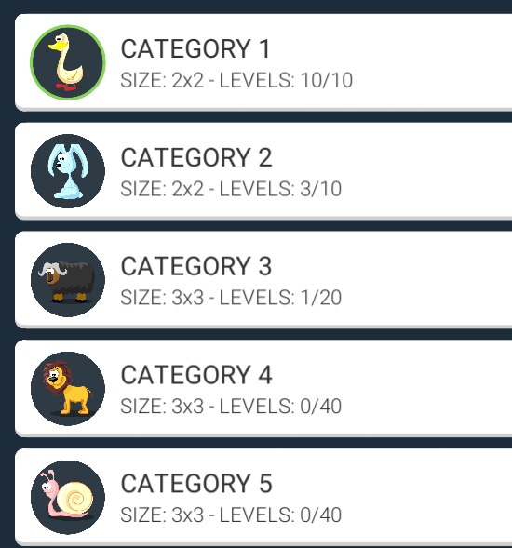
1
No need to complete pervious categories.
Icons cute.
CATEGORIES
Choose your favorite subject.
Remember better with images.

Slide 7
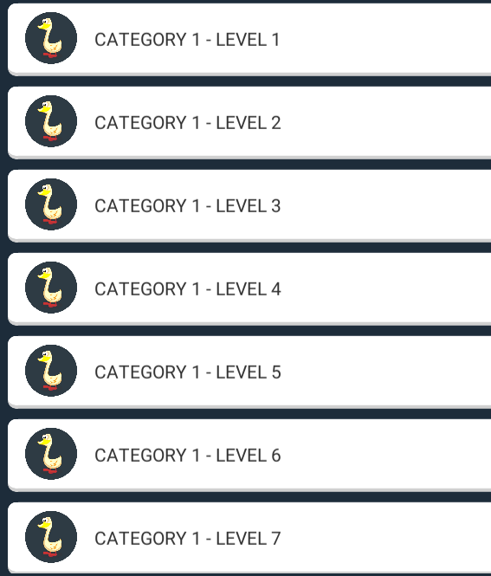
1
Need to complete previous levels.
LEVELS
Push motivation.

Slide 8
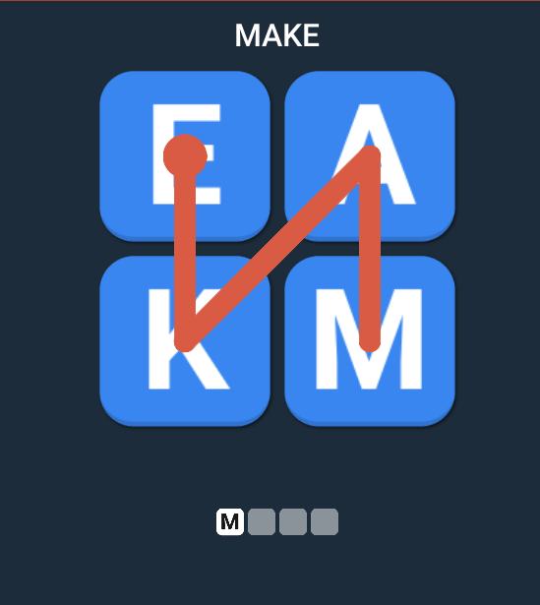
2
Link words adjacent with each other.
LINK WORDS
Number of word is a best hint.

Slide 9
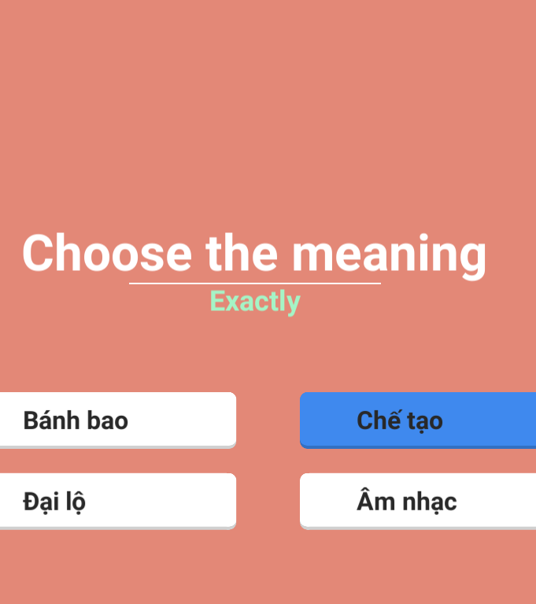
2
25%.
ITS MEANING.
If choose wrong, just try again.

Slide 10
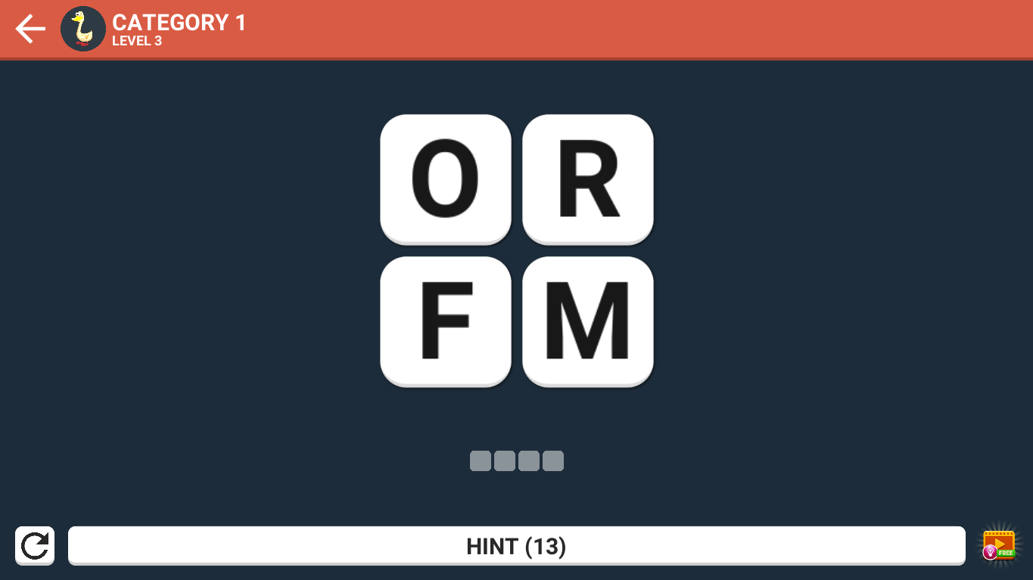
3
Pass 1 level, gain 1 hint.
HINT
1 hint can use to know 1 word.
Gain 10 hints by pass daily puzzle.
Notes:
Tip:
When using complex image as full-bleed background add a transparency (70%-90%) fill layer to give contrast to text.

Slide 11
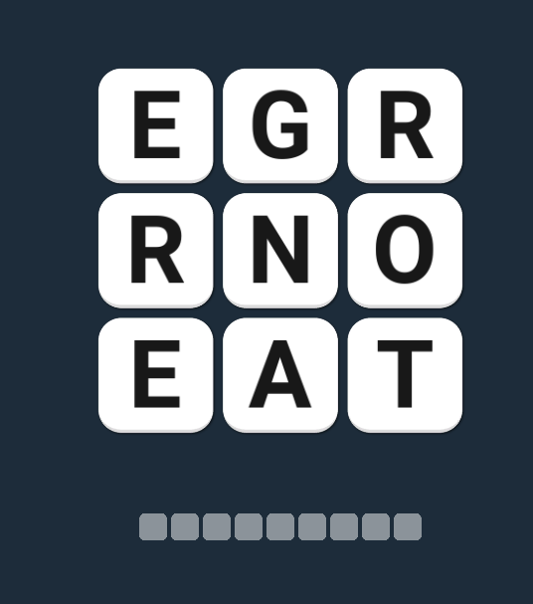
4
Gain 10 hints everyday
DAILY PUZZLE
Hard level.
1 puzzle 1 day.

Slide 12
5
RETRY
PROMOTION
Notes:
Tip:
When using complex image as full-bleed background add a transparency (70%-90%) fill layer to give contrast to text.

Slide 13
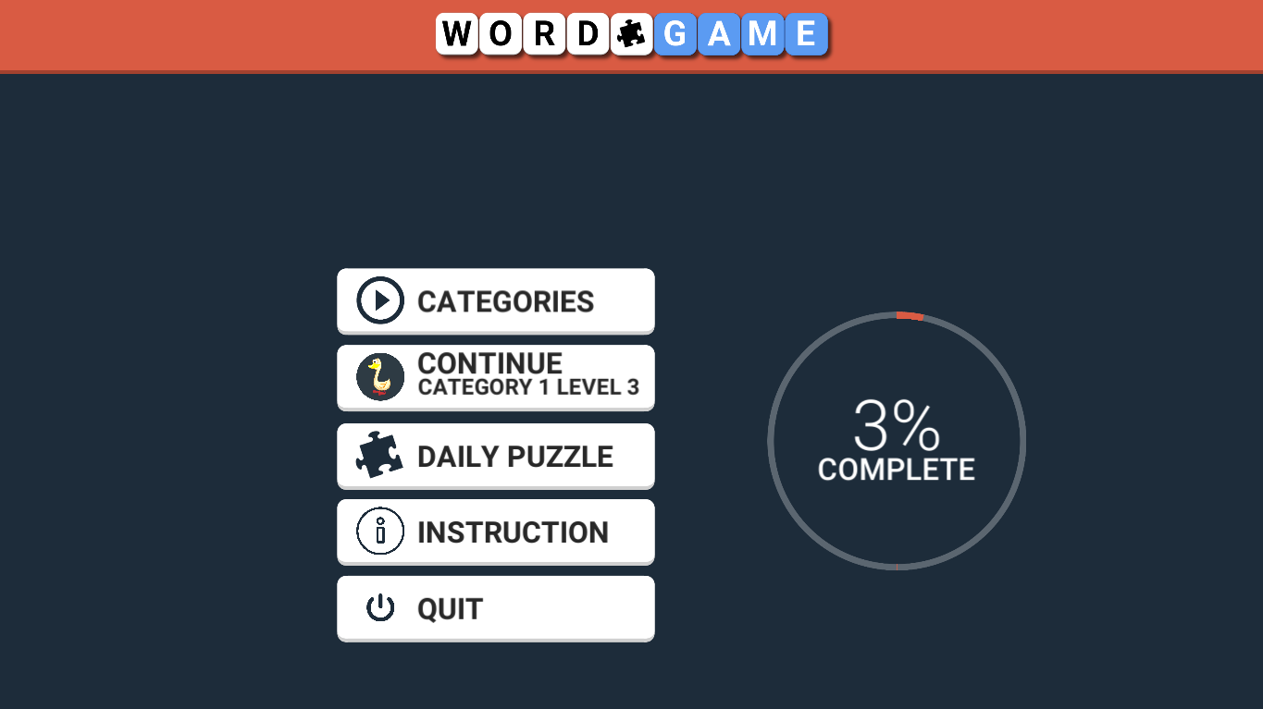
5
5
RETRY
PROMOTION
Notes:
Tip:
When using complex image as full-bleed background add a transparency (70%-90%) fill layer to give contrast to text.

Slide 14
GUESS VOWELS & CONSONANT
TIP
To reach high levels and become word master!
!
A E I O U
B C D F G H J K L M N P Q R S T V W X Y Z

Slide 15
HINT IS NOT UNLIMITED.
FACT
Gain more, use less.

Slide 16
IF YOU ARE NOT WILLING TO LEARN, NO ONE CAN HELP YOU.
IF YOU ARE DETERMINED TO LEARN, NO ONE CAN STOP YOU.
—InspiringThinkn

Slide 17
WORD GAME INTRODUCTION
THANK YOU

