Slide 1
Percolating 2D Lattices
By Tahoe, Ksenia, and Xinmeng

Slide 2
In this presentation:
The basics of percolation
Extracting the percolation probability
Extracting the critical exponent

Slide 3
What is Percolation?

Slide 4
Basics
Percolation is when a lattice exhibits a spanning cluster
A spanning cluster is a cluster that touches all sides of a lattice
Physical Ramifications
Movement and filtering of liquids through porous materials
Phase transitions

Slide 5
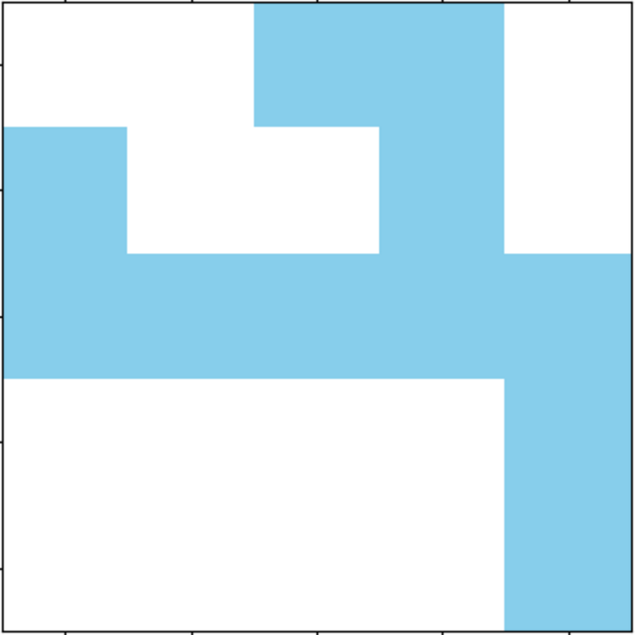
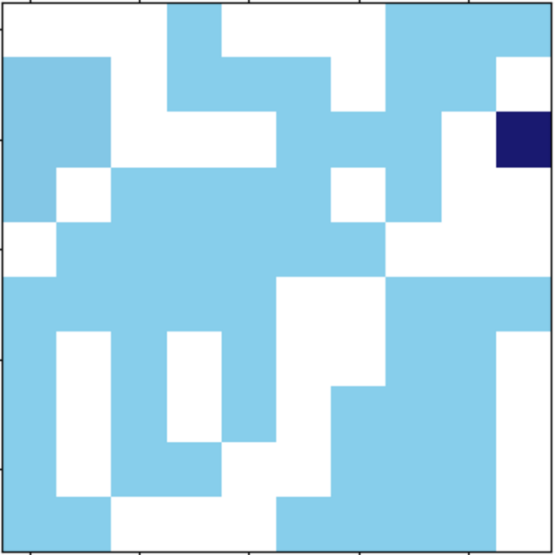
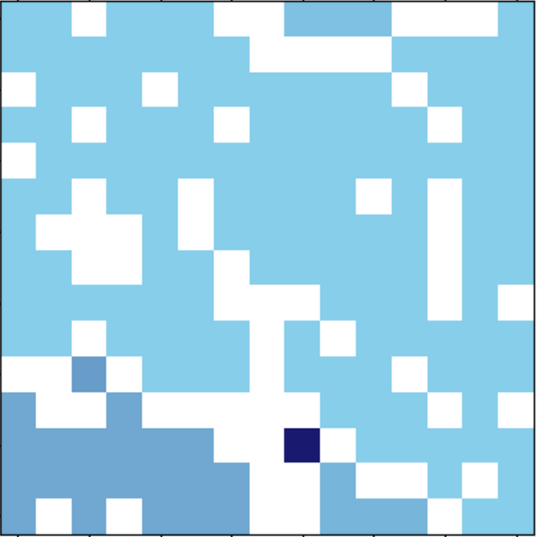
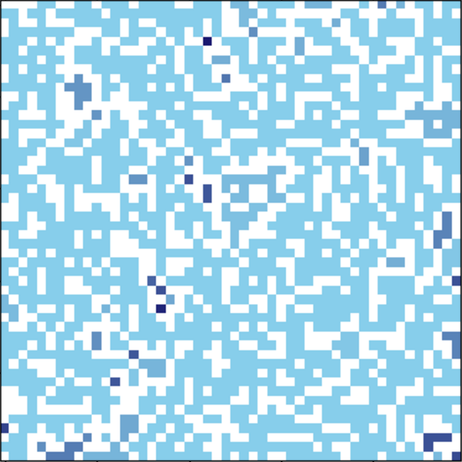
Spanning Clusters
Pseudocode
Generate a lattice
Populate a site, call it a cluster
If the site touches a different cluster, define the 2 (or more) clusters to be the same cluster
Repeat until the same cluster touches all sides
For N = 5, 10, 15, and 50

Slide 6
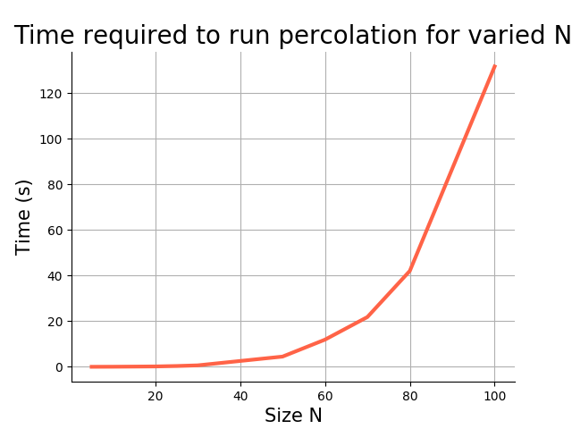
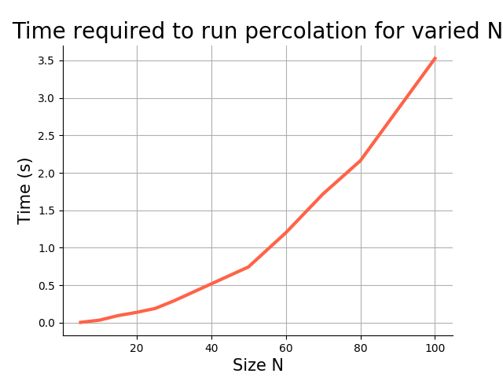
Time to run – speed up

Slide 7
Cluster Building
For N = 30
Snapshots taken at equally spaced steps

Slide 8
Percolation Probability

Slide 9
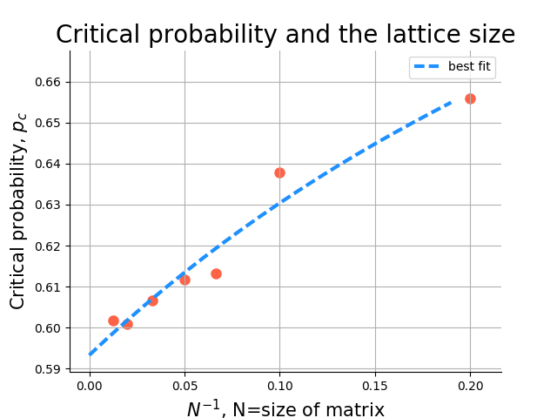

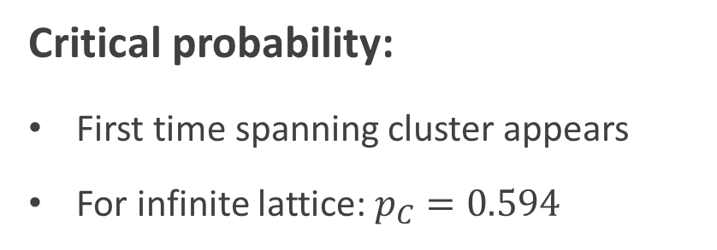
Occupation probability:
Critical probability:
First time spanning cluster appears
For infinite lattice: $p_{C}=0.594$

Slide 10
Critical Exponent

Slide 11
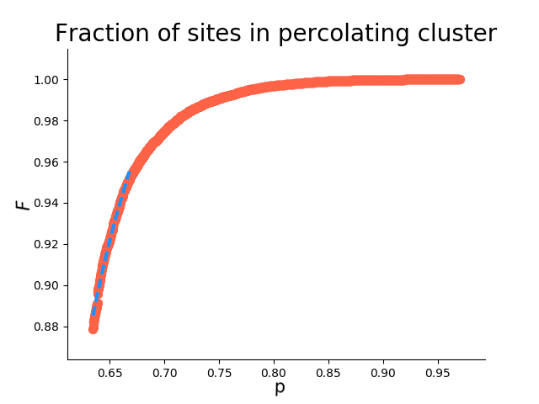



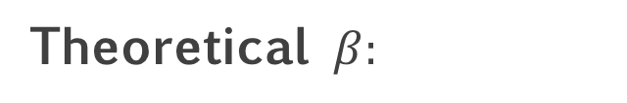
Critical Exponent
Theoretical $β:$
$$5/{36}≈.1389$$
Our results:
0.1383
0.1094
0.1232

Slide 12
Thank you for your time!

