Slide 1
People Analytics - IBM HR Dataset
Data Mining (MSCA 31008) Final Project
Nic Carlson, Martin Copello, Michael Jason, Matt Kendall, Nick Lesh

Slide 2
Agenda
Problem Statement and Data Overview
Dimensionality Reduction
Clustering
Linear Classifiers
Non-Linear Classifiers
Conclusions

Slide 3
Problem Statement and Data Overview

Slide 4
Dimensionality Reduction

Slide 5
Clustering

Slide 6
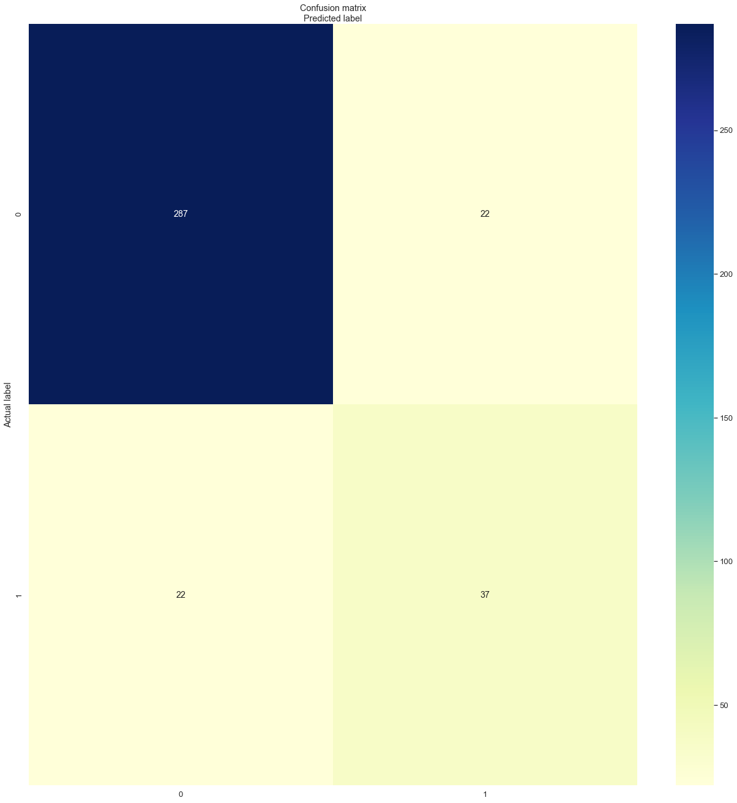
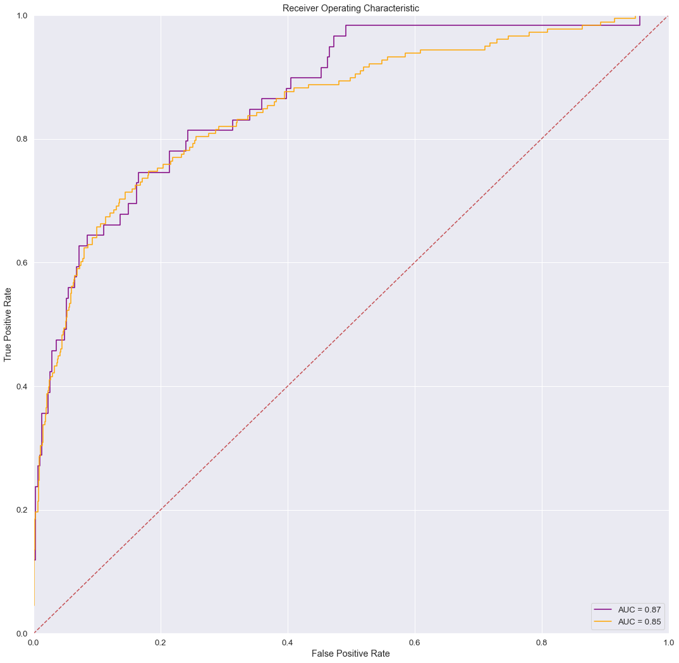
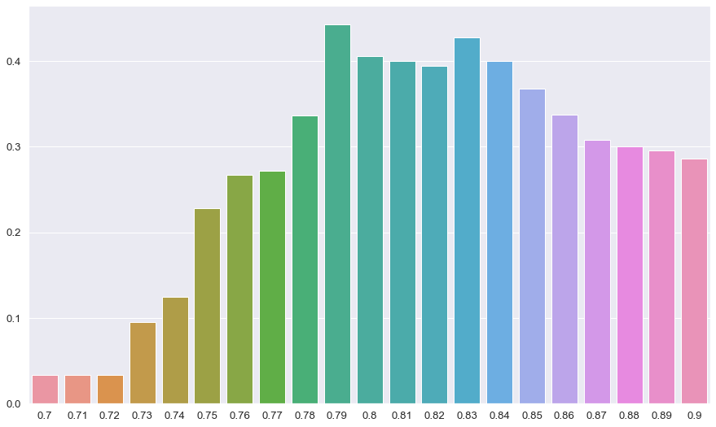
Linear Classifiers
ROC curve for unregularized logistic regression
3 linear classification models created
Support vector classifer
Unregularized logistic regression (statsmodel library)
Regularized logistic regression (sklearn library)
Additionally, a fourth model was created to see if predicting attrition of higher level employees was significantly different than the employee population as a whole
Receiver Operating Curves, AUC, F1 Scores, and Confusion Matrices were used for validation.
Prediction threshold moved from 0.5 to account for unbalanced target variable. Threshold selected to maximum F1 Score for each model.
F1 score is the harmonic mean of precision (true positives/total positives) and recall (true positives/predicted positives)

Slide 7
Non-Linear Classifiers

Slide 8
Conclusions

