Slide 1
Computer Vision
A deep learning approach

Slide 2
Project: Sign Language Interpreter

Slide 3
Tools:
Python, OpenCV, TensorFlow, Keras
Objective:
Recognize ASL gestures using a webcam and deep learning.

Slide 4
Problem Statement
Problem: Communication with deaf or hard-of-hearing individuals can be difficult in real-time scenarios. Interpreters are not always available.
Solution: Use a CNN-based deep learning model to detect American Sign Language (ASL) gestures via webcam in real-time and convert them to readable text.

Slide 5
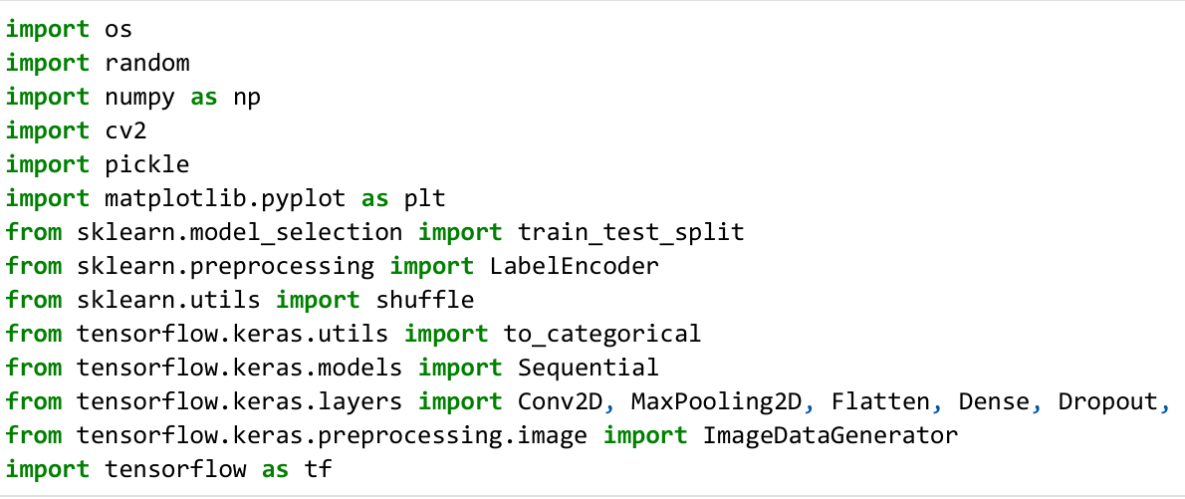
Import Necessary Libraries

Slide 6
Dataset Description
Source: ASL Alphabet Dataset (from Kaggle or archive)
Classes: 29 (A-Z, 'del', 'space', 'nothing')
Format: Images (.jpg) of hand gestures
Preprocessing:
Resized to 64x64 pixels
Normalized pixel values
Max 1000 images per class

Slide 7
Data Visualization
Sample images of various ASL letters
Histogram of image counts per class
Split: 80% training / 20% testing

Slide 8
Methodology / Model Architecture
Layers:
Conv2D → BatchNorm → MaxPooling (×3)
Flatten → Dense → Dropout
Output layer: Softmax (29 classes)
Training:
Optimizer: Adam
Loss: Categorical Crossentropy
Epochs: 15–30
Batch size: 64
Augmentation: Via ImageDataGenerator

Slide 9
Data Preprocessing
Images resized to 64×64
Normalized pixel values (0–1)
Label encoded → one-hot encoded
Train/test split: 80/20
Used up to 1000 images per class to reduce imbalance

Slide 10
Training Process
Trained for 15 to 30 epochs
Batch size: 64
Optimizer: Adam
Loss function: Categorical Crossentropy
Validation accuracy measured after each epoch

Slide 11
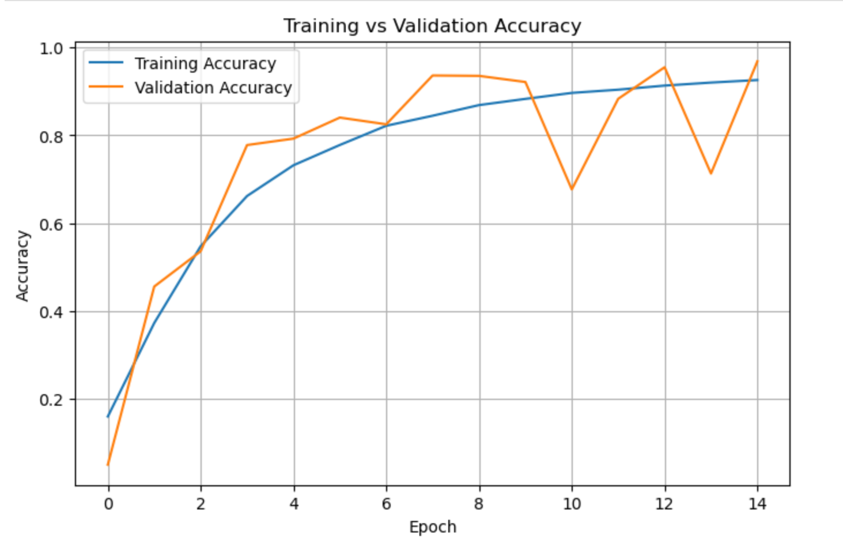
Evaluation Metrics & Graphs
Training vs Validation Accuracy

Slide 12
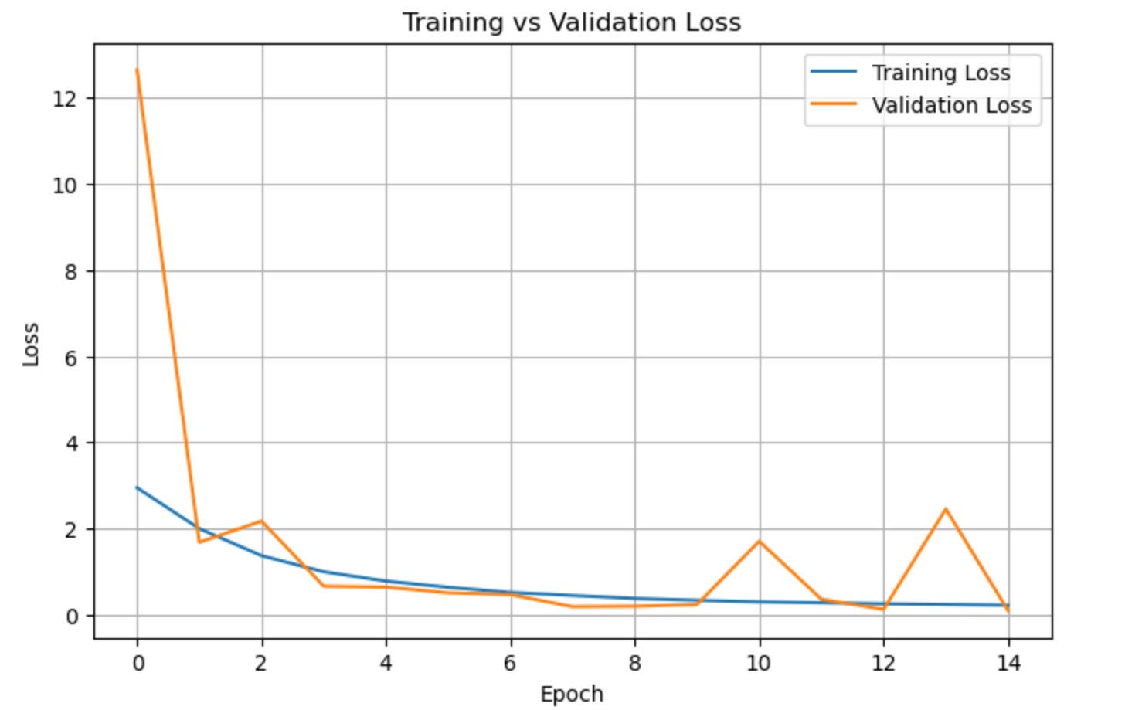
Evaluation Metrics & Graphs
Training vs Validation Loss

Slide 13
Webcam-Based Real-Time Prediction
Uses OpenCV to access the webcam
Live bounding box to show hand region
Predicts label with confidence
Displays prediction in real-time on screen

Slide 14
Results & Observations
Training Accuracy: 92%
Validation Accuracy: 98%
Model Saved As: asl_sign_language_cnn_model.h5
Live Webcam Prediction:
Real-time bounding box
Predicted class with confidence

Slide 15
Challenges Faced
Some images unreadable or invalid
Slight class imbalance
Model accuracy varied depending on lighting conditions in webcam feed

Slide 16
Conclusion
Successfully built a real-time ASL interpreter using deep learning
Recognizes 29 hand gestures with high accuracy
Can be extended for sentence-level recognition and deployed in accessibility tools

Slide 17
Future Work
Recognize multiple signs (sentence formation)
Add gesture-to-speech conversion
Improve accuracy in real-world scenarios
Deploy as a mobile or web app

Slide 18
References
ASL Alphabet Dataset on Kaggle
TensorFlow & Keras documentation
OpenCV for computer vision tasks

Slide 19
THANK YOU.

