Slide 1
Review-2 Mood-aware Music Recommendation System with Facial Recognition
Eppali Pravallika - 2010030046
Tahseen Begum - 2010030168
M.Rushitha Sri - 2010030362
K.Kavya - 2010030550
Under the Guidance of
Dr. N. Chiranjeevi
Professor
Computer Science and Engineering Department
KL Hyderabad Off Campus, Aziz Nagar, Hyderabad

Slide 2
Overview
Introduction
Objectives of the Project
Algorithm
Implementation Details
Results
References

Slide 3
Introduction
Mood-aware music recommendation system that utilizes facial recognition technology to personalize music choices.
Experience the synergy of facial recognition and mood-based music curation, revolutionizing how we connect with music on an emotional level.
By analyzing users’ facial expressions, accurately determines their emotional states and suggests music that aligns with their feelings.
This real-time approach enhances user experience, providing seamless access to suitable tracks that cater to their current moods.

Slide 4
Objectives of the Project
Objective 1: Facial Recognition Integration
The project integrates facial recognition to interpret real-time emotional expressions, enabling personalized music recommendations based on users' captured cues. This enhances the interactive experience, fostering emotional connection through accurate facial analysis for responsive music suggestions.
Objective 2:Mood-aware Music Recommendation
The project aims to build an innovative music recommendation system that accurately interprets users' moods through inputs like facial expressions and actions. By suggesting music aligned with their emotions, the system enhances music discovery and fosters emotional connections through music.
Objective 3: Voice Assistant
Spotify had been testing a "Hey Spotify" wake word for its voice assistant, allowing users to control the music streaming service with voice commands. It aimed to enhance the user experience by enabling hands-free control of music playlists, and more.

Slide 5
Algorithm
MobileNet is a type of Convolution Neural Network architecture which uses depth wise separable convolution layers. There are other models as well but what makes MobileNet special is that it has very less computation power to run or apply transfer learning. The core layer of MobileNet is depthwise separable filters, named as Depthwise Separable Convolution. The network structure is another factor to boost the performance. Finally, the width and resolution can be tuned to trade off between latency and accuracy. Depthwise separable convolutions is nothing but the depth wise convolutions followed by point wise convolutions. It is a light weight deep neural network and the complexity is also less. This architecture reduces computation cost. Therefore it is well suited for mobile and embedded applications.
K-Means Clustering is an Unsupervised Learning algorithm, which groups the unlabeled dataset into different clusters. Here K defines the number of pre-defined clusters that need to be created in the process, as if K=2, there will be two clusters, and for K=3, there will be three clusters, and so on.
So here model uses the K-means Clustering, which is an unsupervised algorithm. As we are building a recommendation system using 2000 songs, let's consider 10 categories where each group will have 200 songs on average.

Slide 6
Implementation Details
2010030168_Tahseen Begum - working on the application using HTML, CSS, and JavaScript.
2010030046_Eppali Pravallika - working on voice assistant using JavaScript
2010030362_Rushitha Sri - working on facial recognition using MobileNet, libraries – keras, numpy
2010030550_K.Kavya - working on music recognition using the K-Means Clustering.

Slide 7
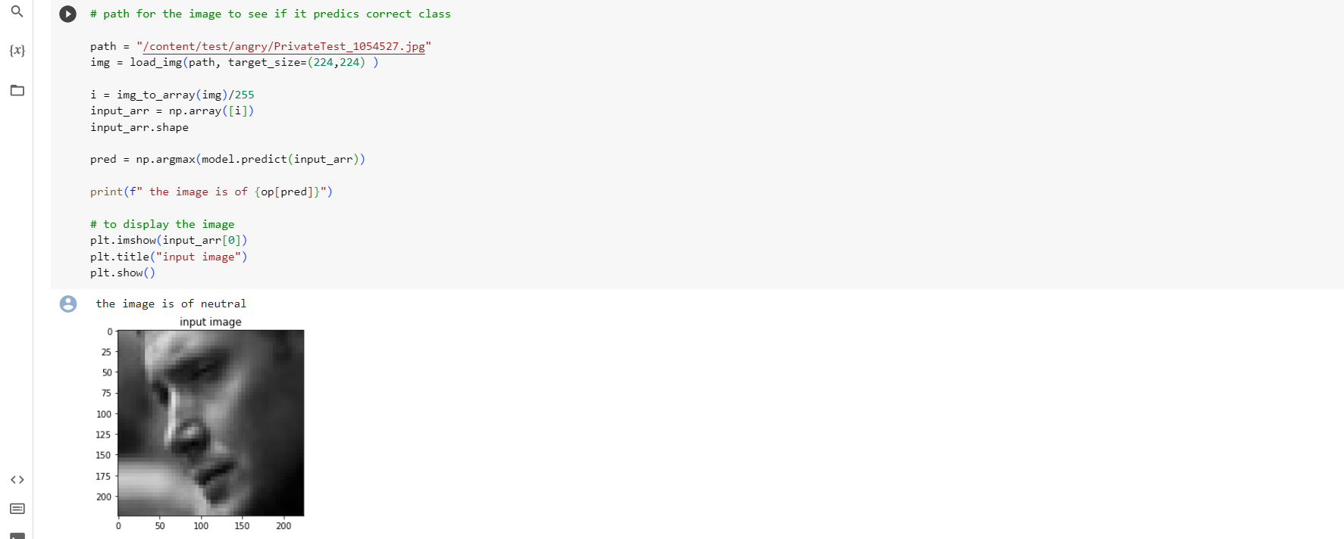
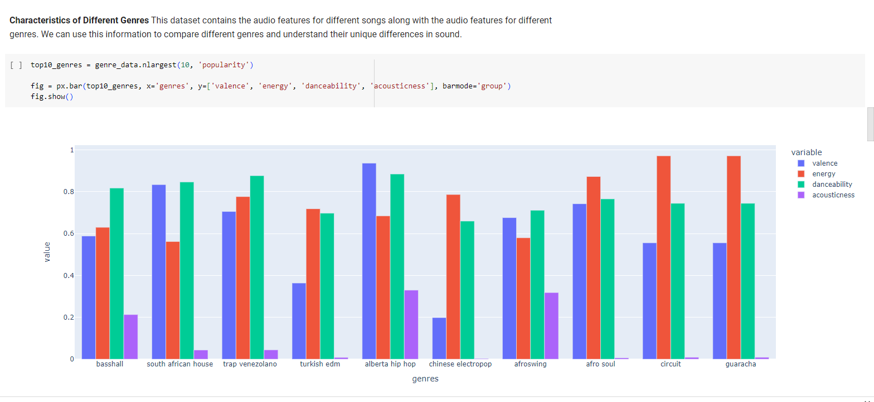
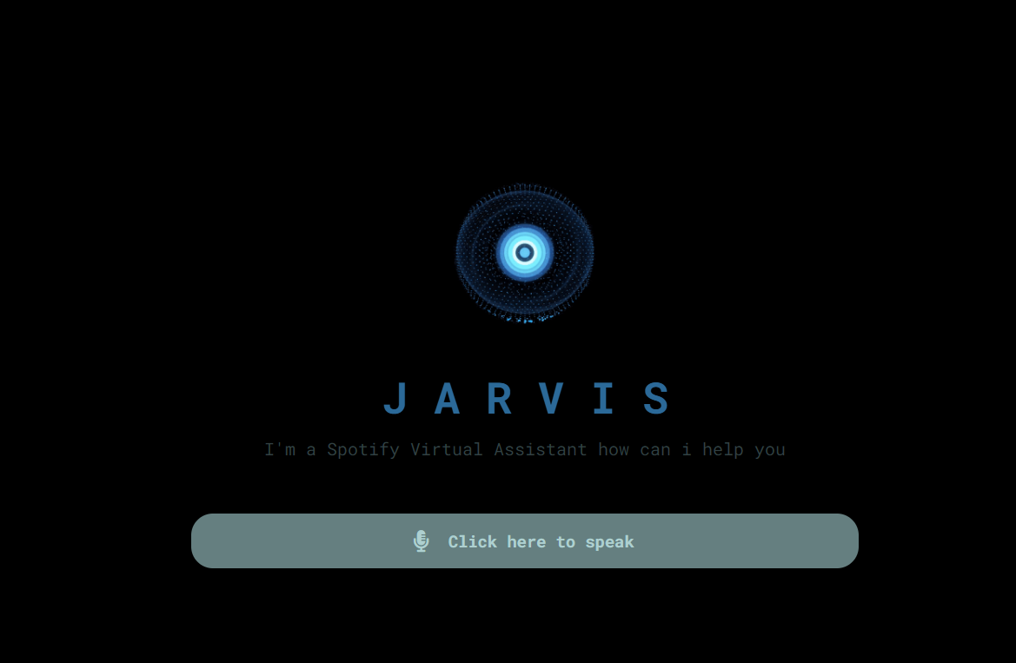
Results
Emotion Detection
Music recommendation
Voice Assistant

Slide 8
References
https://www.researchsquare.com/article/rs-2719247/v1
http://www.journal-iiie-india.com/1_june_23/19.3_6.pdf
https://www.researchgate.net/publication/352780489_Mood_based_music_recommendation_system
https://www.researchgate.net/publication/221055652_Real-World_Mood-Based_Music_Recommendation

Slide 9
Thank you

