Slide 1
Automated Testing
(Mahdi Tahsildari @ Dayan)

Slide 2
Table of contents

Slide 3
Code Refactoring
to improve the design, structure, and implementation.
Restructuring existing code, without changing external behavior.

Slide 4
Benefits
Test more frequently In less time
catch bugs before deploying
refactor with confidence

Slide 5
Why?
Glue.
Make sure code under test works correctly, fast, easy, and exact
Fewer bugs in production.
Protection from “bad changes” -> less bugs | easier to fix bugs
More time to work on features rather than bugs
Documentation.
Complex systems covered by tests are easier to understand
It’s a must, not an option: A professional programmer writes unit test

Slide 6
Automated Test Types
Unit tests
Integration tests
end to end tests

Slide 7
Unit Test
Test a unit of an application without its external dependencies (like database, message
queues, web services, files, etc.)
execute faster
easier to write

Slide 8
Integration Test
Test a piece of application with its external dependencies (like database, message
queues, web services, files, etc.)
execute longer
give more confidence

Slide 9
End to end Test
Runs a test through the application interface (UI, api, sdk, etc.)
slowest to run
give greates confidence
very fragile

Slide 10
End to end Test
Manual
Manual Tests
End to End Tests
Automatic
Integrations Tests
Unit tests

Slide 11
Dictionary
SUT : System under Test. An instance of an object, the units of which are going to be tested.
Setup
Teardown
Arrange
Act
Assert

Slide 12
What is a Unit Test really?
A unit test is a function which calls another function (unit) and checks the correctness of the outcome from the called function.
A Unit Test is a specific method written in a specific class.
The class and method are marked with attributes so that the IDE can find and run them.
Unit Tests are written in a (or some) separate projects. They are Isolated and they can be ran without dependency to the main project.

Slide 13
Good Unit Test
It’s an automated piece of code that invokes a different method and then checks some assumptions on the logical behavior of that method or class.
It’s written using a unit-testing framework.
It can be written easily.
It runs quickly.
It can be executed repeatedly by anyone on the development team.
It is self-explanatory
What defines a good Unit Test?

Slide 14
First Unit Test
Using nunit

Slide 15
Naming and Placing rules
Project
Create a test project named [ProjectUnderTest].Tests.
Class
For each class, create at least one class with the name [ClassName]Tests.
Method
For each method, create at least one test method with the following name: [UnitOfWork]_[Scenario]_[ExpectedBehavior].
Method must be public, class should not.

Slide 16
Technical requirements
On the Tests project:
Add NUnit package
Add NUnit3TestAdapter package

Slide 17
Syntax rules
Class
Any class with [TextFixture] attribute is meant to hold Test methods.
Method
Any method with [Test] attribute inside a Test Class, can be run as a Test and the Testing Framework identifies Test by this feature.
NUnit requires test methods to be void and accept no parameters.
Methods marked with [Setup] and [TearDown] attributes run before/after each test run

Slide 18
What Unit Testing Frameworks do
Provide :
structure for writing tests
Test runner tool
Review result tool

Slide 19
Framework: Structure
Framework supplies the developer with a class library that contains :
Base classes or interfaces to inherit
Attributes to place in your code to note which of your methods are tests
Assertion classes that have special assertion methods you invoke to verify your code

Slide 20
Framework: Test Runner
Framework provides a test runner (a console or GUI tool) that :
Identifies tests in your code
Runs tests automatically
Indicates status while running
Can be automated by the command line

Slide 21
Framework: Results
How many tests ran
How many tests didn’t run
How many tests failed
Which tests failed
The reason tests failed
The ASSERT message you wrote
The code location that failed
Possibly a full stack trace of any exceptions that caused the test to fail, and will let you go to the various method calls inside the call stack

Slide 22
ok, code please…
: )

Slide 23
Do not test…
Legacy code
Language features
3rd-party code
Testable code is clean
Clean code is testable

Slide 24
Clean Test : AAA
Arrange
Create and Setup objects and data
Act
Call the method(s)
Assert *
Prove that the result is as expected
Write test with AAA approach and remember to put empty lines between them (for readability)
* Claim, prove, defend

Slide 25
Order of thought, what goes first? “This is the question…”
A good approach is the one that gives us the best result
We can either : Write the code first (1) write the test next (2) and refactor the code then (3) and it is costly.
or
Write the tests first (1) and write code according to the tests (2) and repeat (refactor – 3) and it is great.

Slide 26
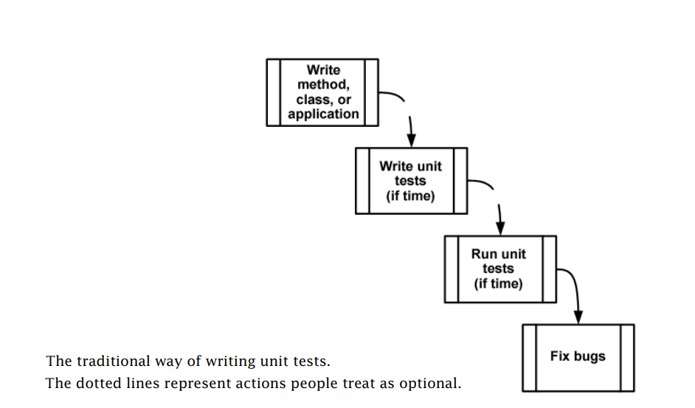
Traditional Unit Testing
They used to write test like this

Slide 27
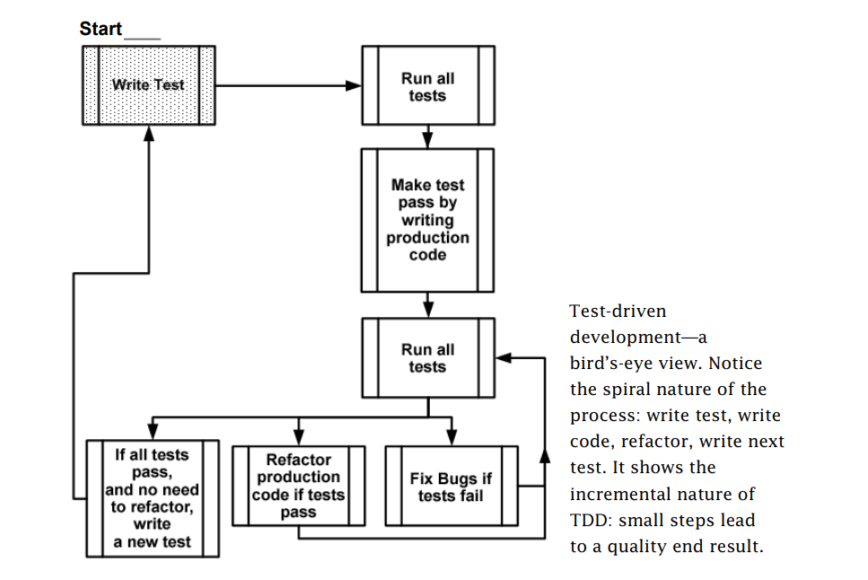
TDD
Test-Driven Development

Slide 28
TDD
Red-Green-Refactor
start with a failing test
then pass it
and then make your code readable and more maintainable.
Large code logics are difficult to secure, you do not know which lines of code might throw exceptions, they are hard to spot because there is a lot of them. So break your ONE BIG LOGIC into MANY SMALLER LOGICS and test them one by one.
Test-Driven Development

Slide 29
Expect Exceptions
Assert.Catch()
Allows any kind of exception
Assert.Catch<Exception>
Allows Exception and any derived type (like NullReferenceException, ApplicationException, etc.)
Assert.Throws<IOException>
Allows only IOException (derived types fail: eg. FileNotFoundException)
Assert. DoesNotThrow()
Verifies that the delegate does not throw any exceptions (fails if an exception is raised)

Slide 30
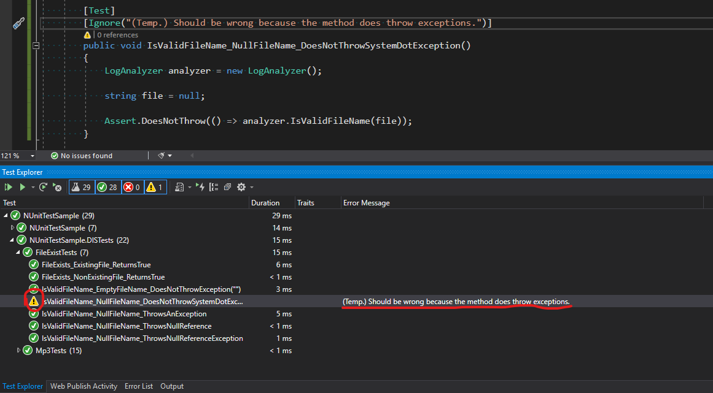
How to ignore a Test

Slide 31
Parameterized Tests
add [TestCase]
add proper parameters
assert against parameter

Slide 32
Using STUBS to break DEPENDENCIES
External Dependency
An external dependency is an object in your system that your code under test interacts with and over which you have no control. (Common examples are filesystems, threads, memory, time, and so on.)
Stub
A stub is a controllable replacement for an existing dependency (or collaborator) in the system. By using a stub, you can test your code without dealing with the dependency directly.

Slide 33
Dependency injection: inject a fake implementation into a unit under test
Constructor
Receive an interface at the constructor level and save it in a field for later use.
Code not clean, less readable, less maintainable
Solution: IoC frameworks
Property
Receive an interface as a property get or set and save it in a field for later use.
Use when your dependency is optional or the dependency has a default instance.
Or
A parameter to the method (parameter injection)
A factory class
A local factory method
Variations on the preceding techniques

Slide 34
Dummy, Fake, Stubs, Mocks
Dummy objects are passed around but never actually used. Usually they are just used to fill parameter lists.
Fake objects actually have working implementations, but not same as production one. Usually they take some shortcut which makes them not suitable for production (an in memory database is a good example).
Stubs is an object that holds predefined data and uses it to answer calls during tests. It is used when we cannot or don’t want to involve objects that would answer with real data or have undesirable side effects..
Spies are stubs that also record some information based on how they were called. One form of this might be an email service that records how many messages it was sent.
Mocks are objects that register calls they receive.
In test assertion we can verify on Mocks that all expected actions were performed.

Slide 35
Test order
First write and run VALUE or STATE Tests
Because they are easier and less complicated
Then go for Action Tests (Interaction testing as last option)
Because are much more complicated and harder to solve

Slide 36
Mocking frameworks
Mocking frameworks are independent from Unit Testing frameworks.
Two types: Constrained frameworks – Unconstrained frameworks.

