Slide 1


A Presentation on Dimensionality Reduction of Radiomic Features in Dual CT Images
Mohammad Tahsin Mostafiz
PhD Student
Supervised by: Dr. Navid Asadi & Dr. Reza Forghani
Radiomics and Augmented Intelligence Laboratory (RAIL
Department of Radiology and the Norman Fixel Institute for Neurological Diseases
University of Florida College of Medicine

Slide 2
Outline
Background
Motivation
Problem with Higher Dimensional DECT feature space
Feature Inspection
Conclusion

Slide 3
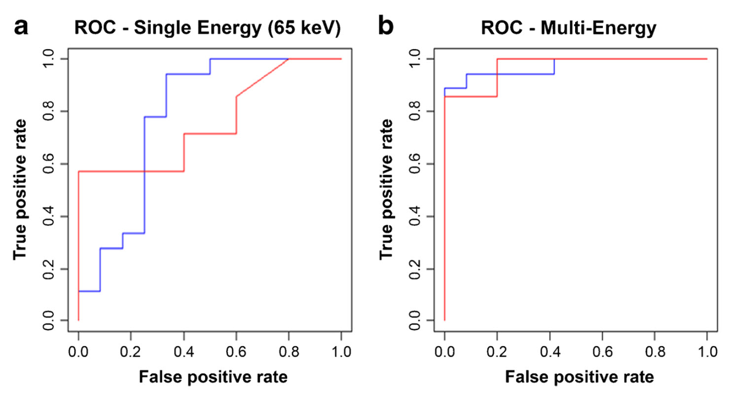
Why DECT Imaging?
Qualitative Analysis
Potential for advanced applications
Promising aspects in Machine Learning Domain
Spectral multi-energy CT texture analysis with machine learning for tissue classification:
an investigation using classification of benign parotid tumors as a testing paradigm
@Eiman Al Ajmi, Behzad Forghani, Caroline Reinhold, Maryam Bayat, Reza Forghani
Notes:
Improved tissue characterization: DECT allows for the acquisition of images at different energy levels, which can provide additional information about the composition and properties of tissues. This can help in better characterizing different types of tissues, such as differentiating between different types of tumors, identifying the presence of calcifications or iodine contrast agents, and detecting subtle changes in tissue density or composition.
Enhanced diagnostic accuracy: DECT has been shown to improve diagnostic accuracy in various clinical scenarios, such as detection of pulmonary embolism, evaluation of renal stones, assessment of gout, and identification of different types of lesions. The ability to differentiate tissues with greater accuracy can aid in more accurate diagnosis and treatment planning.
Quantitative analysis: DECT enables quantitative analysis of various parameters, such as iodine concentration, electron density, and material decomposition, which can provide valuable information for assessing treatment response, monitoring disease progression, and evaluating treatment efficacy.
Reduced artifacts and improved image quality: DECT can help reduce artifacts that may occur in traditional CT imaging, such as metal artifacts or beam-hardening artifacts. This can result in improved image quality, allowing for better visualization and assessment of anatomical structures and lesions.
Potential for advanced applications: DECT has the potential for advanced applications, such as virtual non-contrast imaging, virtual monochromatic imaging, and material decomposition imaging. These advanced techniques can provide additional information and insights into different tissues and conditions, expanding the capabilities of CT imaging for various clinical applications.
Research and innovation: DECT has been a topic of active research and innovation in the field of radiology and medical imaging, with ongoing advancements and developments in DECT technologies, algorithms, and applications. The motivation behind DECT also includes driving further research and innovation in the field, exploring new possibilities and applications, and pushing the boundaries of CT imaging capabilities.

Slide 4
Motivation
Large dimensional radiomic features extracted from small dual energy CT dataset leads to difficulty in data analysis and model overfitting
Not all the radiomic features bear the same importance during diagnosis
Getting rid of irrelevant features and features of less importance leads to reduced dimensionality and complexity and less overfitting

Slide 5
Dual CT Energy Project
Target
Detecting the type of Head and Neck Squamous Cell Carcinoma (HNSCC) from the image data only.
Feature dependence among different keV images.
Data Distribution
Mouth[Oral Cavity (OC)]
Middle Part of the throat near the mouth[Oropharynx (OP)]
Voice box [Larynx(L)], Lower part of the throat near larynx [Hypo-larynx (HP)]
Nasal cavity and paranasal sinuses, Upper part of the nasal cavity[Nasopharynx]
33
24
27
11

Slide 6
DECT Data Analysis
68 patients with histological grading
21 energy levels (40 keV, 45 keV, … 120 keV)
4019 Radiomic Features
Data dimension: Batch size x 21 x 4019
Goal
  Find out whether using multiple keV images per patient gives better feature selection than using one keV image per patient.
  Find which keV level features provide most significant information
  Compare the results by training a supervised model

Slide 7
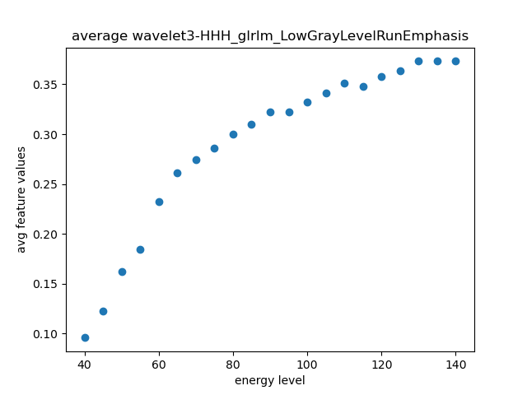
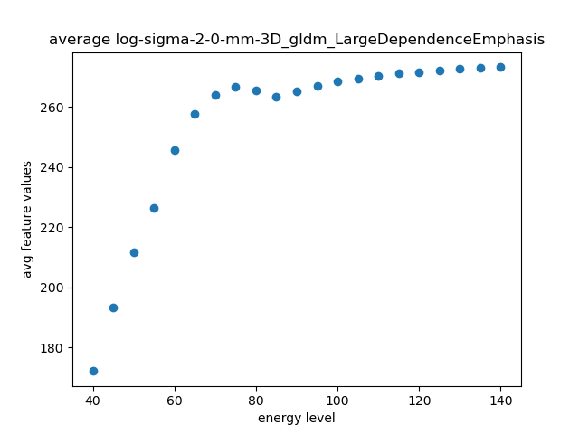
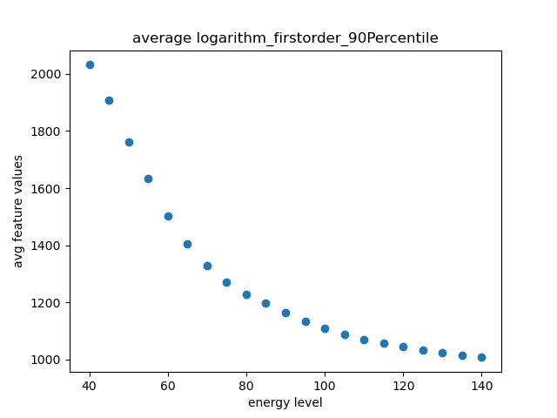
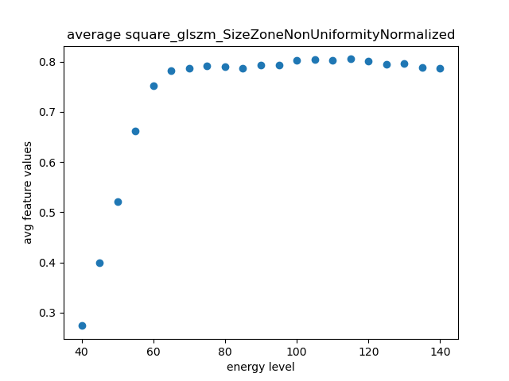
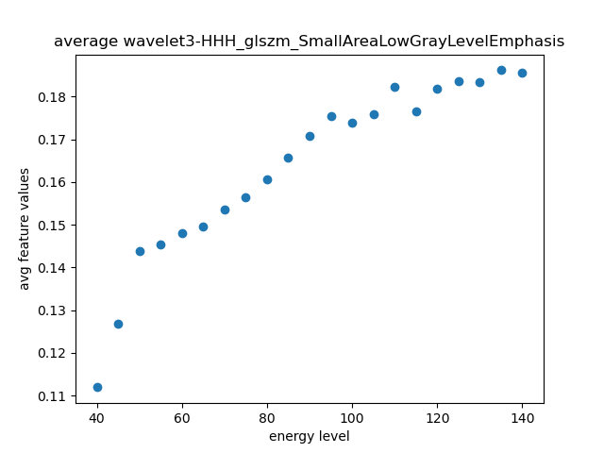
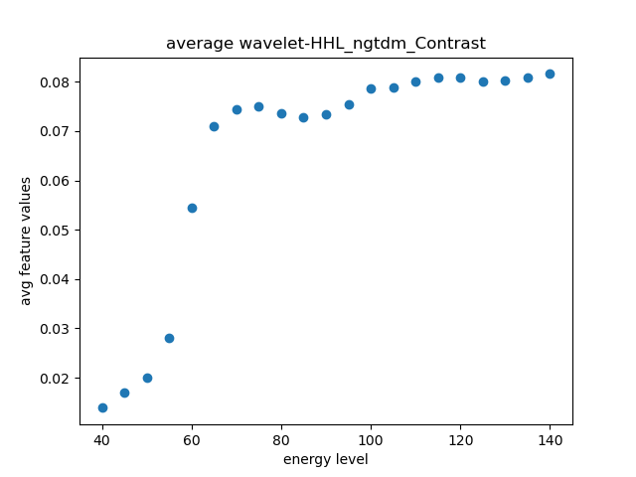
Graphical Inspection

Slide 8
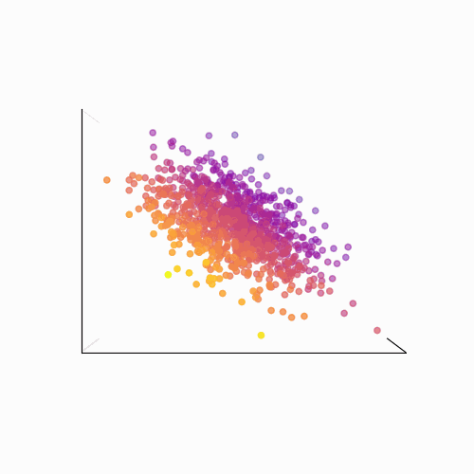
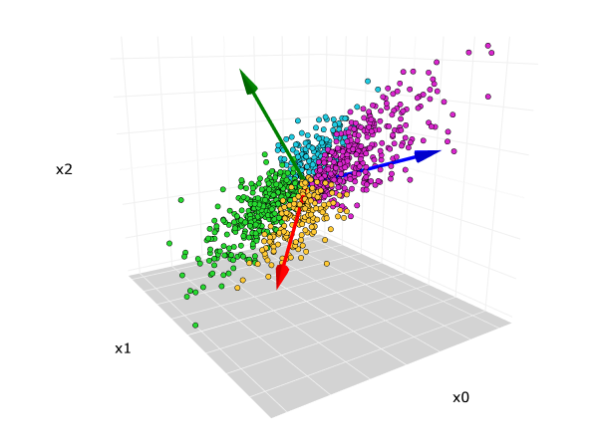
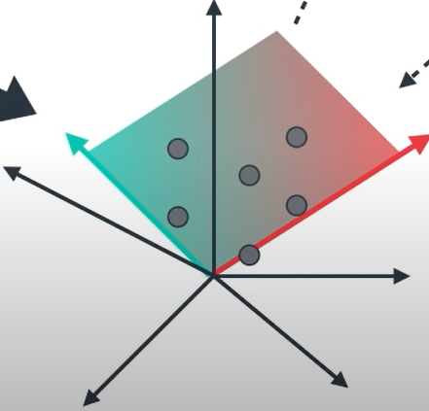
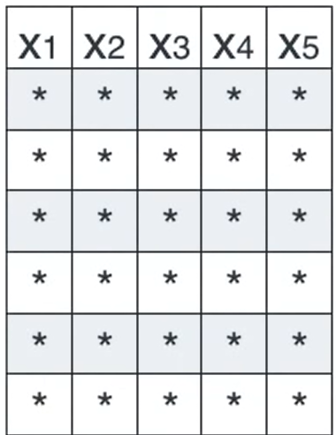
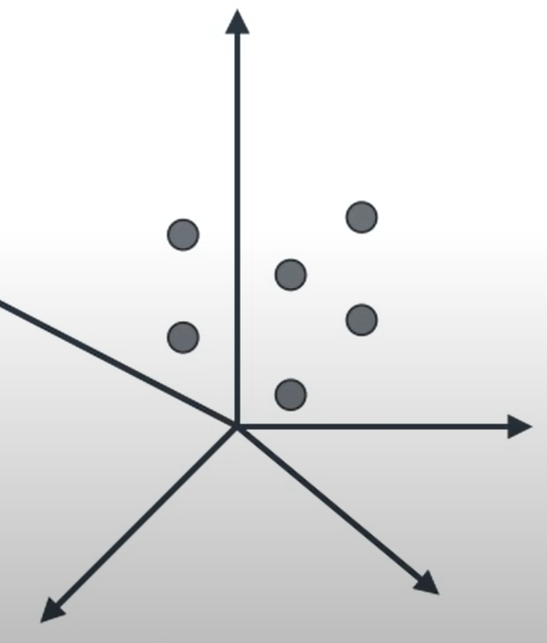
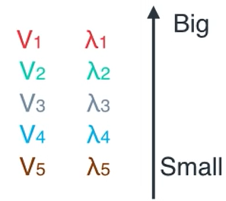
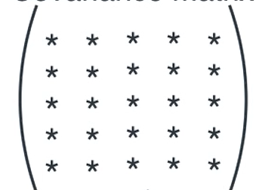
Principal Component Analysis (PCA)
Data Standardization
Eigenvalue Decomposition
Principal Component Selection and Projection
Pseudo 5D plot
Covariance Matrix
Eigen vector
Eigen
value

Slide 9
Feature Inspection
Single energy level Data(68x4019)
Feature selection via Principal Component Analysis (PCA)
Data with Reduced Dimensionality
Multilayer Perceptron
31 comp for 40keV → 80x31
32 comp for 45keV → 80x32
… … …
… … …
34 comp for 140keV → 80x34
65 keV → 4019 features → → 34 feature
PCA

Slide 10
Results
Radiomic features
Principal Component Analysis (PCA)
Selected Important Features
Supervised Classifier (MLP)
ML Pipeline
Selected Features | Appearances in Energy Levels
Square_ngtdm_Coarseness | 17
Log_first_order_90_percentile | 14
Lbp_2d_firstorder_90_percentile | 12
Original_shape_elongation | 12
Energy Levels (keV) | No. of selected features by PCA | Accuracy(%) | F1 Score
40 | 42 | 0.693 | 0.804
65 | 43 | 0.706 | 0.808
100 | 43 | 0.693 | 0.8
130 | 43 | 0.708 | 0.811

Slide 11
Conclusion
DECT has the potential to provide better insight into HNSCC
Small dataset with higher dimensionality has a higher tendency of increasing data complexity and model overfitting
Dimension reduction techniques such as PCA may reduce the data complexity with slight variation on prediction performance
Research potential for energy dependency of feature analysis

Slide 12
Thank You

