Slide 1
Heart Disease Prediction
Krishnanshu Gupta, Tahsin Amio, Karen Huang

Slide 2
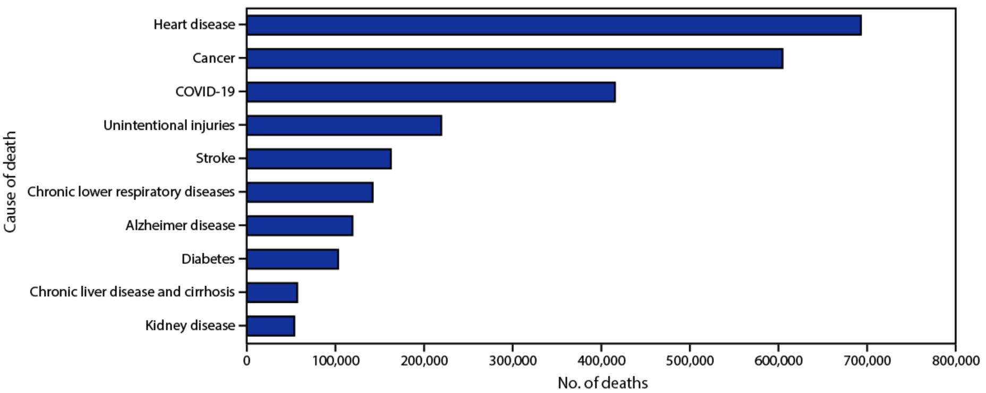
Motivation for Research
Heart disease is the leading cause of mortality in the United States and globally according to the CDC
700,000 lives annually in the US and 18 million worldwide.
1 out of every 5 deaths in the country, with someone dying from it every 33 seconds.
$240 billion annually in heart disease prevention and treatment costs.
Goal: Leveraging machine learning algorithms, KNN and Logistic Regression, to identify patterns and relationships in order to predict patients' likelihood and risk of heart disease

Slide 3
Dataset
18 columns of different factors/indicators for predicting Heart Disease likelihood
Target: HeartDisease
Quantitative Data: BMI, PhysicalHealth, MentalHealth, SleepTime
Categorical Data: AgeCategory, Race, Diabetic, GeneralHealth
Binary Data: Smoking, AlcoholDrinking, Stroke, DifficultyWalking, Sex, PhysicalActivity, Astham, KidneyDisease, SkinCancer

Slide 4
Methodology/Approach
Parsing and cleaning the CSV data in and converting it to an RDD format.
Perform exploratory data analysis (EDA), using basic charts and visualizations to observe the distributions within the data.
Custom implementation of K Nearest Neighbors:
Using metrics of Precision, Recall, Sensitivity, Accuracy, and F1-score, as well as a few other ones, to evaluate the model.
Basic implementation of Logistic Regression using the Spark ML library for testing purposes and to compare results to KNN.

Slide 5
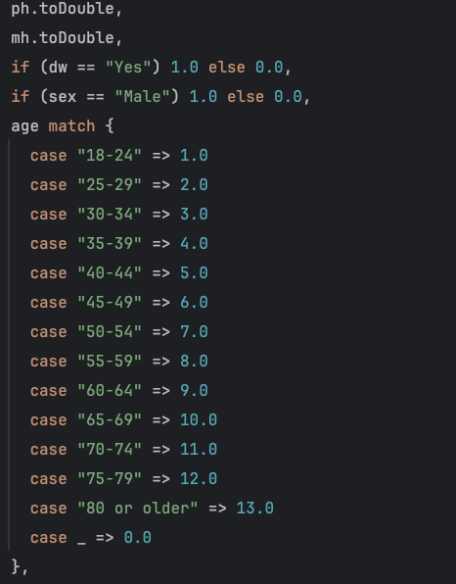
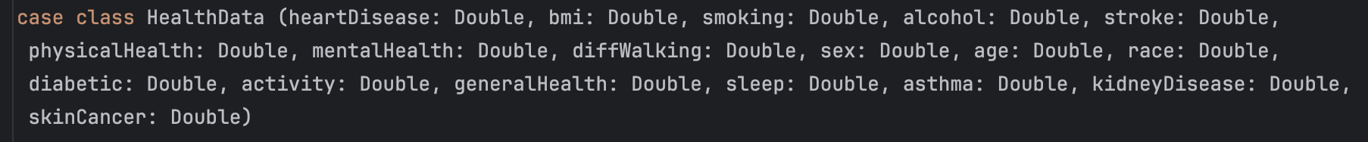
Data Parsing and Cleaning
Split the CSV data file by commas and mapped the fields to a case class called “HealthData”.
Used pattern matching and then converted all data into decimal format.
Binary data:“Yes” will become 1.0 and “No” becomes 0.0.
Categorical data columns of Age, Race, and General Health used ordinal encoding to convert the categories to integer values starting from 1.0 onwards.
Numerical data columns: converted to double for consistency
To handle missing values and invalid data, rows with fewer than 18 columns were removed from the dataset by mapping them to None.

Slide 6
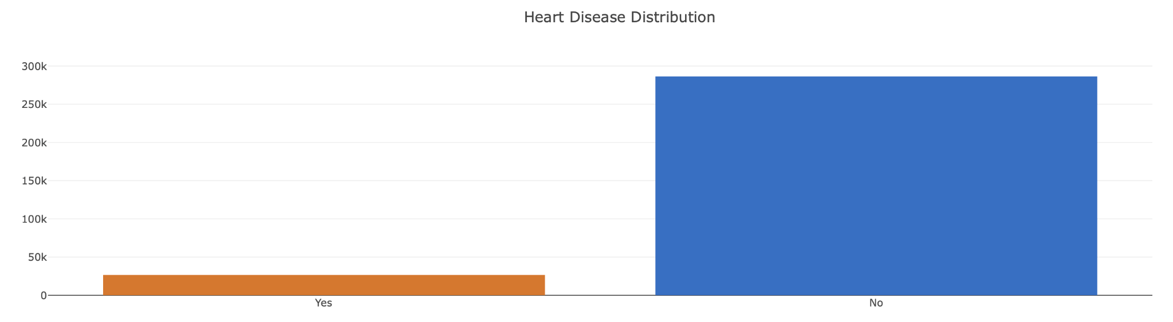
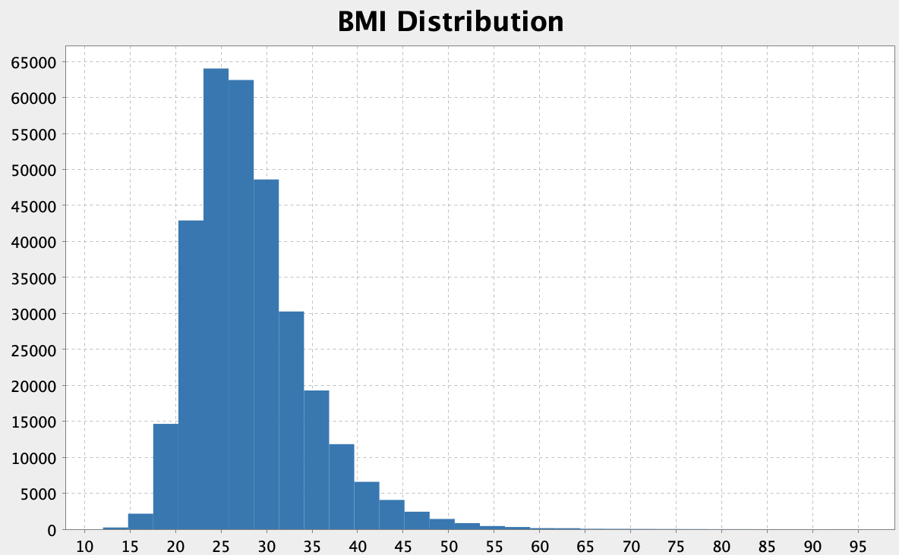
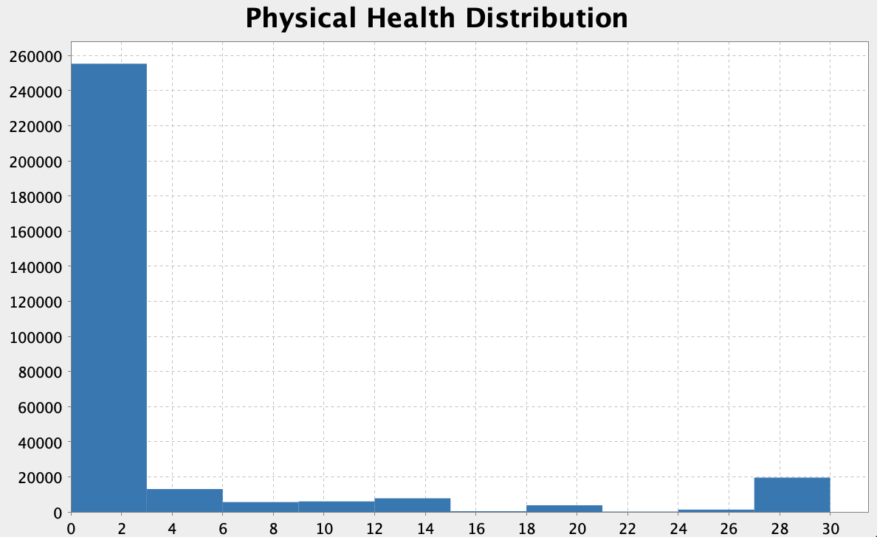
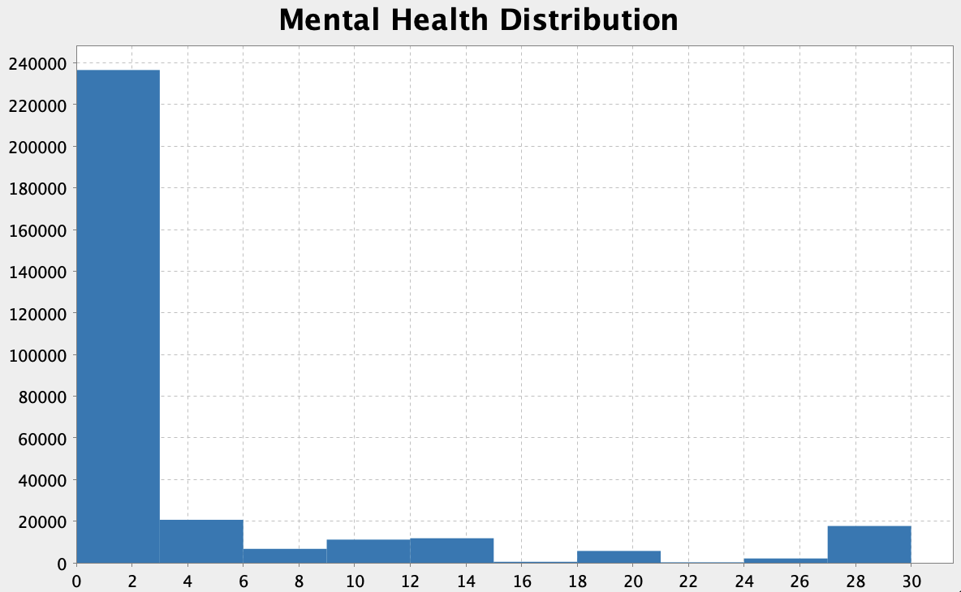
Data Exploration
Used Breeze Plot for the distributions
Used Plotly for the left bar chart on Heart Disease target counts.

Slide 7
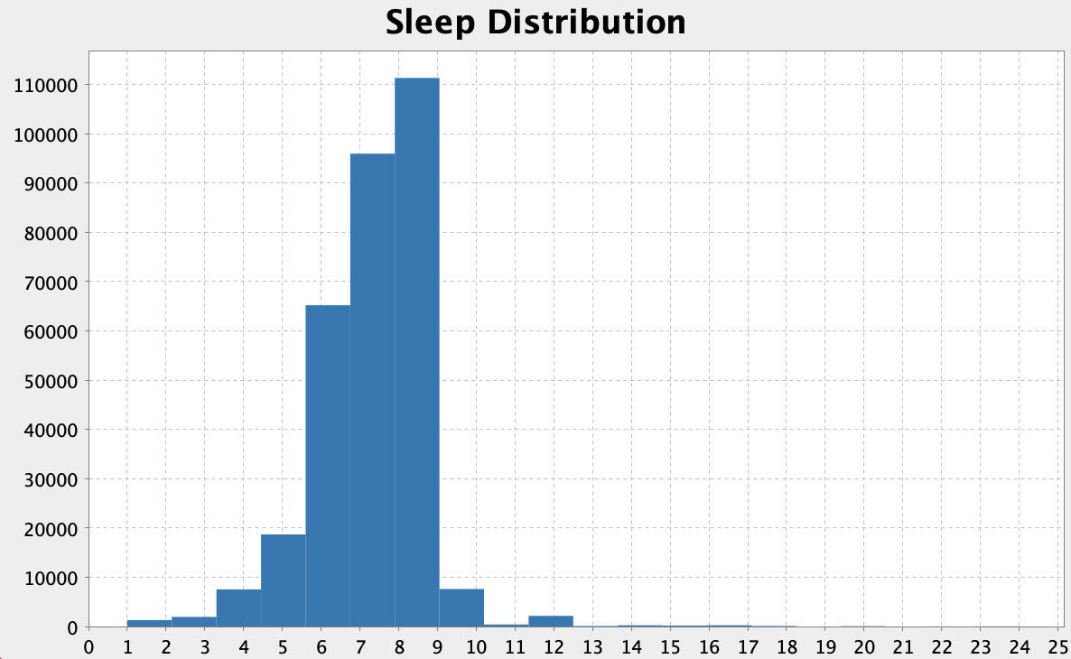
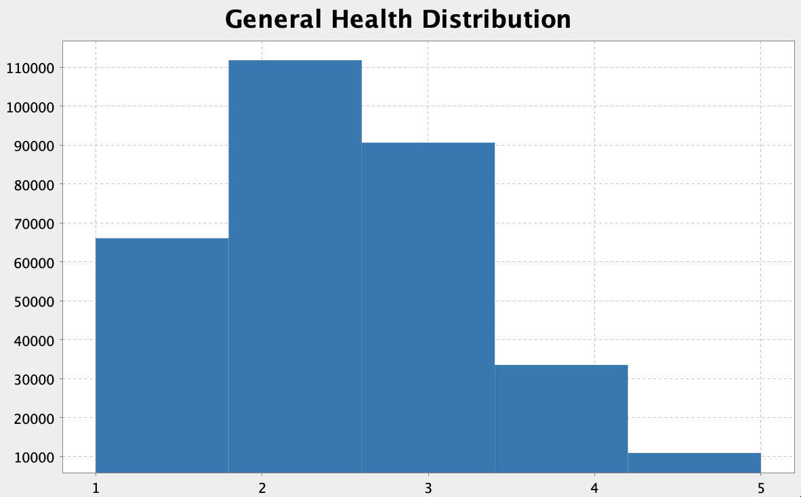
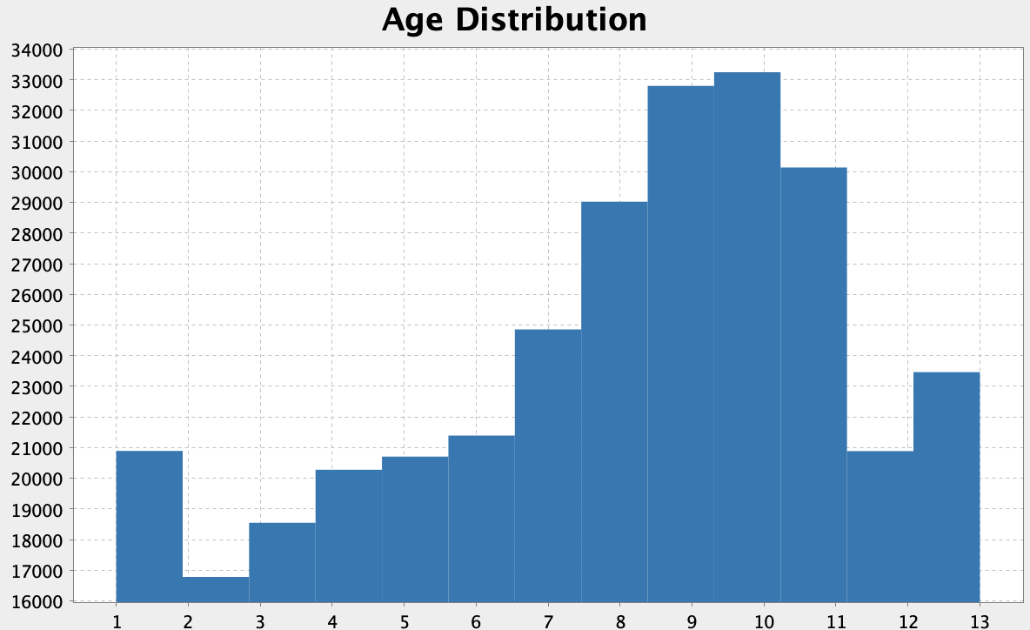
Data Exploration

Slide 8
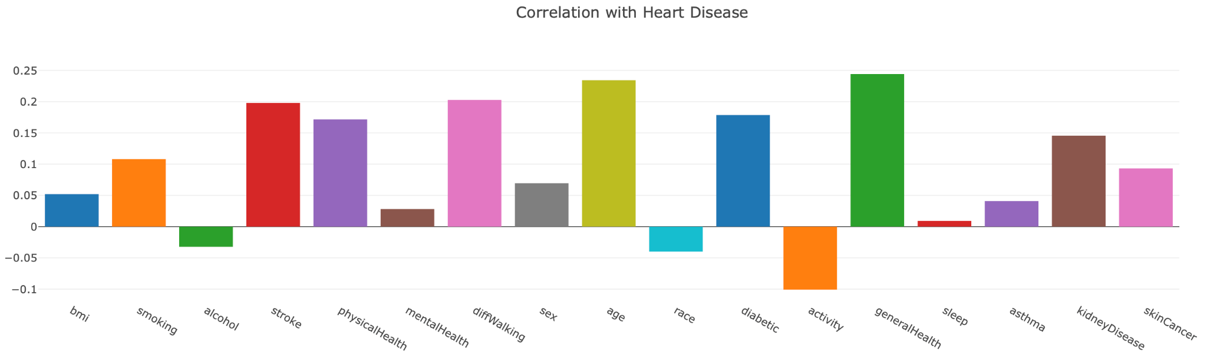
Data Exploration - Correlation Analysis
Used Spark SQL to convert RDD to Dataframe, and then used df.stat.corr to get the correlations with HeartDisease target column.

Slide 9
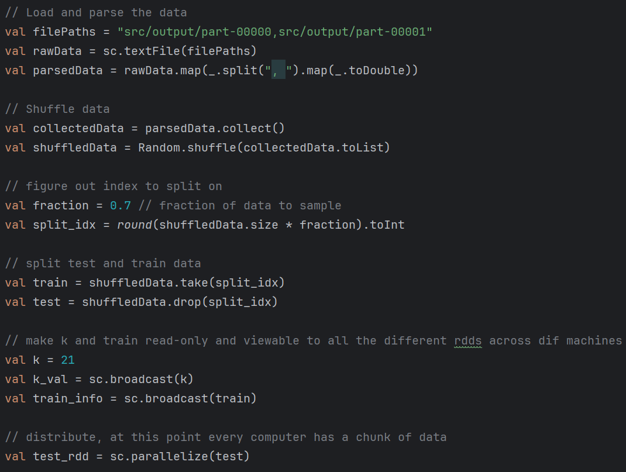
K Nearest Neighbors

Slide 10
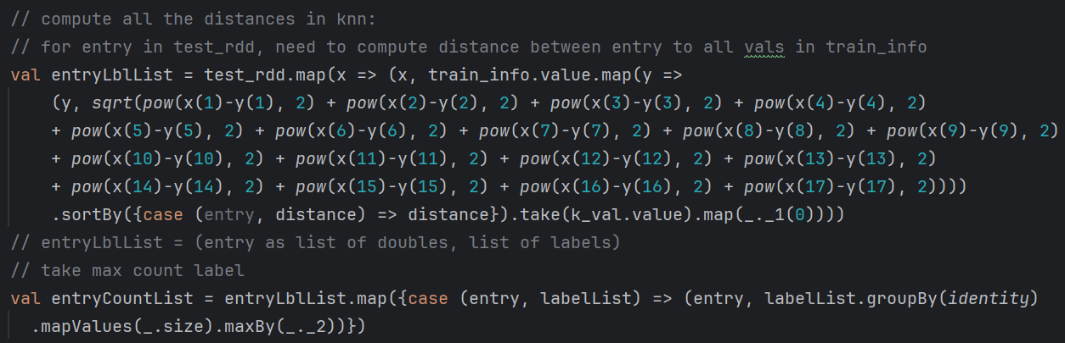
K Nearest Neighbors

Slide 11
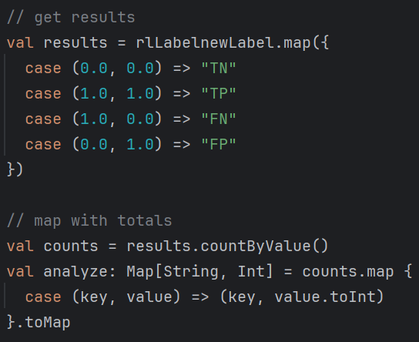
K Nearest Neighbors

Slide 12
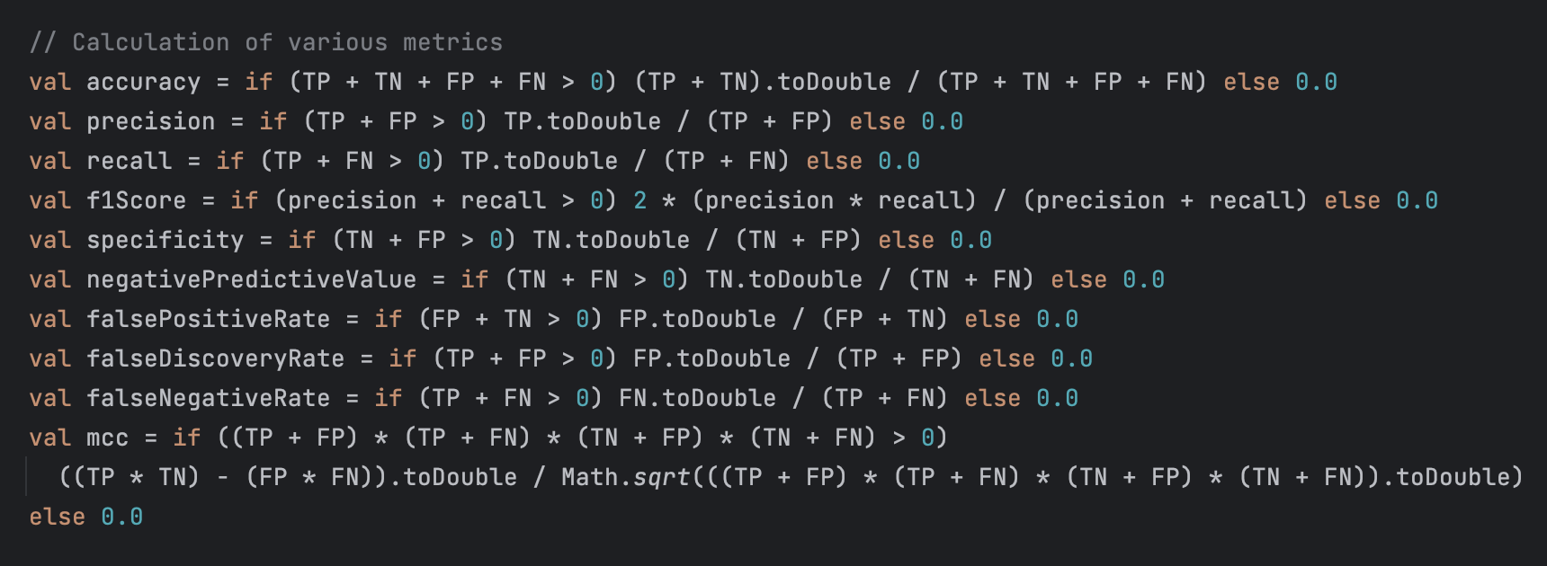
K Nearest Neighbors

Slide 13
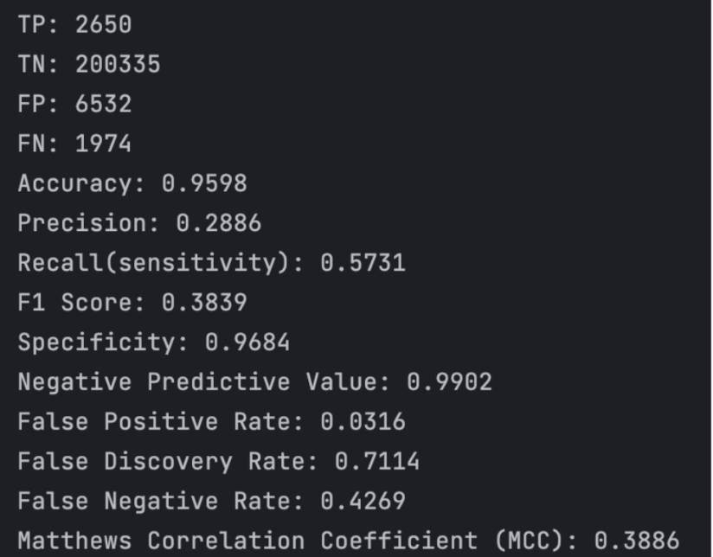
Results
Sensitivity/recall is more important than precision
We want to minimize FN
Accuracy is really good, F1 is not
Why?
KNN is heavily biased towards majority class (negatives)
Large dimensionality of data
Did not normalize data
Values like these should have been normalized + remove some of the columns/features
Notes:
FN = someone with heart disease that we didn’t catch -> THIS IS BAD!!
Accuracy is only good because we have a ton of TN

Slide 14
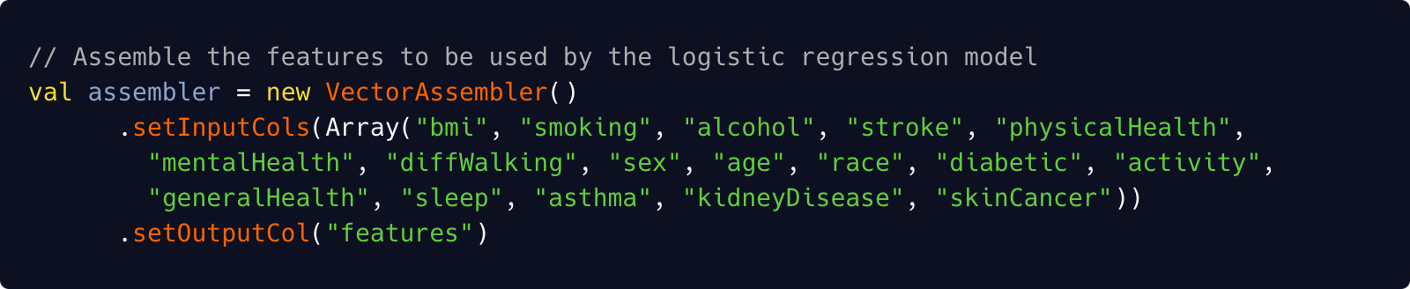
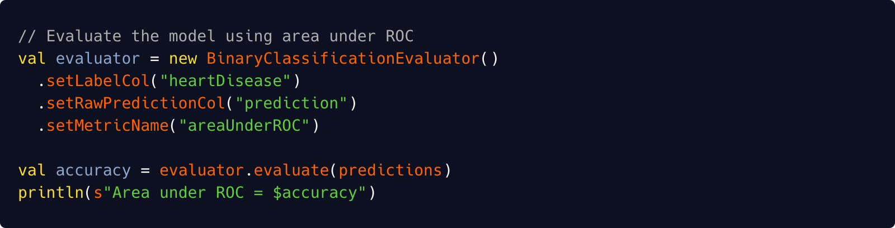
Logistic Regression

Slide 15
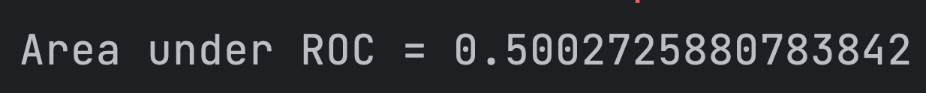
Logistic Regression

Slide 16
What We Learned?
Deeper understanding of how to use Spark/Scala for more complex ML and Data Science tasks.
Extremely useful for processing large datasets by abstracting away process of splitting task into multiple nodes
Learned how to create a custom implementation of KNN algorithm without any external libraries
Gained an understanding of using Spark ML libraries to create a basic version of Logistic Regression
Figured out how to create visualizations and plots in Spark/Scala using libraries like Plotly and Breeze Plot.

Slide 17
Major Obstacles
Spark/Scala visualization and plotting tools are not great, and creating basic plots like Pie Charts is quite difficult.
Due to our custom implementation of KNN
Code was not optimized so it took longer than expected to run.
Poor model performance - recall, precision, F1, and other metrics were low
Data preprocessing and feature selection were harder to perform than in Python due to unfamiliarity
Hyperparameter tuning to optimize train/test split and k-value
Had to manually do this step through trial-by-error experimentation
Abandoned custom implementation Logistic Regression
Had a heavy reliance on libraries to get good results
Accuracy was poor at around 50%, similar to a coin toss.

