Slide 1

Exploratory Data Analysis
G2M Cab Investment
21 December, 2022

Slide 2

Agenda
Executive Summary
Problem Statement
Approach
EDA
EDA Summary
Recommendations

Slide 3
Executive Summary
City – Yellow Cab is more popular and has more customers, especially in cities where cab users are a higher percentage of the population
Gender- Yellow Cab has more male and female customers than Pink Cab
Payment Method- Yellow Cab has more customers paying by both card and cash than Pink Cab
Cost- Yellow Cab charges more per km and more extra cost than Pink Cab

Slide 4
Problem Statement
Statement: XYZ is a private firm in US. Due to remarkable growth in the Cab Industry in last few years and multiple key players in the market, it is planning for an investment in Cab industry
Objective: Given the data of the two Cab Industry, find the best company for XYZ to invest in

Slide 5
Approach
Step 1- Assumptions
Step 2- Analyze and Explain Data
Step 3- Produce findings based on following hypotheses/questions:
Which company was used more by each city (Analysis of Cities and key findings)
Does one gender rely more on another company? (Analysis of gender and key findings)
How does payment method effect company? (Analysis of payment method and key findings)
Which company generates the most revenue? (Analysis of cab transactions relative to company)
Step 4- EDA Summary
Step 5- Recommendations

Slide 6
EDA: Assumption
Assumption 1- All data from both companies have been received accurately
Assumption 2- Genders of each customer has been recorded accurately, although no explanation as to how their genders were recorded
Assumption 3- No mistakes were made in payment transactions or calculations by cab drivers
Assumption 4- “Users” in the City.csv dataset are number of transactions

Slide 7
EDA: Data Explanation
The following is the data used in this project:
Cab_Data.csv – Transactions of customers of the two companies, Yellow Cab and Pink Cab respectively. Cost of trip and price charged are included, along with distance in KM and city
Transaction_ID.csv- Transaction ID with customer’s ID and their payment method
Customer_ID.csv- Customer ID and their respective information; gender, age, income
City.csv- Cities in which data was collected, with city population and cab users

Slide 8
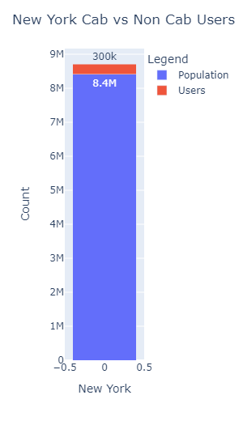
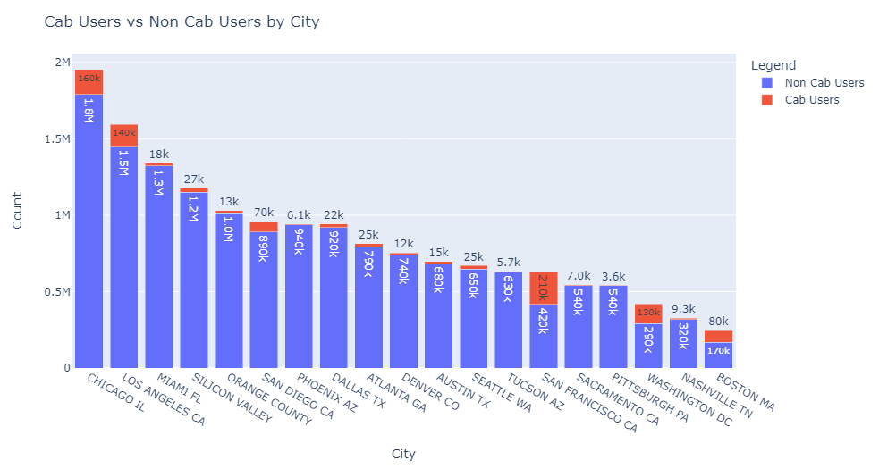
EDA Analysis: City
Cab Users vs Non Cab Users. The three highest proportions are Washington D.C. (43.5% of the population uses cabs), Boston MA (47.3% of the population uses cabs), and Chicago (9.9% of population uses cabs). Next slide shows analysis of yellow cab vs pink cab based on these three cities
NOTE: San Francisco had the highest proportions (51.4%), however there is no data San Francisco for yellow and pink cab

Slide 9
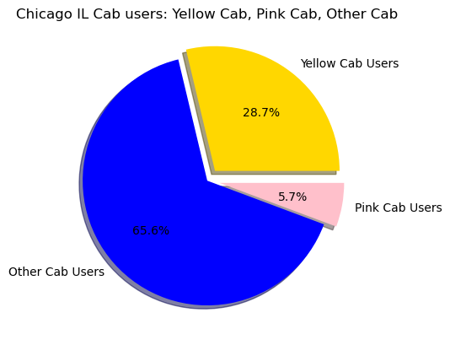
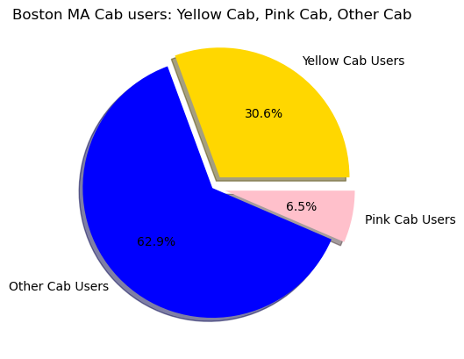
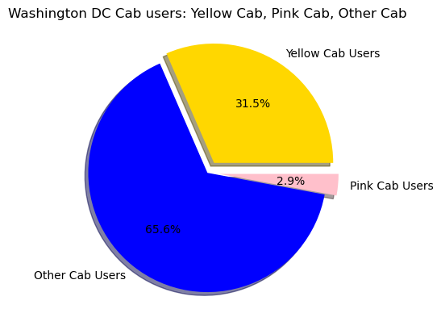
EDA Analysis: City
Yellow Cab consistently has higher cab users than Pink Cab, and makes a significant portion of cab users out of the total Cab users of these three cities
NOTE: City.csv did not clarify if users are counted transactions or individual customers. For this, they will be seen as counted transactions. Regardless, the conclusions are the same.

Slide 10
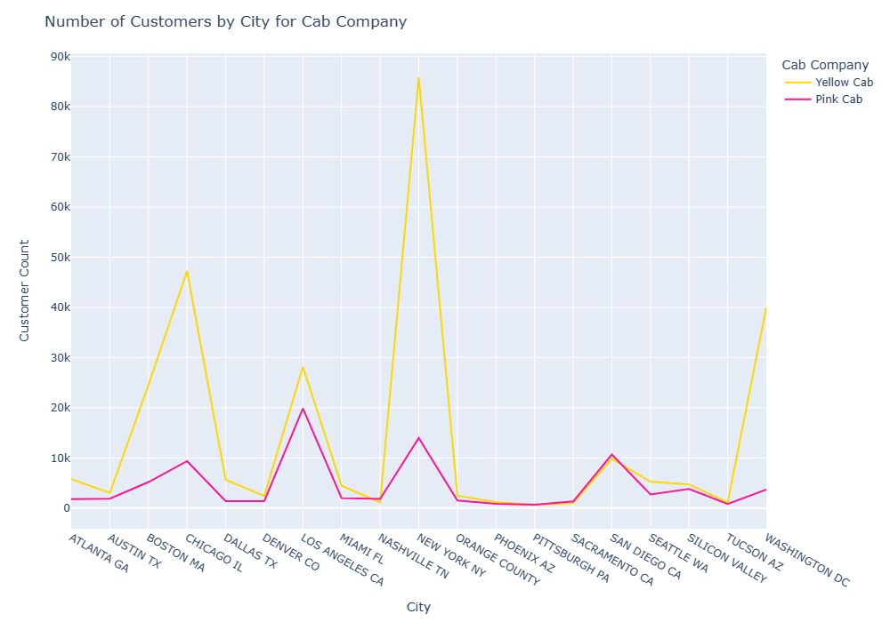
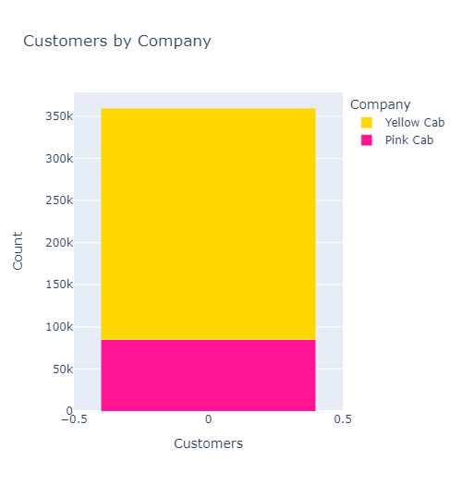
EDA Analysis: City
Yellow Cab has more customers during this time period. They have a larger number of customers in some cities such as Boston, New York, and Washington DC

Slide 11
EDA: City
Conclusion on City:
Based on the findings, Yellow Cab generally has more customers than Pink Cab by city. In some cities, such as New York, Yellow Cab far outnumbered Pink Cab, whereas the opposite cannot be said. In the three cities with the highest ratio of cab users versus non cab users, Yellow Cab had significantly higher users.

Slide 12
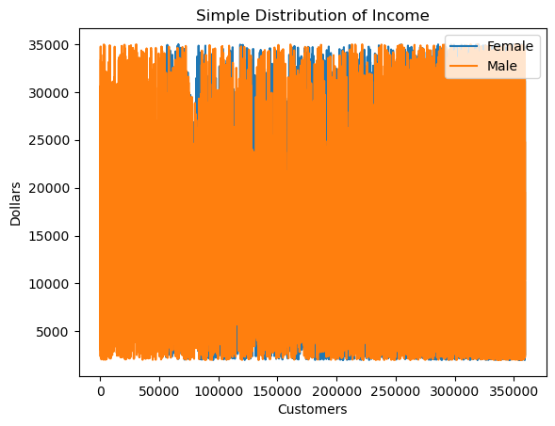
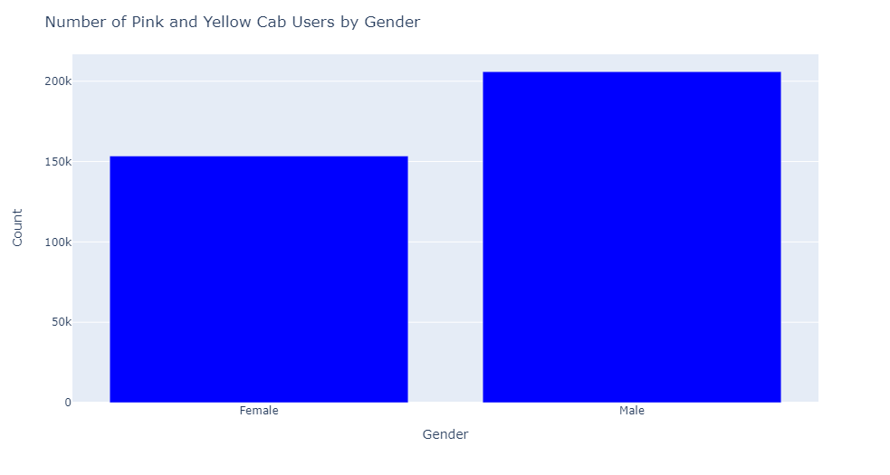
EDA Analysis: Gender
Both Male and Females who use Yellow Cab and Pink Cab make roughly the same amount of money, as seen in the distribution graph. Therefore, there is no business preference for one gender over the other. There are more Male customers than Female customers.

Slide 13
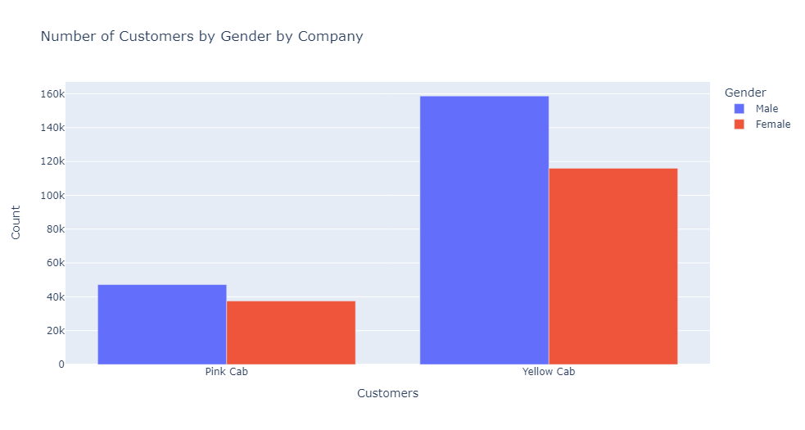
EDA Analysis: Gender
There are far more male customers for Yellow Cab than male customers for Pink Cab. There are more female customers for Yellow Cab than female customers for Pink Cab. Interestingly, the female customers of Yellow Cab are more than Pink Cab male and female customers combined

Slide 14
EDA: Gender
Conclusion on Gender:
Based on the findings, both genders have similar income distribution. Yellow Cab has more male customers than Pink Cab’s male customers, and Yellow Cab has more female customers than Pink Cab’s female customers. Both cabs have more male customers than their respective female customers. Yellow Cab’s female customers outnumber Pink Cab’s male and female customers combined.

Slide 15
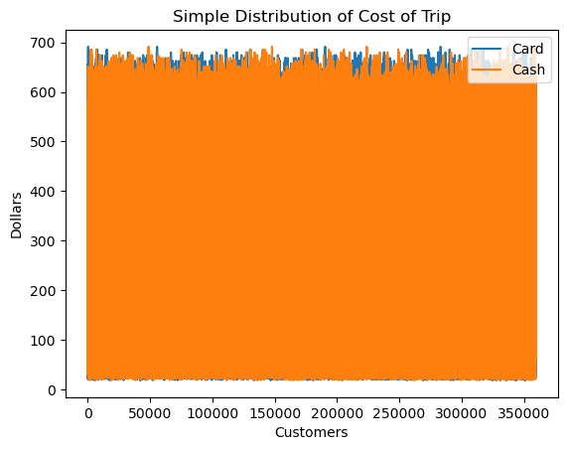
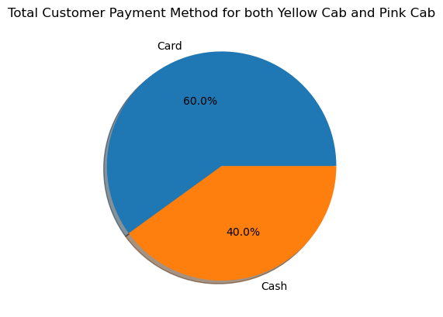
EDA Analysis: Payment Method
60% of customers of Yellow Cab and Pink Cab use card and 40% use cash. There is not significant difference between the cost of the trip based on the payment method- regardless of payment method, customers generally paid the same

Slide 16
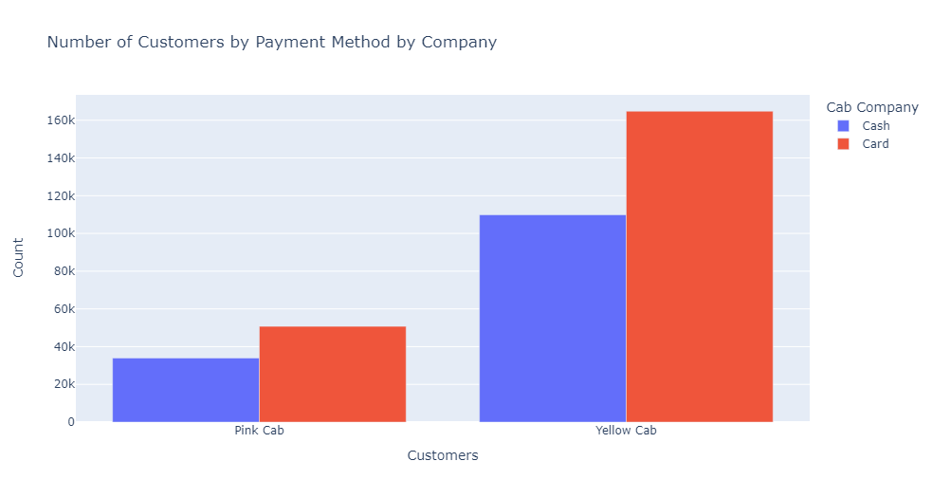
EDA Analysis: Payment Method
For both Yellow Cab and Pink Cab, customers paid more by Card than Cash. Yellow Cab had more customers paying by card and cash than Pink Cab

Slide 17
EDA: Payment Method
Conclusion on Payment Method:
First, the distribution of cost of trip was checked. This was to see if one payment method paid more, for example if customers who paid by card travelled longer and therefore paid more. However, this was not the case. Therefore payment method had no influence in cost of trip.
Customers for both companies paid more by card than cash. Yellow Cab had more card and cash transactions than Pink Cab, which is predictable due to having more overall transactions.

Slide 18
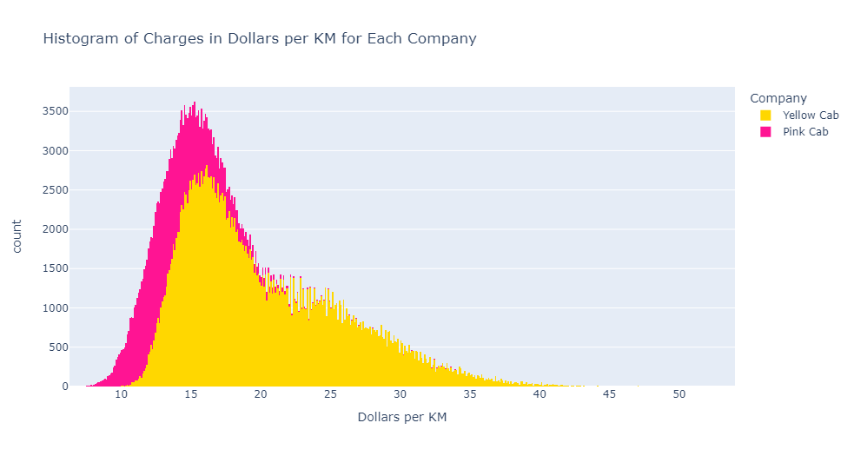
EDA Analysis: Cost/Revenue
Pink Cab charges between 11-17 dollars per km while Yellow Cab charges 14-25 dollars per km.

Slide 19
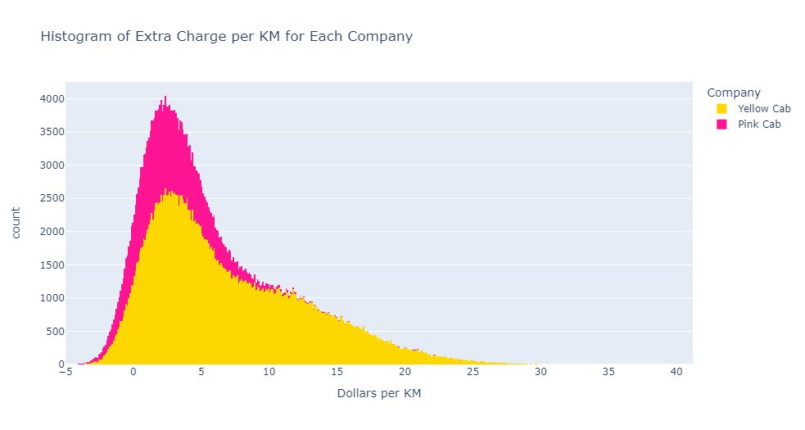
EDA Analysis: Cost/Revenue
Pink Cab mostly charges between 0 and 5 dollars extra per km than the charge of the actual trip, whereas Yellow Cab mostly charges between 5 to 10 dollars extra per km than the charge of the actual trip.

Slide 20
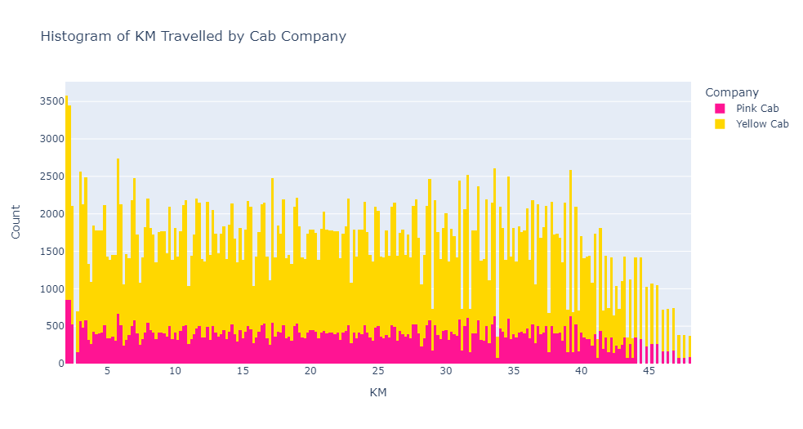
EDA Analysis: Cost/Revenue
Both companies have similar distances travelled, Yellow Cab simply has more counts due to more transactions. Both have an even amount of KM travelled, although Yellow Cab has more trips 0-5 km compared to its other distances.

Slide 21
EDA: Cost/Revenue
Conclusion on Cost/Revenue:
Yellow Cab charges more per km travelled than Pink Cab, and charges more extra cost per km. From a business and investment standpoint, this makes Yellow Cab better as it may generate more revenue, although more data is needed.
Both Yellow Cab and Pink Cab have an evenly distributed distances travelled by KM, but Yellow Cab simply has more due to more transactions recorded

Slide 22
EDA Summary
Yellow Cab had more customers than Pink Cab in most cases, and the few cases it did not were miniscule. In cities with a significant percentage of cab users, Yellow Cab ruled over Pink Cab in terms of customers.
Both male and female cab users had a similar distribution of income, so neither is favored over the other from a business viewpoint. Both companies had more male cab users than female cab users, but Yellow Cab had a much larger amount of both male and female cab users, such that Yellow Cab female cab users were more than Pink Cab male and female users combined
Both card and cash payment methods had a similar distribution of the cost of a trip, so neither is favored over the other from a business viewpoint. Both companies had more customers paying via card than cash, but Yellow Cab had a larger amount of both card and cash users.
Both companies had a similar distribution of distances travelled, but with Yellow Cab having more counts of each respective distance travelled. Yellow Cab charged more per kilometer than Pink Cab and charged more extra cost than Pink Cab. It can be assumed that Yellow Cab therefore generates more revenue, but more data is preferable before coming to this conclusion with certainty

Slide 23
EDA Recommendation
Recommendation:
XYZ should invest in Yellow Cab

Slide 24
Thank You

