Slide 1
Covid-19 Data Integration with Azure Data Factory

Slide 2
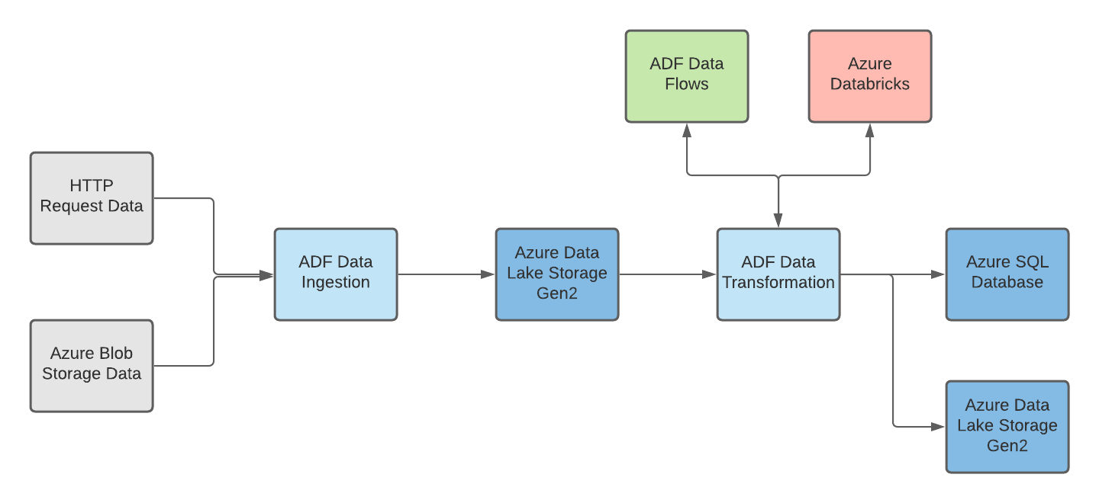
Solution Architecture
Below is the solution architecture for the data engineering solution. All resources used can be generated within Microsoft Azure Portal and Azure Data Factory using a free trial account.

Slide 3
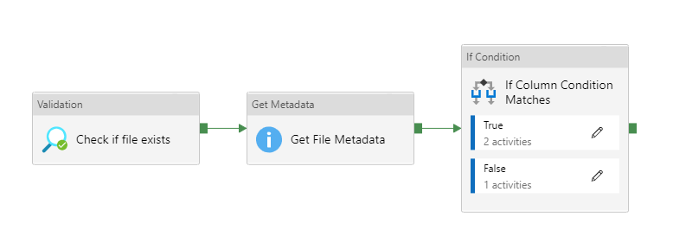
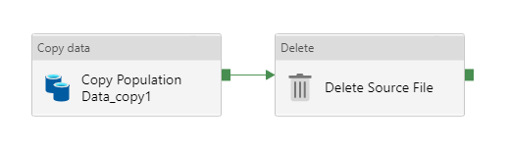
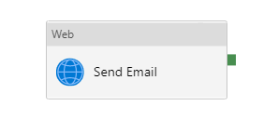
Data Ingestion Pipeline (Azure Blob)
The population dataset is a tsv file stored within an Azure Blob container.
To extract the data, an ingestion pipeline was created which checks if the file exists, and then calls an If Condition to check if the ingested files has the correct number of columns (retrieved from file metadata)
If conditions are met, the pipeline invokes a Copy activity to copy the file to the Data Lake (Azure Data Lake Storage Gen2).
If conditions are not met, an email is sent indicating job failure.
True
False

Slide 4
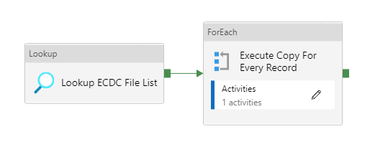
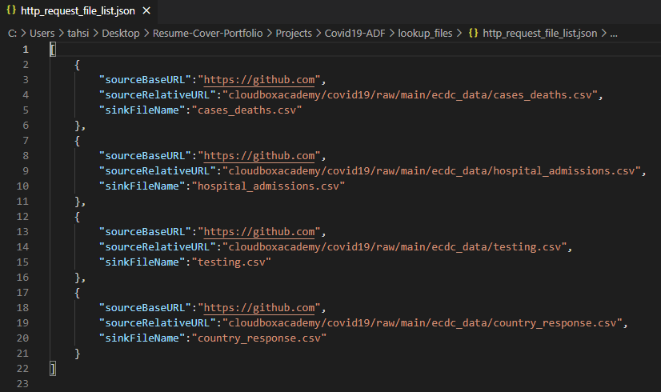
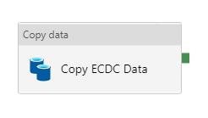
Data Ingestion Pipeline (HTTP Request)
4 data tables are retrieved using HTTP requests from a Git repository.
Json file data containing the http links is used in a lookup activity to execute a Copy activity for each URL. This is done with a ForEach activity.
json file

Slide 5
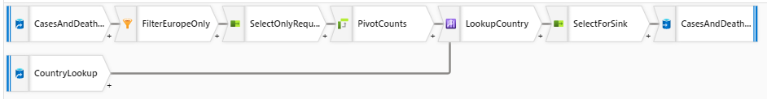
Data Transformation (Cases & Deaths)
Below is the Data Flow activity to perform transformations on cases and deaths data
The transformations performed include source transformation, filter transformation, select transformation, pivot transformation, lookup transformation, and sink transformation.

Slide 6
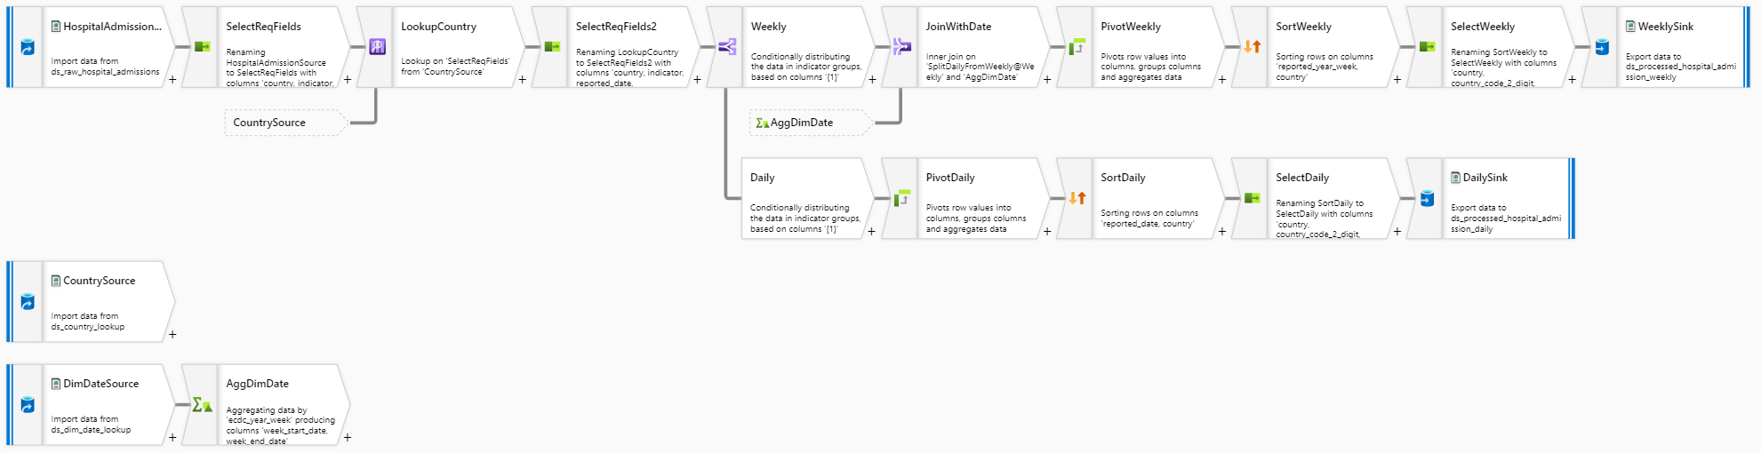
Data Transformation (Hospital Admissions)
Below is the Data Flow activity to perform transformations on hospital admissions data
The transformations performed include source transformation, select transformation, lookup transformation, conditional split transformation, derived column transformation, aggregate transformation, join transformation, pivot transformation, sort transformation, and sink transformation.

Slide 7
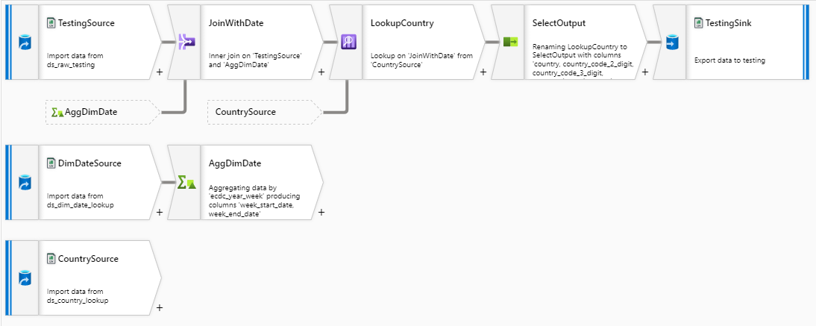
Data Transformation (Testing)
Below is the Data Flow activity to perform transformations on testing data
The transformations performed include source transformation, join transformation, lookup transformation, select transformation, aggregate transformation, and sink transformation.

Slide 8
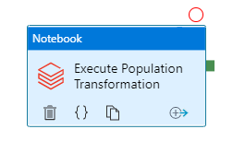
Data Transformation (Population)
For population data transformations, the required changes are more complex, therefore an Azure Databricks activity was used to execute transformations defined in a Python script
The transformations performed include:
Split the country code & age group
Exclude all data other than 2019
Remove non-numeric data from percentage
Pivot the data by age group
Join to dim_country to get the country, 3-digit country code and the total population

Slide 9
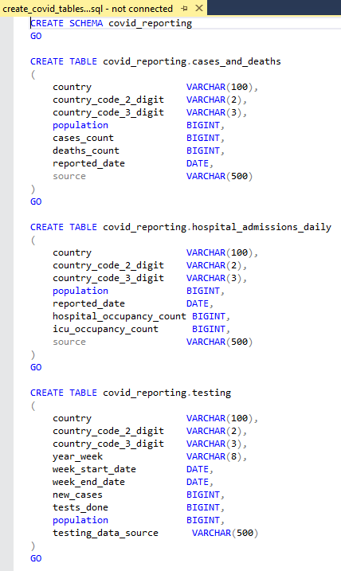
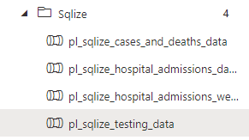
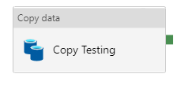
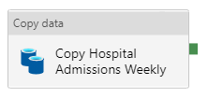
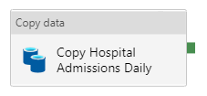
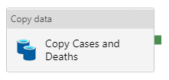
Loading Data to SQL Server
Lastly, 4 pipelines were created to load the processed data to an Azure SQL Server Database
Before performing copy activities to load the data into the server, a SQL schema containing the desired tables, columns, and variable types is created.

