Slide 1
Automated Stock Trading: Real-Time Trading & Historical Simulation
Tahsin Iqbal

Slide 2
Project Scope
Test Stock Trading Algorithm Performance using 20+ years historical data (automated testing in Excel)
Develop Trading algorithm based on technical indicators and statistics
Implement trading algorithm in Excel and simulate real-time trading
Optimize trading strategy based on results and re-run simulations
Create Trading bot to execute buy/sell orders live on Interactive Brokers (IB) trading platform
Create data pipeline using third party data source
Implement trading algorithm in Python application
Feed live data into Python application and determine stocks to purchase
Use IB broker API to manage orders and monitor account funds

Slide 3
Testing Algorithm: Processing Third Party Data
Due to receiving third party data in excel format, numerous macros were created in VBA for the following tasks:
Data cleanup and standardization
Determining which stocks met the criteria for trade entries
Determining if the trade entries resulted in “wins” or “losses”
Combining the results and simulating real-time trading by establishing realistic trading rules (limited account size, # of positions allowed)
*The slides in this presentation show a few screenshots of the project; however, all source code/files can be found on GitHub: github.com/tahsiniqbal98/Stock-Trading-Bot-and-Testing

Slide 4
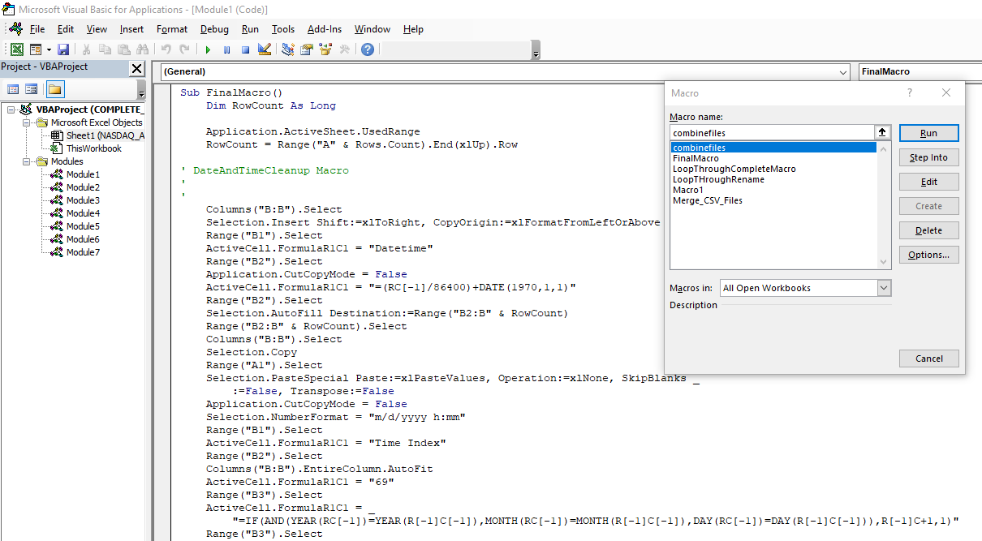
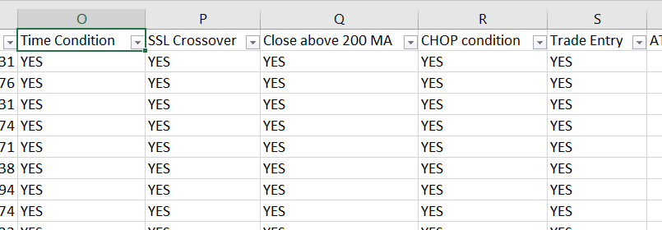
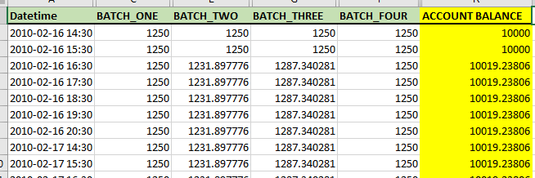
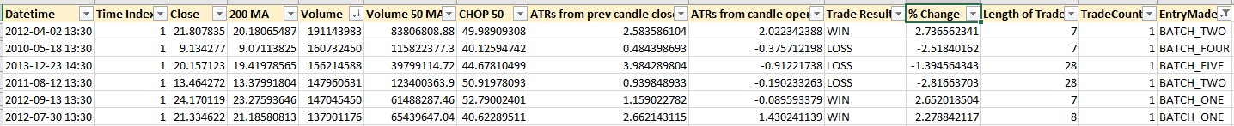
Testing Algo (cont.)
<- Excel VBA Macro
<- Data Outputs

Slide 5
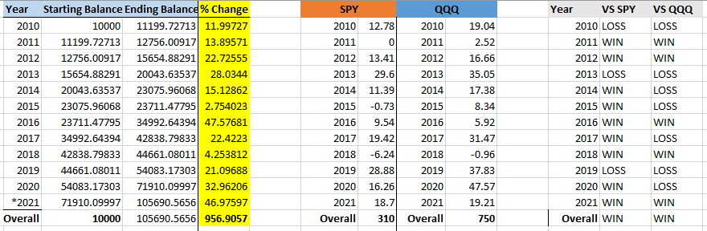
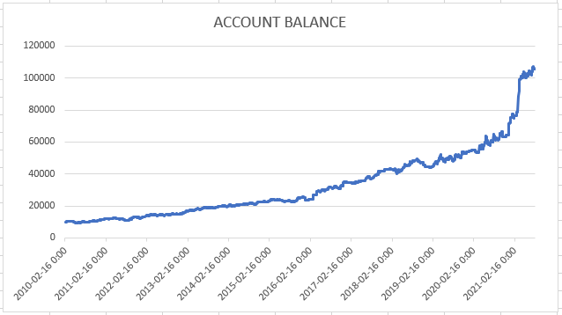
Optimizing Trading Strategy
The technical indicators used for the strategy include the following:
Average True Range (Measure of Volatility)
Choppiness Index (Measure of Volatility)
Gann Hilo Indicator (Measure of Trend Direction)
Simple Moving Average (Measure of Trend Direction)
The specifications on for each indicator were varied, and results for different trials were analyzed to determine the optimal settings for maximizing profits

Slide 6
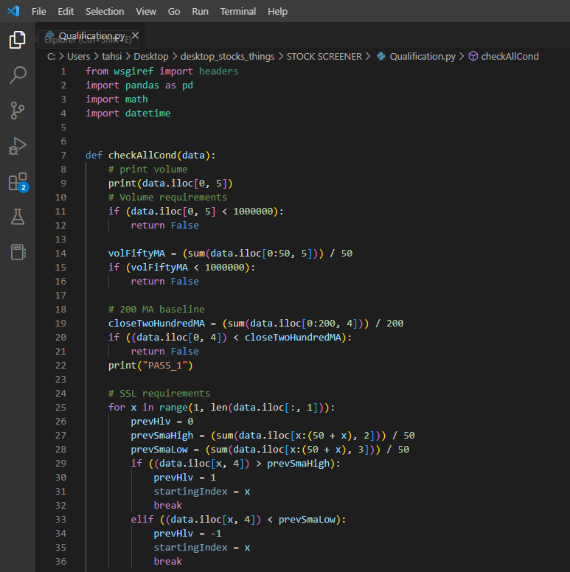
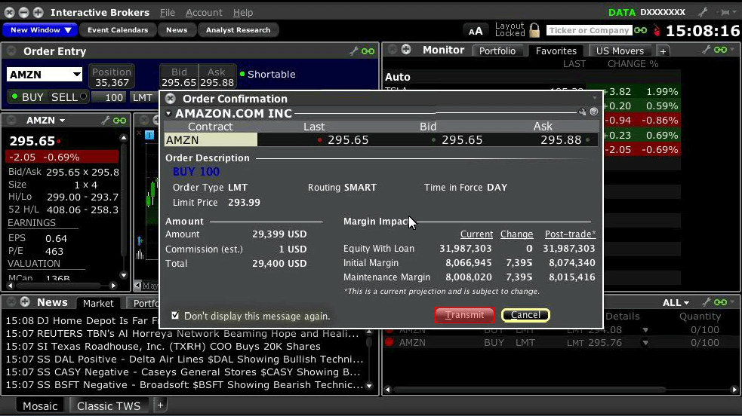
Creating Trading Bot: Python Implementation
After the strategy was tested, all technical indicators and trade entry/exit requirements were programmed in Python for the live-trading app
AlphaVantage (3rd party API) was used to stream data into the app and make real-time trading decisions
Interactive Brokers (IB) API was used to connect the app to a real trading account, automatically sending orders to buy/sell stocks when all conditions were met
Snippet of Python code and IB Broker account ->

Slide 7
Conclusion
Through trading strategy simulation and optimization using 10+ years of historical data, confidence was developed that the strategy would achieve an average return of 22.5%/year.
In creating the automated trading bot in Python and integrating with live data and Interactive Brokers API, a hands-free passive income stream was created.
After trading live for 1 year, +15% returns were achieved – significantly better returns than industry standard funds like SPY (-20%) and QQQ (-33%)

