Slide 1
NO-CODE AUTOMATION / PROJECT DEMO
Clothing Shop
Order Management
Automation
A practical workflow demo built with
Google Sheets + Make.com
SHEETS → ROUTER
→ HUMAN REVIEW
PERSONAL DEMO
Presented by Tahsin Nasif Khan
TAHSIN NASIF KHAN • AI WORKFLOW AUTOMATION DEMO
2026

Slide 2
01 / THE CHALLENGE
02
Why order handling gets messy
01
Manual order entry
02
Incomplete details
Order details are entered and tracked by hand.
Size, colour, address or contact fields may be missing.
03
Quantity mistakes
04
Difficult tracking
Invalid quantities can move into the order list.
It can be hard to see which orders need attention.
TAHSIN NASIF KHAN • AI WORKFLOW AUTOMATION DEMO
2026

Slide 3
02 / THE WORKFLOW
03
A simple no-code order validation flow
01
02
03
Google Sheets
→
Make.com Router
→
Status update
Order details are manually entered
Checks the quantity condition
Routes each row to the right status
Human review remains required before customer-facing actions.
TAHSIN NASIF KHAN • AI WORKFLOW AUTOMATION DEMO
2026

Slide 4
03 / TESTING & VALIDATION
04
Three test cases. Two routing outcomes.
TEST CASE
INPUT
EXPECTED STATUS
RESULT
01
Quantity = 2
Pending Human Approval
PASS
02
Quantity = 1
Pending Human Approval
PASS
03
Quantity = 0
Needs Correction
PASS
Quantity ≥ 1 → Pending Human Approval | Quantity < 1 → Needs Correction
Personal demo test cases. Confirm each result in the latest Google Sheets run before presenting.
TAHSIN NASIF KHAN • AI WORKFLOW AUTOMATION DEMO
2026

Slide 5
04 / DEMO SCOPE
05
What this demo does — and does not do
INCLUDED
NOT INCLUDED
Included in this demo
Outside the demo scope
✓ Manual order entry in Google Sheets
— Automatic Facebook Messenger reading
✓ Quantity validation in Make.com
— Automatic customer confirmation
✓ Automatic status update in the sheet
— Payment processing
✓ Human review before customer-facing actions
— Production deployment or live customer data
TAHSIN NASIF KHAN • AI WORKFLOW AUTOMATION DEMO
2026

Slide 6
LET'S CONNECT
Thank you.
BUILDING
PRACTICAL WORKFLOWS
Tahsin Nasif Khan
Aspiring AI Automation Specialist
Make.com • Google Sheets
EMAIL
tahsinnasif318@gmail.com
LINKEDIN
linkedin.com/in/tahsin-nasif-06512a29b
PERSONAL LEARNING DEMO
TAHSIN NASIF KHAN • AI WORKFLOW AUTOMATION DEMO
2026

Slide 7
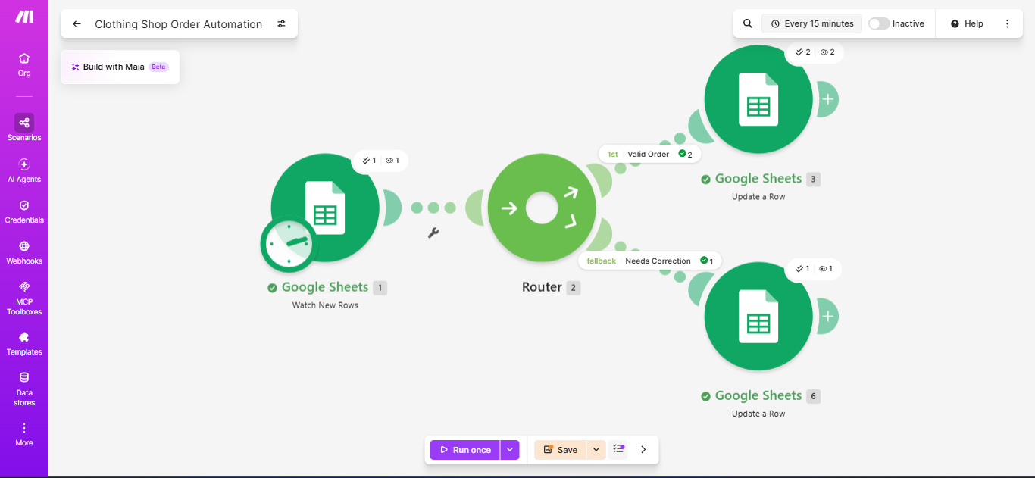
05 / LIVE PROJECT EVIDENCE
07
Make.com workflow execution
The scenario shows Google Sheets Watch New Rows → Router → two Google Sheets Update a Row routes.
Evidence: 2 bundles reached the Valid Order route and 1 bundle reached Needs Correction in the displayed run.
TAHSIN NASIF KHAN • AI WORKFLOW AUTOMATION DEMO

Slide 8
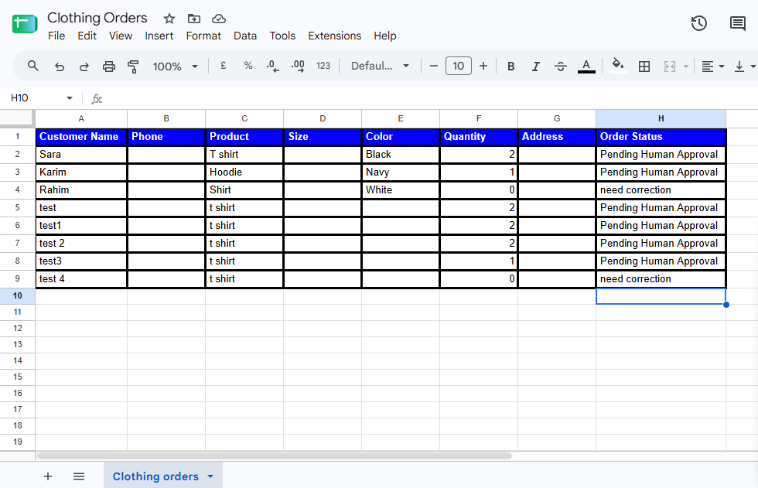
05 / LIVE PROJECT EVIDENCE
08
Google Sheets status results
The sheet records the resulting order status for each tested quantity.
Visible results: quantities 1 and 2 are marked Pending Human Approval; quantity 0 is marked need correction.
TAHSIN NASIF KHAN • AI WORKFLOW AUTOMATION DEMO

