Slide 1

Exploring Transportation Justice through the “Transportation Justice Threshold Index Framework (TJTIF) ” in Oklahoma County
Tahsin Tabassum
Masters in Regional and City Planning
University of Oklahoma

Slide 2
Overview
Research Question
Objective of the Study
Literature Review
Study Area Profile
Methodology
Result and Discussion
Recommendations and Implication in Transportation Planning

Slide 3
Research Question
What is the scenario of transportation justice in OKC Metropolitan Area?
How transportation justice in OKC metropolitan area impacts its residents in terms of transportation access and affordability?

Slide 4

Objective of the study
To develop ‘Transportation Justice Threshold Index (Tjtif) Framework’ to identify transportation justice (TJ) regions based on socio-economic and demographic factors.
To identify unique challenges faced by residents in terms of transportation access and affordability

Slide 5


Concepts of Transportation Justice
Transportation justice frequently focuses on the social equity resulting from urban-scale problems like accessibility, travel time, and large transportation investments (Gössling, 2016).
Transportation justice aim to provide safe, reliable, and affordable transportation options for everybody, despite their physical attributes, race, or socioeconomic status

Slide 6
Concepts of Transportation Justice
Three dimensions are used to identify transport injustices: exposure, space, and time.
Some organizations have broadened the definition of environmental justice regions to include populations such as households without cars, persons with disabilities, and elderly, beyond age 65 with limited access to mobility (Bailey et al., 2012; Forkenbrock & Schweitzer, 1999)
The investigation of mobility, access, and modal opportunity is done through the lens of transportation justice explaining how environmental justice concepts are applied to the sector of transportation (Forkenbrock & Schweitzer, 1999)

Slide 7
Methods of Measuring Transportation Justice
Graduated Scale Approach
A rating scale instead of a threshold. Enables calculation of intensity in identifying EJ populations.
Index Approach
Assigning points to regions based on attainment or non-attainment of a metric. Two index methodologies identified: buffer comparison index and area comparison index.
Threshold Approach
An established threshold to determine if a community meets or exceeds specific demographic attributes (usually based on regional averages). Drawbacks include relativity and inability to represent intensity.

Slide 8
Transportation Justice Threshold Index Framework (TJTIF)
A rigorous and comprehensive method, evaluates and identifies inequities in terms of factors related to Demographic, Socioeconomics and Transportation & Land Use.
A region is considered to be in a TJ area if its composite index value is positive (greater than 0).
If it is negative, the locality is not in a TJ area.
A composite index value of zero indicates that further investigation of the locality is recommended, as it might soon be considered a TJ area.

Slide 9
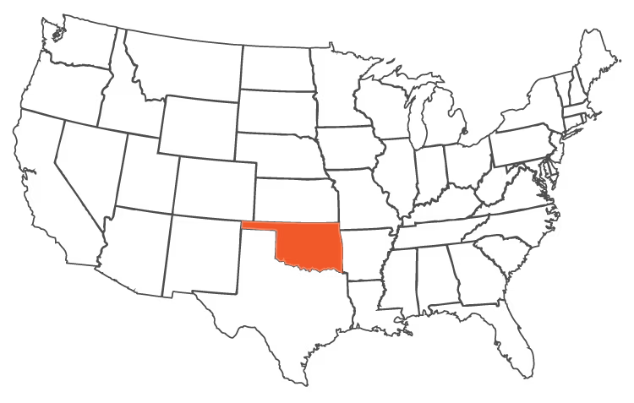
Study Area Profile
The Oklahoma City metropolitan area, located in Central Oklahoma, largest urban region in the Oklahoma state
The OKC MA area includes counties like Canadian, Cleveland, Grady, Lincoln, Logan, McClain, and Oklahoma.
OKC Metropolitan Area (red) within the state of Oklahoma
OK state(Orange) within USA

Slide 10
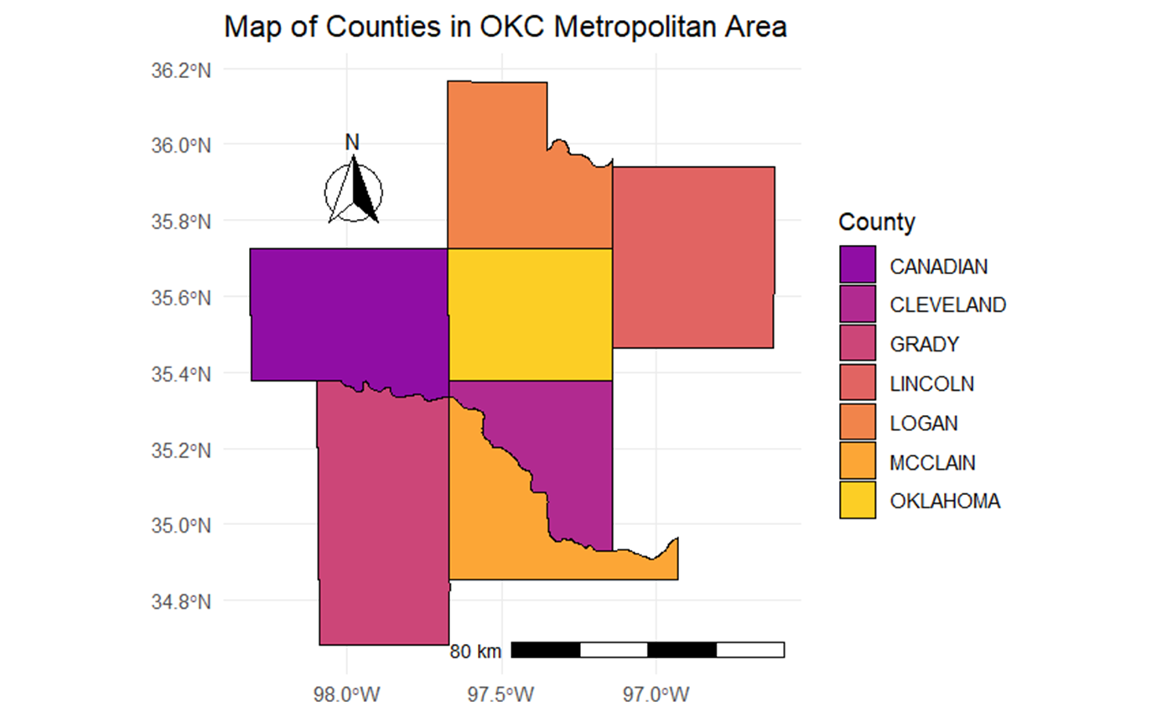
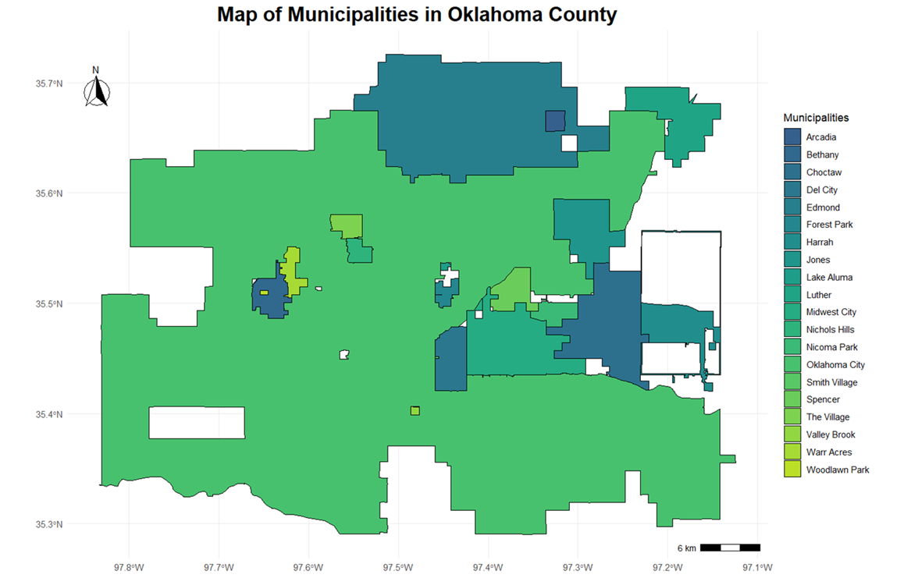

Study Area Profile
Population OKC metropolitan area of 1,425,695 in 2020, up from 1,252,987 in 2010
20 Municipalities in Oklahoma County
Mean travel time to work (minutes), workers 16 years+, 2018-2022 is 21.8

Slide 11
Methodology
Required Data
Table 1: Transportation justice variables for demographics category
Category | TJ Variable | Definition | Data Source | Direction of Need
Demographics | Race | Percentage of non-white population including two or more races | U.S. Census | Above average
 | Age | Percentage of the population below the age of 18, and above the age of 65 | U.S. Census | Above average
 | Disability | Percentage of population with a disability | U.S. Census | Above average
Direction of Need: The factor scale can be determined based on whether a lower percentage indicates
a higher need (Below Average), or if a higher percentage indicates a higher need (Above Average).

Slide 12
Table 2 : Transportation justice variables for socio economic category
Category | TJ Variable | Definition | Data Source | Direction of Need
Socio-economic | Household income | Percentage of households earning less than the average household income of the area | U.S. Census | Above average
 | Single parent household | Percentage of single parent household regardless of having children under 18 as a compared to family households | U.S. Census | Above average
 | Vehicles per household | Percentage of households with less than one vehicles per household | U.S. Census | Above average
 | Economic development | Percentage difference in people employed between 2017 and 2022 | U.S. Census | Above average
 | Cost of living | The percentage of people with median monthly housing costs for occupied housing units lower than the regional average. | U.S. Census | Above average

Slide 13
Table 3 : Transportation justice variables for transportation and land use
Category | TJ Variable | Definition | Data Source | Direction of Need
Transportation and land use | Public transit Access | Percentage of land within one mile of a fixed route transit stop | Bureau of Transportation Statistics | Above average
 | Crash rates | Percentage of fatal crashes per year | Oklahoma Highway Safety Office interactive crash map | Above average
 | Truck volume | Percentage of truck traffic per current annual average daily traffic rate | Oklahoma Freight Transportation Plan | Above average

Slide 14
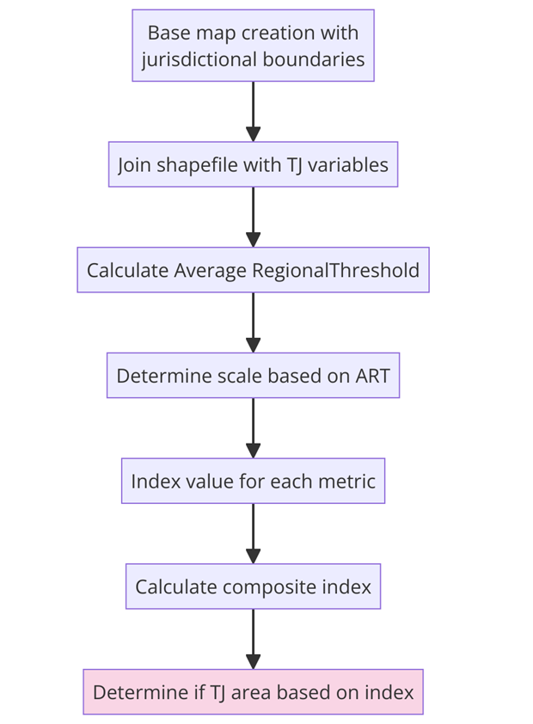

Methods
The scale was calculated by dividing the scale into seven different categories, based on the distance between the ART (representing the mid-point) and the minimum and maximum values for every factor.
Any municipalities greater than the ART would receive a positive value, indicative of a higher need.
The threshold index values were generated
A positive composite index value= A TJ area Negative composite index value= Not a TJ area.
If a composite index value = 0, it is suggested that the municipality be investigated more in depth as it may be a potential TJ area in the near future.

Slide 15

Result and Discussion

Slide 16
Table 4 Oklahoma county TJTIF application compared to Oklahoma Metropolitan Area.
Regional Values (based on 7 counties) |  |  |  |  | Cities and towns in Oklahoma county
Category | TJ Variable | Region Min | Region Max | ART | Lake Aluma | Woodlawn Park | Nichols Hills | Smith Village | Nicoma Park | Harrah | Jones | Choctaw | Luther | Edmond | The Village | Valley Brook | Bethany | Warr Acres | Oklahoma City | Midwest City | Del City | Arcadia | Spencer | Forest Park
Demographics | Race | 6.40% | 21% | 11% | 3% | 3% | 6% | 9% | 10% | 10% | 10% | 11% | 15% | 15% | 17% | 18% | 18% | 27% | 30% | 35% | 36% | 62% | 68% | 77%
 | Age | 35% | 42% | 39% | 68% | 63% | 46% | 23% | 44% | 43% | 45% | 46% | 42% | 40% | 33% | 40% | 43% | 44% | 38% | 42% | 41% | 46% | 46% | 56%
 | Disability | 13% | 20% | 16% | 15% | 12% | 11% | 24% | 15% | 15% | 15% | 18% | 8% | 11% | 13% | 21% | 15% | 15% | 13% | 18% | 20% | 21% | 21% | 17%
Socio-economic | Household income | 51% | 62% | 58% | 100% | 53% | 51% | 71% | 58% | 54% | 54% | 58% | 62% | 52% | 54% | 57% | 64% | 69% | 57% | 64% | 36% | 66% | 65% | 52%
 | Single parent household | 33% | 50% | 39% | 16% | 27% | 21% | 76% | 46% | 40% | 43% | 35% | 49% | 36% | 60% | 54% | 50% | 45% | 50% | 55% | 55% | 83% | 56% | 31%
 | Vehicles per household | 1% | 6% | 4% | 0% | 0% | 0% | 0% | 2% | 4% | 6% | 6% | 1% | 3% | 4% | 12% | 7% | 3% | 6% | 5% | 8% | 10% | 12% | 3%
 | Cost of living | 13% | 80% | 50% | 0% | 0% | 59% | 0% | 69% | 55% | 60% | 43% | 95% | 28% | 63% | 80% | 47% | 61% | 49% | 51% | 53% | 75% | 48% | 0%
 | Economic development | 0% | 2% | 1% | 3% | 15% | 0% | 4% | 5% | 3% | 2% | 0% | 12% | 1% | 6% | 13% | 1% | 1% | 1% | 0% | 0% | 2% | 8% | 2%
Transportation and land use | Network connectivity | 0 | 4.90% | 2.20% | 0.3% | 0.0% | 12.9% | 0.0% | 1.5% | 0.0% | 0.0% | 0.1% | 0.0% | 0.0% | 6.2% | 16.5% | 5.0% | 11.7% | 6.1% | 0.0% | 1.1% | 0.0% | 0.1% | 2.0%
 | Truck Volume | 1 | 8 | 3.88 | 2 | 6 | 1 | 6 | 1 | 8 | 2 | 1 | 2 | 2 | 2 | 2 | 1 | 1 | 8 | 2 | 6 | 35 | 2 | 3
 | Crash rates | 0% | 100% | 8.29% | N/A | N/A | 0% | N/A | N/A | 100% | 0% | 33.30% | N/A | 1.57% | 0% | N/A | 4.54% | 5.88% | 5.82% | 5.37% | 9.23% | 0% | 5.82% | N/A

Slide 17
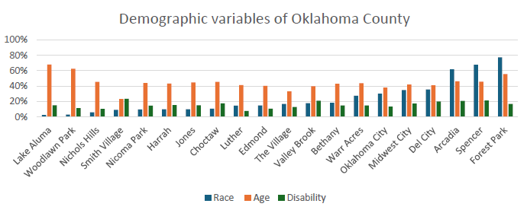
Demographic Category
The racial composition has a general regional range of 6.40% to 21%.
Municipalities like Oklahoma City and Arcadia have higher percentages, indicating a more diverse population.
The age cohorts from 35% to 42%, with Luther and Arcadia showing higher percentages.
Disability rates range from 13% to 20%, with some towns having lower rates. Harrah has a higher prevalence at 24%.

Slide 18
Table 5 :Index value for each matric of demographic category
City Name | Race | Age | Disability
Arcadia | 1 | 1 | 0
Del City | -3 | 0 | 0
Smith Village | 0 | -3 | 1
Valley Brook | -2 | 0 | 0
Jones | 0 | 0 | -2
Lake Aluma | 0 | 2 | -2
Forest Park | 2 | 2 | -3
Choctaw | -1 | 1 | -3
Spencer | 2 | 1 | 0
Midwest City | -3 | 0 | -3
Nicoma Park | 0 | 0 | -2
Edmond | -1 | 0 | -1
Oklahoma City | -3 | -1 | -1
The Village | -2 | -2 | -1
Nichols Hills | 0 | 1 | -1
Warr Acres | -2 | 0 | -2
Bethany | -2 | 0 | -2
Woodlawn Park | 0 | 2 | -1
Harrah | 0 | 0 | -2
Luther | -1 | 0 | 0

Slide 19
Socio-economic Category
Low economic development is prevalent, with some areas showing improvements.
Spencer, with a 95% median monthly housing income below the regional average

Slide 20
Table 6 : Index value for each matric of socio-economic category
City Name | Economic Development | Household income | Single parent household | Vehicles per household | Cost of living
Arcadia | -1 | -3 | 2 | 1 | 1
Del City | 0 | 0 | 0 | 0 | 0
Smith Village | -2 | 0 | 2 | 0 | 0
Valley Brook | 2 | -1 | 0 | 1 | 2
Jones | -1 | -1 | -3 | -3 | 0
Lake Aluma | -2 | 2 | 0 | 0 | 0
Forest Park | -1 | -1 | -1 | -1 | 0
Choctaw | 0 | -3 | -1 | -3 | -2
Spencer | 0 | -3 | 0 | 1 | -3
Midwest City | 0 | -3 | 0 | -2 | 0
Nicoma Park | -3 | -3 | -3 | -1 | 1
Edmond | -1 | -1 | -1 | -1 | -1
Oklahoma City | -1 | -1 | 0 | -3 | -3
The Village | -3 | -1 | 0 | -2 | 0
Nichols Hills | 0 | -1 | 0 | 0 | 0
Warr Acres | -1 | 0 | -3 | -1 | 0
Bethany | -1 | -3 | 0 | -3 | -2
Woodlawn Park | 2 | -1 | 0 | 0 | 0
Harrah | -2 | -1 | -3 | -2 | 0
Luther | 1 | -3 | -3 | 0 | 2
Notes:
In valley brook economic development , vehicle per household,

Slide 21
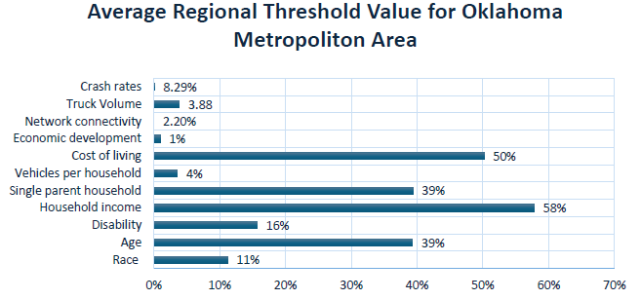
Transportation and Land Use Category
Transit access ranging from 0% to 4.90%
Edmond and The Village having higher connectivity.
Truck volume is highest in Oklahoma City, with 35 trucks and crash rates are highest in Oklahoma City at 9.23%.
Average Regional Threshold Value
16% of the population having disabilities.
Most households earn below average, indicating income inequality.
The high vehicle ownership rate suggests reliance on automobiles
Economic development is slow

Slide 22
Table 7 : Index value for each matric of transportation and land-use
City Name | Public transit Access | Truck Volume | Crash Rates
Arcadia | 0 | 2 | 0
Del City | 0 | -1 | -1
Smith Village | 0 | -1 | 0
Valley Brook | 2 | 0 | 0
Jones | 0 | 0 | 0
Lake Aluma | 0 | 0 | 0
Forest Park | 0 | 0 | 0
Choctaw | 0 | 0 | -2
Spencer | 0 | 0 | 0
Midwest City | 0 | 0 | 0
Nicoma Park | 0 | 0 | 0
Edmond | 0 | 0 | 0
Oklahoma City | -3 | -2 | 0
The Village | -3 | 0 | 0
Nichols Hills | 1 | 0 | 0
Warr Acres | 1 | 0 | 0
Bethany | -2 | 0 | 0
Woodlawn Park | 0 | -1 | 0
Harrah | 0 | -2 | 2
Luther | 0 | 0 | 0

Slide 23
Table 8 :TJTIF results for municipalities in Oklahoma County, OK
City Name | Composite Index | Remarks
Oklahoma City | -18 | NOT A TJ AREA
Bethany | -15 | NOT A TJ AREA
Choctaw | -14 | NOT A TJ AREA
The Village | -14 | NOT A TJ AREA
Midwest City | -11 | NOT A TJ AREA
Nicoma Park | -11 | NOT A TJ AREA
Harrah | -10 | NOT A TJ AREA
Jones | -10 | NOT A TJ AREA
Warr Acres | -8 | NOT A TJ AREA
Edmond | -7 | NOT A TJ AREA
Del City | -5 | NOT A TJ AREA
Luther | -4 | NOT A TJ AREA
Forest Park | -3 | NOT A TJ AREA
Smith Village | -3 | NOT A TJ AREA
Spencer | -2 | NOT A TJ AREA
Nichols Hills | 0 | POTENTIAL TJ AREA
Lake Aluma | 0 | POTENTIAL TJ AREA
Woodlawn Park | 1 | A TJ AREA
Arcadia | 4 | A TJ AREA
Valley Brook | 4 | A TJ AREA

Slide 24
TJTIF results for municipalities in Oklahoma County, OK

Slide 25
Recommendations and Implication in Transportation Planning
Integrating Theories of Justice into Transportation Policy
Focusing on Procedural and Distributive Justice
Implementation of Comprehensive transportation Planning
Promoting Sustainable and Inclusive Mobility
Enhancement of Health and Transportation Integration

Slide 26

Thank you

