Slide 1
Cellular Division
Prof. Dr. md. Mahbubul Morshed

Slide 2
Cell Division
All cells are derived from pre-existing cells
New cells are produced for growth and to replace damaged or old cells
Differs in prokaryotes (bacteria) and eukaryotes (protists, fungi, plants, & animals)

Slide 3
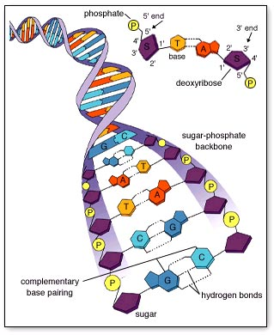
Keeping Cells Identical
The instructions for making cell parts are encoded in the DNA, so each new cell must get a complete set of the DNA molecules

Slide 4
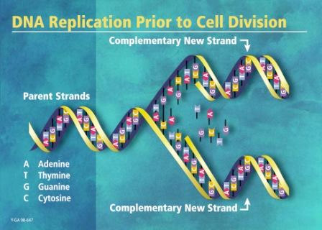
DNA Replication
DNA must be copied or replicated before cell division
Each new cell will then have an identical copy of the DNA
Original DNA strand
Two new, identical DNA strands

Slide 5
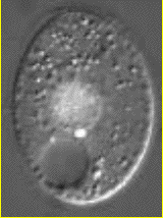
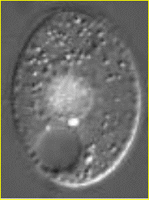

Identical Daughter Cells
Two identical daughter cells
Parent Cell

Slide 6
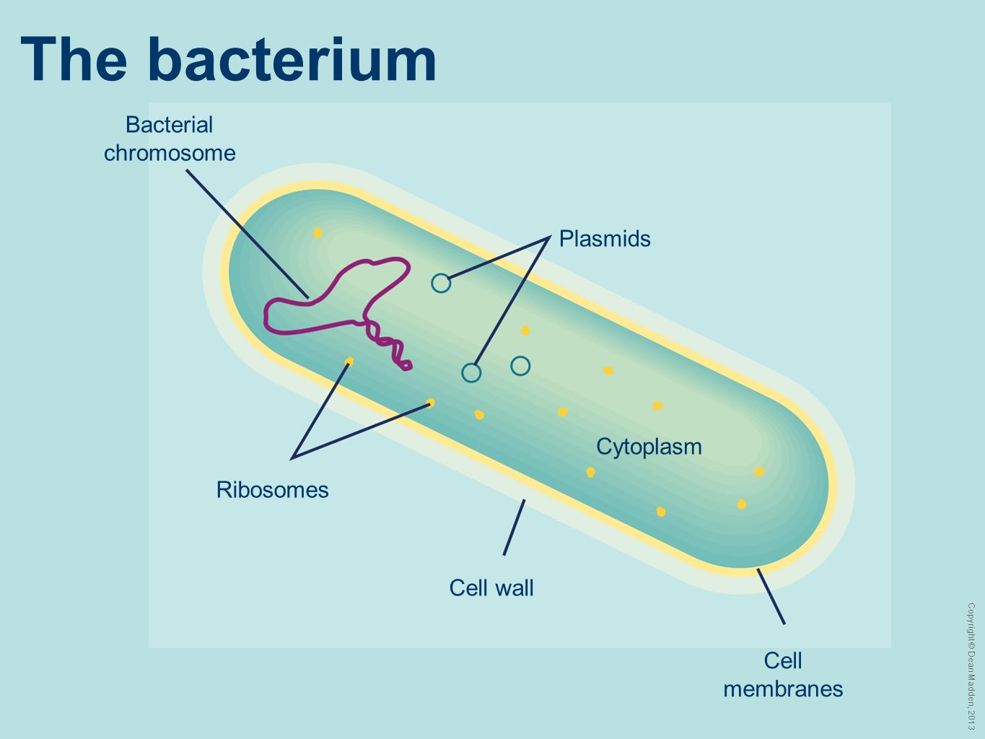
Prokaryotic Chromosome
The DNA of prokaryotes (bacteria) is one, circular chromosome attached to the inside of the cell membrane

Slide 7
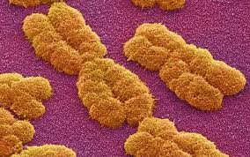
Eukaryotic Chromosomes
All eukaryotic cells store genetic information in chromosomes
Most eukaryotes have between 10 and 50 chromosomes in their body cells
Human body cells have 46 chromosomes or 23 identical pairs

Slide 8
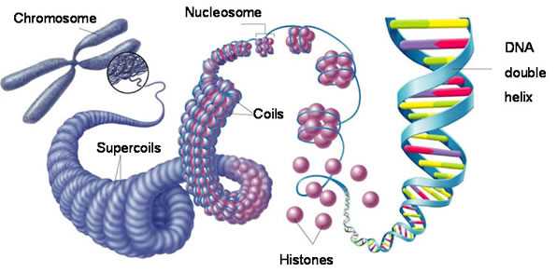
Compacting DNA into Chromosomes
DNA is tightly coiled around proteins called histones

Slide 9
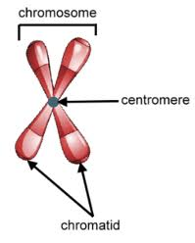
Chromosomes in Dividing Cells
Duplicated chromosomes are called chromatids & are held together by the centromere
Called Sister Chromatids

Slide 10
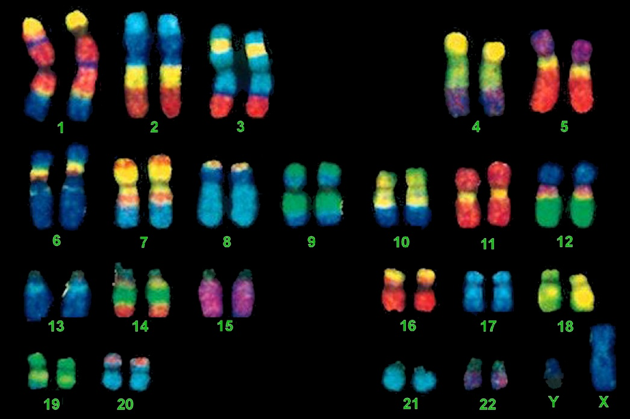
Karyotype
A picture of the chromosomes from a human cell arranged in pairs by size
First 22 pairs are called autosomes
Last pair are the sex chromosomes
XX female or XY male

Slide 11
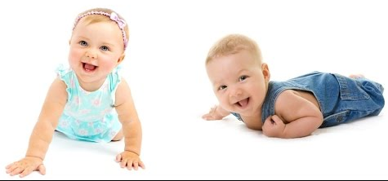
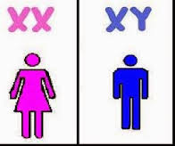
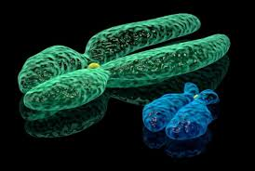
Boy or Girl?
The Y Chromosome Decides
X - Chromosome
Y - Chromosome

Slide 12
Aging
All cells die after a certain number of divisions (programmed cell death-”apoptosis”). At any given time some cells are dividing and some cells are dying
Childhood Cell division > cell death
Adulthood Cell division = cell death
Aging Cell division < cell death

Slide 13
Cell Reproduction

Slide 14
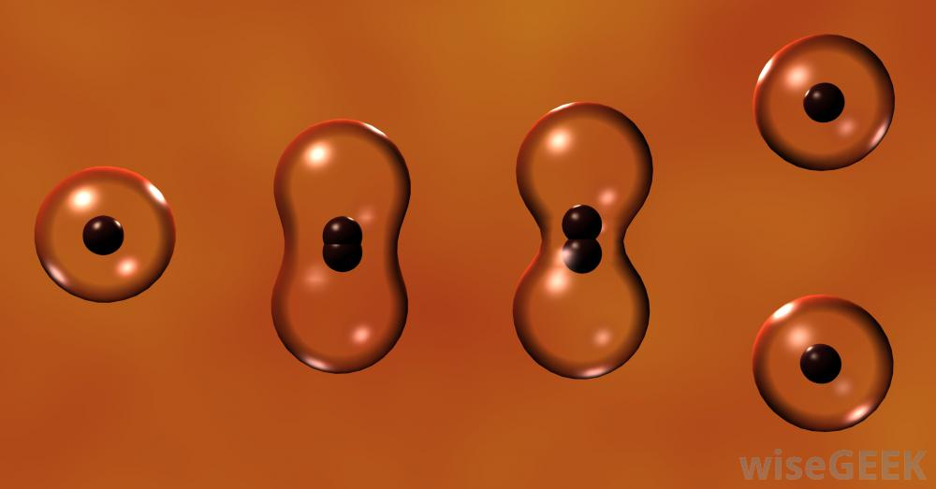
Cell Division in Prokaryotes

Slide 15
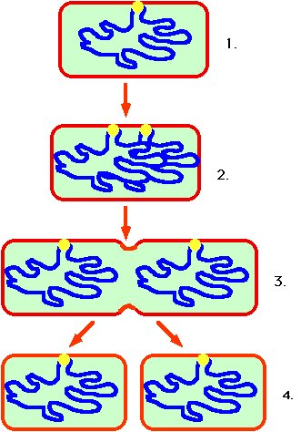
Cell Division in Prokaryotes
Prokaryotes such as bacteria divide into 2 identical cells by the process of binary fission
Single chromosome makes a copy of itself
Cell wall forms between the chromosomes dividing the cell
Parent cell
Chromosome replicates
Cell splits
2 identical daughter cells

Slide 16
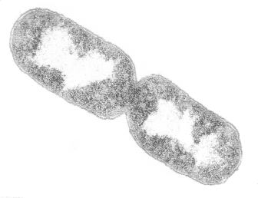
Prokaryotic Cell Undergoing Binary Fission

Slide 17
The Cell Cycle

Slide 18
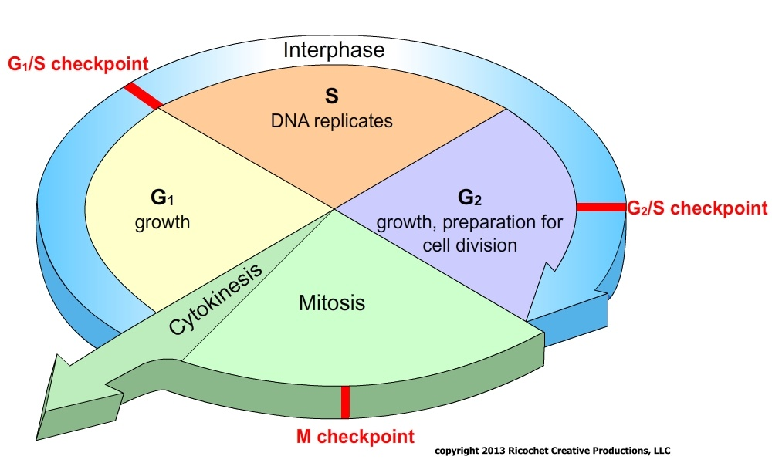
Five Phases of the Cell Cycle
G1 - primary growth phase
S – synthesis; DNA replicated
G2 - secondary growth phase
  collectively these 3 stages are called interphase
M - mitosis
C - cytokinesis
Interphase ~ 90% of the time.

Slide 19
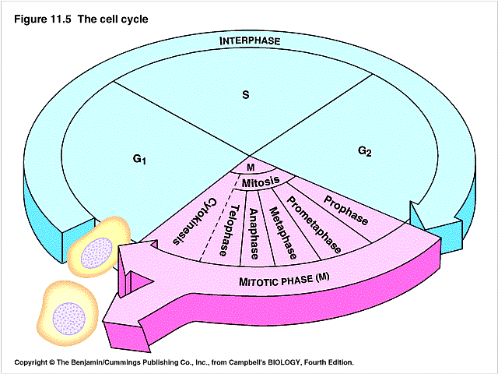
Mitosis
Division of somatic cells (body cells)
  (non reproductive cells) in eukaryotic organisms
  A single cell divides into two identical daughter cells (cellular reproduction)
  Maintains chromosome ploidy of cell
Ploidy – refers to the number of pairs of chromosomes in cells
  Haploid – one copy of each chromosome – designated as “n”
  Diploid – two copies (pair) of each chromosome – designated as “2n”

Slide 20
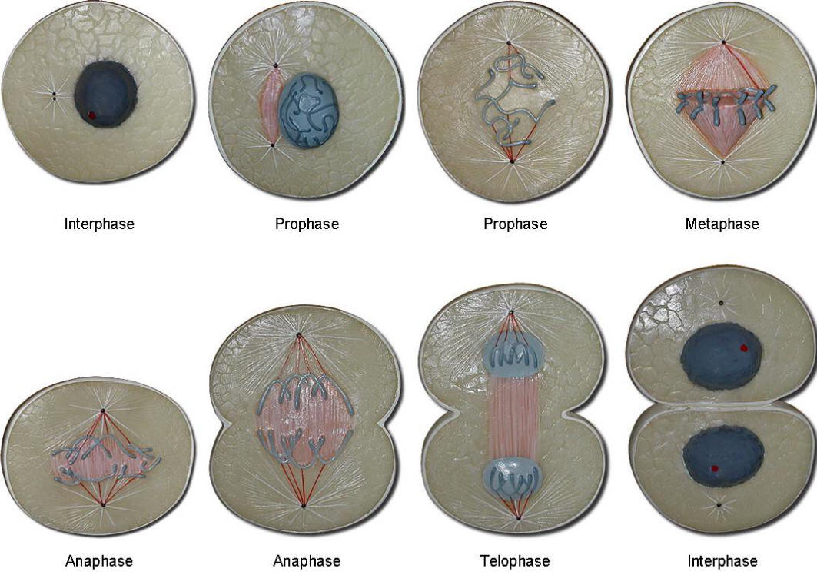
Mitosis
Division of the nucleus
Also called karyokinesis
Only occurs in eukaryotes
Has four stages
Doesn’t occur in some cells such as brain cells

Slide 21
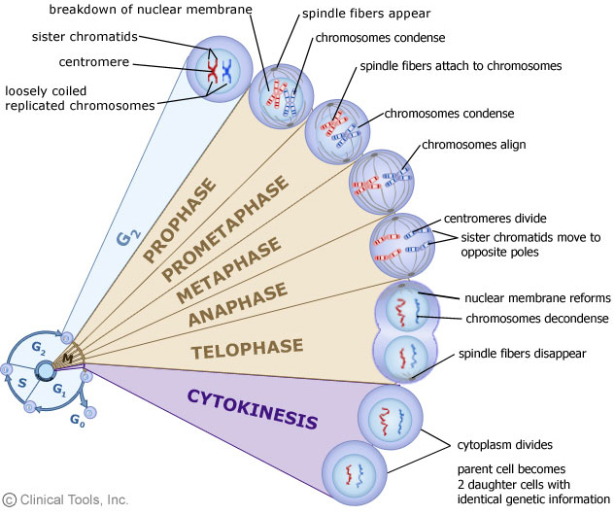
Four Mitotic Stages
Prophase
Metaphase
Anaphase
Telophase

Slide 22
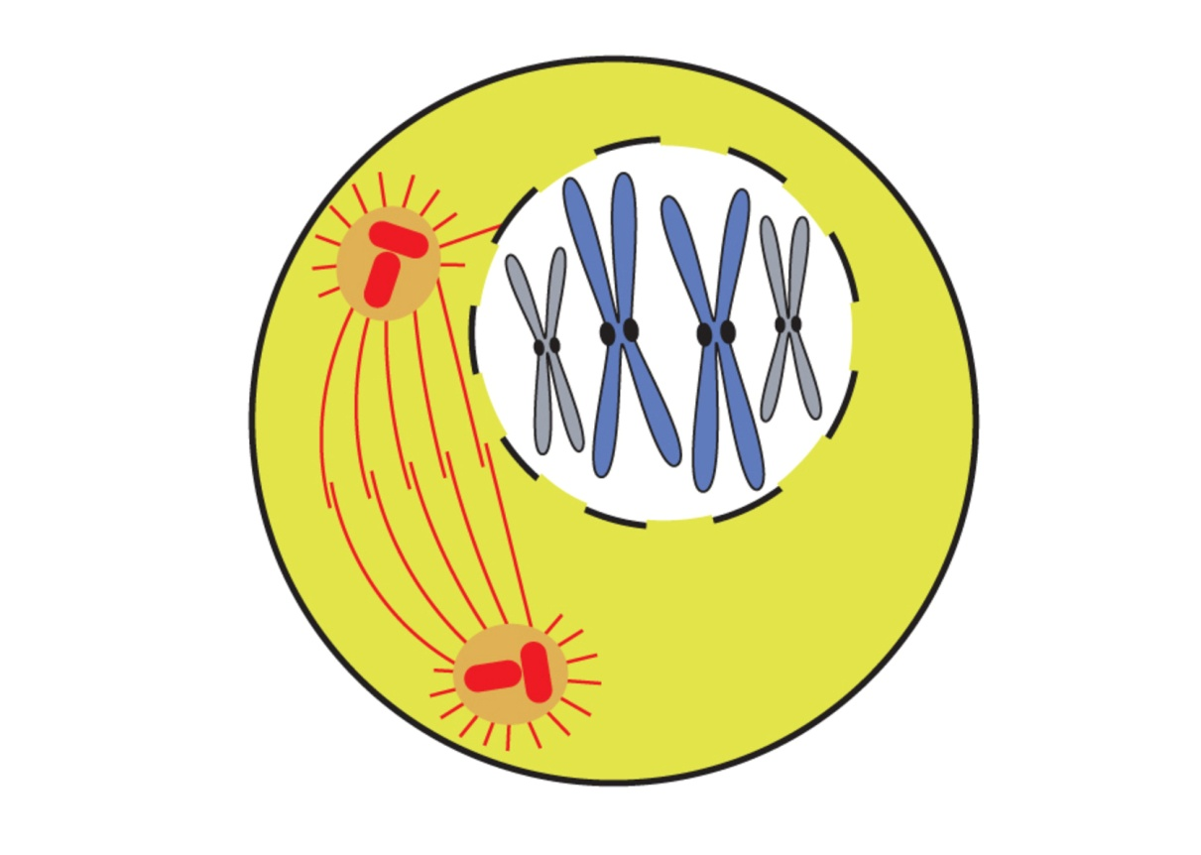
Prophase
Chromatin condenses (coils) into chromosomes.
Sister chromatids joined by centromere.
Nuclear membrane dissolves.
Centrioles divide and move to opposite poles forming
spindle between them.
Notes:
Prophase
Prophase occupies over half of mitosis. The nuclear membrane breaks down to form a number of small vesicles and the nucleolus disintegrates. A structure known as the centrosome duplicates itself to form two daughter centrosomes that migrate to opposite ends of the cell. The centrosomes organise the production of microtubules that form the spindle fibres that constitute the mitotic spindle. The chromosomes condense into compact structures. Each replicated chromosome can now be seen to consist of two identical chromatids (or sister chromatids) held together by a structure known as the centromere.

Slide 23
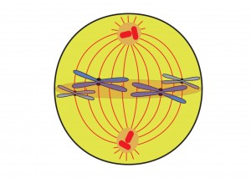
Metaphase…
Sister chromatids line up on metaphase plate.
Centromeres lock on to spindle fibre
Notes:
Prometaphase
The chromosomes, led by their centromeres, migrate to the equatorial plane in the mid-line of the cell - at right-angles to the axis formed by the centrosomes. This region of the mitotic spindle is known as the metaphase plate. The spindle fibres bind to a structure associated with the centromere of each chromosome called a kinetochore. Individual spindle fibres bind to a kinetochore structure on each side of the centromere. The chromosomes continue to condense.
Metaphase
The chromosomes align themselves along the metaphase plate of the spindle apparatus.

Slide 24
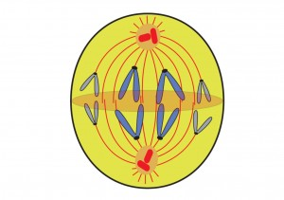
Anaphase…
Centromeres divide.
Spindle fibres contract pulling sister chromatids apart to poles
Notes:
Anaphase
The shortest stage of mitosis. The centromeres divide, and the sister chromatids of each chromosome are pulled apart - or 'disjoin' - and move to the opposite ends of the cell, pulled by spindle fibres attached to the kinetochore regions. The separated sister chromatids are now referred to as daughter chromosomes. (It is the alignment and separation in metaphase and anaphase that is important in ensuring that each daughter cell receives a copy of every chromosome.)

Slide 25
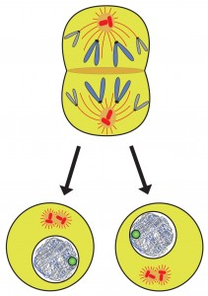
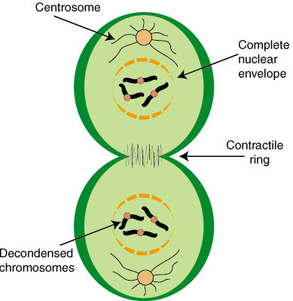
Telophase…
New nuclear membranes form around new nuclei
Notes:
Telophase
The final stage of mitosis, and a reversal of many of the processes observed during prophase. The nuclear membrane reforms around the chromosomes grouped at either pole of the cell, the chromosomes uncoil and become diffuse, and the spindle fibres disappear.

Slide 26
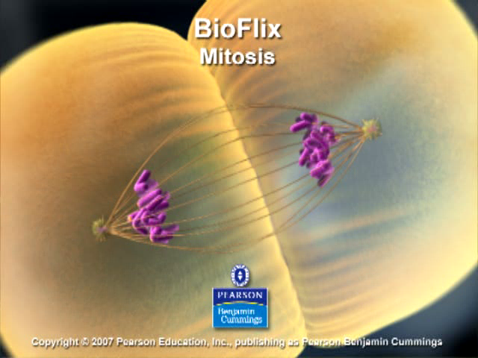
Mitosis
Mitosis
Prophase
Metaphase
Anaphase
Telophase
Notes:
https://www.youtube.com/watch?v=DwAFZb8juMQ

Slide 27
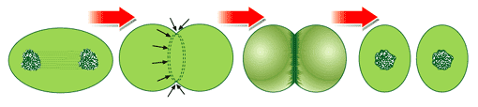
CYTO KINESIS – Cytoplasm splits into 2 cells.
-Animal cells: Cleavage furrow forms from outside in.
-
Notes:
Cytokinesis
The final cellular division to form two new cells. In plants a cell plate forms along the line of the metaphase plate; in animals there is a constriction of the cytoplasm. The cell then enters interphase - the interval between mitotic divisions.

Slide 28
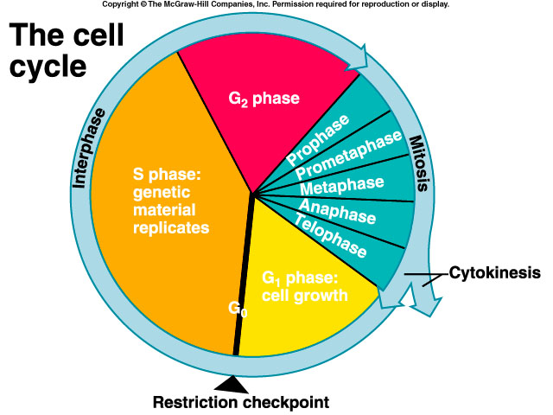
Cell cycle
Cell now returns to interphase .
The chromosomes uncoil back into chromatin.
The whole cell cycle starts over again…..
Notes:
http://www.cellsalive.com/mitosis.htm

Slide 29
Daughter Cells of Mitosis
Have the same number of chromosomes as each other and as the parent cell from which they were formed
Identical to each other, but smaller than parent cell
Must grow in size to become mature cells (G1 of Interphase)

Slide 30
Animation on cell cycle and mitosis
https://www.youtube.com/watch?v=woD6zvp-4E8

Slide 31
Meiosis
Formation of Gametes
(Eggs & Sperm)

Slide 32
Facts About Meiosis
Preceded by interphase which includes chromosome replication
Two meiotic divisions --- Meiosis I and Meiosis II
Called Reduction- division
Original cell is diploid (2n)
Four daughter cells produced that are monoploid (1n)

Slide 33
Facts About Meiosis
Daughter cells contain half the number of chromosomes as the original cell
Produces gametes (eggs & sperm)
Occurs in the testes in males (Spermatogenesis)
Occurs in the ovaries in females (Oogenesis)

Slide 34
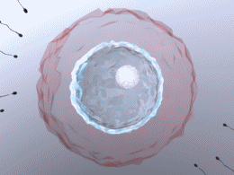
Why Do we Need Meiosis?
It is the fundamental basis of sexual reproduction
Two haploid (1n) gametes are brought together through fertilization to form a diploid (2n) zygote

Slide 35
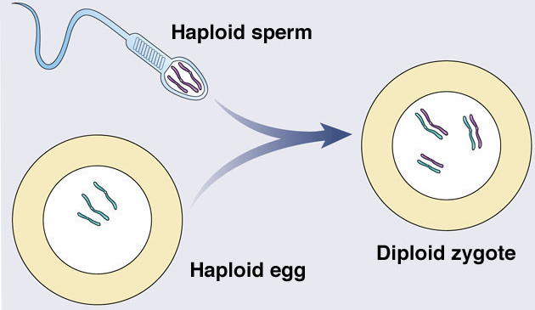
Fertilization – “Putting it all together”
2n = 6
1n =3

Slide 36
Meiosis Forms Haploid Gametes
Meiosis must reduce the chromosome number by half
Fertilization then restores the 2n number
from mom
from dad
child
too
much!
meiosis reduces
genetic content
The right number!

Slide 37
Process of Meiosis
Meiosis animation

Slide 38
Comparing Mitosis and Meiosis

Slide 39
Comparison of Divisions
 | Mitosis | Meiosis
Number of divisions | 1 | 2
Number of daughter cells | 2 | 4
Genetically identical? | Yes | No
Chromosome # | Same as parent | Half of parent
Where | Somatic cells | Germ cells
When | Throughout life | At sexual maturity
Role | Growth and repair | Sexual reproduction

Slide 40
Types of Cell Reproduction
Asexual reproduction:
Involves a single cell dividing to make 2 new, identical daughter cells
• Binary fission and budding are examples of asexual reproduction
Sexual reproduction
Involves two cells (egg & sperm) joining to make a new cell (zygote) that is NOT identical to the original cells.
Meiosis is an example

Slide 41
Asexual reproduction:
Binary Fission:
Binary fission is the simplest form and involves the division of a single organism into two complete organisms, each identical to the other and to the parent.
Fission is common among unicellular organisms such as bacteria, many protists, some algae such as Spirogyra and Euglena, as well as a few higher organisms such as flatworms and certain species of polychaete worms.

Slide 42
Asexual reproduction:
Regeneration:
A similar form of asexual reproduction is regeneration, in which an entire organism may be generated from a part of its parent.
The term regeneration normally refers to re-growth
of missing, or damaged body parts in higher organisms, but whole body regeneration occurs in
Hydra, starfish, and many plants.

Slide 43
Asexual reproduction:
Asexual Spore:
Spores are another form of asexual reproduction and are common among bacteria, protists, and fungi.
Spores are DNA-containing capsules capable of sprouting into new organisms; unlike most seeds, spores are produced without sexual union of gametes, that is, reproductive cells.

Slide 44
Asexual reproduction:
Budding:
Budding is another method of asexual reproduction in which a group of self-supportive cells sprouts from and then detaches from the parent organism.
Unlike eggs or spores, buds are multicellular and usually contain more than one cell layer.
Hydra and sea squirts reproduce by budding.

Slide 45
Asexual reproduction:
Vegetative Reproduction:
Vegetative reproduction is common among plants and consists of certain parts that grow out from a main parent plant and eventually root and sprout to form new, independent plants.
Examples are the runners of strawberries, the tubers of potatoes, and the bulbs of onions.
Parthenogenesis:
Parthenogenesis is an important means of asexual reproduction in which new individuals are formed from unfertilized eggs.
It occurs in some insects, amphibians, reptiles, and birds and in some species of plants.

