Slide 1
BIOLOGY 1
BIO 103
Cell Structure and Function
  Organelles description

Slide 2
CELL STRUCTURE AND FUNCTION
Cells
A cell is the smallest unit of life.
Cells can survive and reproduce on its own.
Some cells live and reproduce independently. Others do so as part of a multicelled organism.
Discovery of cells
In the middle of the 17th century, one of the pioneers of microscopy, Robert Hooke (1635–1703), decided to examine a piece of cork tissue with his home-built microscope. He saw numerous box shaped structures that he thought resembled row of empty boxes or rooms, so he called them ‘cells’.

Slide 3
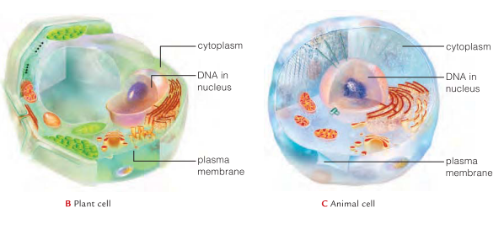
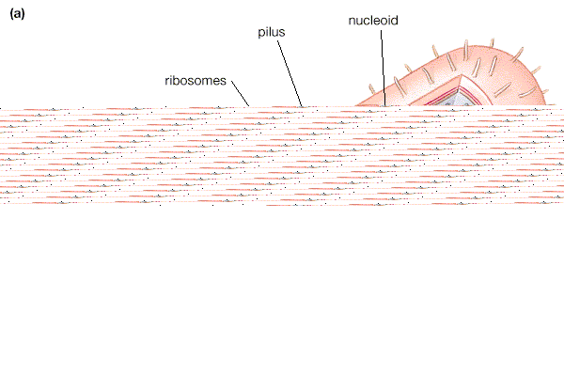
THE CELL THEORY
  Every organism is composed of one or more cells
  Cell is the smallest unit having properties of life
  Continuity of life arises from growth and division of single cells.
CELL TYPES
Biologists have categorized cells into two general types:
Eukaryotic Cells
Prokaryotic Cells

Slide 4
PROKARYOTIC AND EUKARYOTIC CELL
Prokaryote
Usually unicellular
No True Nucleus
Organelles absent
Smaller ribosomes
Example: bacteria, Archaea.
Eukaryote
Usually multicellular
Membrane bound nucleus
Organelles present
Larger ribosomes
Example: animal, plant, fungi, algae.
More differences from handout

Slide 5
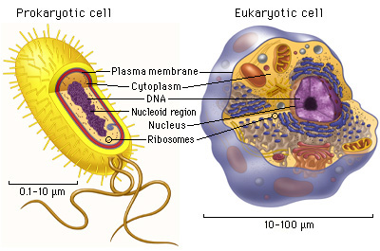
PROKARYOTIC AND EUKARYOTIC CELL

Slide 6
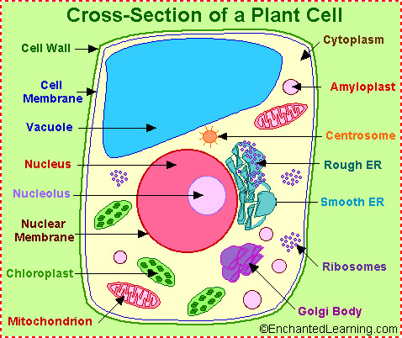
DRAW BY YOURSELF….
Can you find the difference between animal and plant cell?

Slide 7
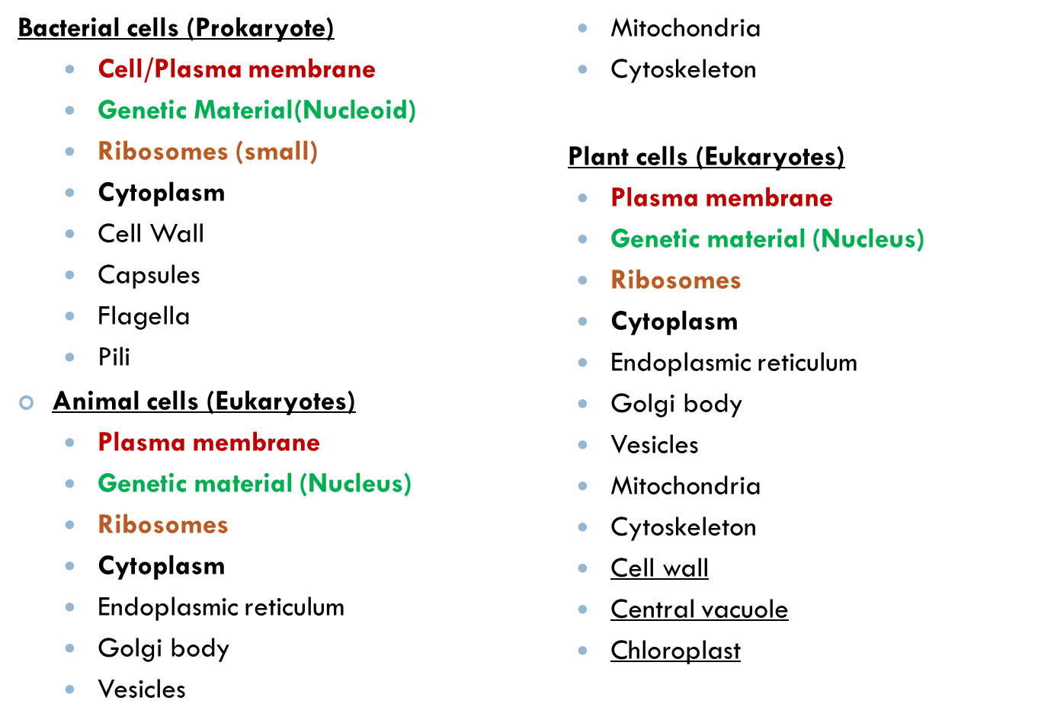
CELL STRUCTURE
Unique
to plants

Slide 9
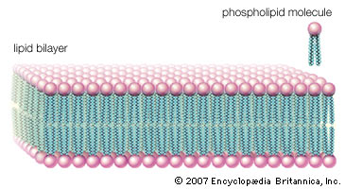
STRUCTURE COMMON TO ALL CELLS:
PLASMA MEMBRANE
The plasma membrane is the boundary between the cell and its environment.
It isolates the cell, regulates what enters and leaves the cell.
It allows interaction with other cells. It comprises of lipids and proteins.
Lipid Bilayer
Lipids—mainly phospholipids—make up the bulk of a cell membrane.
A phospholipid consists of a phosphate containing head and two fatty acid tails. The polar head is hydrophilic, which means that it interacts with water molecules. The nonpolar tails are hydrophobic, so they do not interact with water molecules, but they do interact with the tails of other phospholipids.
Lipid bilayers are the basic structural and functional framework of all cell membranes, gives membrane it's fluidity

Slide 10
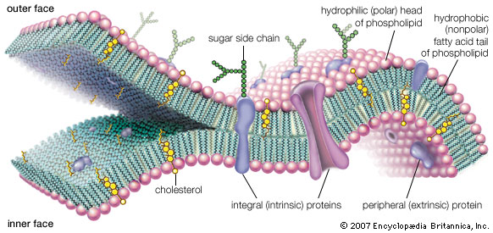
FUNCTIONS OF PLASMA MEMBRANE
A cell must exchange materials with its surroundings, a process controlled by the plasma membrane
Plasma membranes are selectively permeable, regulating the cell’s molecular traffic.
Hydrophobic (nonpolar) molecules, such as hydrocarbons, can dissolve in the lipid bilayer and pass through the membrane rapidly.

Slide 11
STRUCTURE COMMON TO ALL CELLS:
EUKARYOTIC CELL: NUCLEUS
The nucleus is the defining organelle of eukaryotic cells.
The nucleus is separated from the cytoplasm by a double membrane (two phospholipid bilayers); known as the nuclear envelope.
The nuclear envelope controls the passage of molecules between the nucleus and cytoplasm.
The nucleus contains the DNA, the stored genetic instructions of each cell. In addition, important reactions for interpreting the genetic instructions occur in the nucleus.
In the nucleus, DNA is organized into discrete units called chromosomes
Each chromosome is composed of a single DNA molecule associated with proteins

Slide 12
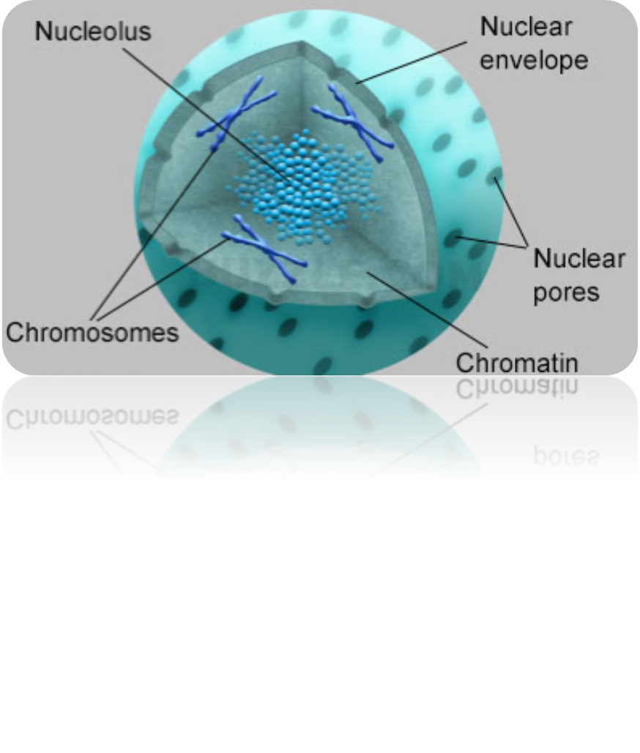
Structure – Nucleus

Slide 13
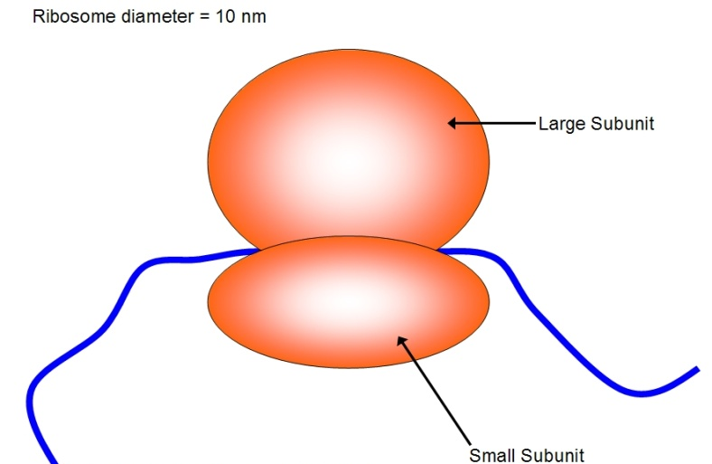
STRUCTURE COMMON TO ALL CELLS: RIBOSOMES
Ribosomes are non-membranous organelles responsible for the synthesis of proteins from amino acids.
They are composed of RNA and protein.
Each ribosome is composed of two subunits—a large one and a small one.
Two types:
  Bound ribosomes: Many ribosomes are attached to the endoplasmic reticulum. Areas of rough ER are active sites of protein production.
  Free ribosomes: Many ribosomes are also found floating freely in the cytoplasm wherever proteins are being assembled. Cells that are actively producing protein (e.g., liver cells) have great numbers of free and attached ribosomes.

Slide 14
STRUCTURE COMMON TO ALL CELLS: CYTOPLASM
In prokaryotes, cytoplasm inside the membrane is a jelly-like substance comprises of water, enzymes and some proteins. It also contains the genetic material.
In eukaryotes, the cytoplasm is a network of fibers that organizes structures and activities in the cell and known as cytoskeleton.
Between the nucleus and plasma membrane of all eukaryotic cells is a system of interconnected protein filaments collectively called the cytoskeleton.
The cytoskeleton is a network of fibers extending throughout the cytoplasm. Elements of the cytoskeleton reinforce, organize, and move cell structures, anchoring many organelles.

Slide 15
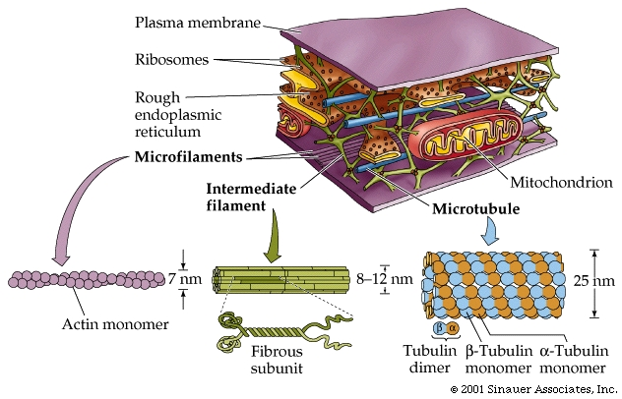
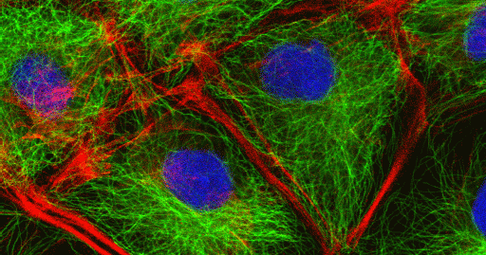

Slide 16
COMPONENTS OF CYTOMEMBRANE SYSTEM- ENDOPLASMIC RETICULUM
Part of the cytomembrane system is an extension of the nuclear envelope called endoplasmic reticulum, or ER.
ER forms a continuous compartment that folds into flattened sacs and tubes.
The space inside the compartment is the site where many new polypeptide chains are modified.
Two kinds of ER:
Rough ER
Ribosomes on surface give it a rough appearance
Some polypeptide chains enter rough ER and are modified
Cells that specialize in secreting proteins have lots of rough ER
Smooth ER
No ribosomes on surface
Lipids assemble

Slide 17
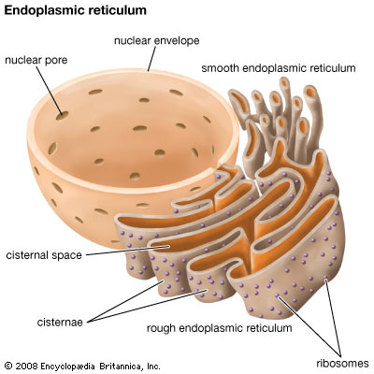
Functions of ER
The smooth ER
Synthesizes lipids
Metabolizes carbohydrates
Detoxifies drugs and poisons
Stores calcium ions
The rough ER
Has bound ribosomes
Distributes transport vesicles, proteins surrounded by membranes
Is a membrane factory for the cell

Slide 18
COMPONENTS OF CYTOMEMBRANE SYSTEM- GOLGI BODIES
The Golgi is a series of flattened membrane compartments, whose purpose is to process and package proteins produced in-the rough endoplasmic reticulum.
The processed molecules are packaged into membrane vesicles, then targeted and transported to their final destinations.
Functions of the Golgi apparatus
Modifies products of the ER
Manufactures certain macromolecules
Sorts and packages materials into transport vesicles.

Slide 19
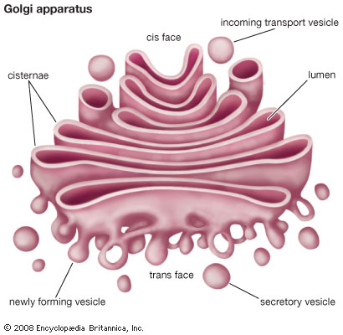

Slide 20
COMPONENTS OF CYTOMEMBRANE SYSTEM- VESICLES
Small, membrane-enclosed, saclike vesicles form in great numbers, in a variety of types, either on their own or by budding. There are many types but two main are:
i) Lysosomes: Digestion & recycling centers
That bud from Golgi bodies take part in intracellular digestion.
They contain powerful enzymes that can break down carbohydrates, proteins, nucleic acids, and lipids.
The enzymes work best in the acidic environment inside the lysosome.
Lysosomes break down worn out cell parts or molecules so they can be used to build new cellular structures

Slide 21
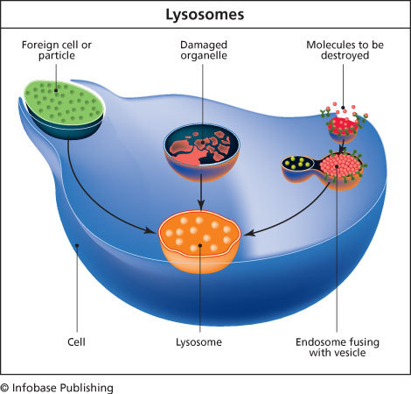
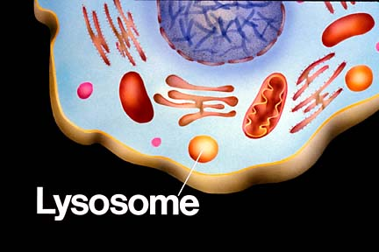

Slide 22
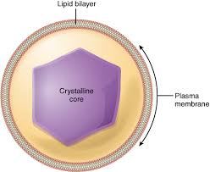
COMPONENTS OF CYTOMEMBRANE SYSTEM- VESICLES
ii) Peroxisomes:
In plants and animals, vesicles called peroxisomes.
Peroxisomes contain enzymes that digest fatty acids and amino acids.
Peroxisome enzymes convert hydrogen peroxide to water and oxygen, or use it in reactions that break down alcohol and other toxins.

Slide 23
ENERGY RELATED ORGANELLES: MITOCHONDRIA
The mitochondrion (plural, mitochondria) is a type of organelle that specializes in making ATP (molecule used by cells as main energy source).
They have various enzymes to catalyze cellular respiration.
Cells that have a very high demand for energy tend to have many mitochondria e.g. liver needs more because needs more energy.
Mitochondria, like most organelles, can move within the cell and they grow and divide independently.

Slide 24
Mitochondria structure
Double membrane system:
Smooth outer membrane facing cytoplasm
Inner membrane (cristae) where chemical reactions to make ATP takes place.

Slide 25
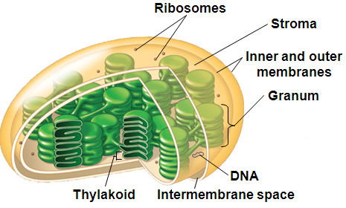
ENERGY RELATED ORGANELLE:
CHLOROPLAST
Plastids are a category of membrane-enclosed organelles that function in photosynthesis or storage in plant and algal cells.
Plastids called chloroplasts are organelles specialized for photosynthesis which contain the green pigment chlorophyll, as well as enzymes and other molecules that function in photosynthesis.

Slide 26
ENERGY RELATED ORGANELLE:
CHLOROPLAST
Chloroplast structure includes
Stroma: Each has two outer membranes enclosing a semifluid interior, the stroma, that contains enzymes and the chloroplast‘s own
DNA.
Thylakoids: Inside the stroma, a third, highly folded membrane forms a single, continuous compartment (Thylakoid membrane) which resembles stacks of flattened disks and the disks are called grana (singular, granum).
  By the process of photosynthesis, chlorophylls and other molecules in the thylakoid membrane harness the energy in sunlight to drive the synthesis of ATP. The ATP is then used inside the stroma to build carbohydrates from carbon dioxide and water.

Slide 27
ENERGY RELATED ORGANELLE:
MITOCHONDRIA & CHLOROPLAST
Mitochondria and chloroplasts have similarities with bacteria:
  Double membrane envelope
  Free ribosome and circular DNA
  Independent growth and reproduction
They may have evolved from ancient bacteria that were engulfed but not digested.
Mitochondria and chloroplasts developed because as a prokaryote it gained protection by living inside the eukaryote and in turn produced energy for the eukaryote (symbiotic relationship).

Slide 28
LOCOMOTOR APPENDAGES:
CILIA & FLAGELLA
Cilia – Cilia (singular, cilium) are short, hair-like structures that project from the surface of some cells. Mainly found in eukaryotic cells.
  The coordinated waving of many cilia propels cells through fluid, and stirs fluid around stationary cells.
Flagella –Flagella are long hair-like structure and present in both prokaryotic and eukaryotic cells.
  In prokaryotes flagellum projects from the cell wall and enables a cell to move. In eukaryotes, flagellum structure is different from the prokaryotic cells and whip back and forth to propel cells such as sperm through fluid. They have a different internal structure and type of motion than flagella of bacteria.

Slide 29
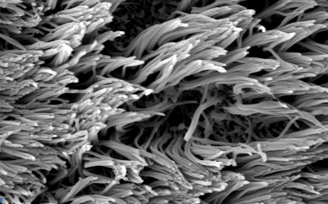
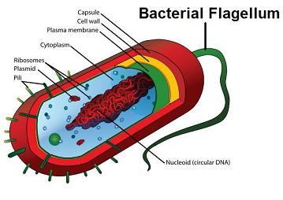
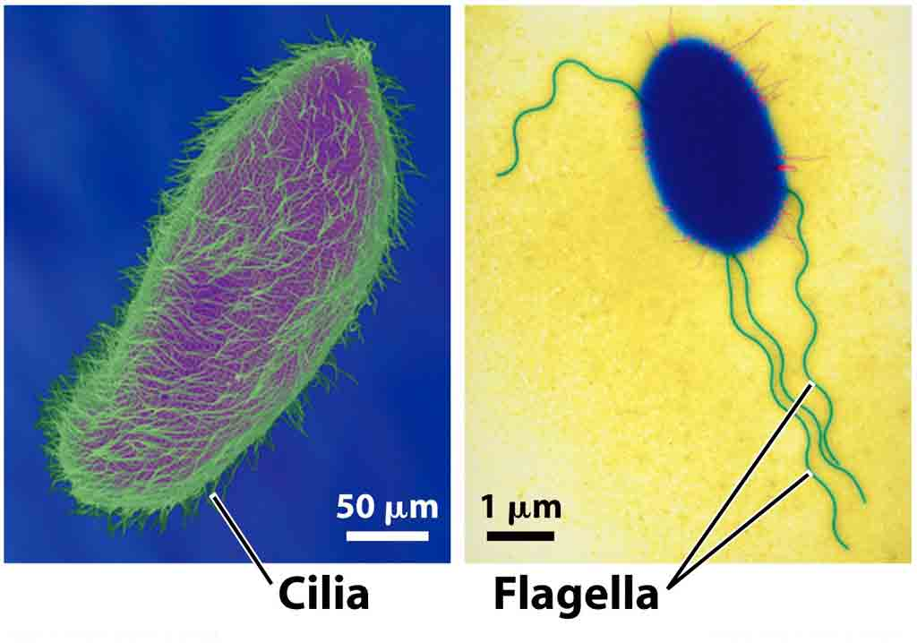
Cilia

Slide 30

THANK YOU

