Slide 1
Central Dogma of life
Transcription and Translation
Prof. Dr. Md. Mahbubul Morshed

Slide 2
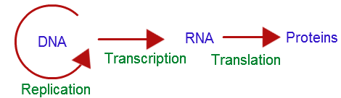
Central Dogma of life
The information content of DNA is in the form of specific sequences of nucleotides
The DNA inherited by an organism leads to specific traits by dictating the synthesis of proteins
Gene expression, the process by which DNA directs protein synthesis, includes two stages: transcription and translation
Genes specify proteins via transcription and translation
The central dogma of biology describes the flow of information from gene sequence to protein product

Slide 3
An Analogy
When you get to the library, you search through the shelves until you find a book that has a good set of instructions for making a table.
The library doesn't have a photocopier, but you came well-prepared and you whip out your pen and notebook and copy down (or 'transcribe') the instructions.
Satisfied, you take your notes and head back home.
At home, you have all the wood and tools to make the table.
You follow the instructions and make the table, effectively 'translating' the written words into a table which you can use in your room.

Slide 4
An Analogy
Library = Nucleus
Books in the library = DNA in the form of chromosome
One chapter = One gene ( contains instruction for one type of protein)
Notebook = Represents RNA, which is a smaller molecule that can move out of the nucleus into the cytoplasm, where proteins are made
Home = Cytoplasm
Table = One protein product
Wood to make the table = amino acids for building proteins

Slide 5
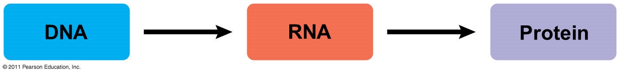
Basic Principles of Transcription and Translation
RNA is the bridge between genes and the proteins for which they code
Transcription is the synthesis of RNA using information in DNA
  Transcription produces messenger RNA (mRNA)
Translation is the synthesis of a polypeptide, using information in the mRNA
  Ribosomes are the sites of translation

Slide 6
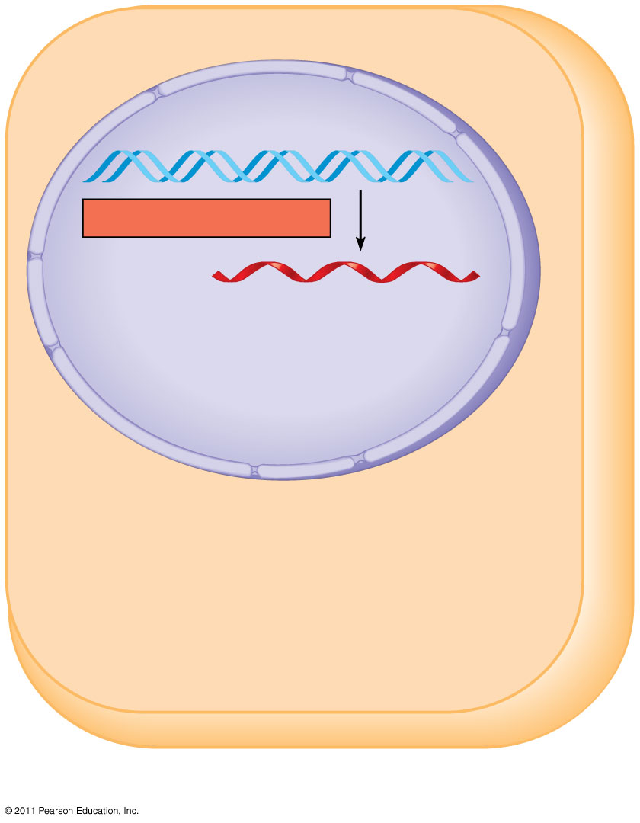
Nuclear
envelope
DNA
TRANSCRIPTION
Pre-mRNA
(b) Eukaryotic cell
Notes:
Figure 17.3 Overview: the roles of transcription and translation in the flow of genetic information.

Slide 7
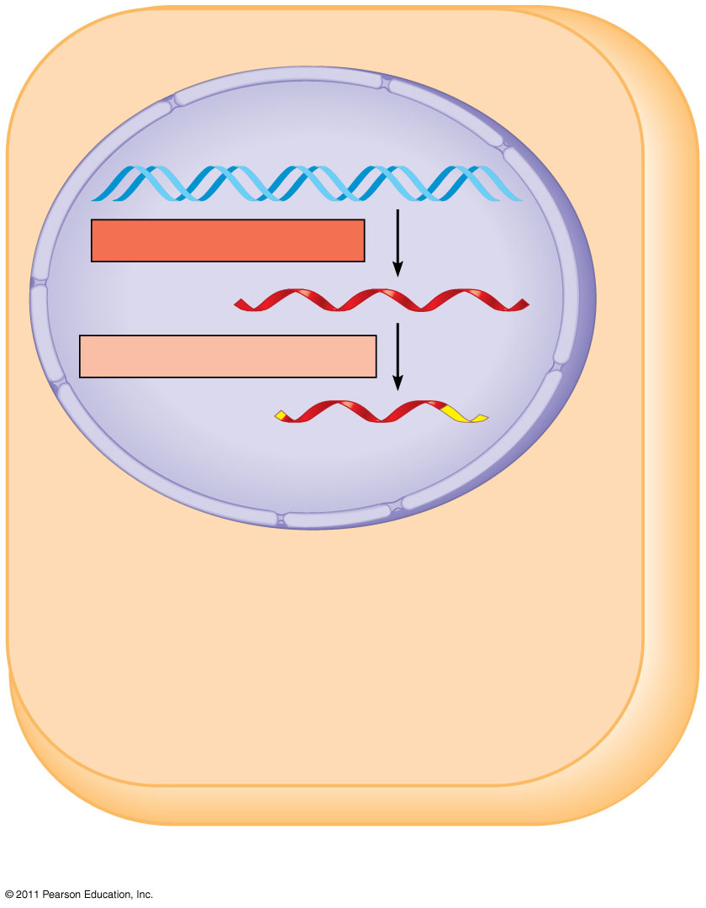
Nuclear
envelope
DNA
TRANSCRIPTION
Pre-mRNA
RNA PROCESSING
mRNA
(b) Eukaryotic cell
Notes:
Figure 17.3 Overview: the roles of transcription and translation in the flow of genetic information.

Slide 8
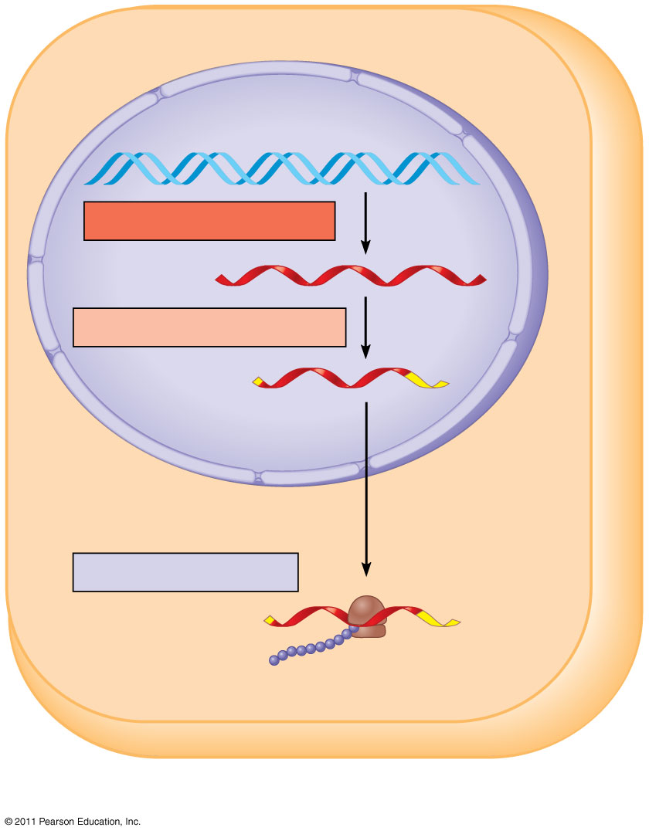
Nuclear
envelope
DNA
TRANSCRIPTION
Pre-mRNA
RNA PROCESSING
mRNA
TRANSLATION
Ribosome
Polypeptide
(b) Eukaryotic cell
Notes:
Figure 17.3 Overview: the roles of transcription and translation in the flow of genetic information.

Slide 9
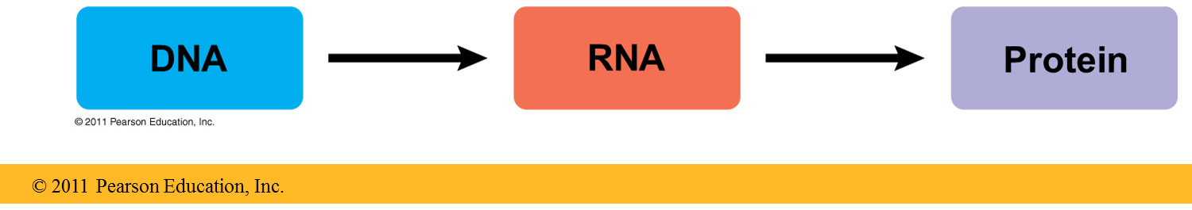
Transcription
DNA sequence information is converted to mRNA in a process called transcription
Steps:
1. The double-stranded DNA molecule is partially unzipped
An enzyme called RNA polymerase copies the gene's nucleotides one by one into an mRNA molecule.
  Like DNA, mRNA is made of a particular sequence of nucleotides
  Unlike DNA, mRNA has only a single strand, and the base Thymine in DNA is replaced by Uracil in RNA
  Very importantly, mRNA is small and can easily exit the nucleus and go to the cytoplasm, where proteins are made.
RNA Polymerase
Notes:
Back to our analogy: it's very easy to carry your notes home from the library. You wouldn't want to have to build your table there in the library, and you certainly wouldn't want to take the library's entire permanent collection of books to your house! Transcription of DNA to RNA just makes sense.

Slide 10
Translation
The sequence encoded in the mRNA molecule is decoded and converted to an amino acid sequence in a process called translation.
Steps:
After a mature mRNA leaves the nucleus of a cell, it heads for a ribosome in the cell’s cytoplasm where the code it contains can be translated to produce a protein
As the strand of mRNA slides through the ribosome, the code is read three nucleotides at a time (called a codon).
Each codon specifies one amino acid in the polypeptide chain of a protein which are linked together to form a protein.

Slide 11
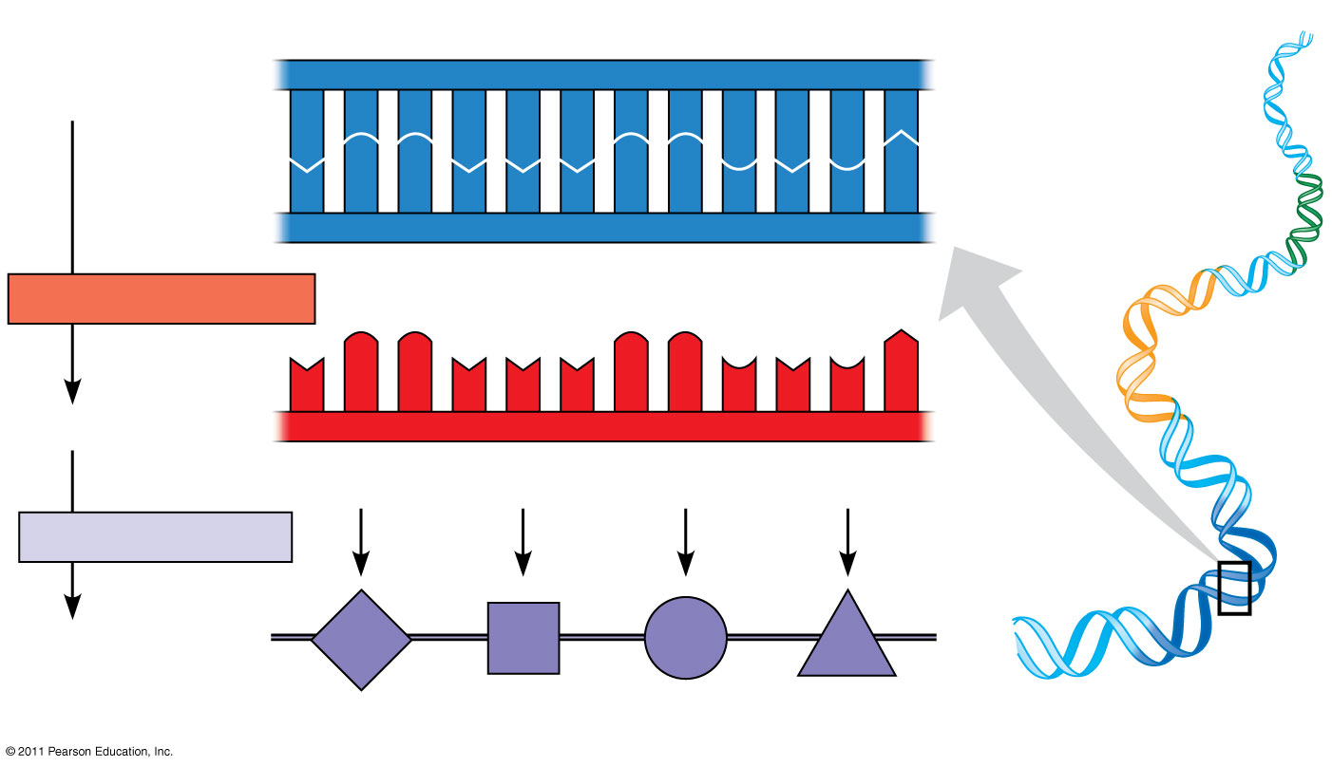
DNA
template
strand
3′
5′
DNA
A
C
C
A
A
A
C
C
G
A
G
T
molecule
T
G
G
T
T
T
G
G
C
T
C
A
Gene 1
5′
3′
TRANSCRIPTION
Gene 2
U
G
G
U
U
U
G
G
C
U
C
A
5′
3′
mRNA
Codon
TRANSLATION
Protein
Trp
Phe
Gly
Ser
Gene 3
Amino acid
11

Slide 12
Comparison between translation and transcription
 | Transcription | Translation
Purpose | To make RNA copies of individual genes | To synthesize proteins which are used for cellular functions
Definition | Transcription is the synthesis of RNA from a DNA template. | Translation is the synthesis of a protein from an mRNA template. i.e., translating the DNA genetic information carried by mRNA to synthesize proteins. This is the second step of gene expression.
Products | mRNA | Proteins
Location | Nucleus | Cytoplasm
https://www.youtube.com/watch?v=zwibgNGe4aY

