Slide 1
Classification of Living Things
Prof. Dr. Md. Mahbubul Morshed

Slide 2
Take Home points
What is classification
Early biological classification
Modern biological classification
Binomial nomenclature
The genus and species concept
Why use scientific names
The main classification groups (Taxa)
Various classification system
Phylogenetic system

Slide 3
Classification of Living Things
Over two million (2,000,000) different kinds of organisms exists
1.5 million (1,500,000) different kinds have been identified
It has been estimated that for each kind of organism now alive, another 400 kinds once lived but have since become extinct.
One billion (1,000,000,000) different kinds of living things may have existed on the earth at one time or another.
Notes:
Biologists believe that there may be over two million (2,000,000) different kinds of organisms. Already over 1.5 million (1,500,000) different kinds have been identified and new ones are still being discovered. One biologist estimates that for each kind of organism now alive, another 400 kinds once lived but have since become extinct. Therefore, as many as one billion (1,000,000,000) different kinds of living things may have existed on the earth at one time or another.
How ca we keep track of such a bewildering number of organisms? How can we even name the organisms now alive when no known language has two million words in it? Biologists have answers to these questions.

Slide 4
What is Classification?
  Supermarket manager
  Stamp collectors
  Word listings in a dictionary
The grouping of similar things for a
specific purpose is called
classification
Early Biological Classification
Modern Biological Classification
Notes:
What is Classification?
Whenever we work with a large number and variety of things, we usually sort them into groups. Each group contains those things that are similar to one another. We may then separate each of those groups into smaller groups that are even more alike.
The grouping of similar things for a specific purpose is called classification. Although it may be instinctive for human to classify things, there are also practical reasons for doing this. For example, a supermarket manager classifies the foods in his/her store by storing all the cereals together, all the meats together, all the cookies together, and so on. Stamp collectors classify their stamps. They place all the Canadian stamps in one page and all the American stamps in another. The words in a dictionary are classified by alphabetical listings. Clearly, we classify things to make it easier to keep track of what we have, and to find particular items.

Slide 5
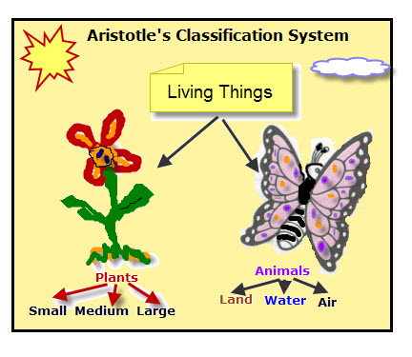
Early Biological Classification
How Earliest Humans classify living things
  Plant Vs Animals or Edible Vs Poisonous Plants or Harmful Vs Harmless animals
300 BC, Aristotle’s Classification System
  Only about 1000 kinds of organisms were known
  This classification system
  survived almost 2000 years
  By the beginning of the 18th century, over 10,000 kinds of organisms were known and Aristotle’s system was unable to classify them all.
  A new system was obviously needed.
Notes:
Early Biological Classification
Biologists have long recognized the need to classify living things. In fact, humans have been classifying living things for thousands of years. The earliest humans probably classified organisms as plants and animals. They may have further classified plants as edible or poisonous, and the animals as harmful or harmless. However, it was 300 BC before the first serious attempt was made to classify all the organisms known. This attempt was made by the Greek philosopher and scientist, Aristotle and his students.
Aristotle’s Classification System
Since only about 1000 kinds of organisms were known at that time, a very simple classification scheme could be used. Aristotle and his students first classified the organisms as plant or animal. They then classified the animals according to where they lived. This resulted in three groupings: air animals, water animals, and land animals. They classified the plants according to the structure of stems. Those with soft stems were called herbs; those with a single woody stem were called trees; and those with many small woody stems were called shrubs.
Aristotle’s classification system survived for almost two thousand years. However, by the beginning of the 18th century, over 10,000 kinds of organisms were known and Aristotle’s system was unable to classify them all. Many of newly discovered organisms would not fit into any category of Aristotle’s simple system. A new system was obviously needed.

Slide 6
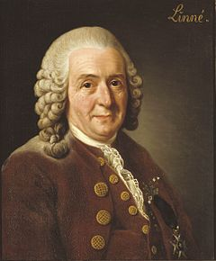
Modern Biological Classification
Taxonomy: Taxonomy is the science that deals with the classification of organisms.
The Contribution of Carolus Linnaeus
  Diversity: the number of kinds of living things.
Linnaeus grouped organisms according
to their structural similarities
  Organisms with very similar structural features were considered to be the same species
Thus all modern-day humans belong to one species, all house cats belong to one species, and all sugar maple trees belong to one species.
Notes:
Modern Biological Classification
Taxonomy
Taxonomy is the science that deals with the classification of organisms.
The Contribution of Carolus Linnaeus
Carolus Linnaeus, a Swedish botanist, developed a simple classification system that forms the basis of our modern method of classification. At the start of the 18th century about 10,000 kinds of organisms were known. By the end of that century over 70,000 kinds were known. Linnaeus tried to develop a classification system for this large number of organisms. By 1753 his system was well developed and modern taxonomy began.
The Basis for Linnaeus Classification
Biologists use the word diversity to mean differences, or the number of kinds of living things.
There seem to be so many kinds of living things and they seem to be so different from one another. Yet, if we study them closely, we can see many likenesses. For example, at first glance lions, horses, humans, and mice seem to have little in common. A closer look however, shows that all have hair, a distinct head, four limbs, two ears, and warm blood. That is, they have similar structural features.
Linnaeus decided to use structural features as the basis for his classification system. Therefore, he grouped organisms according to their structural similarities. These organisms with very similar structural features were considered to be the same species. Thus all modern-day humans belong to one species, all house cats belong to one species, and all sugar maple trees belong to one species.

Slide 7
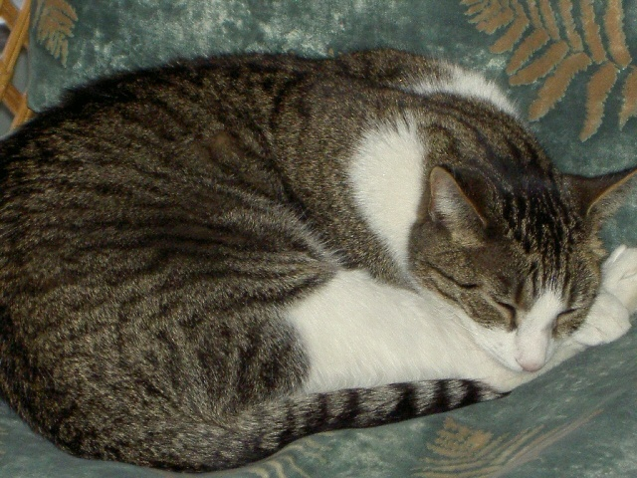
Binomial nomenclature
After classifying, Linnaeus decided to name all the organism.
Every organism’s name is consist of
two words→ Binomial Nomenclature
He decided to write all names in Latin.
Example: Common name: Human
Scientific name:
Homo sapiens (Italic if printed)
Homo sapiens (separate underlines if
handwritten)
Common name: Cat
        Scientific name: Felis domesticus

Slide 8
Genus and species concept
Homo sapiens
Genus
Species
Group of species that are similar.
Plural is ‘genera’.
Example: Maple trees are from genus Acer. So,
Sugar maple: Acer saccharum
Silver maple: Acer saccharinum
Red maple: Acer rubrum
etc.
Organisms that are structurally very similar.
Plural is also ‘species’
Interbreed under natural condition to produce fertile offspring (children) .
Example:
Red maple: Acer rubrum
Notes:
The Genus Concept
A genus (plural genera) groups species that are similar. For example, humans belong to the genus Homo. Thus handy-man (have long hands) (Homo habilis ), upright man(H. ergaster ), and modern humans (H. sapiens) belong to the same genus Homo. Their structure are similar and other features are similar but not identical. Every genus has characteristics that make it stand out clearly from other living things.
The Species Concept
Linnaeus grouped as a species those organisms that he felt were very similar in structural features. In simple terms, a single species is a distinct kind of organism, with a characteristic shape, size, behaviour, and habitat that remains constant from year to year.
Potato (Solanum tuberosum) and the eggplant (Solanum melongena) belong to the same genus because they are similar in many ways. However, they belong to two different species because they are not identical and they have reproductive barrier, that is, they cannot mate (cross or breed) with one another to produce fertile offspring. The members within a species can mate or cross. Thus all varieties of potatoes are in the species because they can interbreed to produce fertile offspring
Modern definition of species
A species (plural also species) is defined as a group of individuals that are alike in many ways and interbreed under natural conditions to produce fertile offspring (children).

Slide 9
Why Use Scientific Names?
Common names can be confusing or misleading
  Felis concolor is called a cougar, mountain lion, puma, panther, painter, and many names
  Domestic cow is
      “la vache” in French,
      ‘die Kuh” in German,
      “la vaca” in Spanish, and
      “gOrU” in Bengali
    Scientific Name: Bos taurus
Notes:
One reason for using Latin scientific name instead of common names is that common names can be confusing or misleading. For example Felis concolor is called a cougar, mountain lion, puma, panther, painter, and many names. The common name for a domestic cow is “la vache” in French, ‘die Kuh” in German, “la vaca” in Spanish, and “garoo” in Bengali. However, in all languages the scientific name is the same, and there is no confusion if we call the cow Bos taurus.

Slide 10
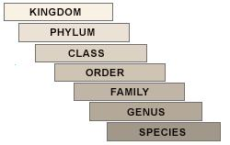
Main classification groups(taxa)
There are seven main taxa or classification groups.
Notes:
This system of classification can be compared to a tree. Many leaves (species) are on a tiny twig (genus). Several tiny twigis (genera) are on a larger twig (family). Several larger twigs (families) are on a little branch (order). Some little branches (orders) are on a larger branch (class). Some larger branches (classes) are on a main limb of the tree (phylum). The few main limbs (phyla) make up the whole tree (kingdom).

Slide 11
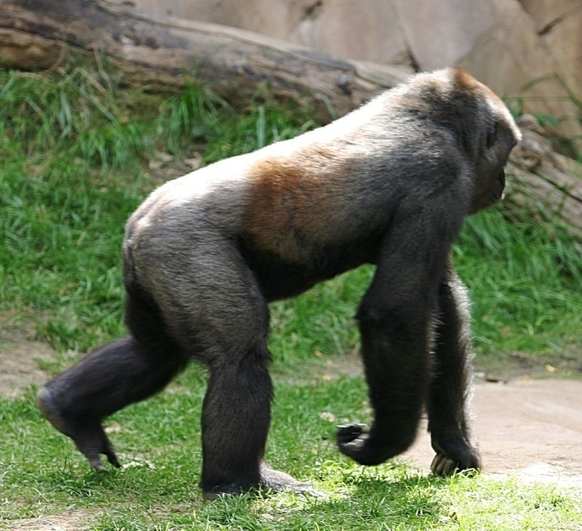
Main classification groups(taxa)
Example:
Taxon | Human | Gorilla
Kingdom | Animalia | Animalia
Phylum or Division | Chordata | Chordata
Class | Mammalia | Mammalia
Order | Primates | Primates
Family | Homonidae | Pongidae
Genus | Homo | Gorilla
Species | sapiens | gorilla

Slide 12
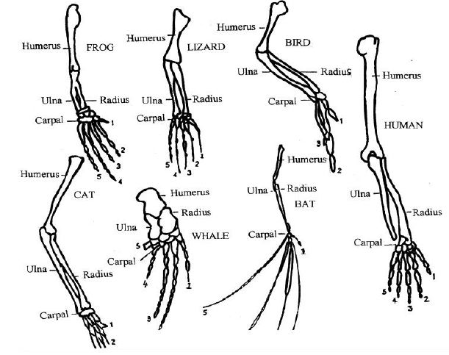
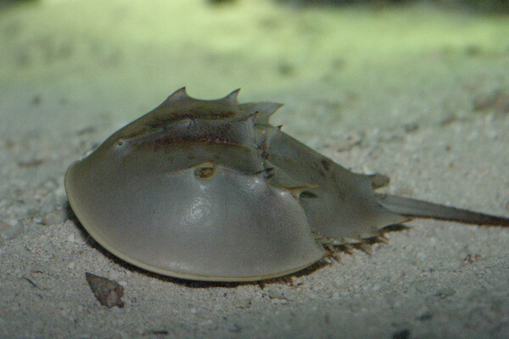
Modern Basis for Classification
Homologous Structure
  show the same basic pattern, the same general relationship to other parts, and the same pattern of development.
Similar Biochemistry
  closely related organisms form similar chemical compounds in their body. They use this belief to help classify organisms
Genetic Similarity
  the greater the similarity of DNA among organisms, the more closely they may be related.
Notes:
Homologous Structure
Carolus Linnaeus used structural features as the basis for his classification system. He grouped organisms according to their structural similarities. Today, taxonomists still use structural similarities as a basis for classification. They look for homologous structures just as Linneaus did.
Homologous structures are structures that show the same basic pattern, the same general relationship to other parts, and the same pattern of development.
However, they need not have the same function. For example, the human arm, the whale flipper, and the bat’s wing, all these appendages are homologous structures that show the same basic pattern. Also, all three appendages are found in the same part of the body. Finally, the bones in all three appendages develop in similar ways. Although their functions are different, they are homologous structures.
Similar Biochemistry
Biochemistry is the study of the chemical compounds formed by living things. Many biologists believe that closely related organisms form similar chemical compounds in their body. They use this belief to help classify organisms. For example, the horseshoe crab was, at one time, classified as a close relative of the true crab. However, chemical analysis showed that its blood was more like spider’s blood than crab’s blood. Thus, the horseshoe crab is now classified as a close relative of spiders.
Genetic Similarity
Most biologists agree that genetic similarity is the best evidence that organisms are closely related. Every organism makes a special compound called DNA that bears hereditary characters. Thus it seems reasonable to assume that the greater the similarity of DNA among organisms, the more closely they may be related.

Slide 13
Phylogenetic System
Carl R Woese→ completely new approach in classification.
Used rRNA sequences which are very conserved.
Based on Evolution: Genetic materials (rRNA) were examined and used in revealing evolutionary relationships.
Organisms are classified into three major DOMAINS
        1. Eukarya
        2. Bacteria
        3. Archaea

Slide 14
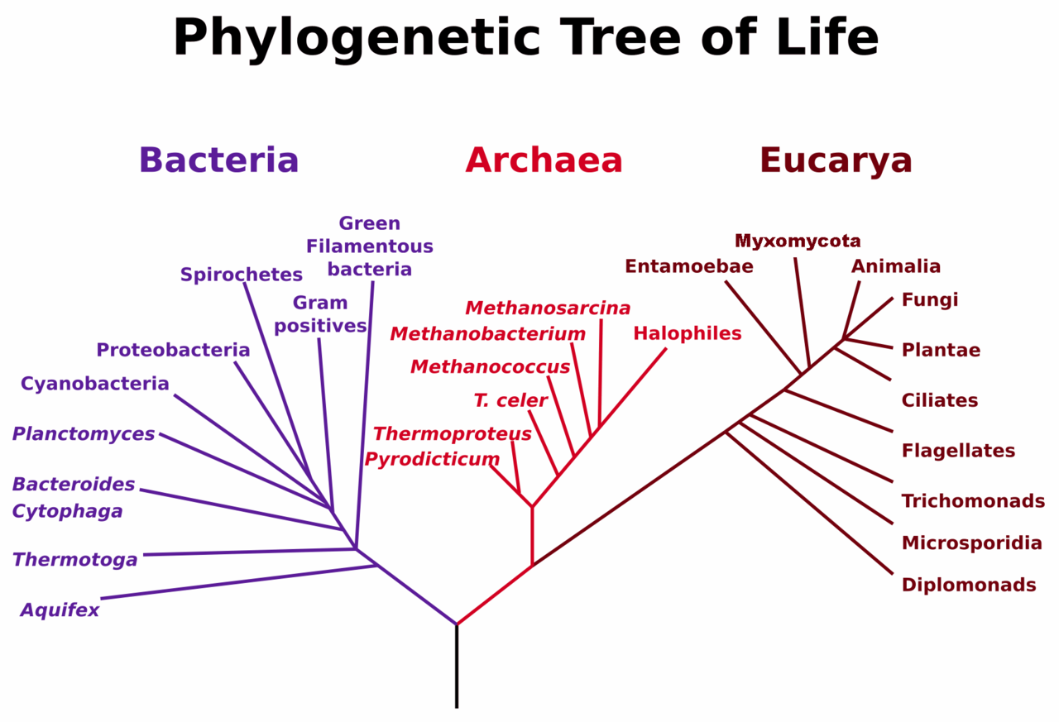

Slide 15
Summary of Various classification system
Classification | System Kingdom
2- Kingdom System | Plantae Animalia
3- Kingdom System | Plantae Animalia Protista
4- Kingdom System | Plantae Animalia Protista Monera
5- Kingdom System | Plantae Animalia Fungi Protista Monera
6- Phylogenetic system | Archaea Bacteria Eukarya

Slide 16
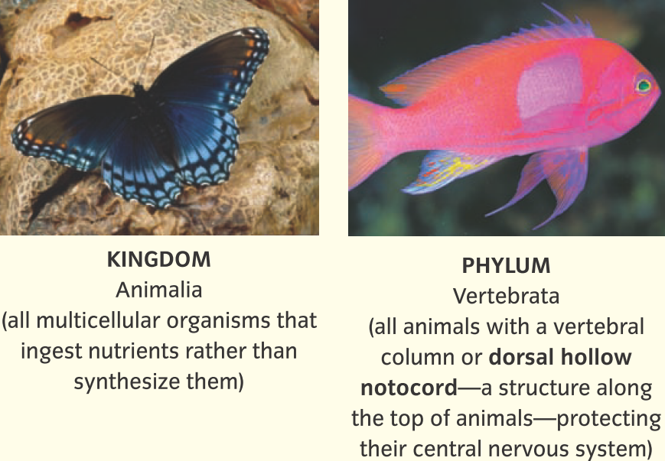
Meet your human taxonomy
Notes:
Each successive category refines the characteristics of "human" to the point where only humans are classified in the final category, Homo sapiens.
Learn the properties of each taxa (for example Animalia, Vertebrata etc) from the slides.

Slide 17
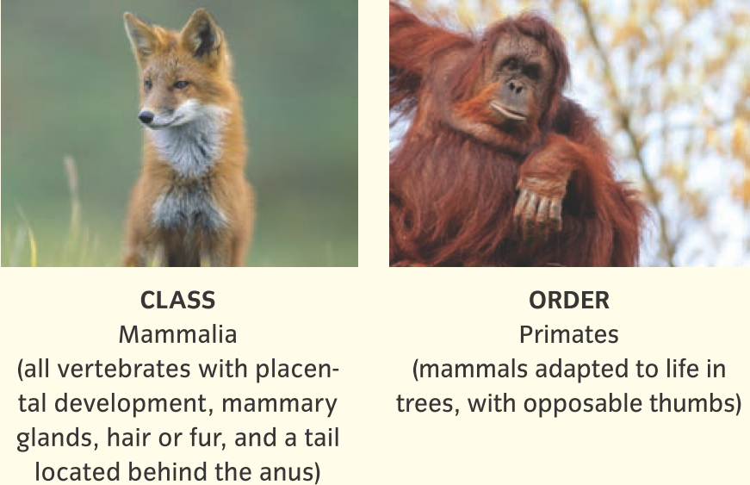
Meet your human taxonomy

Slide 18
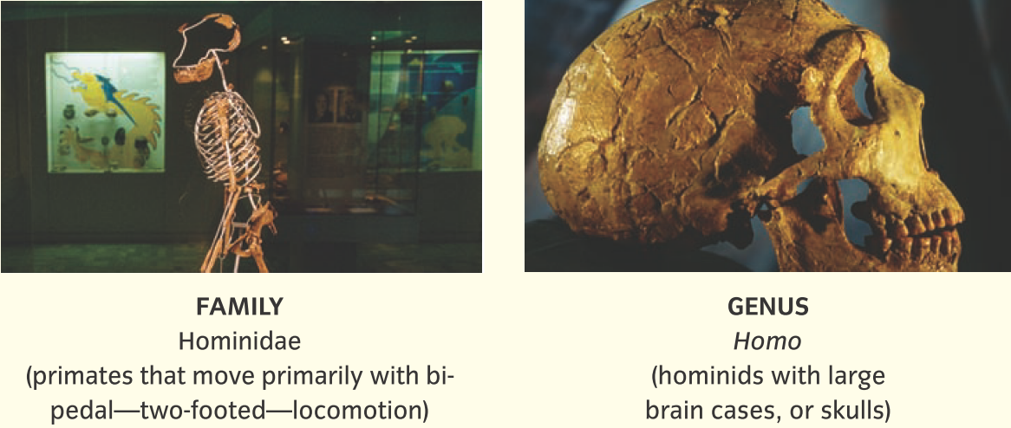
Meet your human taxonomy

Slide 19
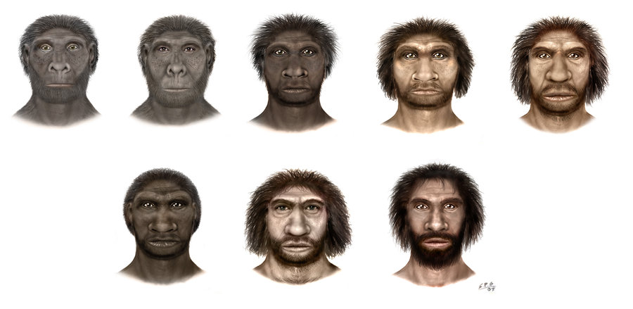
Meet your human taxonomy
-Homo habilis (have long hands)-H. rudolfensis -H. ergaster (African upright man) -H. erectus (upright man) -H. heidelbergensis -H. rhodesiensis –
H. neanderthalensis -H. sapiens

Slide 20
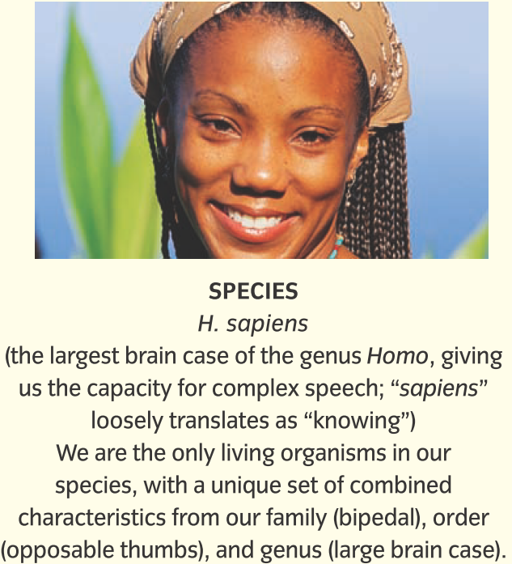
Meet your human taxonomy
Notes:
Despite the amazingly complex and pervasive cultural differences that exist between populations of humans, we are all members of the same species.

Slide 21


