Slide 1
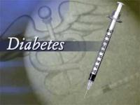
Prof. Dr. Md. Mahbubul Morshed

Slide 2
What is Diabetes Mellitus?
Normal Glucose Metabolism
When the amount of glucose in the blood increases,
e.g., after a meal, it triggers the release of the hormone
insulin from the pancreas. Insulin stimulates muscle
and fat cells to remove glucose from the blood and
stimulates the liver to metabolize glucose, causing the
blood sugar level to decrease to normal levels.
Diabetes Mellitus
Diabetes mellitus is a metabolic disorder characterized
by abnormally high levels of sugar (glucose) in the
blood.
Condition of high levels of glucose in the blood is called Hyperglycemia.
Hereditary and Environmental causes.

Slide 3
Causes of Hyperglycemia
Insulin is a hormone secreted from the islet cells of the
Pancreas.
Insulin enables cells to absorb glucose in order to turn it
into energy, thereby keeping the normal blood glucose
level in the blood.
In diabetes, blood sugar levels remain high, may be
because insulin
  -- is not being produced at all
  -- is not made at sufficient levels, or
  -- is not as effective as it should be.
This causes glucose to accumulate in the blood, often
leading to various complications.

Slide 4
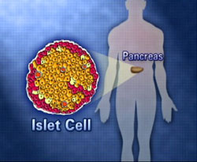
If insufficient/lack of insulin
Glucose can’t enter the cell
Glucose remains in blood
Diabetes Mellitus/Hyperglycemia

Slide 5
Types of Diabetes
There are mainly three types of diabetes:
Type I or insulin dependent diabetes often called
juvenile onset diabetes,
Type II or non-insulin dependent diabetes often called adult onset diabetes &
Gestational diabetes.
The most common forms of diabetes are type 1 diabetes
(5%), which is an autoimmune disorder. and
Type 2 diabetes (95%), which is associated with obesity.
Gestational diabetes is a form of diabetes that
occurs in pregnancy.

Slide 6
Type 1 diabetes:
  most commonly occurs in children
  is a result of the body's immune system attacking and destroying the beta islet cells.
  The trigger for this autoimmune attack is not clear, but the result is the end of insulin production.
Type 2 diabetes
  Type 2 diabetes commonly occurs in adults who are obese.
  There are many underlying factors that contribute to the high blood glucose levels in these individuals.
  An important factor is the body's resistance to insulin in the body, essentially ignoring its insulin secretions.
  A second factor is the falling production of insulin by the beta cells of the pancreas.
  Therefore, an individual with type 2 diabetes may have a
  combination of deficient secretion and deficient action of
  insulin.

Slide 7
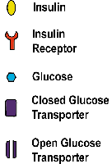
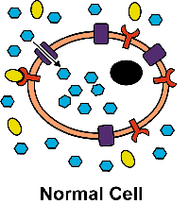
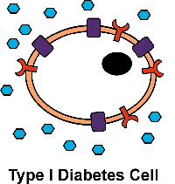
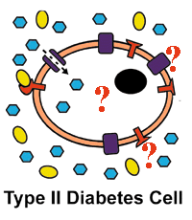
Type I & II Diabetes : Insulin Response
This is a normal
cell.
Insulin is present
and is taken into
the cell to
facilitate proper
glucose uptake.
In Type I diabetes,
insulin is not
produced; so,
there is nothing
to signal the
cells to take in
glucose
and metabolize it.
Here, insulin is
present, but signal
for proper glucose
uptake & metabolism
is lost. The problem
could be in the insulin
itself or in any one
of the proteins involved
in glucose uptake and
metabolism.

Slide 8
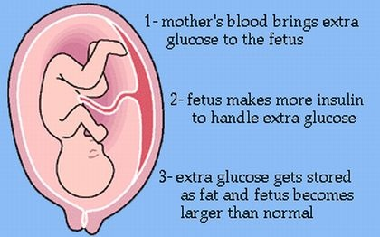
Gestational Diabetes- 3rd Type of Diabetes
Gestational diabetes is diabetes that happens for the first time when a woman is pregnant. Gestational diabetes goes away when any woman has her baby, but it increases her risk for having diabetes later.

Slide 9
Due to Gestational Diabetes- the baby has risks for-
Macrosomia - refers to a baby that is considerably
larger than normal.
Birth injury - may occur due to the baby's large size and difficulty being born.
Hypoglycemia –refers to low blood sugar in
the baby immediately after delivery.
Respiratory distress-difficulty breathing

Slide 10
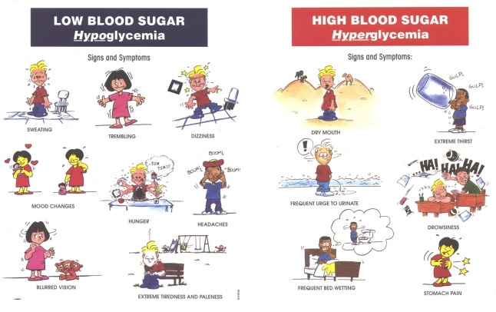

Signs & Symptoms
Sudden
Weight
Loss
gulp
gulp
gulp
Always
Hungry
Dry Mouth
Extreme Thirst
Frequent Urination
Always Tired
Wounds that
won’t heal
Frequent Bed wetting
Stomach Pain

Slide 11
Diagnosis
Diabetes is diagnosed by measuring the blood glucose level during fasting (Fasting plasma glucose test) or an oral glucose tolerance test.
Three status associated with diabetes: people who are not diabetic; those with Impaired Glucose Tolerance (IGT); and those with diabetes.
Category | Blood Glucose (mg/dL)
 | Fasting | After meal
Normal | <115 | <140
Diabetic | >140 | >200
Impaired Glucose Tolerance | <140 | 140-199

Slide 12
Lipid profile

Slide 13
What is a lipid profile?
The lipid profile is a group of tests that are often
ordered together to determine risk of coronary heart
disease. The tests that make up a lipid profile are
tests that have been shown to be good indicators
of whether someone is likely to have a heart attack
or stroke caused by blockage of blood vessels
(hardening of the arteries).

Slide 14
Your Lipid Profile
When doctors order a lab test called a lipid profile (sometimes called a lipid panel), they are looking for information about the amounts of four types of fats in the blood. You will be asked to give a small sample of blood from your arm. The results can help your doctor evaluate your risk for heart disease.

Slide 15
What tests are included in a lipid profile?
The lipid profile includes total cholesterol, HDL-cholesterol (often called good cholesterol), LDL-cholesterol (often called bad cholesterol), and triglycerides.
Sometimes the report will include additional calculated values such as the Cholesterol/HDL ratio or a risk score based on lipid profile results, age, sex, and other risk factors.

Slide 16
Cholesterol helps the body form hormones, vitamin D and other important substances, but too much of it in the blood can clog and damage the blood vessels. Because it is a fat-like substance that doesn't mix with blood, cholesterol has to combine with proteins to form lipoproteins. Lipoproteins can travel in the blood to all the organs and tissues of the body.
Low-density lipoproteins (LDLs, or "bad" cholesterol) build up in the blood and increase your risk of heart disease.

Slide 17
High-density lipoproteins (HDLs, or "good" cholesterol) carry cholesterol to the liver, where it is removed from the body.
Triglycerides store energy for your body to use when it is needed. If there is too much, it can block blood vessels and cause other health problems such as abdominal pain and pancreatitis.

Slide 18
How is a lipid profile used?
The lipid profile is used to guide providers in deciding how a person at risk should be treated. The results of the lipid profile are considered along with other known risk factors of heart disease to develop a plan of treatment and follow-up.

Slide 19
It's important to know that the ranges....
Total Cholesterol (lower is better)
Best = <200 mg/dL
Borderline high = 200-239 mg/dL
High = 240 mg/dL or higher
Triglycerides (lower is better)
Best = <150 mg/dL
Borderline high = 150-199 mg/dL
High = 200-499 mg/dL
Very high = 500 mg/dl or higher

Slide 20
LDL Cholesterol (lower is better)
Best = <100 mg/dL
Good = 100-129 mg/dL
Borderline high = 130-159 mg/dL
High = 160-189 mg/dL
Very high = 190 mg/dL or higher
HDL Cholesterol (higher is better)
Low = <40 mg/dL
Best = 60 mg/dL or higher

Slide 21
